Slide 1
ACTIVITIES DONE AFTER SEMINAR IN POLAND

Slide 2
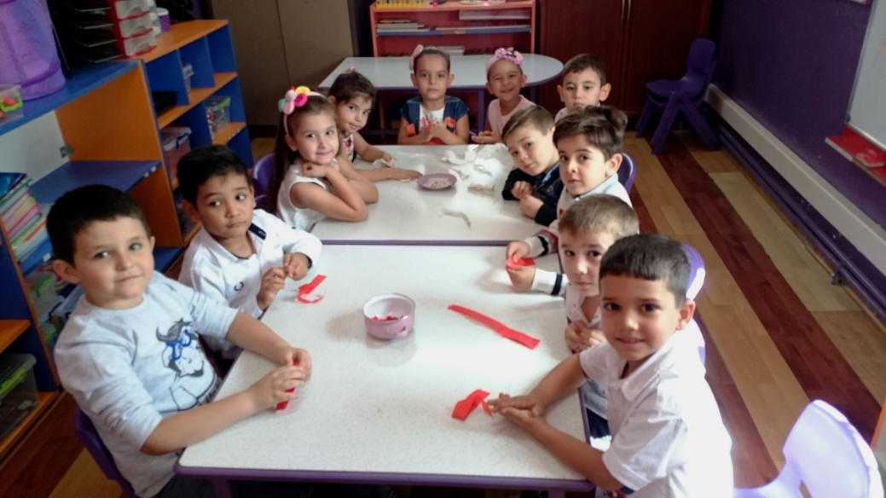
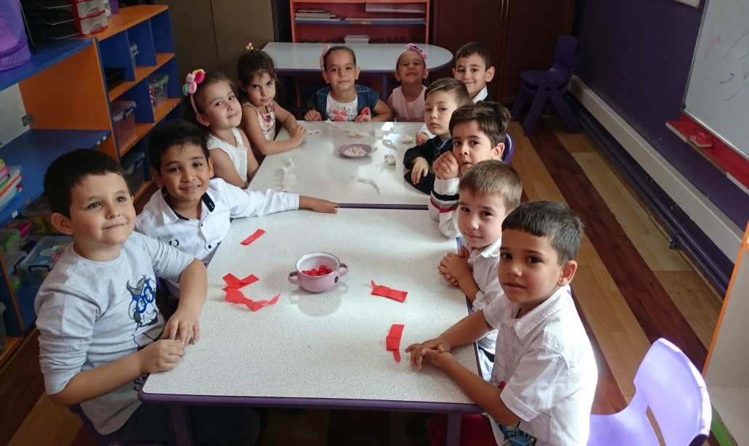
AFTER SEMINAR IN POLAND; WE STARTED TO WORK. WE GOT OUR PEN,OUR PAPER AND OUR SCISSORS.

Slide 3
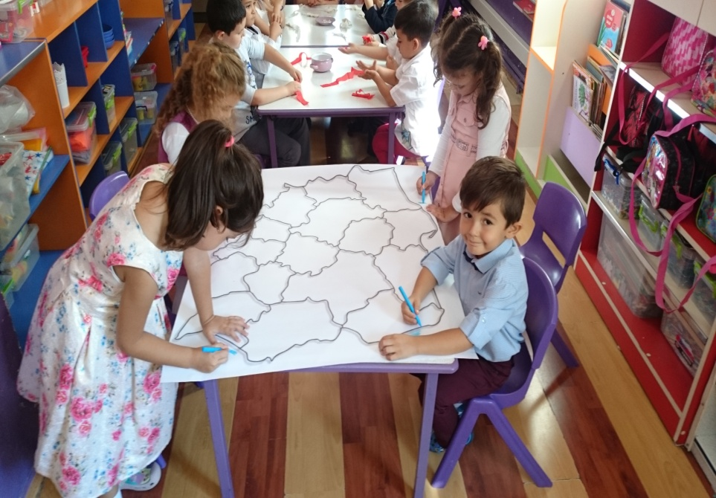
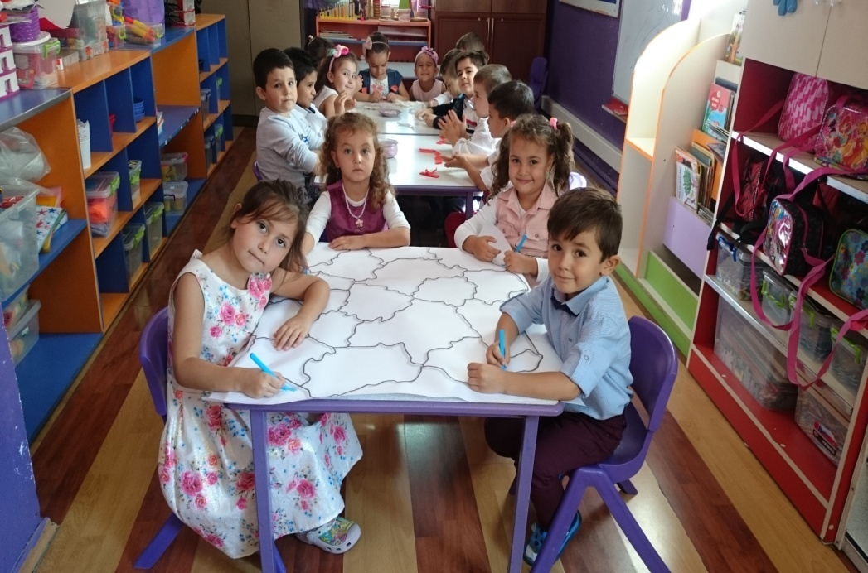
WE MADE MAP OF POLAND AND STARTED TO PAINT IT.

Slide 4
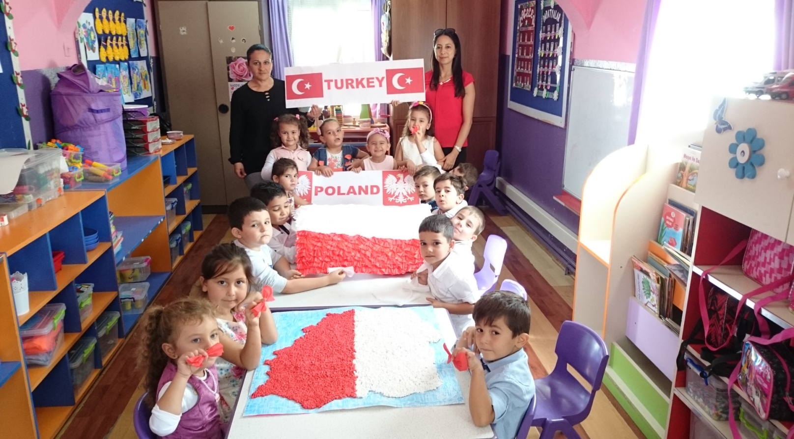
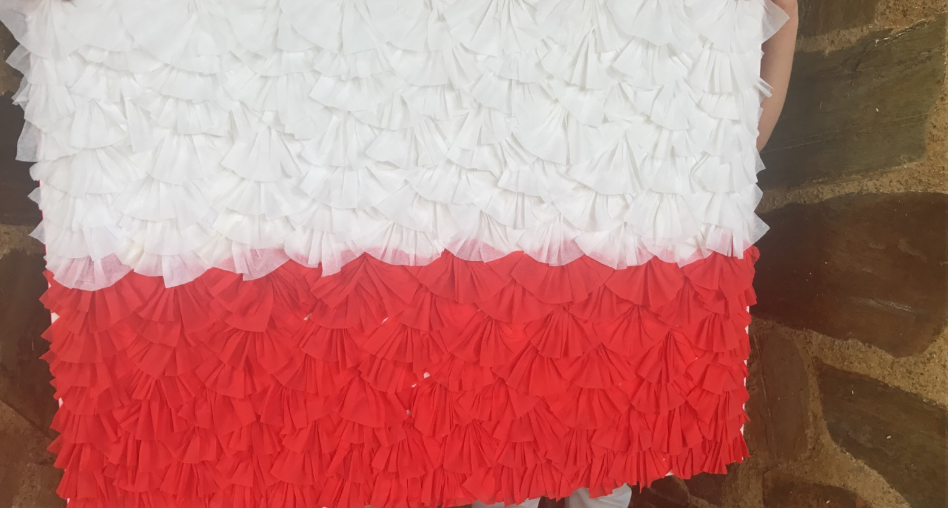
WHILE WE WERE DOING OUR WORK , WE NOTICED THAT BROTHERHOOD OF COLOURS: RED AND WHITE.

Slide 5
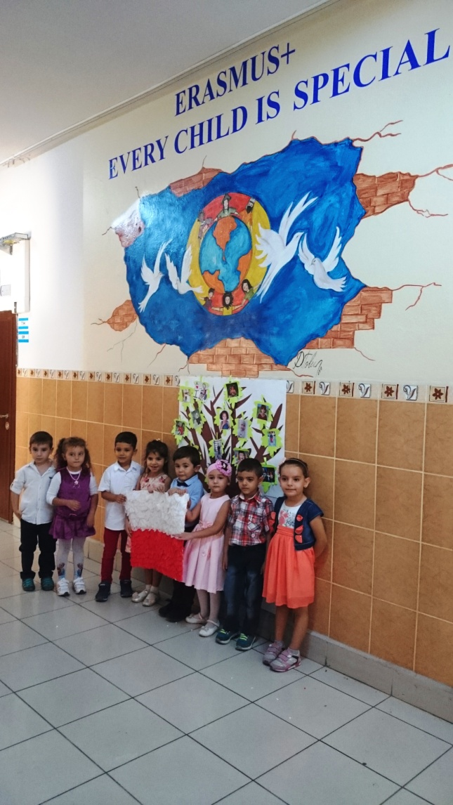
WE TOOK PHOTO WITH POLAND FLAG IN FRONT OF THE OUR WALL OF DIFFERENCIES.

Slide 6
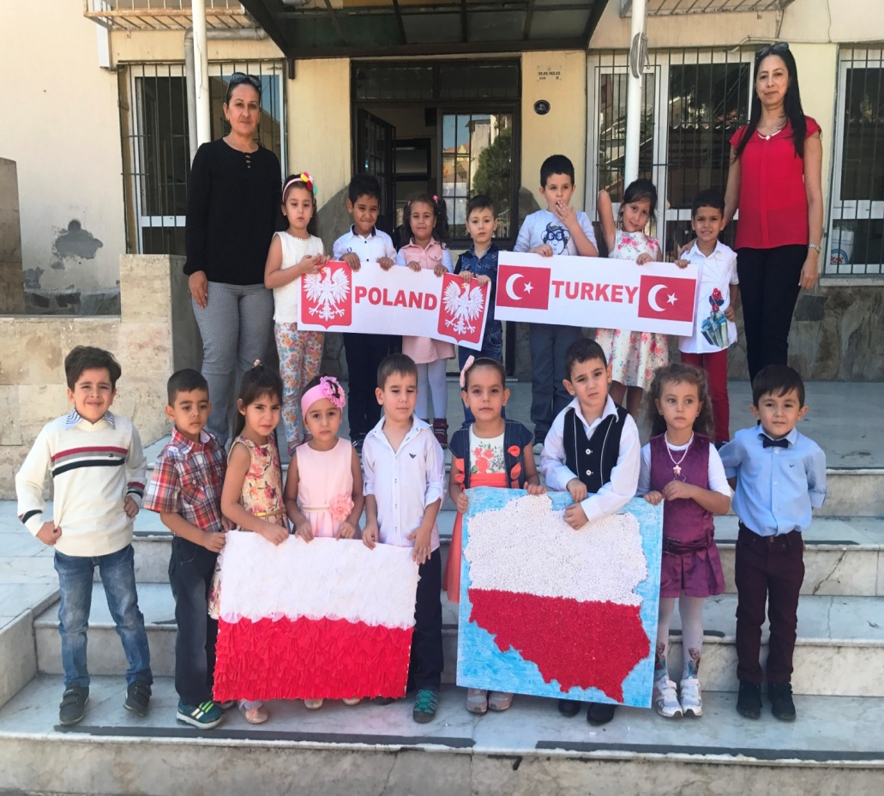
OUR LANGUAGES, OUR SKIN COLOURS, OUR RELIGIONS, OUR LANDS MAYBE DIFFERENT BUT WE ARE JUST HUMAN AND OUR WORLD IS THE SAME.

