Slide 1
PERSONA DOLLS

Slide 2
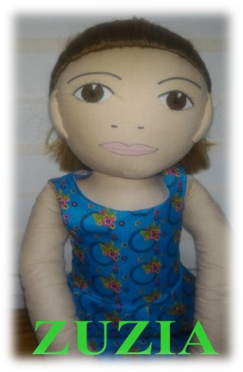
ZUZANNA

Slide 3
NAME: Zuzanna
AGE: 4 year old
LANGUAGE: English, polish (she can say only few words)
WHAT MAKES HER HAPPY: meetings with friends, when grandma visiting her, when she can spend time with parents
WHAT MAKES HER SAD: when parents are very long at work, when she is sick and she can’t play with her friends, when parents are argue
WHAT SHE’S AFRAID: storm, darnkness.
WHERE SHE LIVES: in the flats, she has her own room
PARENTS: father is sales representative in pharmaceutical company, mom is pediatrician
FAVOURITIES PLAYS AT HOME: play with dolls, watching cartoons, helping mom in the kitchen, drawing, playing games with parents
IS SHE/HE GOOD AT SOMETHING/ IS IT SOMETHING DIFICULT FOR HER/HIM: She can draw very nice
FAVOURITE FOOD: pizza, pancakes, ice cream, tomato soup
FOOD SHE DON’T LIKE: cucumber soup, dumplings with meat
WHAT IMPORTANT HAPPEND TO HER: Zuzia lived in London with her parents. Recently, she moved to Poland, because her grandma was very sick, and parents need to take care of her.
STORY:
Zuzia was born in Poland. When she had one year, they moved to London, where her father get well paid job. She went to the kindergarten there, she had a friends whit whom she meet. Her parents speak English mostly, so she know only few fords in Polish. She was very sad, when she found out that grandma is sick, but she also was warried because of movig to Poland. In Poland she can’t find her own place, she don’t have any friends here. In kindergarten, she can’t understand what children and teachers are saying. No one want to play with her, so mostly she is alone.
How she feels?
How would you feel in this situation?
What does Zuzia feel when she has problem with understending the others speech?
How can we help her?

Slide 4
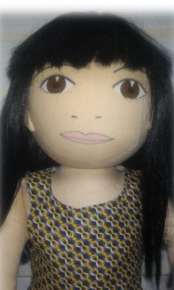
ANETA

Slide 5
AGE: 5 years old
NAME: Aneta
LANGUAGE: Polish
WHEN IS SHE CHEERFUL: She is happy when she plays with her firends. And when her mum reads book in the evening.
WHEN IS SHE SAD: She is sad when her parents argue and when she is sick. Sie is sad when her brother is more important than Aneta for her parents - her brother needs a lot of time because he is seriously sick. She can not cope with her emotions so: to beat different children, to loud stout, she doesn’t listen adults, to throw classroom things.
WHAT IS SHE AFRAID: dogs, noise
WHEN DOES SHE LIVE: Aneta lives with parents and brather in the block of flat. She shares bedroom with her older brother.
PARENTS: Her dad works as bus driver. Her mum works as accountant.
WHAT DOES SHE LIKE TO DO AT HOME: She likes playing of blocks, solving tasks in the book, playing board games with parents
WHAT IS SHE GOOD AT: Aneta can make differents things with papper and she can build house for her dolls.
WHAT IS DIFFICULT FOR HER: She can not wait your turn in the game. She hates when somebody take her toys
FAVOURITE FOOD: pizza, pancakes, ice carems, tomato soup
HATE FOOD: Cucumber soup, dumplings with meat, pepper
STORY:
Aneta always goes to kindergarten in different mood. Sometimes she is happy but sometimes she is irritable because she doesn’t like getting up early ( Kindergarten is far from her home). She goes to Kindergarten by car but first sequence her mum must driver Aneta’s brothers to school. Aneta sometimes takes toys to chldren and she doesn’t want to share toys with different children. Sometimes she can not ask other children about to borrow their toys – when children don’t agree to give toys for Aneta, she begins to beat their and she sometimes bites other children. She is nerovous when her teacher pays attentions to her behave or asks her to tide up toys or when the teacher asks to sit down on the carpet during lessons. Aneta has many friends but when she behaves badly ( to beat, to bite, to take toys, to use vulgar words) chlidren don’t want to play with Aneta.
What do you think why does Aneta beat or bite other children? ,What does feel Aneta when she tease other children?
What do you think that Aneta wolul like to have friends?, What she can do to politely play with children? , How can we help Aneta?

Slide 6
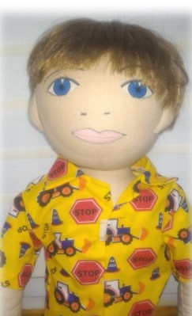
MACIEK

Slide 7
AGE: 3
NAME: Mathew
LANGUAGE: Polish
WHAT MAKES HIM HAPPY: playing with a miniature railway and LEGOs
WHAT MAKES HIM SAD: when he is ill
WHAT HE’S AFRAID OF: dogs
WHERE HE LIVES: Mathew lives with his parents in a big flat in Warsaw
PARENTS: Mathew’s mom and dad have a pharmacy
WHAT DOES HE LIKE: Building with LEGOs
WHAT HE’S GOOD AT/ WHAT’S DIFFICULT FOR HIM?: He draws very nice, he doesn’t like playing with puzzles
FAVOURITE FOOD: pancakes and sandwiches
FOOD HE DOESN’T LIKE: salad, rice
DID SOMETHING IMPORTANT HAPPEND?: Mathew in 3 years old and he went to nursery school in September
STORY:
Mathew was born in Warsaw and he lives there with his parents. He just turned 3 years old and went to kindergarten for the first time. It is hard for him to part with his parents when he comes to kindergarten in the morning. He cries and doesn’t want to stay there or play with other children and teacher. He miss his parents very much and keeps asking „When I’II go home?” and „When my parents will come?”. He’s very sad and keeps crying and walking around the calssroom with a teacher when other children play.
How’s Mathew feeling? How can we help the boy? What can we do to make him feel better at kindergarten?

Slide 8
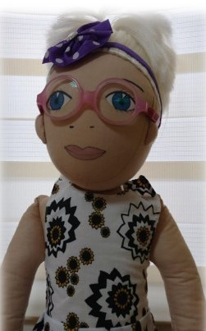
BASIA

Slide 9
AGE: 5 years old
NAME: Barbara
LANGUAGE: Polish
WHEN IS SHE CHEERFUL: She is happy when she plays with her friends. And when she goes to trip with her parents
WHEN IS SHE SAD: She is sad when someone laugh at Barbara and when she is sick. She is sad when it’s raining.
WHAT IS SHE AFRAID: black cats, storm
WHEN DOES SHE LIVE: Barbara lives with parents in the block of flat. She has got own bedroom.
PARENTS: Her mum works in office. Her dad is a policeman
WHAT DOES SHE LIKE TO DO AT HOME: She likes playing dolls, watching a cartoon, drawing, helping her mum in the kitchen and playing with dog
WHAT IS SHE GOOD AT: Barbara cannot tie shoelaces
WHAT IS DIFFICULT FOR HER: She can not wait your turn in the game. She hates when somebody take her toys, and when somebody doesn’t listen her commends.
FAVOURITE FOOD: ice creams, cucumber soup, pizza, spagethi
HATE FOOD: tomato, spinach
STORY:
Barbara goes to kindergarten. She likes spending time in the Kindergarten, she likes her teacher and classmates. She has got glasses for some time. When she was an optician with her parents, the doctors said that her eyesight deteriorated and she must wear glasses. Parents told with Barbara about this situation and why to wear glasses is important. Barbara was warried her sick eyes but when she can choose pink glasses, she was happy. Girl gladly showed herself glasses her friends in the Kindergarten. One day to Kindergarten began to go new boy who laugh at Barbara’s glasses. He often teases Barbara – he pulls Barbara’s hair and takes her glasses. Barbara said her parents that she doesn’t want to go to kindergarten because there isn’t fine. She often forgets about glasses despite the she remembered what doctor and parents said (that is important).
What does she feel?
What do you feel in this situation?
Have you seen how someone laugh at different person because she/he has got glasses?
What can we help Barbara?
Why should she wear glasses?

Slide 10
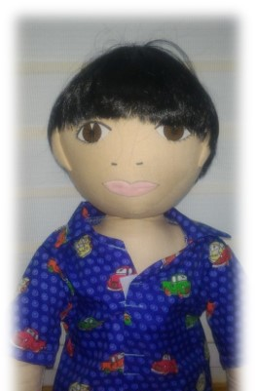
MICHAŁ

Slide 11
AGE: 5 years old
NAME: Micheal
LANGUAGE: Polish
WHEN IS SHE CHEERFUL: He is happy when he can play with his grandparents and when he can play in the playgraund
WHEN IS SHE SAD: He is sad when he cannot go to outside.
WHAT IS SHE AFRAID: spiders
WHEN DOES SHE LIVE: Michael lives in Warsaw in block of flat on tenth floors. The flat has got two rooms. The boy has got own bedroom.
PARENTS: His mum works in the library and his dad works as engineer
WHAT DOES SHE LIKE TO DO AT HOME: He likes playing his planes, helping his mum in the kitchen, playing LEGO blocks
WHAT IS SHE GOOD AT: Micheal can fast run and ride a bike
WHAT IS DIFFICULT FOR HER: He cannot independently put clothes on
FAVOURITE FOOD: tomato soup with pasta, pizza, sandwich with cottage cheese
HATE FOOD: cucumbers, bean soup, cucumber soup
WHAT HAPPENED IN HIS LIFE: His dad lost his job in big company
STORY:Michael was born in Poland and he lives in Warsaw with parents and his younger sister (Camilla). Michael’s dad works in Wrocław and he goes back to home only weekends. The boy goes to Kindergarten. In the Kindergarten he has got two the best friends – Martin and Clara. Micheal cannot accept the rules to prevailing in the group. During lessons, he often stands, teases classmates, shouts. During fun, he takes toys and imposes his views. Micheal wants to be first in all game, if he cannot be first he loud shouts, stamp his feet. He doesn’t tidy up toys and he doesn’t perform tasks on time.
What does he feel? Can you accept this behave?
Why does he behave in this way? Do you know similar story?
What can help Michael?

Slide 12
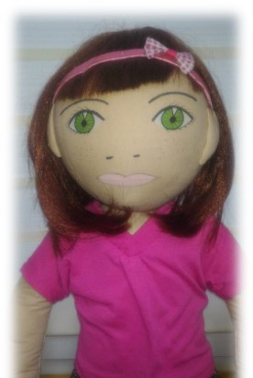
KAROLINA

Slide 13
AGE: 5 years old
NAME : Caroline
LANGUAGES: plish
WHEN IS HE/SHE HAPPY: when she can spend time with her, meet with her friends
WHEN IS HE/SHE SAD: when her sister is sick, when she hasn’t seen her grandma for long time
WHAT IS HE/SHE AFRAID OF: darkness, spiders, the barking dogs
WHERE DOEAS HE/SHE LIVE: Caroline lives in blok of flat with parents and her younger sister. She shares bedroom with sister
PARENTS: Father is a teacher in High School, mother works in library
WHAT DOES SHE LIKE DO AT HOME: play with dolls, watch cartoons, draw, play with younger sister
HE/SHE IS GOOD AT: Carolina can dance very well
FAVOURITE FOOD: sorrel soup, beetroot
IMPRTANT MOMENT IN HIS/HER LIFE: Carolina moved with her parents to a new apartment, she also had to change the kindergarten.
STORY:
Karolinka moved to a new apartment in Mokotów with her parents and sister, and she also had to change the kindergarten. The girl was sad to leave her friends, but she was also glad she could meet new peers. The girl is very sociable and cheerful, likes spending time with other children. She liked her new kindergarten and she also liked her new teacher. However, when Karolinka tried to join the play, she heard from the children: "There is no place anymore", "We do not have enough toys to play with you," „we don’t want you here”. The girl stopped being so cheerful as before. She wanted to have fun together with others, but children didn’t want to invite her to play.
How does Karolinka feel?
Have you ever had a similar situation in your life?
What do you feel in this situation?
What can we do? How can we help?

