Slide 1
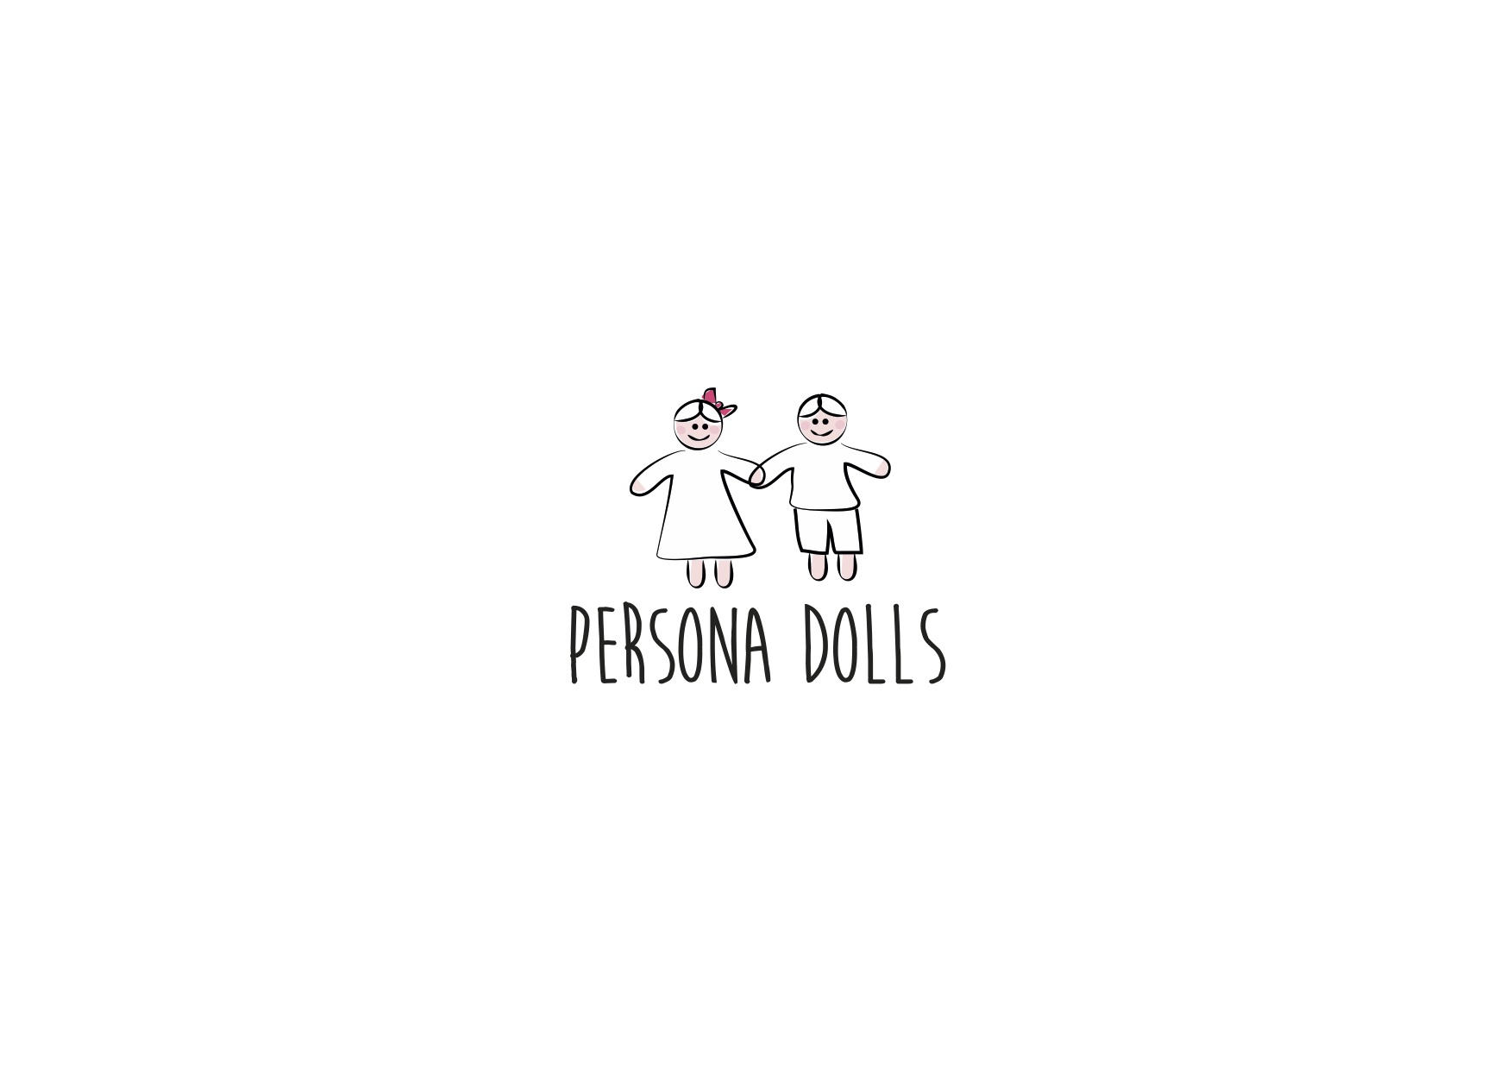
Persona Dolls handbook
Seminar in Czech Republic
8.10.17 – 14.10.17

Slide 2
Chapter 1
Introduction about Persona Dolls methodology
Overall information

Slide 3
Chapter 2
Need to teach and embrace equal teatment and tolerance
About bullying – ”say no to bullying”
Bullying caused by prejudices

Slide 4
Chapter 3
Implementation of methodology
Methodological materials
Examples about the doll profiles

Slide 5
Chapter 4
Introducing and handleing differences
National differences
Wearing glasses
Weight problems, physical differences
Language and communication problems
Social inequality
Special needs

Slide 6
What we have included to the handbook
Pictures about the dolls
Pictures about the activities
Persona dolls profiles
Persona dolls stories
Extra activities included to the doll activities

