Slide 1
“Valuing families and including parents to everyday activities”
Erasmus + project “Every child is special” seminar
in Czech Republic
08.10.17 – 14.10.17

Slide 2
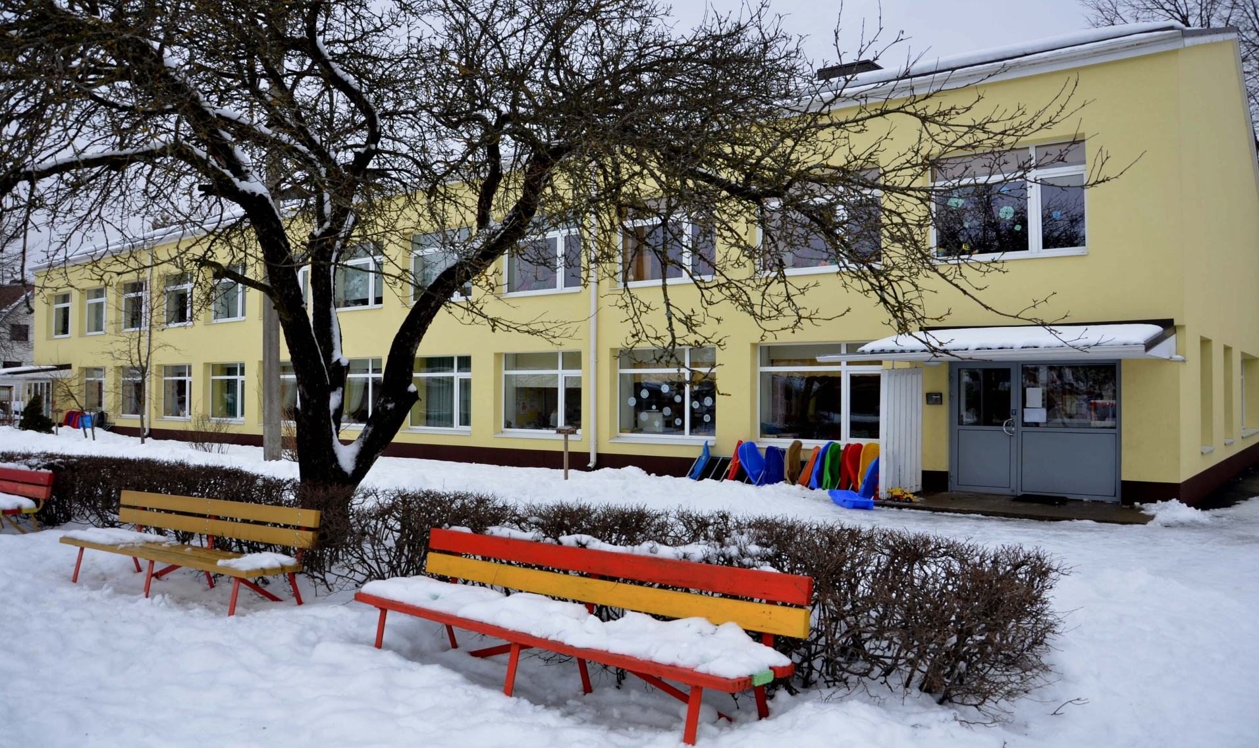
Before children join kindergarten
In spring before new children come to kindergarten all parents are introduced the kindergarten. Teachers introduce new parents our values and the house rules of our kindergarten.

Slide 3
Information about child, agreements about cooperation
When a new child comes to kindergarten then parents fill a application with the information about the child and bring it to teachers. There is also information about children special needs: allergy, information about sleeping, eating, learning difficulties aso.
Children drawings “My family”

Slide 4
Individual approach to children
Teacers evaluate daily how children manage with learning and also socially in kindergarten. Teachers give feedback to parents daily and cooperate with parents. Teachers make agreements with parents about the individual approach to children accourding to problem fields and also give parents advice how to support children development at home.
Hiking in the forest with parents

Slide 5
Family conversations
Family conversations between teachers and parents are held when a new child is joining kindergarten. It is important so that teachers get to know the child and their families. And also that the family will get familiar with kindergarten and teachers.
Pictures from home “My summer”

Slide 6
Children development conversations every year
Children development conversations are held every year in spring between teachers and parents. Teachers give owearall view about child develop and also give parents advise how to support their child development. Parents and teachers set goals for next year accourding to every child personal development.
Parents introducing their job

Slide 7
Parents councelling when children have special needs
When parents turn to teachers with problems in their childs development or teachers point out that a child needs proffesional help then a meeting is held between parents, teachers and other specialist. This is common when appear problems like: ADD, autism, leraning and behaviour diffuculties and other mental problems.
Making apple juice with parents and community

Slide 8
Children development testing
Every year teachers held a test to evaluate every child development individually. Teachers give feedback to parents about the test results and also point out how to support the development of children at home.
Celebrating mothers day with handycraft evening

Slide 9
Parents meetings every year
Every year in September a parents meeting is held in every group. Teachers make presentation about activities and goals set for that year. Teachers and parents make agreements how parents are involved in kindergartens everyday life.
For different events workgroups are set – who from parents is responsible for different avtivities and events.
Reunion with children and parents

Slide 10
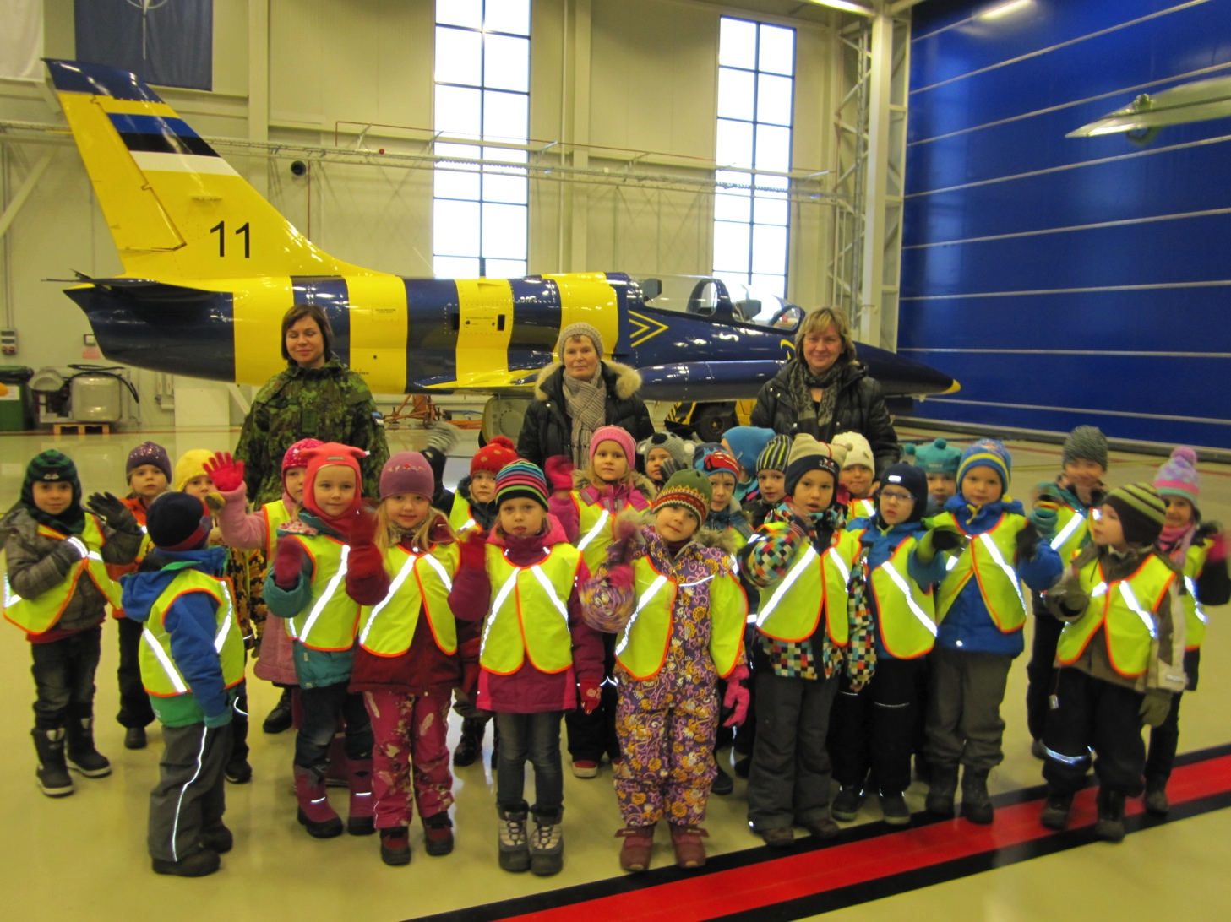
Parents introducing their work to children
Parents introduce their work to children. Parents come to talk about their work to kindergarten or arrange for us to visit their workplace.
Visiting parents workplace

Slide 11
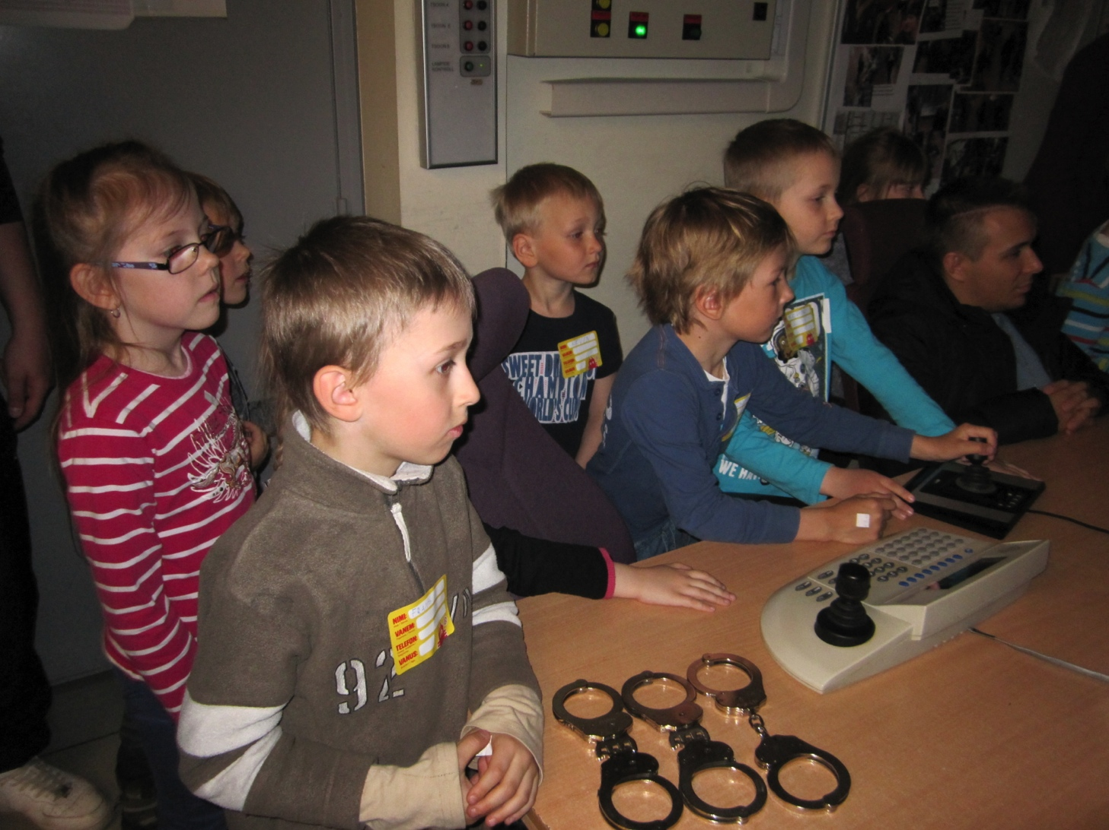
Parents organize activities outside kindergarten to children
Parents organize activities outside kindergarten to children and they also come with us to these events if it includes walking on city streets or driving with public transport.
Parents organize activities for children

Slide 12
Activities and events with parents in kindergarten
Every year there are traditional events where parents are involved. Like family days, fairs, fathers day celebrations, christmas party, kindergartens birthday, singing festival, summerpicnik aso.
Celebrating fathers day

Slide 13
Charity
Every year there are fairs, where some parents bring hand made goods and other parents buy them.
Every year before christmas parents bring gifts to children from poor families.
Concerts and plays are held where parents can donate money.
During christmas time or kindergartens birthday auction is held where some parents bring hand made goods and other parents buy them.
All the benefit goes to the foundation for children from poor families.
Charity auction held by parents

Slide 14
Children costumes for dramaplays
Parents make costumes for children for dramaplays. Parents donate the costumes later to kindergarten so we can use them another time when some child does not have a costume or when we do dramaplays in our group during learningtime.

Slide 15
Assignments in home
Parents have many different assignments in home, like sending pictures, books, toys or things from our home to kindergarten. Or also parents bring their pets to kindergarten.
Parents talk about values with children at home.
Parents introduce pets

Slide 16
Buddy Bear visits children homes
Buddy Bear visits every child home. Parents plan the time of the visit and also the activities during the visit. Parents send pictures about the Buddy Bears visit to their home to teacher.
Buddy Bear at children home

Slide 17
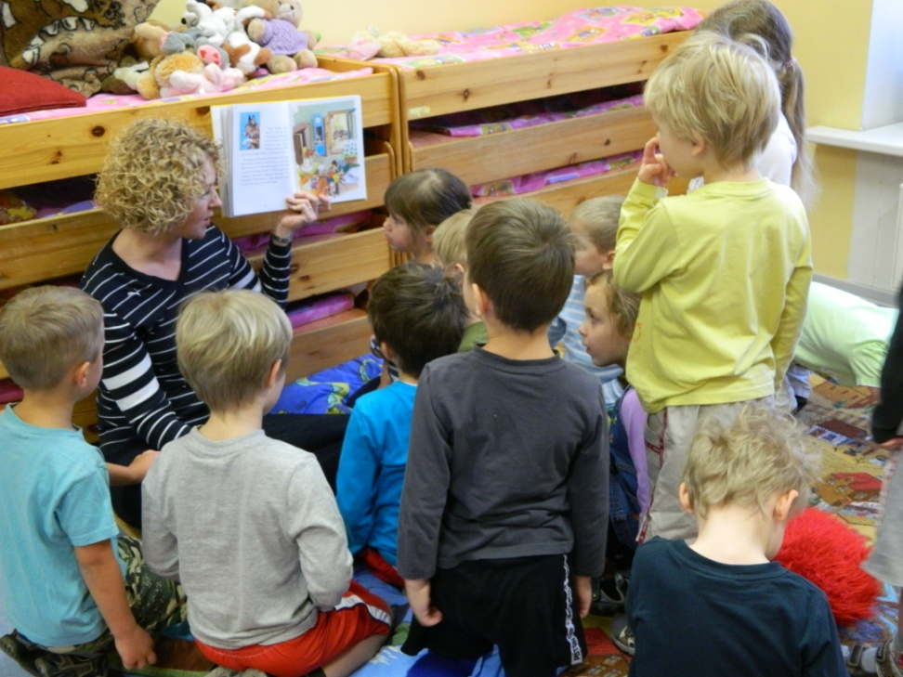
Parents take part in learning activities
Parents come to kindergarten to read stories to children or to make craft with children. Also playevenings are held where parents can enjoy quality time with children.
Parents introduce their work to children
Parents organize learning activities with children

