Slide 1
Presentations for Battipaglia
Kindergarten Šardice
Czech Republic

Slide 2
Supporting childrens individuality
who I am and how I feel
children's activities, awareness of their identity, uniqueness, feelings

Slide 3
In our nursery school we support children's individuality various activities. Every child has all the time attendance in kindergarten portfolio, where we see his development. In our kindergarten we meet little with disabled children.
Our children are just ordinary speech impediments, some wear glasses and have two children with hearing disabilities. We cooperate with educational and psychological counseling centers, special educators for speech disorders, vision and hearing.

Slide 4
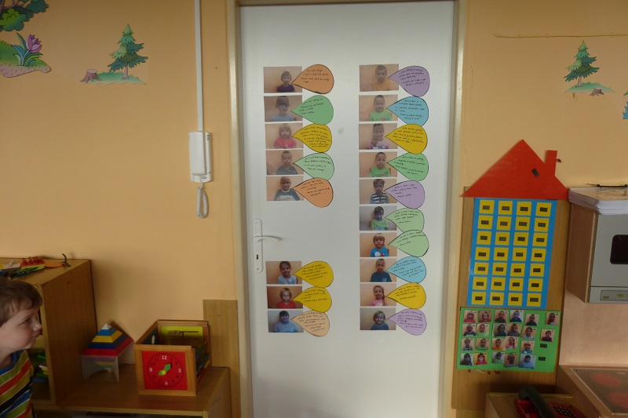
Children's activities Children's answers to the questions what I like and what I do not like

Slide 5
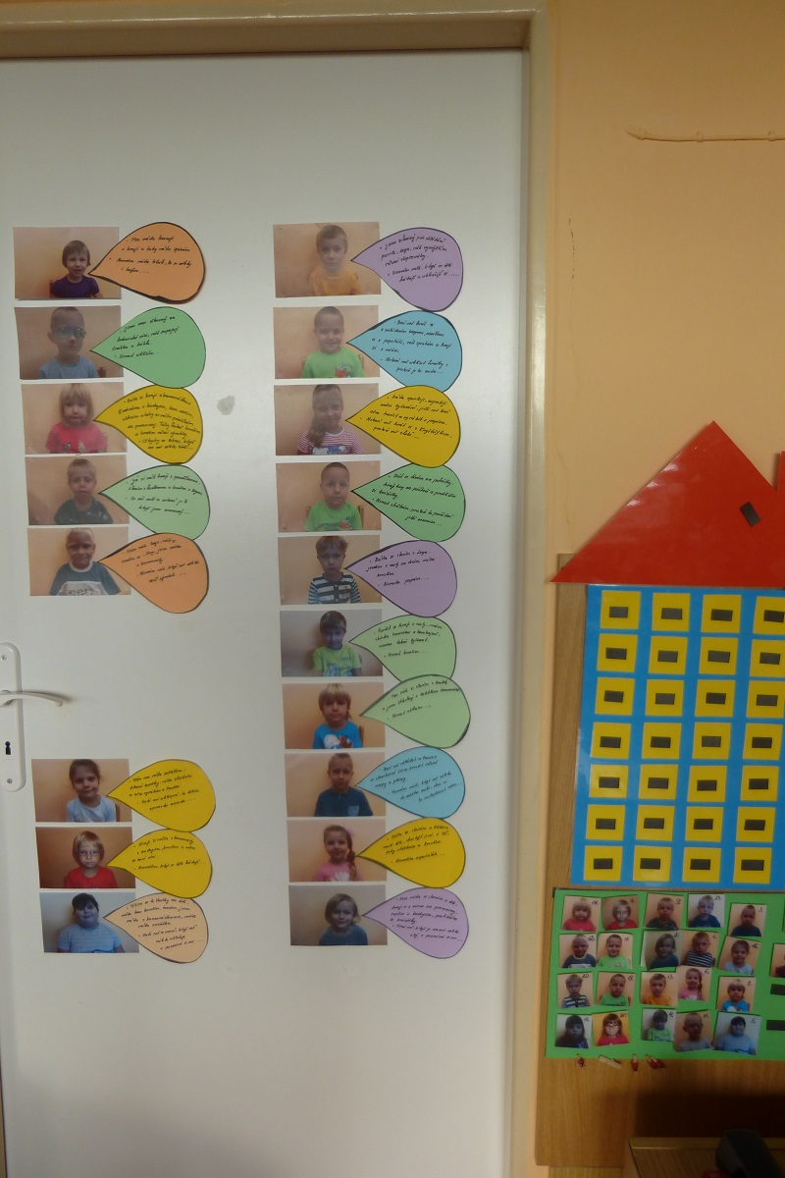

Slide 6
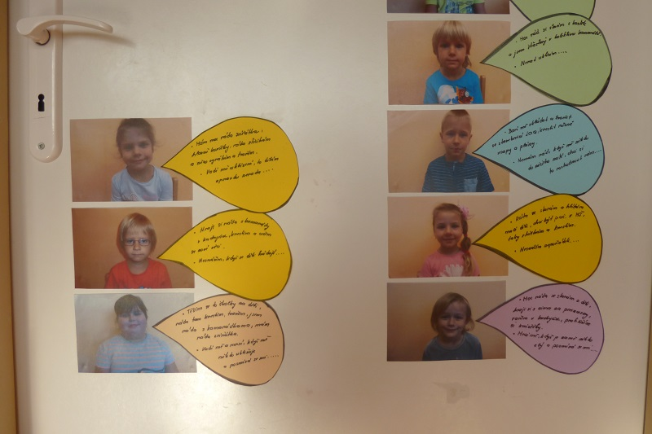

Slide 7
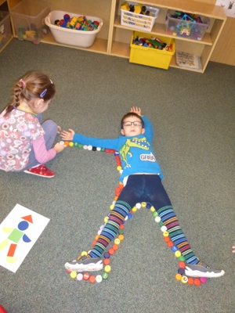
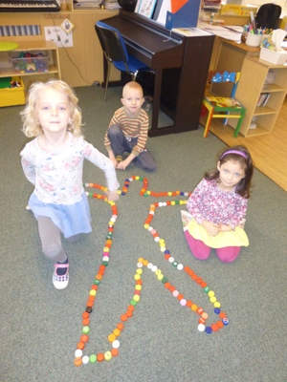
how looks outline of the human body

Slide 8
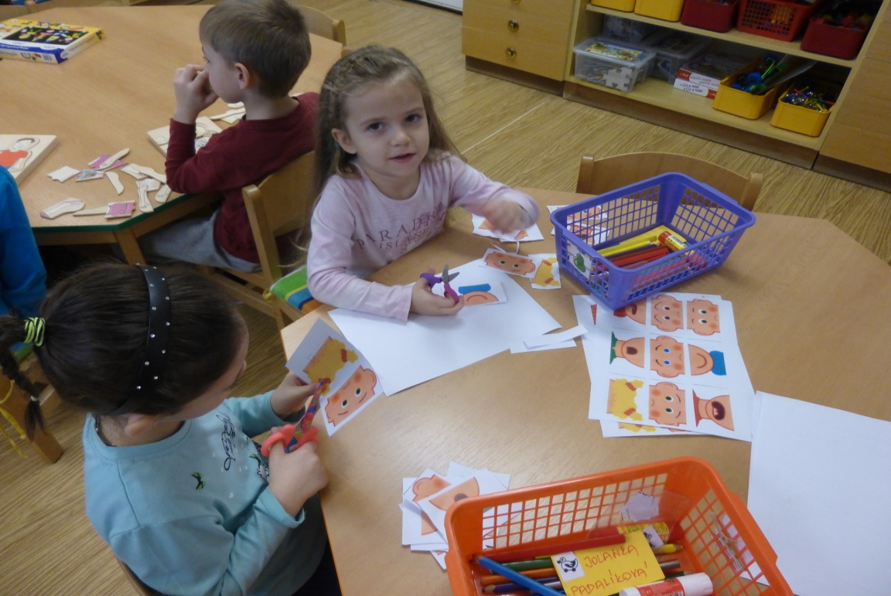
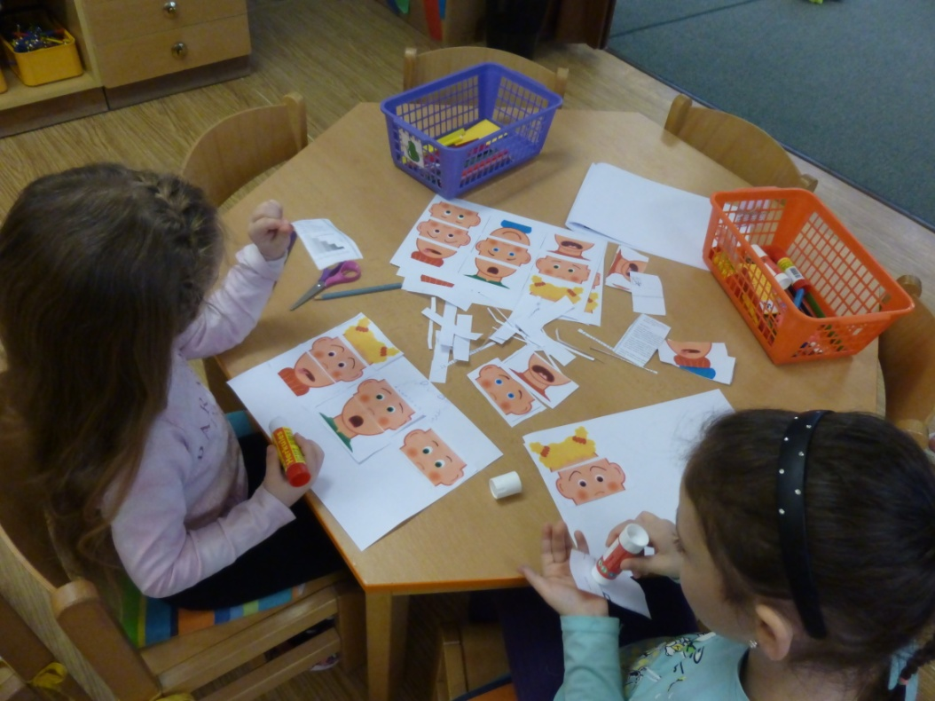

Slide 9
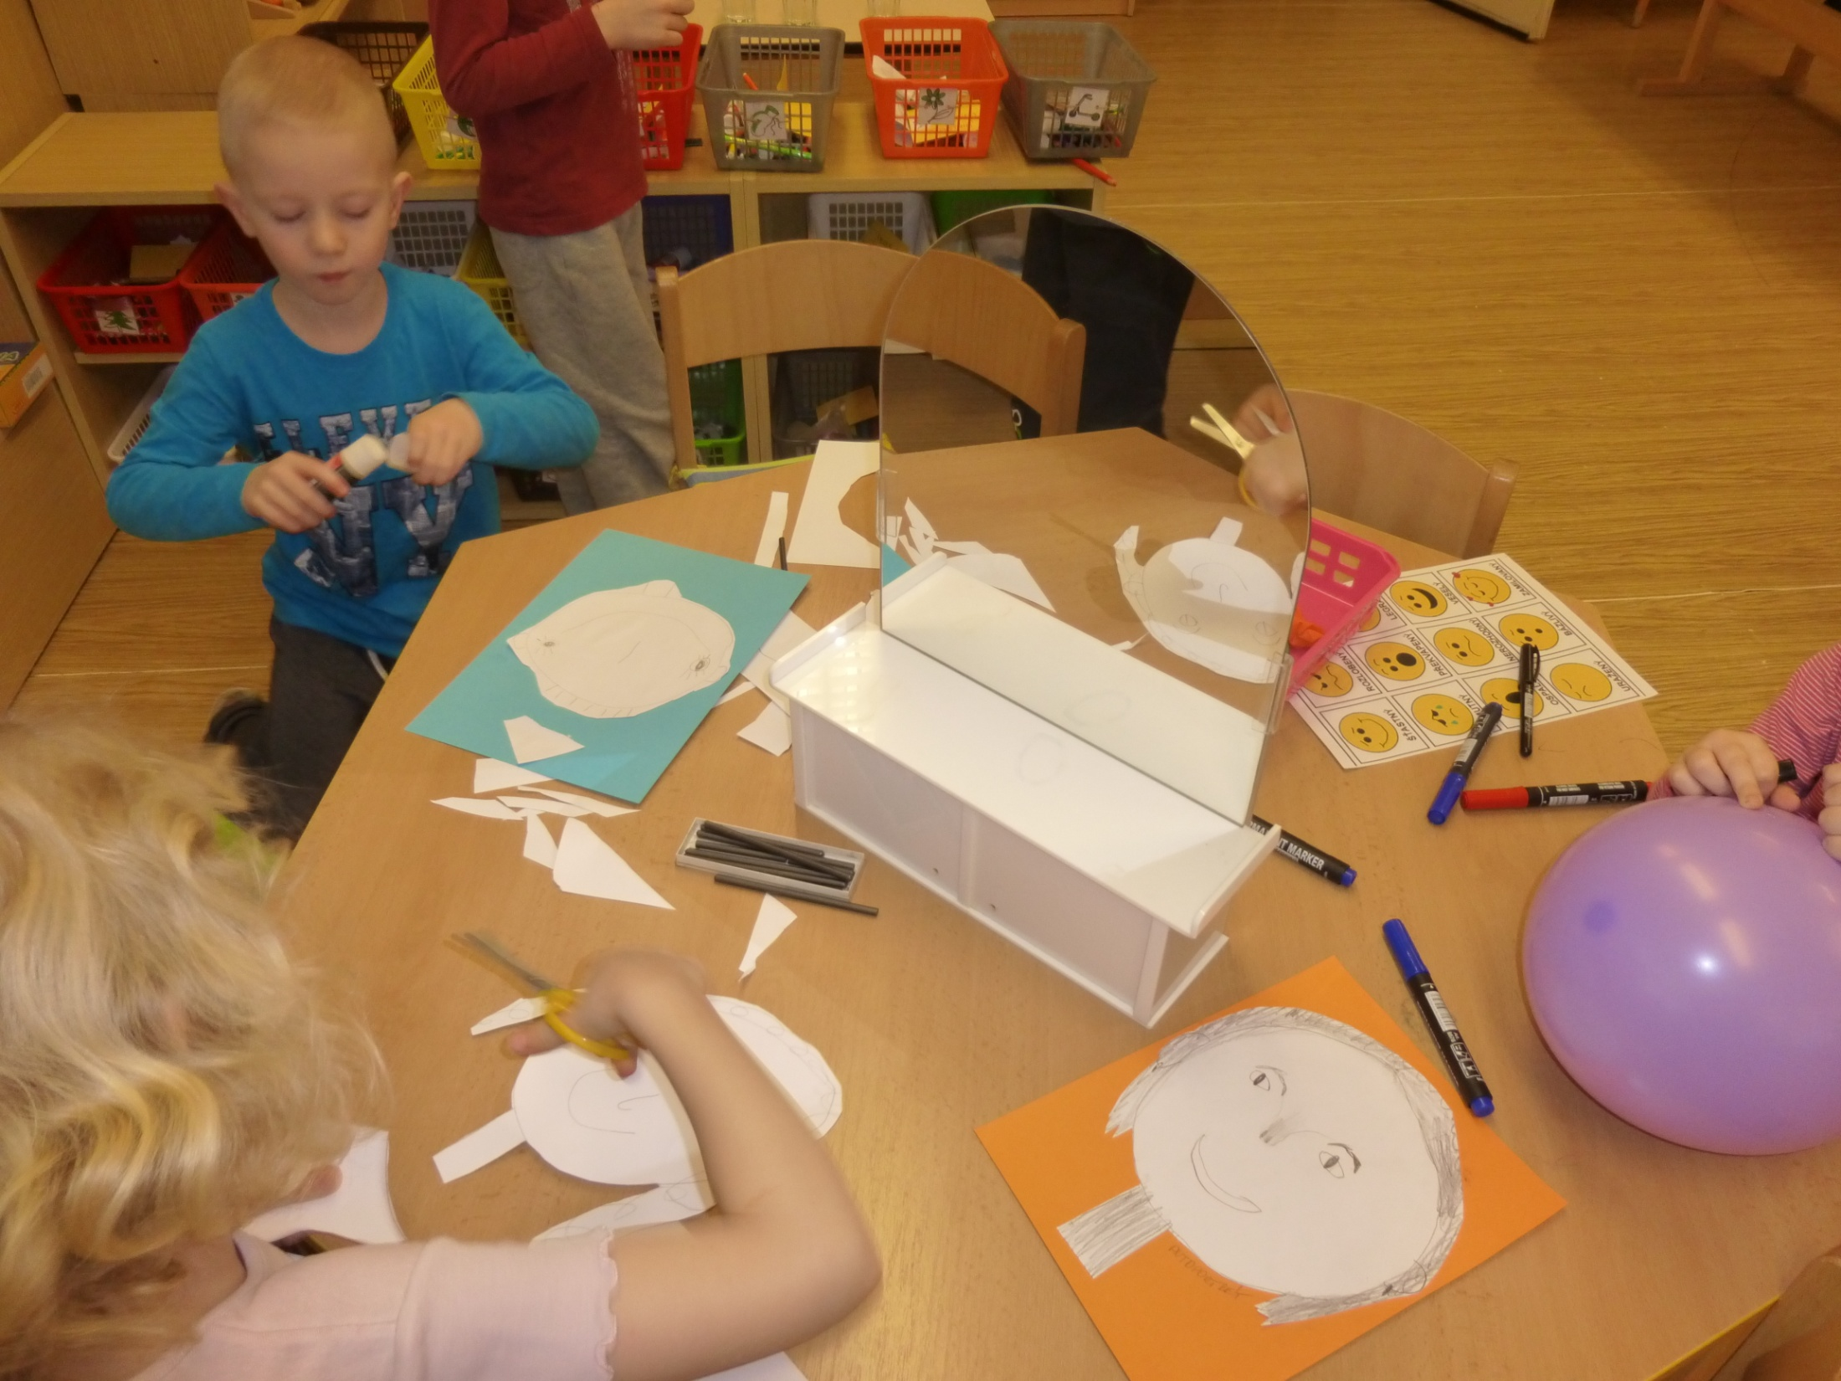

Slide 10
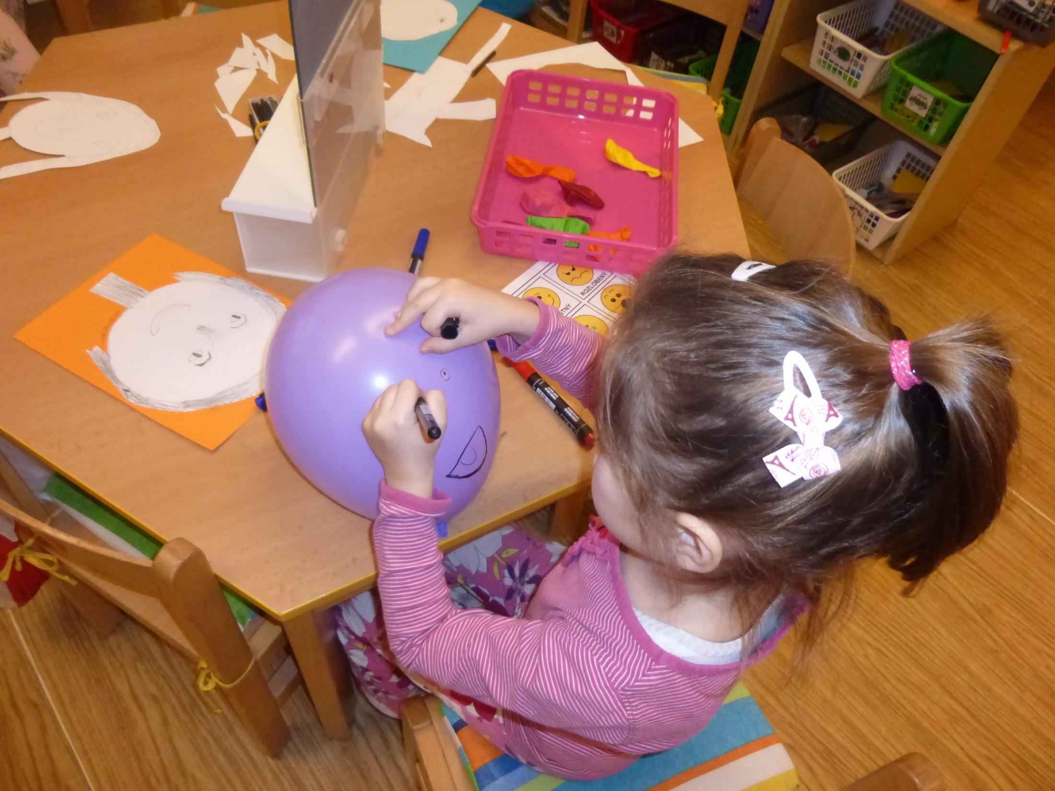

Slide 11
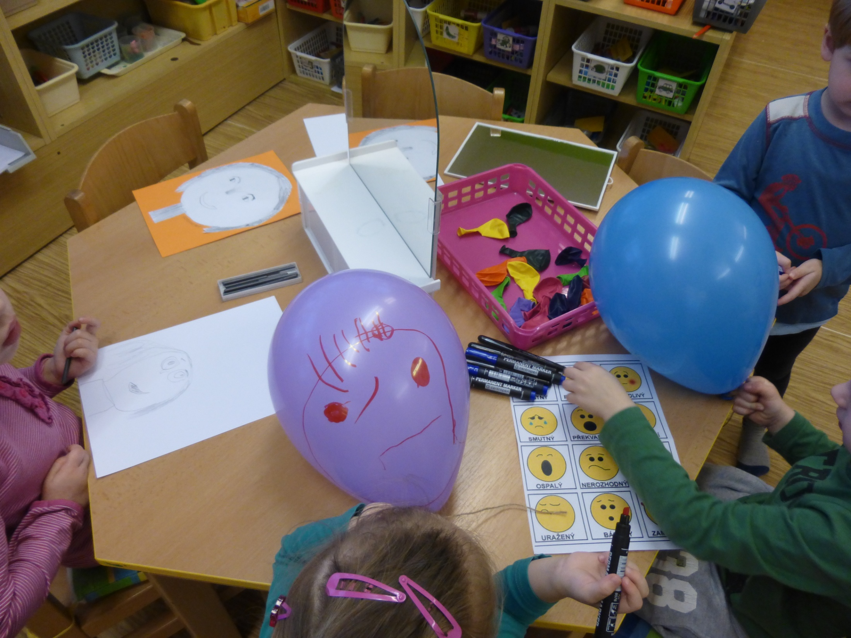

Slide 12
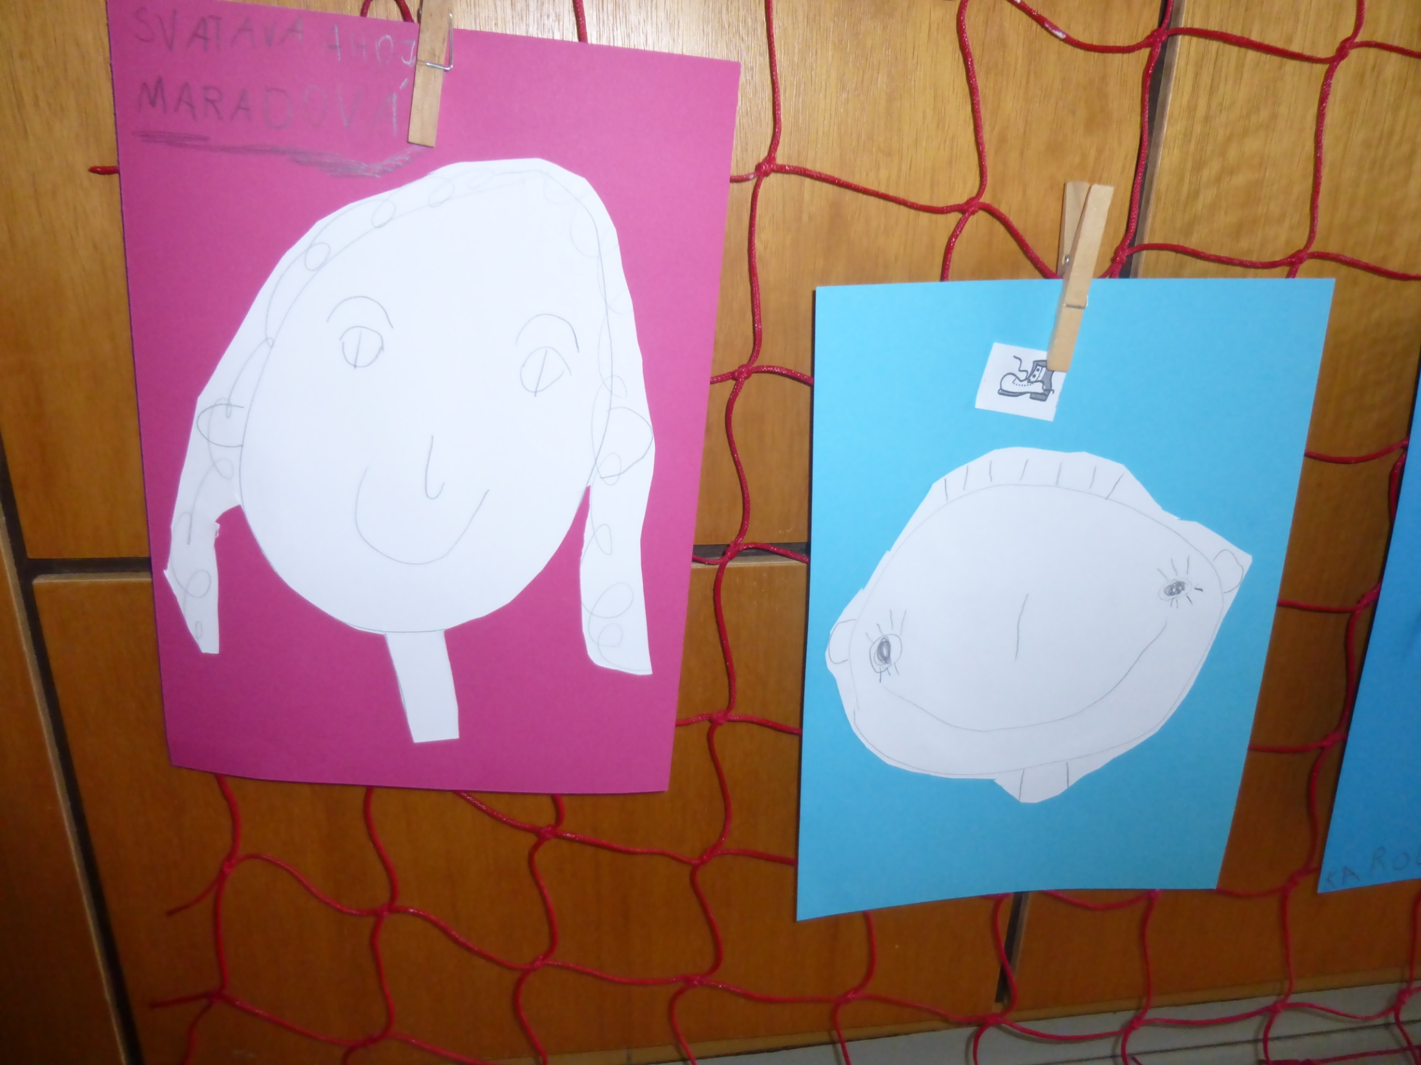

Slide 13
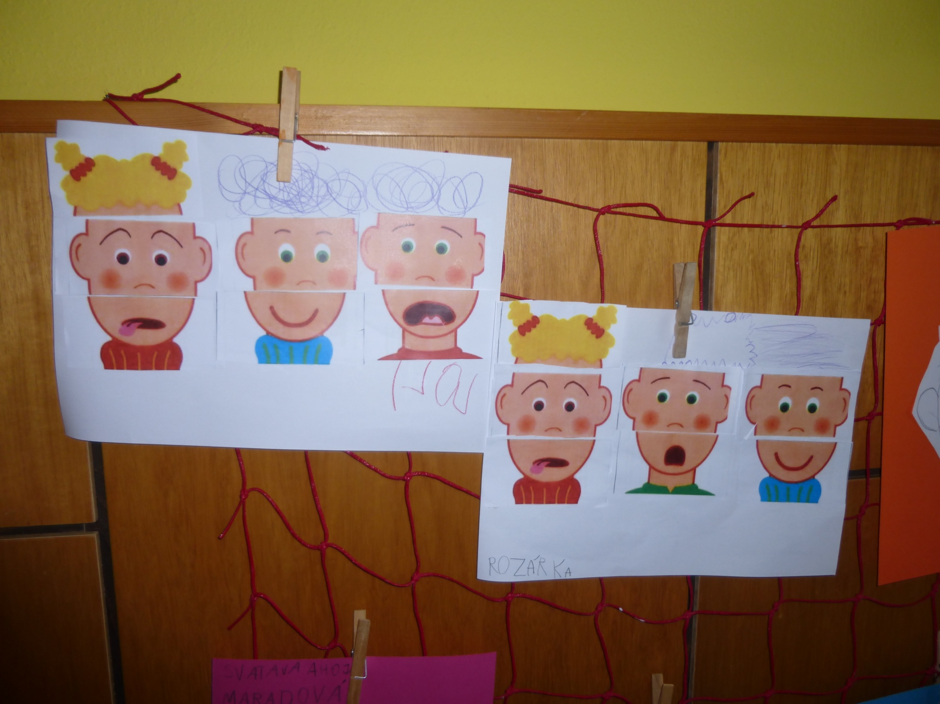

Slide 14
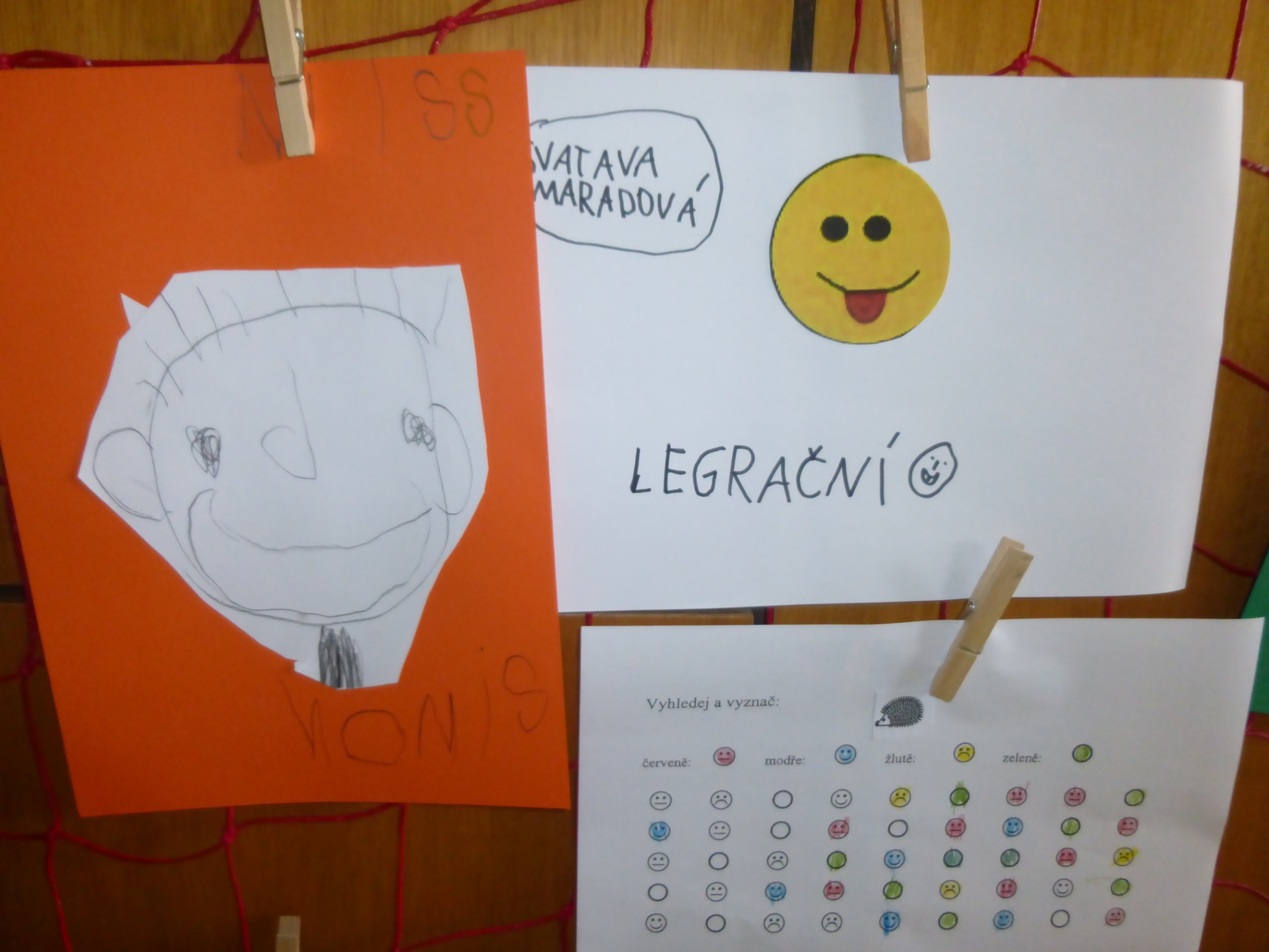

Slide 15
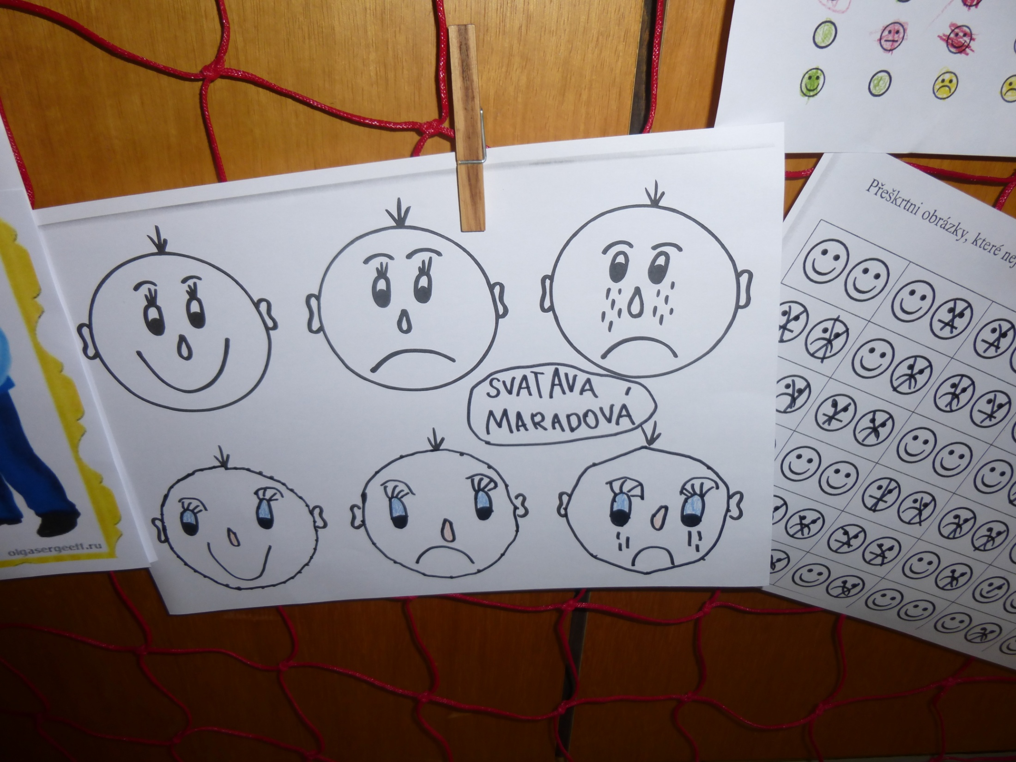

Slide 16
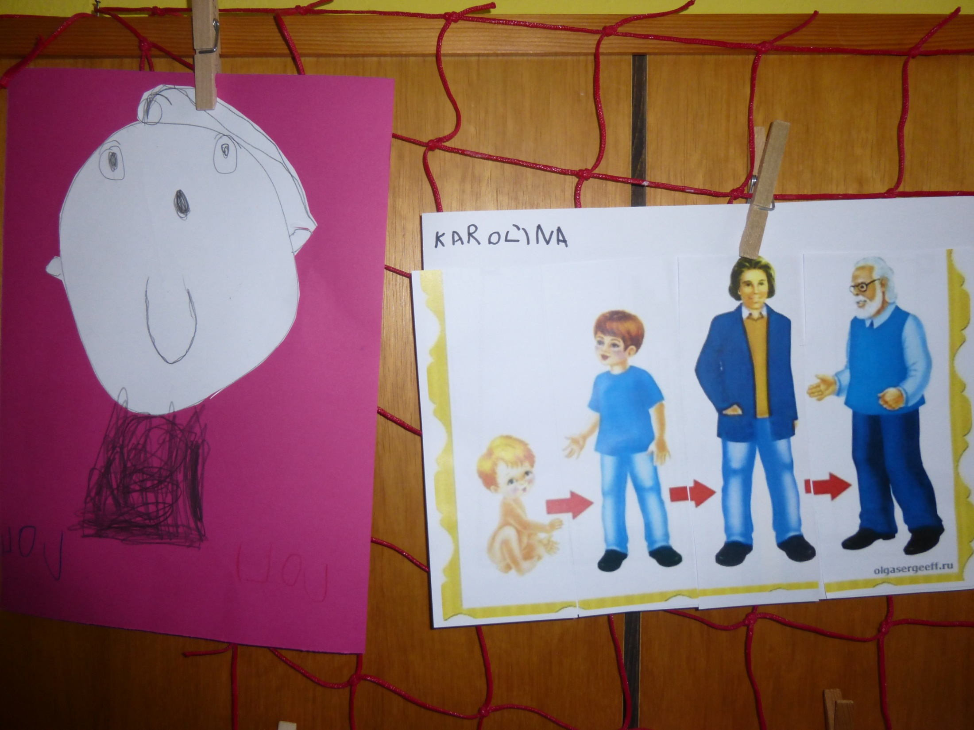
Development of the human body

Slide 17
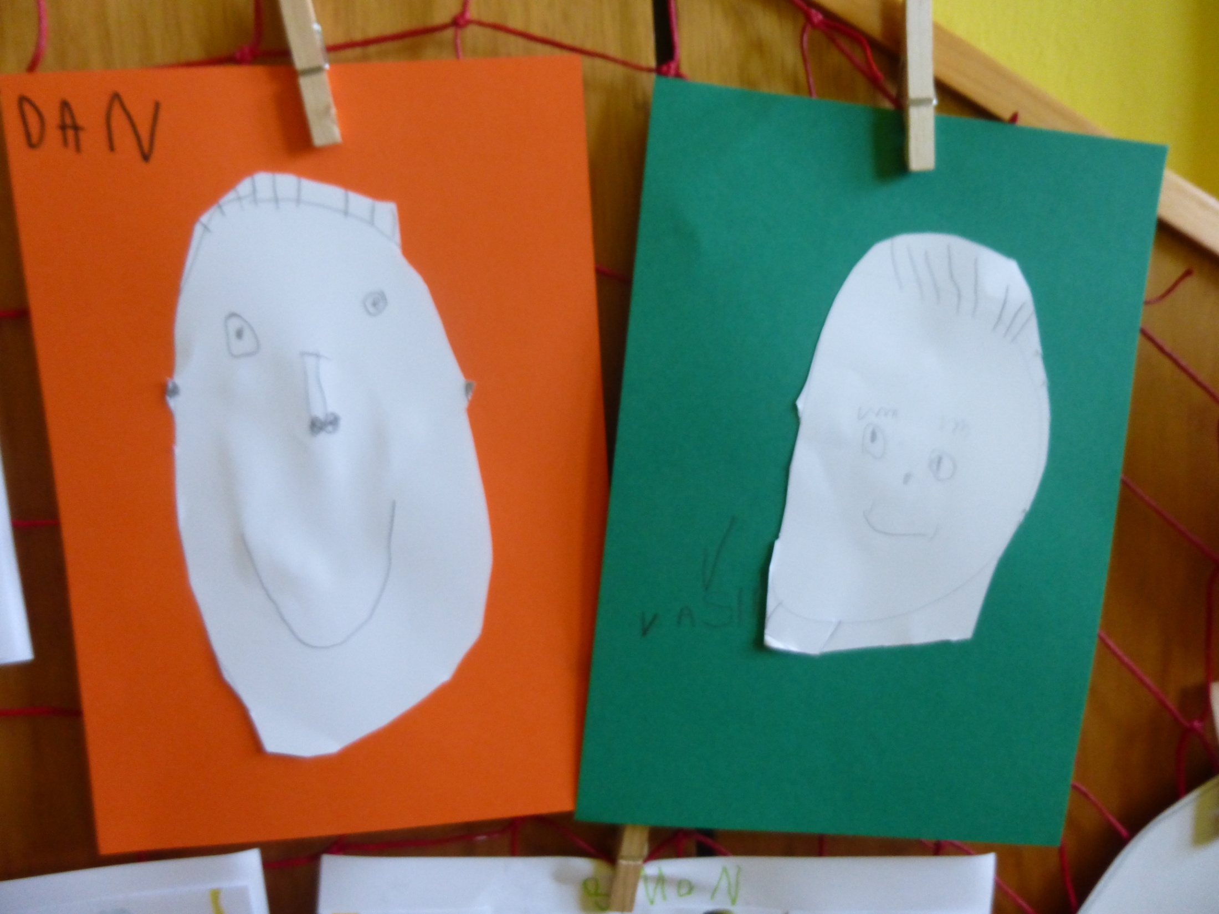

Slide 18
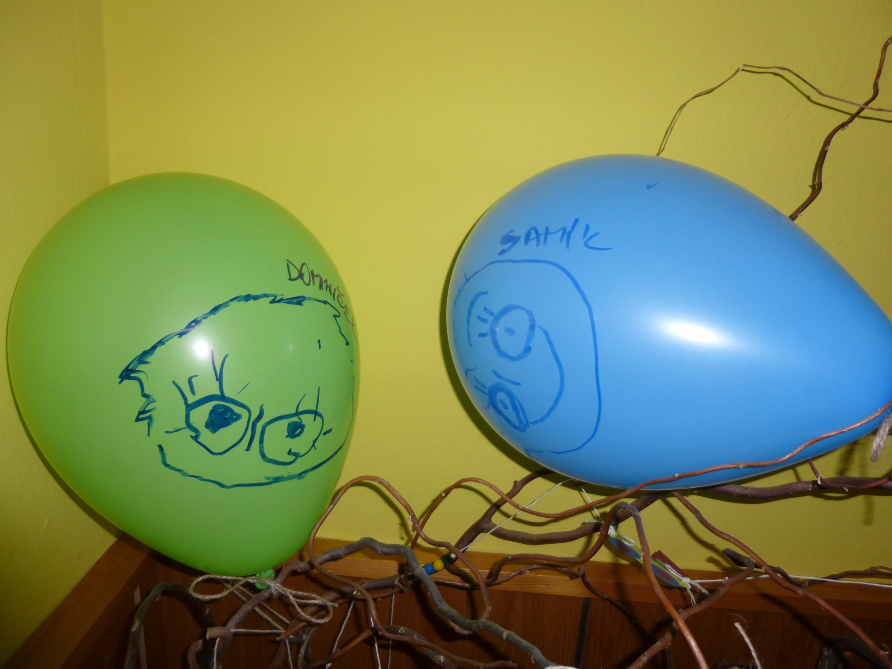

Slide 19
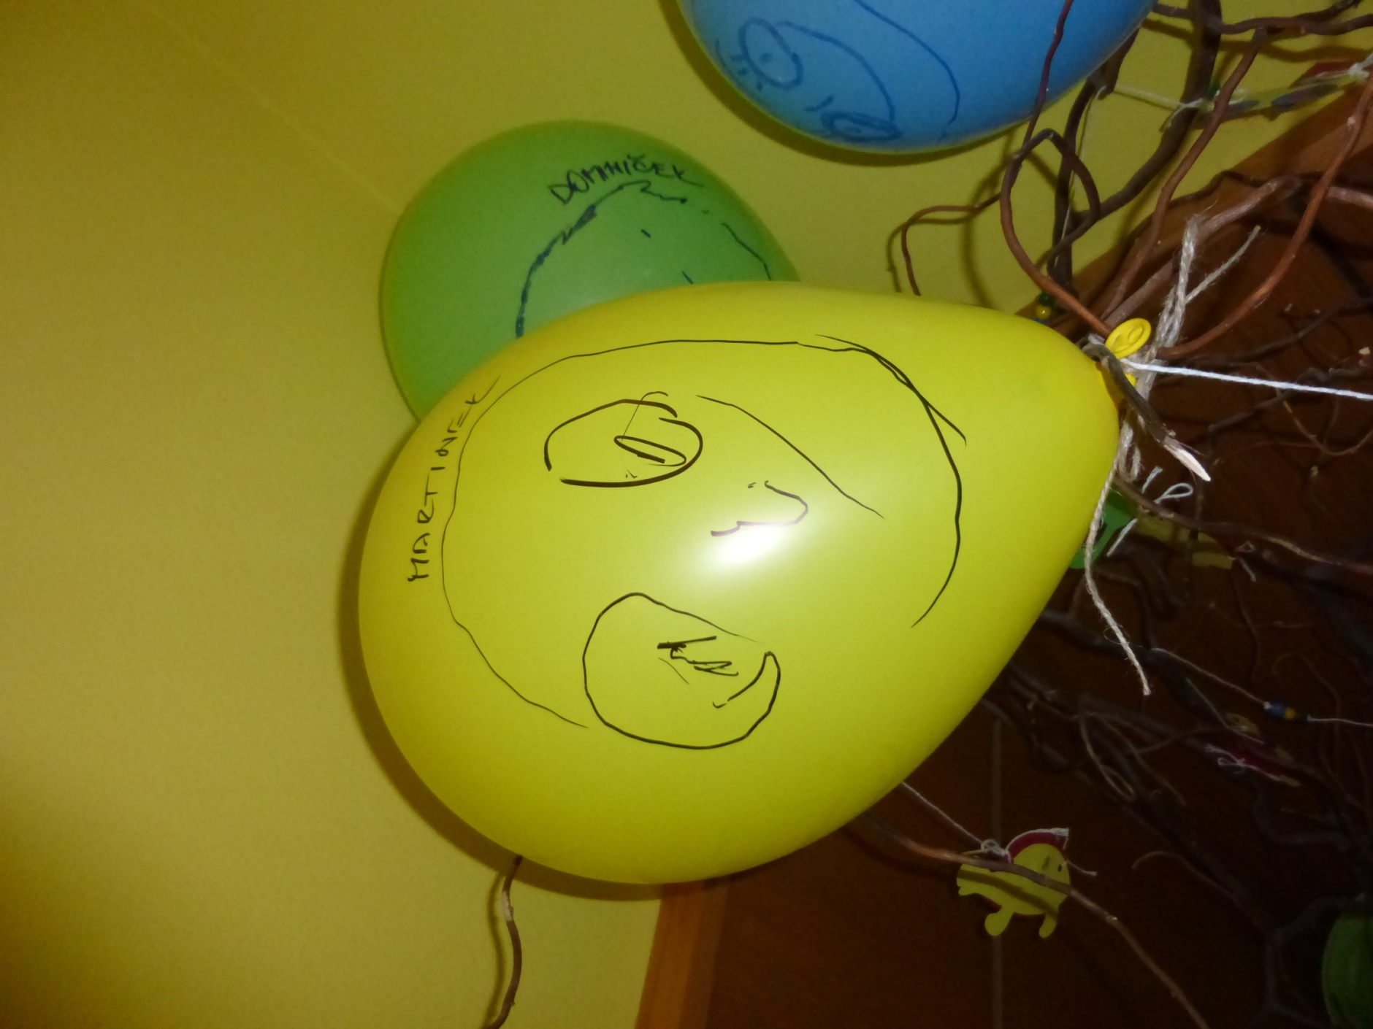

Slide 20
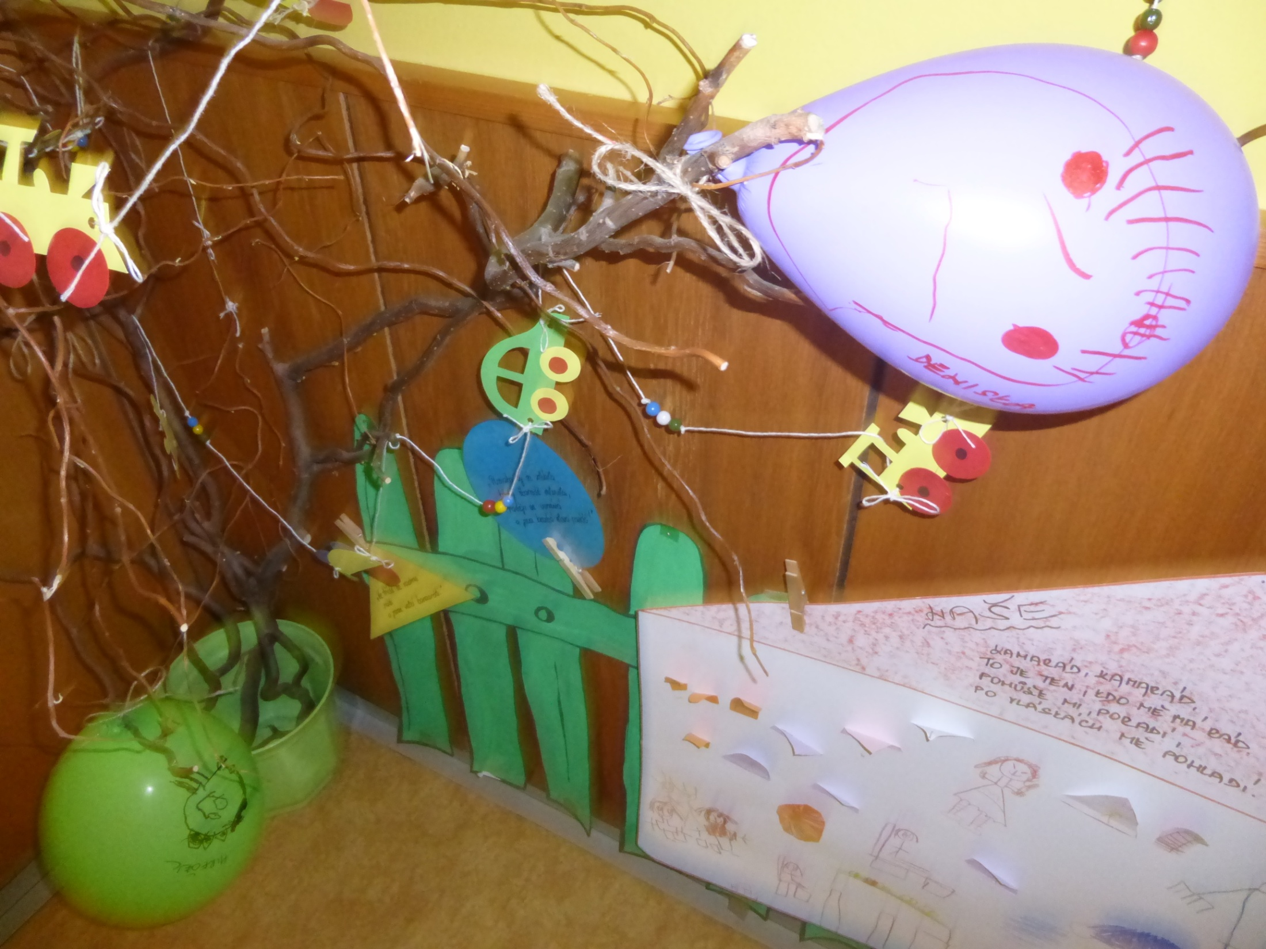

Slide 21
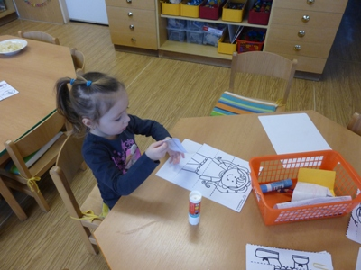

Slide 22
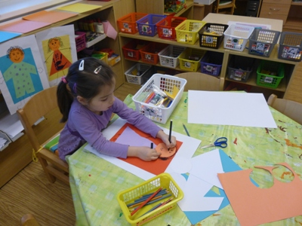

Slide 23
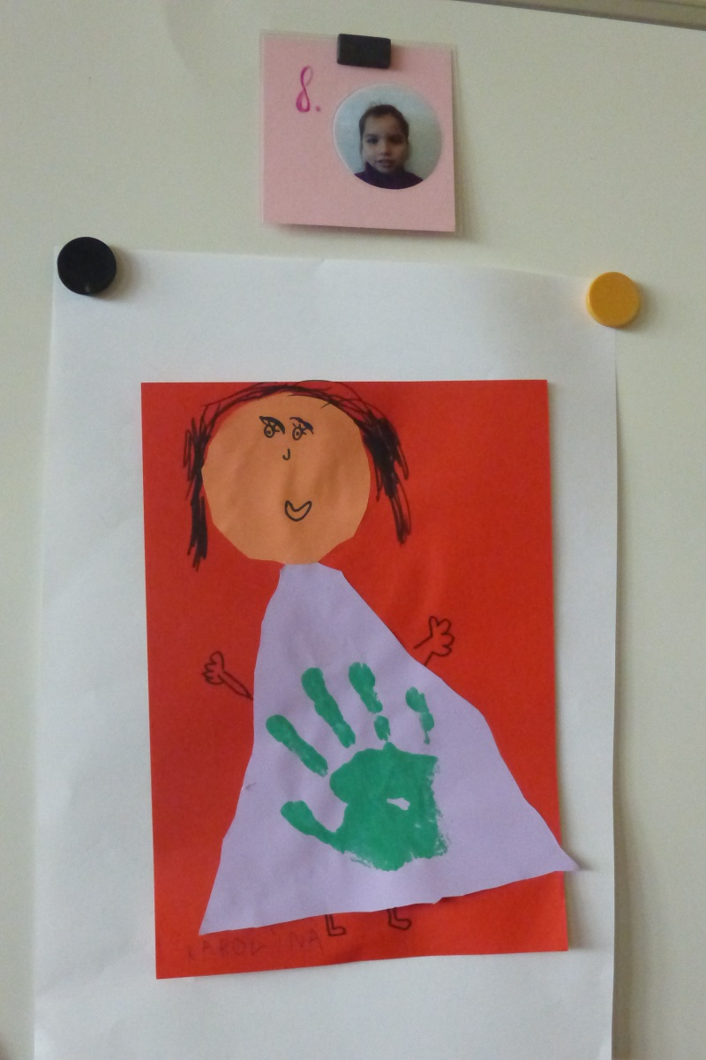
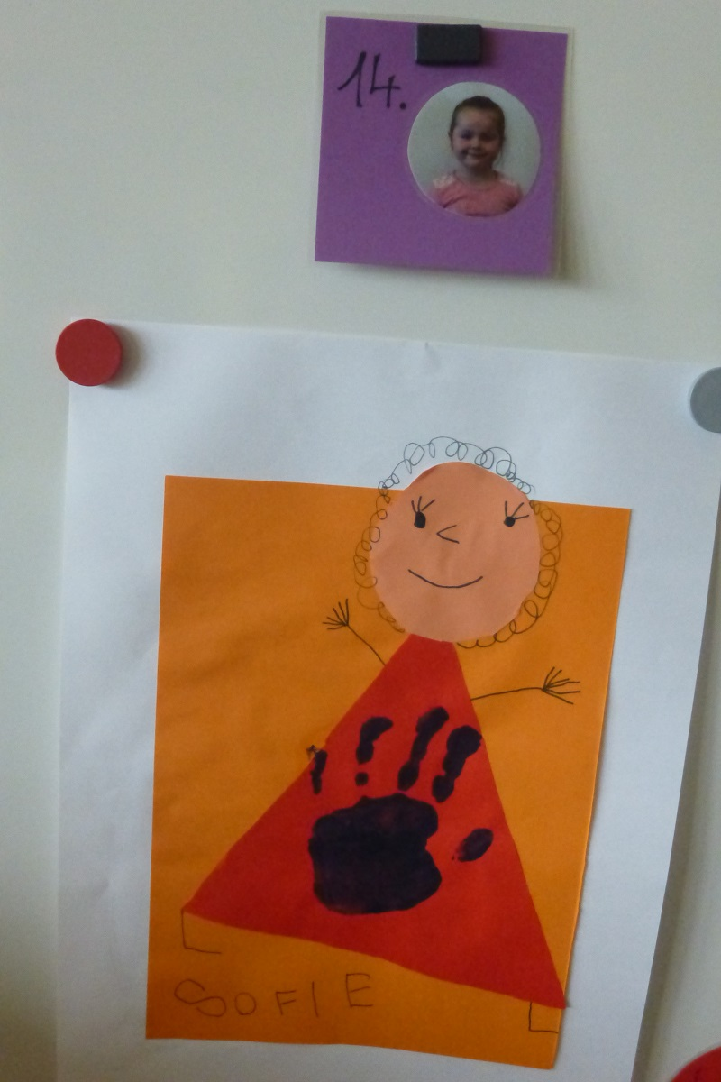

Slide 24
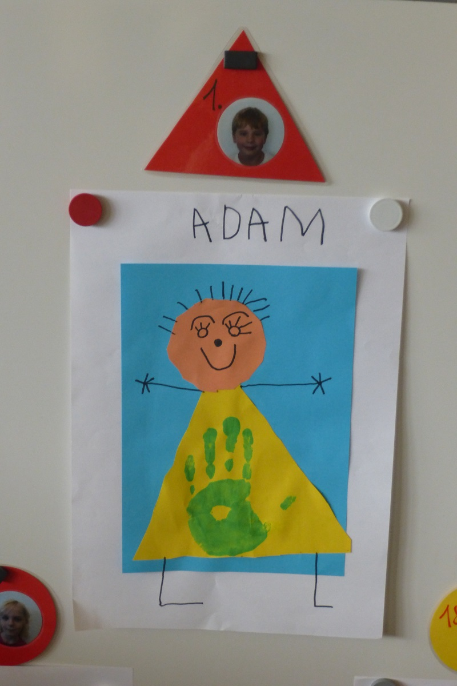

Slide 25
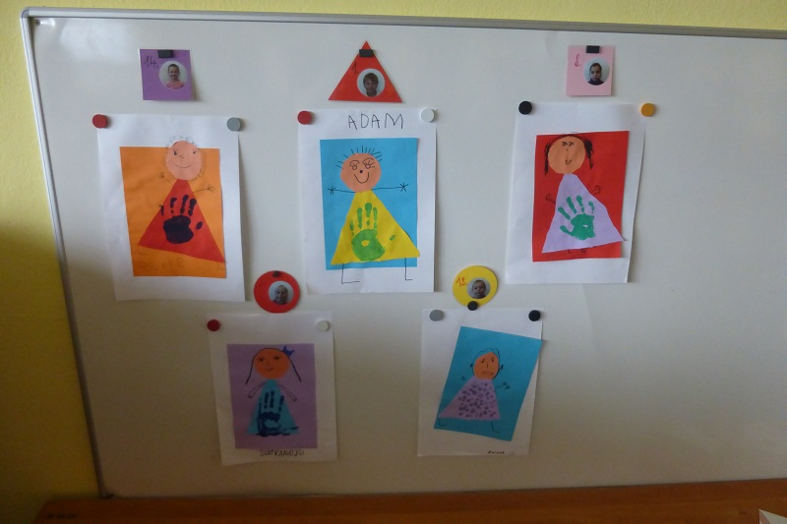

Slide 26
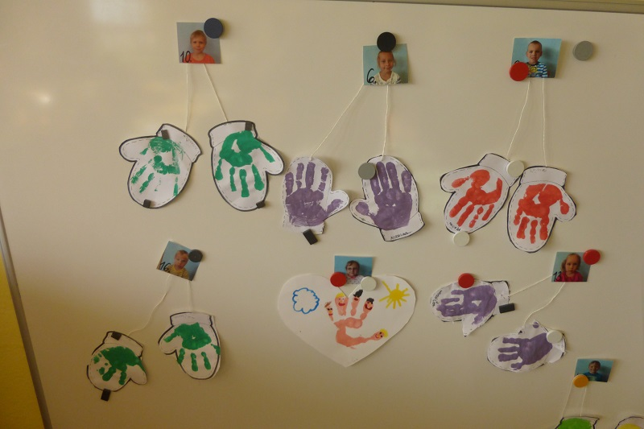

Slide 27
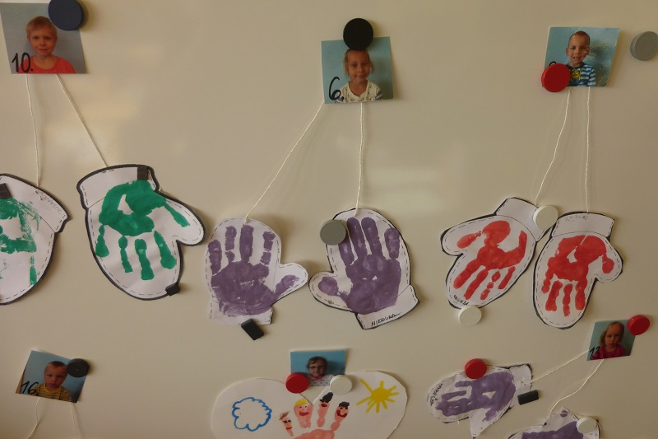

Slide 28
Aktivity done after semminar in Estonia
"Week of differences" January 2016 The topic of week of differences was: tolerance, story "Ugly Duckling".
1.Listening to the reading of the story. 2.Watching film version of the story.
3.Dramatization of the story. 4.Drawing story

Slide 29
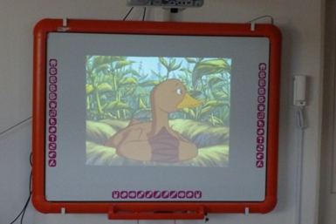

Slide 30
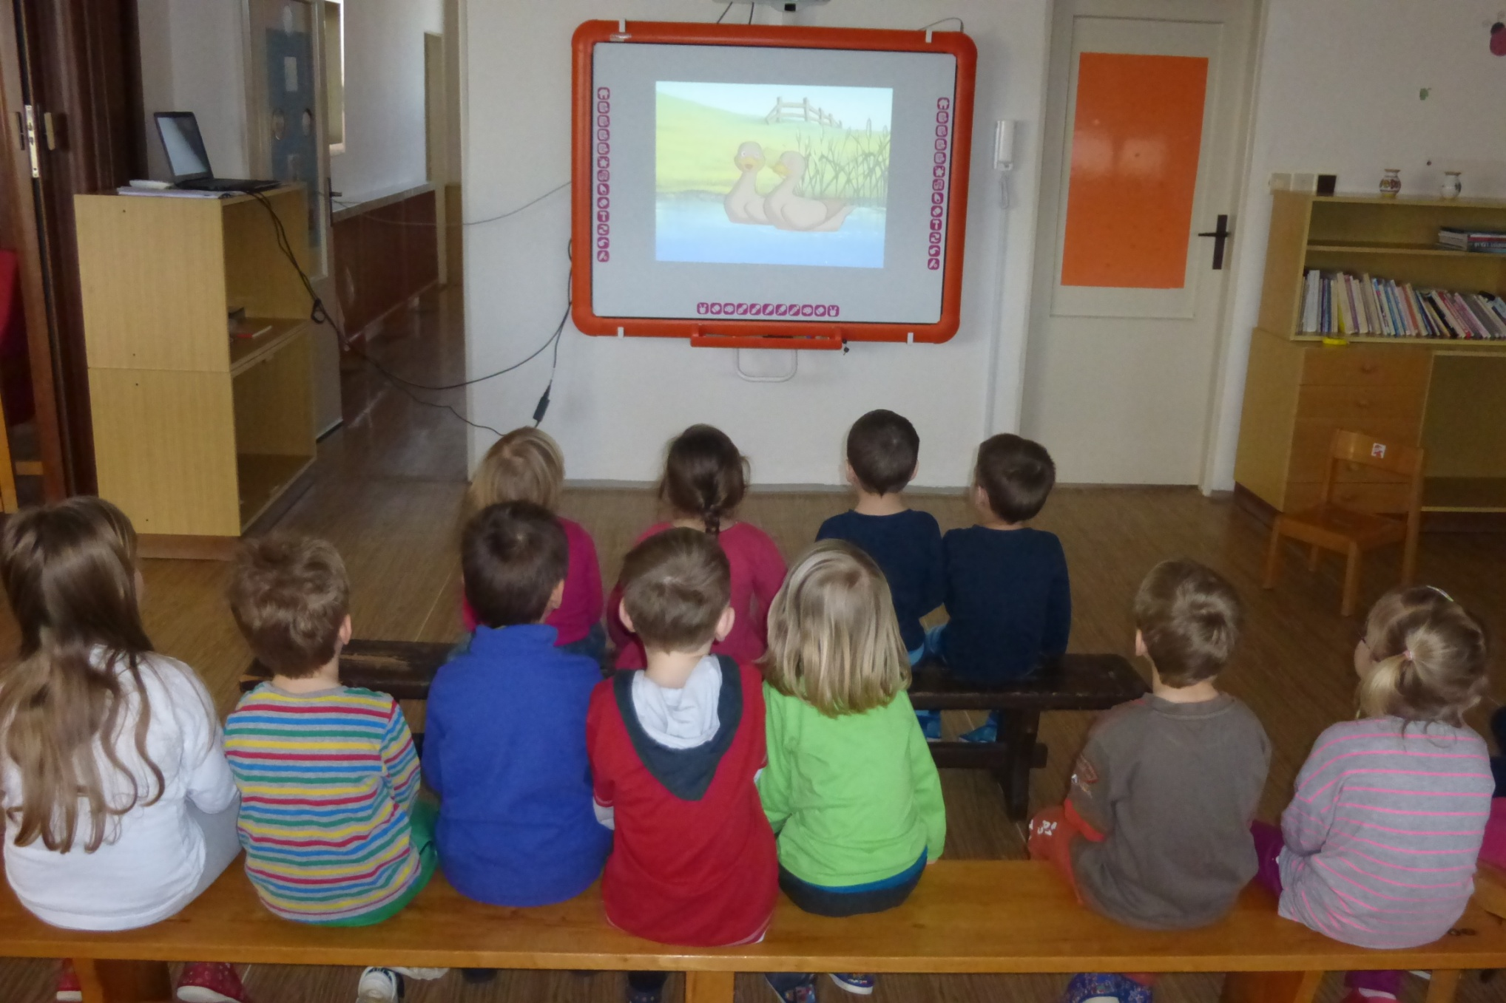

Slide 31
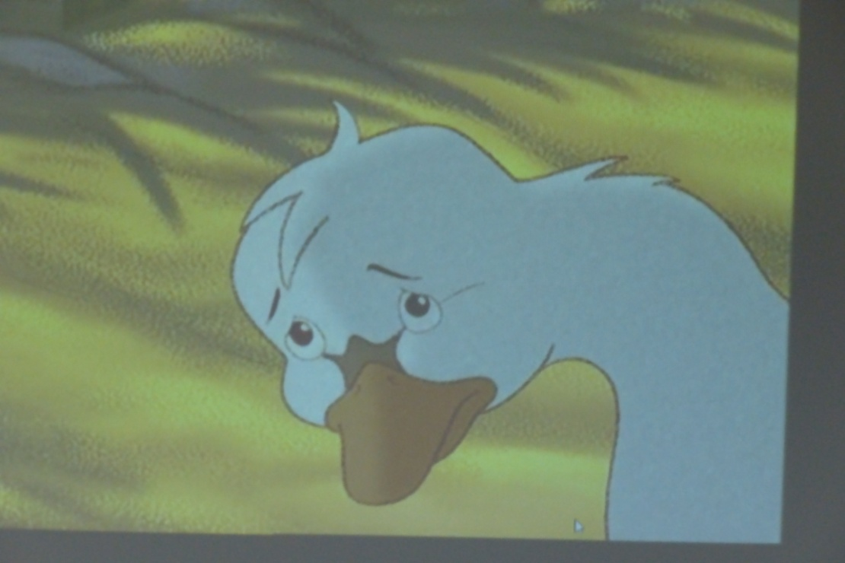

Slide 32
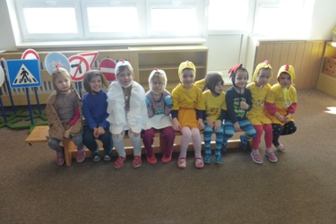

Slide 33
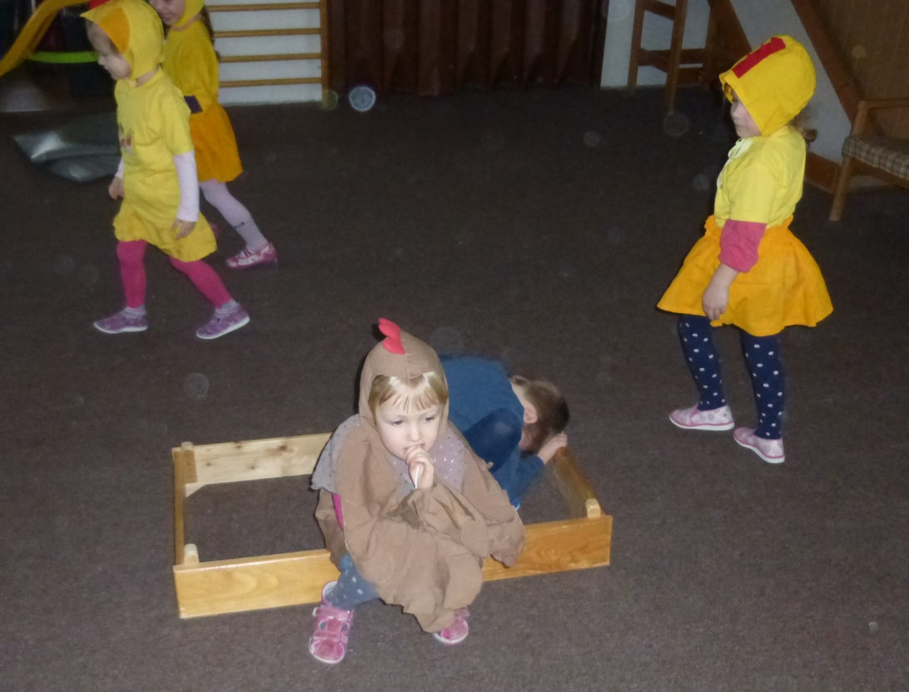
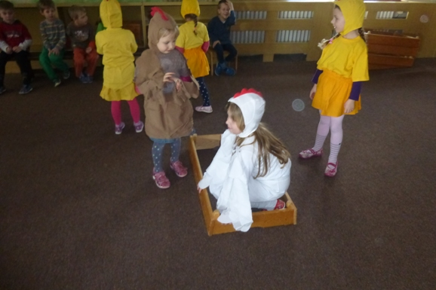

Slide 34
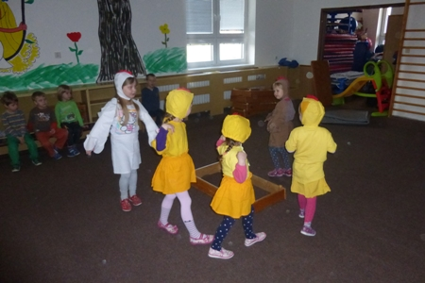
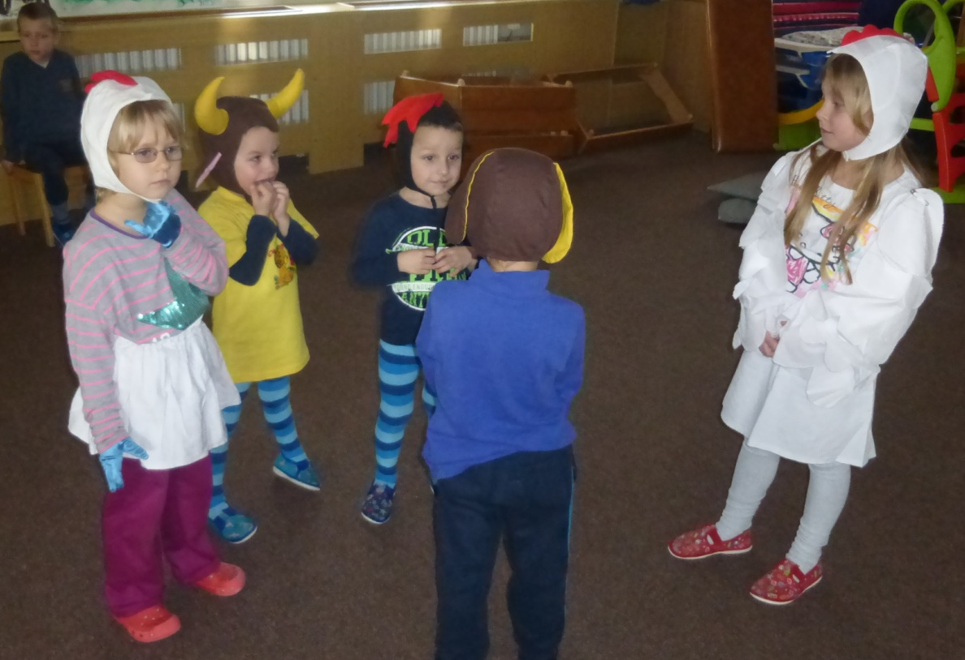

Slide 35
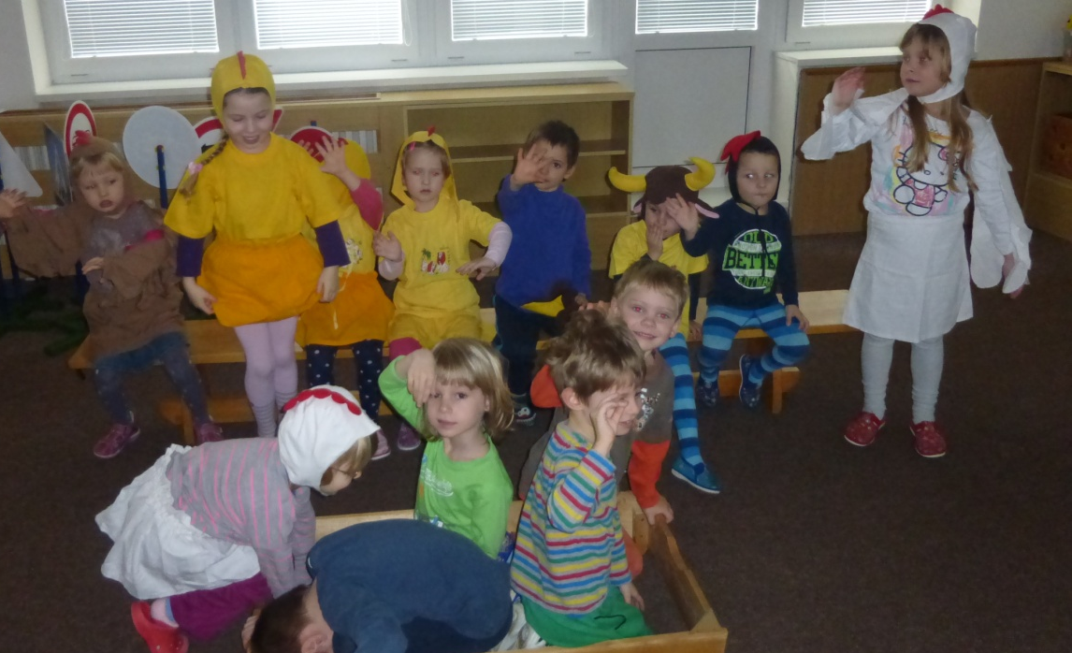
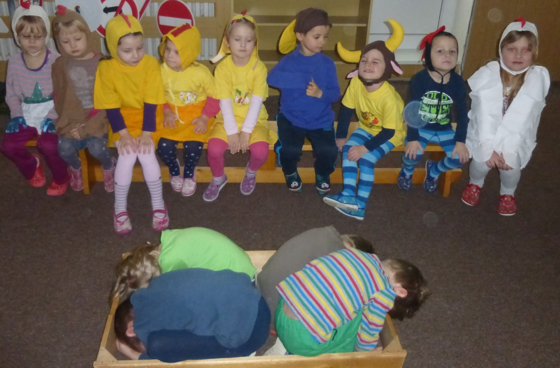

Slide 36
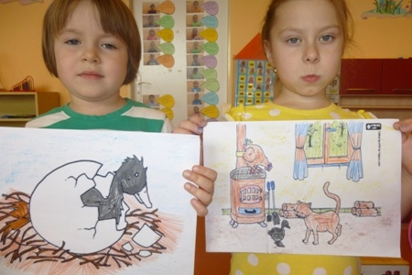

Slide 37
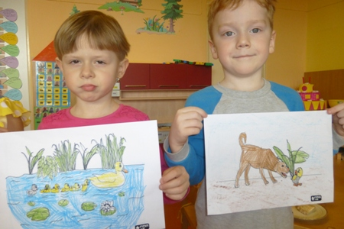

Slide 38
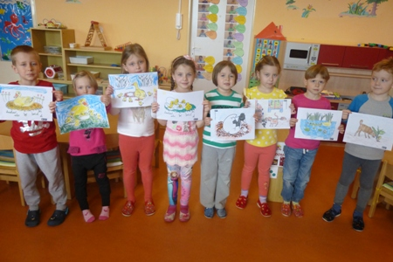

Slide 39
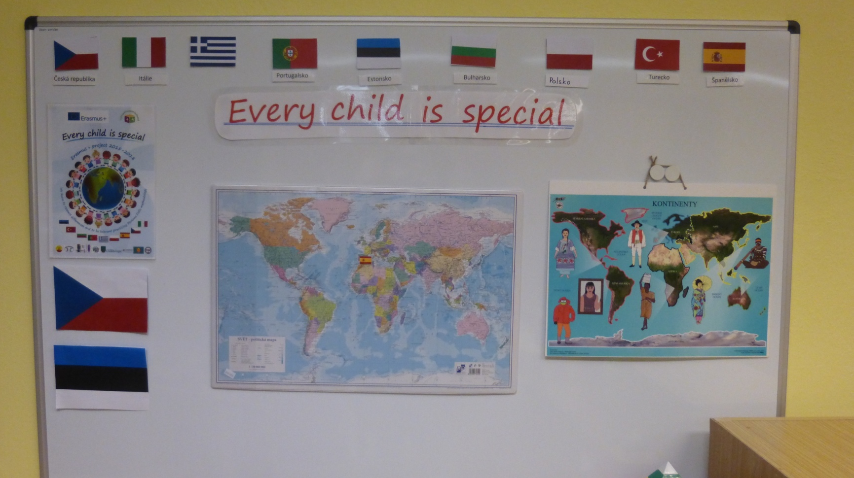
Wall differences
forming the walls helped parents. Mum of one of the children drew a wall around nice pictures
of children of color

Slide 40
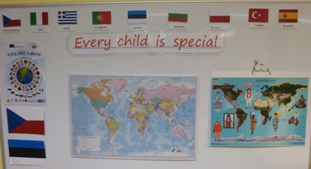

Slide 41
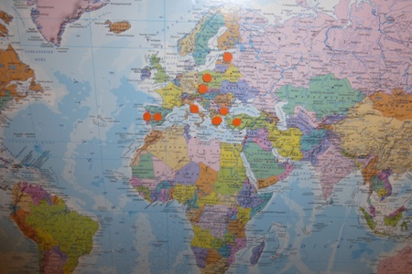
On the map are marked countries our friends from the project „Every child is special“

Slide 42
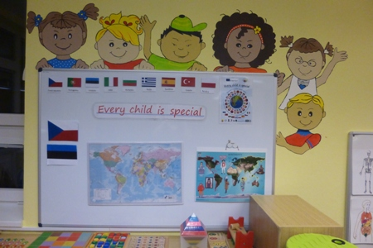

Slide 43
Results of qestionnaire
The questions we asked 15 children
aged 3 years. At the time of project evaluation in 2018 will have these children 6 years old and are still in kindergarten.
The children respond only yes, no,
I don't know. Questions not comment.

Slide 44
QESTIONNAIRE | Yes | no | I don´t know | comment
Which differences could people have? | 9 | 3 | 3 | 0
What is this? When are these aid articles used? | 4 | 5 | 6 | 0
Do you know someone who has a special need? | 10 | 2 | 3 | 0
How can you help a child with special need? | 7 | 0 | 8 | 0
Is it possible to play with a child who does not hear, walk, see? What are these games we can play together? | 12 | 3 | 2 | 0
Is being different good or bad thing? | 10 | 0 | 5 | 0

Slide 45
Profile first Persona Doll

Slide 46
Name: Thomas
Family structure: mother, father, sister( 8 years)
Cultural background: Mother is Czech, father is an Englishman.
Where he lives: Thomas lives in a private house in Prague.
Languages he speaks: With her mother and sister Czech, when the father is at home,everyone speaks English.
Likes: Thomas often plays with Lego, with large cubes- he builds them houses.Outdoors like riding a bike, playing football and various physical games. His favorite sport is swimming. Like playing cards.
Dislikes: Cleaning.
Is difficult: Thomas hard to bear defeat.
Is important for him: To be first everywhere.
Is important for family: Health, family ties- meeting with family( also from England)
The most beautiful days of the year: Holidays, Christmas and birthdays.
Food he likes: Chicken with potatoes, lasagna and Nuttela.
Food he dislikes: Tomato soup, fish and cabbage.

Slide 47
Fears: Of an English school that will come after the holidays.
Physical speciality: Thomas is hyperactive.
Resent history: Thomas was born in Prague. When he was 2 years old, the family moved to Moravia in the village Šardice, because their father had a job here. Thomas was in our village very satisfied. When he was 5 years old, they had to move back to Prague. Thomas was very unhappy. They moved again because of his father’s work and because their father wished the children to attend in Prague an English school. Parents still house in Šardice sold and so they’ve often run as a cottage and Thomas is very happy. He always comes to us also look to Kindergarten.
Wish: Thomas wants to go back to Šardice.

Slide 48
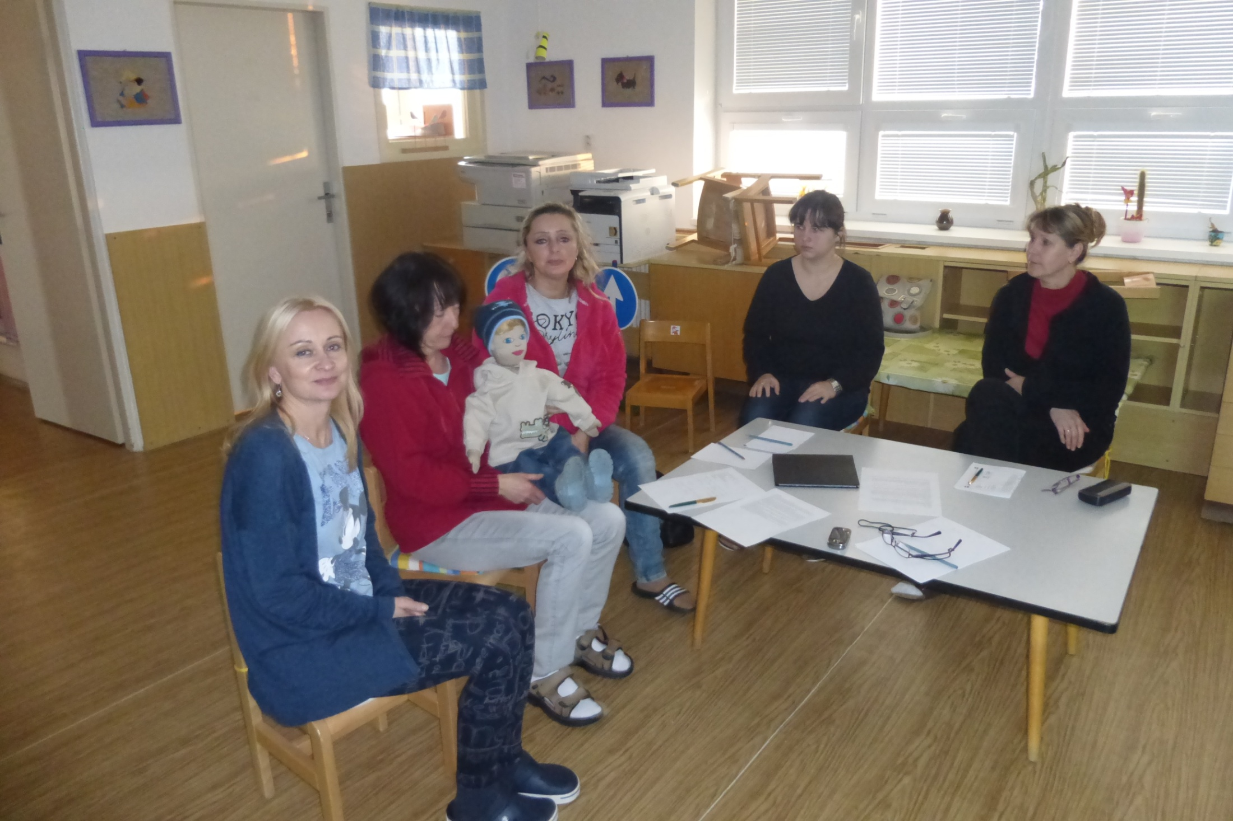

Slide 49
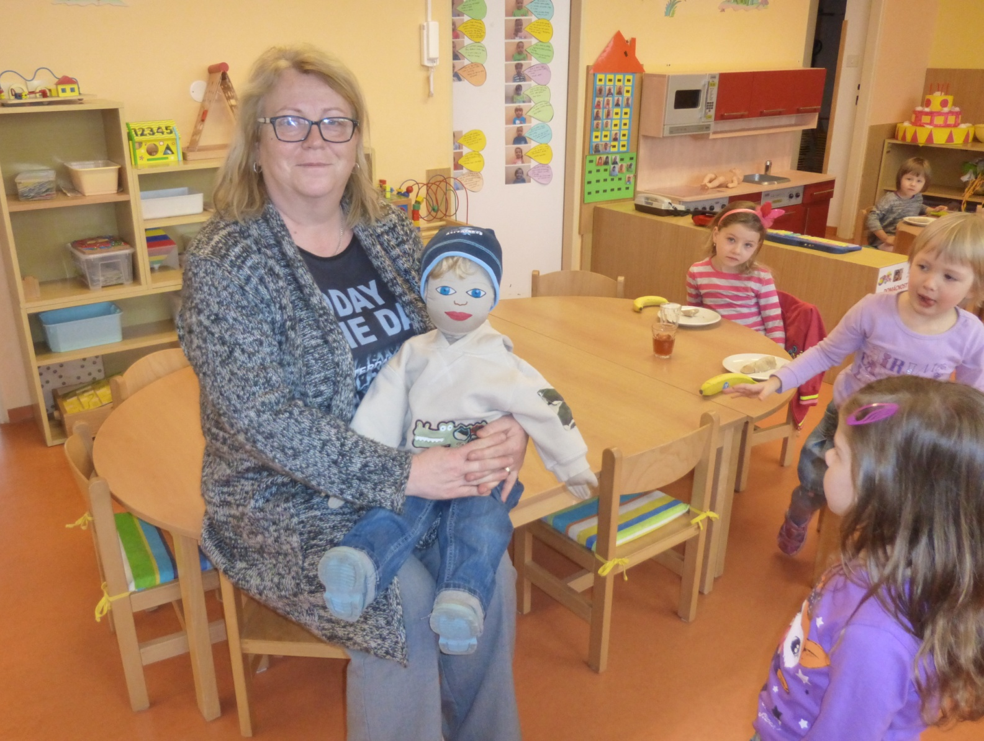

Slide 50
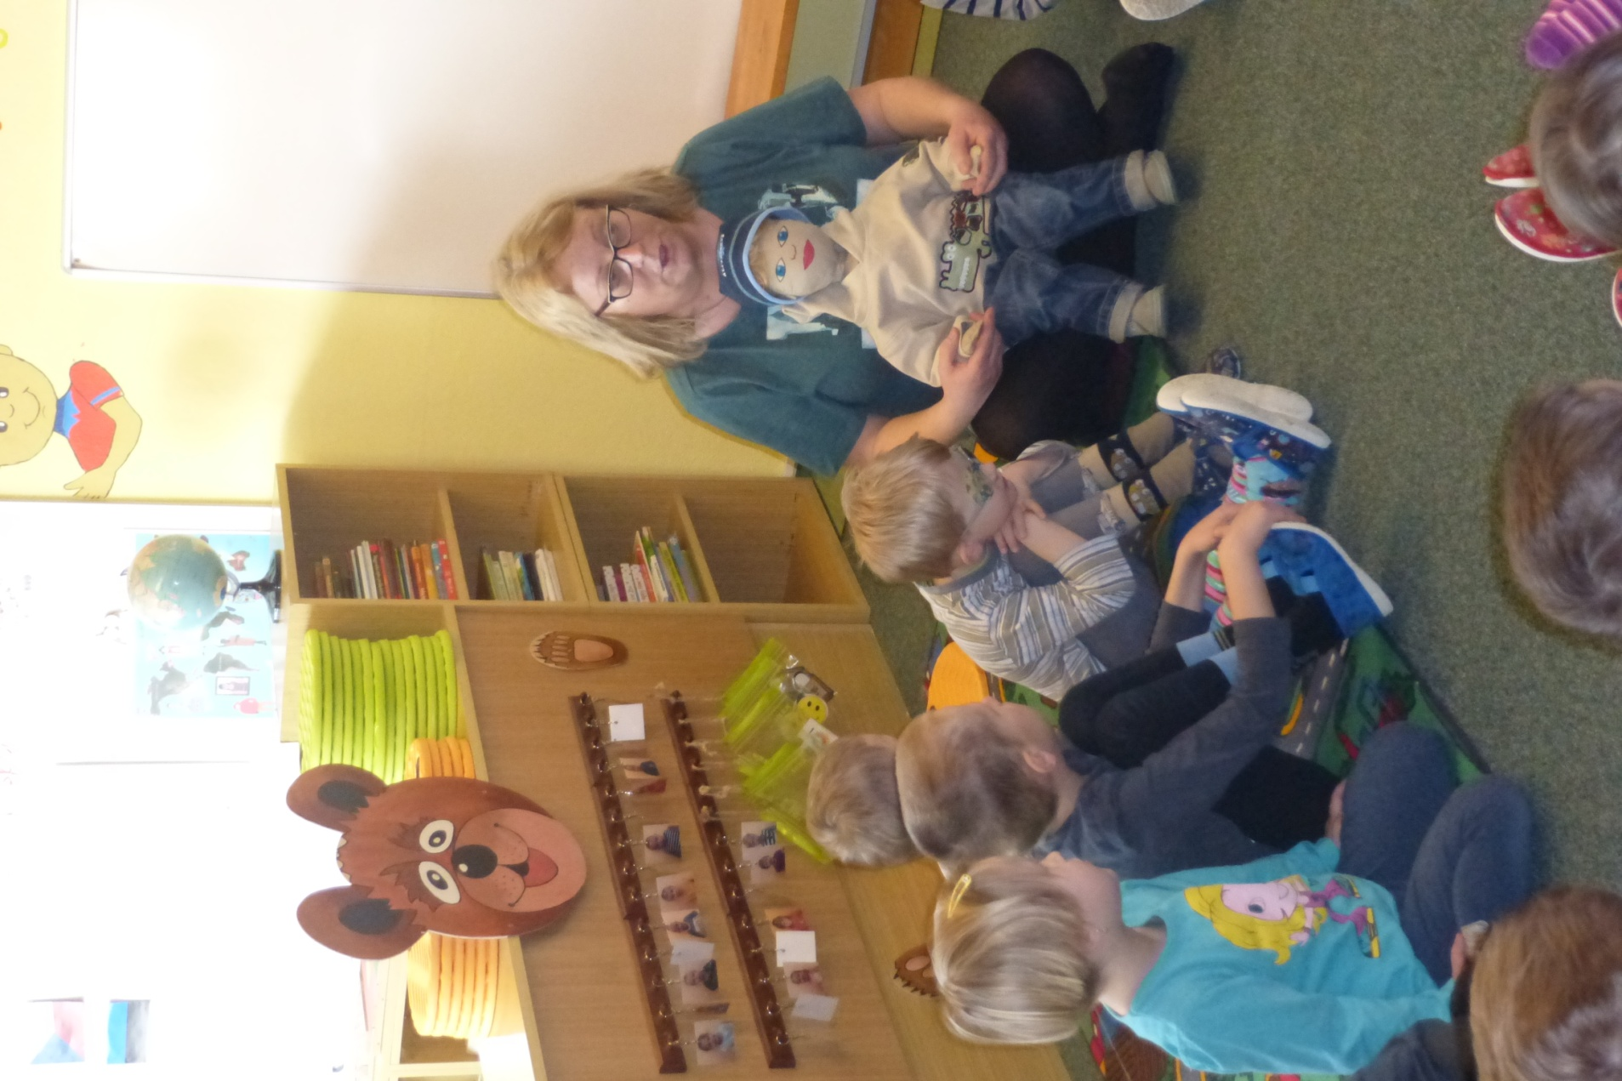

Slide 51
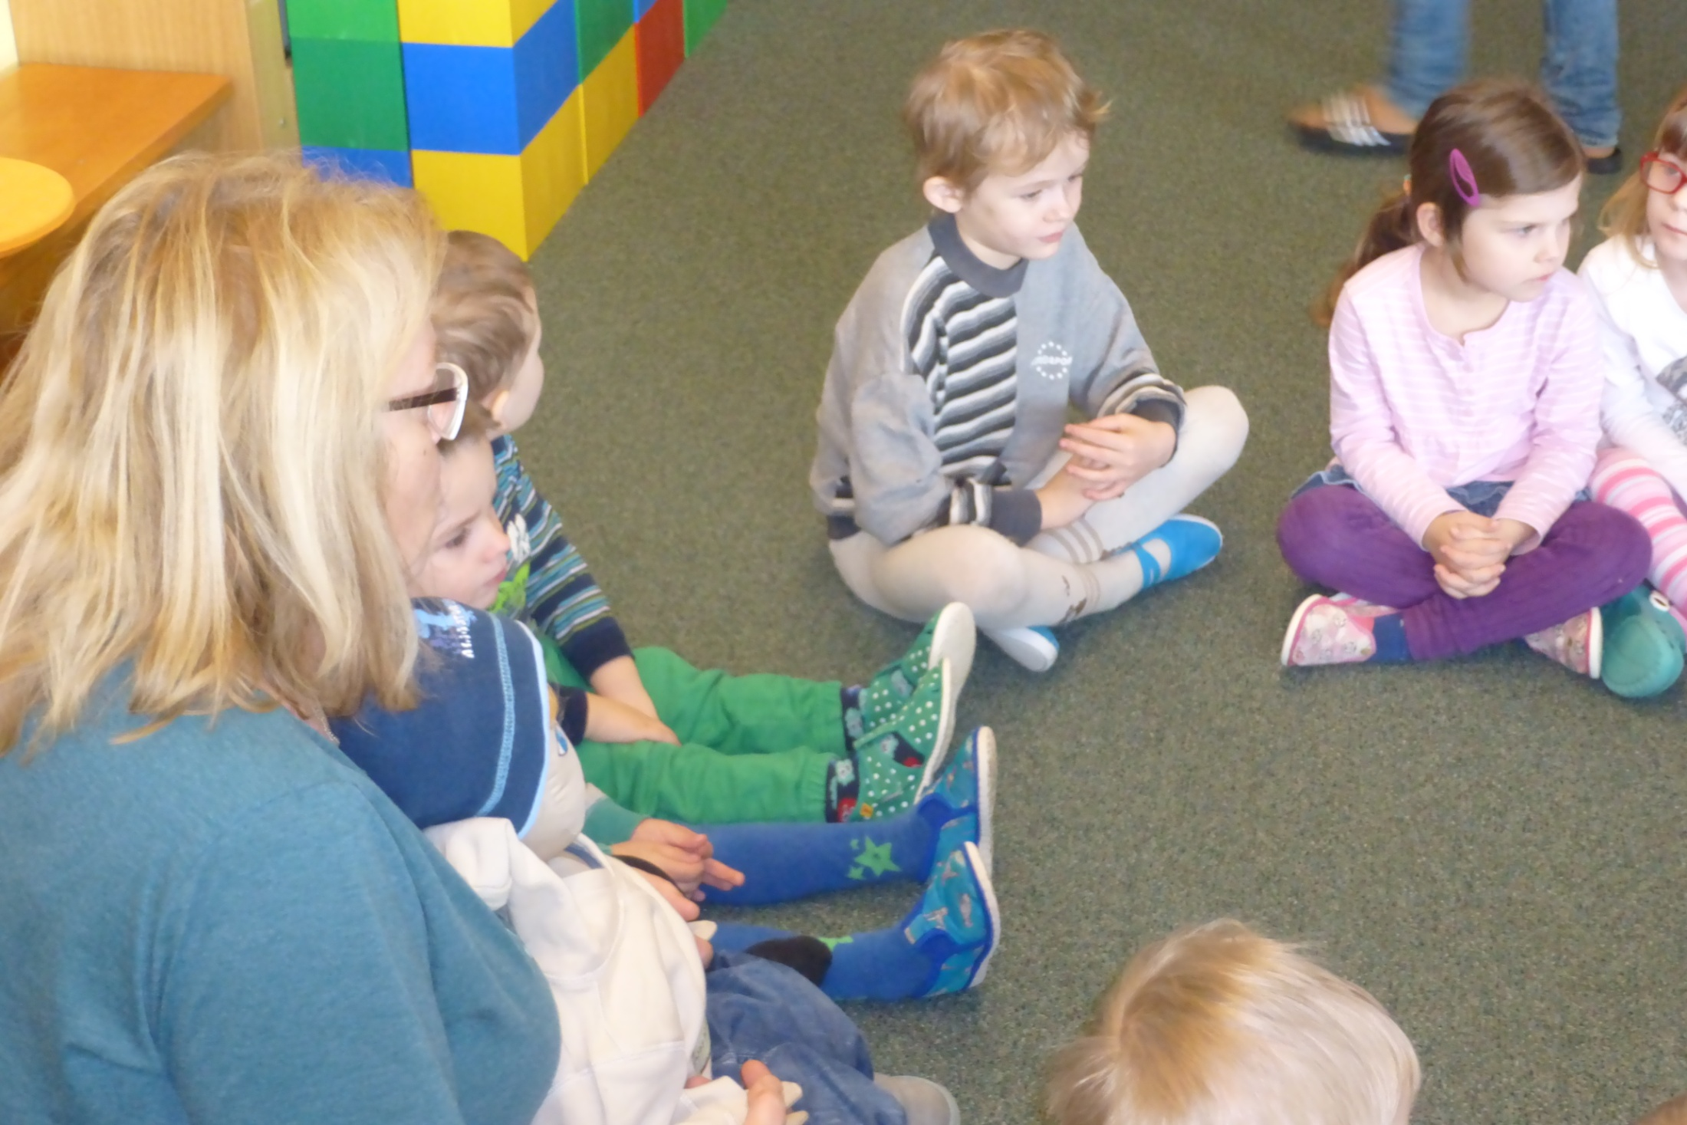

Slide 52
