Slide 1
Culture Awareness
Erasmus+ project, 2015 – 2018
“Every child is special”

Slide 2
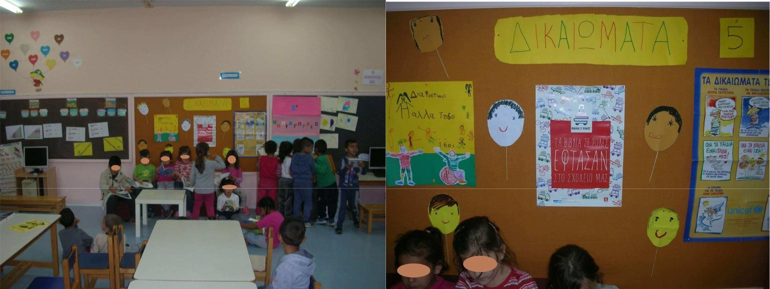
Multicultural Schools all over Greece: A big to Culture Awareness

Slide 3
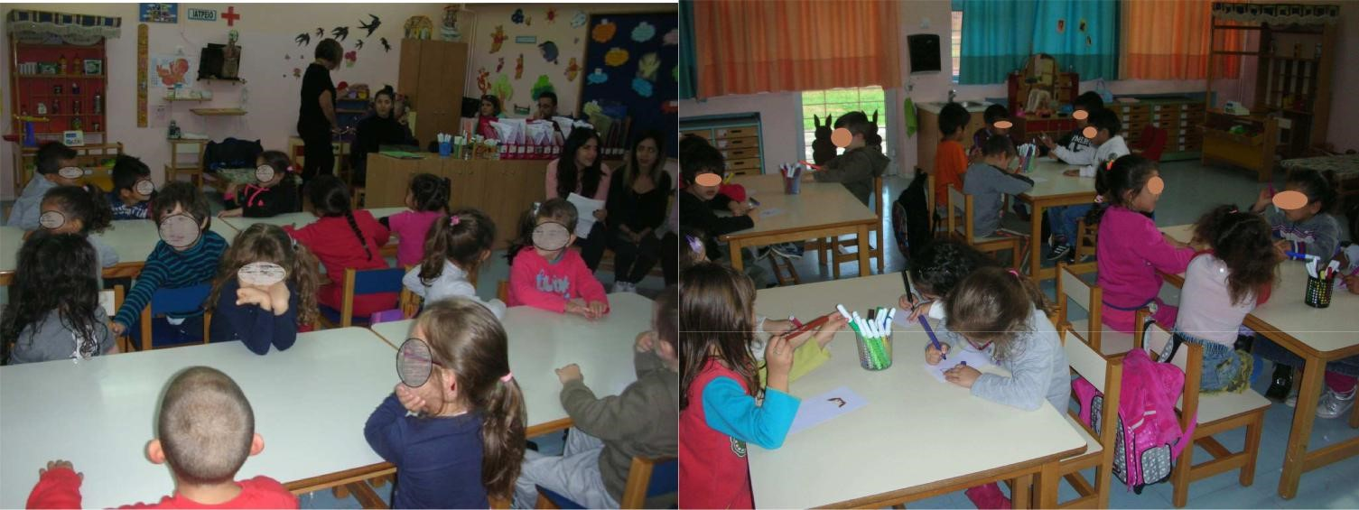
Roma and Migrant students, Asians, Africans, Europeans in the same class

Slide 4
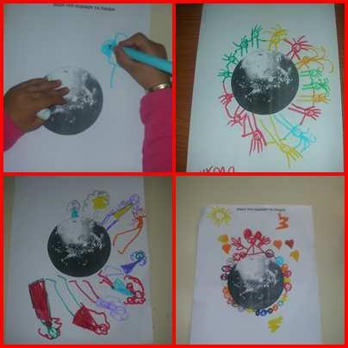
We are the Children…..we are coming from many different countries accepting our cultures

Slide 5
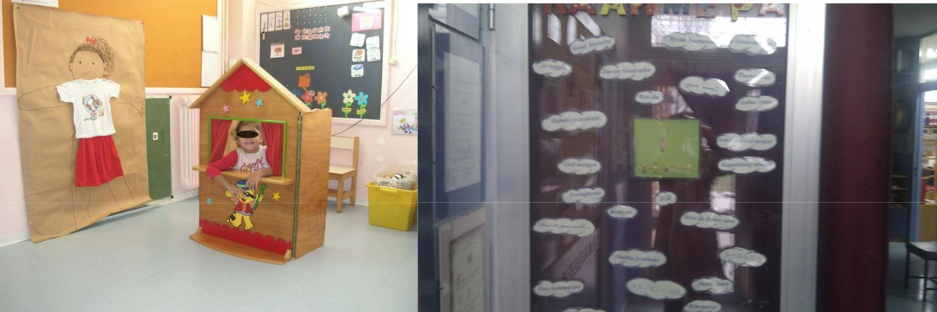
We say ‘’Good Morning’’ in many languages…..everyday!!!

Slide 6
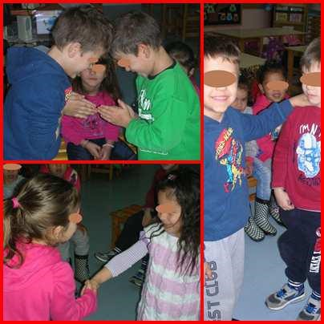
Even ‘’I love you’’ …. it’s different for everyone of us!

Slide 7
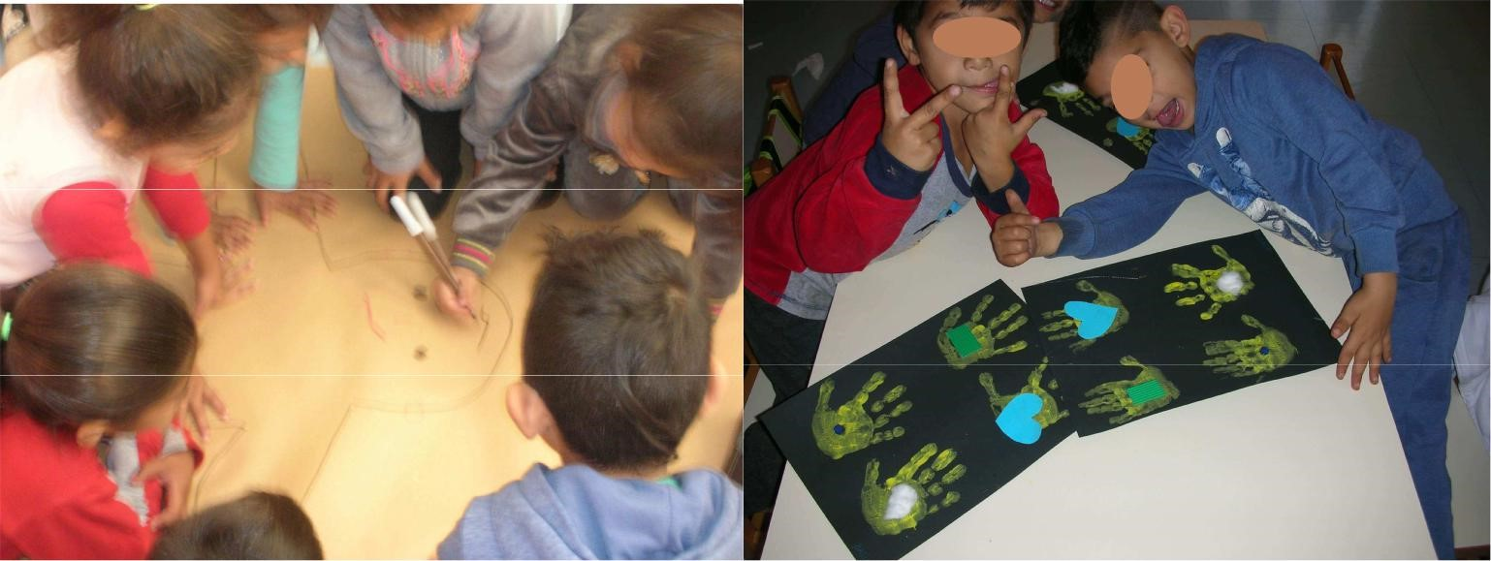
Different colors…. hands, eyes and hair

Slide 8
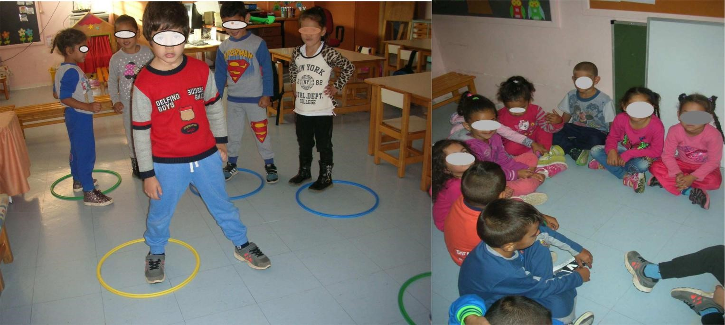
Different games, but we all play….

Slide 9
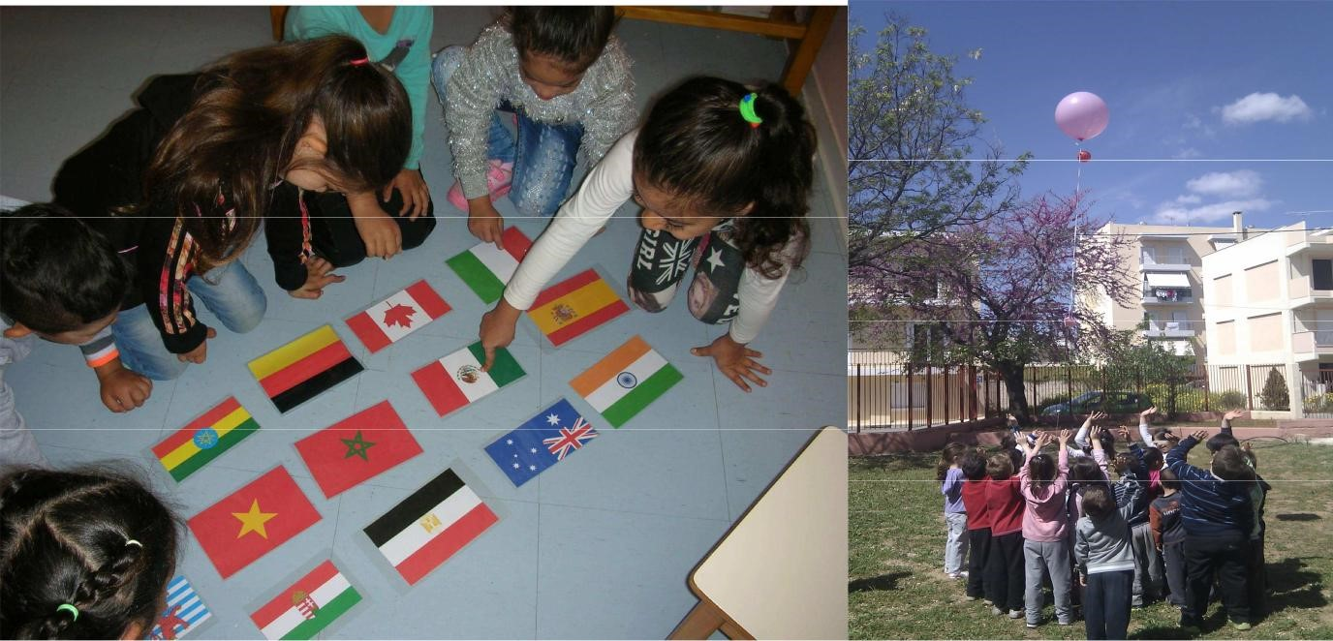
We know countries….we are getting full of hope for a common future respecting each other’s culture

