Slide 1
Erasmus + project “Every child is special” PERSONA DOLL NR: 5
Seminar in Poland, Warzsaw
28.05 – 31.05

Slide 2
Hello my name is Triinu

Slide 3
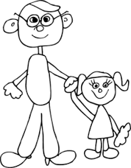
Family
She lives with her father, stepmother and her 2 older sons, in a suburb of Tallinn Mustamäe in a big apartment building.

Slide 4
Why she is special
She has a speech disability
Others can not understand her speech
She can stutter when it is difficult to speak
She speaks with very, very low voice
When others refuse to play with her, then she will get very angry and will speak nasty words and may hurt others physically, is aggressive.
She could be very pushing towards other children.

Slide 5
What she likes/dislikes
She wants to play with others;
It is difficult for her to communicate with others;
She does not like when brothers bully her, she will become aggressive then;
She loves animals;
She has a cat and she mostly likes to play with her kitten.

Slide 6
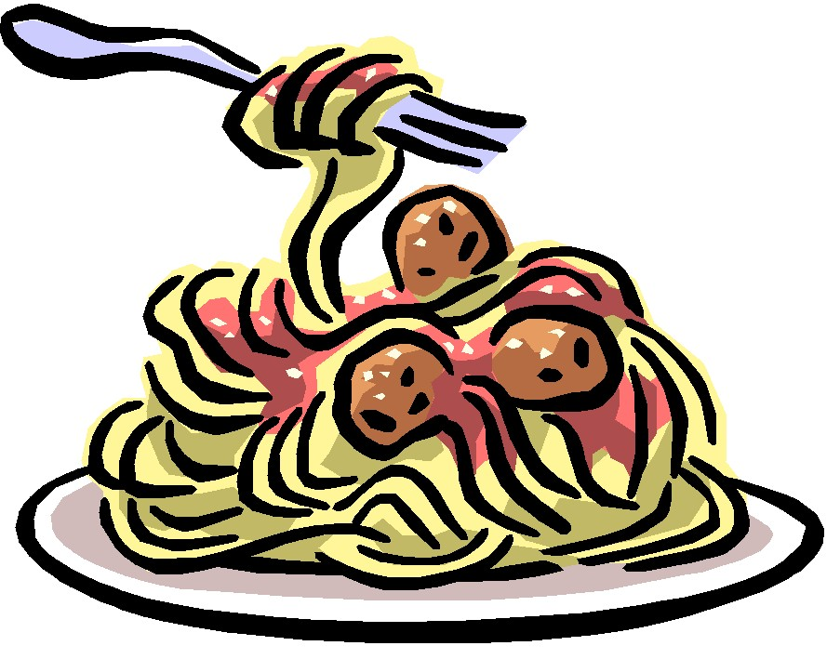
What she likes to eat, and not!
She eats everything. Favourite food is macaroni and sauce with meat.
She does not like potato salad with sour cream.

Slide 7
Fears!
She is afraid to speak in front of others;
She does not like/ want that other point out that they can not understand what she is telling.
Therefore she speaks with very low voice.

Slide 8
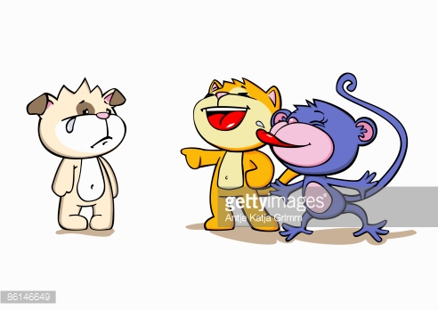
What happened to her recently
She lived with her father,
but father was always busy
and she was always alone.
They moved to the house
of fathers new wife and
her 2 bigger sons.
Triinu hoped that now she
has somebody to play with,
but the boys bully her.
She asks father to help her, but he is too busy.

Slide 9
Teacher asked Triinus father to start to visit a speech therapist.
She hopes that when others understand what she speaks then she will have a lot of friends to play with and she would not feel so lonely.

