Slide 1
EVERY CHILD IS SPECIAL TURKEY ACTIVITIES

Slide 2
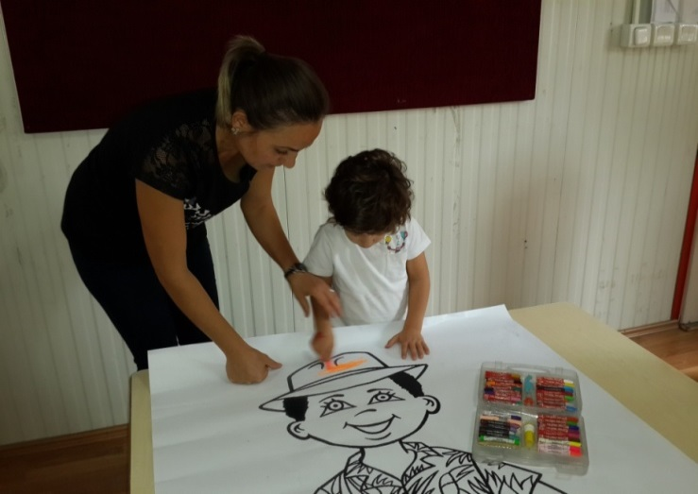
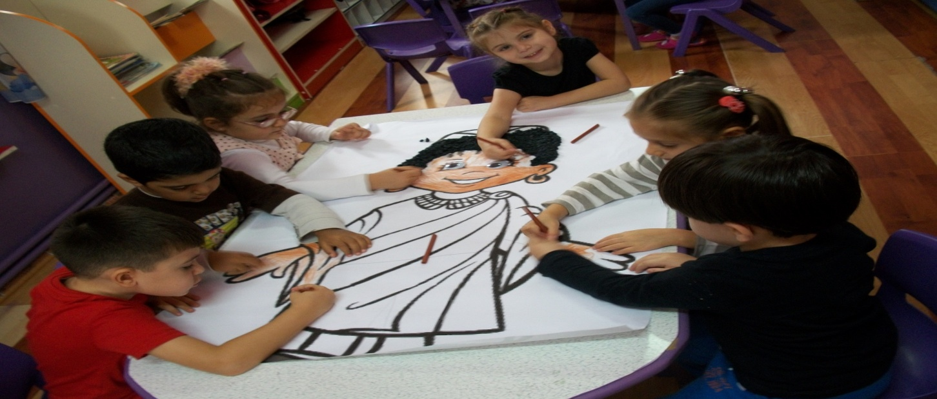
FIRST OF ALL WE MADE ACTIVITIES WITH OUR PUPILS ON DIFFERENCES OF PHYSICAL APPEARENCES

Slide 3
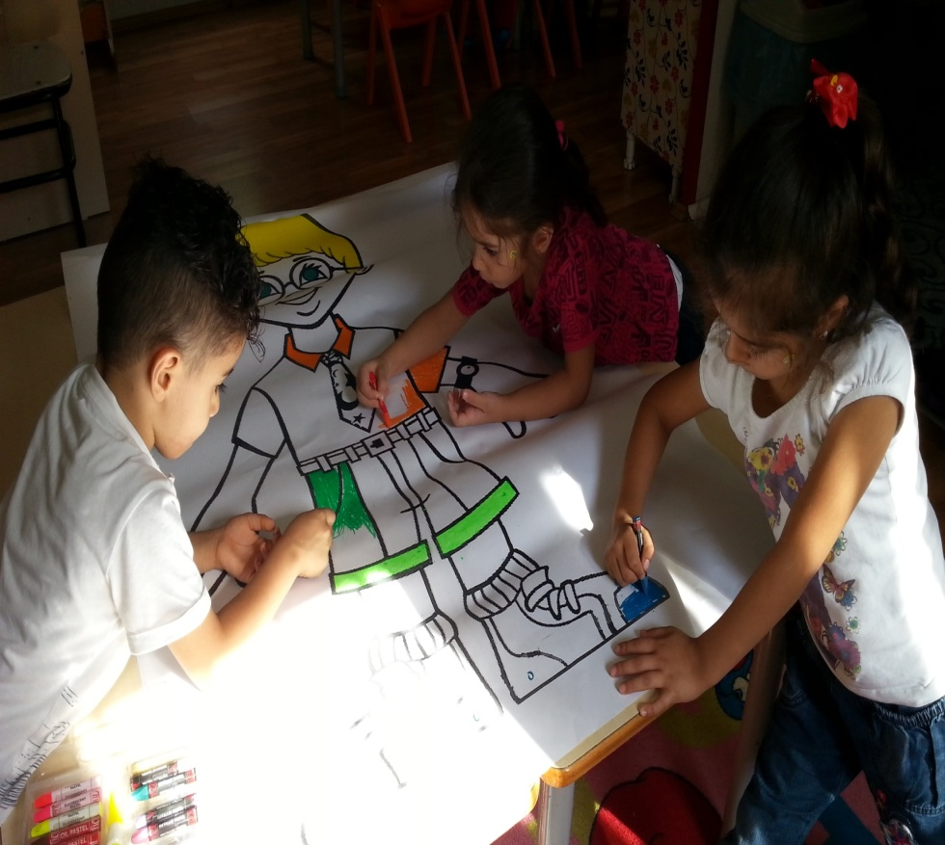
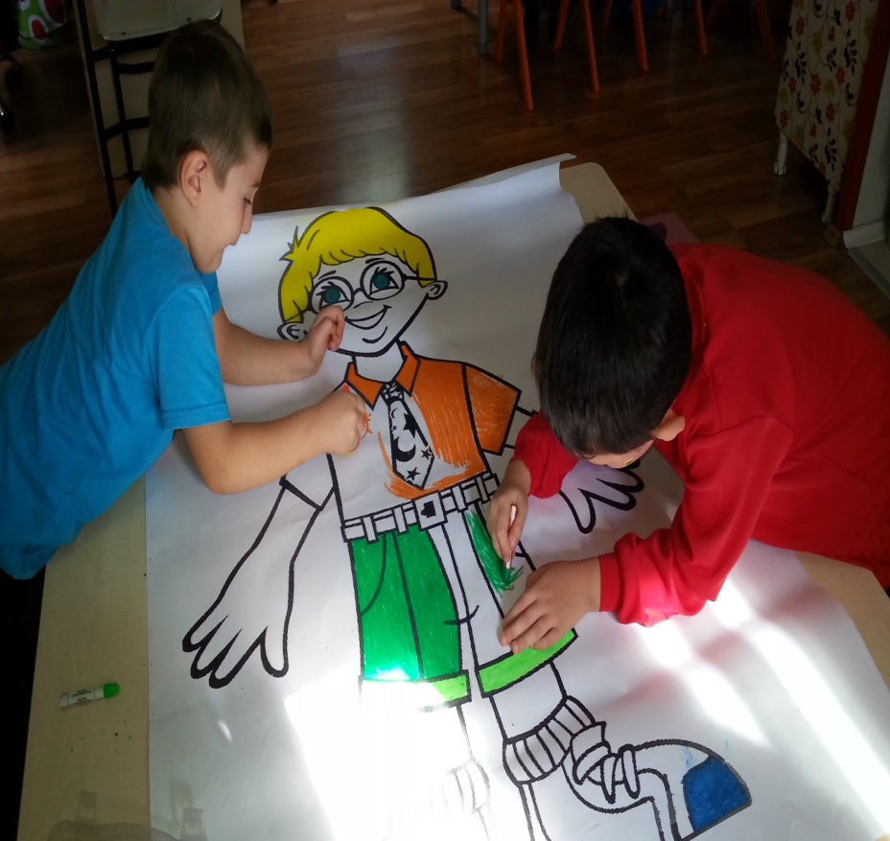

Slide 4
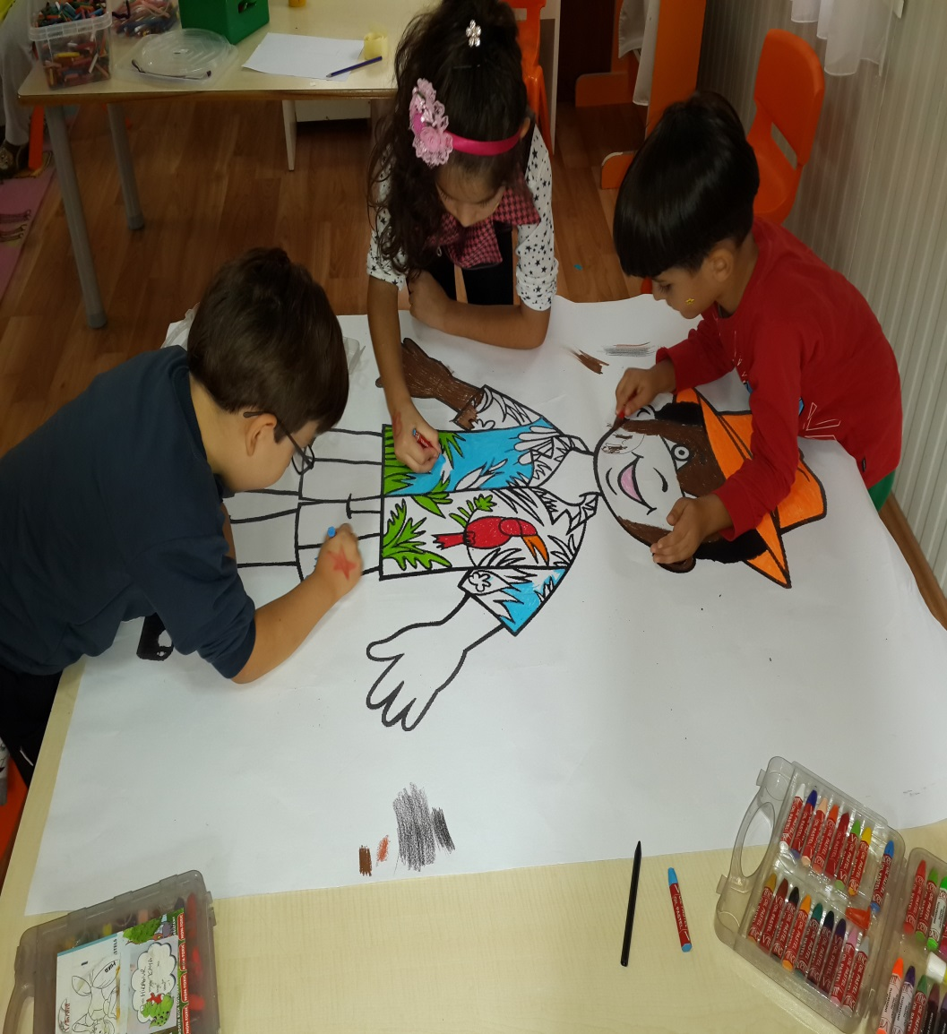
WE HAVE REALIZED DIFFERENCIES WHEN WE ARE MAKING CHILDREN.

Slide 5
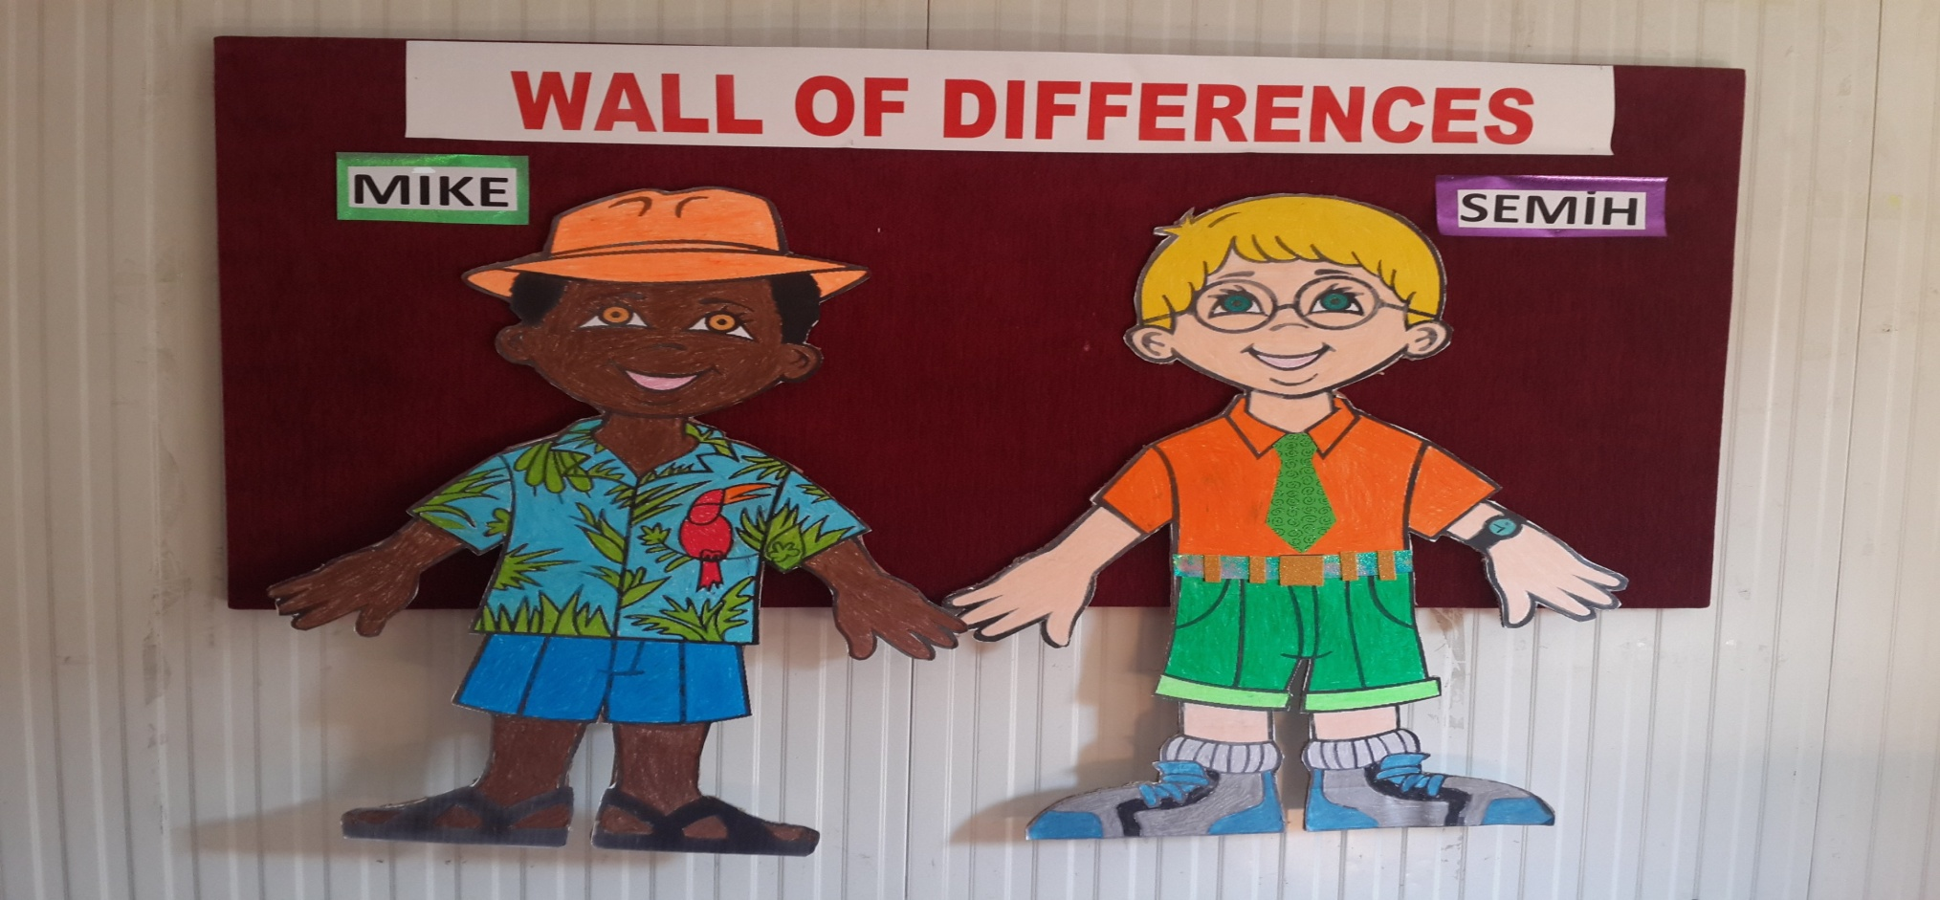
MIKE AND SEMİH ARE GOOD FRIENDS DESPITE THEIR DIFFERENCIES SUCH AS COUNTRY,COLOUR,EYEGLASS ☺

Slide 6
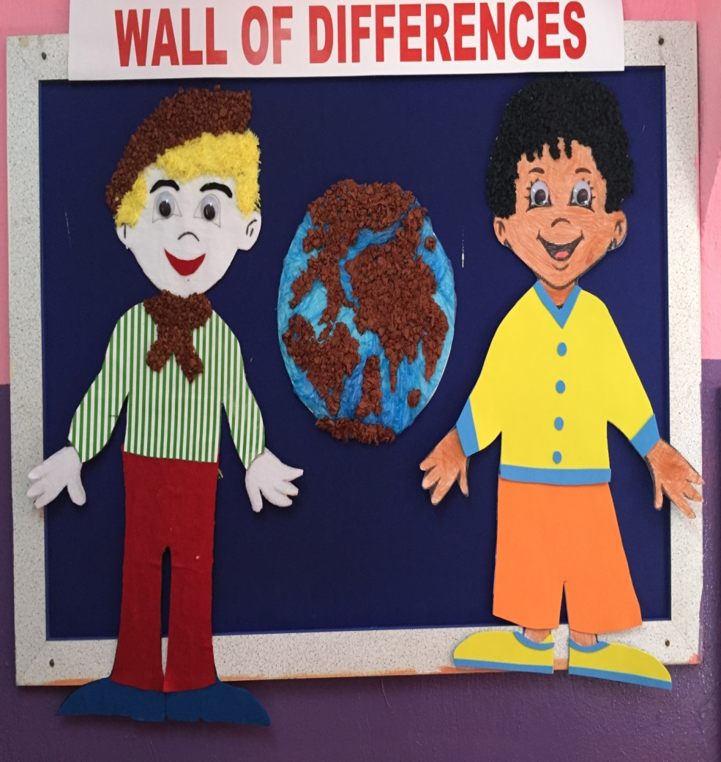
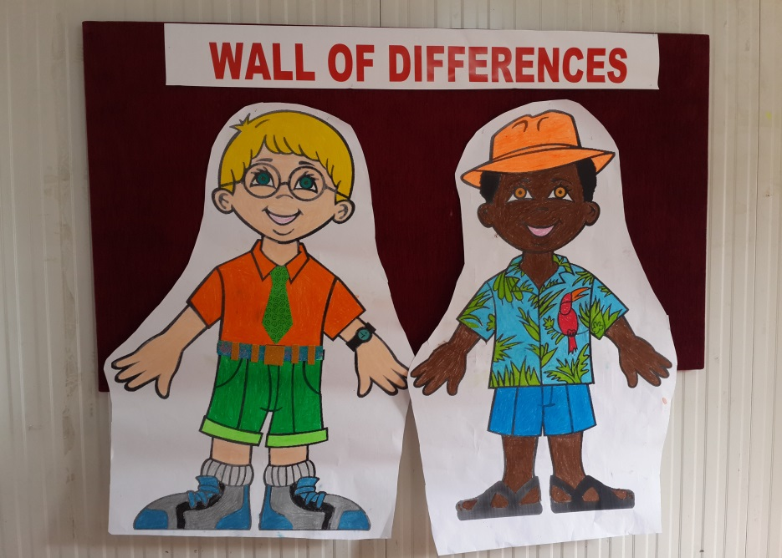
WE WOULD LIKE OUR PUPILS UNDERSTAND HOW DIFFERENT AND HOW BIG WORLD IS.

Slide 7
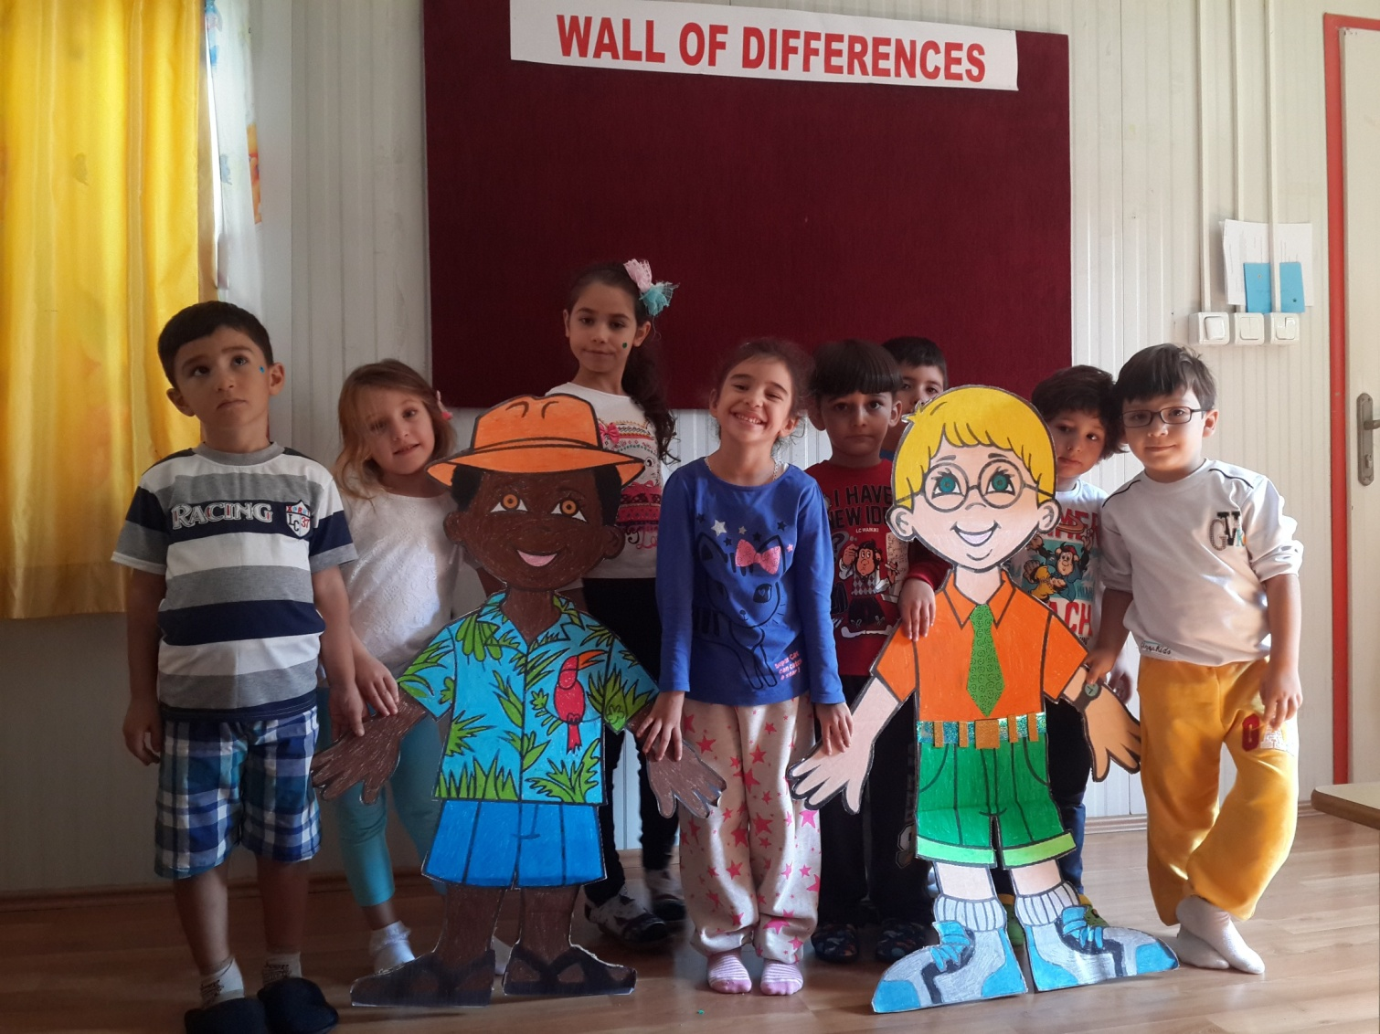
SO WE ALL CAN LIVE EASILY AND PEACEFULLY TOGETHER IN SPITE OF MANY MANY KIND OF DIFFERENCIES.

Slide 8
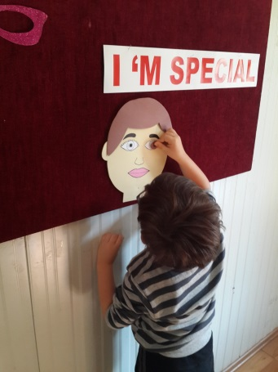
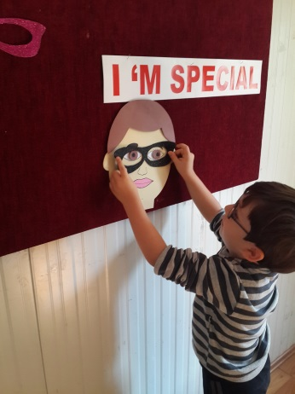
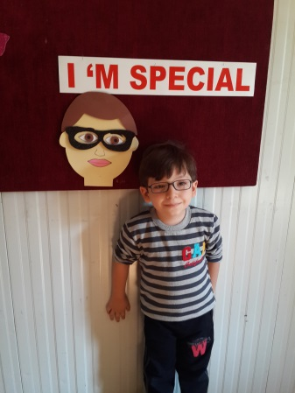
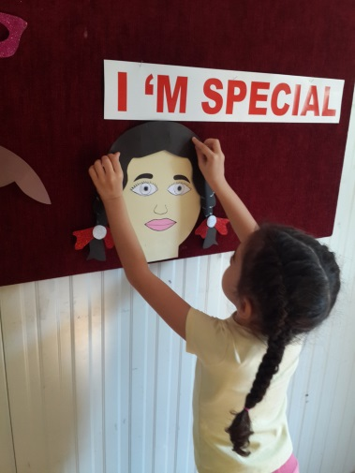
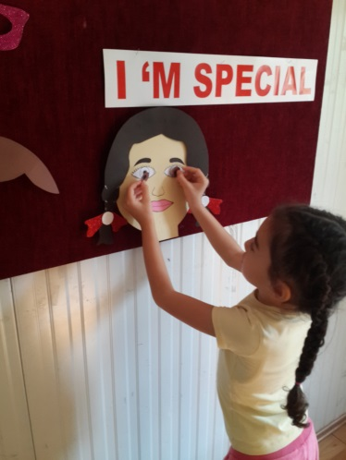
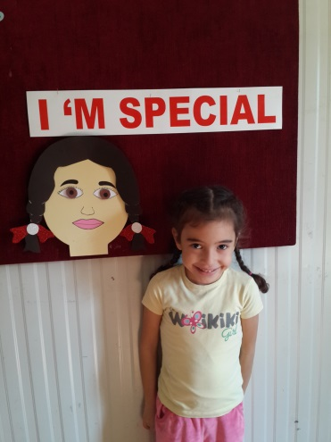
I’M SPECIAL BECAUSE ………

Slide 9
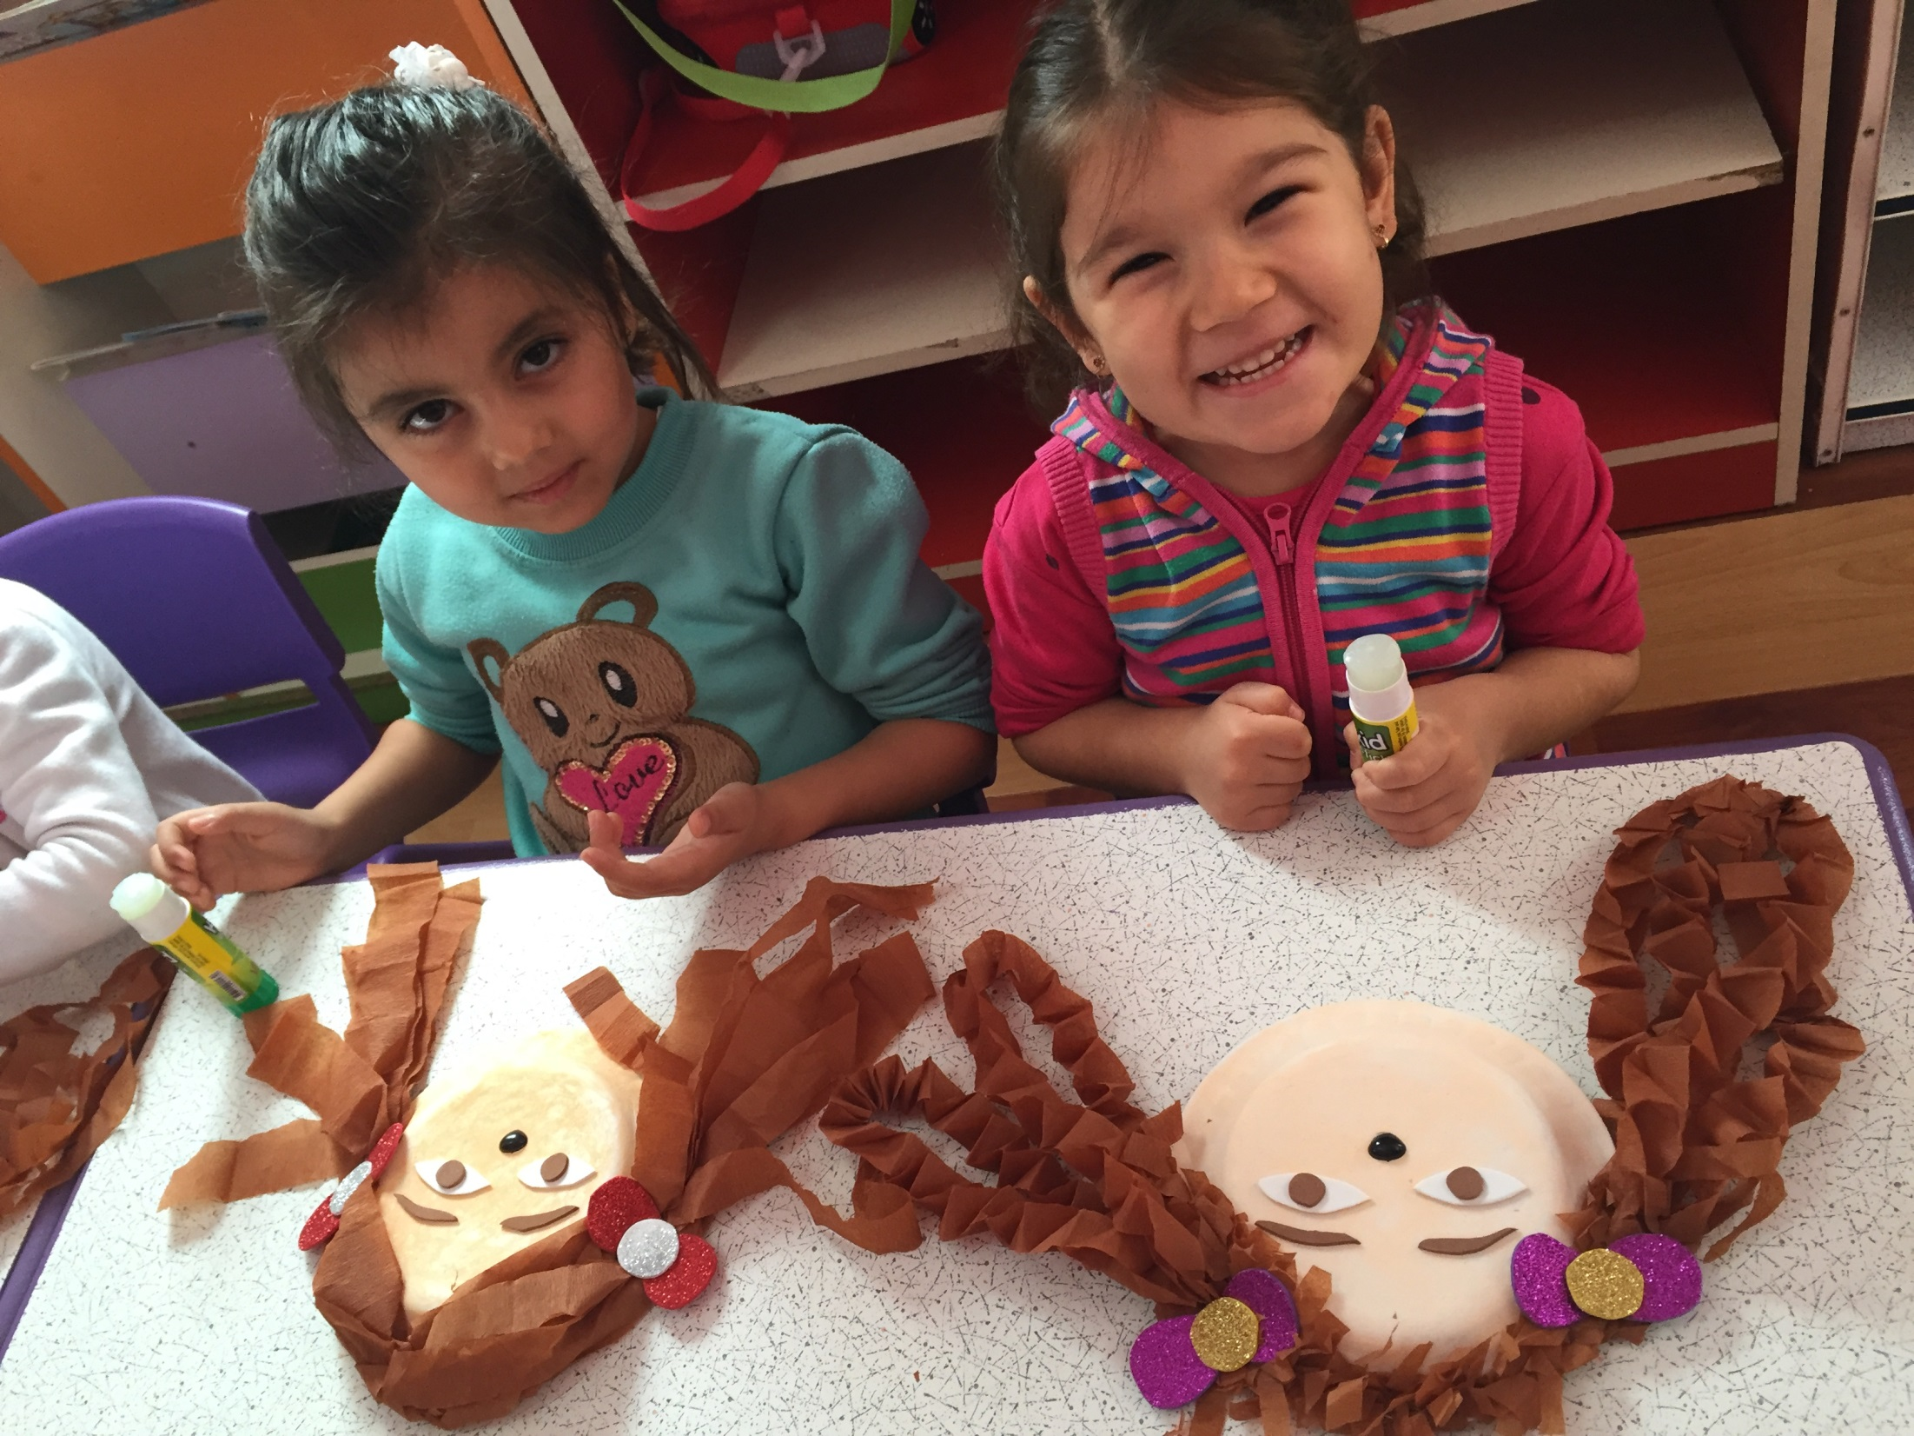

Slide 10
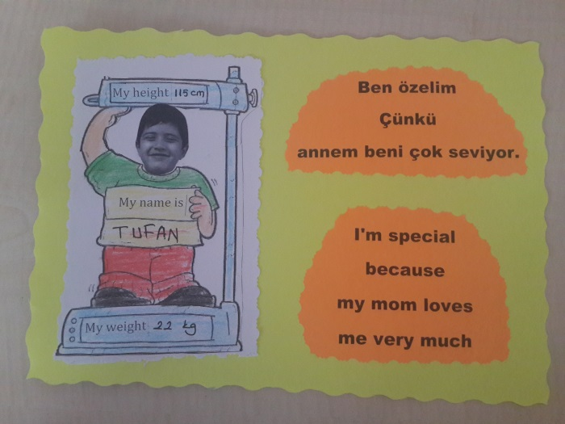
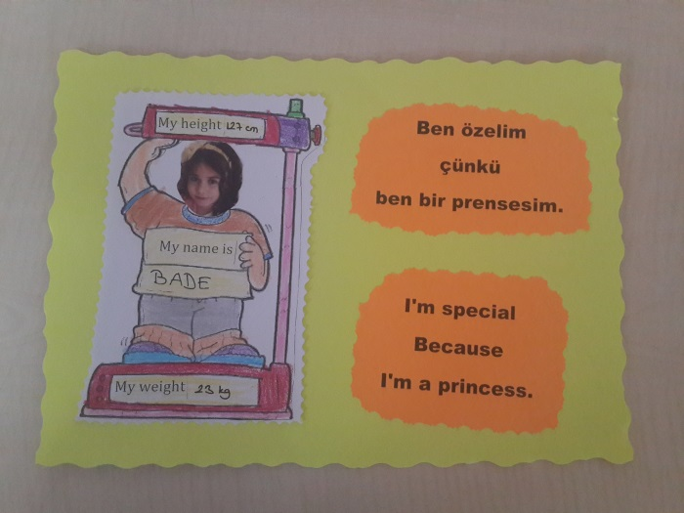

Slide 11
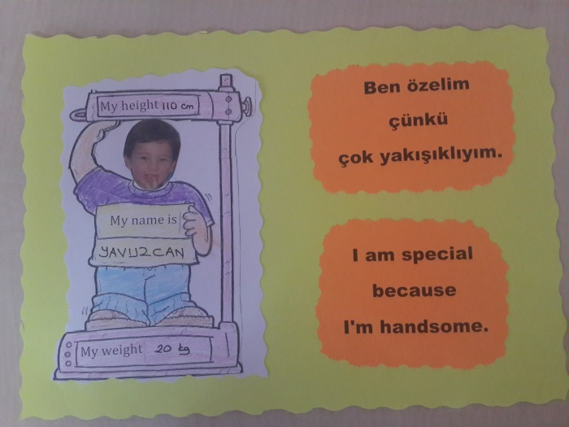
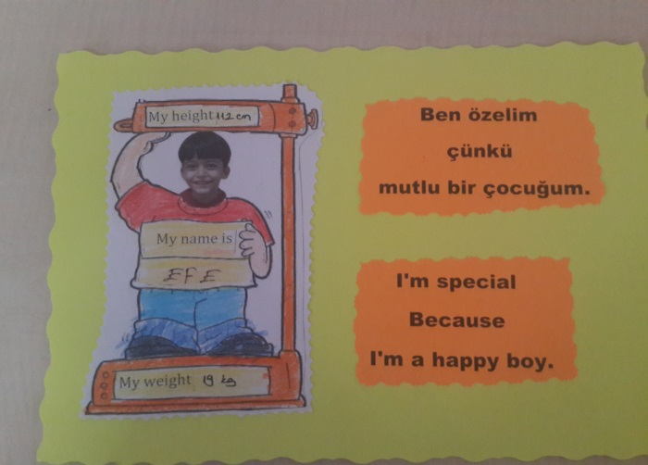

Slide 12
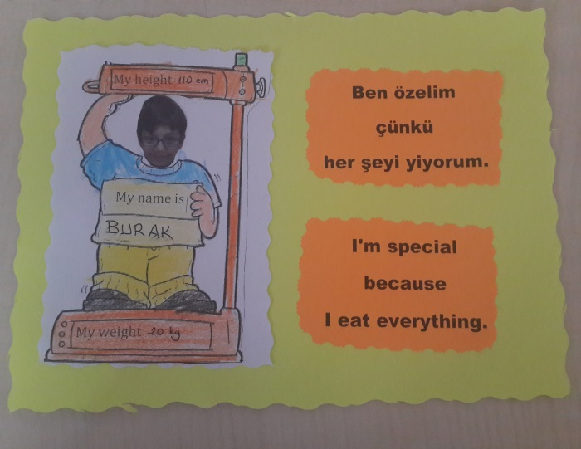
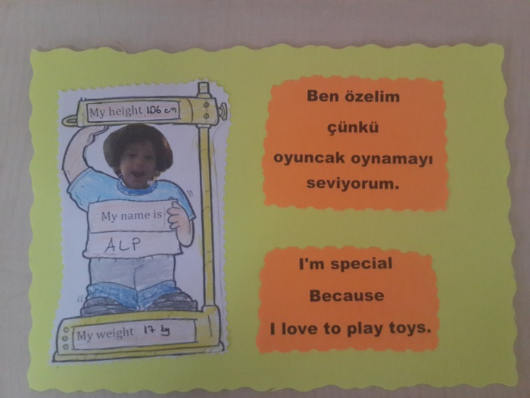

Slide 13
SOME OF US BLOND SOME OF US DARK SOME OF US HAVE BLUE EYES SOME OF US HAVE BLACK EYES.

Slide 14
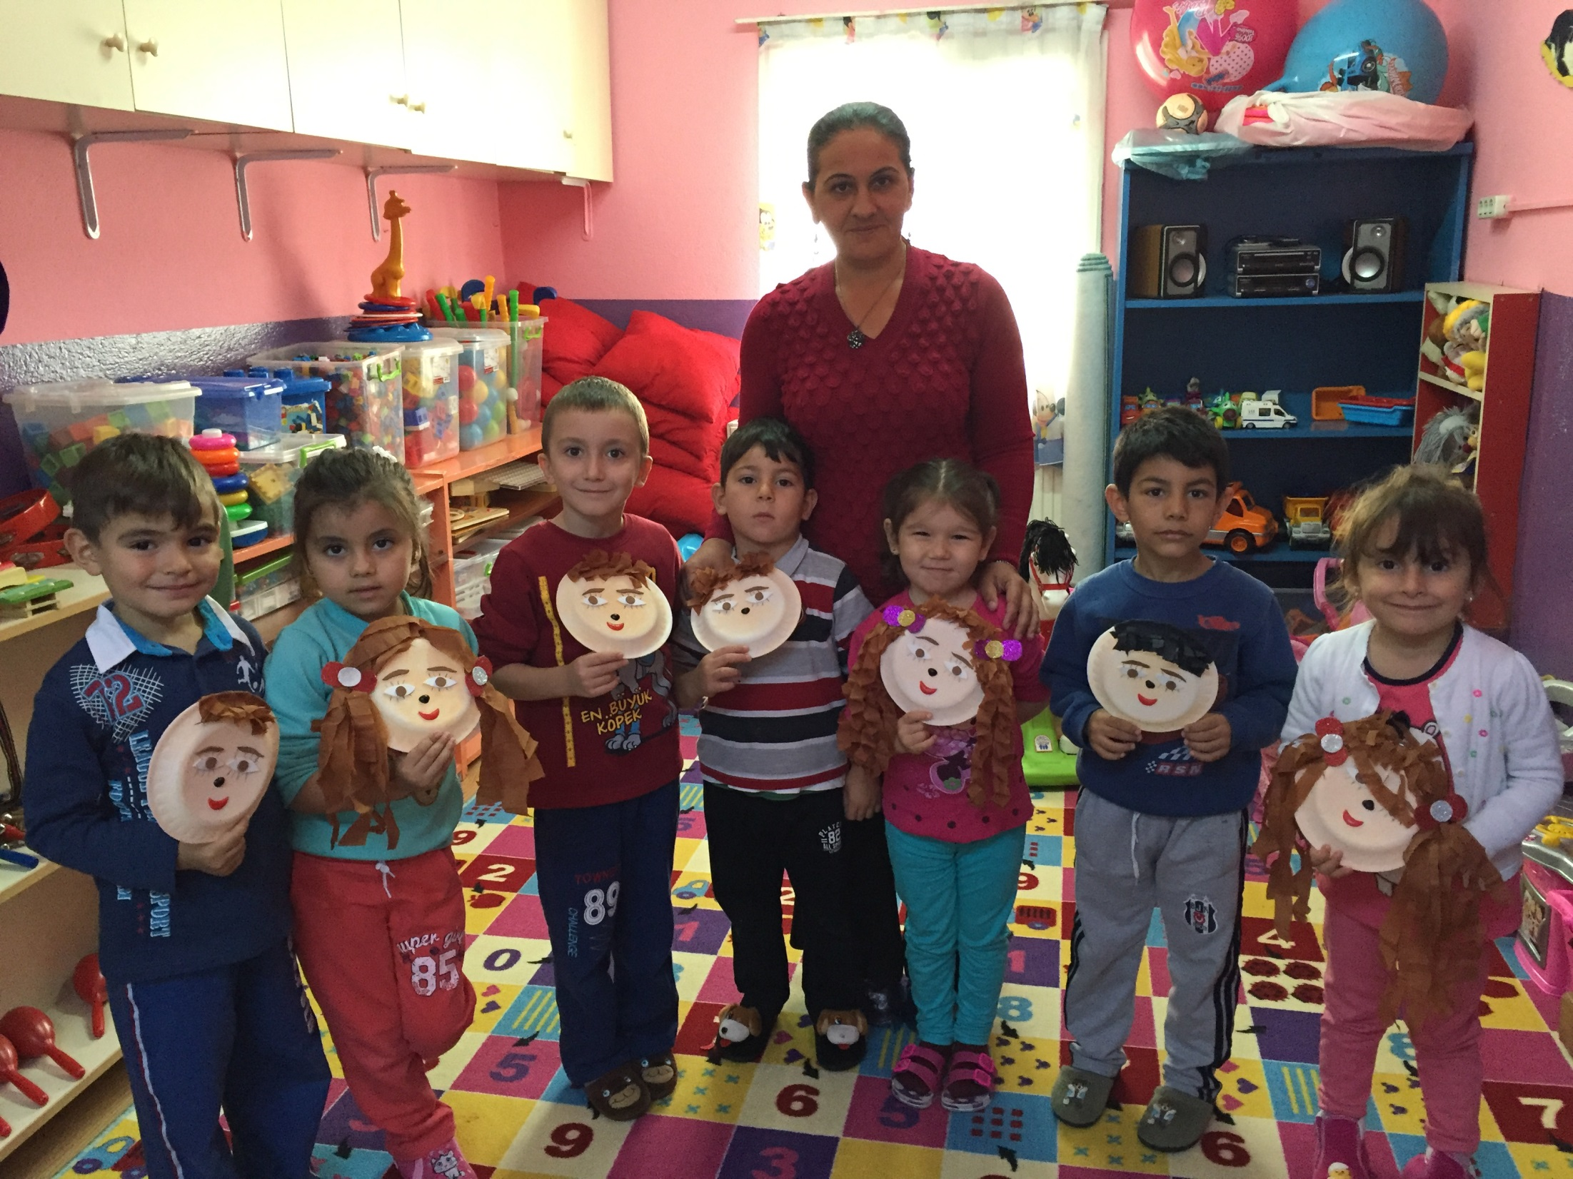

Slide 15
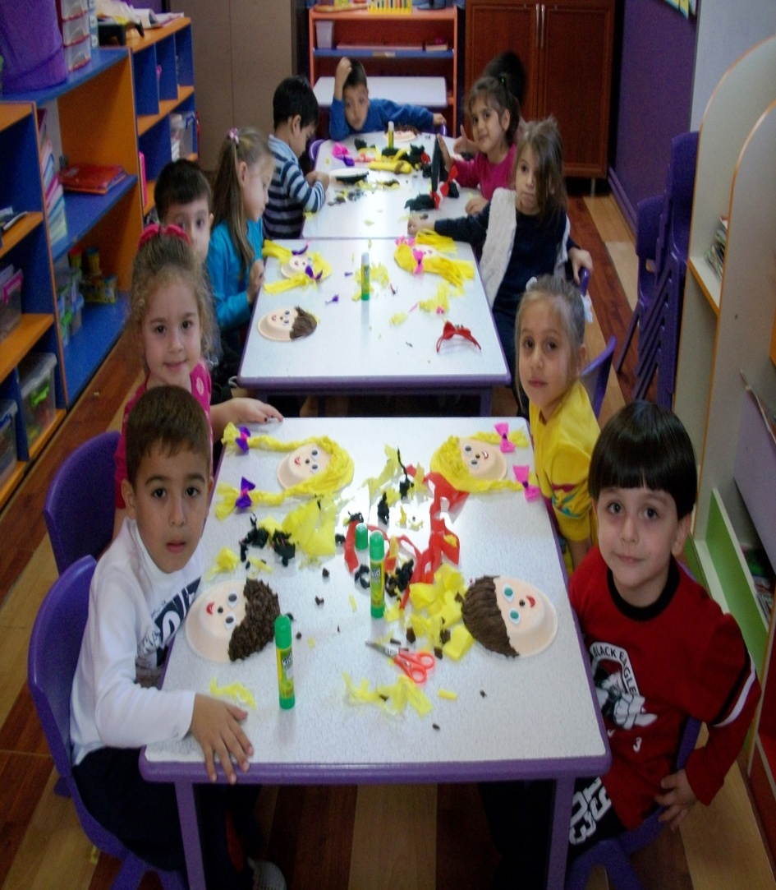
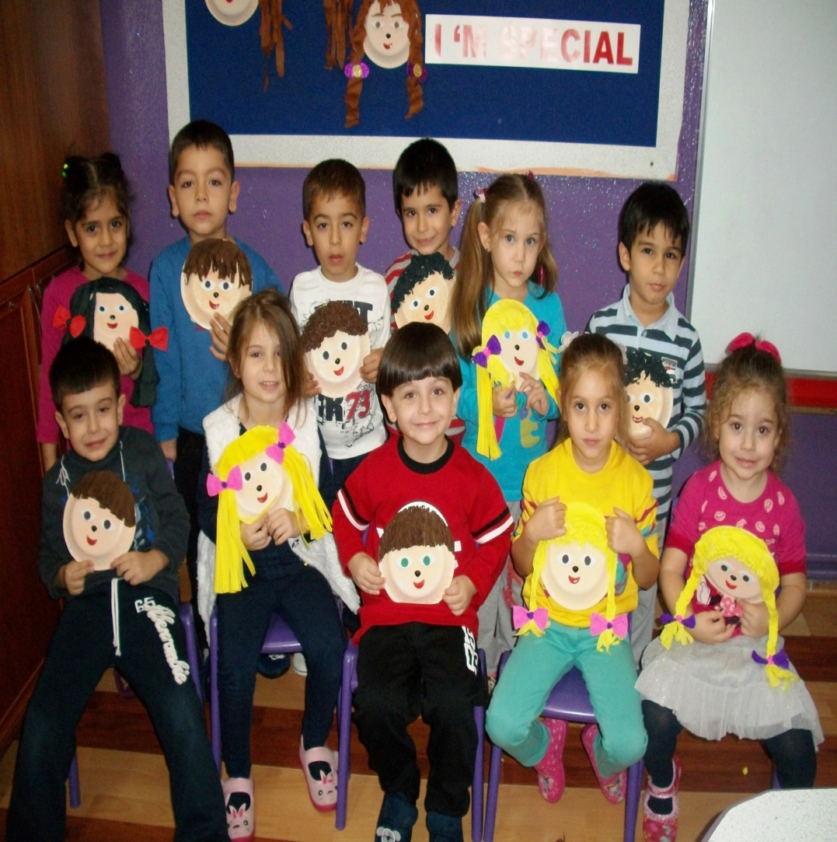
I AM SPECIAL BECAUSE I AM DIFFERENT AND UNIQUE.

Slide 16
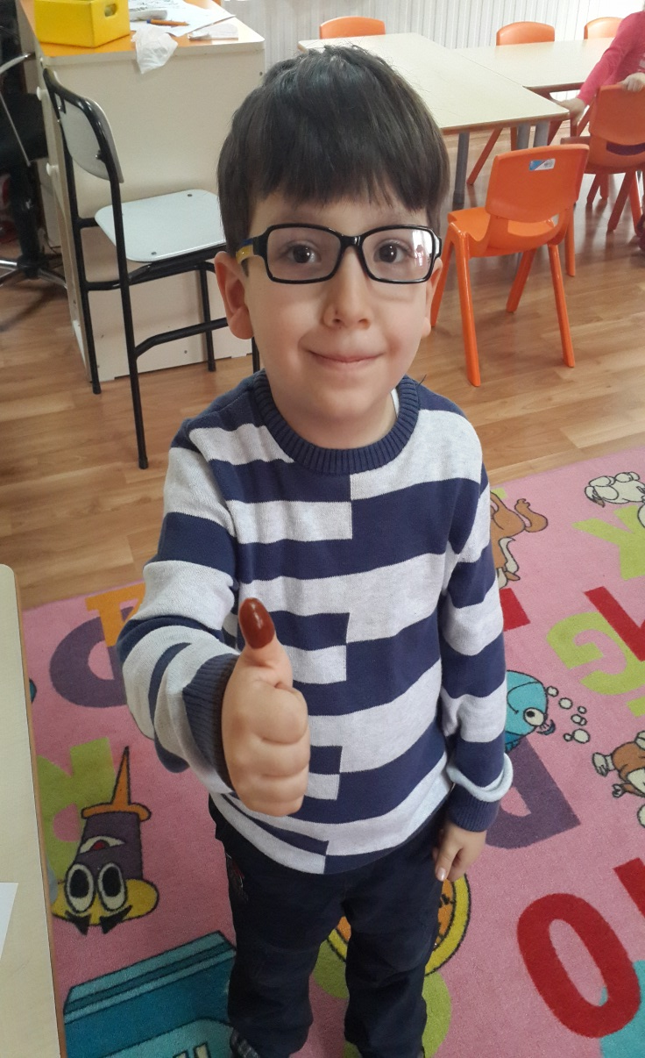
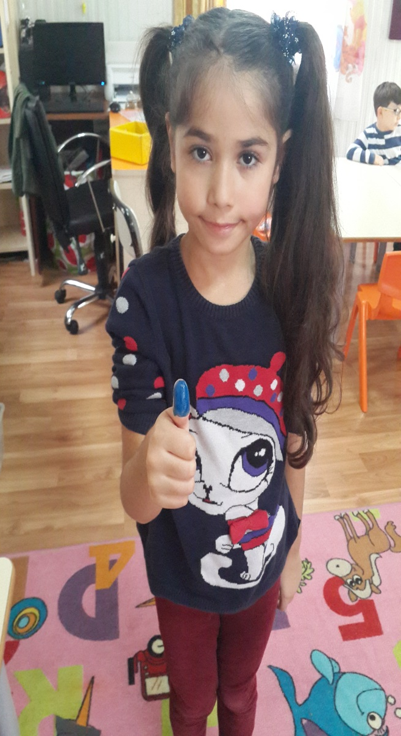
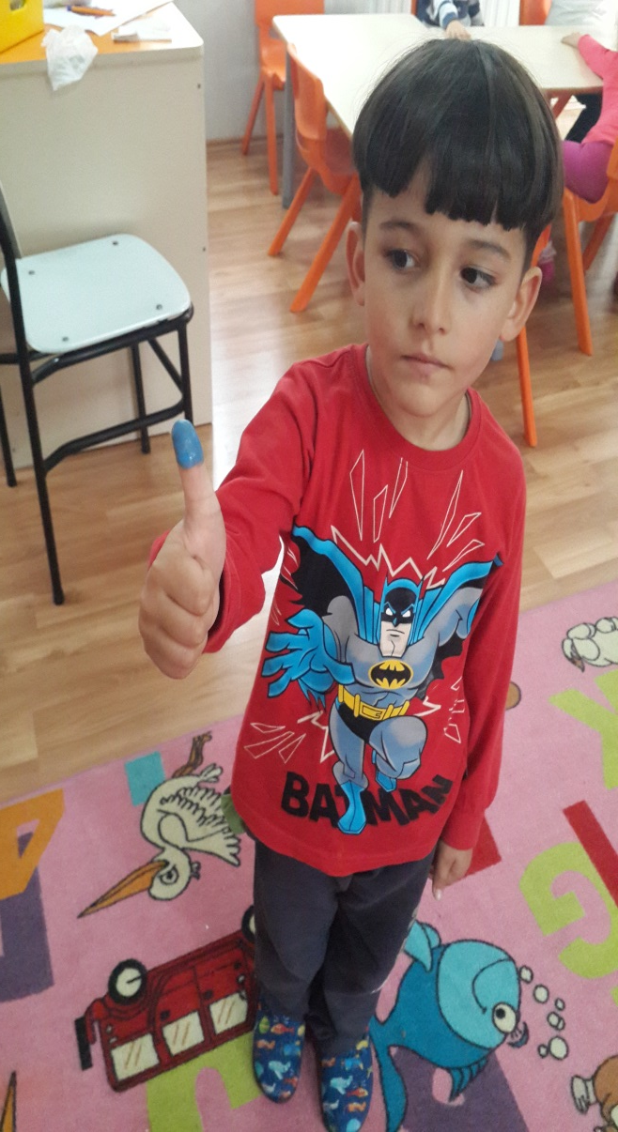
WHAT ARE THESE CHILDREN DOING

Slide 17
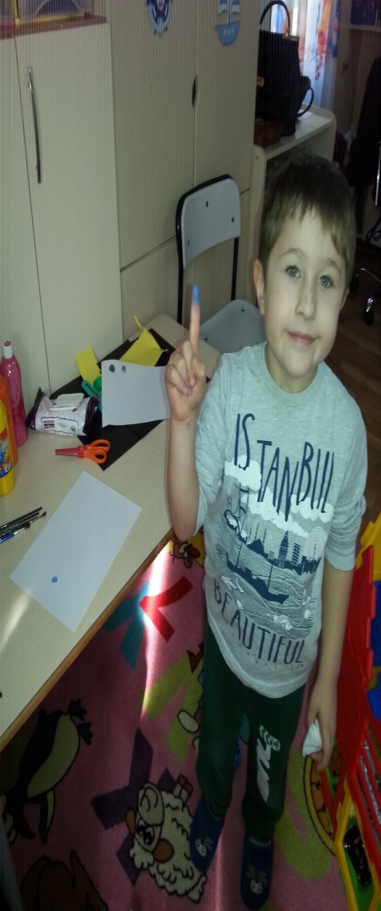
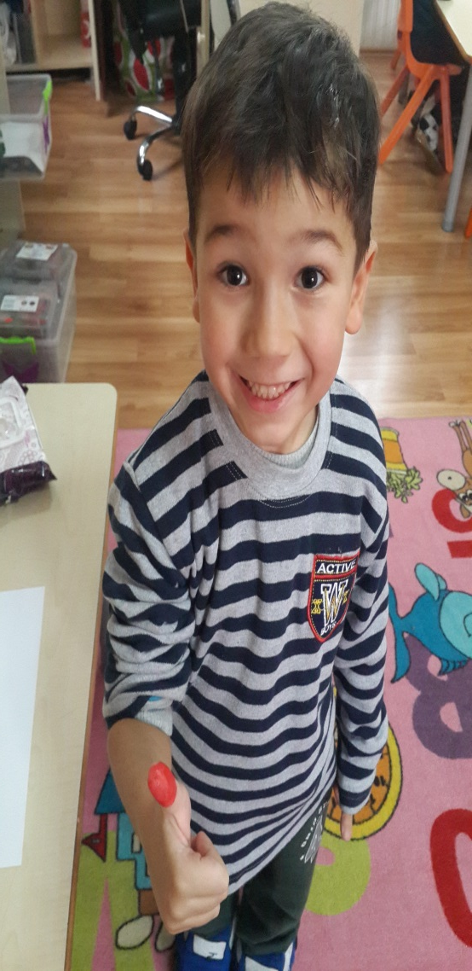
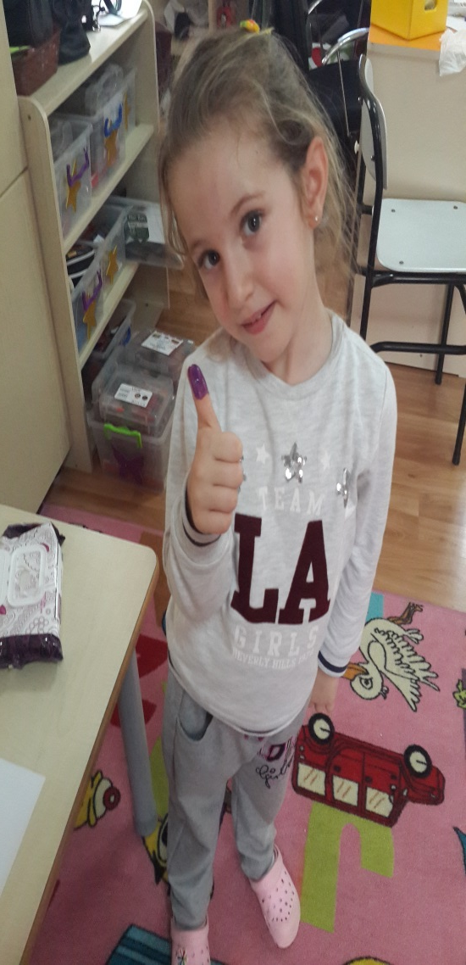
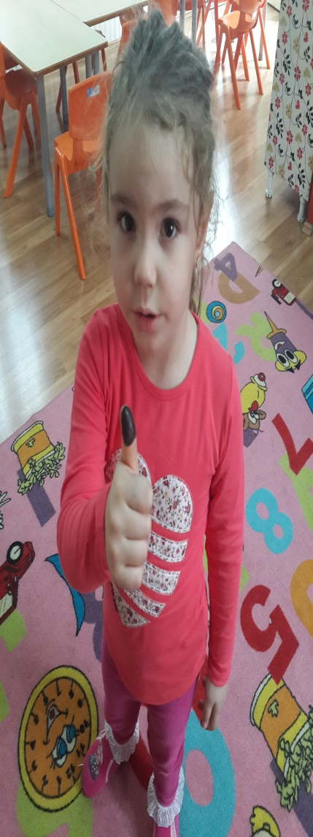
LET’S LEARN WHAT THEY ARE DOING!

Slide 18
THAT’S IT: FINGERPRINTS. BECAUSE……

Slide 19
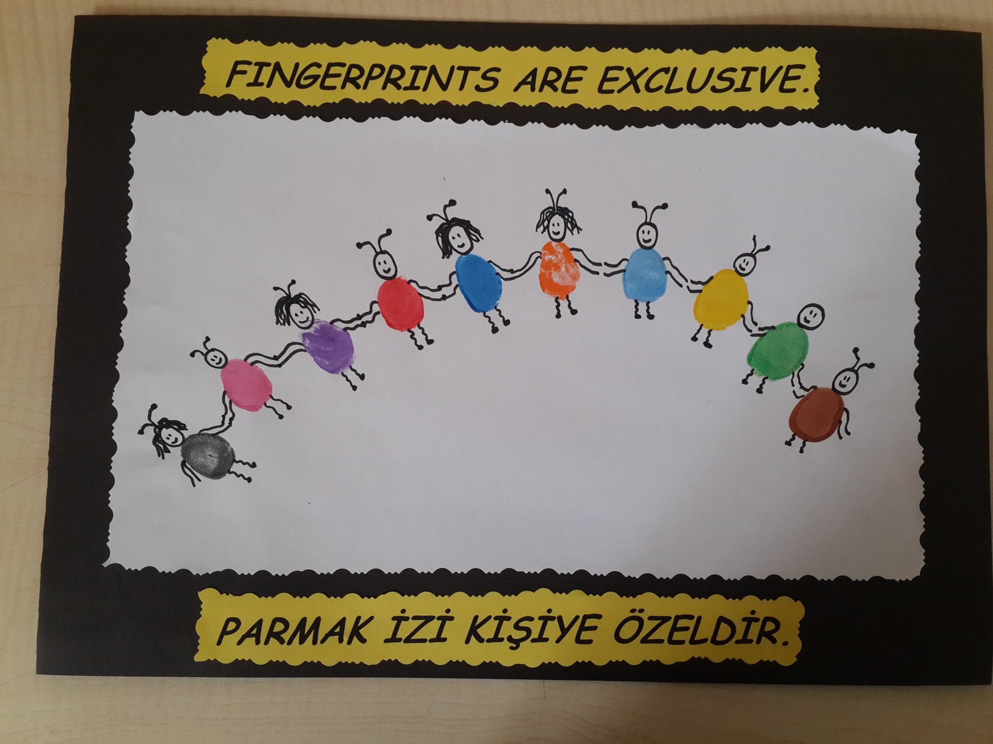
FINGERPRINTS ARE EXCLUSIVE

Slide 20
THAT’S WHY EVERY CHILD IS SPECIAL.

