Slide 1
PERSONA DOLL NUMBER 6
Erasmus + project “Every child is special”
Meeting in Czech Republic
08.10.17 – 14.10.17

Slide 2
HELLO MY NAME IS KRISTJAN

Slide 3
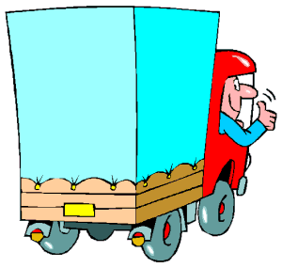
FAMILY
KRISTJAN LIVES WITH HIS MOTHER, FATHER AND OLDER SISTER.
FATHER WORKS AS A TRUCK DRIVER AND IS OFTEN A WEEK AWAY FROM HOME.

Slide 4
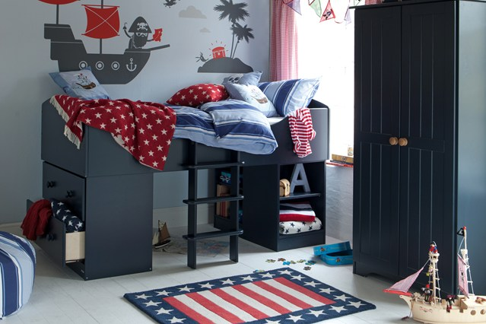
HOME
HE LIVES IN A RENTAL APARTMENT IN A BIG APARTMENT BUILDING IN THE CITY CENTRE
HE IS EXCITED THAT SOON THE FAMILY IS MOVING TO PRIVATE HOUSE
HE THEN HAS HIS OWN ROOM

Slide 5
LIKES, DISLIKES, IS DIFFICULT
LIKES SPORT, GOES TO SWIMMING, ATCHLETICS AND JUDO.
LIKES WHEN HE WINS MEDALS

Slide 6
GOES TO TRAINING CAMPS
WANTS TO BE A PROFFESSIONAL ATHLETE AND COMPETE IN OLYMPIC GAMES

Slide 7
KRISTJAN DISLIKES READING, BOOKS, BOARD GAMES, PUZZLES
KRISTJAN GETS BORED BEHIND THE TABLE

Slide 8
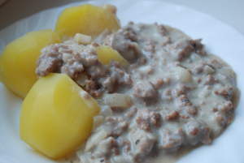
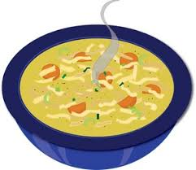
FOOD
EATS EVERYTHING
LIKES CHIKEN SOUP AND MINCED MEAT SAUCE
DOES NOT LIKE SPICY FOOD

Slide 9
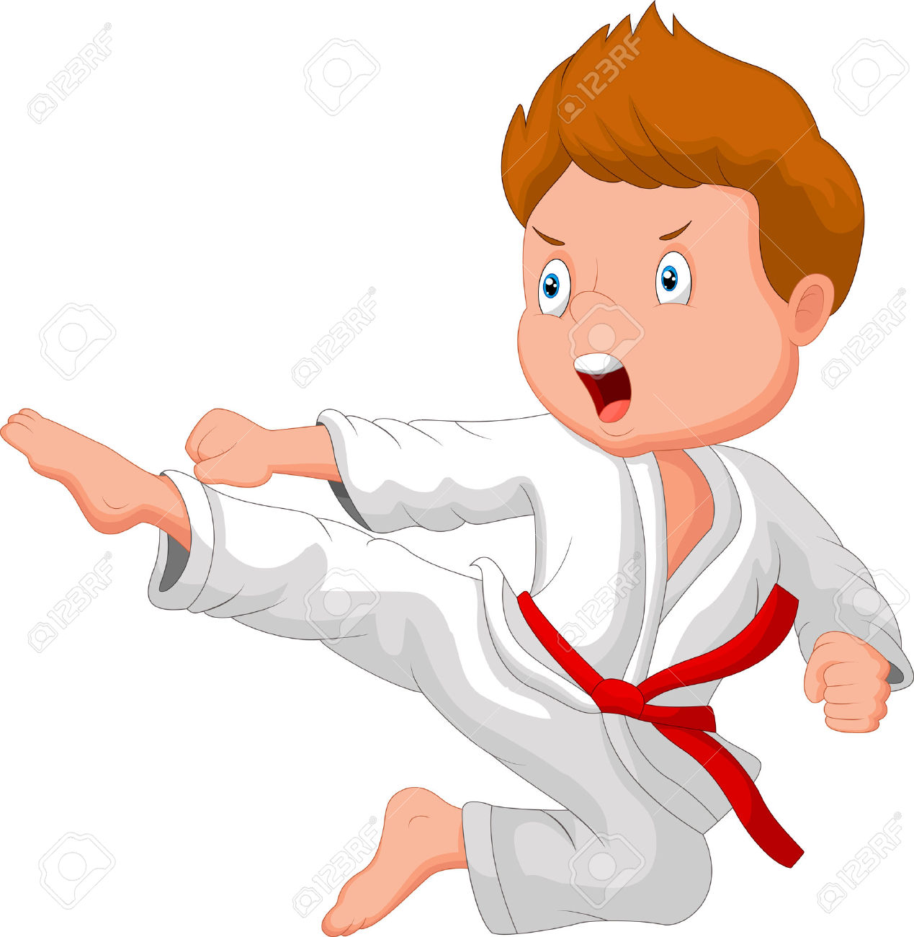
FEARS
KRISTJAN IS VERY BRAVE
HE IS NOR AFRAID OF ANYTHING

Slide 10
RECENT HISTORY
KRISTJAN HAS MANY FRIENDS, SOME BOYS ASK HIM TO CHOOSE WHO TO PLAY WITH
KRISTJAN IS VERY SAD THAT FATHER IS OFTEN AWAY FOR LONG TIME. HE MISSES HIS FATHER A LOT.

