Slide 1
ERASMUS +
“EVERY CHILD IS SPECIAL” TRANSNATIONAL MEETING PORTUGAL
From 8 th to 12 th of MAY.

Slide 2
VALUES’S TREE
Perseverance
Sincerity
Responsibility
Generosity
Patience
Good Manners
Friendship
Creativity
Cooperation

Slide 3
Teachers are permanently involved in values education… sometimes … without even realizing that they are teaching values …

Slide 5
The aim of values education is to encourage young people’s awareness of having values and their corresponding relationship to the world in which they live. It is therefore necessary to try and convey the idea of which values people in our society regard as necessary

Slide 6
Educators and teachers as well as parents are not just there to practise behaviour based on values, but are mainly there to help children to understand the rules which society has developed, to be able to apply them independently and also to participate in political discussions regarding any possible changes to these rules. For this reason, we need educators who do not insist on their own interpretation of moral principles, rather educators who help children to develop their own skills in applying morals to their lives

Slide 8
School is of great importance when it comes to moral-cognitive development. Parents and other authorities should play a part in this process. This means that great efforts regarding the development of these pupils are necessary and that the school, together with the parents, must support these efforts.

Slide 9
School therefore promotes the moral-cognitive development of the individual and in this way, creates the democratic competence of society as a whole. School should give as many children as possible the best general education which will enable them to deal with a complex society and to form their own definite opinions about political, economic, legal and scientific facts. That is an indisputable contribution which school makes towards safeguarding and developing democratic society

Slide 10
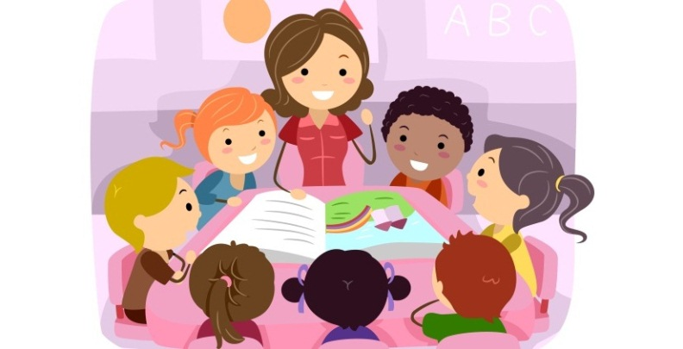

Slide 11
Teaching is understood as education organized in schools in the sense of an extensive help for enculturisation , it also encompasses educational aids which are not only aimed at increasing knowledge and ability but also at acquiring norms and values. Accordingly, school, apart from its main function as a place for teaching, also has the task of providing a moral education. School can be viewed as the precursor to achieving self-determination and taking responsibility for oneself. Pupils should be qualified to have both their own social life and to be in favour of a society in which everybody accepts each other.

Slide 12
Only when the child is prepared to admit freely to the choice he has made, will it have any significance. The child must be able to choose of his own free will. It must be clear to the teacher, however, that he cannot dictate to the children what their values should be or to tell them what experiences they will have. Only events which the children experience themselves will have any effect on their own lives.

Slide 13
What does a teacher do now when he wants to be of help in teaching children to clarify their own values?
He helps them to apply the process of valuing. The teacher should encourage the children to get to grips with the problem of choice and help them to discover other possibilities, to weigh up alternatives and then to think about the consequences. The children should also get the opportunity to prize and cherish and publicly affirm their choice and the teacher should make them more determined to act in accordance with their choices. The adult can support this process of judging and can help the children to independently clarify what they perceive as having value.

Slide 14
Teaching about values is of cross-curricular importance; it is possible in all subject areas and for all content and can be implemented to its best effect in the form of open planning which allows the teacher to influence the course of the lessons. The subject matter can lead to values like this and questions about values can function for most subjects as a coordinating concept. All open forms of teaching facilitate a reflection of values orientation. Teaching effects are not only achieved through mere words, exhortations, conversation or regulations but also through behaviour and reflecting on this behaviour.

Slide 16
THANK YOU SO MUCH FOR YOUR ATTENTION!!!

