Slide 1
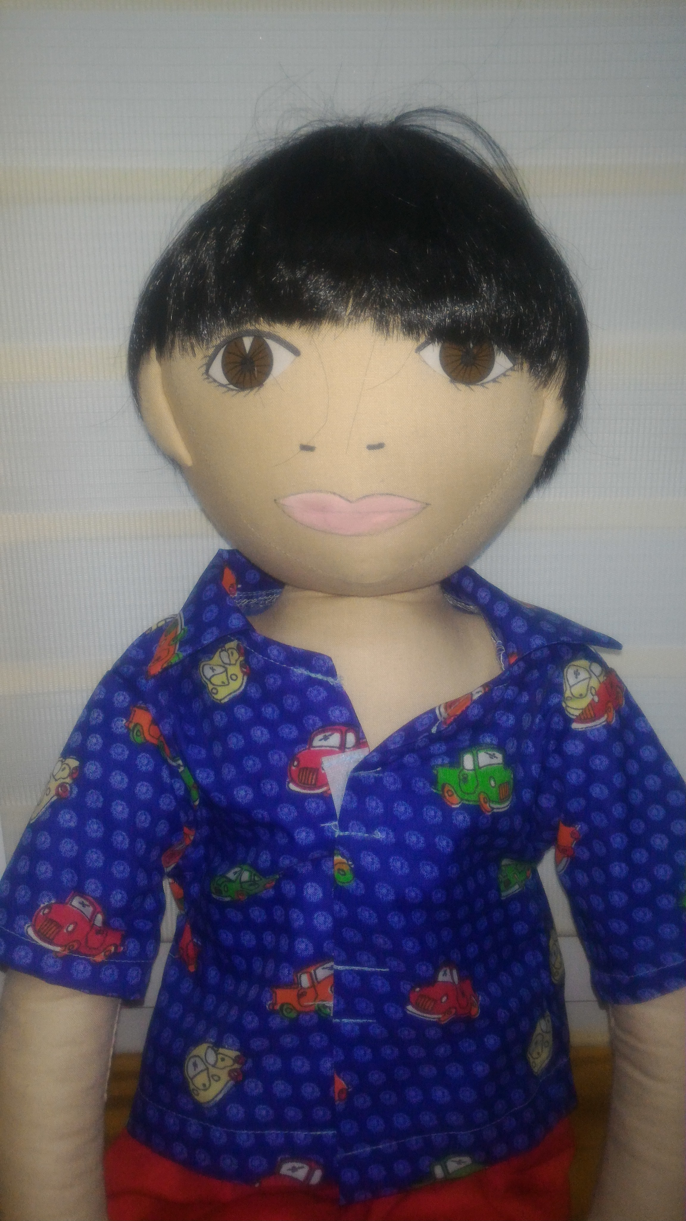
Michał (Michael)

Slide 2
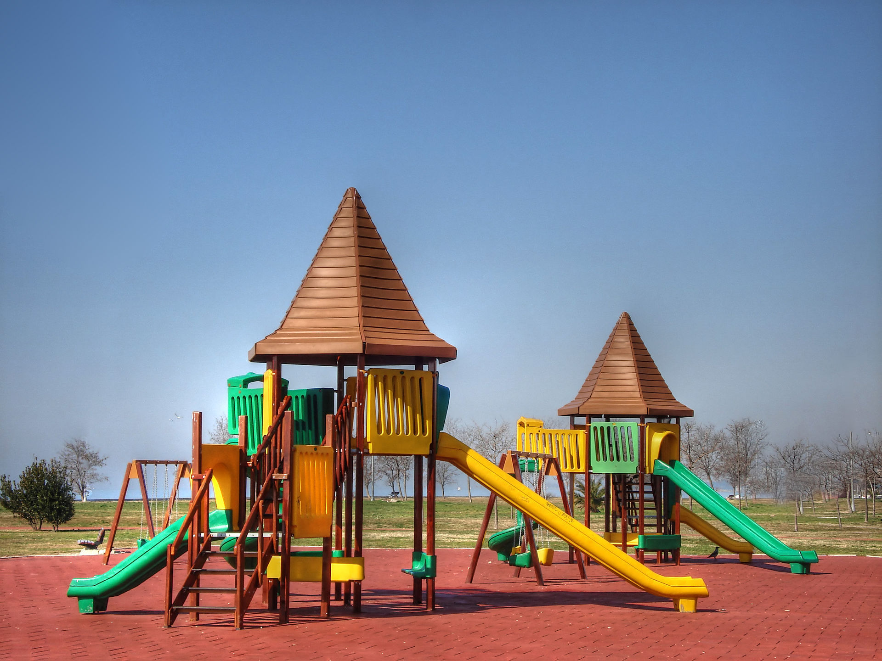
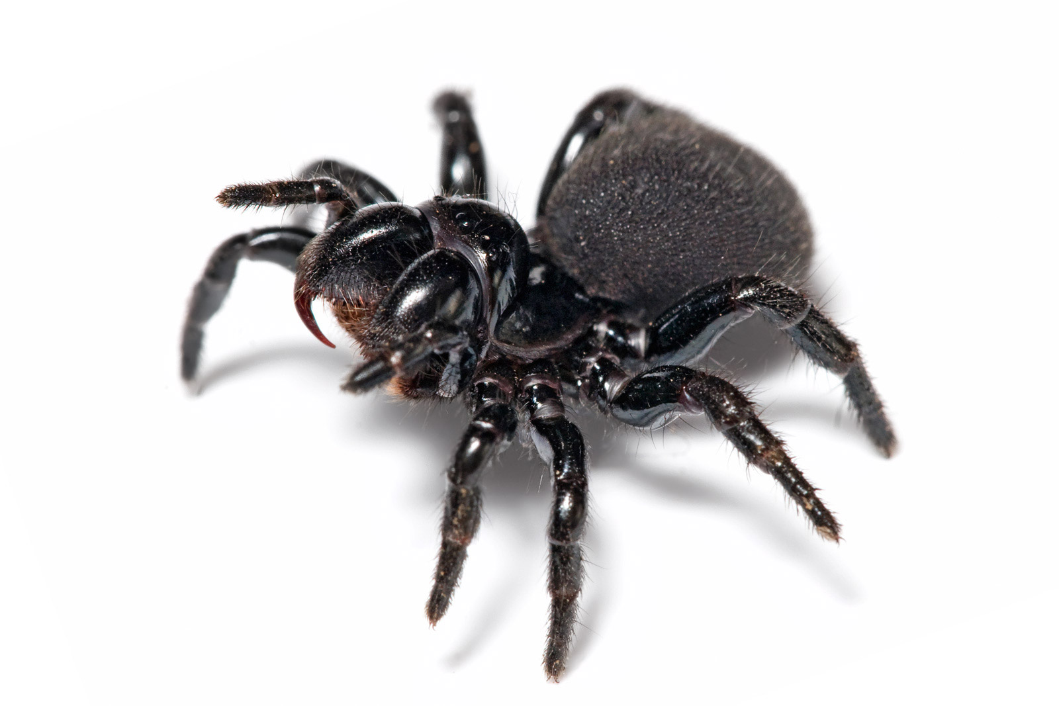
AGE:
5 years old
LANGUAGE:
Polish
WHEN IS SHE CHEERFUL:
He is happy when he can play with his grandparents and when he can play in the playground
WHEN IS SHE SAD:
He is sad when he cannot go to outside.
WHAT IS SHE AFRAID:
spiders

Slide 3
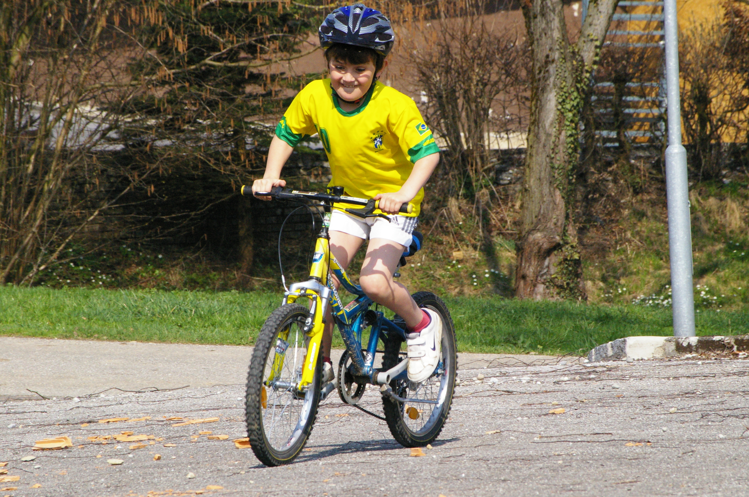
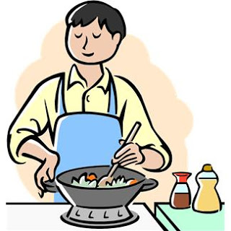
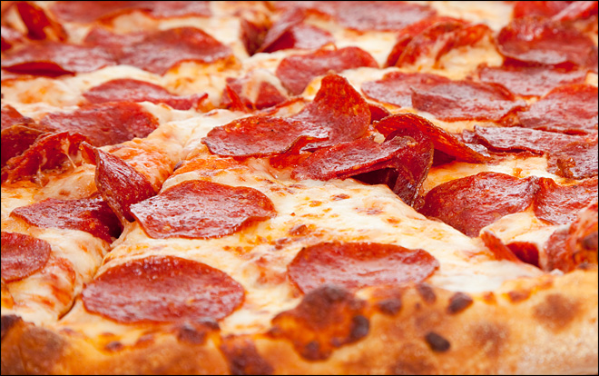
WHEN DOES SHE LIVE:
Michael lives in Warsaw in block of flat on tenth floors. The flat has got two rooms. The boy has got own bedroom.
PARENTS:
His mum works in the library and his dad works as an engineer
WHAT DOES SHE LIKE TO DO AT HOME:
He likes playing his planes, helping his mum in the kitchen, playing LEGO blocks
WHAT IS SHE GOOD AT:
Michael can fast run and ride a bike
WHAT IS DIFFICULT FOR HER:
He cannot independently put clothes on
FAVOURITE FOOD:
tomato soup with pasta, pizza, sandwich with cottage cheese
HATE FOOD:
cucumbers, bean soup, cucumber soup

Slide 4
WHAT HAPPENED IN HIS LIFE:
His dad lost his job in big company
STORY:
Michael was born in Poland and he lives in Warsaw with his parents and his younger sister (Camilla). Michael’s dad, before he lost his job, worked in Wrocław and he come back home only for weekends. The boy goes to Kindergarten. In the Kindergarten he has got two best friends – Martin and Clara. Micheal cannot accept the rules to prevailing in the group. During lessons, he often stands, shouts. During fun, he takes toys and imposes his views. Micheal wants to be first in all game, if he cannot be first he loud shouts, stamp his feet. He doesn’t tidy up toys and he doesn’t perform tasks on time.
What does he feel?
Can you accept this behave?
Why does he behave in this way?
Do you know similar story?
What can help Michael?

