Slide 1
Notes:
1

Slide 2
The Greek Delegation to Acate, Sicily
Mr Kompos Konstantinos (Phd), Headteacher
Mrs Aza Katerina (Msr) : Deputy Headteacher,
Teacher & Erasmus+ Programme School Coordinator
Mrs Manoli Anneta: ICT Teacher
Mr Porfyriadis Vaios (Msr) : School Nurse

Slide 3
During the month dedicated to Italy the Erasmus+ Club members did a research and a presentation of the country. After that they explored further by participating in some online quizzes.

Slide 4
The presentation in class

Slide 5
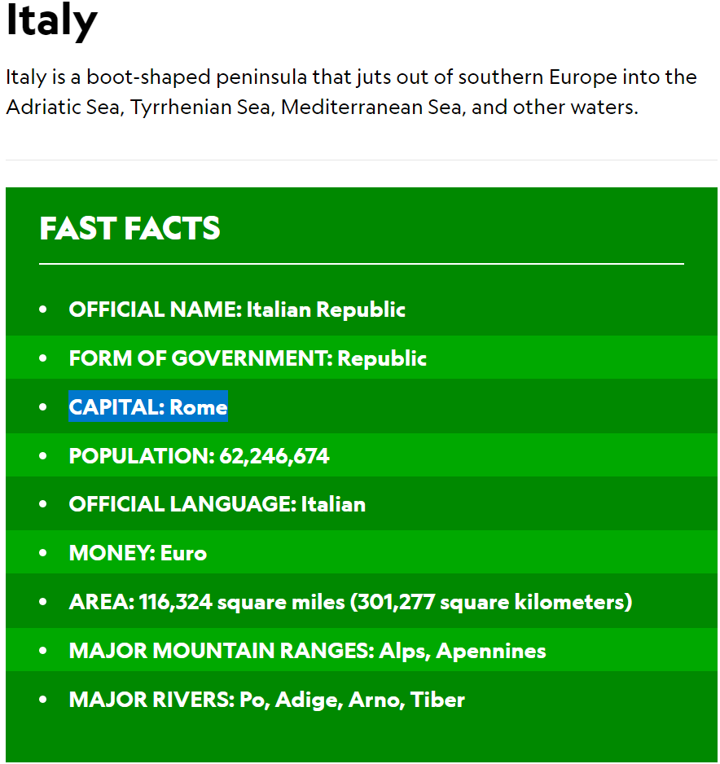

Slide 6
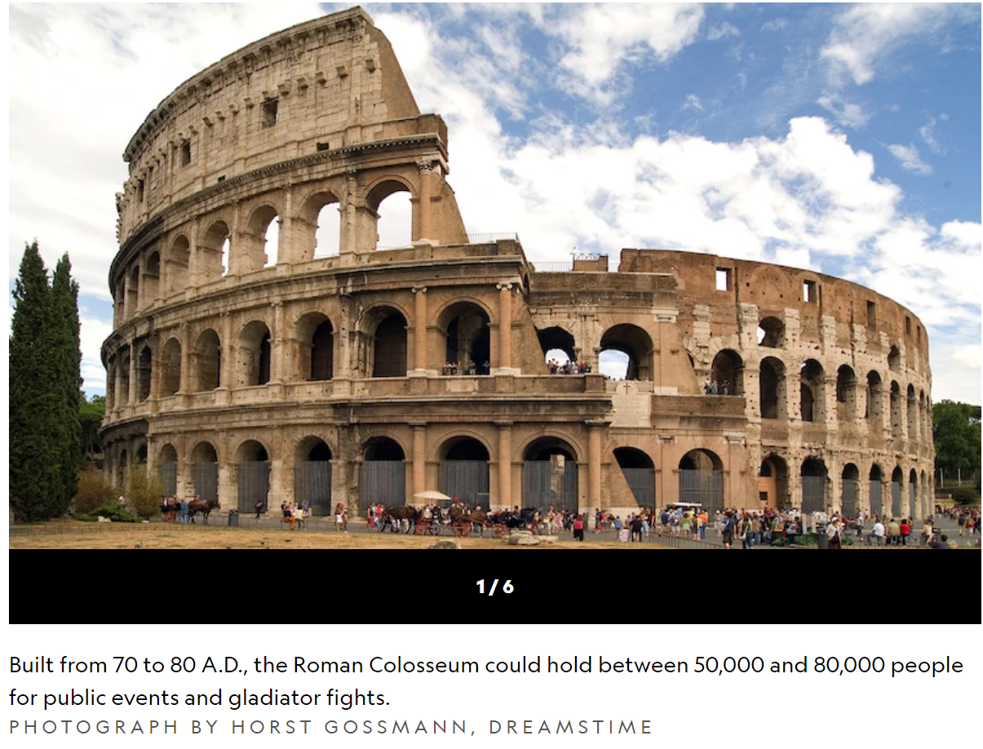

Slide 7
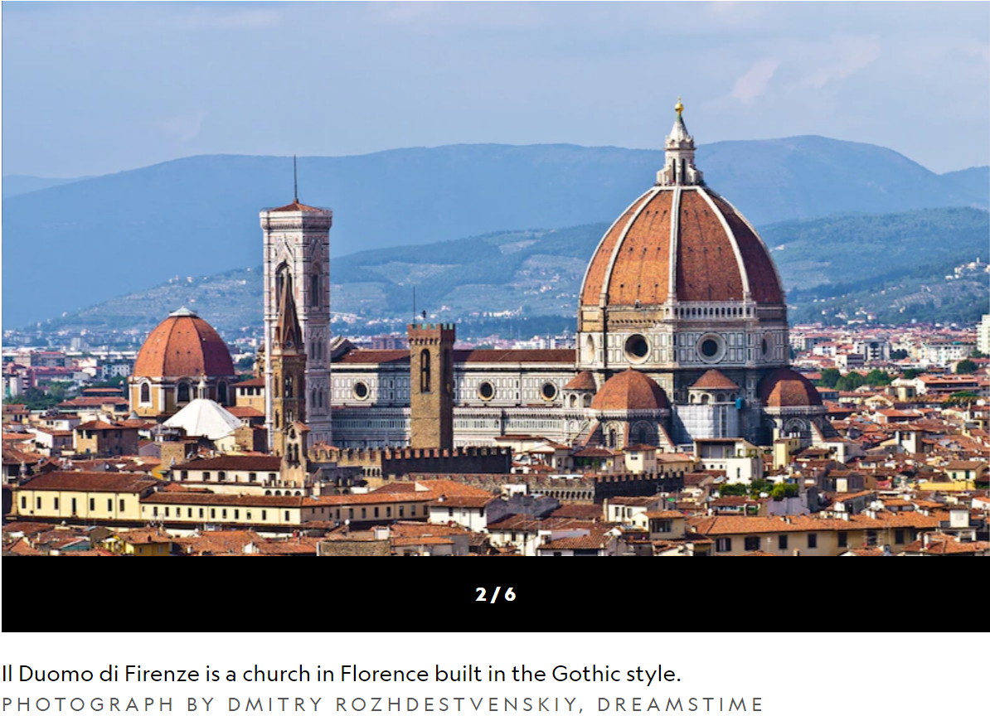

Slide 8
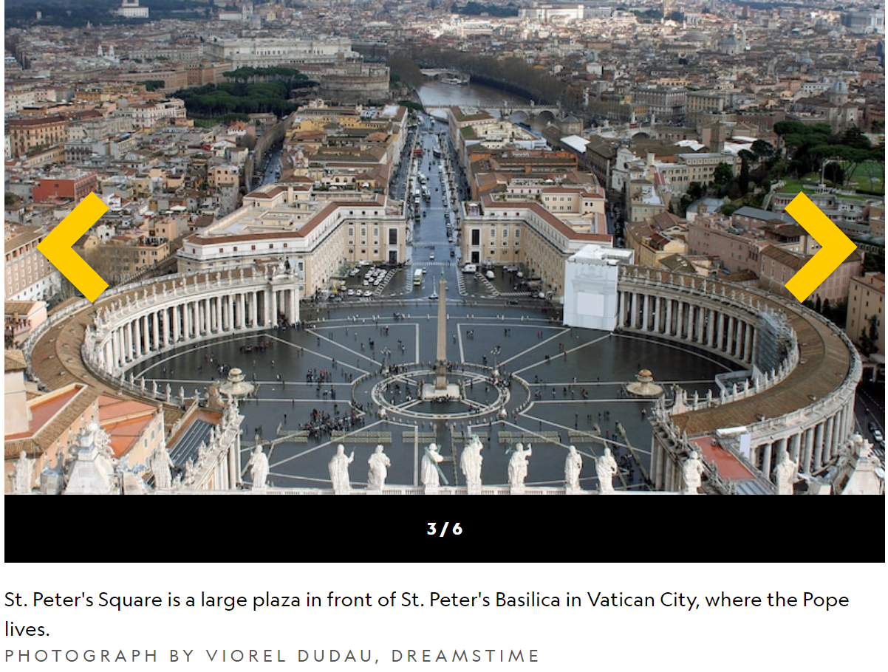

Slide 9
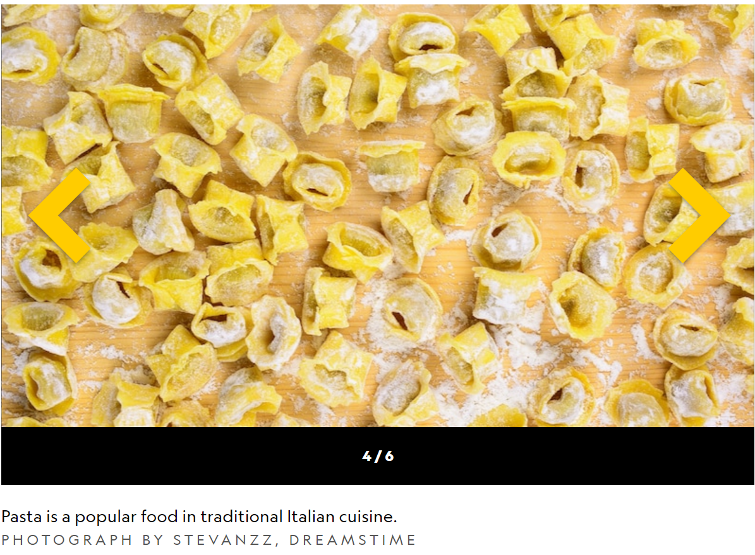

Slide 10
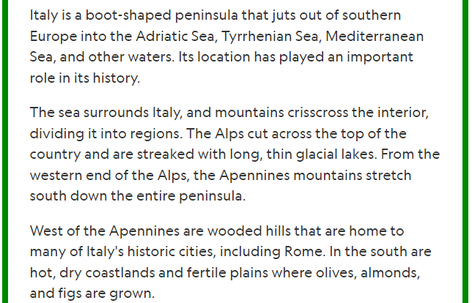
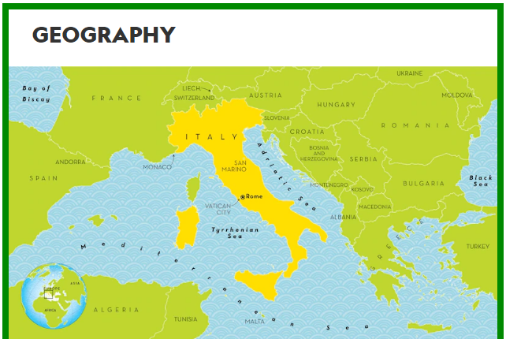

Slide 11
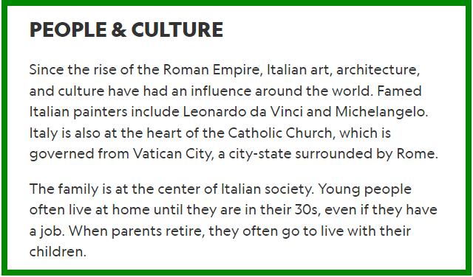

Slide 12
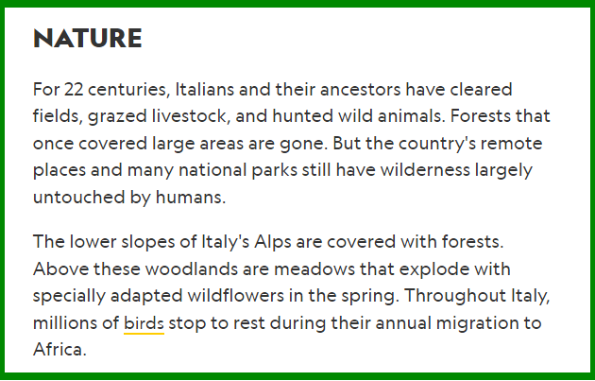

Slide 13
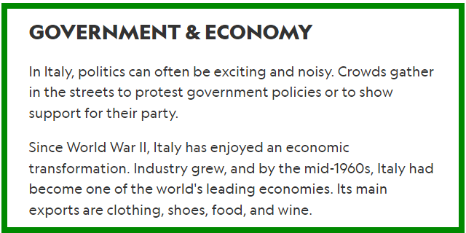

Slide 16
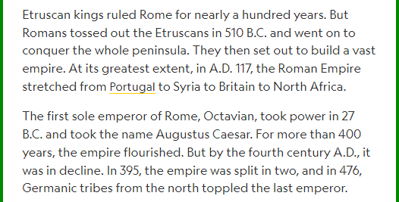

Slide 17
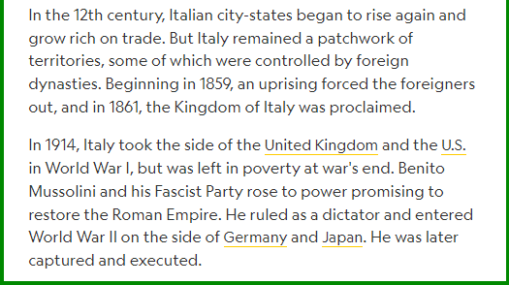

Slide 18
This is Sicily

Slide 19
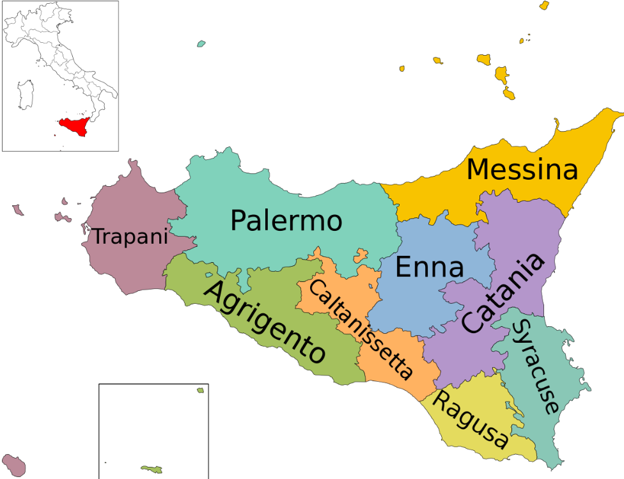

Slide 20
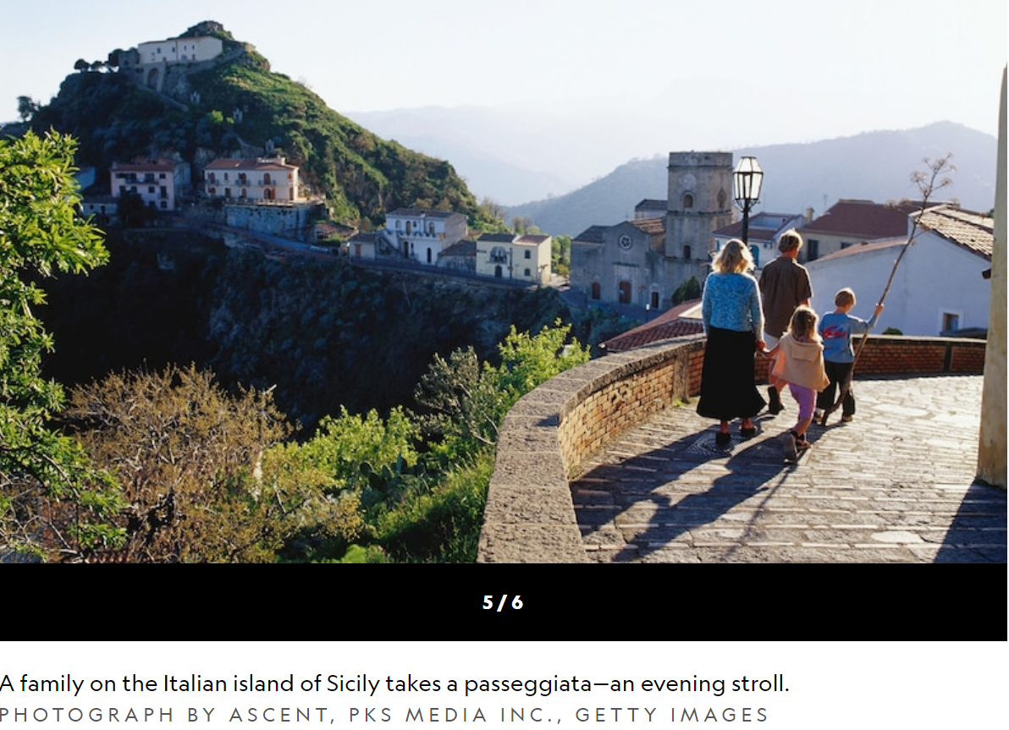

Slide 21
The quizzes we did online: Round 1 – beginners https://www.triviaquestionquiz.com/italian-trivia-questions https://www.understandingitaly.com/quiz-01.html Round 2 – experts https://www.beelovedcity.com/italy-quiz

Slide 22
Thank you for your attention!
Erasmus+ Club
3rd Primary School of Pylaia

