Slide 1

Spectrumschool Belgium

Slide 2
Levels and structure of the secondary technical and vocational education in Belgium
3 Stages
6 or 7 years (age 12-19)
1st stage (year 1 and 2) A-class or B-class
2nd stage (year 3 and 4) TSE or VSE
3rd stage (year 5 and 6) TSE
3rd stage (year 5,6 and 7) VSE
TSE = Technical secondary Education
VSE = Vocational secondary Education

Slide 3

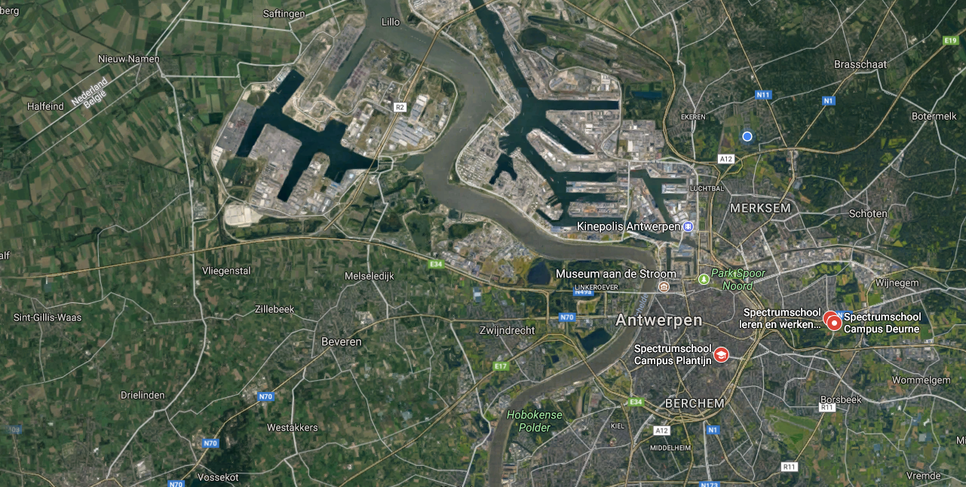
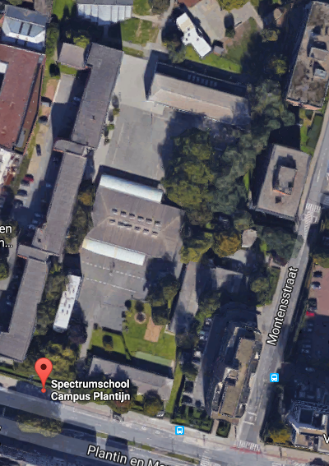
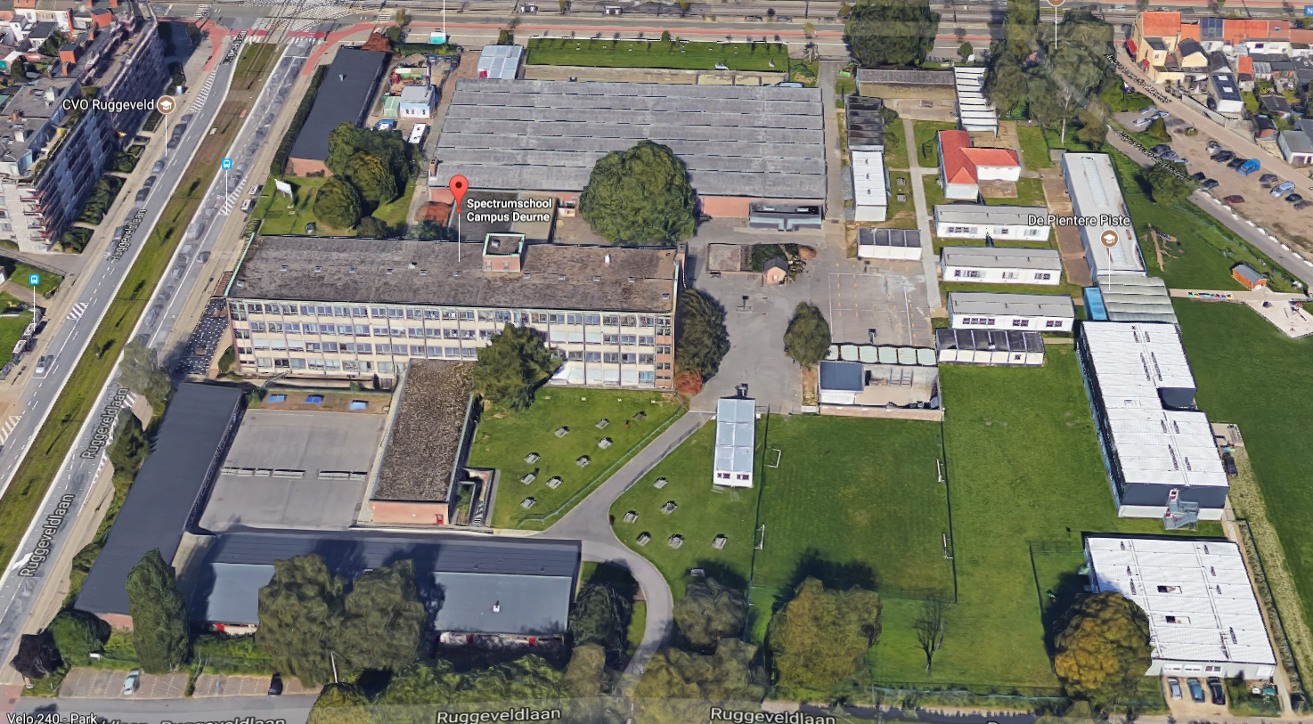
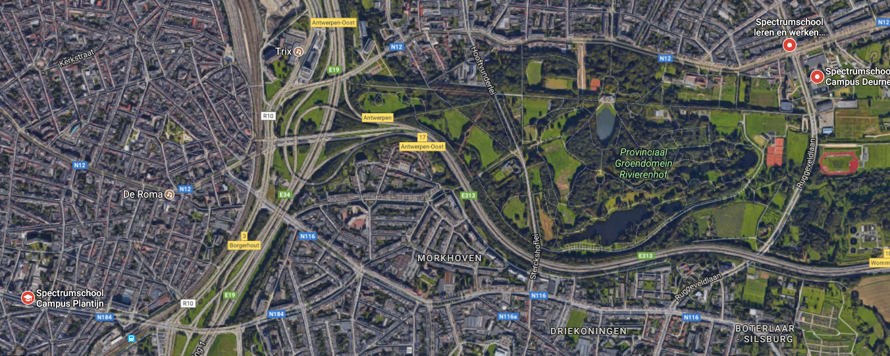

Slide 4
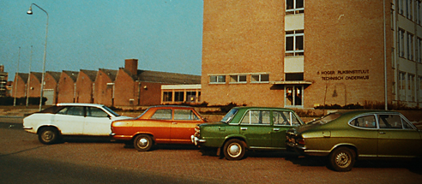
Spectrumschool
Our school, situated on the Ruggeveldlaan in Deurne, started in 1958 in 4 wooden trams which were the first classrooms in the school. Between 1962 and 1964 the first pavilions were built. In 1966 the work shop opened their doors. The main building was put in to use in 1976.
In 1998 KTA Deurne (former name campus Deurne) merged with KTA Borgerhout (former name campus Borgerhout) on the Plantijn en Moretuslei.
Today our school counts over 1150 students
  Traning made to measure
  40 different courses
  70 different nationalities
  Practical approach
  Competence based Evaluation
  Assistance onto the jobmarket

Slide 5
Some of our offered courses
Tech/Voc
Part-Time
Basic Mechanics Option Auto
Basic Mechanics Option Machines
Electricity
Wood
Electrical Engineering
Electromechanics
PE & Sports
Automechanics
Machine tools
Mechanical Maintenance
Electrical Engineering
Computer-controlled machine tools
Industrial electricity Interior Design (NEW)
Auto Electricity (NEW)
Mechanical Maintenance (NEW)
Cook
Waiter
Hotel Services
Administrative Assistant
Store Sales
Technical Sales
Reachtruck
Storage handler
Chidrens guidance
Logistics
Care
Building
Woodwork
Central Heating
PC Technician
Welding
Car Body Work
Sports Guidance
Gardener

Slide 6

Some figures
Leren + Ontdekken (Learn & Discover)
  Wide 1st stage
  250 students
  Technical & Vocational
  Okan

Slide 7
Some figures
Leren + Bekwamen (Learn & Capacitate)
  550 Students
  Technical 3rd – 6th year
  Vocational including 7th year specialisation
  Focus on the Industry as of the 4th year Internships

Slide 8
Some figures
Leren + Werken (Learn & Work)
  Part-Time education
  350 students
  Hard & Soft sectors
  68% fulltime engaged in work projects
  50% have a regular job
  All figures are above Belgian average

Slide 9
Some Figures
Duaal leren (Learning on the Job)

