Slide 1
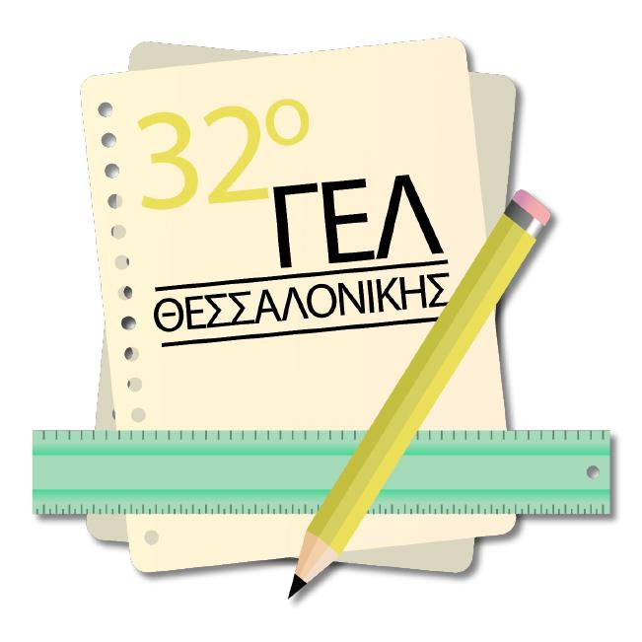
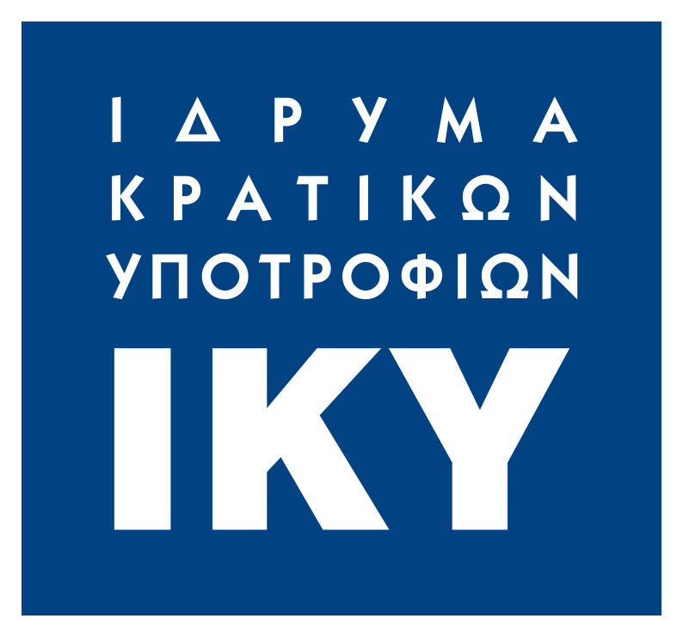
Monuments of Nature
Greek sites inscribed in UNESCO's World Heritage List and the Tentative list

Slide 2
Mount Athos
Mount Athos is known globally for its monasteries and its importance as an Orthodox spiritual center. What most people do not know however is that it was included in Unesco's Heritage Lists, in 1988,not only for its twenty monasteries but for a number of reasons, including its unique natural beauty which meets the seventh criterion for inclusion in the list, i.e containing superlative natural phenomena or areas of exceptional beauty and aesthetic importance.

Slide 3
Τhe peninsula of Athos. better known as the peninsula of Agion Oros, is the easternmost of the three peninsulas of Halkidiki. It differs from the other two, not only in its geography, but also in its geology, morphology and climate.
It is so different from the rest of Halkidiki, that Greek mythology attempts to explain it as follows: Athos was one of the Giants who challenged the Olympian gods during the Gigantomachia (Battle of the Giants). While he was fighting with Poseidon, the god of the sea threw a massive rock at him and buried Athos underneath it. And that is how the peninsula was created

Slide 4
The peninsula, protrudes 50 km (31 miles) into the Aegean Sea at a width of between 7 and 12 km (4.3 and 7.5 miles) and covers an area of 335.6 km2 (130 sq miles). The actual Mount Athos has steep, densely forested slopes reaching up to 2,033 m (6,670 ft).
Though land-linked, Mount Athos is practically accessible only by boat. The surrounding seas, however, especially at the end of the peninsula, can be dangerous. It was recorded by Herodotus that during the first Persian invasion in Greece in 492 B.C. the Persian fleet sank while trying to round the peninsula.

Slide 5
Geology: On the peninsula of Athos we see the extension of the geological formations of the range of Mount Rhodopi, with a continuation of the crystalline schist formations (gneisses, mica schists, limestone and marble) and the igneous rocks (granite, granodiorites, serpentines), as opposed to the other two peninsulas which are made up of tertiary formations.
Morphology: This is the only peninsula of Halkidiki which does not have sandy beaches. Mount Athos rises directly from the sea, shaped like a pyramid that surpasses 2000 meters, in height and the result is steep slopes and precipices along the length of the coastline, and a deeply creased terrain.

Slide 6
Climate: While for the rest of Halkidiki the climate is typical Mediterranean, for the peninsula of Athos It is influenced by the higher elevation of the ground above the sea level, by the north easterly winds prevalent in the region and by ascending and descending currents created by the emergence of Mount Athos. Above 1600 meters the climate is purely Continental.
Flora: As a result of the climate the vegetation includes about 50 types of plant communities (also 1200 species of plants and 350 species of mushrooms) such as broadleaved trees (oak, chestnut, beech) and the mountain, Mediterranean coniferous trees (fir and black pine) and at higher altitudes there is alpine vegetation. All these form a unique mosaic of varieties, which one rarely meets in such a small area.

Slide 7
The forests of the Athos area seem to have remained almost unchanged, retaining their ancient characteristics as pertaining to the mixture of species. Despite the intense logging, to cover the needs of the monasteries, all of the tree species which make up the ecosystem of Mount Athos flourish; except for the conifers, the forests are generally able to sprout and regenerate easily.
The harmonious interaction of traditional farming practices and forestry is linked to the stringent observance of monastic rules over the course of centuries, which has led to the excellent preservation of the mediterranean forests and associated flora.

Slide 8
2. Meteora
Meteora, in Thessaly Greece is another area known for its monasteries as well as its unique rock formations. It was included in UNESCO's list in 1988 for a number of reasons including the seventh criterion, i.e. containing superlative natural phenomena or areas of exceptional beauty and aesthetic importance.
The word Meteora means "suspended in the air".

Slide 9
Meteora is a rock formation in central Greece hosting one of the largest and most precipitously built complexes of Eastern Orthodox monasteries. The six (of an original twenty four) monasteries are built on immense natural pillars and hill-like rounded boulders that dominate the local area.
The rock formations have always been a site of worship for the ancient people of the area, even before the monasteries were built.
According to mythology, the rocks were used by the Olympian gods to defeat the Hecatoncheires, in their war against the older deities.

Slide 10
What makes Meteora's appearance special is the uniformity of the sedimentary rock constituents deposited over millions of years. It is considered a rare geological phenomenon, but scientists have not yet reached a definite conclusion on how the rocks were formed. The prevalent theory is that millions of years ago there was sea water in the area and the peculiar shape of the rocks was given to them due to water corrosion. Because of massive tectonic movements the seabed rose and the area was cut off from the sea.
The height of the rocks reaches up to 313 meters. They are assumed to have been formed about 60 million years ago, during the Paleogene period.

Slide 11
3. Petrified Forest of Lesvos (Tentative List)
The application was submitted in 2014 on the basis of meeting the seventh, eighth and tenth criteria, i.e. to contain superlative natural phenomena or areas of exceptional natural beauty and aesthetic importance, to be outstanding examples representing major stages of earth's history, including the record of life, significant ongoing geological processes in the development of landforms, or significant geomorphic or physiographic features, to contain the most important and significant natural habitats for in-situ conservation of biological diversity, including those containing threatened species of outstanding universal value from the point of view of science or conservation

Slide 12
The Petrified Forest of Lesvos is one of the finest and rarest monuments of geological heritage worldwide. It was created 20 million years ago, when volcanic materials covered and petrified the forest that was covering the area at that time. The large number of standing petrified tree trunks and their fully developed roots systems is proof that the trees were petrified in their original position and they have not been transferred to the location that we find them today. The natural erosion of volcanic rocks reveals impressive standing and laying tree trunks with a length of more than twenty meters and with a diameter of up to three meters.

Slide 13
Because of the systematic excavations that are being carried out in the area by the Natural History Museum of the Lesvos Petrified Forest we now have information about the composition of the paleoflora (an important indicator of the past climatic and environmental conditions and their changes), and the geological history of the Aegean basin for the last 20 million years.
The findings in the Petrified Forest reveal that the area was part of a mixed forest of conifers and angiosperms, an indicator that the flora of the region has evolved considerably. Findings of certain species, such as petrified plane trees show that the Petrified Forest of Lesvos grew in a subtropical climate.

Slide 14
4. Samaria Gorge (Tentative List)
The application was submitted in 2014 on the basis of meeting the seventh, eighth and tenth criteria, i.e. to contain superlative natural phenomena or areas of exceptional natural beauty and aesthetic importance, to be outstanding examples representing major stages of earth's history, including the record of life, significant ongoing geological processes in the development of landforms, or significant geomorphic or physiographic features, to contain the most important and significant natural habitats for in-situ conservation of biological diversity, including those containing threatened species of outstanding universal value from the point of view of science or conservation

Slide 15
The Samaria Gorge in the Lefka Ori (White Mountains) in the southwest of the island of Crete is one of the longest gorges in Europe. It is 17 kilometers long and descends from an altitude of over 1200 metres to the coast of the Libyan Sea. At the narrowest point, it is only a few metres wide, lined with high vertical rock walls. Due to its isolated location, the gorge offers habitat for many endemic plants and animal species, including the Cretan goat also known as the Kri Kri.
The Gorge is a symbol of the island of Crete and apart from its natural beauty and its importance for the local ecosystem, it is also connected with the material and immaterial cultural heritage of Crete and with the Cretan fights for freedom since it served as a hiding place for fighters during hard times.

Slide 16
Instead of just one gorge, there is actually a network of gorges which intersect and are a paradise of biodiversity and form a landscape of unique geological value and beauty.
Species found in the gorge are: the famous Cretan Agrimi Goat (Capra aegagrus cretica) and other rare species such as the Bearded Vulture (Gypaetus barbatus), the Golden Eagle (Aquila chrysaetos), the Cretan Wildcat (Felis silvestris cretensis), Blasius’ Horseshoe Bat (Rhinolophus blasii), as well as the endemic plants Zelkova abelicea and Bupleurum kakiskalae. The Mediterranean Monk Seal (Monachus monachus) is found in the sea caves on the south coast of the National Park

Slide 17
Hiking the gorge is one of the most popular hikes in Greece and one of the most popular tourist attractions in Crete. The walk through Samaria National Park is 13 km long, but one has to walk another two kilometers to Agia Roumeli from the park exit, making the hike 15 km long. The most famous part of the gorge is the stretch known as the Gates where the sides of the gorge close in to a width of only four meters and soar up to a height of almost 300 meters (980 feet).
The village of Samariá lies just inside the gorge. It was finally abandoned by the last remaining inhabitants in 1962. The village and the gorge take their names from the village's ancient church, Óssia María.

Slide 18
The Samaria Gorge has already been subject to National Park protection status for 50 years. Today, it is one the most important pillars for the sustainable development of the entire island of Crete and is supremely important to the local communities living around the National Park. The Greek State has been responsible for the management of the area through the Forest Directorate of Chania since the National Park was founded. In 2008 the Samaria National Park Management Body was established with European Union funding, participating in the management of the Park while promoting the design and implementation of the Specific Environmental Study and the Management Plan for the area. The management of the Park aims to become the best example of viable administration in Greece, with the ultimate goal of protecting the integrity of this unique area.

Slide 19
5. The broader region of Mount Olympus (Tentative list)
The application was submitted in 2014 on the basis of meeting the seventh, eighth and tenth criteria, i.e. to contain superlative natural phenomena or areas of exceptional natural beauty and aesthetic importance, to be outstanding examples representing major stages of earth's history, including the record of life, significant ongoing geological processes in the development of landforms, or significant geomorphic or physiographic features, to contain the most important and significant natural habitats for in-situ conservation of biological diversity, including those containing threatened species of outstanding universal value from the point of view of science or conservation
It is notable in Greek mythology as the home of the Greek gods. It is also noted for its exceptional biodiversity and rich flora. It has been the first National Park in Greece since 1938. It is also a World Biosphere Reserve.

Slide 20
The shape of Olympus was formed by rain and wind. It has many peaks and an almost circular shape. The mountain has a circumference of 150 kilometers (93 mi), an average diameter of 26 kilometers (16 mi), and 500 square kilometers (190 sq mi) of area. The highest peak is Mytikas.
Mount Olympus is formed of sedimentary rock laid down 200 million years ago in a shallow sea. Various geological events that followed caused the emergence of the whole region above the sea. Around one million years ago glaciers covered Olympus and created its plateaus and depressions. With the temperature rise that followed, the ice melted and the streams that were created swept away large quantities of crushed rock in the lowest places, forming the alluvial fans, that spread out all over the region from the foothills of the mountain to the sea

Slide 21
Generally speaking, there are four discernible zones of vegetation. The first, ranging from 300 to 500m, is comprised of evergreen sclerophyllous vegetation and includes shrubs and low trees.
From 600 to 1400m, which is the zone of beech-fir and montane conifers.
From 1400 to 2500 meters the zone of boreal conifers emerges, dominated primarily by Bosnian pine (Pinus heldreichii), a rare species of pine, which makes its appearance at an altitude of
around 1,100 meters.
Above 2,500 meters, the highest treeline in the Balkans, we no longer find forests but a variety of sub-alpine ecosystems of low- growing vegetation with many rare wildflowers, most of which are endemic to Olympus, Greece or the Balkans.

Slide 22
Sources
Athos (mythology) - Wikipedia
Persian Wars Shipwreck Survey Home Page
Nature and the natural environment of mount Athos | PEMPTOUSIA
Mount Athos - UNESCO World Heritage Centre
Meteora:The creation of a unique geological phenomenon
The Unique, Ethereal Beauty of Meteora, Greece
Petrified Forest of Lesvos
Greece's UNESCO Global Geoparks
Petrified Forest of Lesvos - UNESCO World Heritage Centre
Gorge of Samaria National Park - UNESCO World Heritage Centre.
Αγωνία για την κατάσταση του φαραγγιού της Σαμαριάς λόγω... - Flashnews.gr
https://www.kynigesia.gr/faraggi-samarias-entyposiako-plano-me-kri-kri-video/
Βίντεο: Τέσσερις γύπες απελευθερώθηκαν στο φαράγγι της Σαμαριάς | Green Agenda
https://www.samaria.gr/old-settlement-of-samaria-2/?lang=el
Meteora - Wikipedia
Meteora, Greece - Monasteries, maps, itineraries, images, hotels, etc.
Mount Athos - Wikipedia
The Petrified Forest | Απολιθωμένο Δάσος Λέσβου
Rare, Intact 20-Million-Year-Old Petrified Tree Found on Lesvos - Greece Is
Mount Olympus wiki | TheReaderWiki
5 amazing gorges you have to visit while in Crete - Urban Adventures
Walk the Samaria Gorge - Creta Maris Blog
Mount Olympus: Where the Greek Gods Live - Blog | Greeka.com
Mount Olympus - Wikipedia
Στην κορυφή του Άθωνα γιορτάστηκε η Μεταμόρφωση του Σωτήρος -ΦΩΤΟ- - Χαλκιδική Ειδήσεις - Halkidikinews.gr
Απέναντι από τον χιονισμένο Άθω -ΦΩΤΟ- - Χαλκιδική Ειδήσεις - Halkidikinews.gr
https://i0.wp.com/orthodoxia.online/wp-content/uploads/2018/01/orthodoxiaonline-222.jpg?fit=819%2C470&ssl=1
https://www.vimaorthodoxias.gr/agio-oros/agio-oros-fysi-kai-fysiko-perivallon/
https://commons.wikimedia.org/w/index.php?curid=59264666
https://commons.wikimedia.org/w/index.php?curid=59264666

