Slide 1
"Traian Lalescu" Theoretical Highschool Hunedoara
The romanian intangible patrimonium
LTCCAI

Slide 2
1.Călușul
Călușarii represent the participants in Călușul dance, a traditional Romanian dance, present in ancient times both in Moldova, Oltenia and in Transylvania.
Traditionally, the dance is performed in the week before Pentecost, and has a cathartic (healing) purpose, but there are historical documents that attest to the practice of dance on other occasions, for example, the dance performed by soldiers of Michael the Brave, the "gallows". They were under the command of Captain Baba Novac, during the feast given by Sigismund Bathory in 1599, at Piatra Caprei, near Alba Iulia.
Căluș is a Romanian custom practiced during the period popularly called Pentecost, more precisely in the nine days between the Orthodox feast of the Ascension and the so-called Pentecost. Similar traditions exist throughout Europe in the former Roman Empire, from the Moorish Dance in Britain or the Pauliteiros in Portugal.

Slide 3
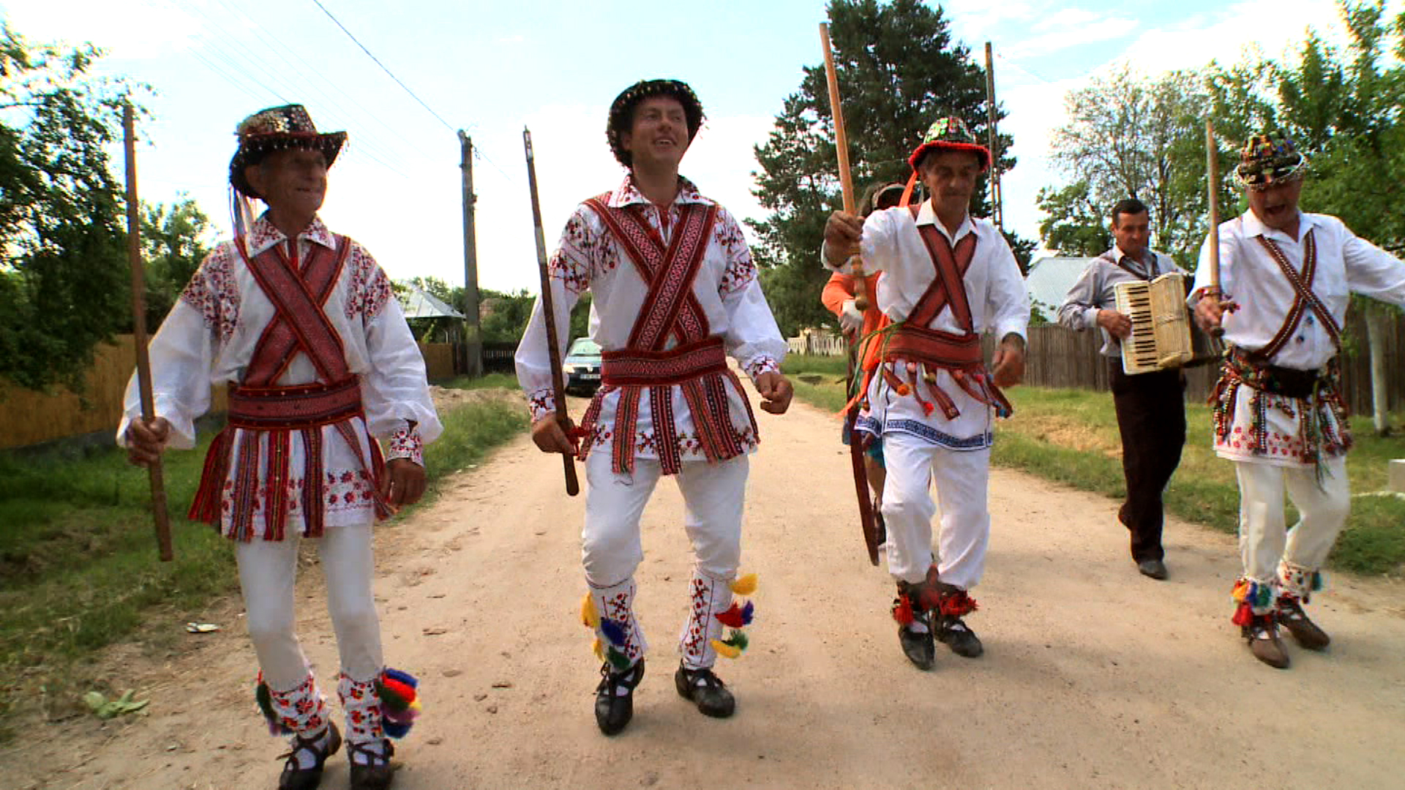

Slide 5
2.Doina
Doina is a lyrical, vocal or instrumental creation, specific to the Romanian people, in which the unknown author directly expresses his feelings of longing, mourning, alienation, revolt, sadness, love, hatred against oppressors, regret, etc. Doina is also called a species of popular literature, belonging to the lyrical genre, in which the author expresses his feelings and beliefs about some problems of life, time and nature and himself.
Characteristics:
expresses directly, deeply and intensely a variety of feelings, ideas, aspirations
it has a varied theme
is inspired by the life of the Romanian people, reflects man's communion with nature, his attitude towards life and death, towards the passage of time

Slide 7
3. The Romanian Lad Dance
It is the first dance in the traditional dance cycle, and its purpose is primarily initiatory. Dancing is a traditional way of celebrating the manhood of young people in the community and affirming their social status, with several variants, depending on the community that practices it. The boy's game is specific to several areas of Transylvania, which maintains its continuity in Romanian folklore, and which - as shown in the decision of the UNESCO Commission - is a demonstration of virtuosity and a harmonious mixture of rhythm and movement. Since 2009, the dance has been included in the Inventory of the Elements of the Intangible Cultural Heritage of Romania developed in accordance with Articles 11 and 12 of the Convention and maintained by the National Center for the Preservation and Promotion of Traditional Culture. Efforts to include the Lad Dance in the UNESCO World Heritage List began in 2013, at the initiative of scientific researcher Zamfir Dejeu, a member of the National Commission for the Safeguarding of the Intangible National Cultural Heritage. In the project were customized several types of games and danced by boys, old people, children, demonstrating permanence, continuity, then danced by different social classes, peasants, townspeople, students.

Slide 9
4. The Horezu Ceramics
Horezu ceramics is a unique type of Romanian pottery that is traditionally produced by hand around the town of Horezu in northern Oltenia (Vâlcea County), close to the famous Horezu Monastery. It reflects many generations of knowledge and skills development of pottery, which is why the craftsmanship of Horezu pottery was inscribed on UNESCO Intangible Cultural Heritage Lists in December 2012.
Production is divided into male and female fabrication processes. Therefore, men extract the earth, which is then cleaned, cut, watered, kneaded, trampled and mixed – transforming it into red clay that potters form in a special finger technique requiring concentration, strength and agility. Each potter has his own technique of shaping, but each respects the sequence of the process. The women decorate the shaped ceramics before firing with special techniques and tools in order to draw traditional motifs. Their skills in combining decoration and color determines the personality and uniqueness of these pieces. Colors are bright shades of brown, red, green, blue and so called "Horezu ivory". Horezu potters use many traditional tools like a mixer for cleaning the earth, a pottery wheel and comb for shaping, a hollowed-out bull's horn and a fine wire-tipped stick for decoration, and a wood-burning stove for firing.
This ancient craft is preserved in the ancestral hearth, now known as Olari Street of Horezu, where artisans shape the clay into the same painstaking process as their ancestors did. Horezu is a singular historical Romanian ceramic center in which this trade remained the main source of income for many families of potters such as: Ogrezeanu, Vicsoreanu, Iorga, Frigura, Mischiu, Popa etc. Today this craftsmanship is transmitted as always in the family circle, but also in workshops from master to apprentice, and pottery festivals and exhibitions.

Slide 10
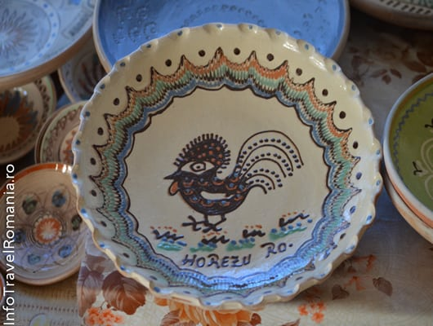

Slide 12
5. Mărțișorul
An element of intangible cultural heritage, Mărţişorul was inscribed by UNESCO, in 2017, in the Representative List of Intangible Cultural Heritage of Humanity following the candidacy of a multinational file (Cultural Practices Associated to the 1st of March - Romania, Bulgaria, Macedonia, Republic of Moldova ). Martisor is an old custom with a lunar and feminine character, spread throughout Romania, practiced in other southeastern European areas. Initially, the braided cord, a red and a white thread, was made by women and offered in the family and in the community, donated mainly to females. Today it is given by grandparents / parents / children to be healthy, by young girls to be beautiful and loving, by men, women, children by mothers, grandparents, relatives, girls and women to other girls and women. It should be noted that in some areas of Moldova and Transylvania it is also given to men. Martisor / March / Martis / Traditional Martisur is an amulet made of a silver coin, through which passes the string whose colors symbolize: white - the purity of the beginning, red - an attribute of vitality (health, beauty or love), but also the victory of the sun on the cold, which marks the rebirth of nature. It is worn on the left hand or chest, for almost the whole month, after which it is tied to the budding branch of a fruit tree. If the tree doesn't bear fruit that year, it's a bad sign. The martisoru can also be worn until the storks arrive when they say, "Don't be bold and give me the whites!" In the popular belief, Martisor has a magical, protective function in an important time threshold - spring and a festive function, which marks an important date in the popular calendar, because he is called the Spring Head. Martisor was caught in the horns of animals or at the entrances to the household, in the house or in the stable, in the belief that it could ensure health in the next vegetative and agricultural year.

Slide 13
