Slide 1
The history of the European Union

Slide 2
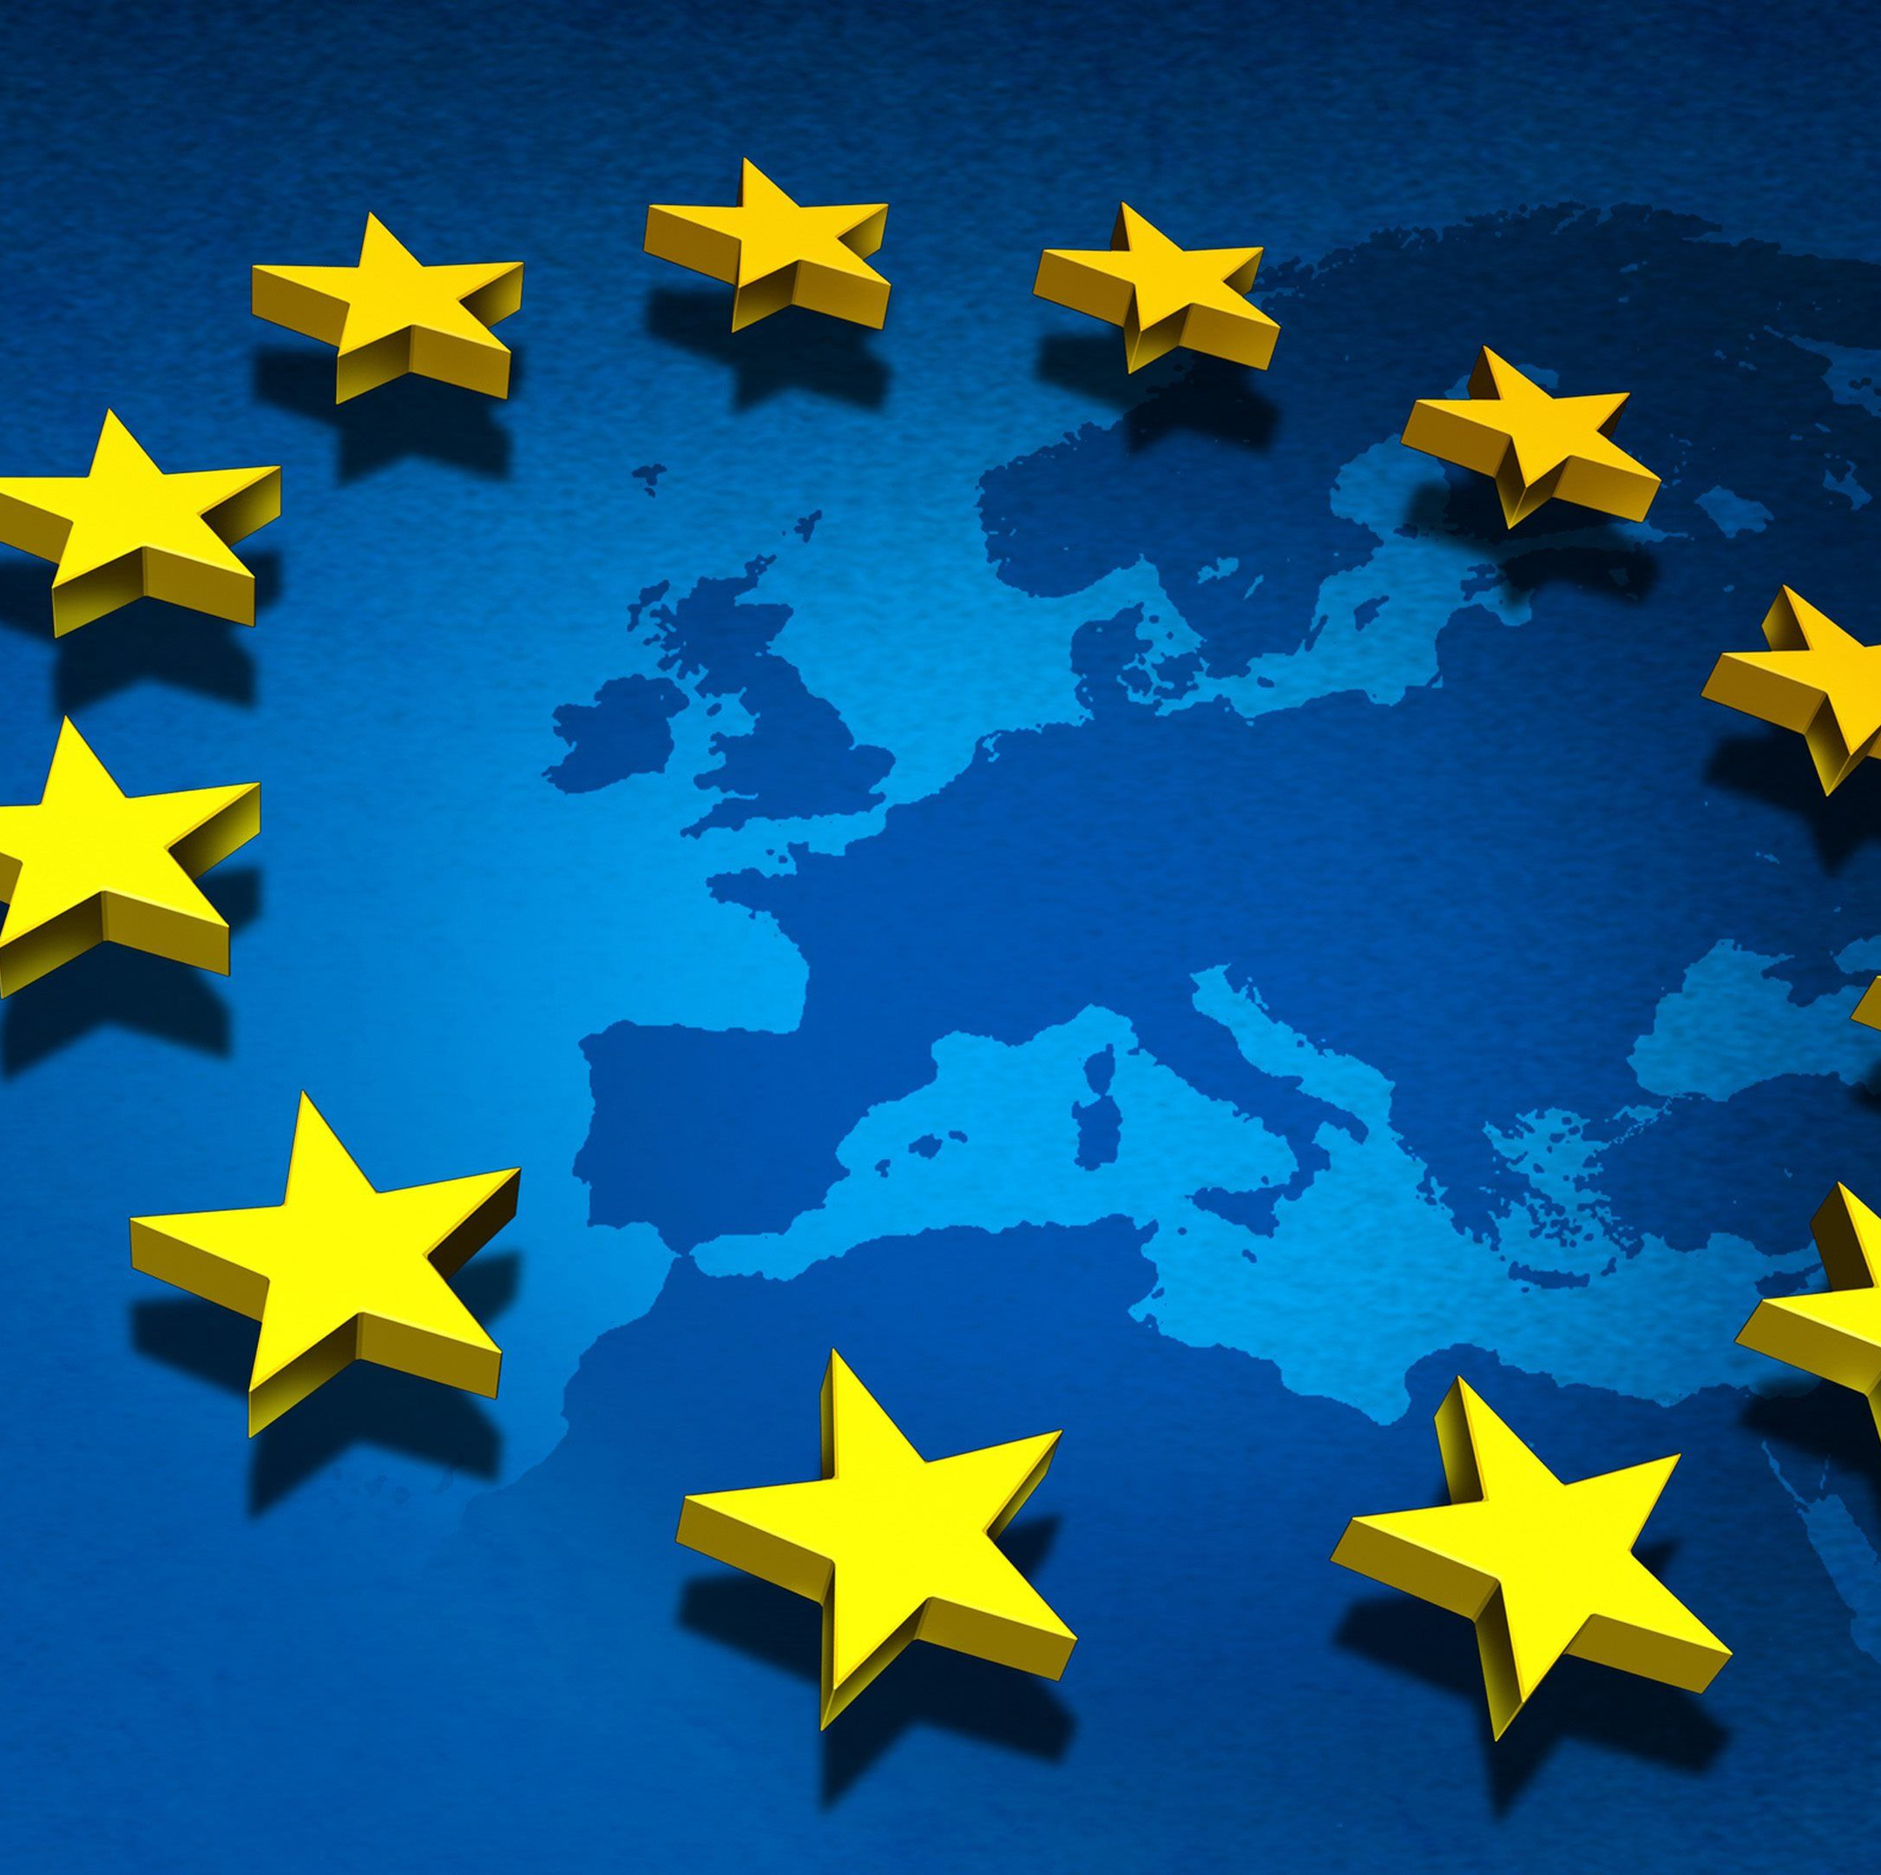
What is the European Union and what is its purpose?
The European Union (EU) is a political and economic union of 27 member states that are located primarily in Europe.[8] The union has a total area of 4,233,255.3 km2 (1,634,469.0 sq mi) and an estimated total population of about 447 million.
It is designed to tear down trade, economic and social barriers and promote flourishing in these areas

Slide 3
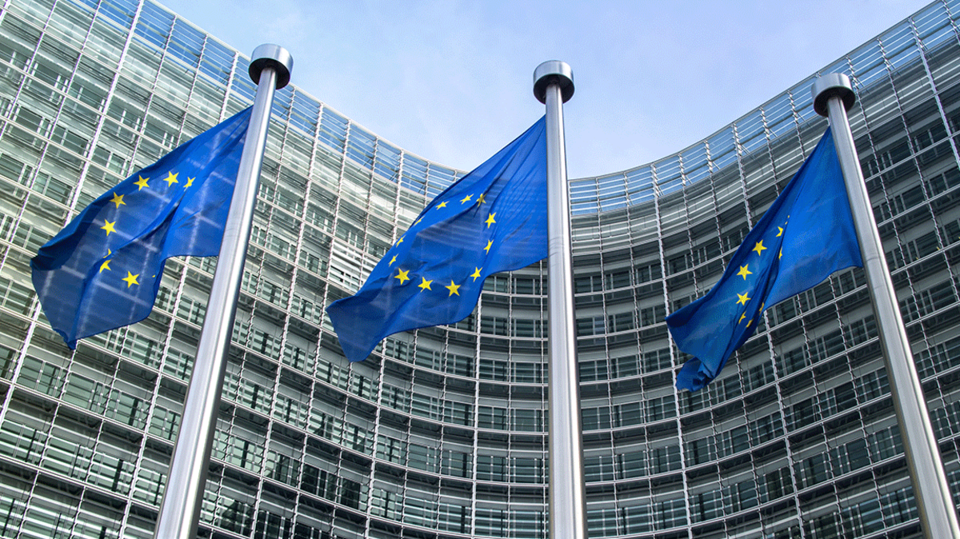
According to the European Union's official website, the union's purpose is to promote peace, establish a unified economic and monetary system, promote inclusion and combat discrimination, break down barriers to trade and borders, encourage technological and scientific developments, champion environmental
protection,
The EU grew out of a desire to form a single European political entity to end the centuries of warfare among European countries that culminated with World War II and decimated much of the continent. The European Single Market was established by 12 countries in 1993 to ensure the so-called four freedoms: the movement of goods, services, people, and money.

Slide 4
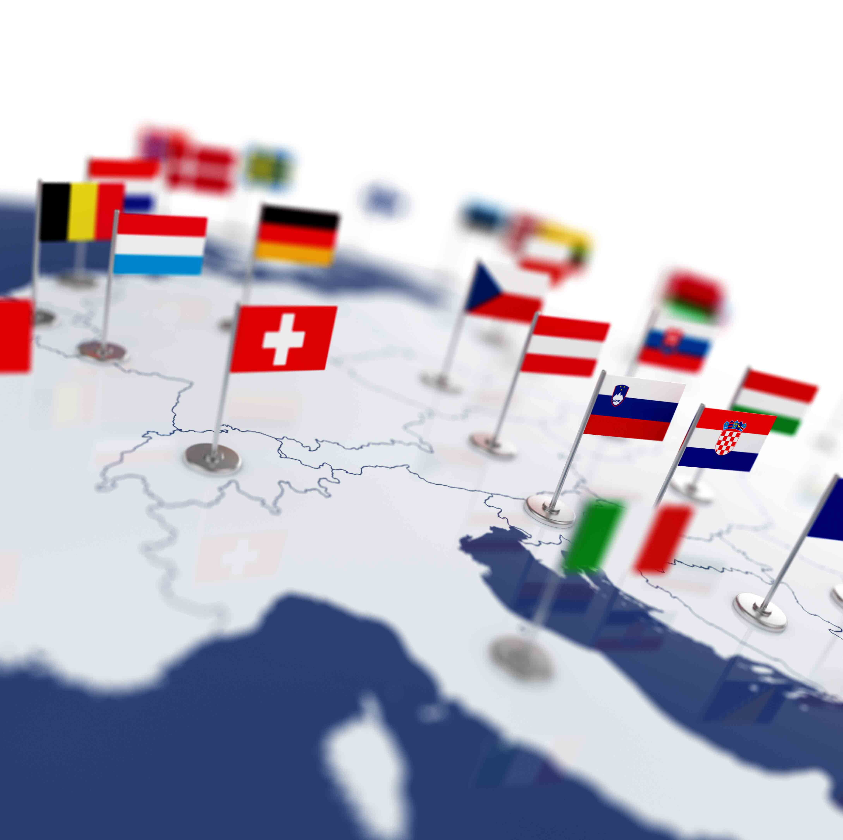
The EU began as the European Coal and Steel Community, which was founded in 1950 and had just six members: Belgium, France, Germany, Italy, Luxembourg, and the Netherlands. It became the European Economic Community in 1957 under the Treaty of Rome and, subsequently, became the European Community (EC).5﻿﻿2﻿

Slide 5
The early focus of the EC was a common agricultural policy as well as the elimination of customs barriers. The EC initially expanded in 1973 when Denmark, Ireland, and the United Kingdom joined. A directly elected European Parliament took office in 1979.

Slide 6
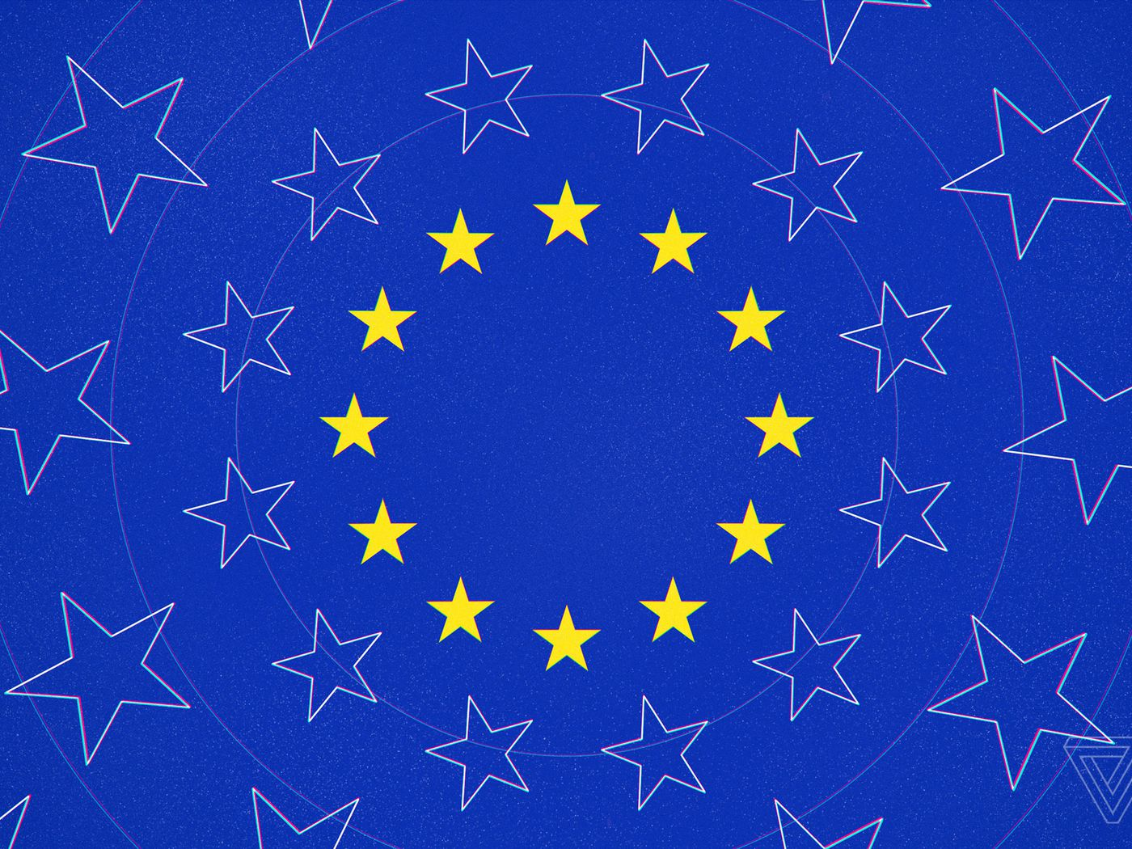
Greece joined in 1981, Portugal and Spain following in 1986.[63] In 1985, the Schengen Agreement paved the way for the creation of open borders without passport controls between most member states and some non-member states.[64] In 1986, the European flag began to be used by the EEC[65] and the Single European Act was signed.

Slide 7
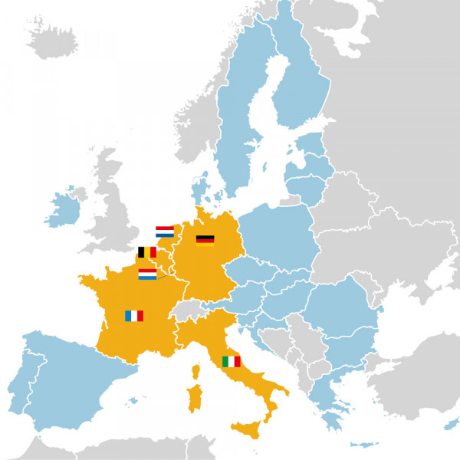
The Maastricht Treaty took effect on November 1, 1993, and the European Union (EU) replaced the EC. The treaty created the euro, which is intended to be the single currency for the EU. The euro debuted on January 1, 1999.6﻿ Denmark and the United Kingdom negotiated "opt-out" provisions that permitted them to retain their own currencies.
In 1995, Austria, Finland, and Sweden joined the EU

Slide 8
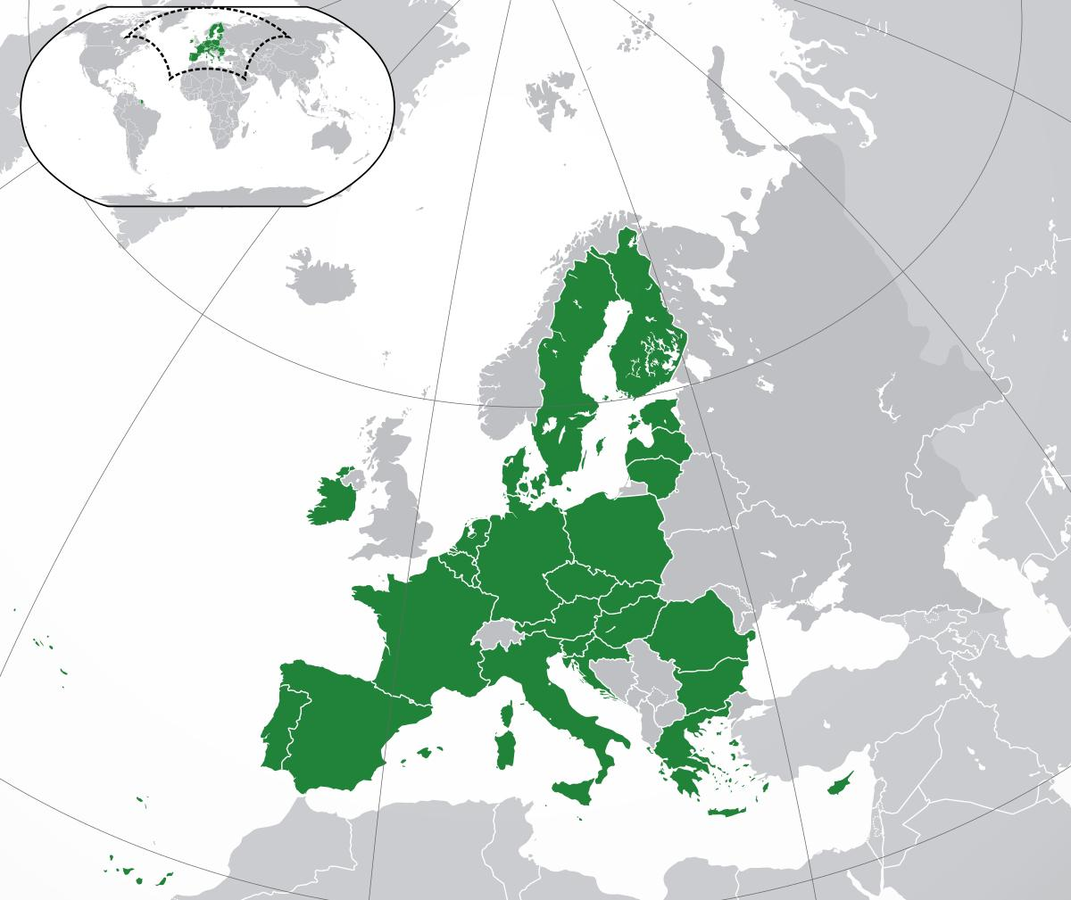
In 2004, the EU saw its biggest enlargement to date when Cyprus, the Czech Republic, Estonia, Hungary, Latvia, Lithuania, Malta, Poland, Slovakia, and Slovenia joined the union.[69]

Slide 9
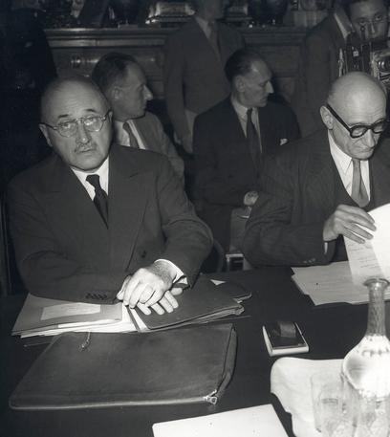
Lisbon Treaty (2007–present)
In 2007, Bulgaria and Romania became EU members. Later that year, Slovenia adopted the euro,[69] followed by Cyprus and Malta in 2008, Slovakia in 2009, Estonia in 2011, Latvia in 2014, and Lithuania in 2015.

Slide 10
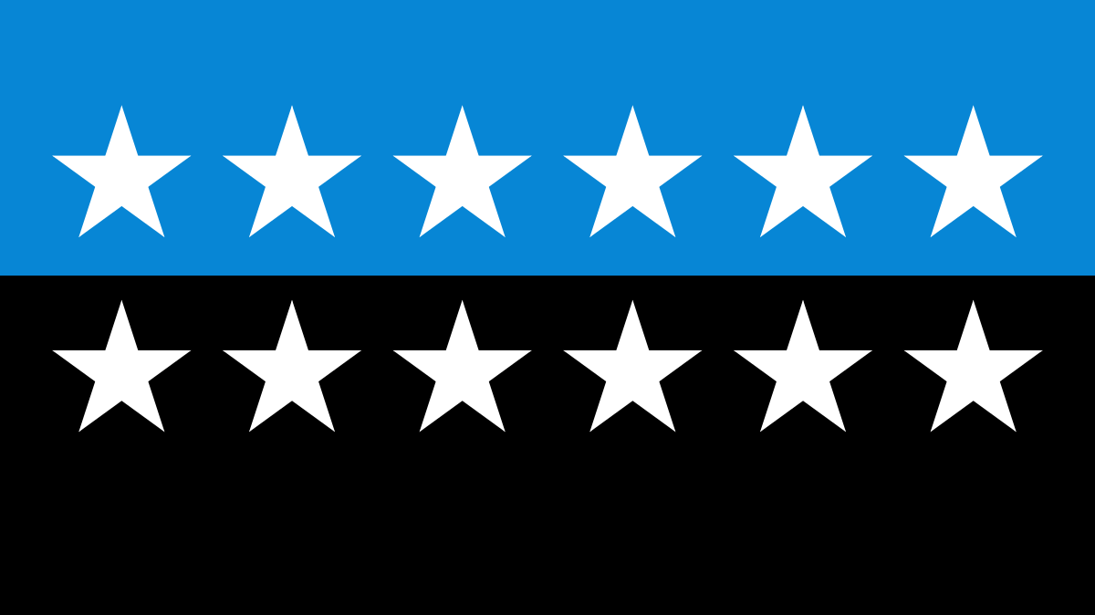
Several newer members of the EU have not yet met the criteria for adopting the euro common currency.
EU institutions
The EU has 7 main institutions, and the role of each one is set out in the treaties.
European Council
The European Council brings together the heads of state or government of every EU country and decides on the political direction of the EU.

Slide 11
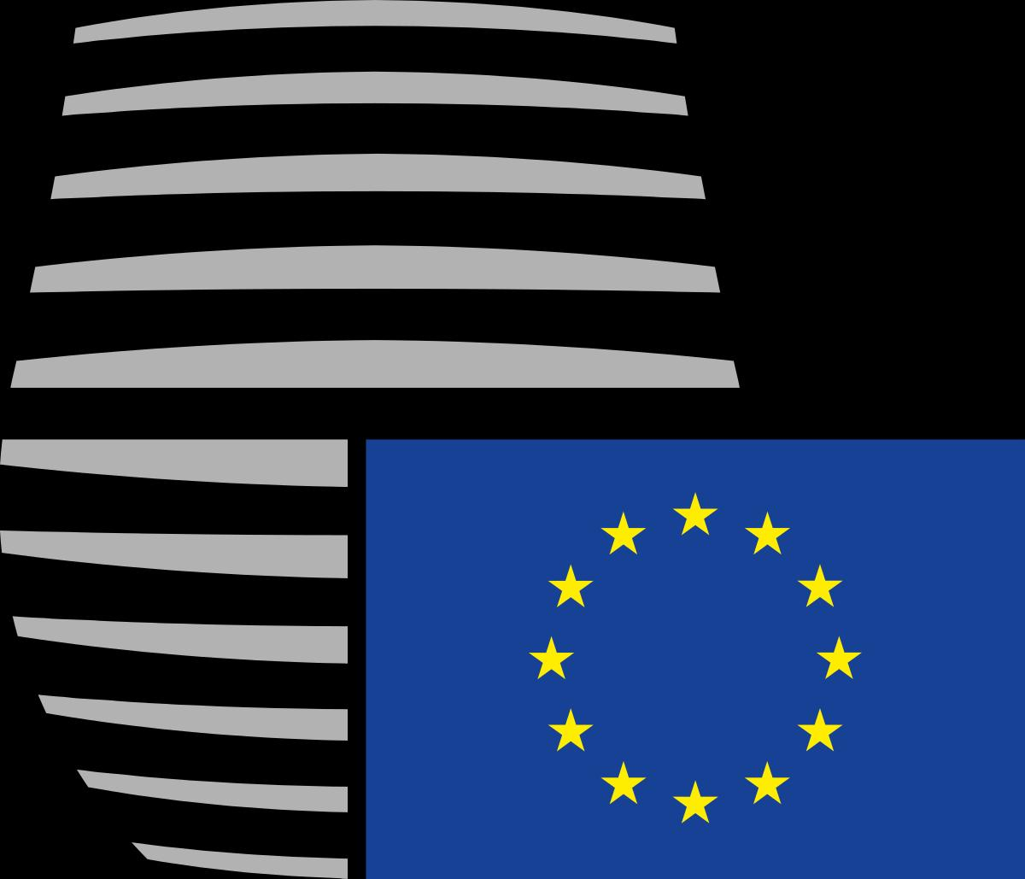
Council of the European Union
The Council of the European Union consists of one government minister from every member state. The Council is part of the law making process in the European Union.
Members of the European Council
The members of the European Council are the heads of state or government of the 27 EU member states, the European Council President and the President of the European Commission.

Slide 12
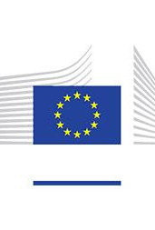
European Commission
The European Commission is the executive of the European Union.
Role: Promotes the general interest of the EU by proposing and enforcing legislation as well as by implementing policies and the EU budget
Members: A team or 'College' of Commissioners, 1 from each EU country
President: Ursula von der Leyen
Year established: 1958
Location: Brussels (Belgium)
Website: European Commission
The European Commission is the EU's politically independent executive arm. It is alone responsible for drawing up proposals for new European legislation, and it implements the decisions of the European Parliament and the Council of the EU.

Slide 13
European Parliament
Тhe European Parliament is the EU's only directly-elected institution with legislative, supervisory, and budgetary responsibilities
Its 705 Members are there to represent you.
President: David-Maria Sassoli
Established in: 1952 as Common Assembly of the European Coal and Steel Community, 1962 as European Parliament, first direct elections in 1979

Slide 14
Location: Strasbourg (France), Brussels (Belgium), Luxembourg
European Court of Justice
The European Court of Justice ensures that European law is interpreted and applied in each member state.
Court of Auditors
The main task of the European Court of Auditors, is auditing and overseeing the accounts and budgets of the institutions of the European Union.
European Ombudsman
The European Ombudsman safeguards the fundamental rights of citizens living in Europe by ensuring open and accountable administrations within the European Union

Slide 15
Thank you for your attention

