Slide 1
Folk culture and traditional Spiš cuisine

Slide 2
Spiš
is a museum of ancient times
is a rich thesaurus of artistic relics and historical monuments
Spiš has many sights that are listed in UNESCO Heritage (Spiš castle, ecclesiastical town Spišská Kapitula, Spišské Podhradie, Žehra, Dobšinská Ice Cave) and many national cultural monuments:
the works of Master Paul from Levoča, St.Jacob ´s
Cathedral in Levoča, Spiš castle, Church in Žehra

Slide 3
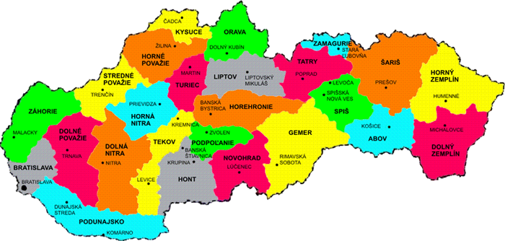
Spiš is the region with its own peculiarities.

Slide 4
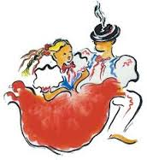
Regional folk culture consists of:
customs and traditions
songs and dances
folk costumes
crafts
cuisine
architecture

Slide 5
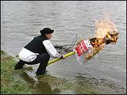
Customs and Traditions
Epiphany – the feast ofThree Kings
Shrovetide (Fašiangy)
Carrying of Morena(in the form of
straw effigy dressed in woman´s clothing
Easter customs
Midsummer Night
The feast of St. Ondrej, St. Nicholas, Lucy .... (witches days)
Christmas

Slide 6
Songs and Dances
„Each of our folk songs is like a precious stone, like an absolute diamond .“
they were preserved by the word of mouth
they express peoples´ feelings, moods, thoughts and desires
the best known coupled twisted dance in Spiš is „Krucena“.

Slide 7
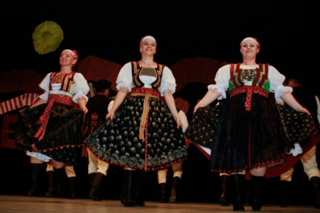
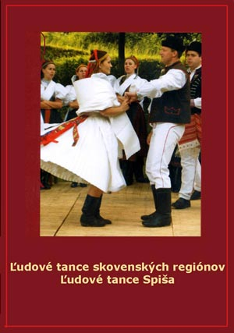
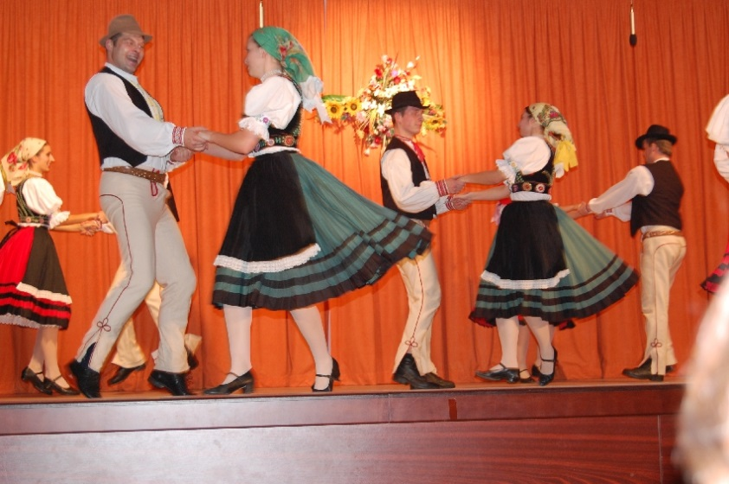

Slide 8
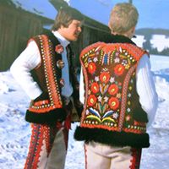
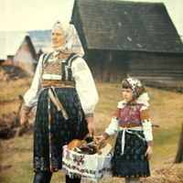
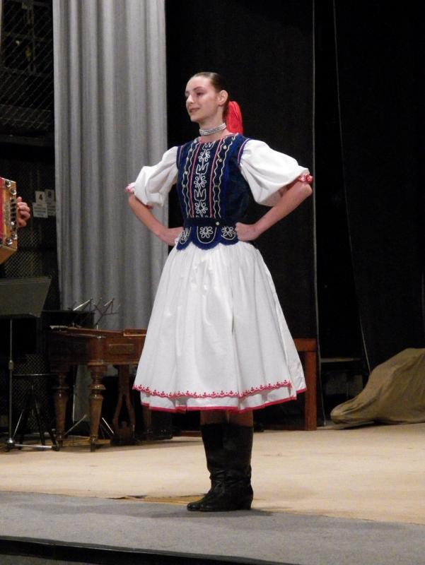
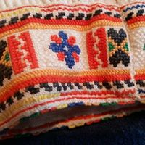
Folk costumes

Slide 9
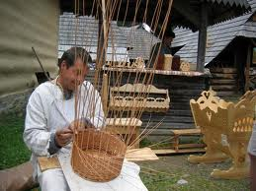
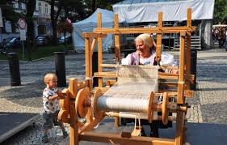
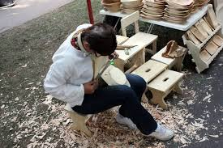
Crafts
Pottery and Jug-shaping
Coopery, Gingerbread making
Tinkering, Tannery
Stove making, Smithery
Basket-making
Joinery
Woodcraft
jewel-making
Weaving

Slide 10
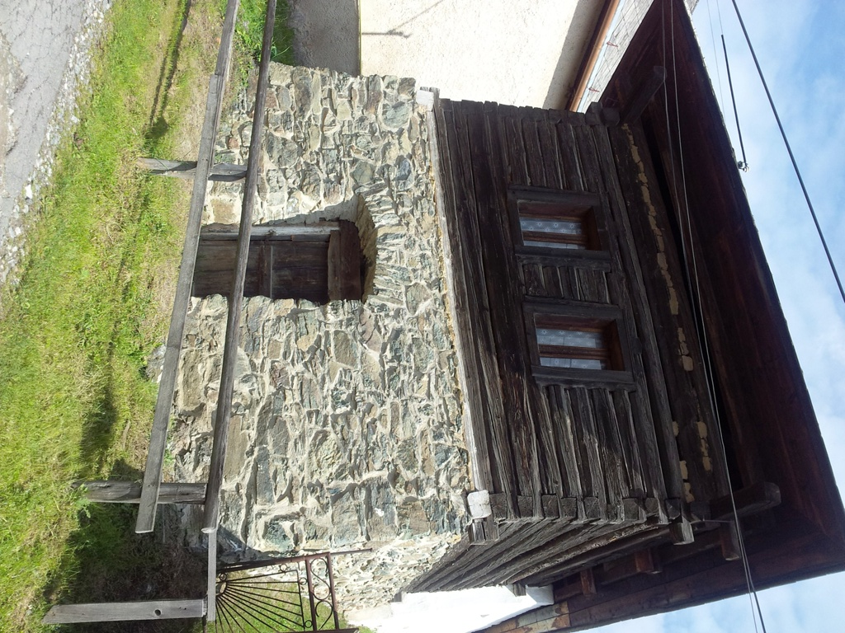
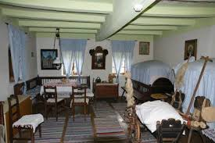
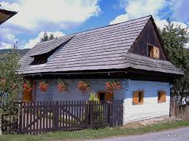
Folk architecture

Slide 11
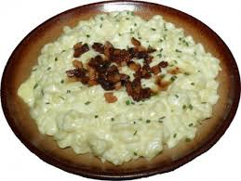
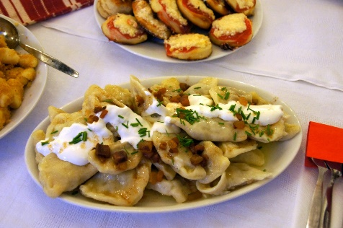
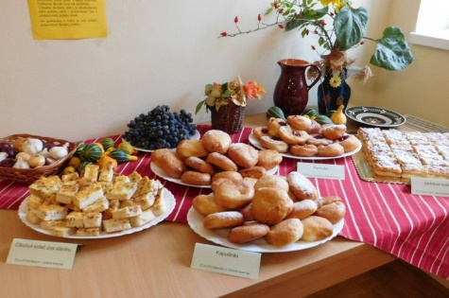
Traditional cuisine
The most typical Slovak meals are:
sheep cheese gnocchi(halušky) with bacon
pankušky(a kind of fried cakes), flat cakes, kukuričanka(mush)
sauerkraut soup, garlic soup
yeast dough cakes – steamed dumplings
džatky, kuľaša(potato mash), special soups – demikát and papcún,
salty cakes, kapustník(sauerkraut cake)
Cracklings round cakes(oškvarkové pagáče)

Slide 12
Thank you for your attention!

