Slide 1
Let's get to know each other through myths and legends - Strumyani Municipality – mythology and legends

Slide 2
Project Managers Simo Parov and Hristina Chorbadjiyska after exploring and commenting on local myths and legends, turned to the legend of King Marko, who freed three chains of slaves.

Slide 3
Strumyani Municipality - mythology and legends
Managers stood on this legend, because in the vicinity of our native land there are names of places and natural landmarks associated with the name of King Marko:
Marko Rock;
Marko step;
The church “St. Spas”
Dragon hole;
Marco wells

Slide 4
Strumyani Municipality - mythology and legends
The Marko Rock, also called "Water Rock", is a typical ancient Thracian altar dotted with fragments of ceramics. According to the legend, the water appeared in the footsteps of King Marko. The legend tells that once Marco jumped here from Pirin, and because he was very thirsty, God gave water bleeding from the rock.

Slide 5
“Marko step” – The hero's footsteps were seen printed on other rocks between the villages of Palat and Igralishte.

Slide 6
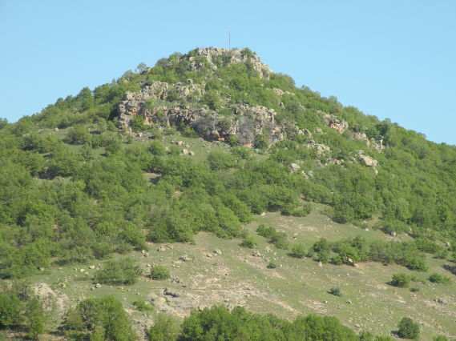
The Church “St. Spas””- Legends connect another holy place with King Marko - the churches of “St. Spas”, located about 4 km. Northwest of the village of Krastiltsi

Slide 7
Dragon Hole In connection with the legend of King Marco is the popular song among the locals about the dragon, loving girl Vena. The song is interesting because of the explanations about the dragon's dwelling - the top of the third mountain, where there is a lake and a big tree. The ethnographic and archaeological material from the village of Pirin show that this idea is extremely sustainable among the local population and can be found artifacts from pagan antiquity.

Slide 8
According to the legend of the people, persecuted by the Turks, King Marko and his mother hid in the rock. They raised their bees here, giving them the place called Pchelina or Bee Rock. The honey of these bees was inviolable. No one could reach it. That's why honey flew in river Struma.

Slide 9
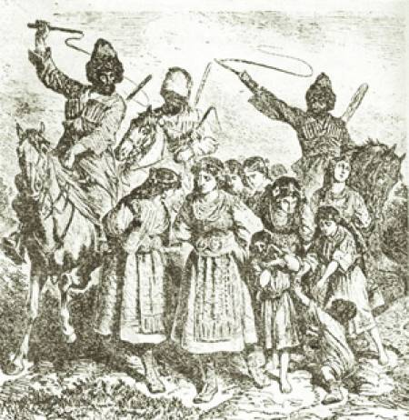
One of the most famous legends about King Marko is the legend in which the hero frees three chains of slaves.

Slide 10
King Marco freed three chains of slaves
The legend tells that King Marco decided on a Sunday to go to a church. As he prepares, his mother notices that he habitually takes his weapon with and advises him to leave his gun because he goes to church and does not need it. But despite all his wife Elena secretly puts him in the saddle of his horse. When the hero arrives at the field of Strumyani, he can hear the cry of slaves. He directs himself there, and when he reaches them he sees black turkish araps that lead three chains of slaves - one with young girls, one with young boys and others with young brides. King Marko asks the araps to release the slaves by promising to give them coins, but they refuse him and threaten him to be bonded to the slaves.

Slide 11
King Marco freed three chains of slaves
At that moment, the henna Mark's blood is boiling. He scratches his waist for his weapon, but regrets that he has left him on the advice of his mother. The horse reminds him of checking in the saddlebags, because his wife is petulant and probably put the weapon. Then he finds him and returns to the araps that make the slaves.
In one shot he cuts off the heads of all three araps, releases the slaves and gives them one coin of gold to avoid going naked, thirsty and hungry. Then he continued his journey to the church.
Students participating in the Erasmus + project tried to make the legend that you would see in the video after the presentation.

Slide 12
Legend Dramatization Process
The work on the dramatization of the legend began with the choice of children to play the roles. First we started by studying the lyrics of the legend, then learning the actions, gestures and movements of the heroes. The work went on to play the cast in scenes, and then assemble the whole storyline.

Slide 13
Legend Dramatization Process
In the course of the work students developed some of the requisite requisites for dramatization.
We provided stage costumes from the museum in Strumyani Municipality.
The horse for dramatization provided the child who played the role of King Marko.
The pictures of the dramatization we made in the vicinity of the village of Ilindentsi, Strumyani municipality.

