Slide 1
Pottery in Poland
By Basia and Monika

Slide 2
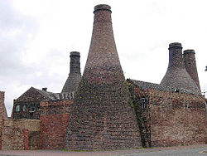
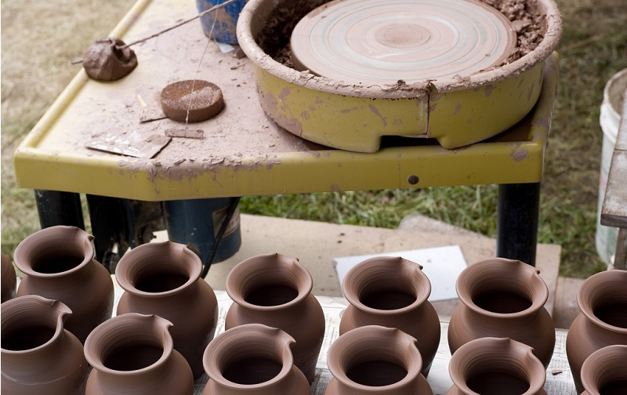
History
This job is one of the oldest crafts (known from the Neolithic period). It is a handicraft product of ceramic dishes and everyday objects.

Slide 3
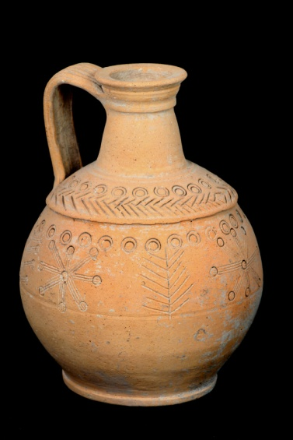
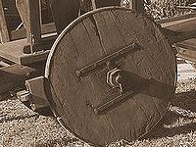
Stages of pottery production
Preparation of the materials – clay preparation
The potter arranges the clay on the potter's wheel and turns them with his feet, and with his hands he works the clay.
The vessel is left to dry.
The dishes after drying are burned in the oven
This is a film about pottery. https://vimeo.com/49798427

Slide 4
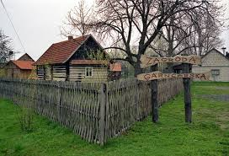
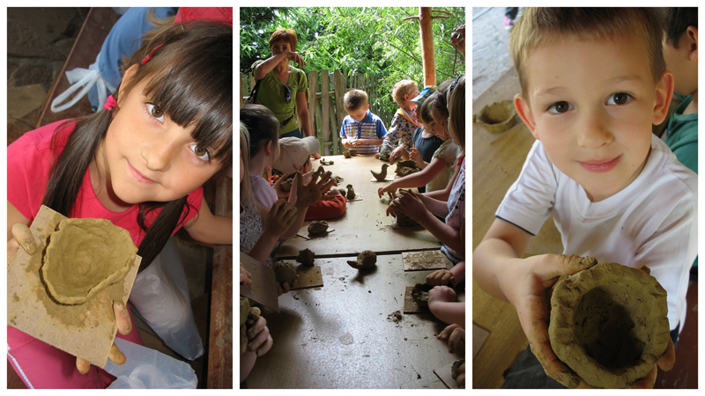
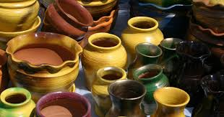
Place where they are made in Podkarpacie
Medynia Głogowska

Slide 5
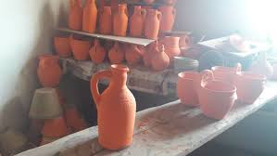
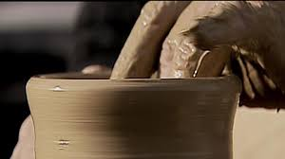

Slide 6
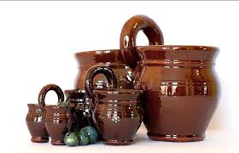
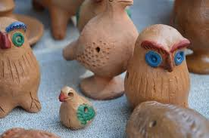

Slide 7
Thank you for watching this presentation ☺

