Slide 1
Glassblowing and Glassworks in Bavaria

Slide 2
Structure
Origin and Marketing Location
What is made out of glass?
How is the glass blown?
Things blown out of glass

Slide 3
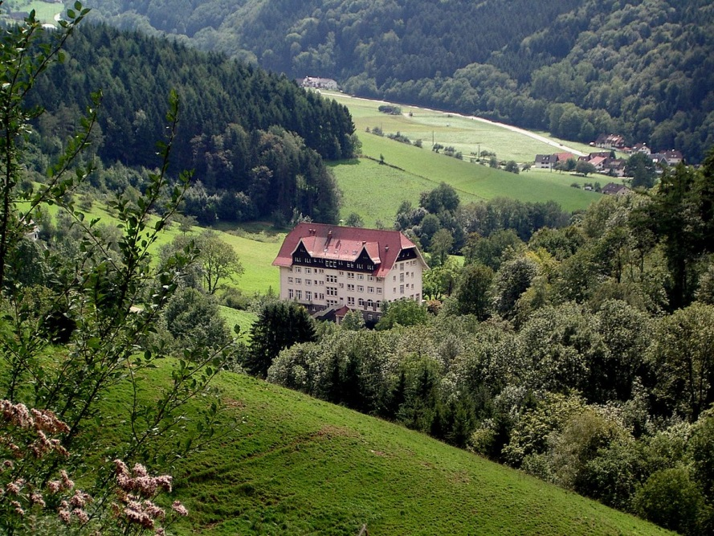
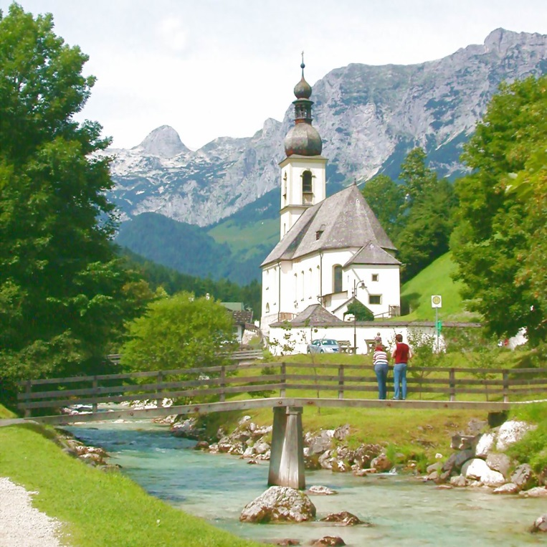
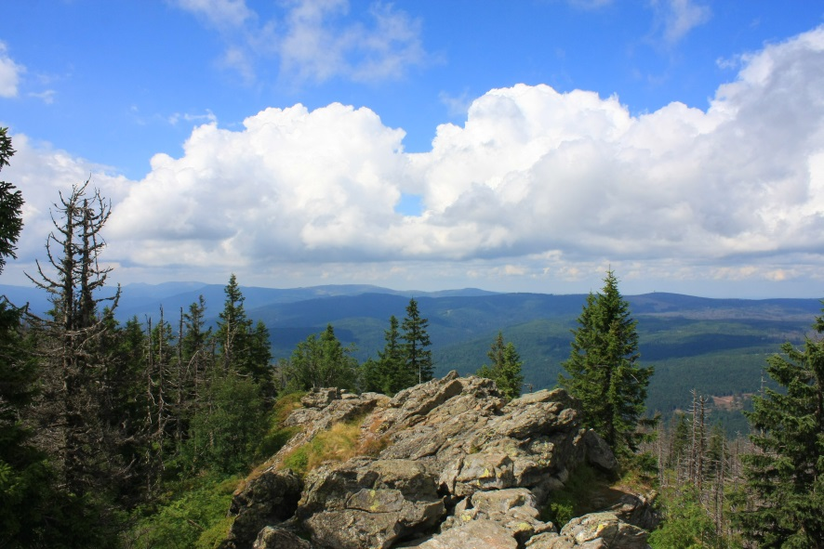
Origin and Marketing location
Bavarian Forest & Black Forest
Since 19th Century

Slide 4
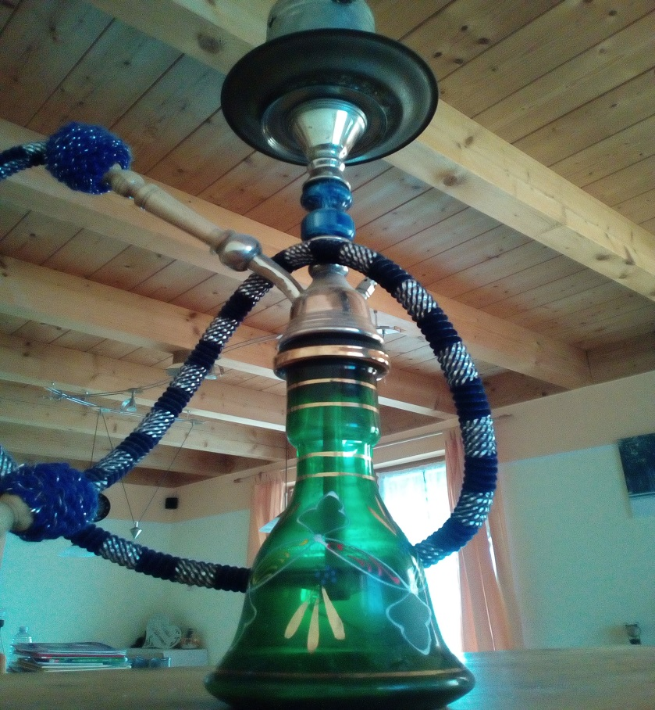
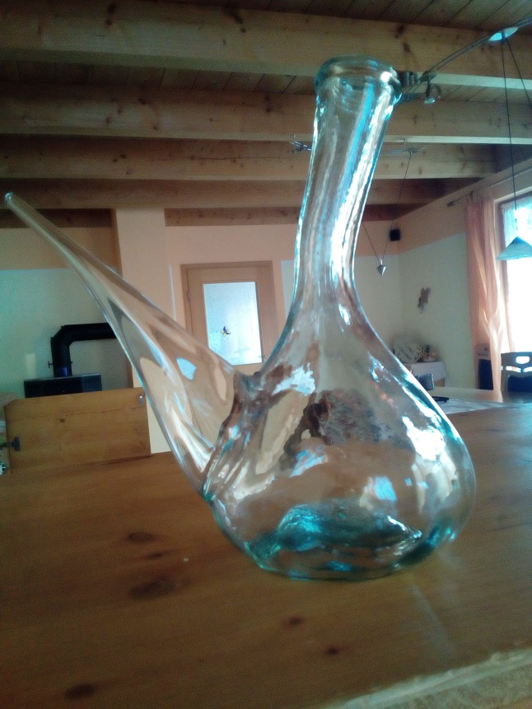
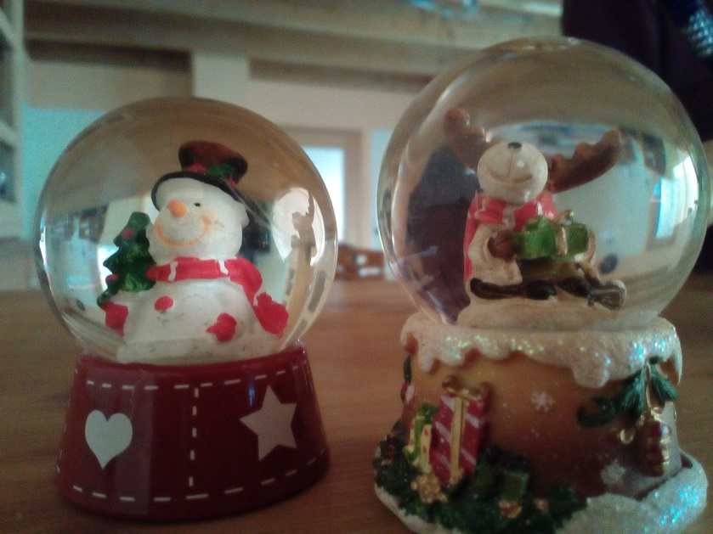
What is made of Glass?
windows
decoration
sculptures
cups
trophies
pens
crockerie

Slide 5
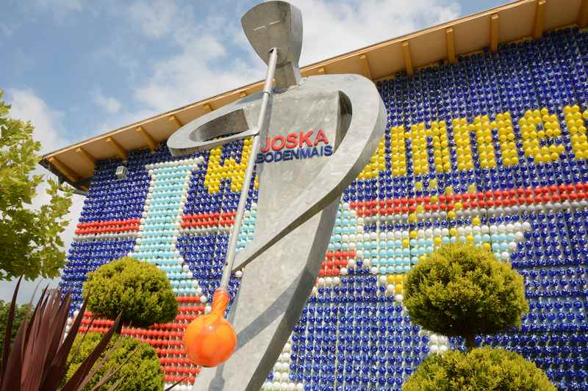
How is the glass blown?
Glass needs to be heated up until it has the right
temperature and texture
then you blow through a glassblowing whistle into the space in the little glass bulb and turn it constantly while blowing
In between it needs to be heated up again and that will be continued until the glass has the form that is wanted
It is decorated with differently colored pieces of glass that are put on the slightly molten glass
Then the decoration glass gets molten on the finished glass figure so that it can be embellished
https://www.youtube.com/watch?v=TxVQQnj-VOI

Slide 6
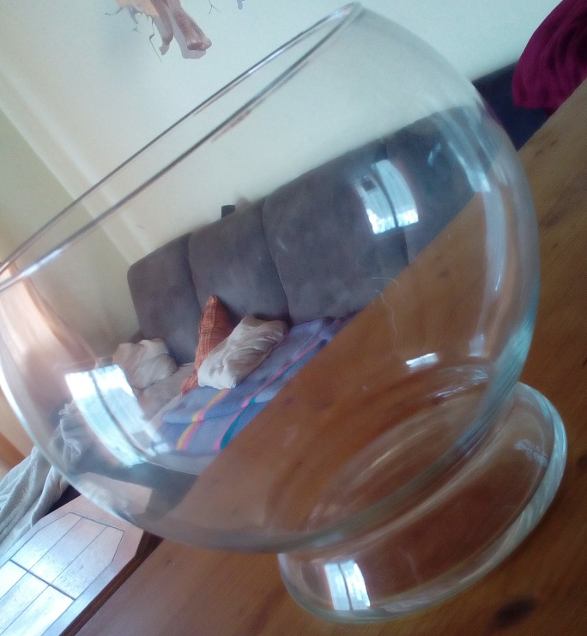
Things blown out of glass
shishas
decoration
cups
snow globes
vases
sculptures
trophies
chemical instruments like: test tubes

Slide 7
ressources
https://www.bayerischer-wald-ferien.de/glashuetten-niederbayern-glasblaesereien-oberpfalz.html
https://www.joska.com/glasparadies/
https://www.sehenswertes-bayern.de/glashuette-bayerischer-wald-glasblaeserei.html
https://www.bayerischer-wald.de/Urlaubsthemen/Kultur-Kulinarik/Glaskunst/Glashuetten
https://www.zeit.de/karriere/beruf/2011-03/beruf-glasblaeser
https://www.youtube.com/watch?v=TxVQQnj-VOI
informationfolder from Joska

