Slide 1
PRIMARY SCHOOL DOBROVO

Slide 2
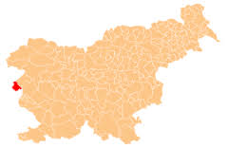
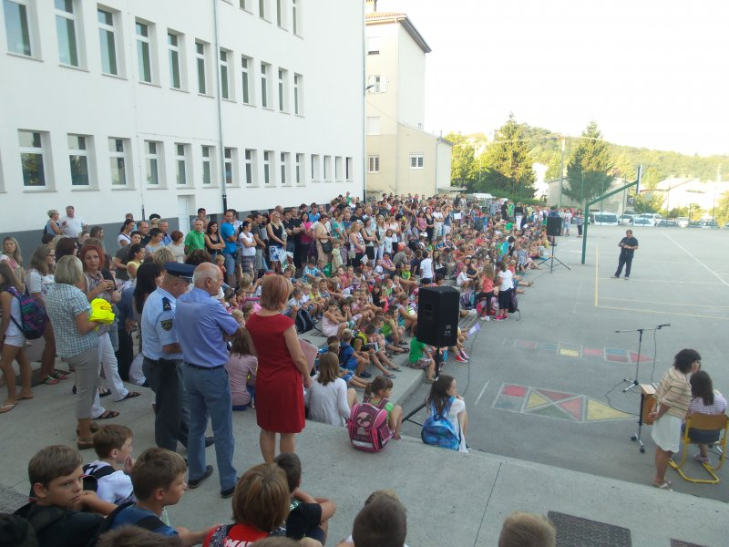
ABOUT OUR SCHOOL
It is in West Slovenia in Goriška Brda.
There are about 400 students in our school.
Our principal is Mrs Vesna Filej.
We have 9 grades and students are from 6 to 15 years old.
We have different teachers for different subjects.
We have about 6 periods per day, which are 45 minutes long.
There is a 5-minute break in between lessons and once per day we have a 20-minute long break for snack.

Slide 3
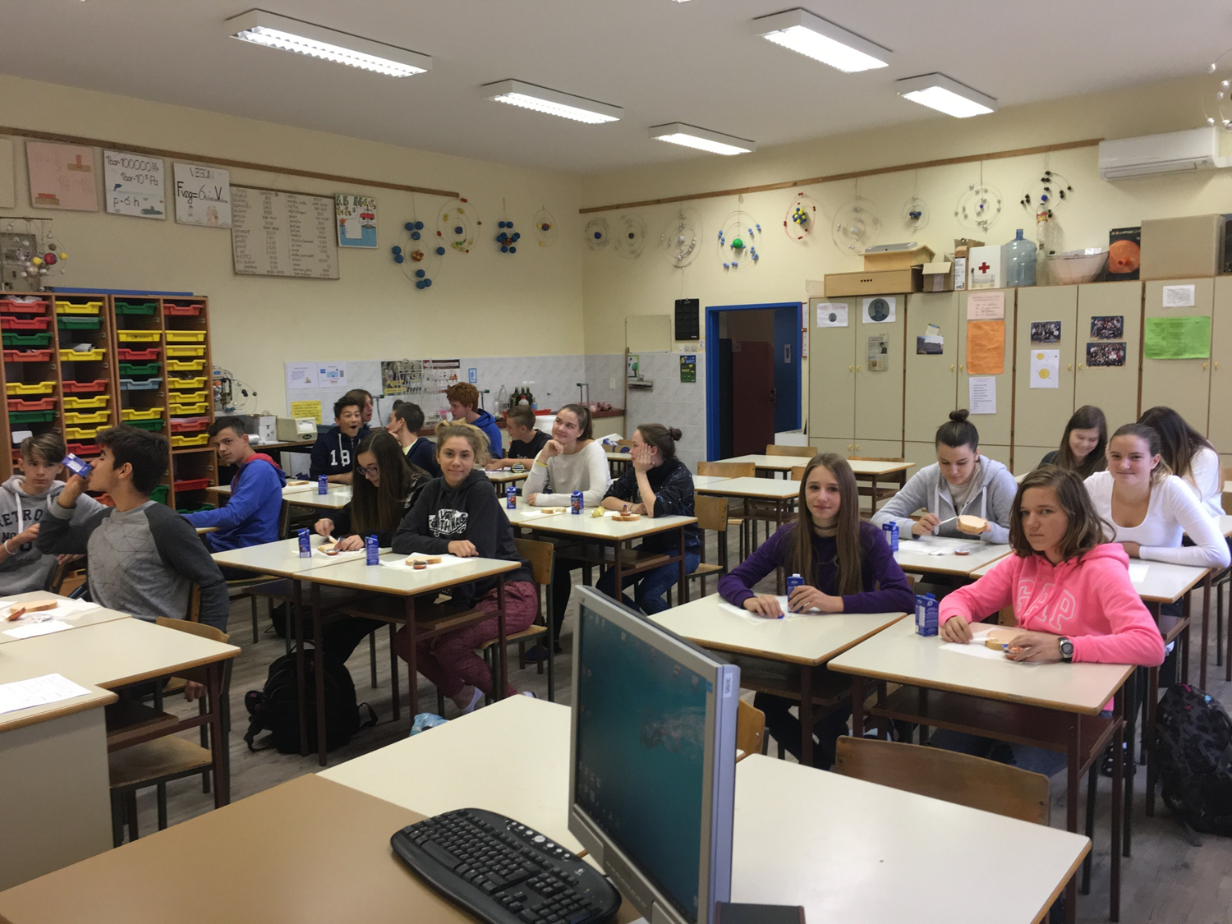
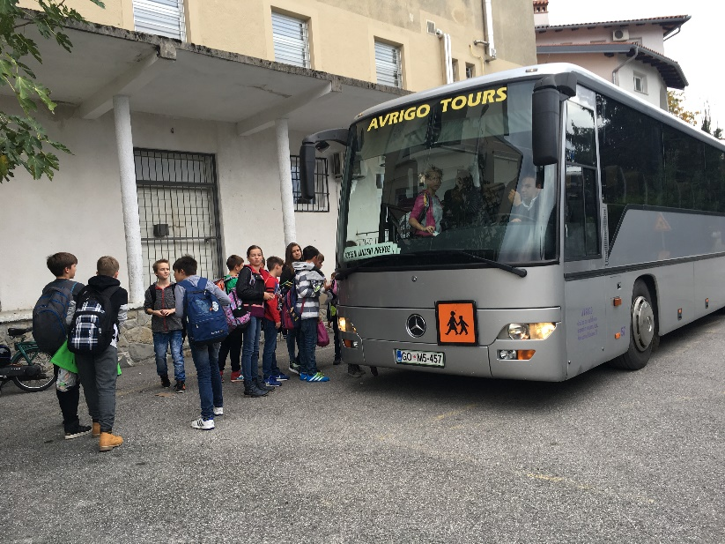
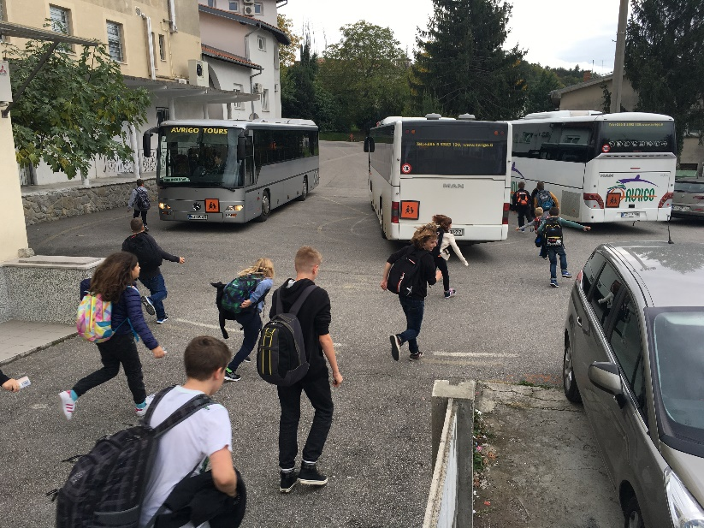
OUR DAY IN SCHOOL
Classes start at 8.05 AM and after the first two periods, we have a snack break.
We have another 2 – 4 periods and then we have a cooked lunch in our canteen.
We usually catch our buses at 1.45 PM .
Some students have extra classes after 1.40 PM

Slide 4
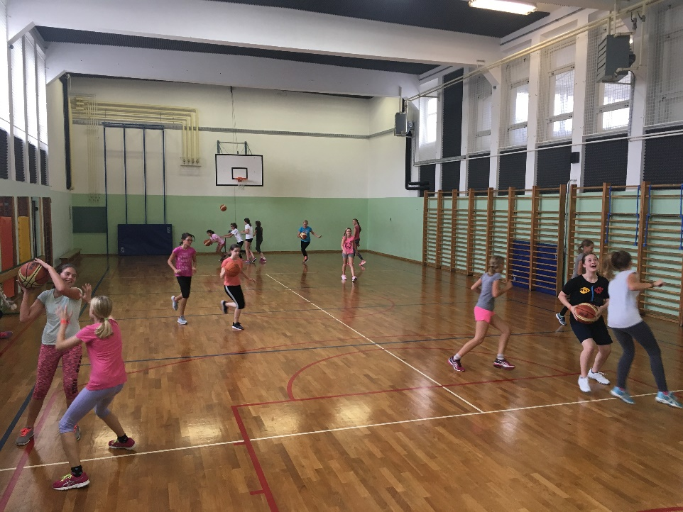
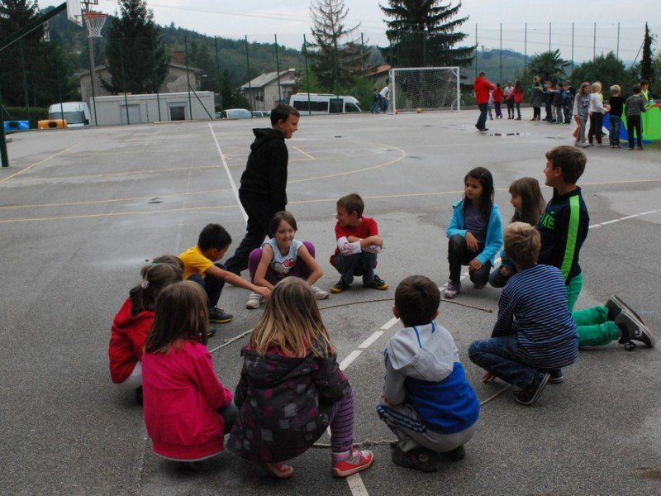
GYM
We have our PE class twice a week.
Our school has 2 small gyms and 2 playgrounds, where we can play football, basketball and dodgeball.

Slide 5
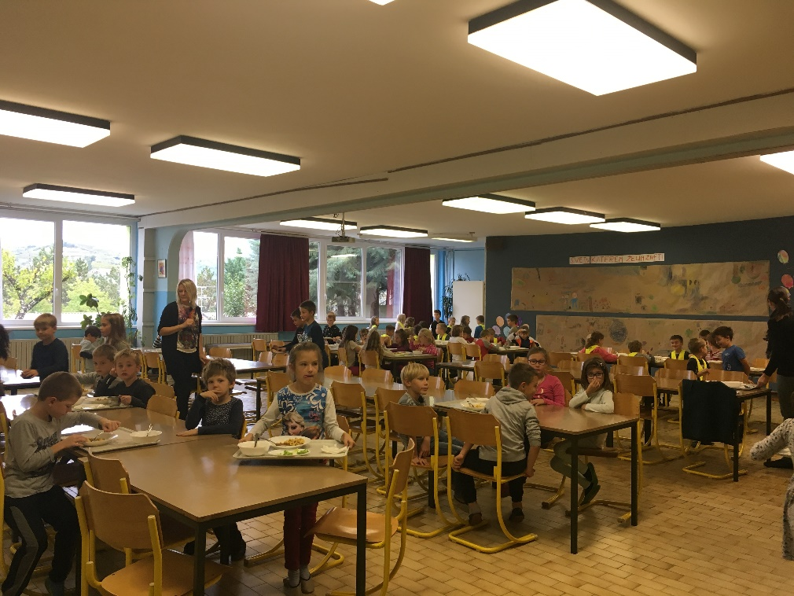
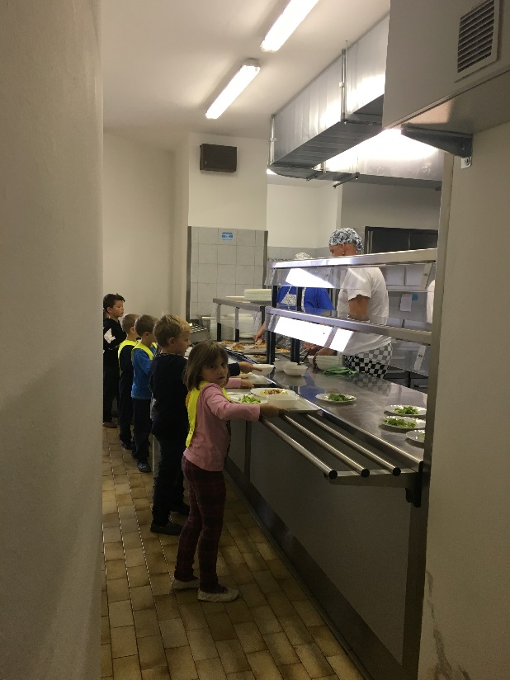
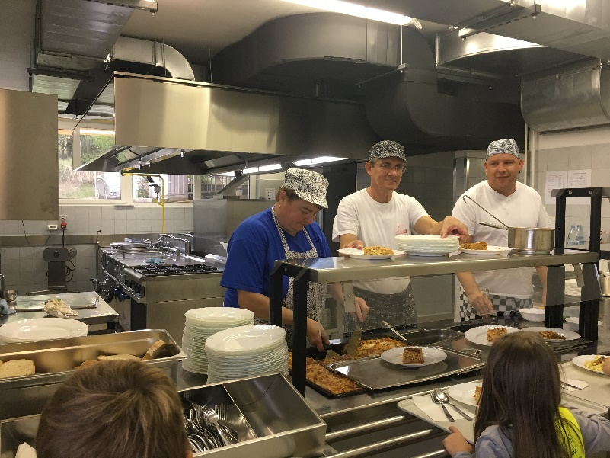
CANTEEN
We eat a snack and cooked lunch in our school.
We have a canteen, where our cooks cook for us.

Slide 6
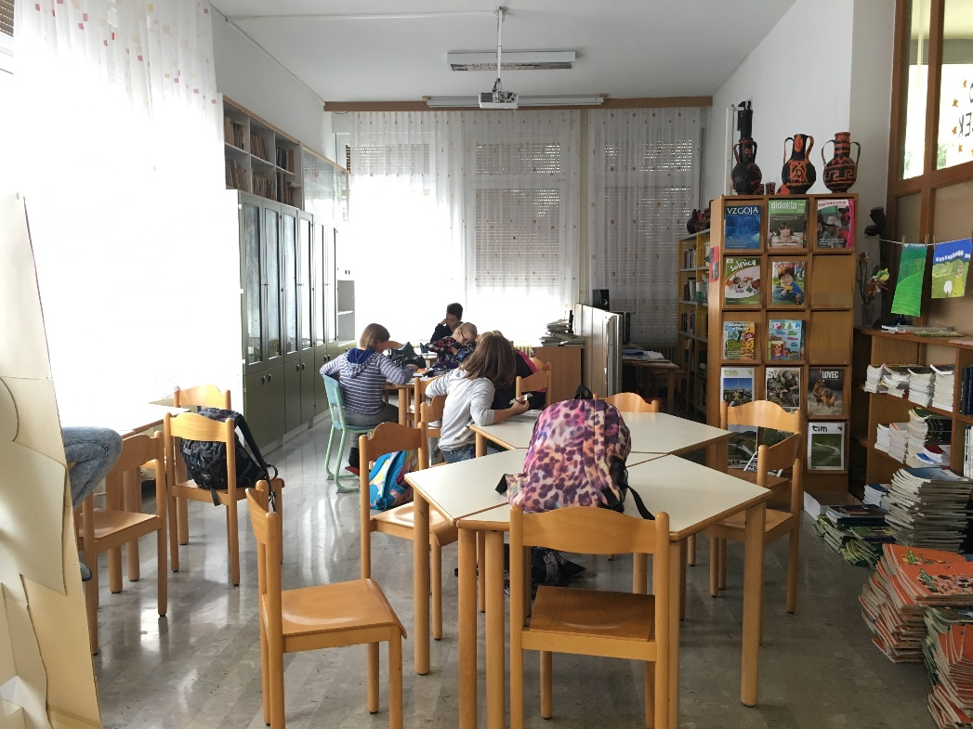
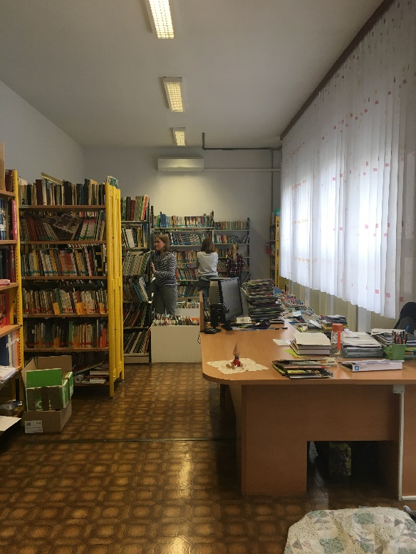
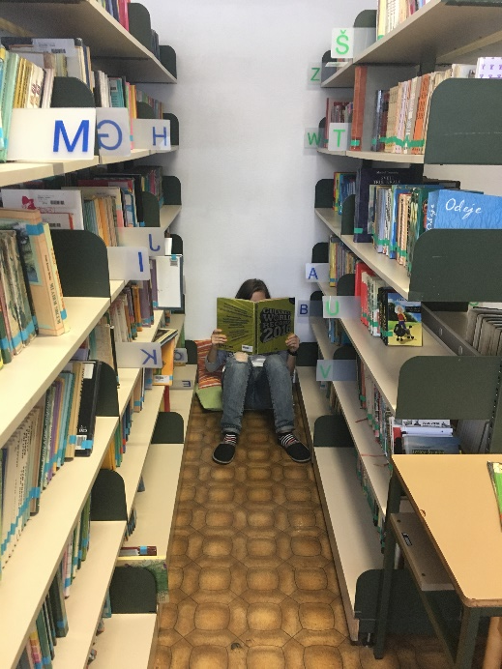
LIBRARY
We can borrow books in our library.
We have a reading room where we can read, study and do our homework.

Slide 7
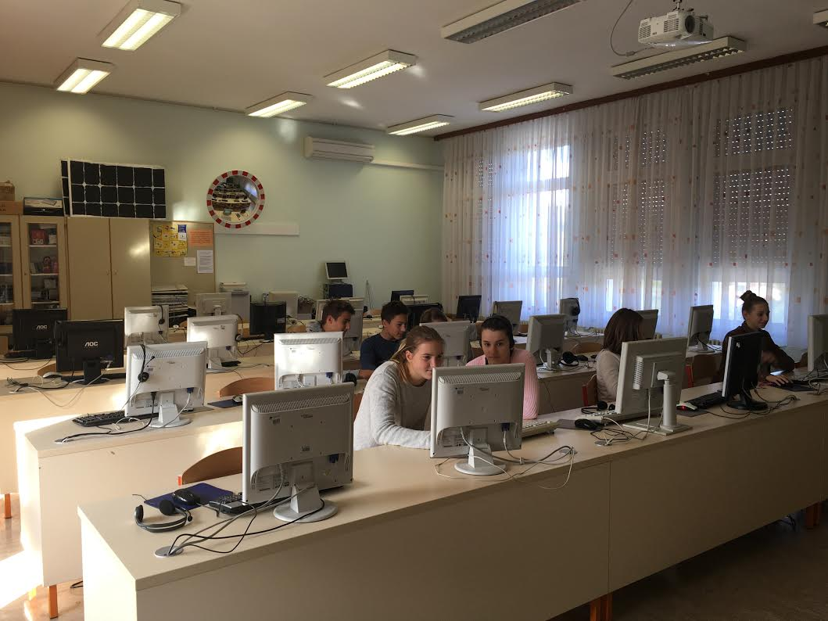
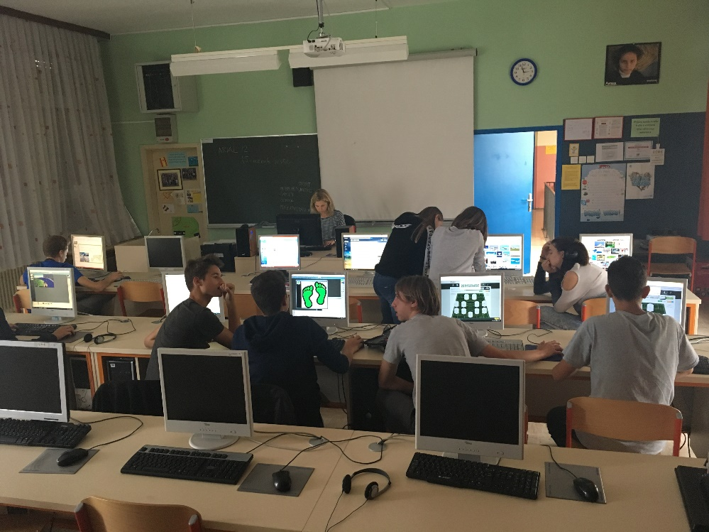
COMPUTER ROOM
We have 28 computers in our IT classroom.
We have also IT lessons for students who want to learn more about computers.

Slide 8
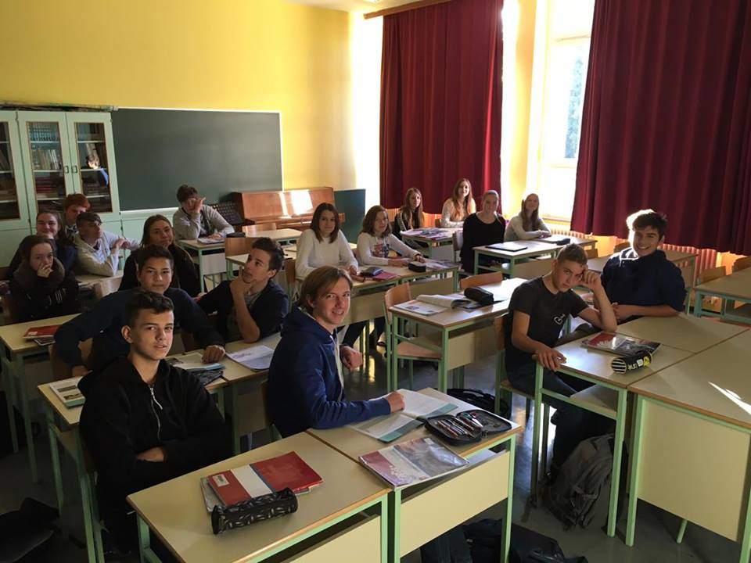
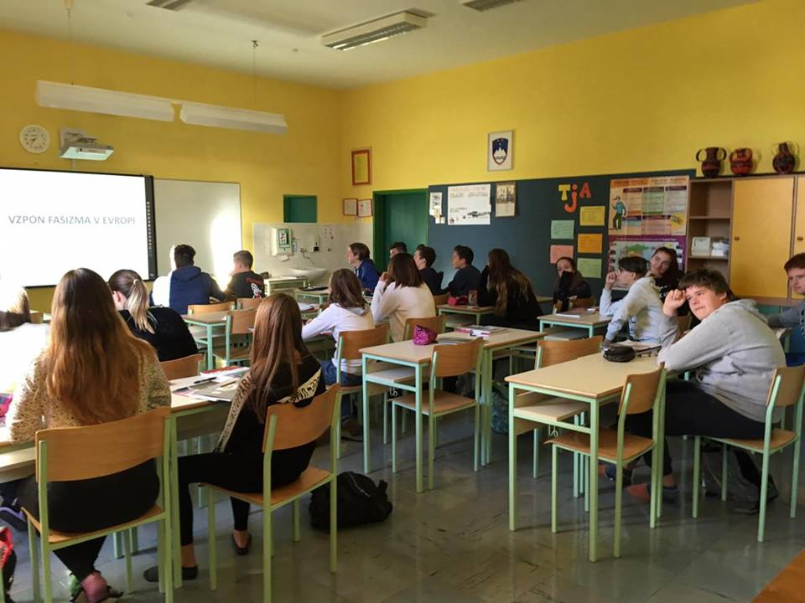
CLASSROOM
We have 19 classrooms in our school. Some belong to1st – 5th graders and all the others are for the students from gades 6 – 9 and each one of them is for a different subject.

Slide 9
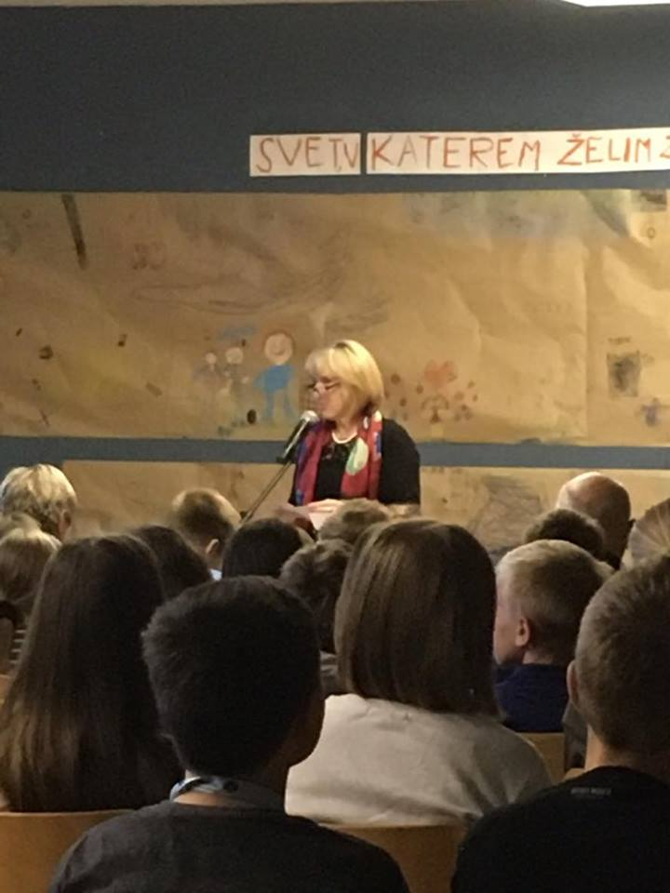
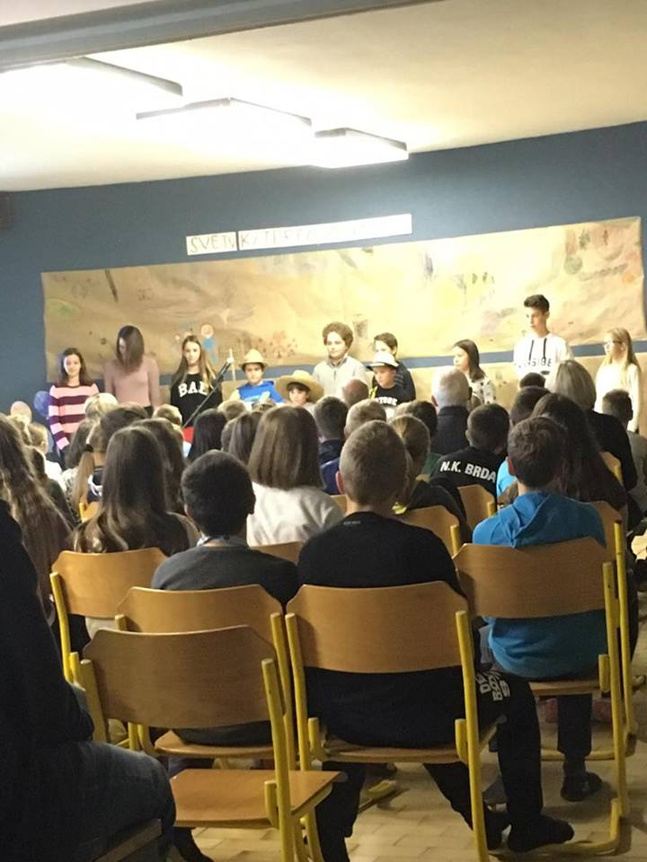
MARKING CELEBRATIONS
In our school, we have celebrations for different holidays.
Our school chorus usually sings and students recite some poems.

Slide 10
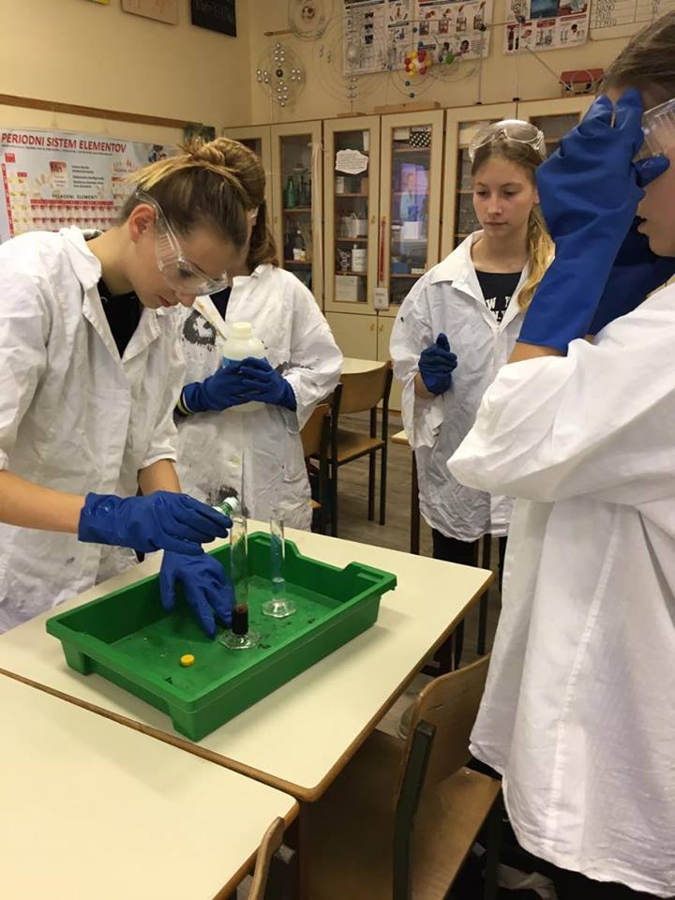
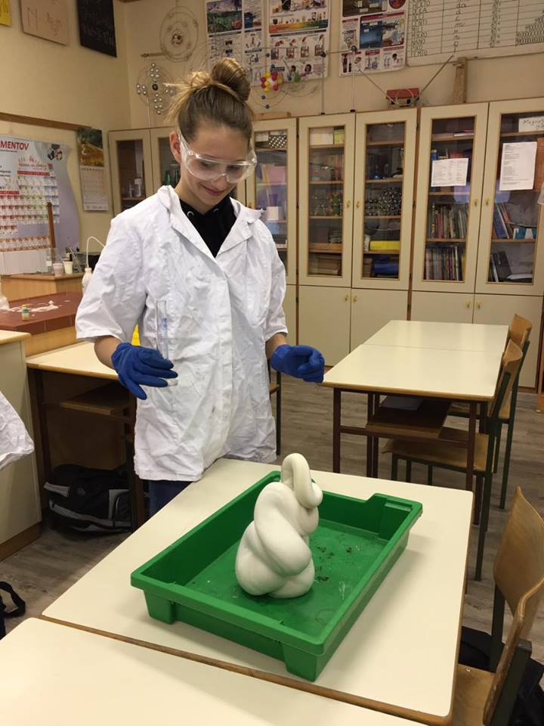
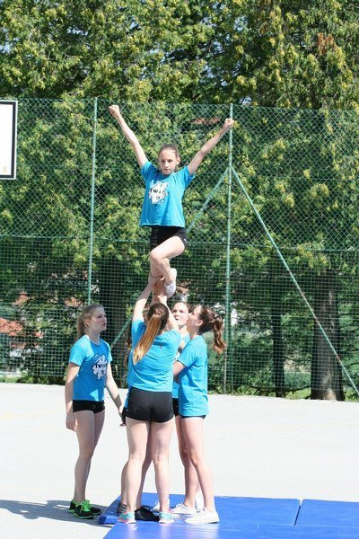
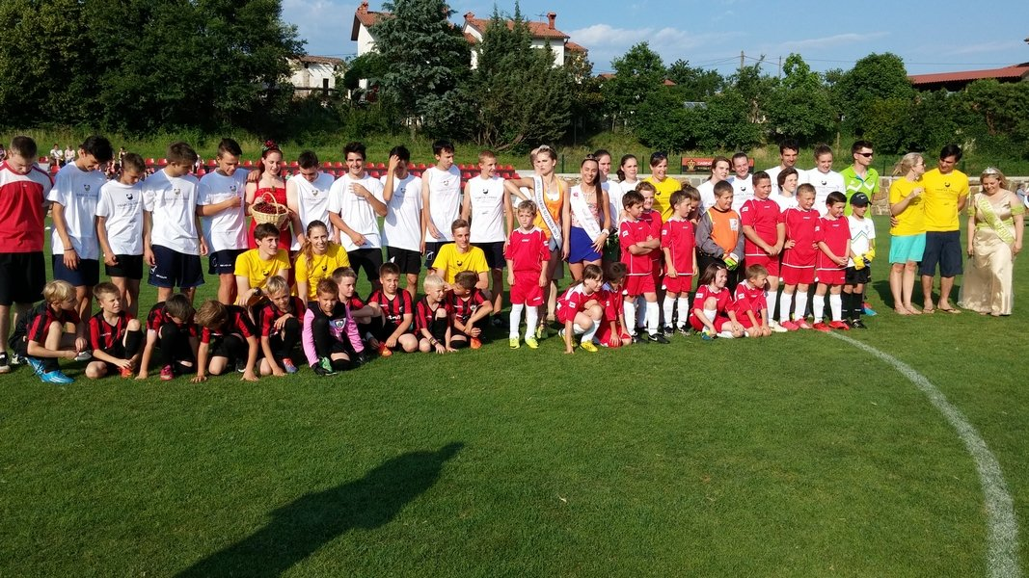
ACTIVITIES AT SCHOOL
In our school, we have different sports activities such us volleyball, football, dodgeball, dancing and cheerleading.
We have also different science clubs such as the chemistry club.

Slide 11
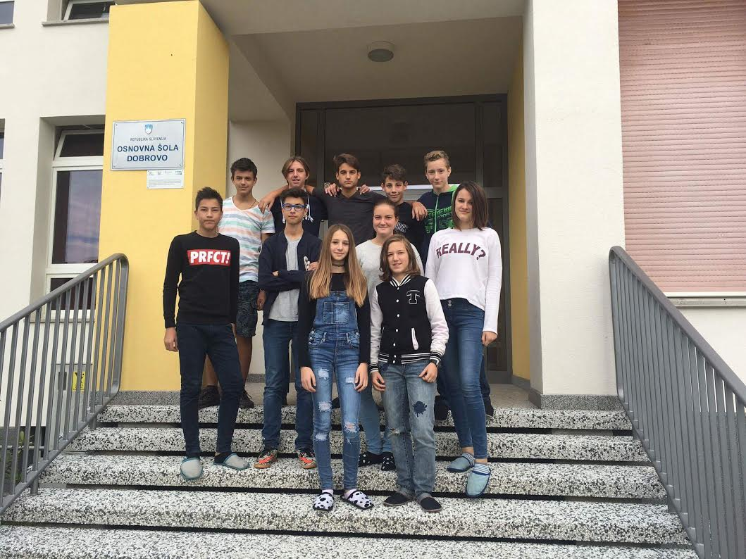
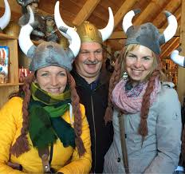
eTWINNING IN OUR SCHOOL
In our generation, there are 37 students and 11 of us are in the eTwinning project.
Our mentors are Mrs Tanja Slapernik Tominec, Mrs Tamara Klanjšček and Mr Damijan Marinič

