Slide 1
Our school „Mica Stojkovic“

Slide 2
Histori of our school
The first primary school was founded in Umcari 1864. In addition to children from Umcari there were classes by children from Pudarci and Kamendol. In the period 1903 to 1908. a new school was built , and it was made of hard materials. The building was built in the Swiss style according to the plan of the Ministry of Education.

Slide 3
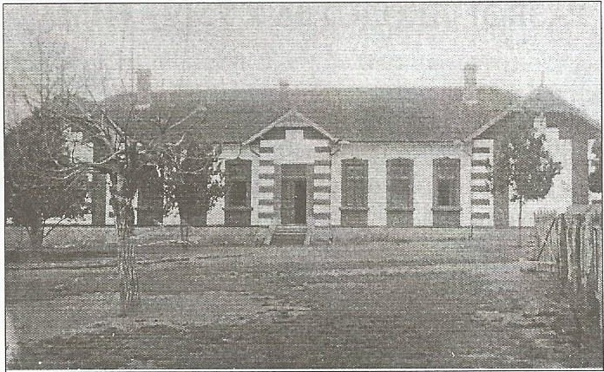

Slide 4
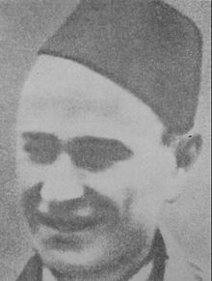
It is named after the national hero Mića Stojković, who died in 1943

Slide 5
Our school today Elementary school ”Mica Stojkovic” now has about 480 students. It consists of 4 regional schools and the central in Umcari.

Slide 6
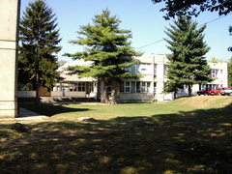

Slide 7
In our school organized a number of sections, events, celebrations and visits of writers, actors.

Slide 8
My name is Ivana Ivković, and I am 13.

