Slide 1
1. Our school

Slide 3
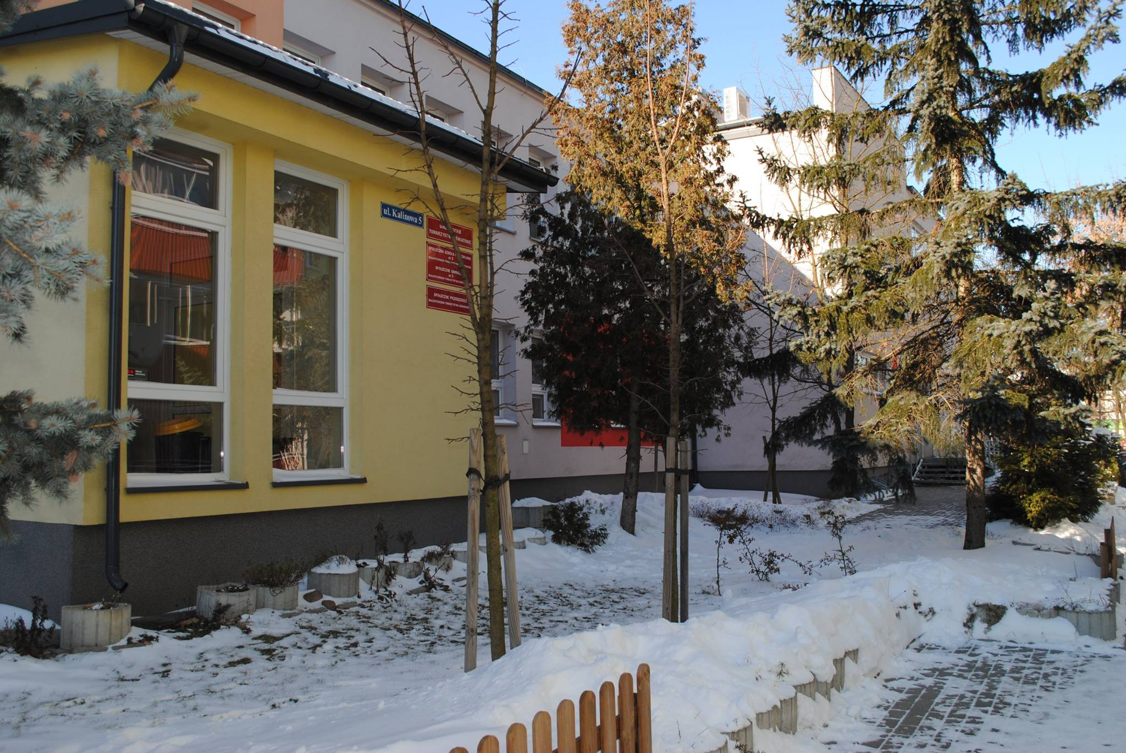
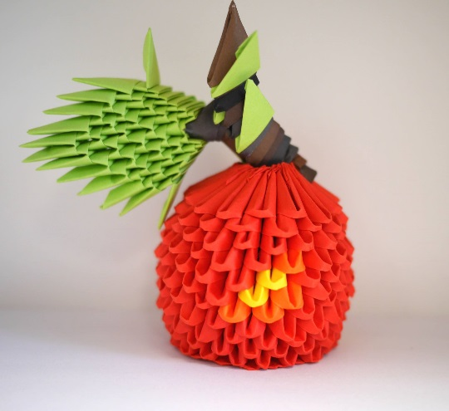
Zespół Szkół Społecznych nr 3 BTO is a school complex (kindergarten, primary and middle school) located at 5 Kalinowa Street.
The school employs 43 teachers

Slide 4
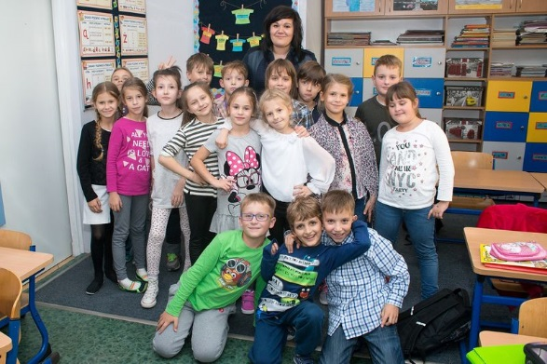
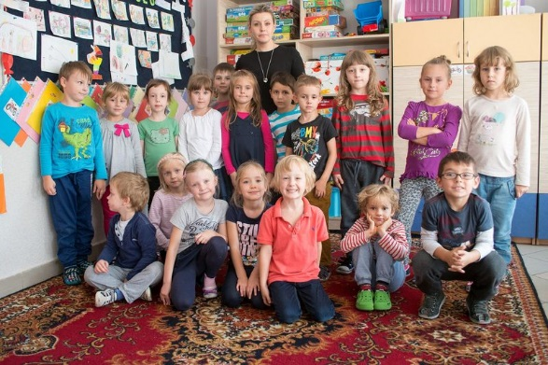
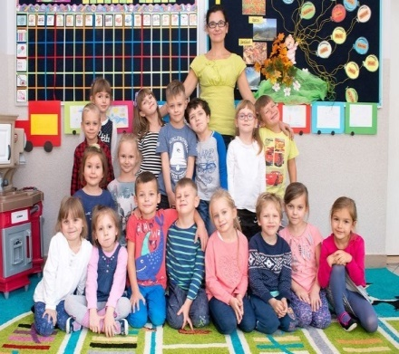
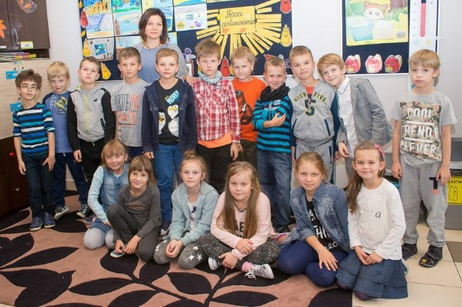
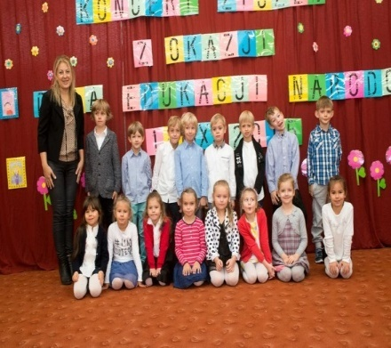
Our students 340 students are taught in 19 classes (1 kindergarten, 12 primary classes, 6 middle school classes)

Slide 5
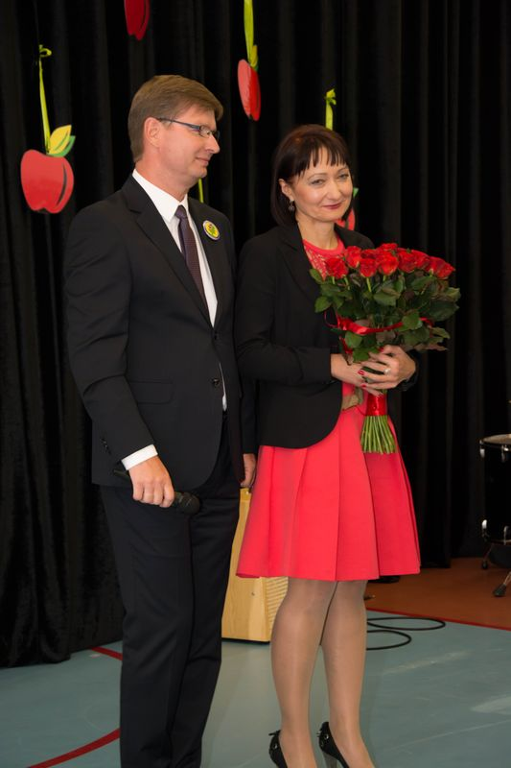
BTO (Białystok Educational Sociaty) - the Board, the Audit Committee and the general Assembly- supervises the activities of the school and the work of the Head Teacher. As individual non-public school it is maintained primarily from tuition payments made by parents and subsidies from the state budget.

Slide 6
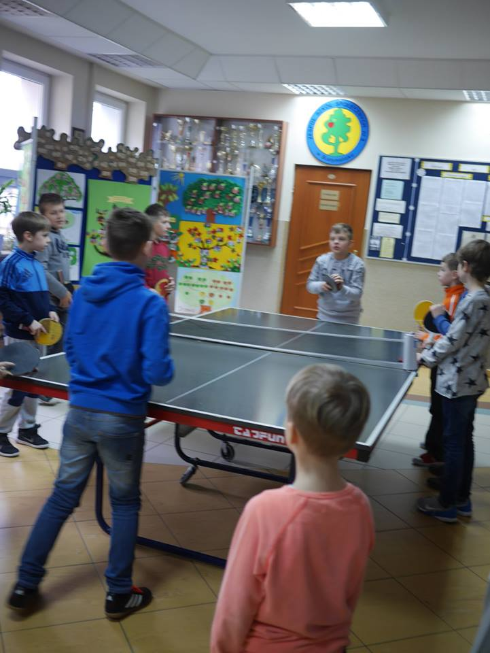
Typical Day The lessons start at 8 am. One lesson takes 45 minutes. The breaks between the lessons last from 5 to 15 minutes. The 15 minutes breaks are called "the snack break" and "the lunch break". In the grades 1-3 there is one teacher that teaches all the subjects except for English and Religious Education. Since the 4th grade each lesson is dedicated to a different subject and each subject is taught by a different teacher. The classes usually end at around 1 pm and students start their additional activities or go to the day care club. The day care club runs from 7.00 am to 5 pm.

Slide 7
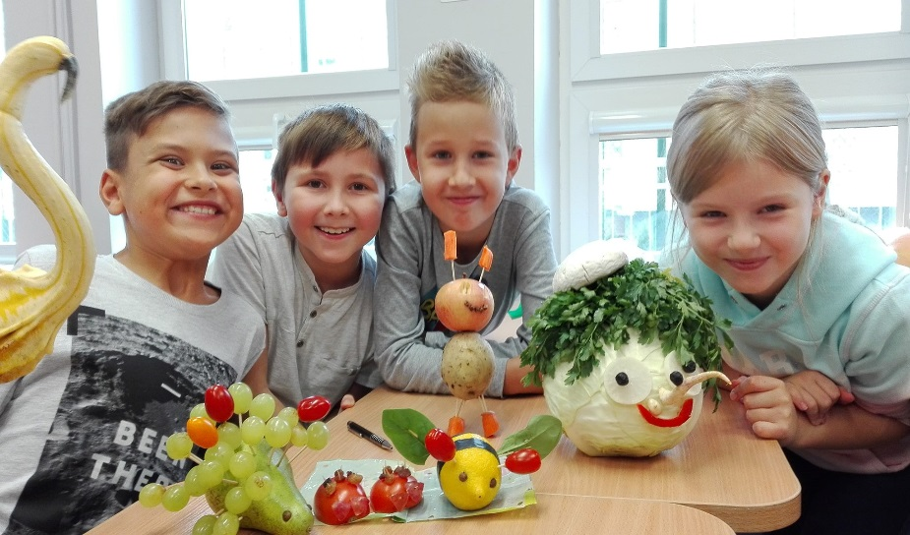
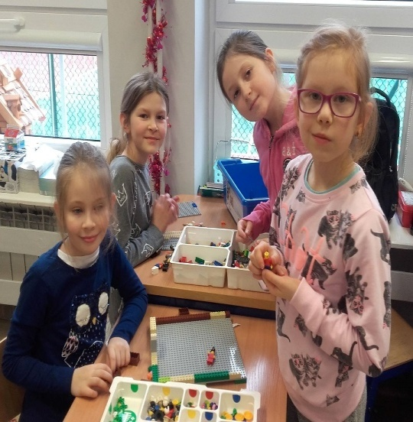
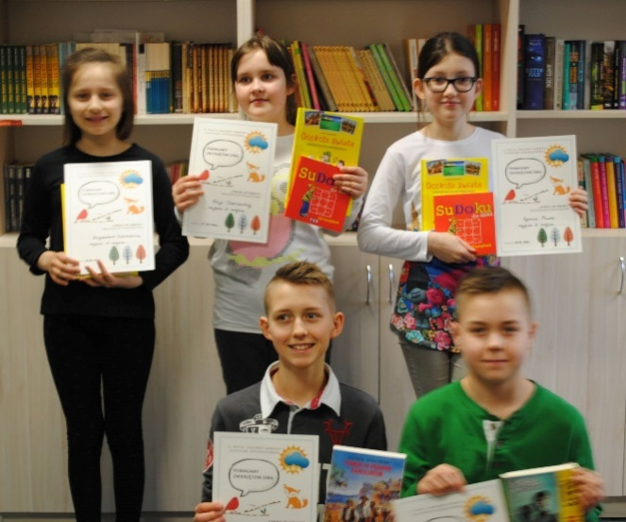
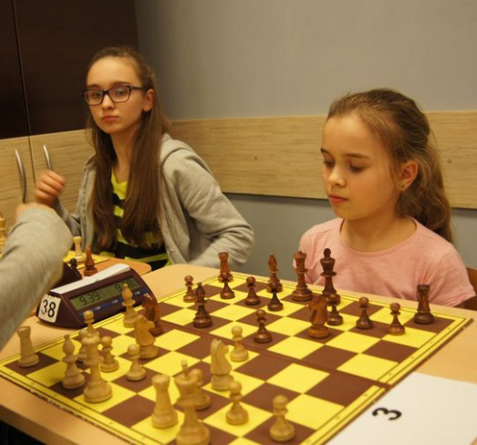
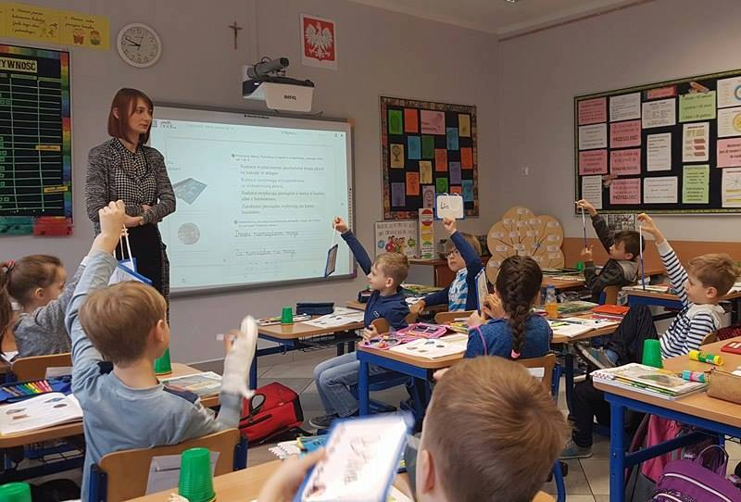
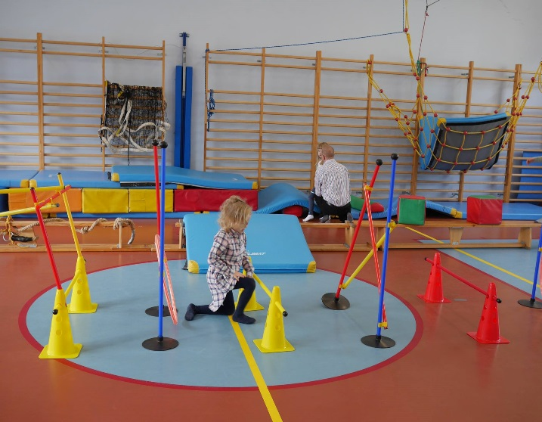
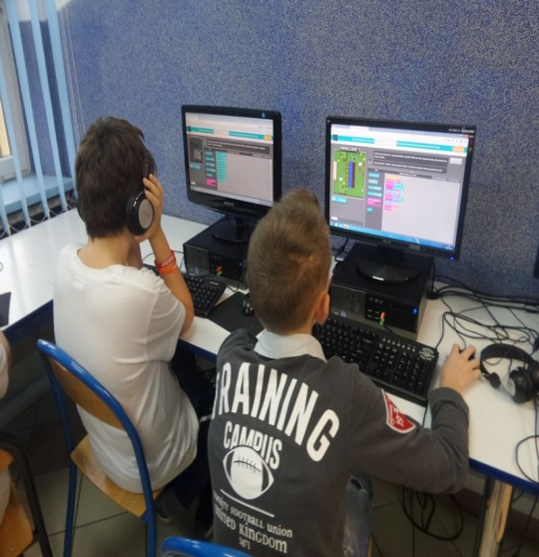
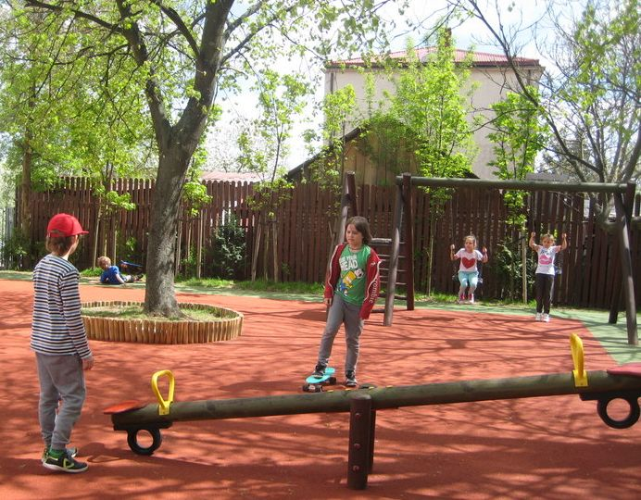
A modern computer lab, classrooms equipped with interactive boards, a Lego room, a library, a modern gym and a canteen are available to students and teachers. On warm, sunny days students play in the sports field and a playground.

Slide 8
2. Working with Lego „Snow White and Seven Dwarfs”- story building
Age group: 11 years

Slide 9
During the lesson students are asked to do brainstorming to the story entitled „Snow White and Seven Dwarfs”

Slide 10
They share their ideas about the vocabulary, objects and characters conected with that fairy tale. After a few minutes of description, the teacher plays the CD with the fairy tale.

Slide 11
Students listen to it, but in the middle of the listening, it is suddenly stopped. Students are given the task to think about diffrent endings of the story.

Slide 12
They worked in group of four. They are given 15 minutes.

Slide 13
After that time each group shows their results, they present them. It always makes them happy.

Slide 17
Best of the lesson:
Group work
Sharing information
Finding diffrent ways of finishing the story
You can learn more about a child in an hour of play, than through the lesson
Children are more free and more flexible to talk in English with the use of Lego

Slide 18
3. Working with Playmobil

Slide 19
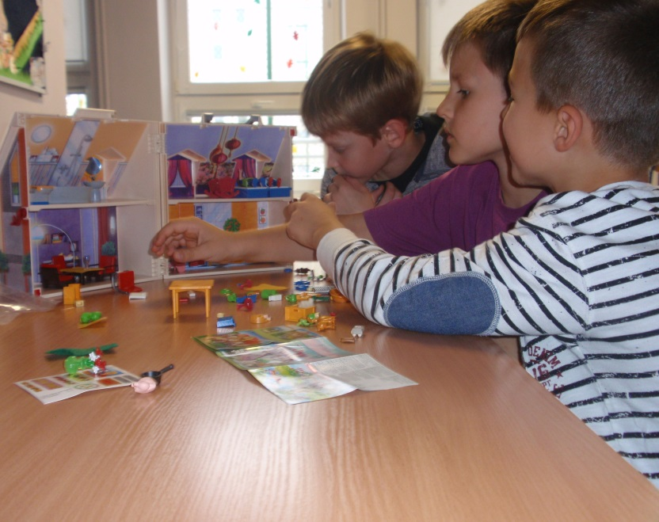
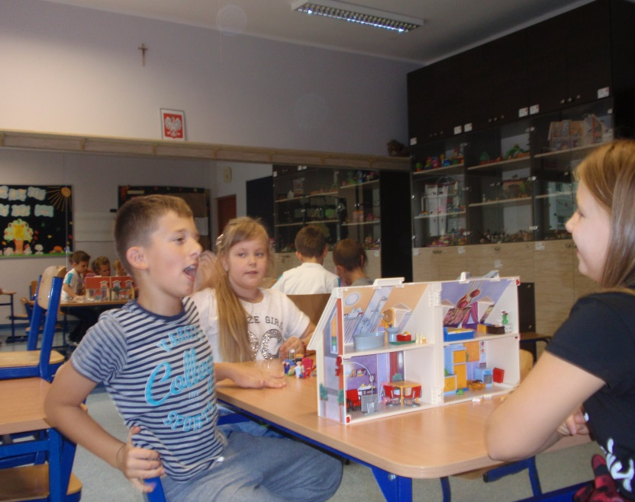
Topic : Rooms in the House
Age group: 8-9 years old
Description: Children work in groups of three. They tell each other how to furnish a Playmobil house by making sentences such as: The table goes in the kitchen. Later on one kid in a group should place a toy family figure in the house without the rest seeing it. The children ask questions to find out where the toy figure is, e.g. Is mum in the kitchen?
Best of: The kids especially enjoy the ‘design’ side of the activity.

Slide 20
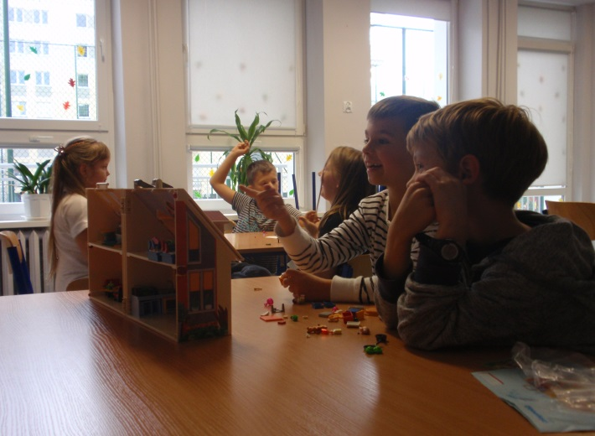
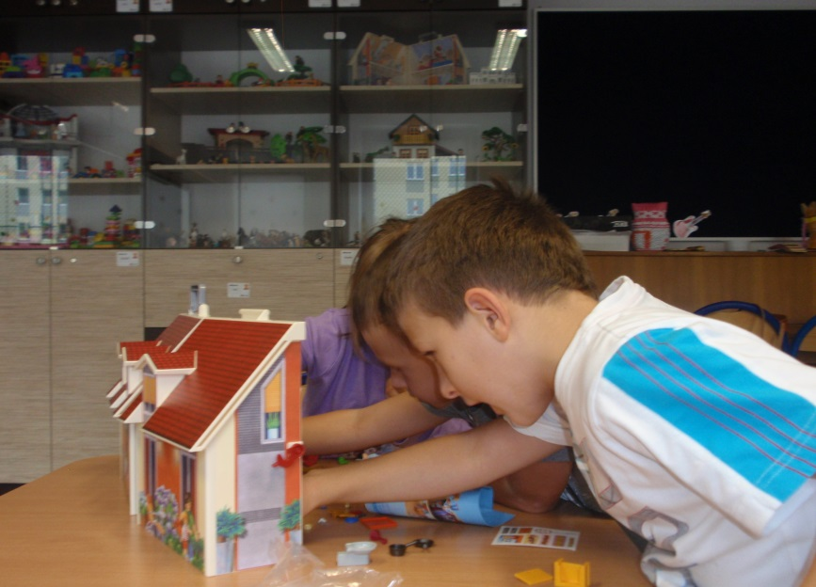
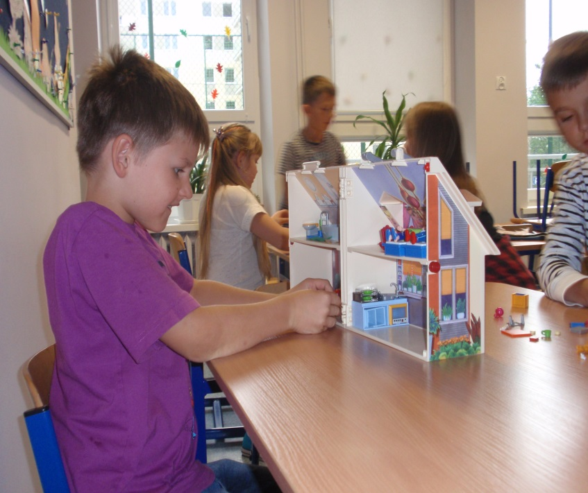

Slide 21
4. Working with Schleich

Slide 22
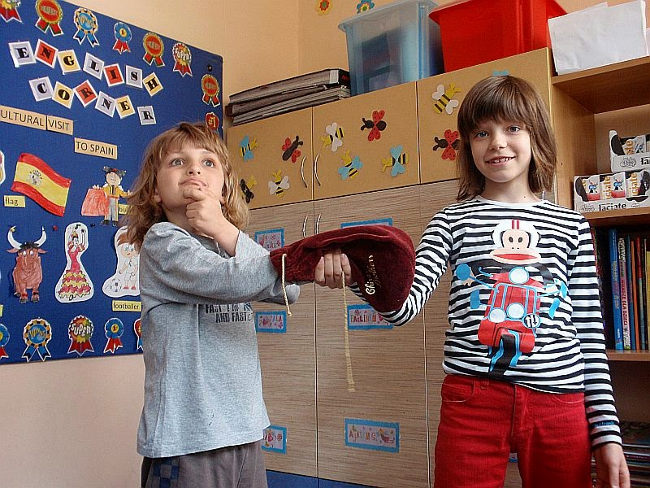
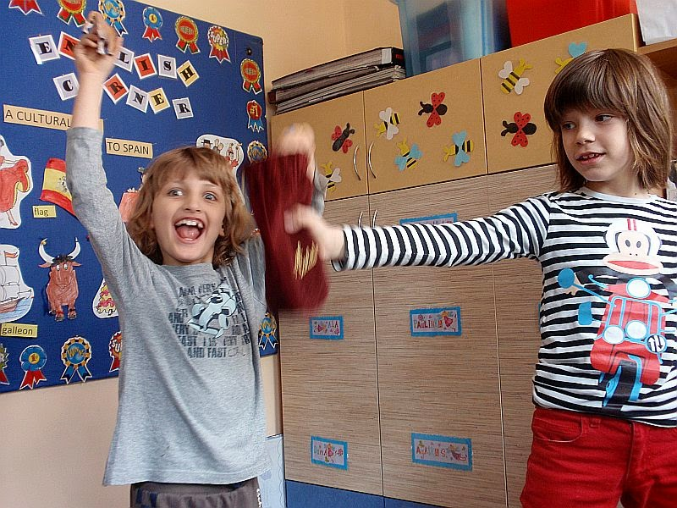
Topic: Traditional games with Schleich animal figures
Age group: 6-8 years old
Description: Put an animal figure in a bag. Children take turns to put their hand in the bag and guess what it is.

Slide 23
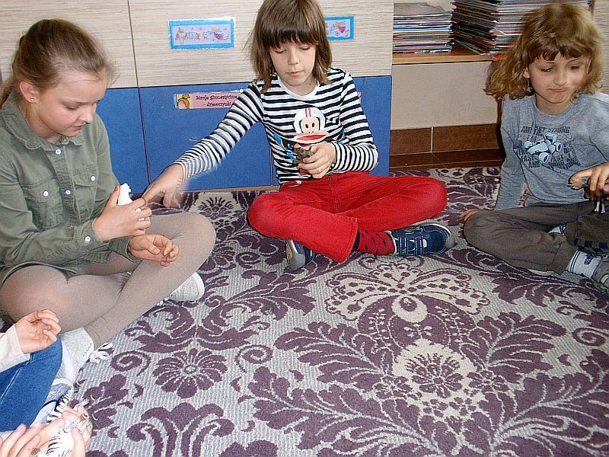
Play any music. Children sit in a circle and pass animal figures round the circle. Pause the music. Children hold their animal up and make a sentence to describe it.

Slide 24
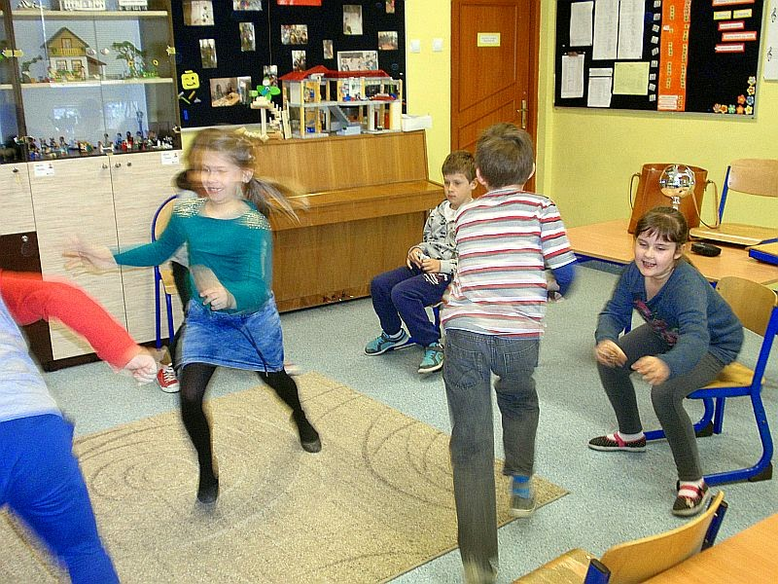
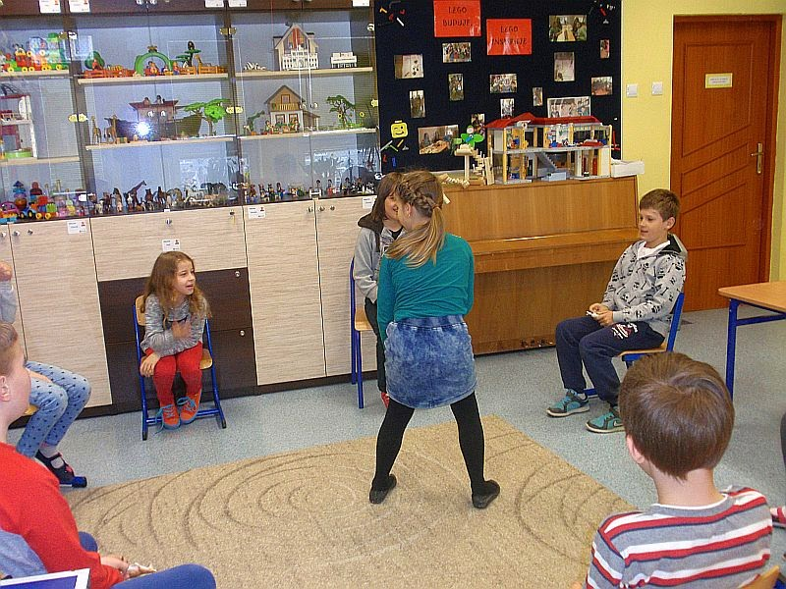
Children sit in the circle of chairs and hold an animal figure (two kids with the same animal) The person without a chair stands in the center. The player in the middle calls out the chosen animal, kids holding that animal must change their place. Meanwhile, the pupil in the middle tries to get a seat.
Best of: The kids like energy, movement and fast pace of the last game.

Slide 25
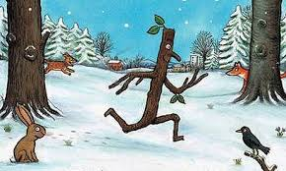
5. Children’s Literature

Slide 26
Literature became an essential part of the project and it involved various activities. Reading was a trigger to develop other skills and engage students into the creative process.
During the project our students read books such as „Stick Man” and „Charlie and the Chocolate Factory”
They participated in Literature Fairs which were huge events for our school community.
Our school was visited by The Bear Educational Theatre which supports English teaching by producing interactive educational theatre performances and workshops for schools.

Slide 27
Our whole school was involved with the project. There are pupils aged 5-16 in the school and they all participated in different activities.
Younger students read „ Stick Man” whereas the older read „Charlie and the Chocolate Factory”
Everybody took part in Literature Fairs and in the show by The Educational Theatre.

Slide 28
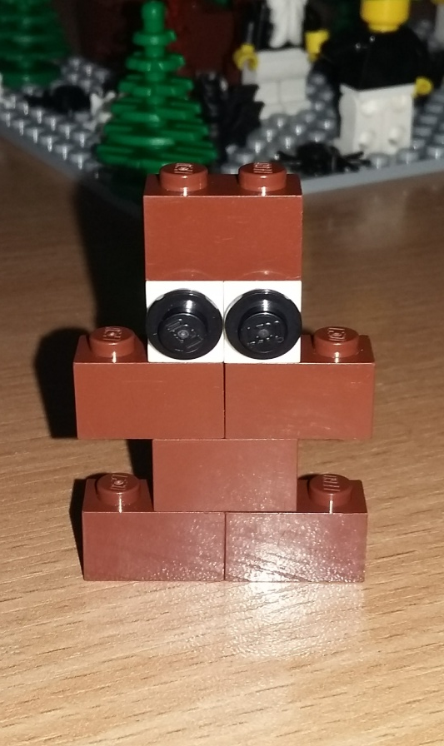
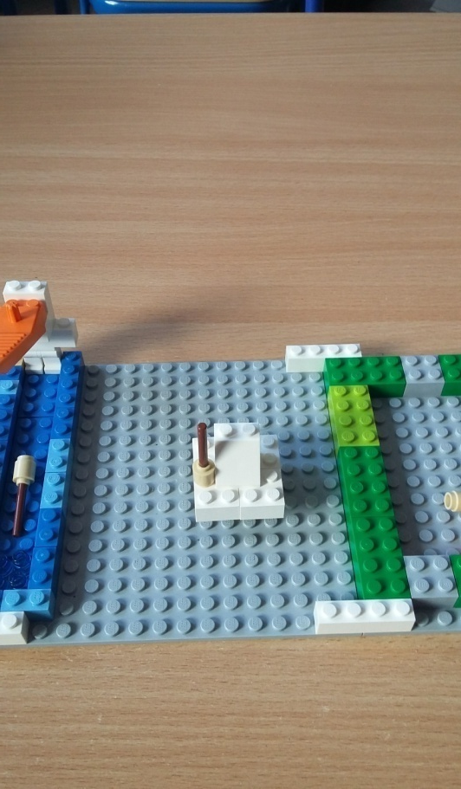
Here are some photos presenting what happened in our school: Stick Man

Slide 29
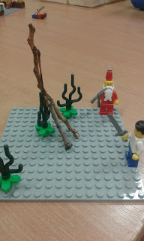
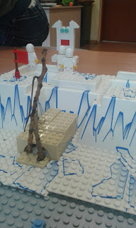
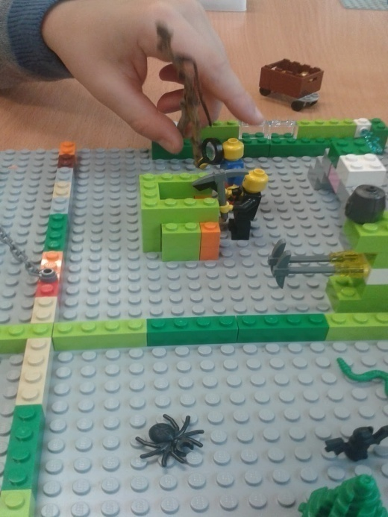
One Stick Man - different stories
One group came up with new parts of the story. Using Lego blocks they presented adventures of Stick Man on the North Pole and in gold mines.

Slide 30
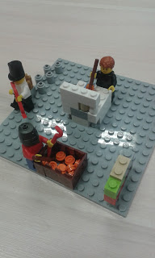
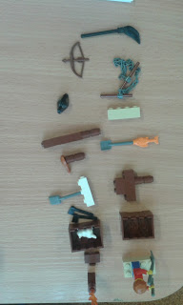
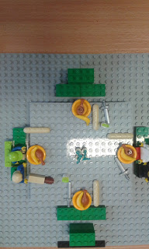
When they read the story they could see that Stick Man was very useful to people and animals. Some kids thought about other ways it could be used, for example as a tennis paddle, lollipop stick, mast, flute, torch, broomstick, toothpick, ski poles and chopsticks.

Slide 31
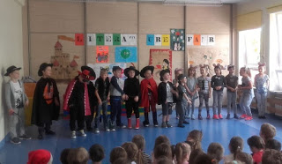
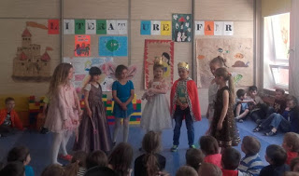
Literature Fairs
Some students prepared guessing games based on popular tales like Pinocchio, Cinderella, Puss in Boots, Snow White, Red Riding Hood, etc. The youngest pupils tried to recognize and guess the tales. The students of the middle school put on a play The Cracow Dragon which was based on a very popular Polish legend. Everybody had fun.

Slide 32
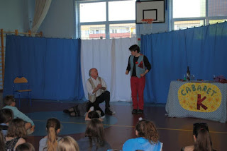
The Bear Educational Theatre

Slide 33
6.The process of making „The Little Prince” play

Slide 34
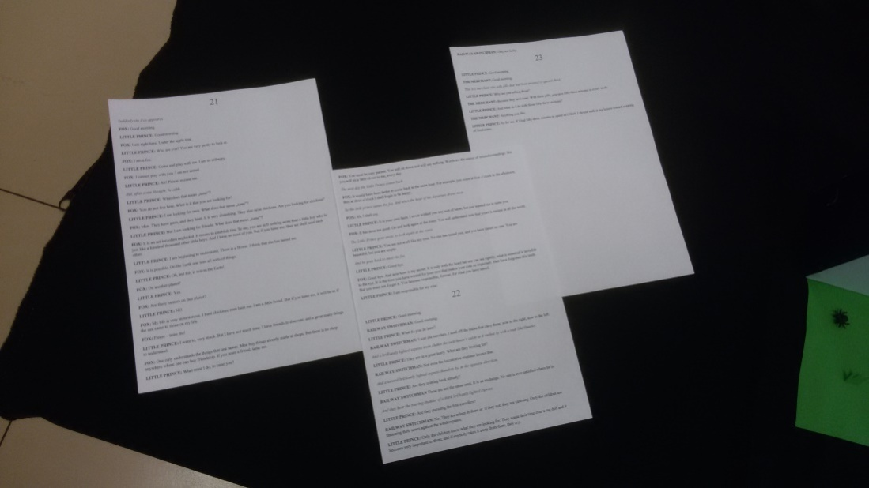
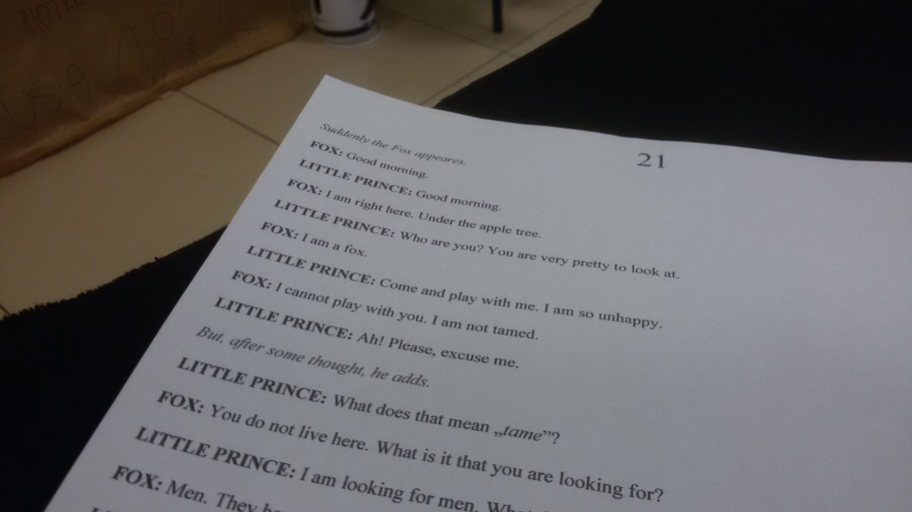
The script
First we prepared the script which was based on the book „The Little Prince”. It took us a few hours but after that, we could finally start learning our lines.

Slide 35
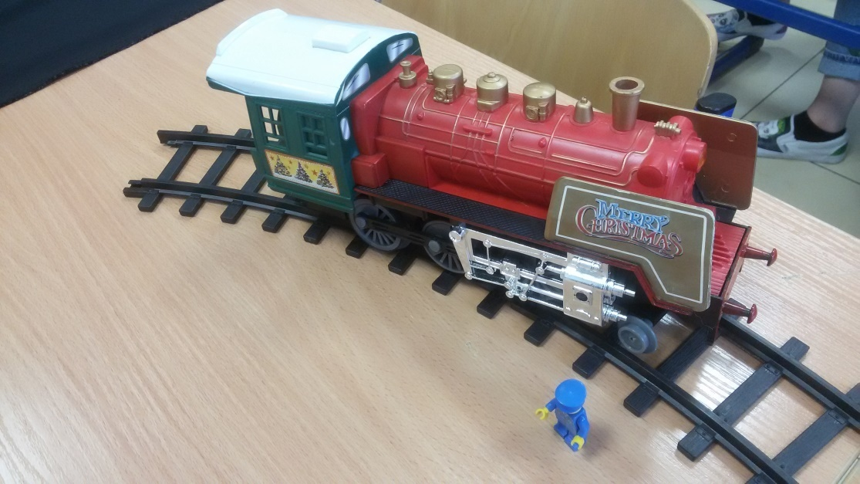
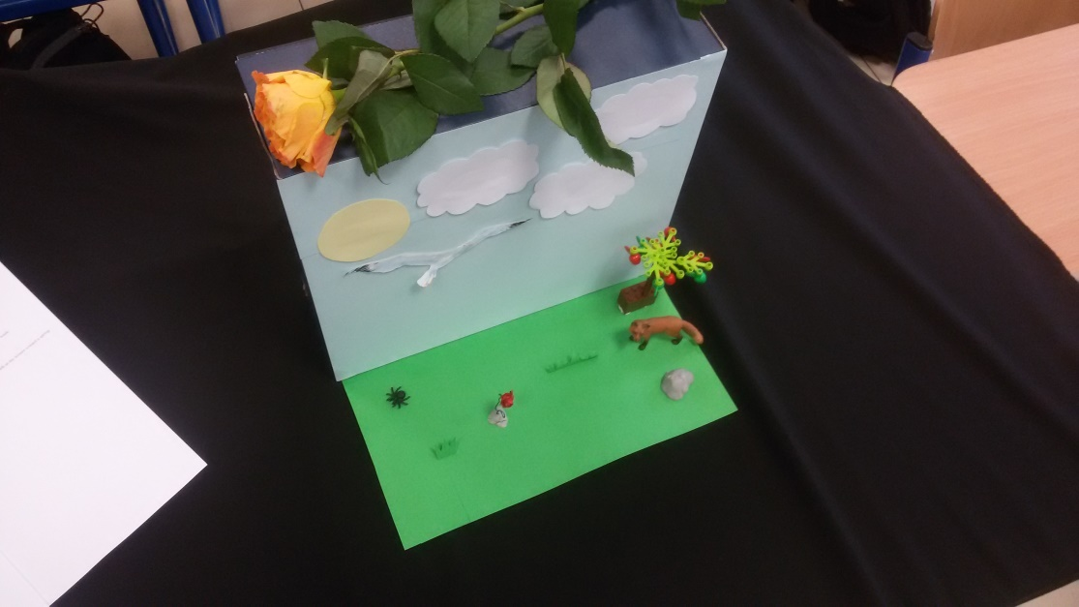
The setting
In the meantime, another group got a task to create the scenery. It involved spending time at home but the scenography turned out looking perfect.

Slide 36
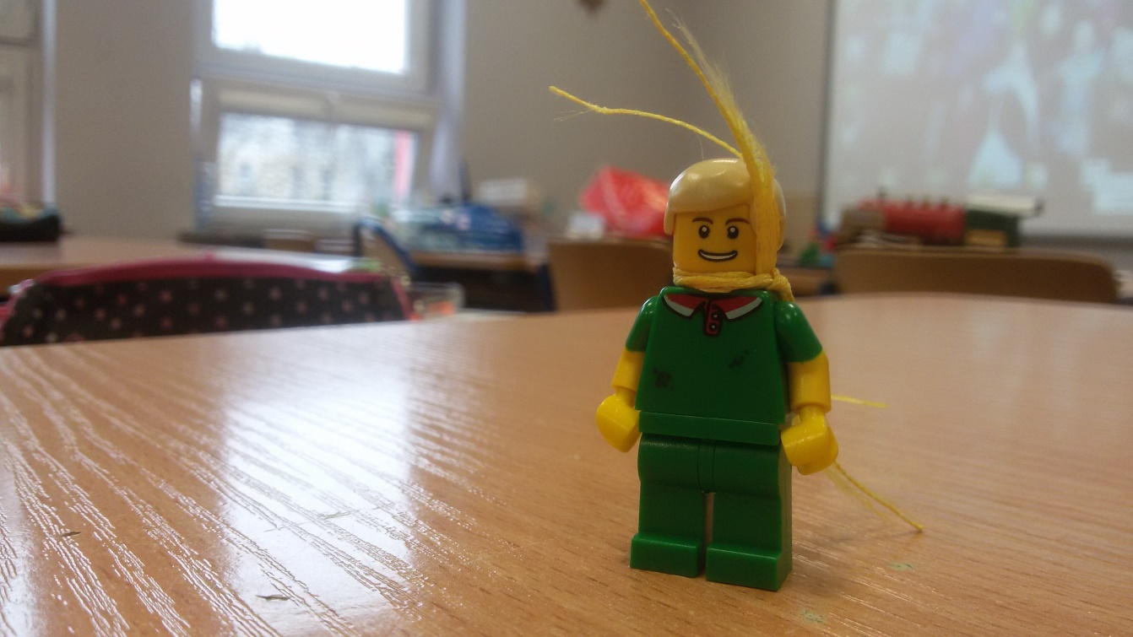
The Little Prince
One of us had to prepared the proper costume for our main character. We used a narrow bookmarker to create the scarf for the Little Prince.

Slide 37
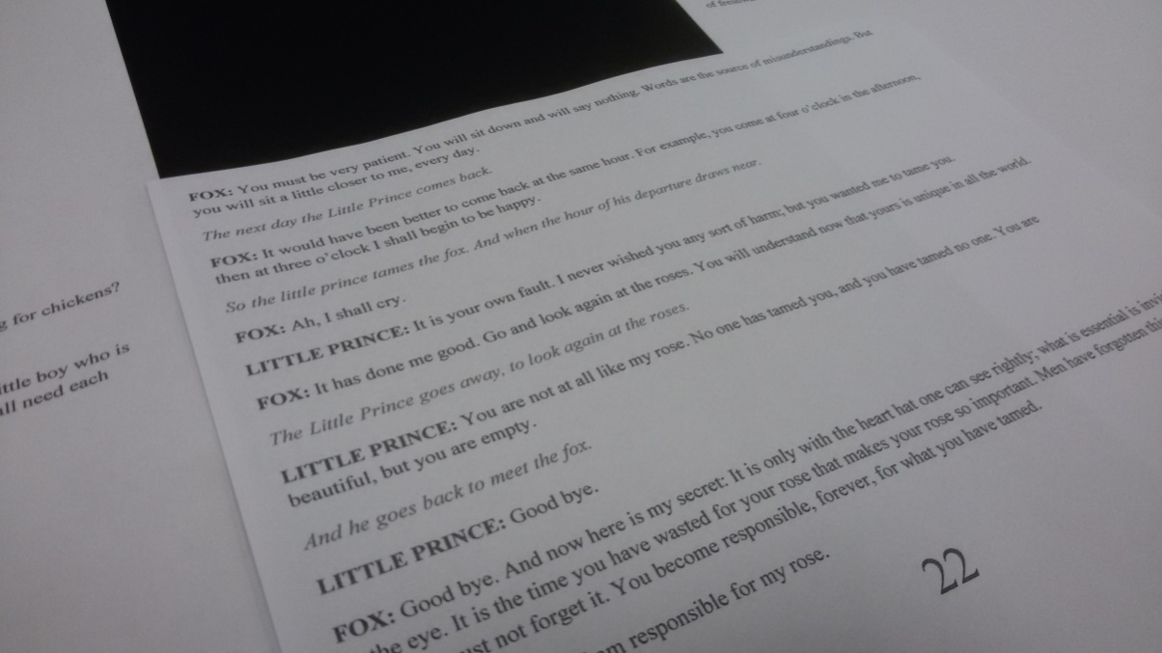
Sounds and recording
After making the scenery, costumes and preparing the script, we began doing a real job. We recorded us talking as characters from the book. We had to repeat taping a few times but it was worth it.

Slide 38
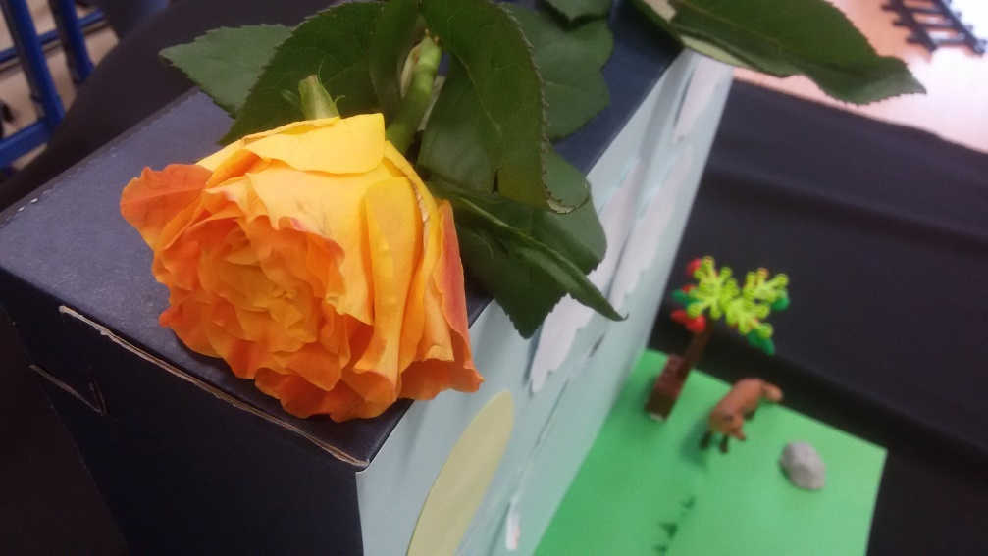
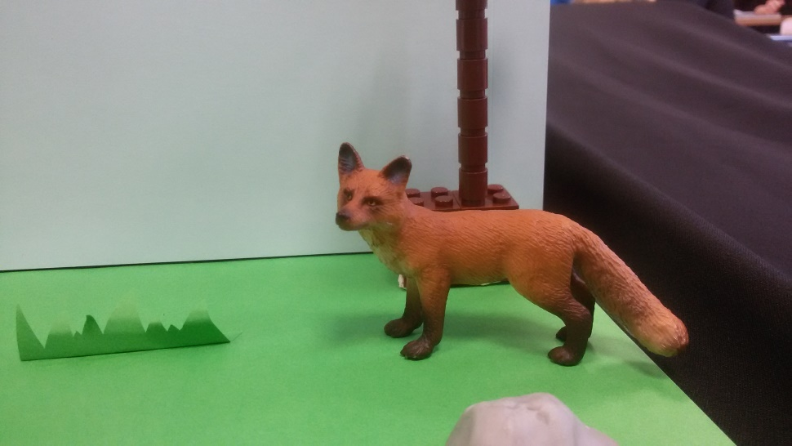
Making a film
The last but not least task was to make a real film. One of us took photos and then, using a video editing programs, made a movie.

Slide 39
7. Our highlights from the blog

Slide 40
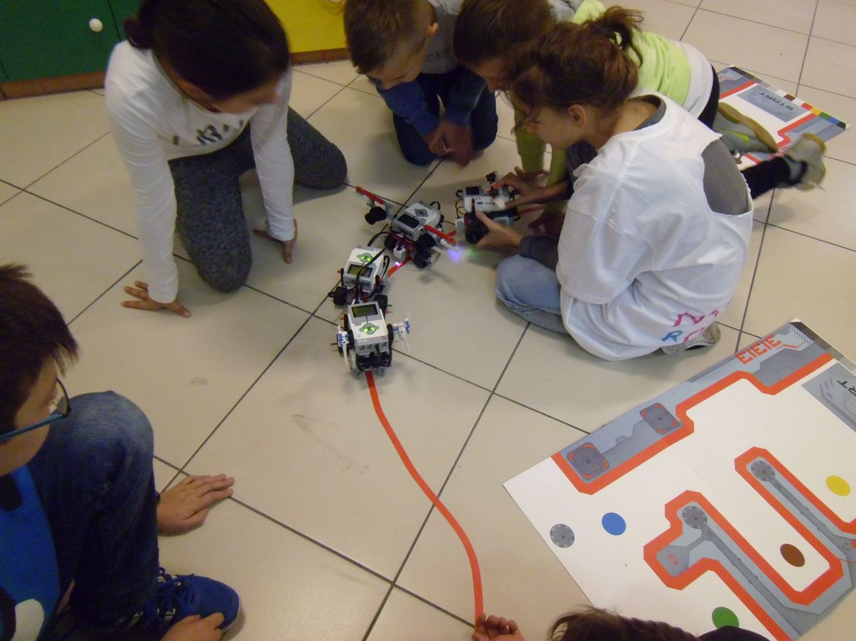
Pupils construct robots using sets of Lego Mindstorms EV3

Slide 41
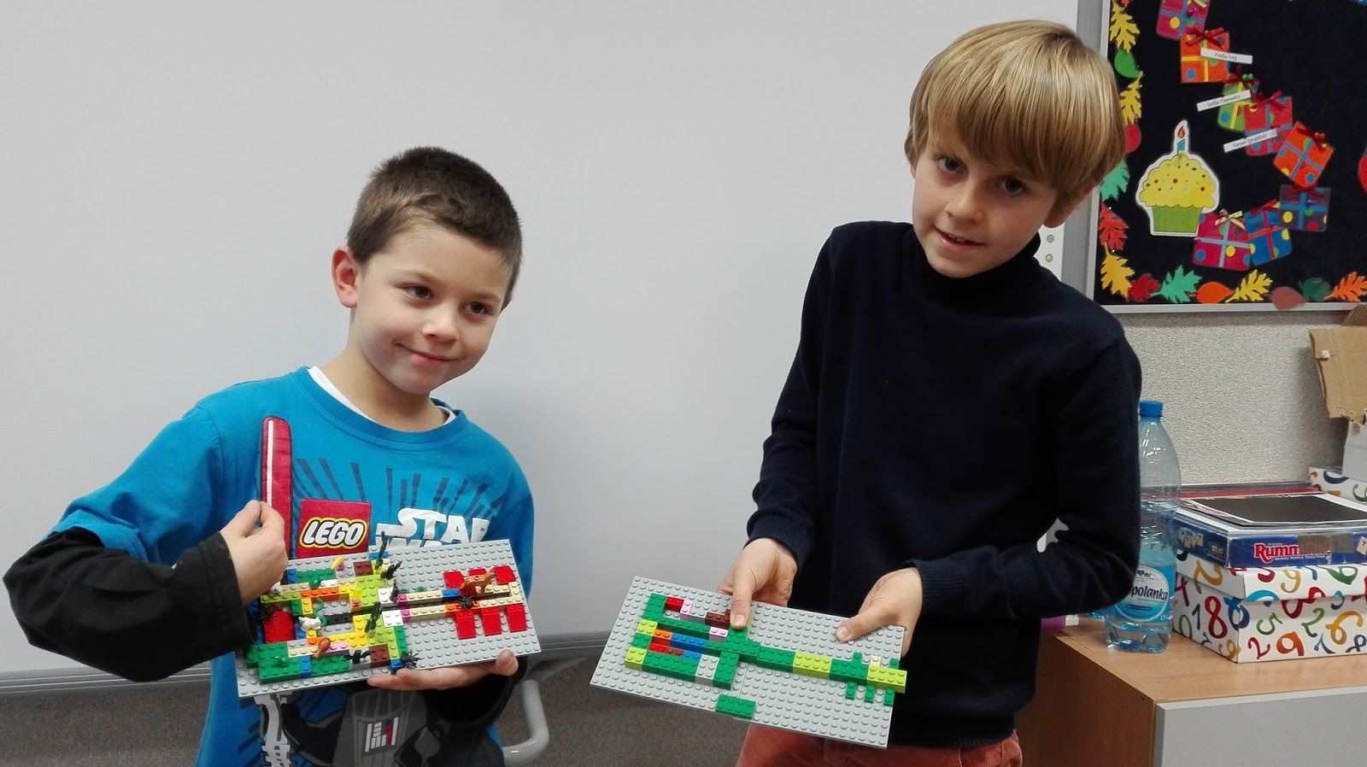
WE USED LEGO IN OUR MUSIC CLASSROOM AS WELL

Slide 42
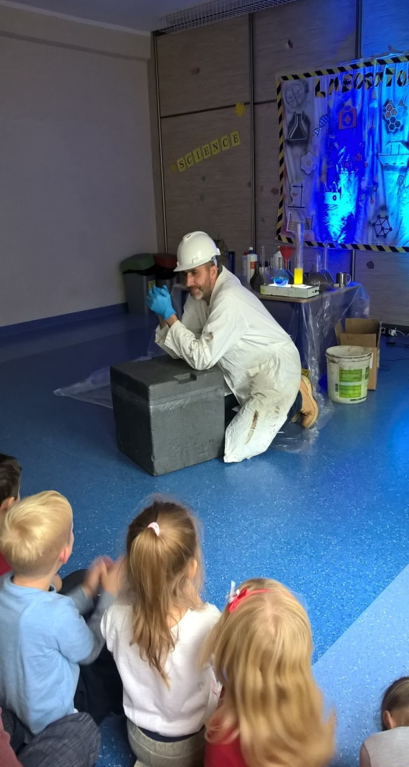
WE ORGANIZED SCIENCE FAIR AND INVITED SCIENTISTS FROM THE ACADEMY OF SCIENCE

Slide 43
DURING CONFECTIONERY WORKSHOPS WE LEARNT HOW TO DECORATE MUFFINS

Slide 44
TO ENHANCE CREATIVE THINKING WE TAKE PART IN A WORLDWIDE COMPETITION ODYSSEY OF THE MIND

Slide 45
8. Changes in school during the project

Slide 46
We opened a Lego room

Slide 47
We have Lego as a regular subject taught in grades 2 and 3

Slide 48
We introduced robotics in our school

Slide 49
We are open to new visitors

Slide 50
Ombretta from Italy and Maide from Spain

Slide 51
We have written a new project „To understand the world” and recieved funds to buy new Lego machines. They have just arrived☺

