Slide 1
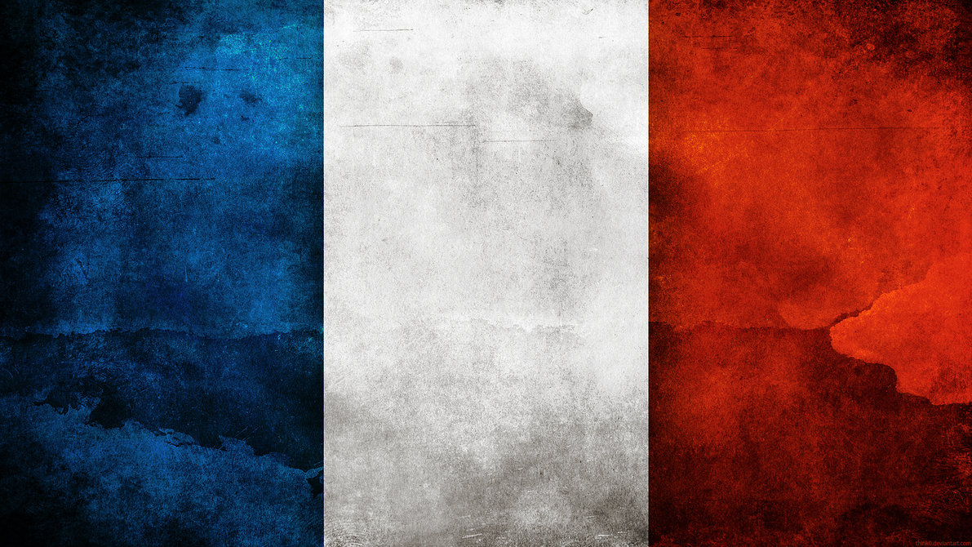
FRANCE

Slide 2
BASIC INFORMATION
CAPITAL: PARIS
LANGUAGE: FRENCH
POPULATION: 66 MLN
CURRENCY: EURO

Slide 3
We were in Clermont-Ferrand

Slide 4
Institution Sainte-Thérèse
Les Cordeliers

Slide 5
Everybody said Hello!

Slide 6
WE ENJOYED AN
AMAZING SHOW
EACH COUNTRY HAD ITS DANCE PRESENTED

Slide 7
And this is our polish team

Slide 8
We ate a lot!!
Yummy, yummy!

Slide 9
And we watched amazing
LEGO shows!

Slide 10
France is the most visited country in the world: 83 million tourists in 2012.

Slide 11
There's only one STOP
sign in the entire city of Paris.

Slide 12
During WWII, when Hitler visited Paris,
the French cut the lift cables on the Eiffel Tower
so that Hitler would have to climb the steps
if he wanted to reach the top.

Slide 13
There are more people
speaking French in Africa
than in France.

Slide 14
Paris: Eiffel Tower, Notre Dame, Louvre,
Montmartre, Arc de Triomphe,
river Seine
and many other great attractions

Slide 15
French is the official language in France
and it is also the second major language in Europe.
French is one of the Romance languages.
These languages, including also Italian and Spanish,
have their origins in the Latin language.
Today, French is the second most studied language
after English and spoken by more than
300million people around the world
as first or second language.

Slide 16
Here is some typical French food:
Baguette: long bread stick
Croque Monsieur/Croque Madame:
ham and cheese grilled sandwich
while Croque Madame is the more heavy version with ham, cheese and a fried egg on top
Escargots: snails
Foie Gras: Goose liver pate
Ratatouille: vegetable stew
Pain au chocolat: similar to a croissant filled with chocolate
Crepes: French very thin pancakes with filling

Slide 17
