Slide 1
A visit to Spain
Creating Tomorrow’s schools Today

Slide 2
Europe

Slide 3
Map of Spain Spain is located on the Iberian Peninsula

Slide 4
Fact file
Population : about 47 million people
Language: Spanish
Capital: Madrid
Currency: Euro
Climate: continental and Mediterranean

Slide 5
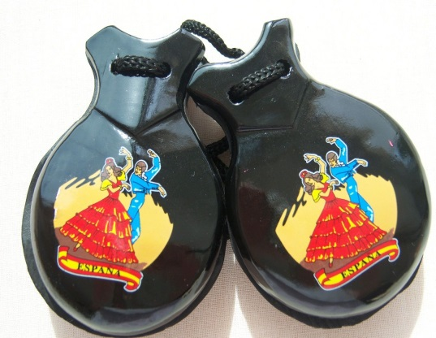
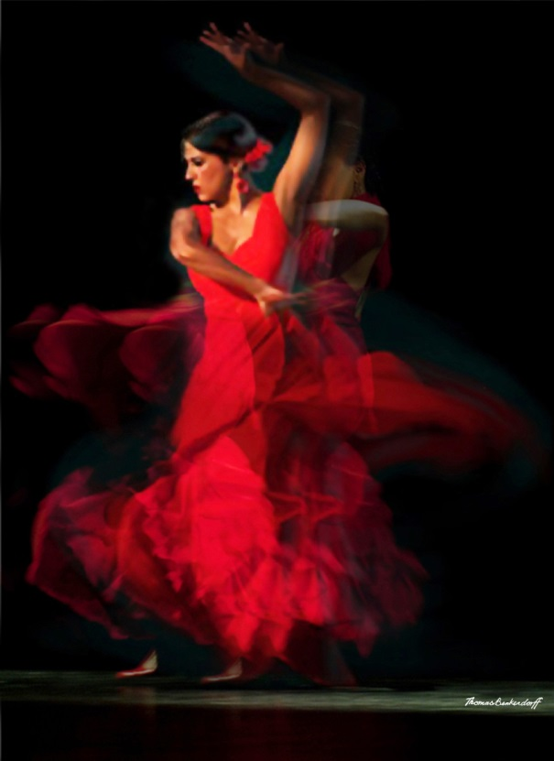
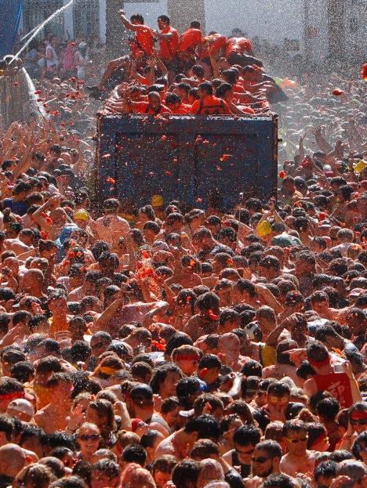
Culture and Tradition
Flamenco - a fast and lively Spanish dance and music
Siesta – an afternoon nap
3 Kings Day – children get presents on the 6th of January
Musical instruments: castanets, accordion and guitar
Festivals – La Tomatina – participants throw tomatoes at each other purely for fun
Greetings consist of a handshake and a kiss on both cheeks

Slide 6
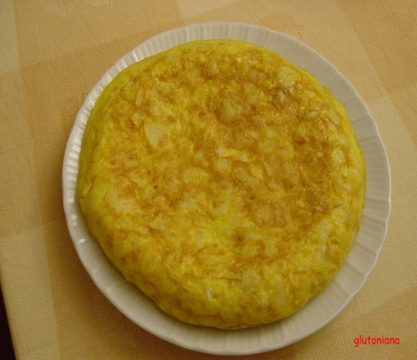
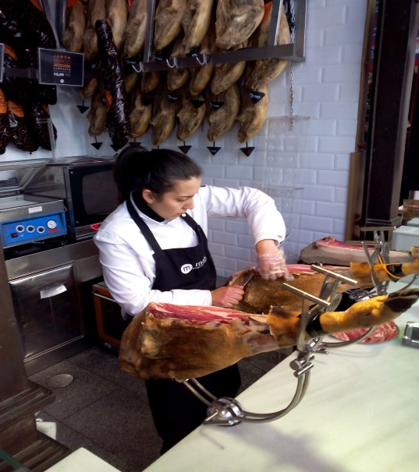
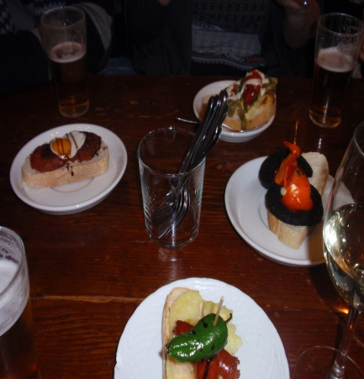
Food
Tapas – a wide variety of snacks (cold or hot)
Tortilla – Spanish omelette made with potatoes and onions
Paella – a dish of rice, chicken and seafood
Jamón – dry-cured ham

Slide 7
Sport
Bullfighting
Football

Slide 8
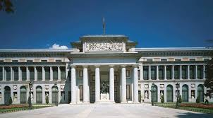
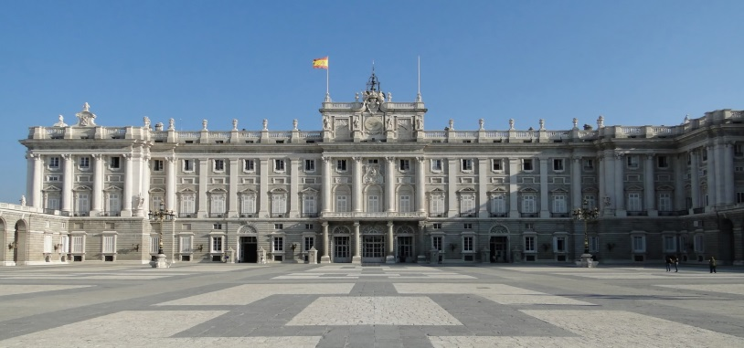
Madrid
Symbol: The bear and The Strawberry Tree
Famous sites: Plaza Mayor, Prado Museum and Royal Palace

Slide 9
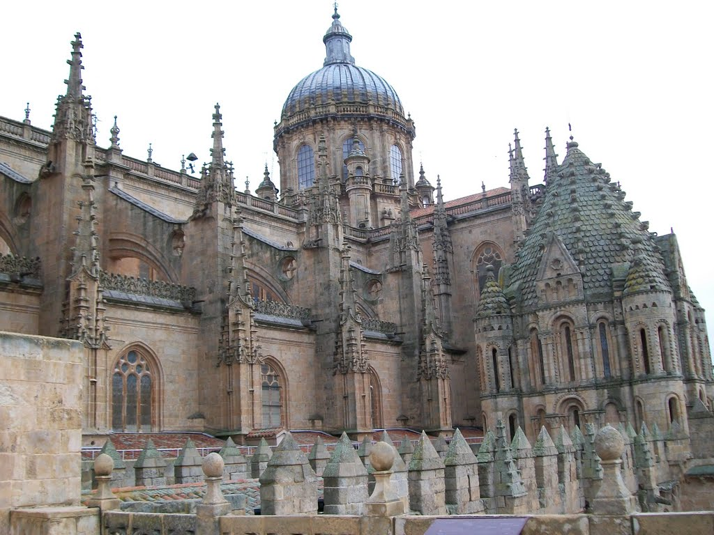
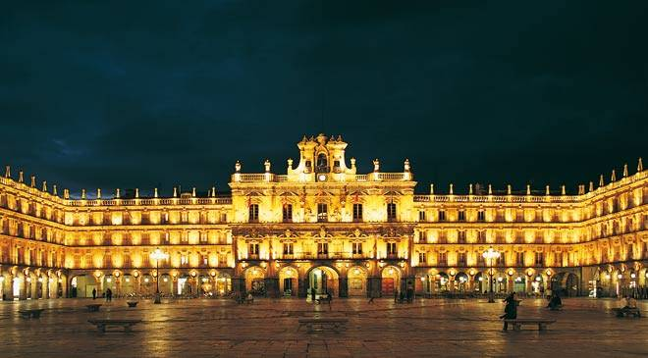
Salamanca
Its Old City was declared a UNESCO World Heritage Site in 1988
It is one of the most important university cities in Spain
The University of Salamanca, which was founded in 1134, is the oldest university in Spain and third oldest in the world.

Slide 10
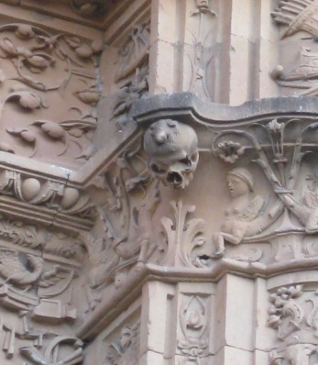
The legend of the frog
Students of University of Salamanca, are greeted with the old legend of the frog on the skull. It is presented as a challenge, that the students must spot the frog on the skull on the façade of the University, otherwise they will not be able to graduate as doctors.

Slide 11
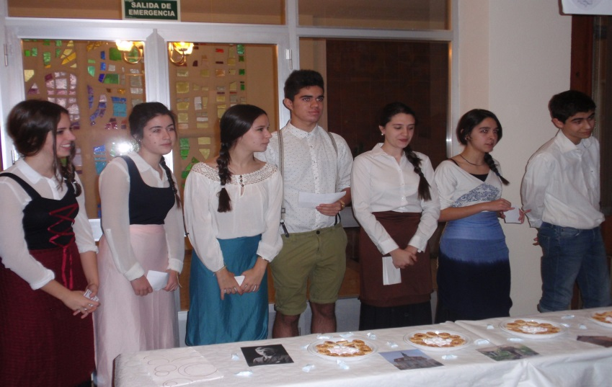
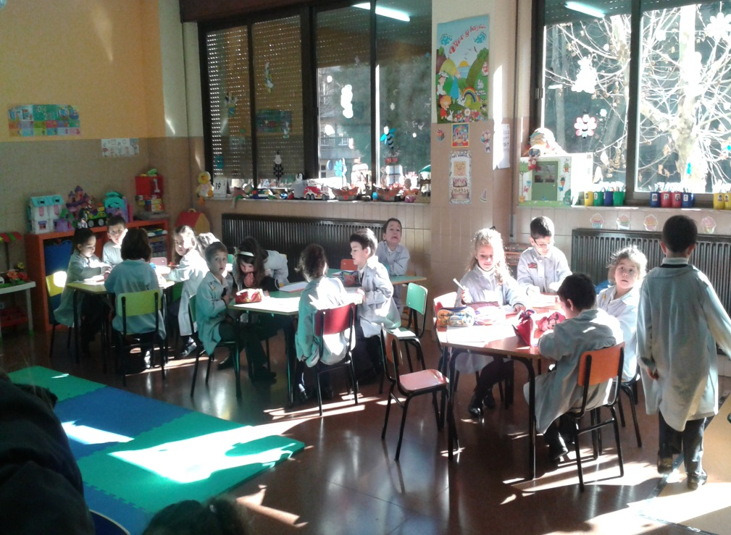
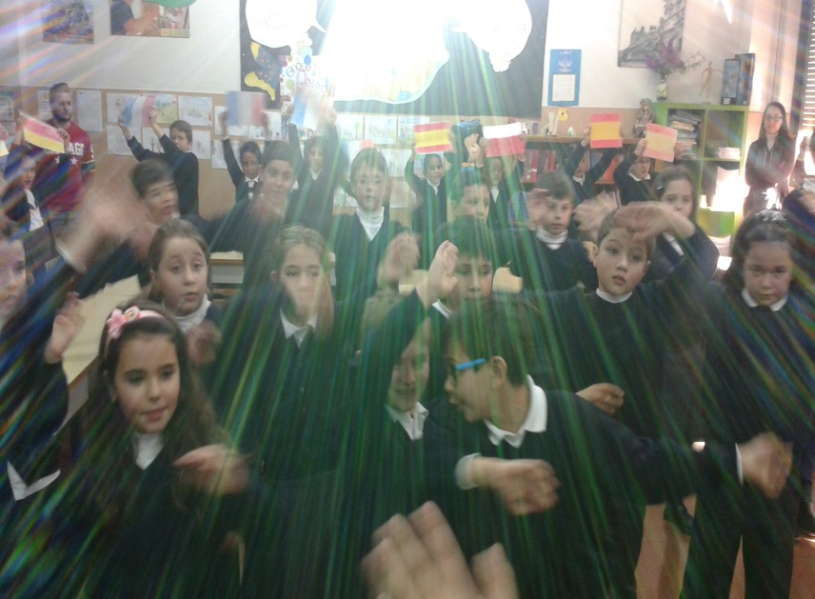
Colegio Santisima Trinidad Salamanca

Slide 12
Thanks for watching
References:
http://en.wikipedia.org
http://www.culturaltravelguide.com/salamanca-mysterious-hidden-carvings
Some photos taken from Google Images

