Slide 1
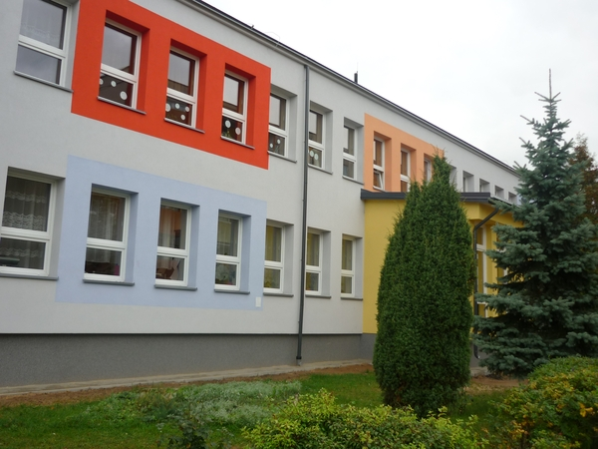
Our school

Slide 2
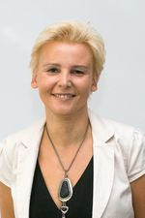
Headmistresses
Mrs. Bożena Niechoda
Mrs. Elżbieta Stasiewicz

Slide 3
Teachers

Slide 4
Students

Slide 5
0a

Slide 6
0b

Slide 7
1a

Slide 8
1b

Slide 9
2a

Slide 10
2b

Slide 11
2c

Slide 12
3

Slide 13
4a

Slide 14
4b

Slide 15
5a

Slide 16
5b

Slide 17
6a

Slide 18
6b

Slide 19
1a gymnsium

Slide 20
1b gymnasium

Slide 21
2a gymnasium

Slide 22
2b gymnasium

Slide 23
Classes

Slide 24
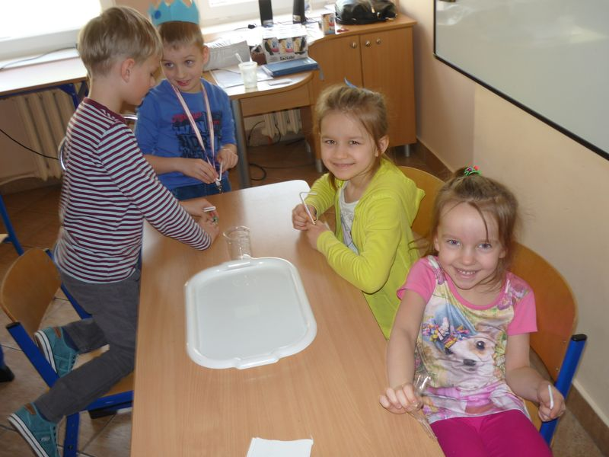
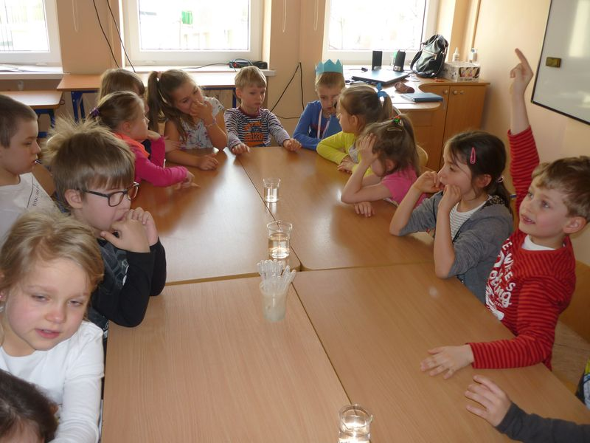
Chemistry

Slide 25
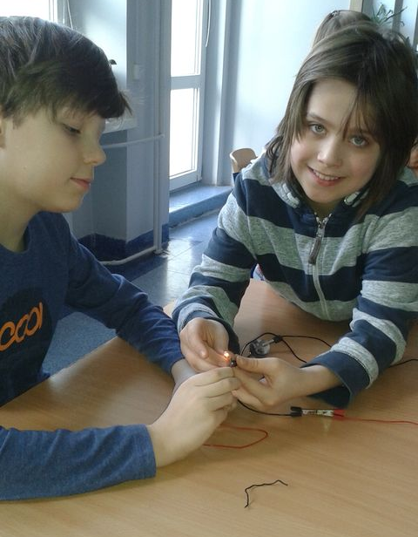
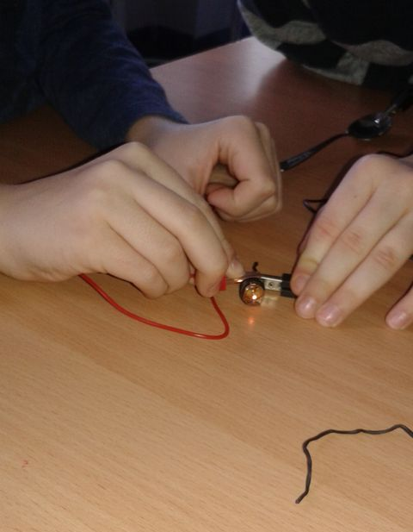
Examining the current

Slide 26
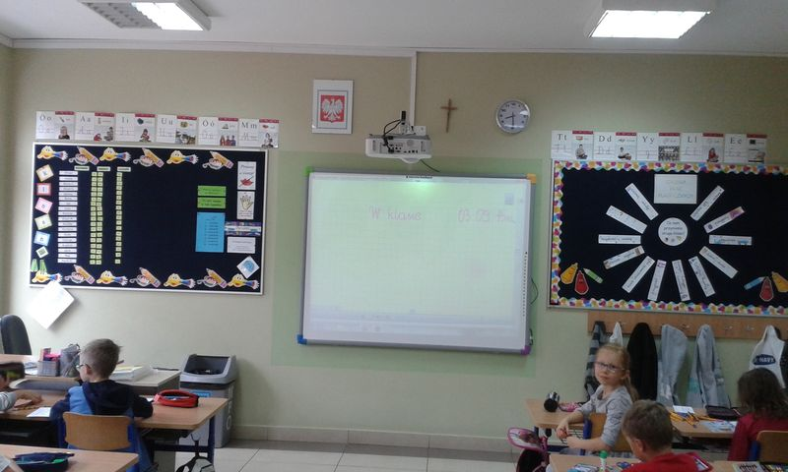
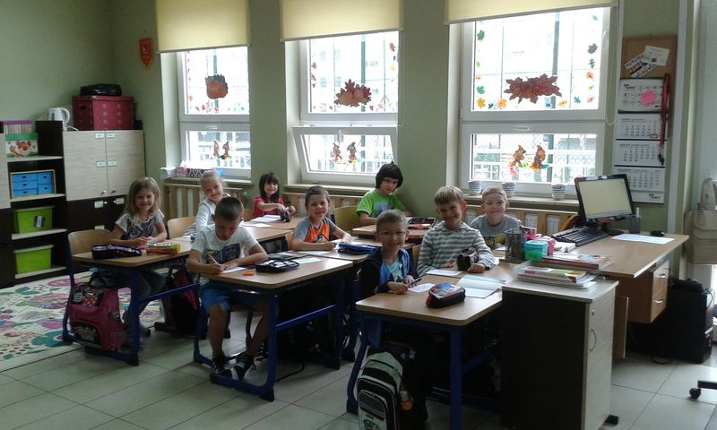
First day in school

Slide 27
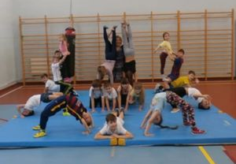
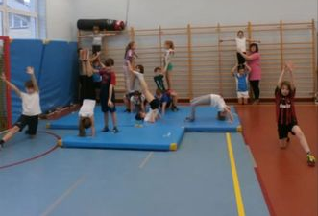
Gymnastics
Click the photo
Third class
First class
Second class

Slide 28
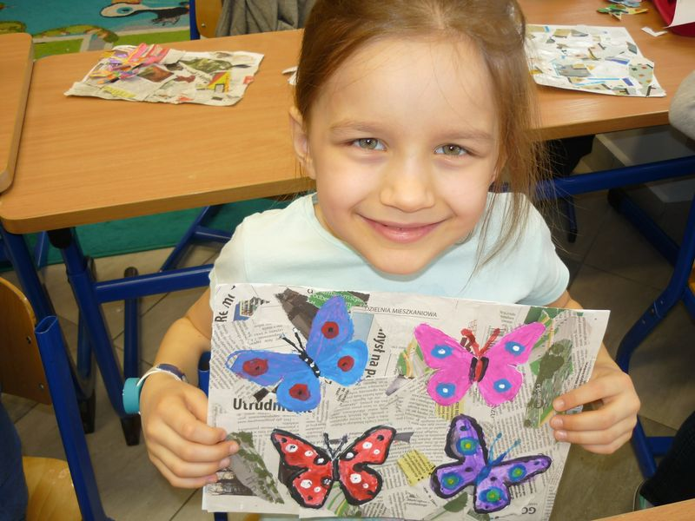
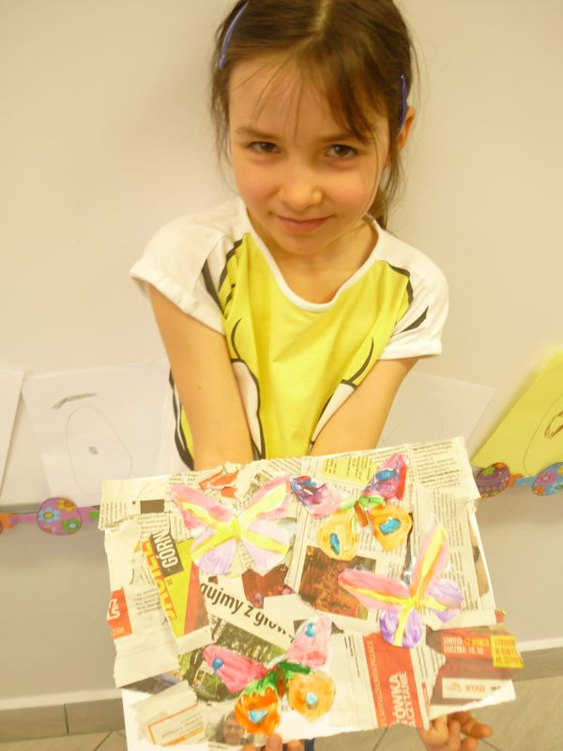
Insect’s life

Slide 29
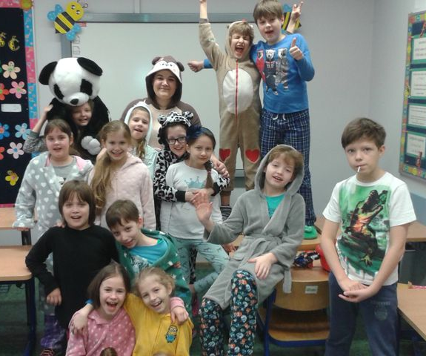
Pyjamas Day

Slide 30
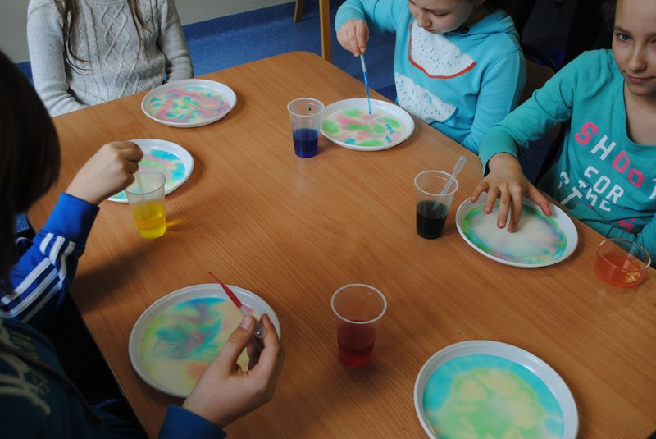
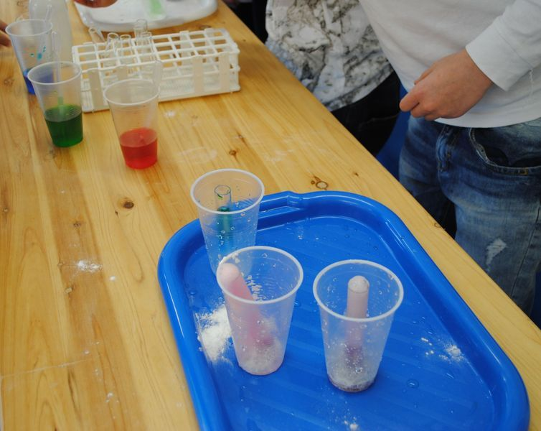
Science Fair

Slide 31
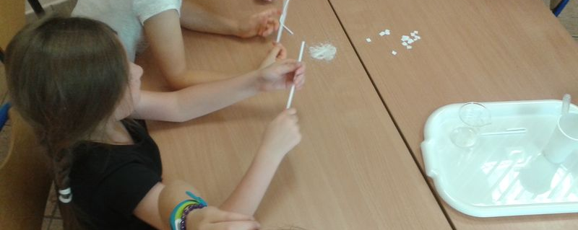
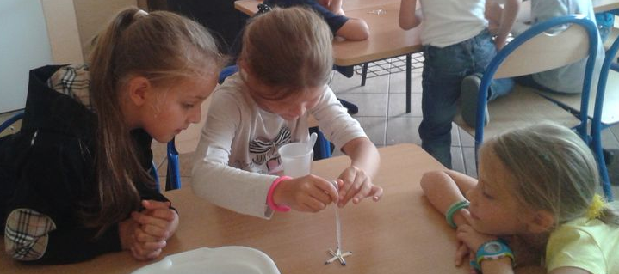
Small chemists

Slide 32
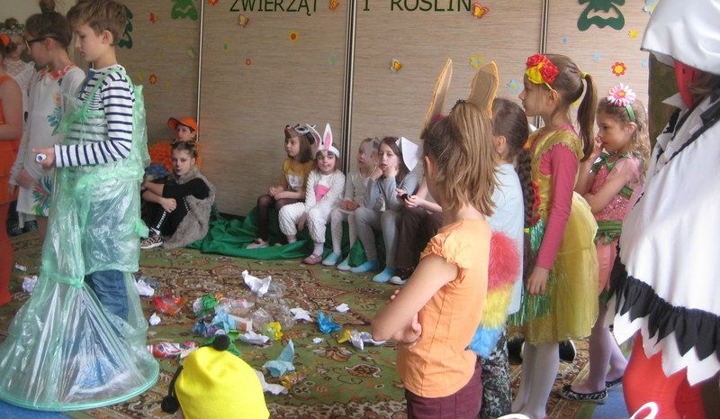
The Earth Day

Slide 33
Clubs

Slide 34
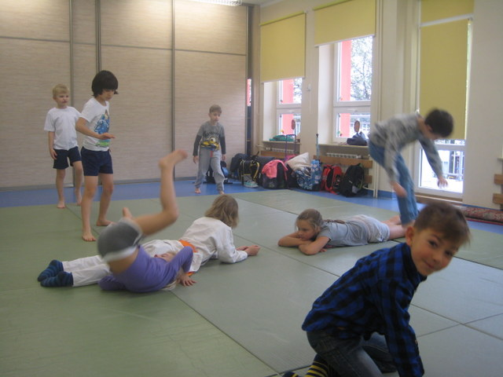
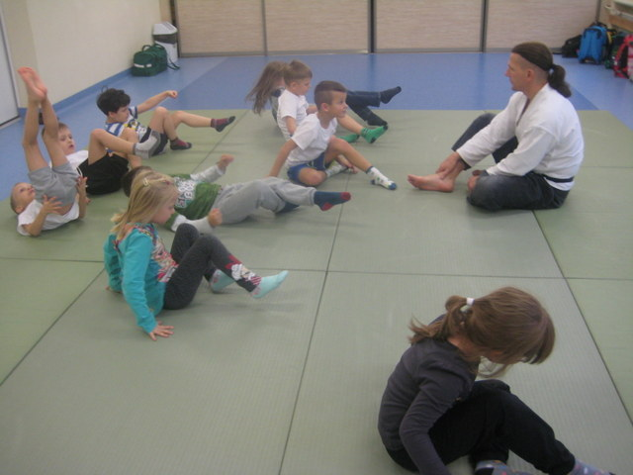
Aikido

Slide 35
Athelitcs section

Slide 36
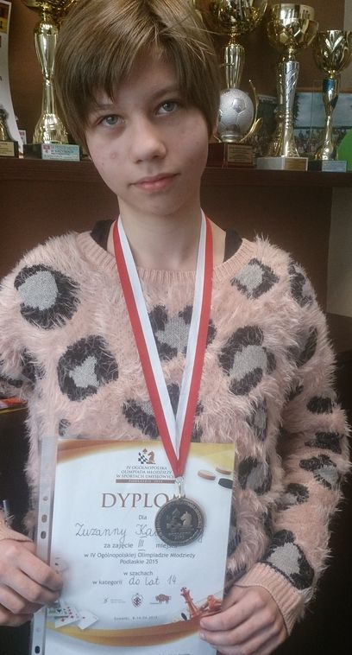
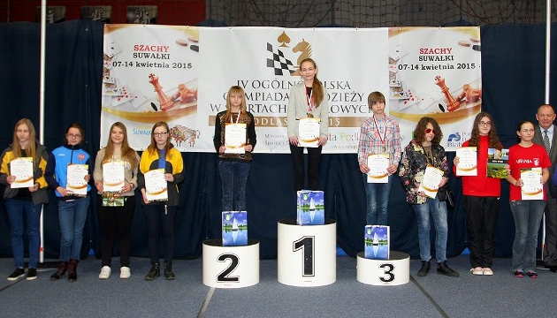
Chess

Slide 37
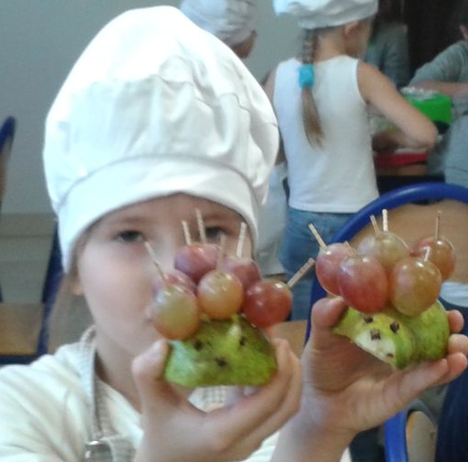
Cooking classes

Slide 38
Journalists

Slide 39
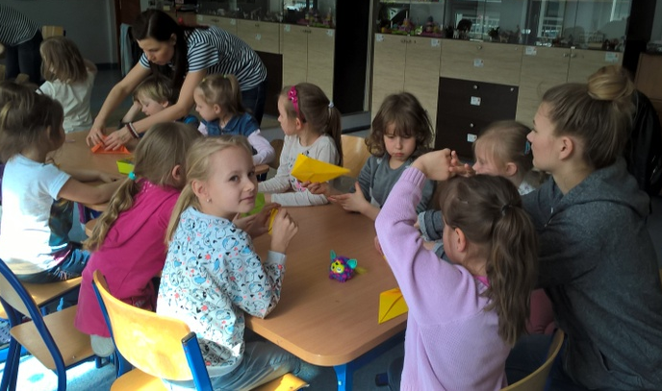
Origami

Slide 40
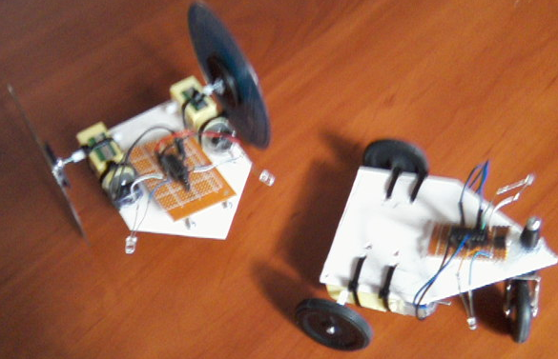
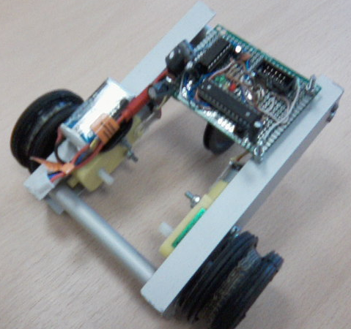
Robotics

Slide 41
Swimming masters

Slide 42
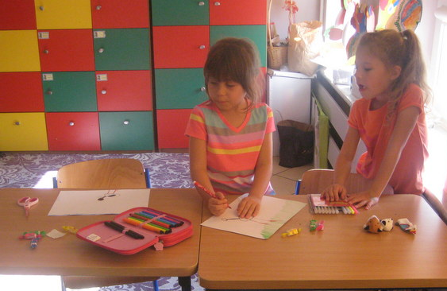
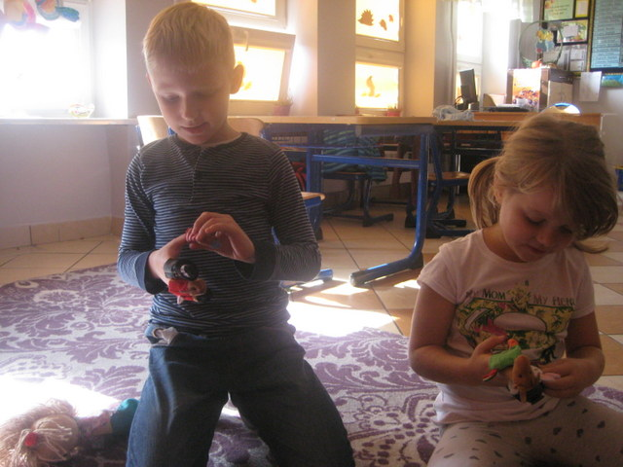
Theatre

Slide 43
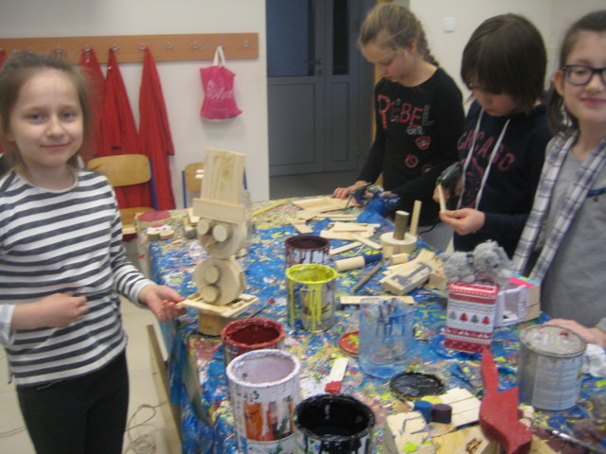
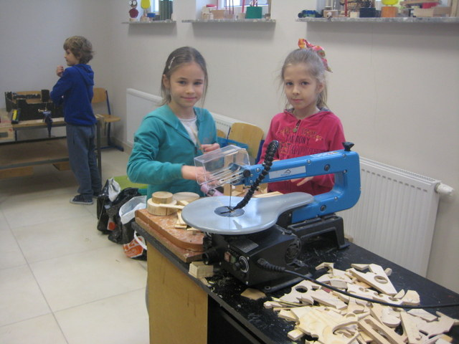
Wooden inspirations

Slide 44
After school

Slide 45
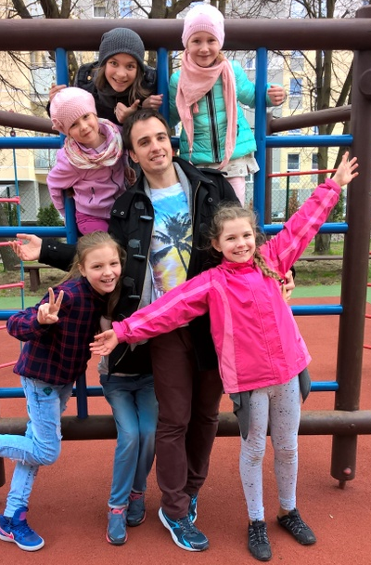
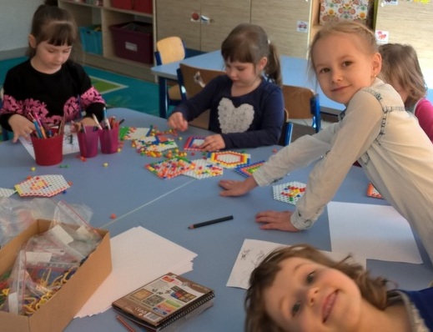
A day in a day room

Slide 46
Lego project

Slide 47
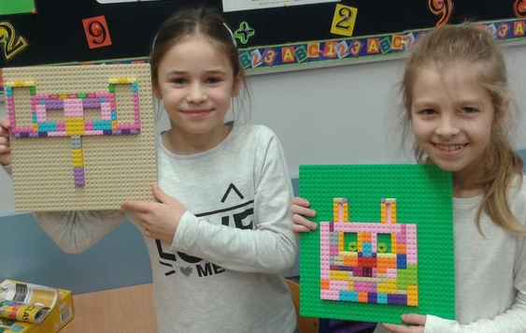
Carnival masks

Slide 48
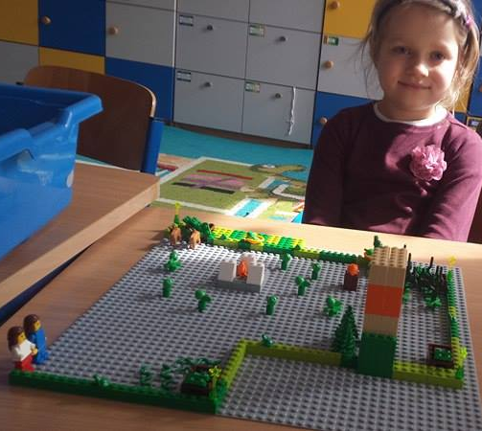
Games designers

Slide 49
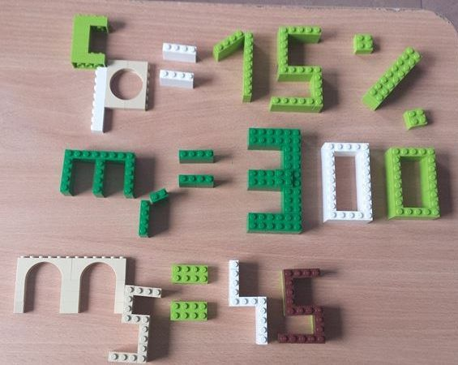
Lego in chemistry

Slide 50
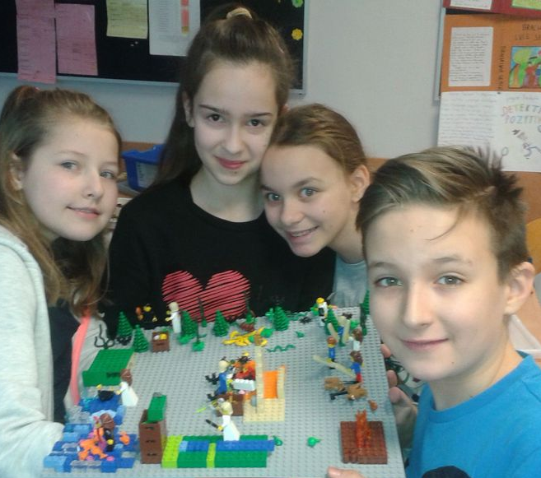
Lego in history

Slide 51
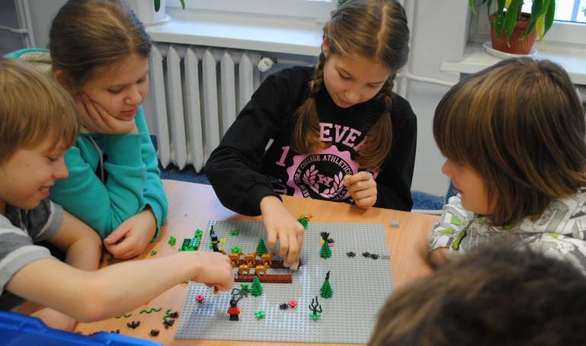
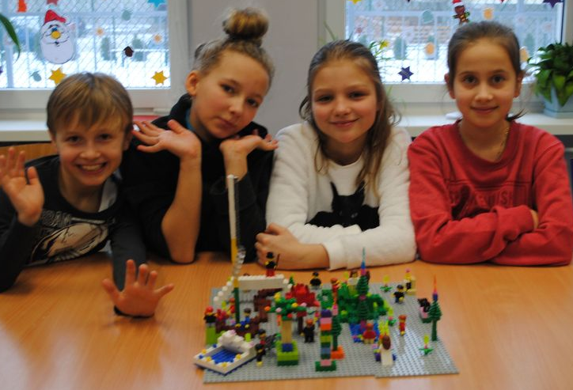
Magical countries

Slide 52
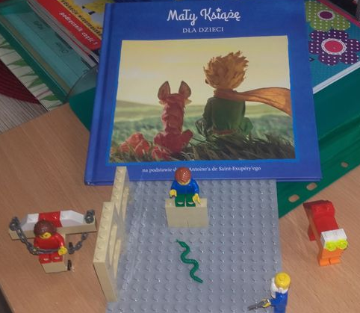
Small prince

Slide 53
Trips

Slide 54
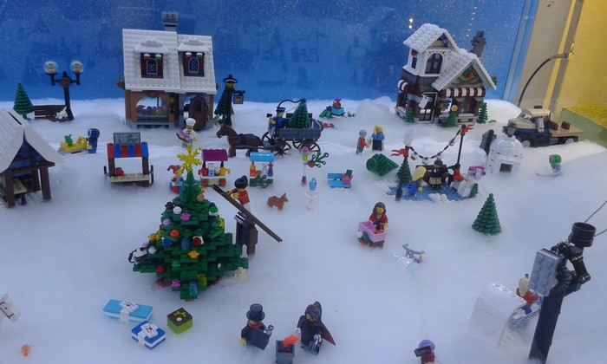
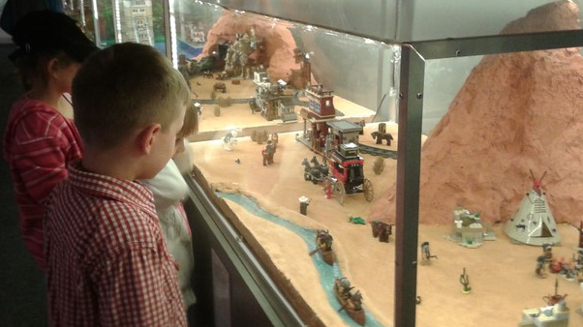
A trip to see a Lego exhibition

Slide 55
Sleńdzińskich Gallery

Slide 56
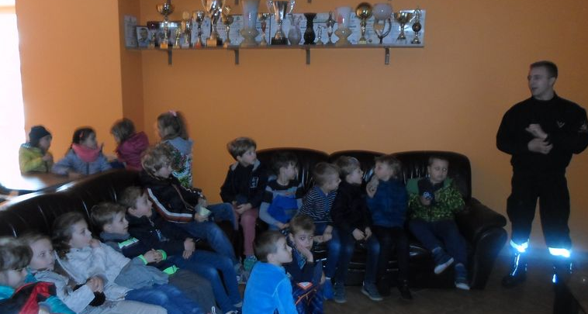
At the fire department

Slide 57
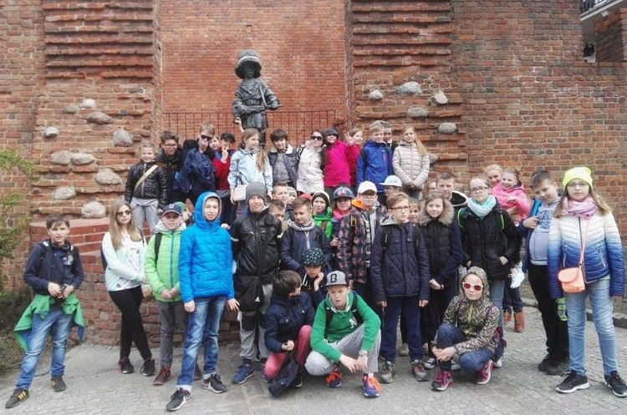
In Warsaw

Slide 58
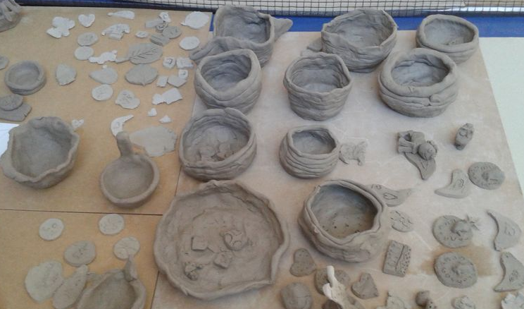
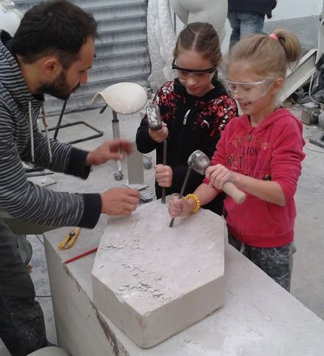
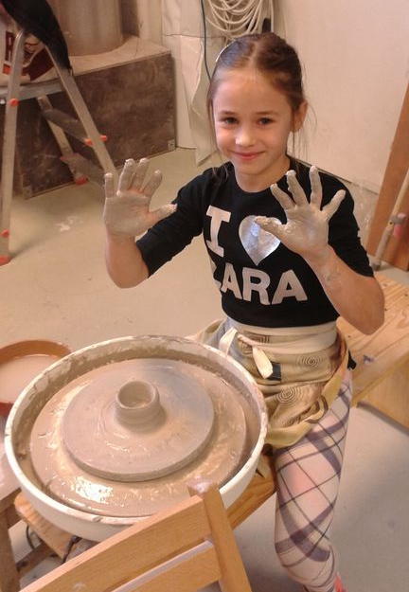
Sculptors

Slide 59
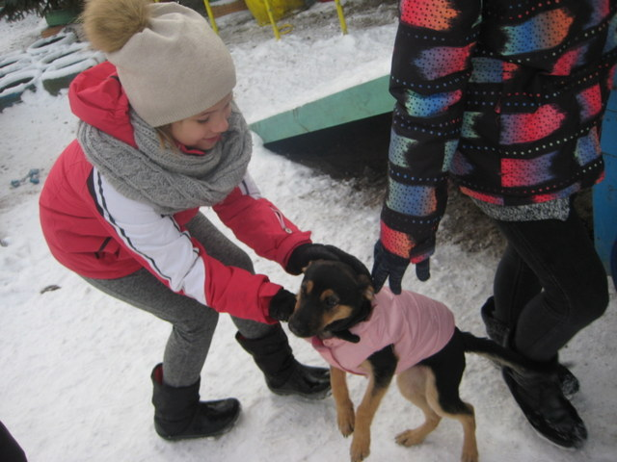
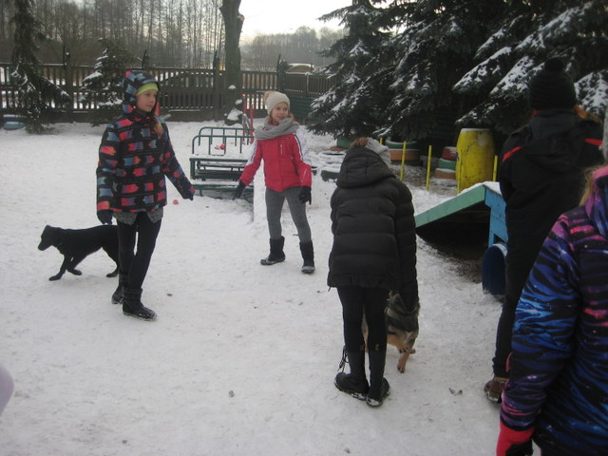
Visit in an animal shelter

Slide 60
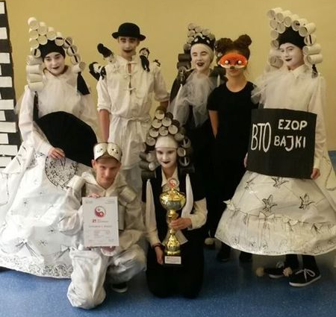
Odyssey of the mind
We won Polish Finals. The next step will be in the USA.

Slide 61
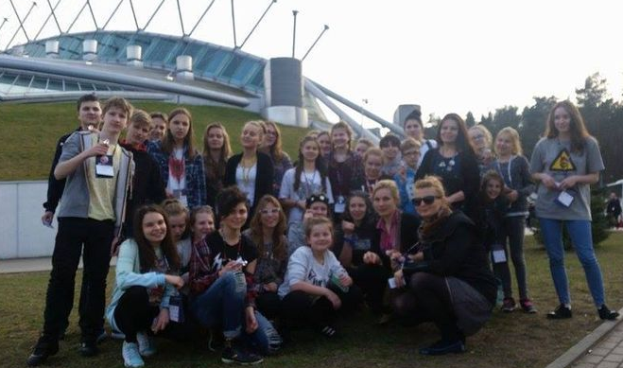

Slide 62
Thank you
By Julia Czajkowska and Ewa Bączek

