Slide 1
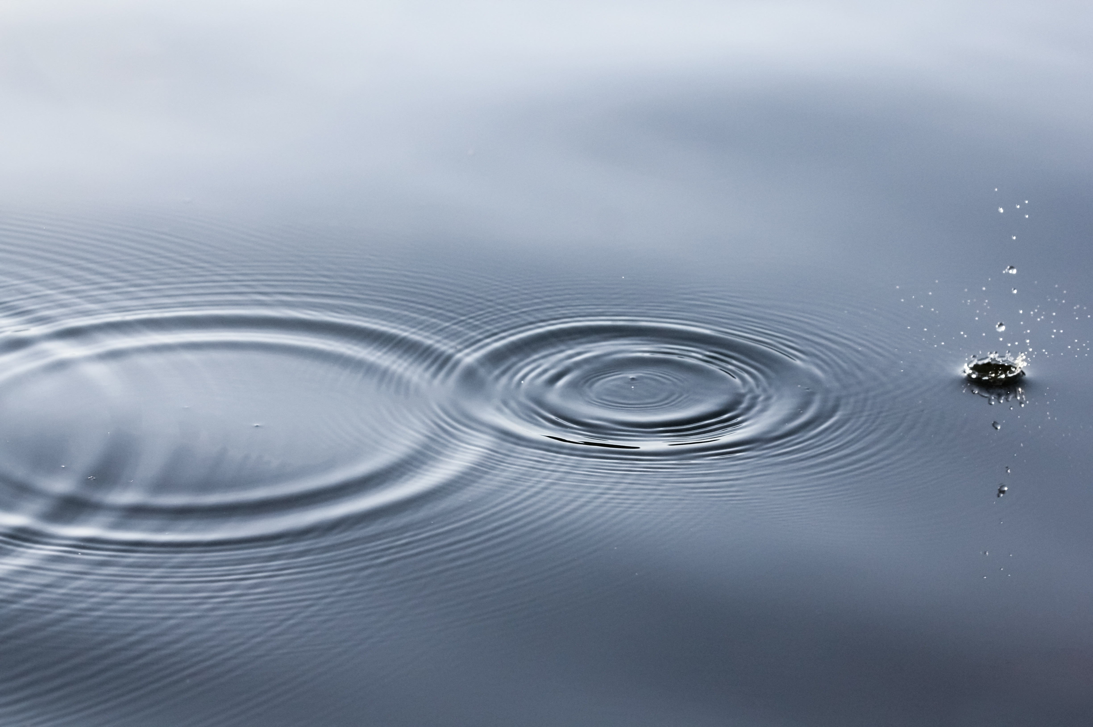
Harmful Substances from Polluted water
Student: Radu-Todor Alexandru, XI A, Romania

Slide 2
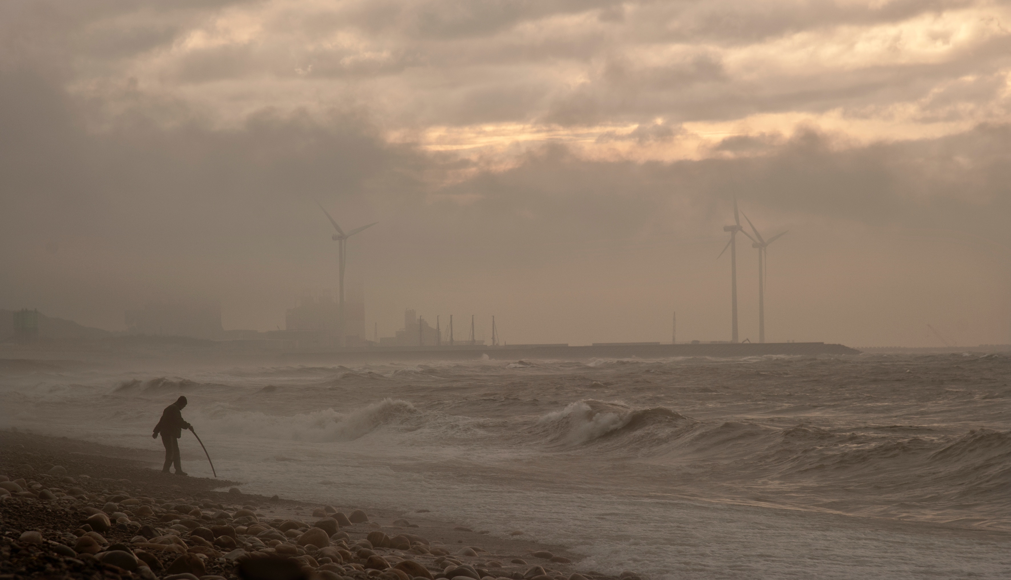
Water Pollution
Water pollution represents the contamination of water bodies, due to human activity or natural processes, making it unsuitable for desired usage.

Slide 3
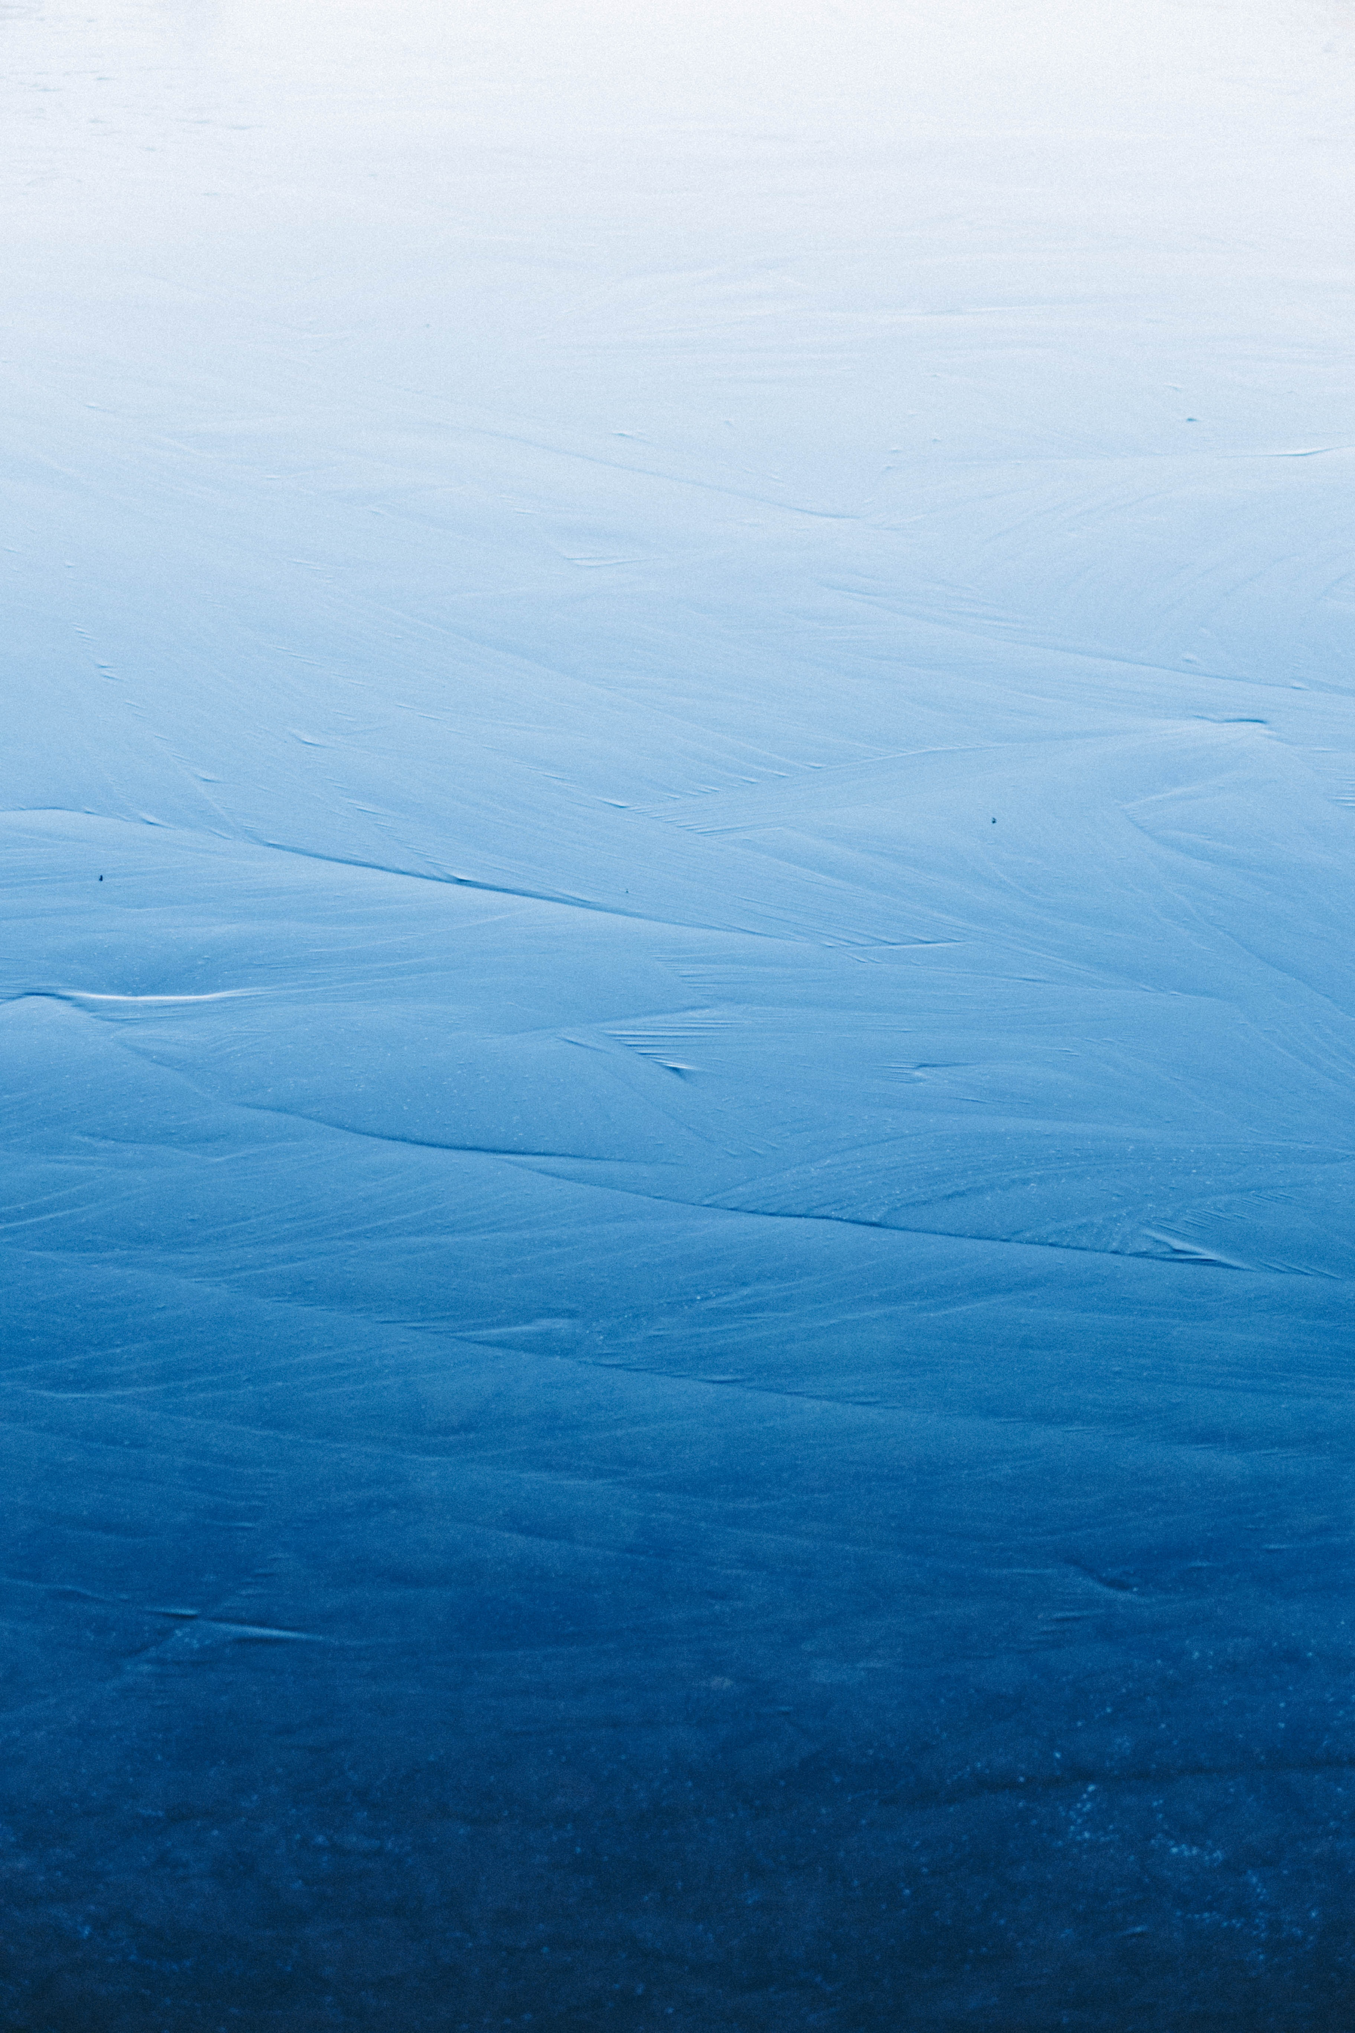
Types
Known as a “universal solvent”, water is uniquely vulnerable to pollution due to it being able to dissolve more substances than any other liquid on earth. Water pollution can be categorized in:

Slide 4
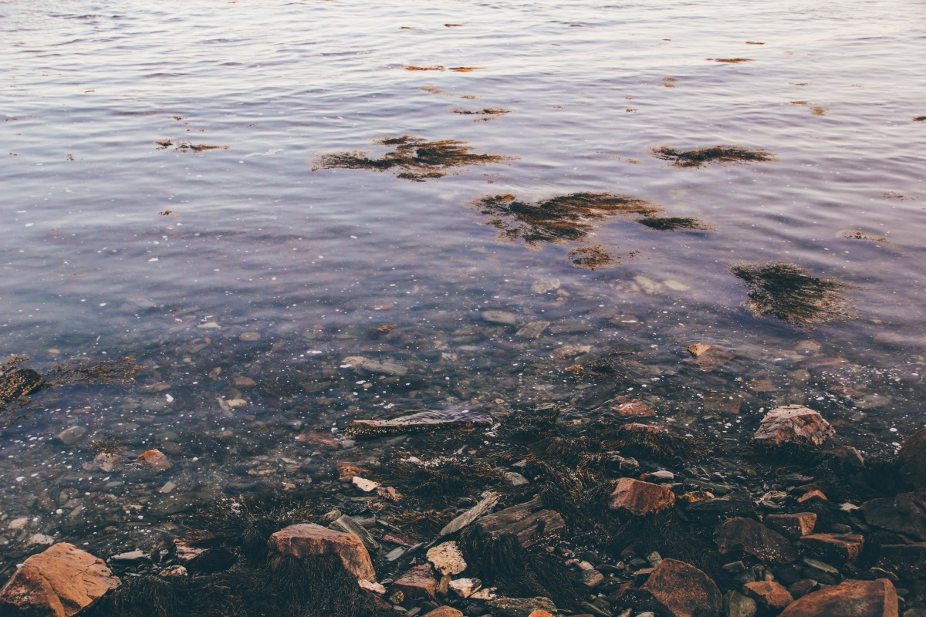
Surface water pollution appears when toxic substances enter lakes, rivers, oceans and they get dissolved or stay above water.

Slide 5
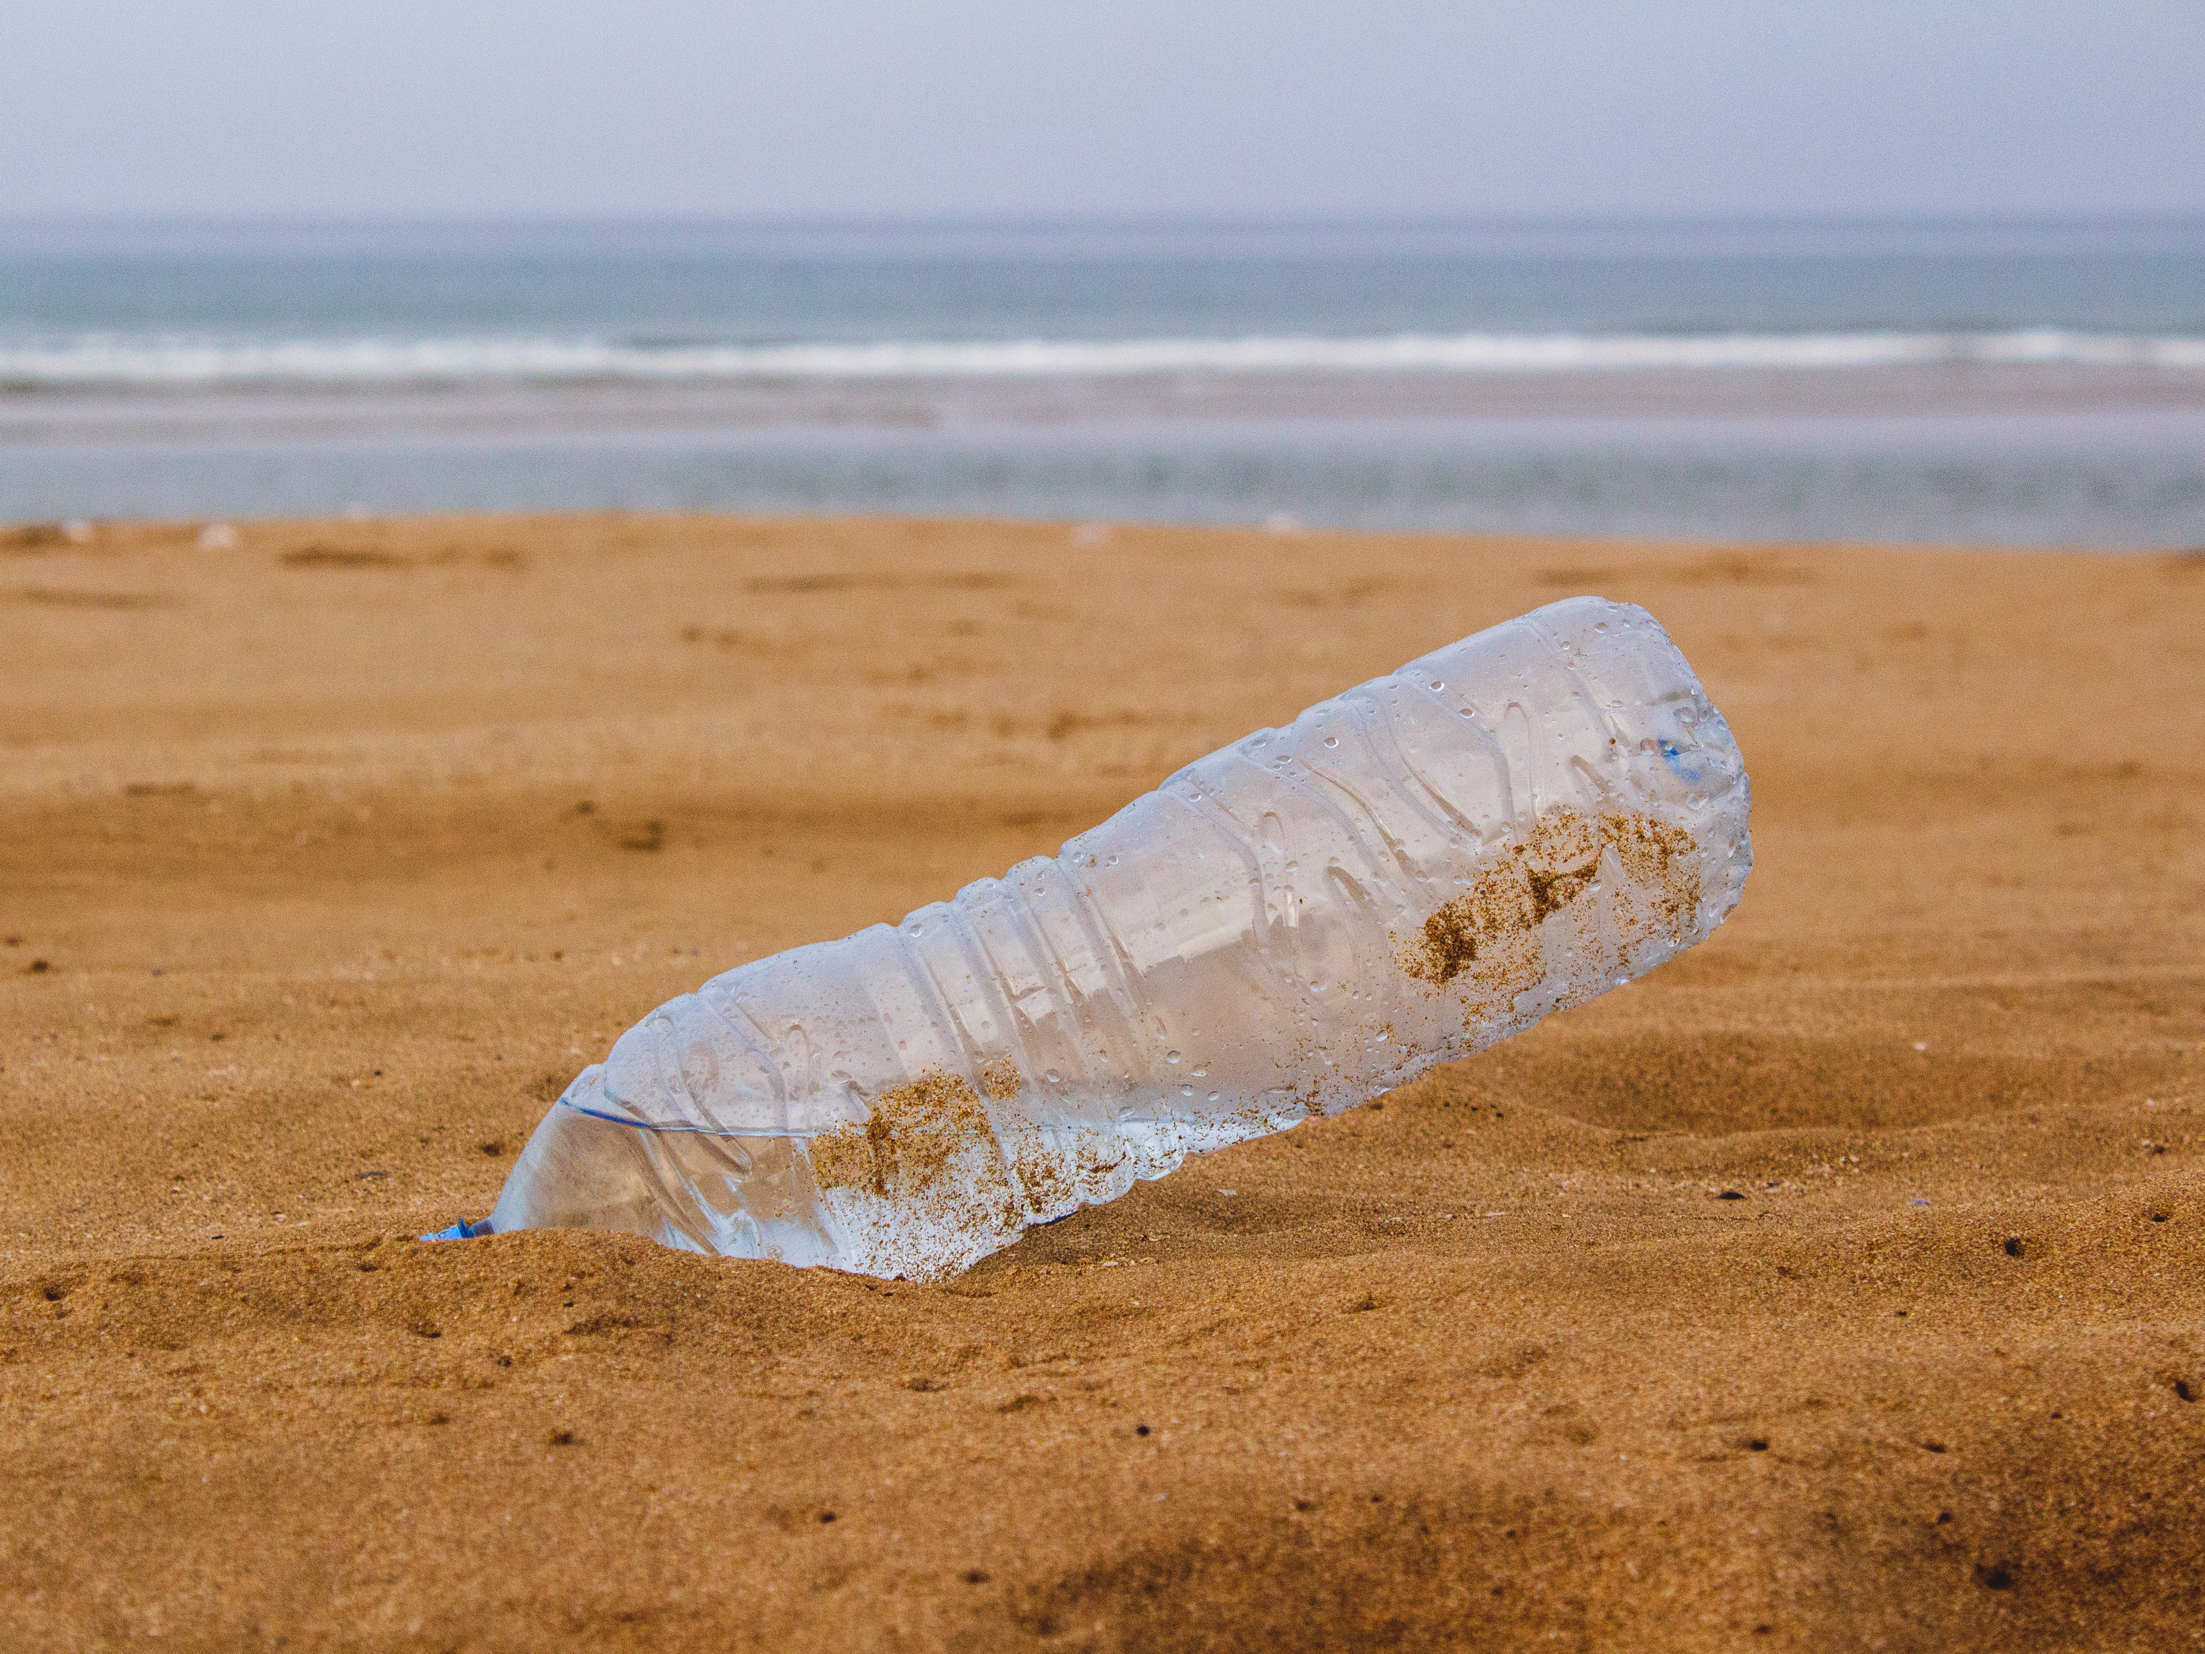
Groundwater pollution appears when polluants are released to the ground and make their way to the ground water.

Slide 6
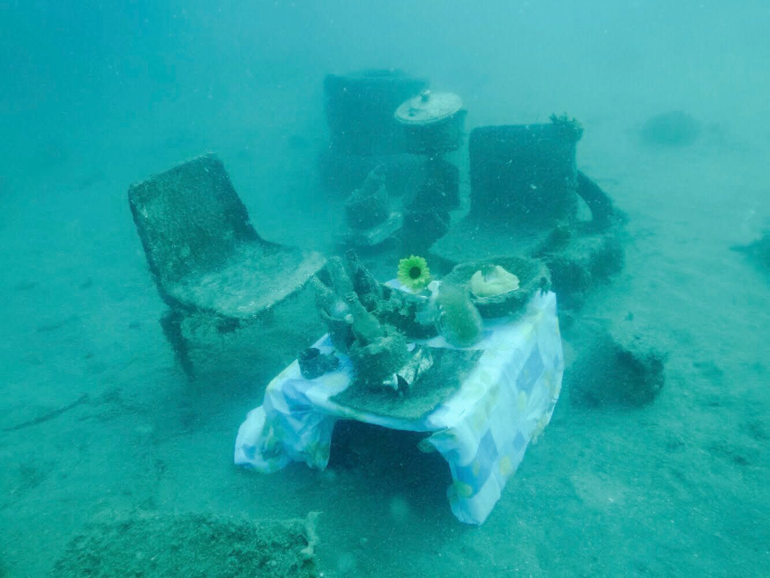
Pollution sources
By sources, water pollution can be categorized in:
Point sources, referring to contaminants that enter a identifiable way, such as a pipe or ditch;
Non-point sources, referring to the cumulative effect of small amounts of contaminants gathered from a large area.

Slide 7
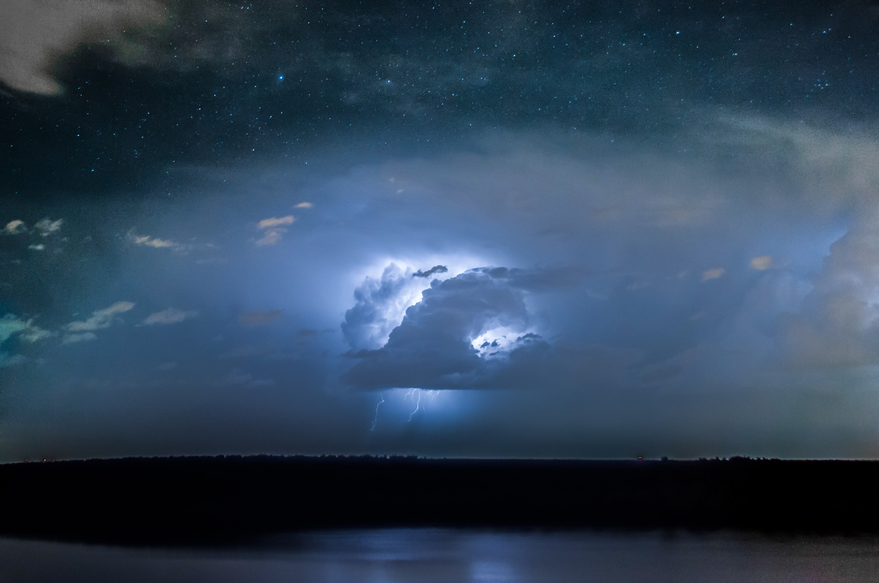
Natural Sources of pollution
Despite not being as spread as human sources, volcano eruptions, storms and earthquakes also cause major changes in the water composition and the ecological status of water

Slide 8
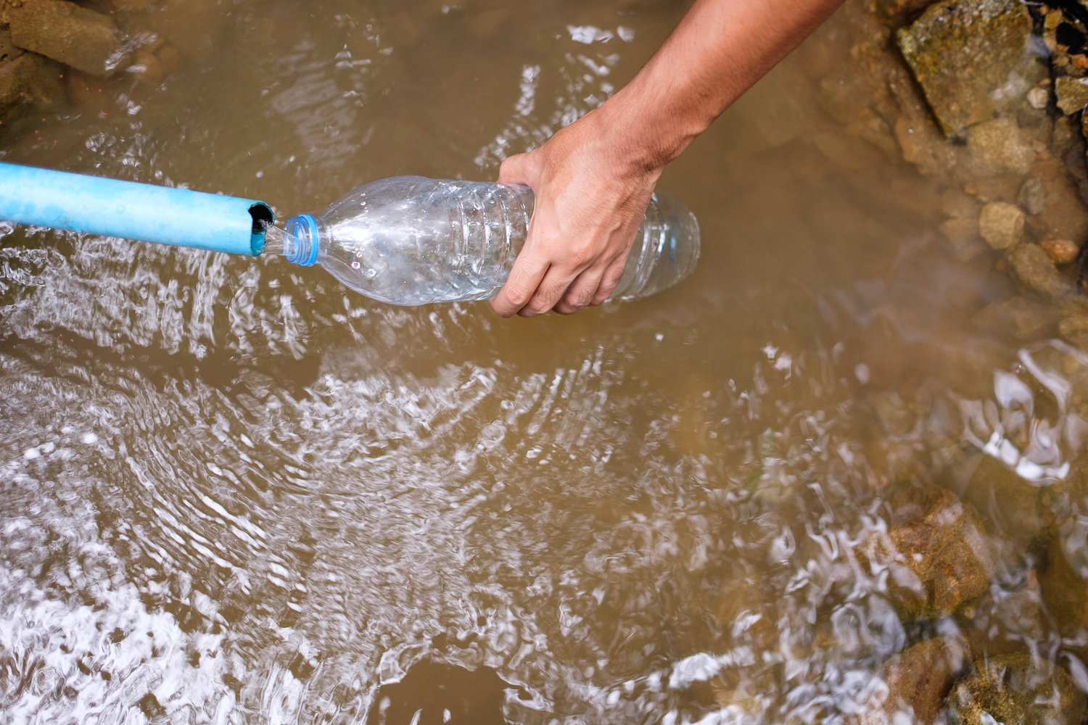
Effects on humans
Contaminated water can be a cause for illness because of the waterborne pathogens that appear in the form of disease-causing bacteria and viruses from human and animal waste. Unsafe water sickens about 1 billion people every year.

Slide 9
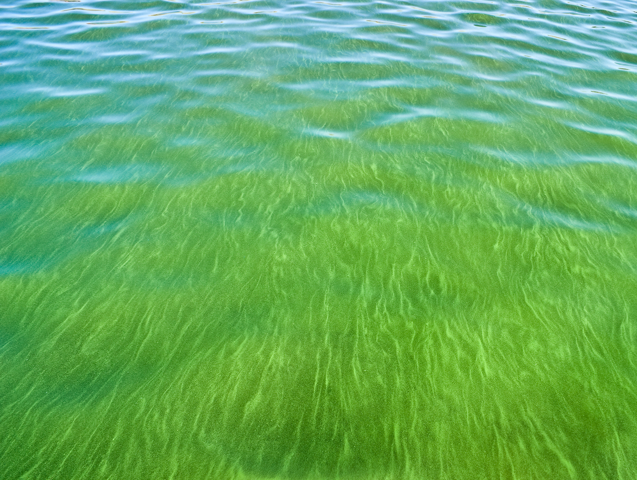
Effects on environment
Chemicals and heavy metals are toxic to aquatic life, most often reducing an organism’s life span and ability to reproduce. Water pollution can also cause an algal bloom, stimulating plant and algae growth and reducing oxygen levels in the water. This dearth of oxygen suffocates plants and animals creating water zones devoid of life.

Slide 10
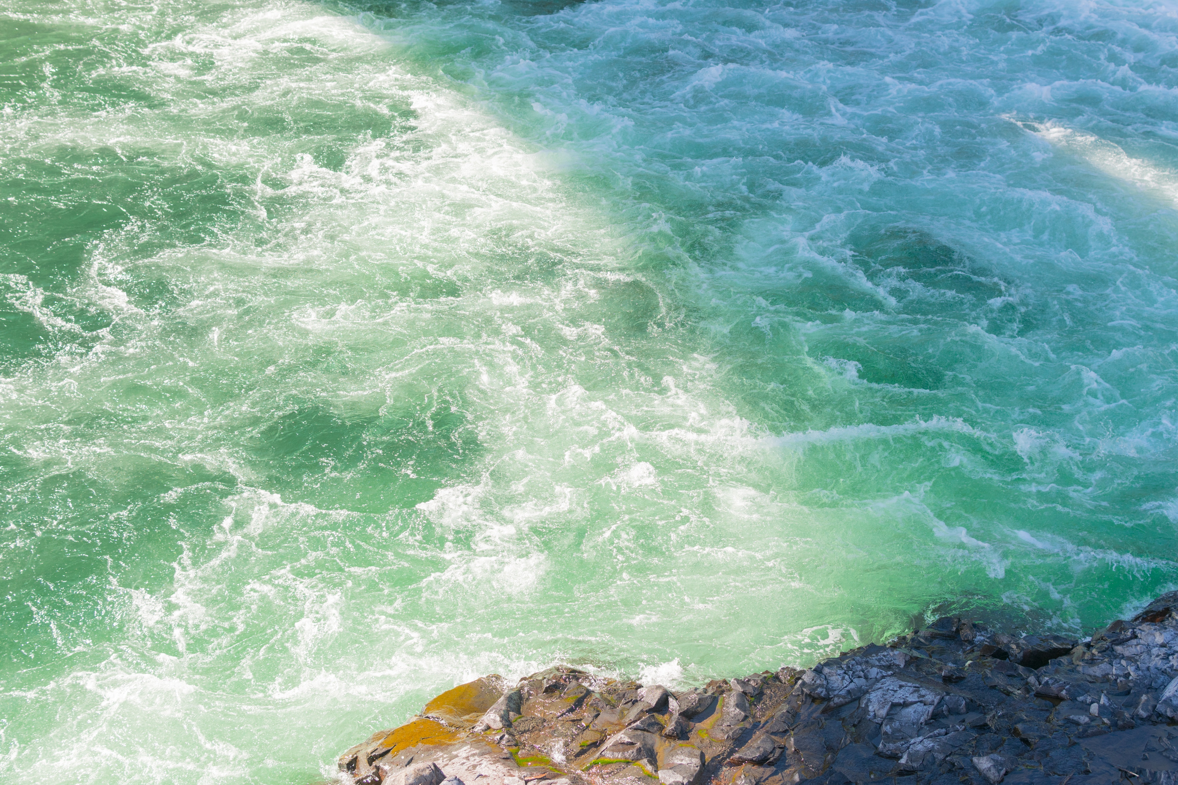
Conclusion
Water is vital for human life to exist on earth, covering more than 70% of earth’s surface. In order for life to continue existing as it does now, water should not be polluted.

