Slide 1
KOLBUSZOWA
our town

Slide 2
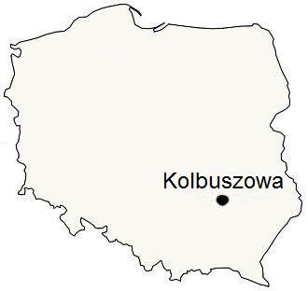
Location
Kolbuszowa is a small town in the south-east of Poland, near Rzeszów . In Kolbuszowa there is a river called Nil.

Slide 3
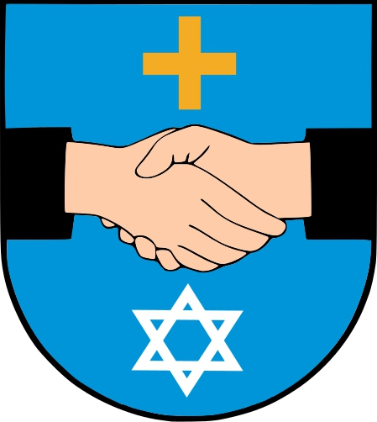
Crest
This is crest of Kolbuszowa. It symbolizes good relationship between Catholics and Jews in town.

Slide 4
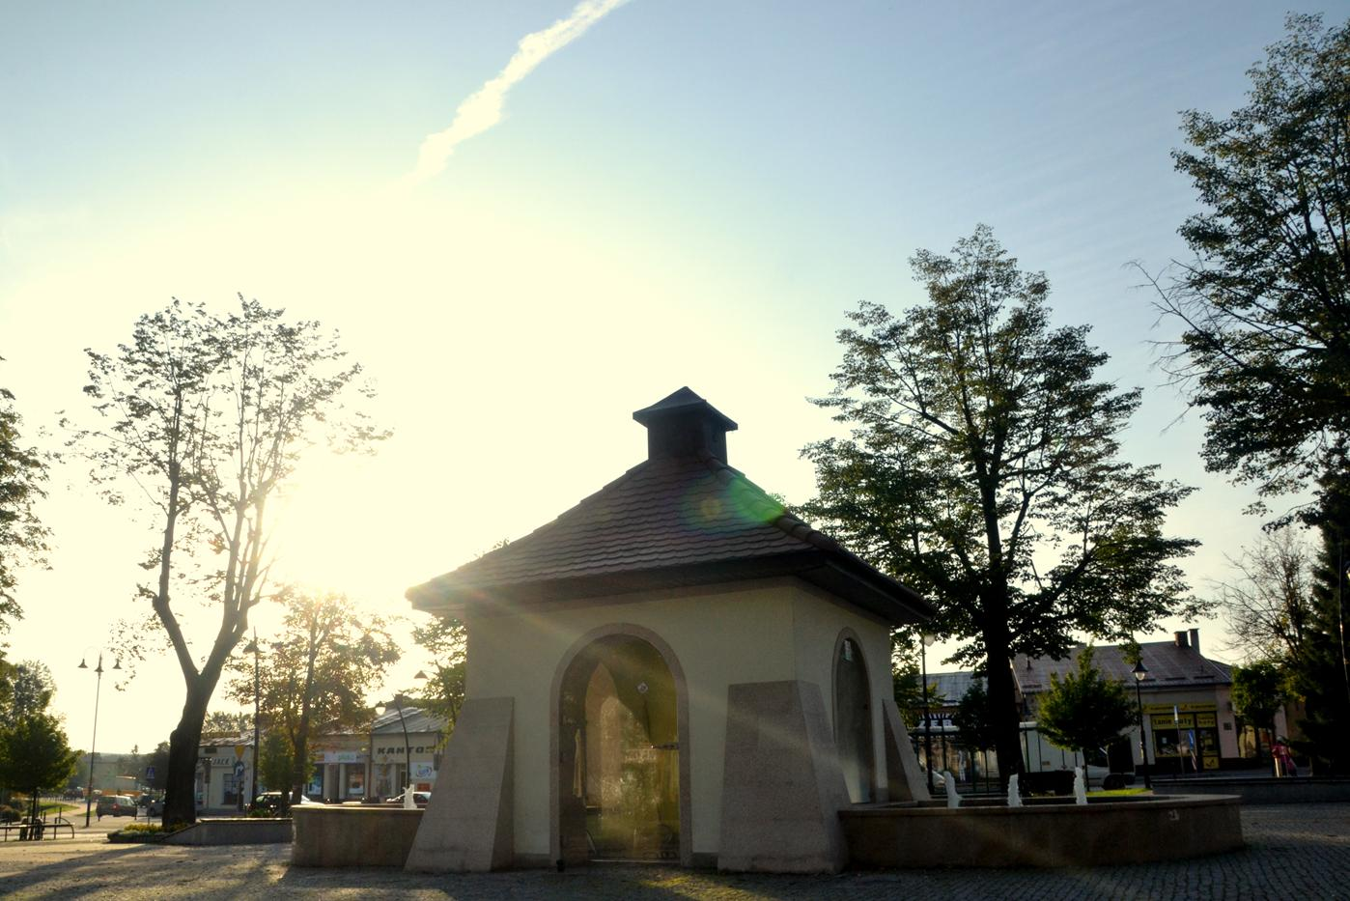
Main Square
On the main square in Kolbuszowa there are monuments like 'crocodile' and ‘ the Monument of Soldiers and Heroes'. There is also a well. You can have nice time on this squre.

Slide 5
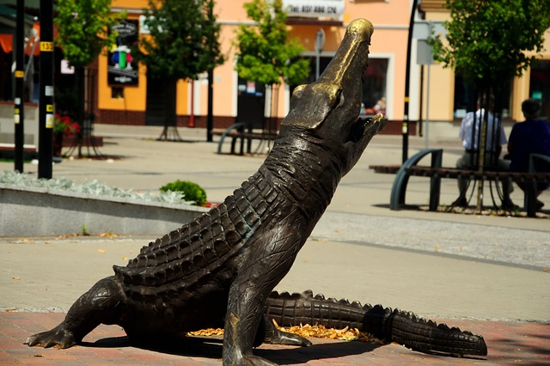
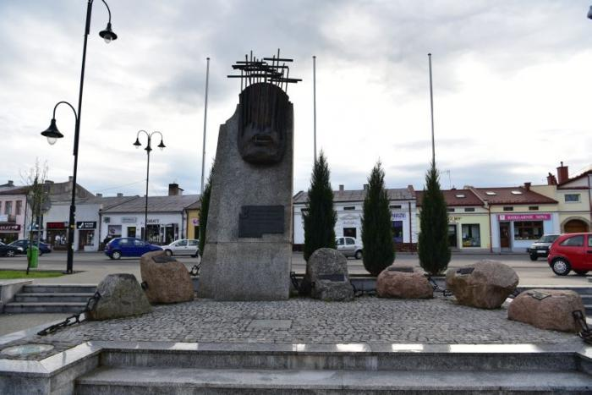
Monuments
Crocodile
The Monument of Soldiers and Heroes

Slide 6
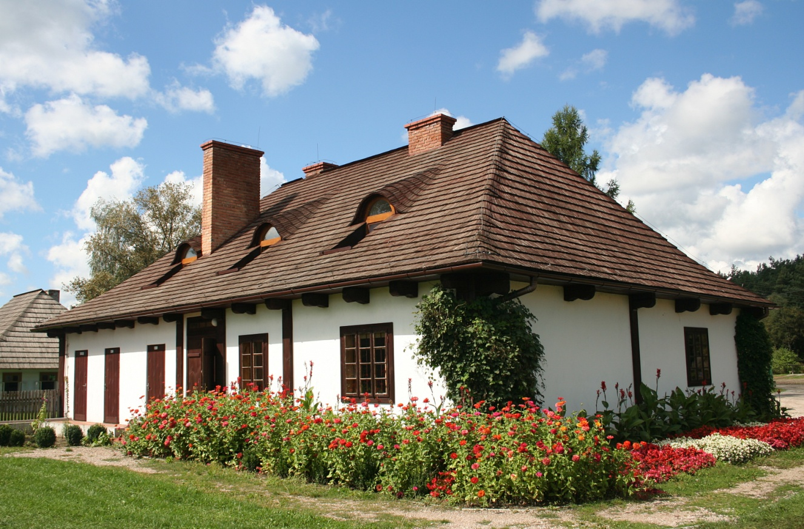
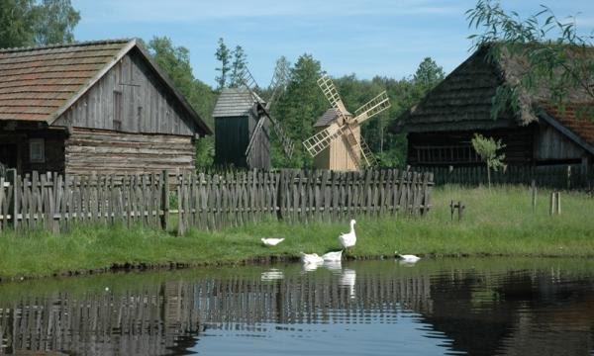
Atractions
In Kolbuszowa there is a Folk Culture Museum. It was opened in 1959. There is an ethnographic park. It is quite big beceause it occupies 30 hectares!

Slide 7
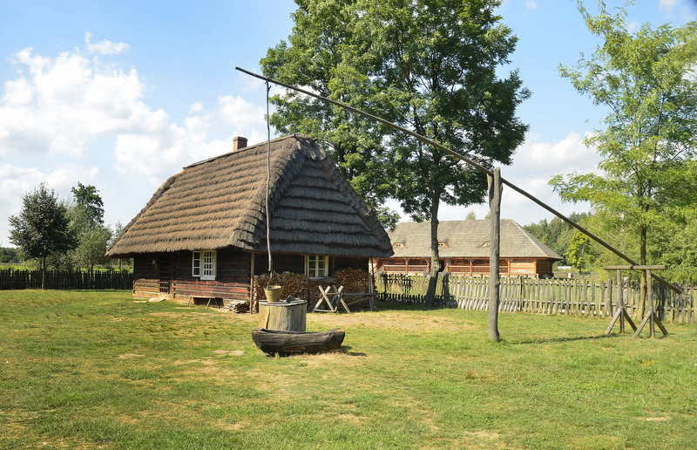
This place reminds us how Lasowiacy and Rzeszowiacy (people of our region) lived formerly.

Slide 8
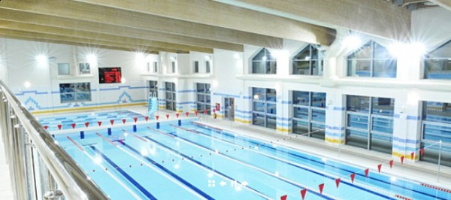
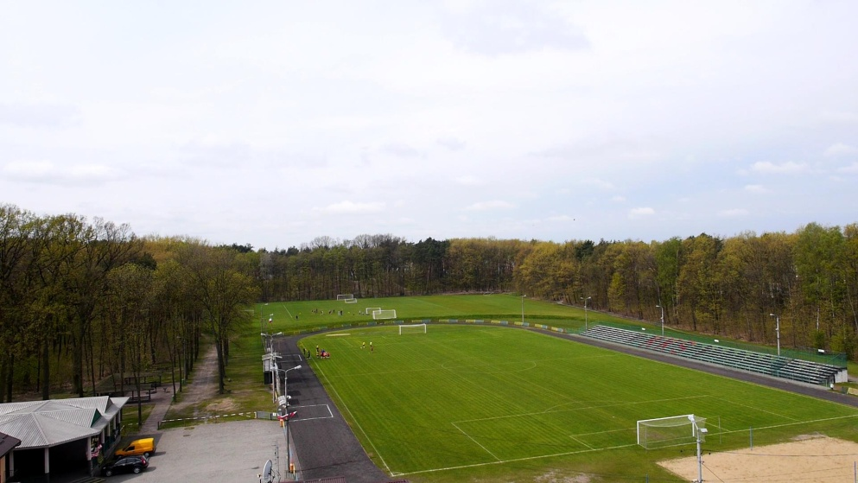
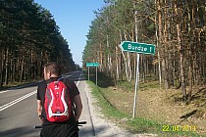
In our town we have a swimming pool, gyms and football pitches. You can also ride a bike on our four bike routes.

Slide 9
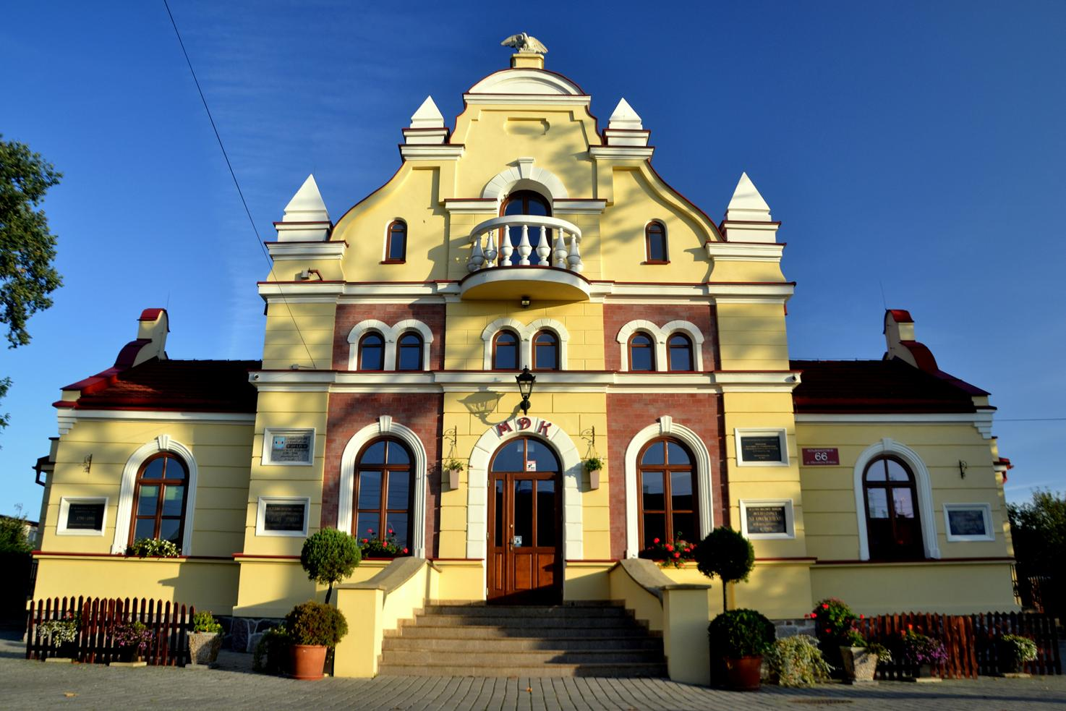
Community centre
This is the cultural centre of the town that holds various spectacles, concerts and competitions.

Slide 10
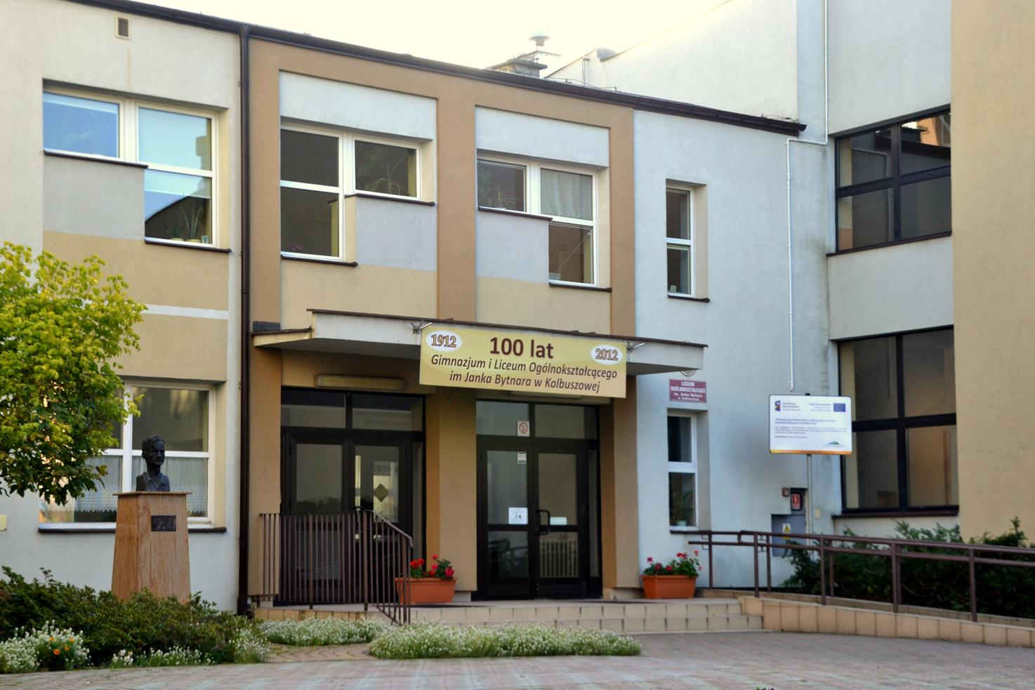
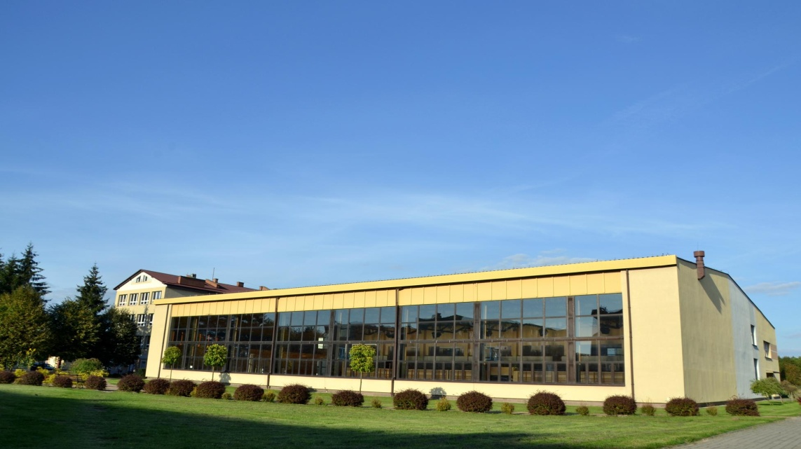
Our high school…
…which you can learn about from another presentation.

