Slide 1
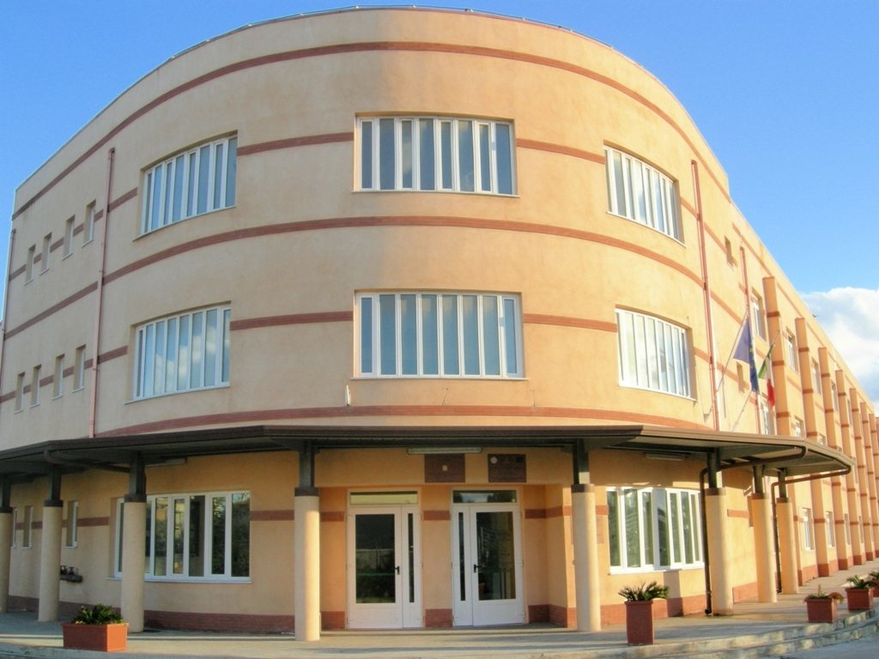
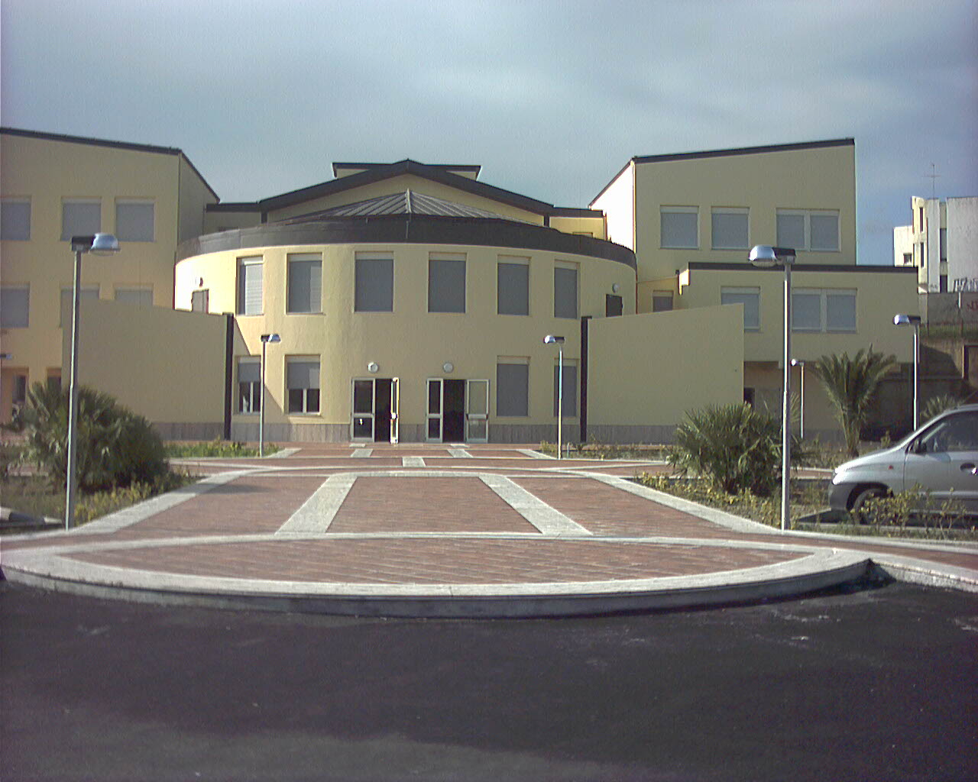
ISTITUTO DI ISTRUZIONE SUPERIORE "E. FERMI"
LICEO SCIENTIFICO
LICEO SPORTIVO
Science and Sport curricula
LICEO SCIENTIFICO
Science Curriculum
Sport Curriculum
LICEO LINGUISTICO
LICEO DELLE SCIENZE UMANE
Foreign Languages and Human Science curricula

Slide 2
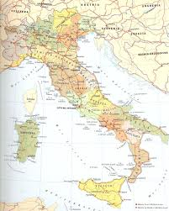
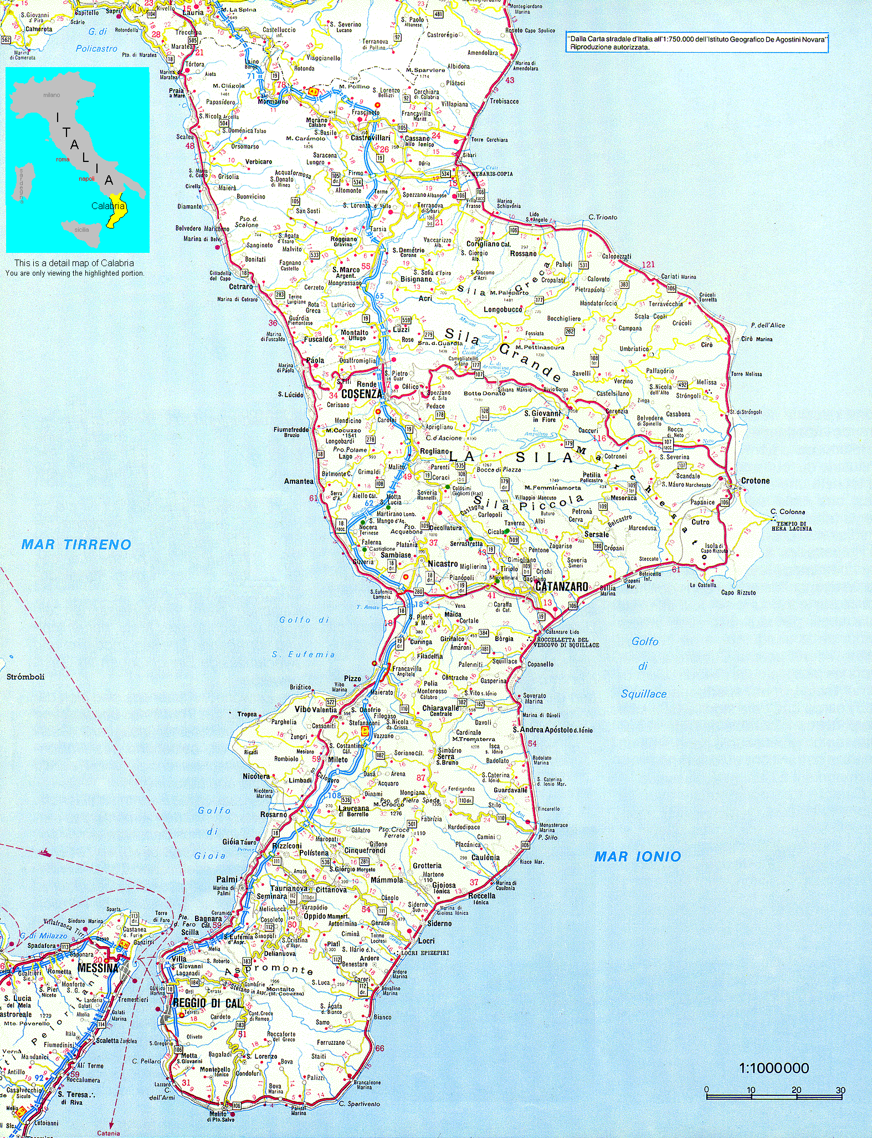
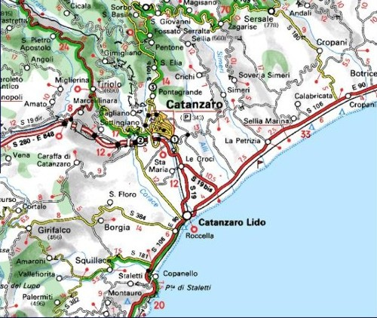
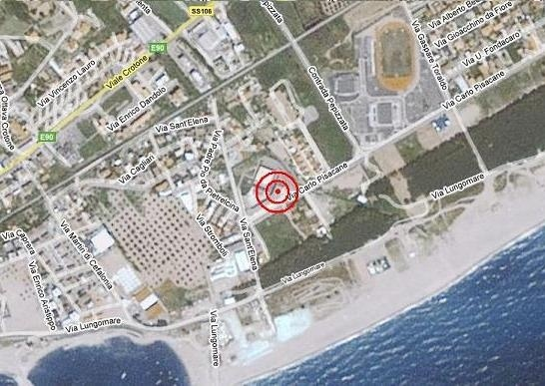

Slide 3
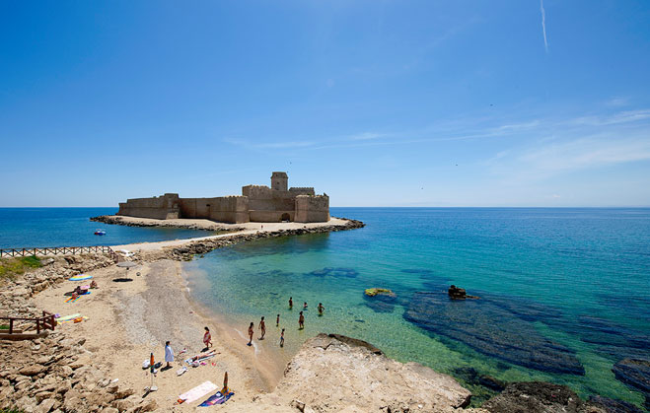
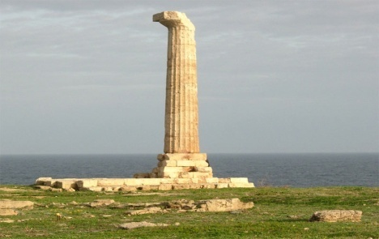
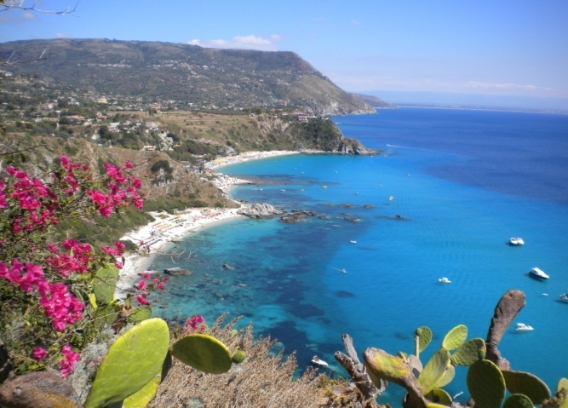
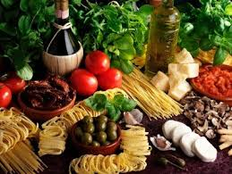
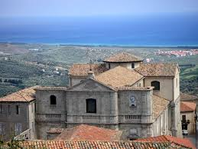
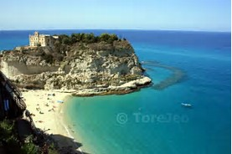
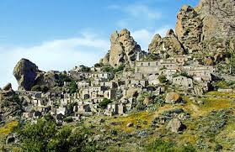
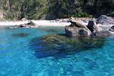
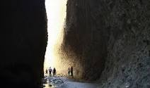
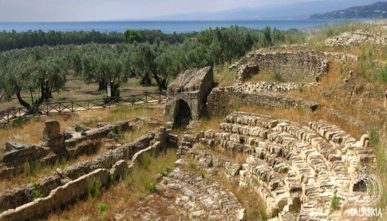
Archeological park
of Capo Colonna
Le Castella, Ionian sea
Squillace
Tropea, Tyrrhenian sea
Valli Cupe
Roccelletta di Borgia
Pentadattilo

Slide 4
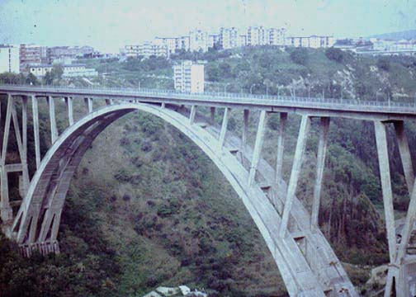
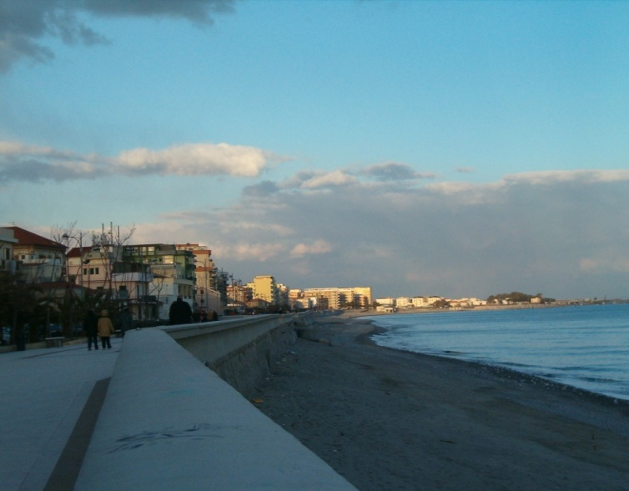
CITY OF CATANZARO
CATANZARO LIDO
The promenade
CATANZARO
The bridge “MORANDI”
ISTITUTO DI ISTRUZIONE SUPERIORE “E. FERMI”

Slide 5
ISTITUTO DI ISTRUZIONE SUPERIORE ENRICO FERMI, Catanzaro, ITALY
State General High School
1214 pupils, 109 teachers
Four main curricula:
Science
Sport
Human Science (with a Socio-economical option)
Foreign languages (with ESABAC option)

Slide 6
General educational aim:
to educate our pupils to be
European citizens sharing Paris Declaration 2015 values such as freedom, tolerance, non-discrimination, equality, human rights and dignity

