Slide 1
Good practice
Slow down education in the nature
Erasmus+ KA229 project

Slide 2
General information
School – Palade Põhikool
Country – Estonia
Subject – science, practical experiment
Teacher – Anne Luukas- STEM teacher

Slide 3
Cabbage Chameleon
Materials needed
Materials needed
Red cabbage
Grater
Sieve
Worksheet with pencil
Water (1L)
Different bowls for cabbage juice- 2
Different acid, alkaline and neutral solutions
Suitable for acidic solutions: acidic toilet cleaner(H₂SO₄),citric acid solution, vinegarCH3COOH)- choose one of them
Suitable for alkaline solutions: pipe cleaner (strong NaOH solution), baking soda solution(NaHCO₃), washing powder solution(Na₂CO₃ )
Water as a neutral solution

Slide 4
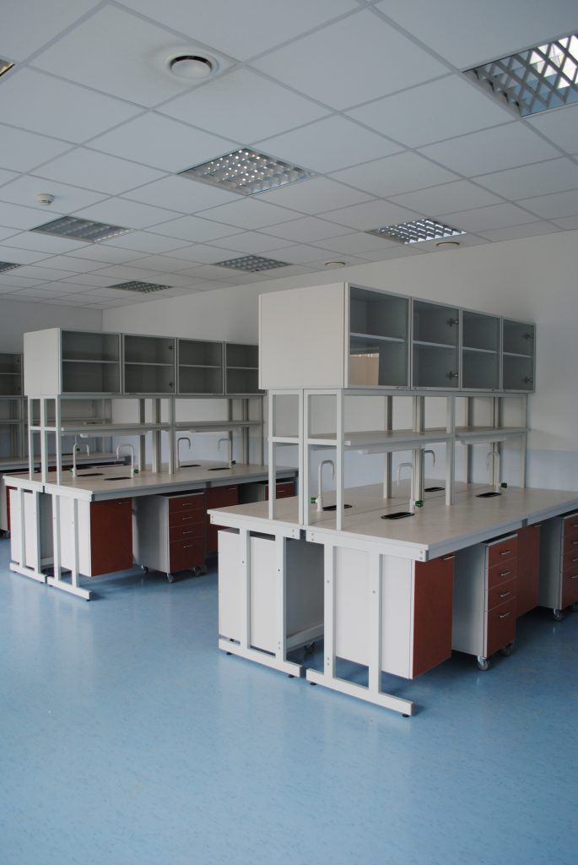
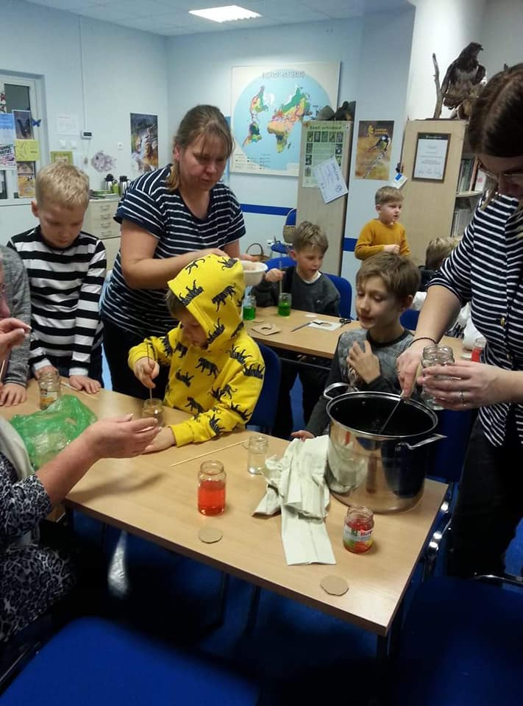
Surroundings
School LAB
Classroom
Home

Slide 5
Description
Introduction
We all know the chameleon- an animal who changes its colour as the environment changes around it.
We are going to use this feature in a different setting. We use red cabbage to show how its fluid changes its colour in different solutions. Is the solution acid, neutral or alkaline? Like the chameleon, red cabbage fluid changes its colour in different kinds of solutions.

Slide 6
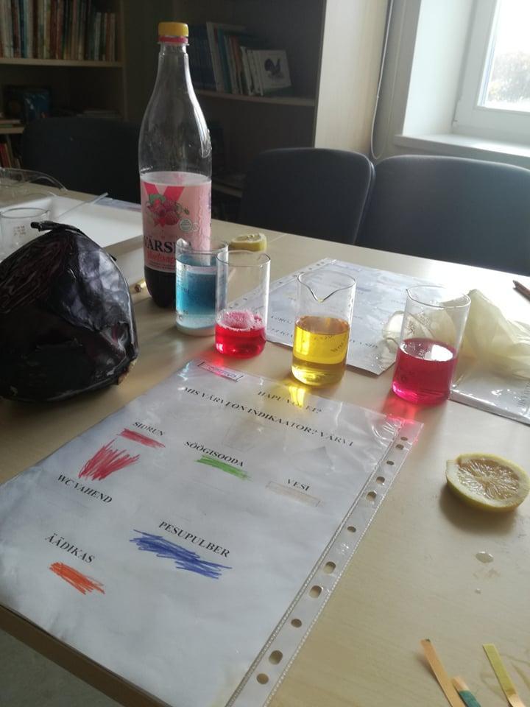
Aim
Through the practical experiment find out how red cabbage fluid changes its colour in different solutions

Slide 7
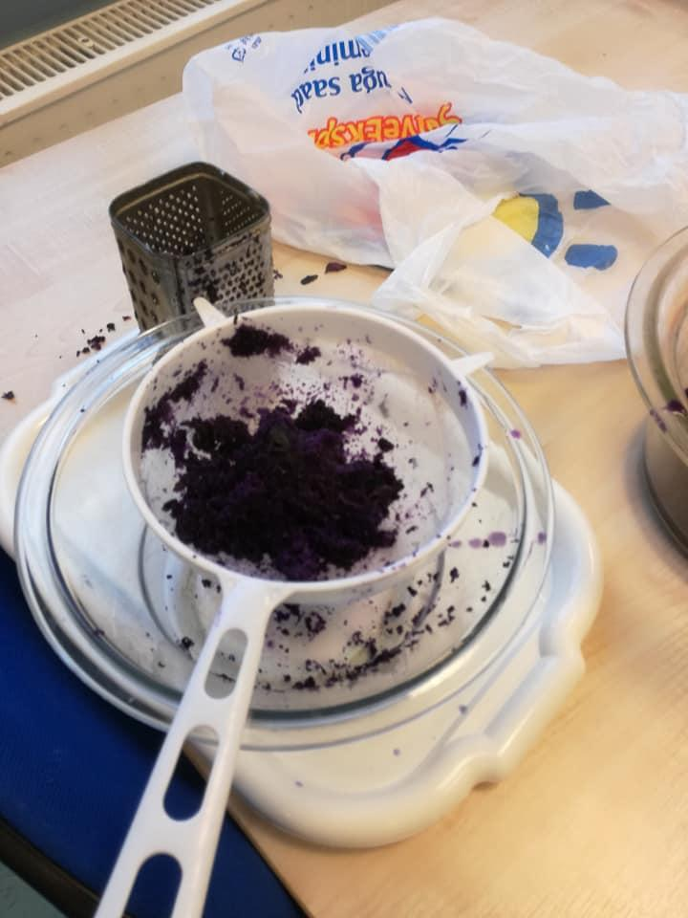
How it works?
1. Grate the cabbage through biggest holes of grater;
2. Put mass of cabbages in a bowl and pour out water on top of it.
3. Stir and wait 2- 3 minutes
4. Drain the cabbage juice with a sieve
Mass of red cabbage in sieve after soaking it in water- we use just cabbage fluid

Slide 8
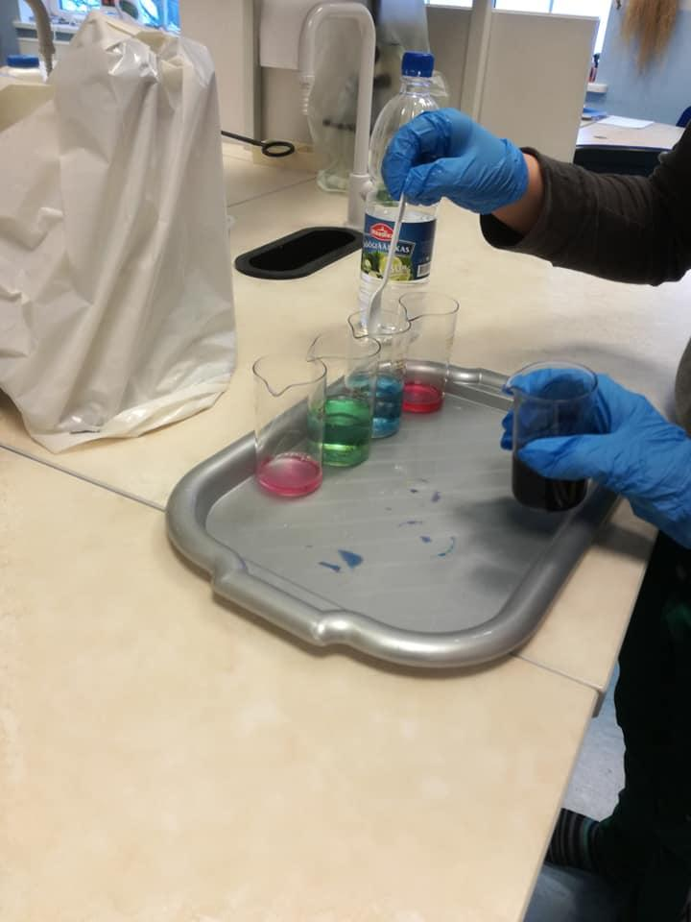
How it works?
4. Drain the cabbage juice with a sieve;
5. You will gain some blue fluid in the bowl.
6. Put your solutions ready, if needed, write notes on it.( NaOH, H₂SO₄ etc)
7. Pour some cabbage fluid in every solution.

Slide 9
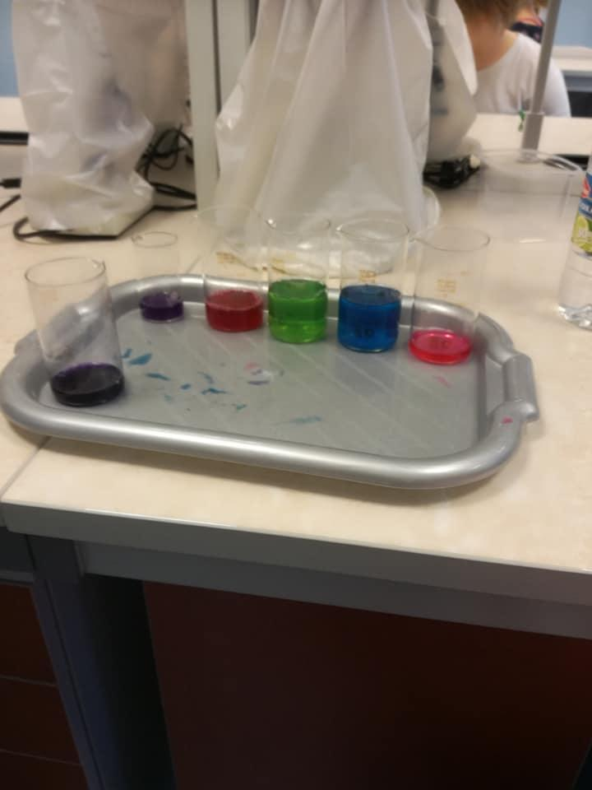
How it works?
8. Describe which colours will appear.
9. NB! you must be quick to notice that some solutions change its colour several times.
10. Write your observations in the table .
Picture description: different solutions and colours. Acids, alkaline and water. Dark blue is cabbage fluid

Slide 10
Table sheet
Solution | Colour of solution

Slide 11
Conclusions:
Alkaline(name)..................................... cabbage fluid was ……...................colour.
Acid(name)..............................................cabbage fluid was............................ colour.
In water cabbage fluid was …………........................................colour.
Red cabbage is a natural indicator like blueberry. It changes its color dependence on PH. In Laboratory we use indicators like litmus, universal test paper and phenolphthalein.
GOOD LUCK!

