Slide 1
Good practice
Slow down education in the nature
Erasmus+ KA229 project

Slide 2
General information
School – LICEUL TEHNOLOGIC TOPOLOVENI
Country –ROMANIA
Subject – Science
Topic – Taste Buds
Teacher – Tabarac Virginia
Date: September 2021

Slide 3
Detecting the four taste buds
Aims- The children will be able to understand where the taste buds for each taste are located.
Materials needed :
- bottles with sugar solutions, table salt, acetic acid (vinegar), wormwood tea
- small cotton swabs
- Four tweezers
- Four glasses
Surrounding - outside in the nature

Slide 4
Activity description
The students worked in teams, did experiments that highlighted the location of the four tastes on the surface of the tongue.
Procedure:
Soak the small cotton swab in the sugar solution and apply it on the middle of the tongue, then on the edges of the tongue, towards the top. The student always indicates the Taste sensation felt. The experiment is repeated for all the other solutions.
Fill in the blanks:
The sweet taste is localized to the tongue.
The salty taste is localized to the tongue.
The sour taste is localized to the tongue.
The bitter taste is localized to the tongue.

Slide 5
Activity description
They had to fill in a worksheet with the location of the four taste buds:
“The sweet taste is localized to the tongue ______________________
The salty taste is localized to the tongue ________________________
The sour taste is localized to the tongue ________________________
The bitter taste is localized to the tongue _______________________”

Slide 6
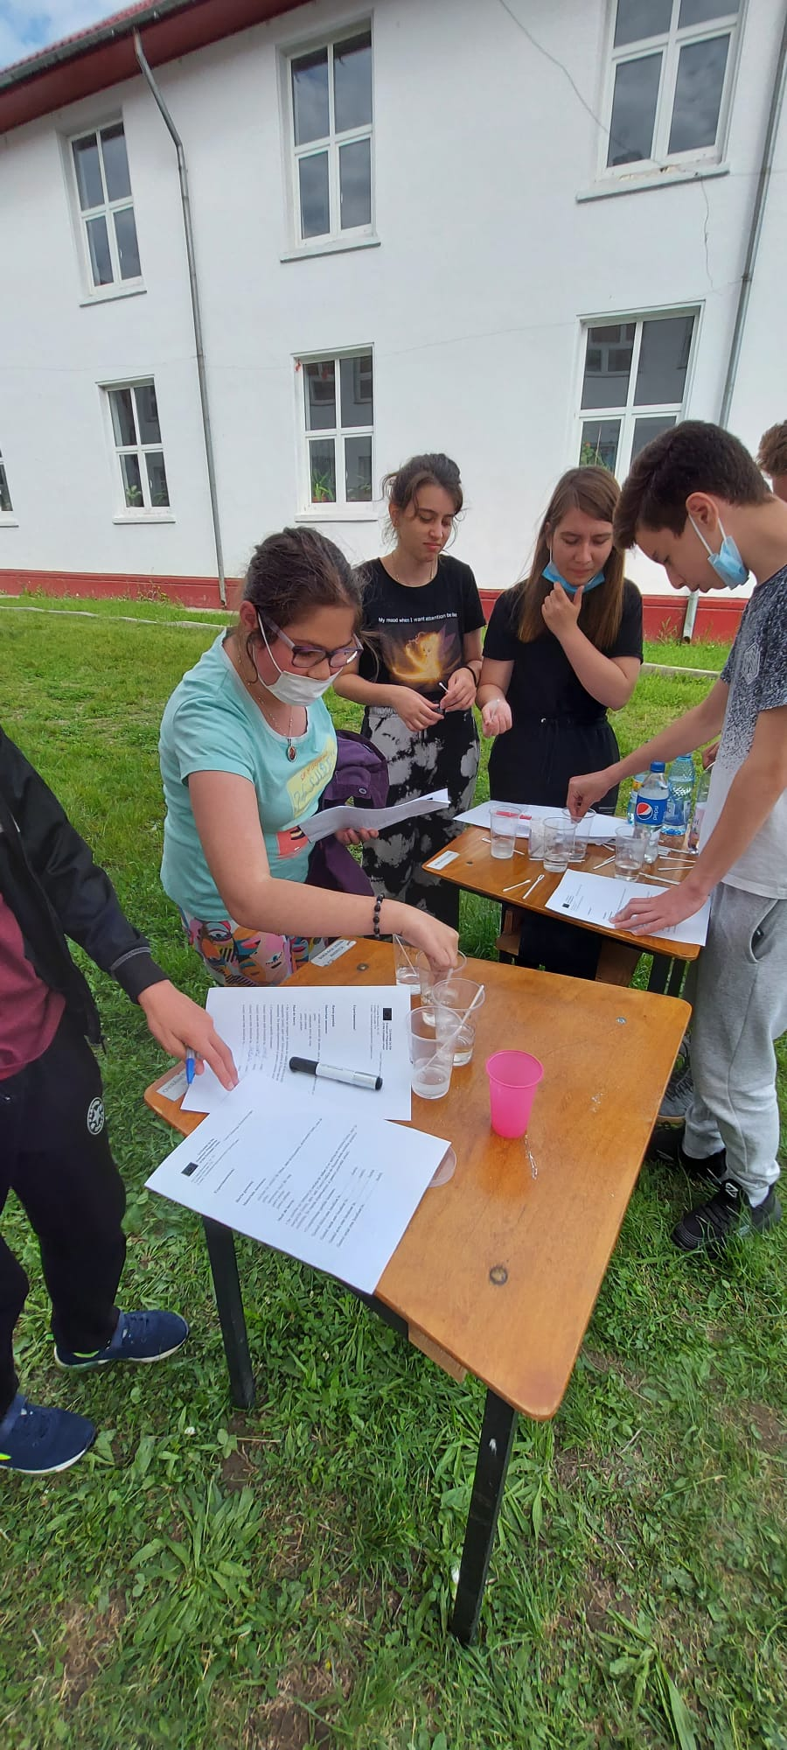
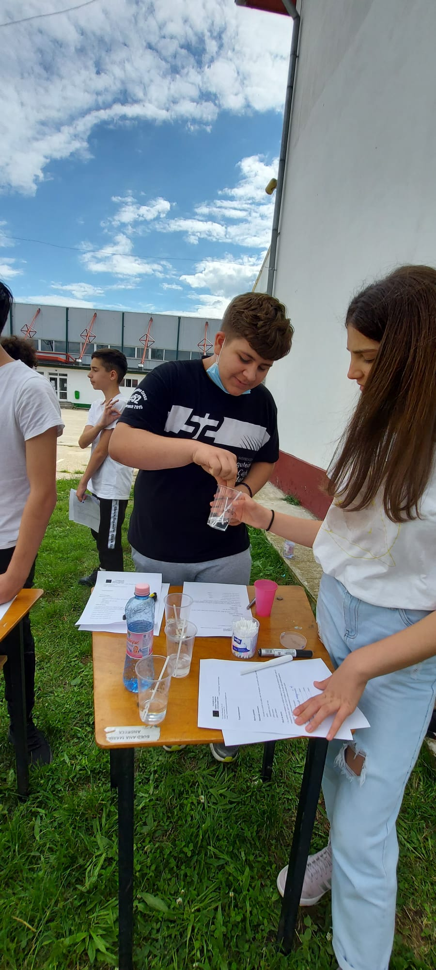
Gallery

Slide 7
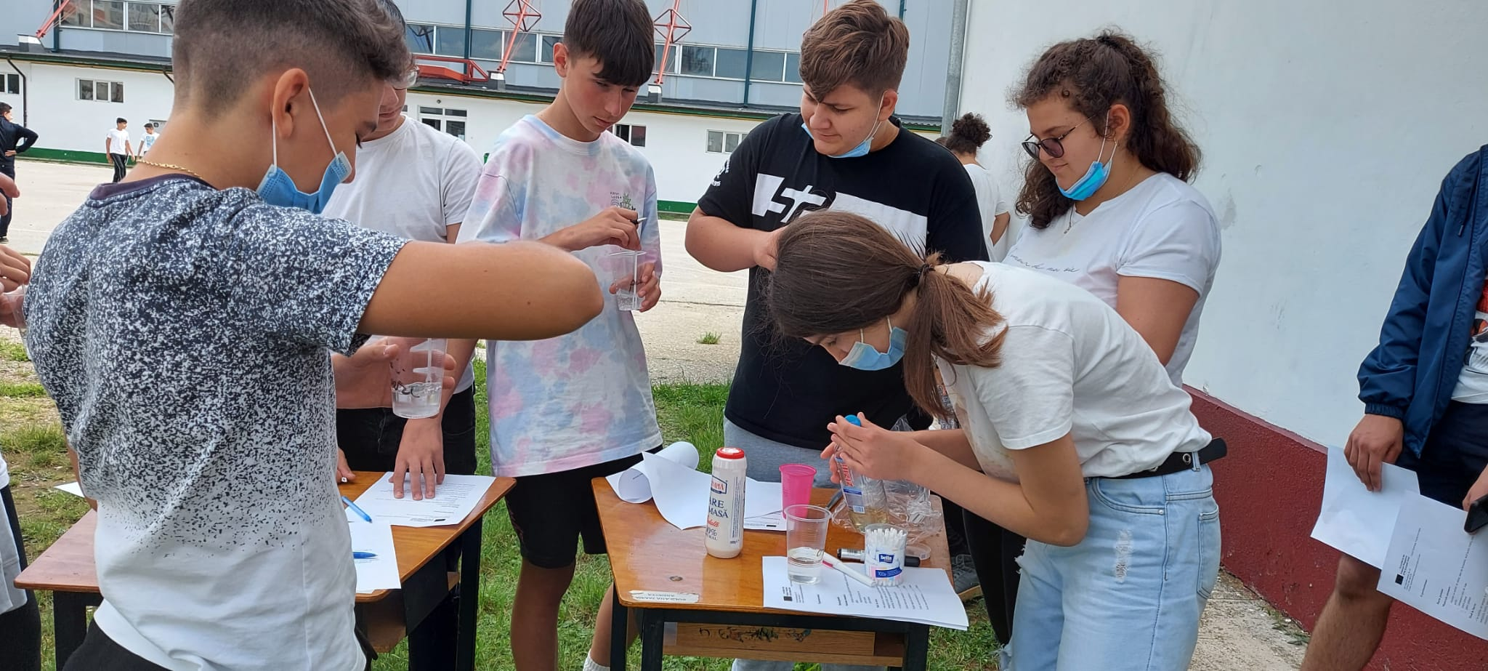
Gallery

