Slide 1
The Million Dollar Project STEM project
Erasmus + KA229 project “Slow down education in nature“
OOU “Lazo Angelovski“ - Skopje
Team members:
Jovana Nikolovska 8th grade
Simona Grashkoska 7th grade
Teodora Jovanovska 6th grade
Angela Krstevska 6th grade
Teacher mentor:
Daniela Davkovska

Slide 2
Project description
IMAGINE THIS:
You’ve just won $1 000 000 !!!
CONGRATULATIONS!!!
Now it is time to start planning what you are going to do with it. There are certain guidelines to your inheritance. You must follow them. If you do not spend the money in that certain way you will lose it!
Happy shopping!
Project aims
This project is designed to help you plan for your future, build your math skills, put them in a real-life situation by spending money within a budget and have same fun while researching!

Slide 3
Project guidelines
Here are the items you must purchase
1. Put at least $75,000 aside for college education. Research the cost of the education for ONE year at your favorite university and then calculate it against how many years it will take you to achieve your degree. 2. Purchase a home that is NO MORE than $300,000. Research various homes in locations that you would like to live. Find the home that you feel is PERFECT for you and print out one page with the specs from the home. 3. Take a family vacation. Use a travel agency to determine expenses for the total cost including: hotel, airfare, meals, transportation, spending money, etc. 4. Purchase a vehicle. Using dealership sites, find a car or vehicle that is to your liking and print out the one page with the specs for the car from the dealership. 5. Make one charitable donation. Remember that friends, family, and pets do not qualify as a charity. Find a charity that means something to you and give them funds based on a project they are working on. You may NOT spend more than $1,000,000 but you want to spend as much of it as possible.

Slide 4
1. College education
Stanford University, officially Leland Stanford Junior University is a private research university in Stanford, California. The campus occupies 3,310 hectares, among the largest in the United States, and enrolls over 17,000 students. Stanford is ranked among the best universities in the world
Tuition costs $52,857 per year, while room and board costs $16,433 per year. The school also estimates that students can expect to pay about $1,905, books and supplies that cost about $1,245 and personal expenses of about $2,130.
Total cost for 4 years: $=\$298280$

Slide 5
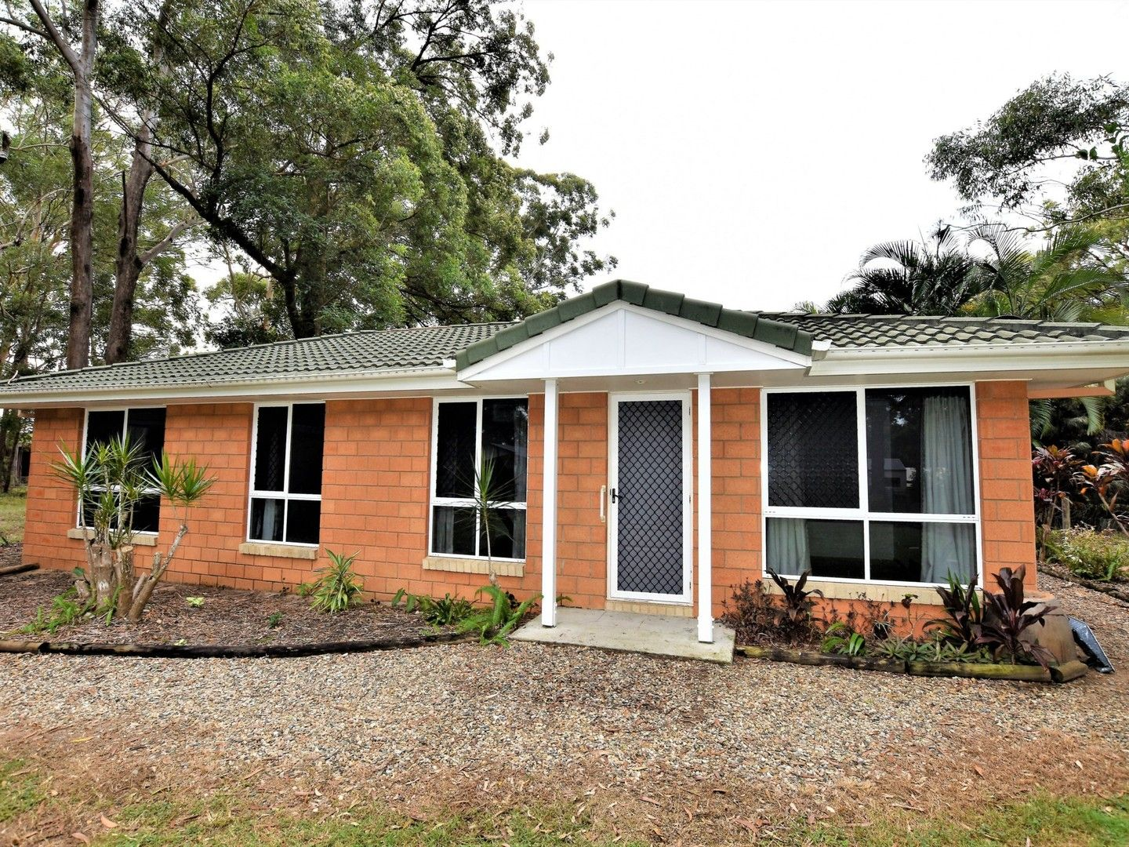
2. Home
Some of the cheapest homes for sale can be found in Queensland at 33 Angora Street, Russell Island.
The neat brick house, with four bedrooms, refreshed flooring, modern kitchen and bathroom.
Total cost: $229,000.

Slide 6
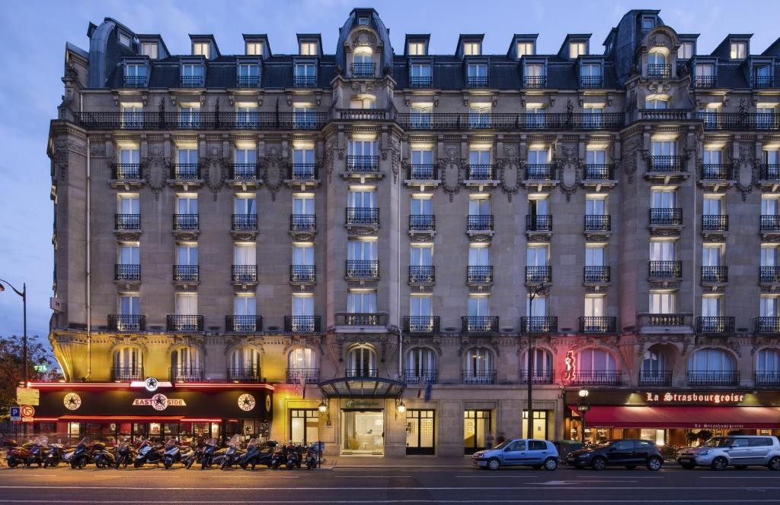
3. Family vacation - PARIS
This Holiday Inn Paris Gare de l'Est hotel is located opposite Gare de l’Est Train and Metro Station, which provides direct access to attractions such as Saint-Michel and the Latin Quarter. It offers a lobby bar with lead glass windows.
1 standard room and 1 twin room perfect for 2 adults and 2 children for 6 nights cost MKD 129,808 on Booking.com
Flight from Skopje to Paris for 1 person with Austrian Airlines cost €157. Total cost for 4 persons €628.
Additional cost for food, shopping, souvenirs $2,000.

Slide 7
4. Vehicle
Jeep® Wrangler 4xe Plug-In Hybrid RUBICON
The Wrangler 4xe is a plug-in hybrid electric SUV that combines a powerful electric motor with a gas engine, which means that even when the Wrangler 4xe isn't charged, you can still drive using the gas engine.
Cost for one $56,220, we will buy two
Total cost $112,440

Slide 8
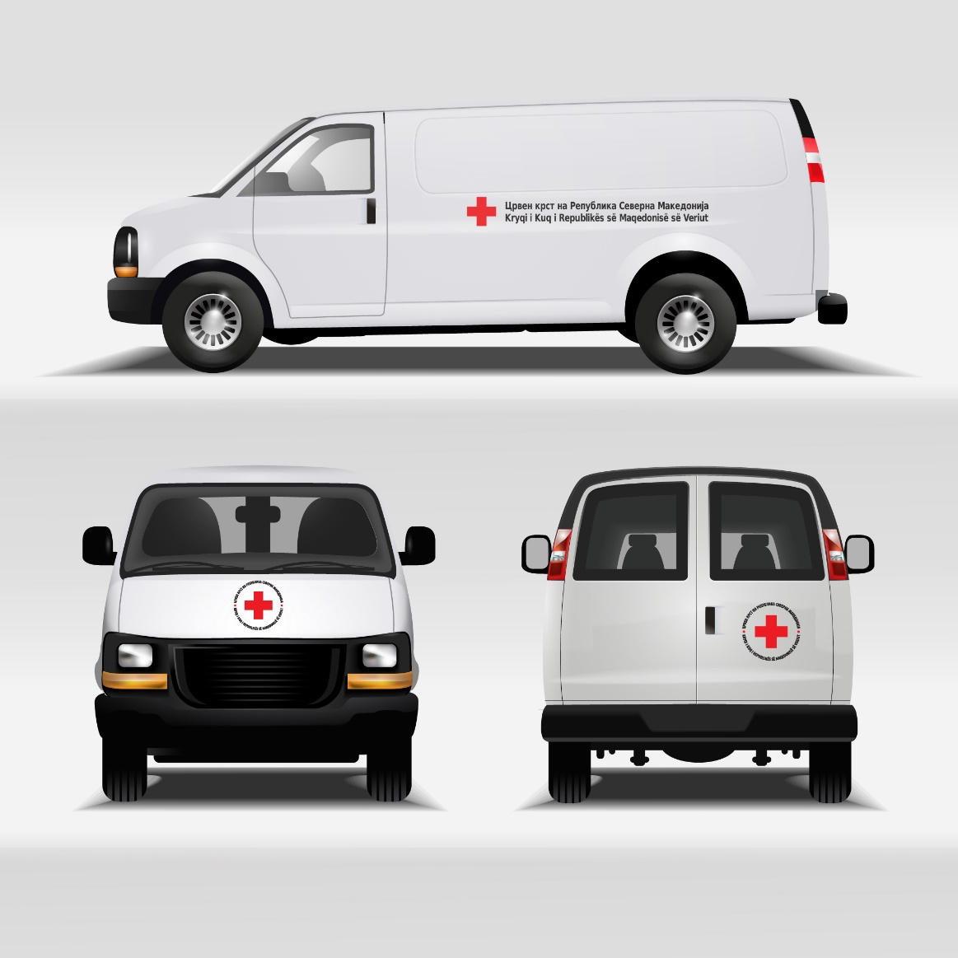
5. Charitable donation
Donation to Red Cross organization for medical vehicles.
This vehicles are intended for older people who need help in emergency situations.
$200,000

Slide 9
Calculations
ITEM NAME | COST | REMAINING BALANCE
College education | $$\text{(}\$\text{52}\text{857+}\$\text{16433+}\$\text{1905+}\$\text{1245+}\$\text{2130)}∙4=\$74570∙4=\$298280$$ | $$\$1000000−\$298280=\$701720$$
Home | $$\$229000$$ | $$\$701720−\$229000=\$472720$$
Family vacation | $$MKD129808 :54.32+$$ $$€157∙4 ∙1.13+\$2000=$$ $$\$2390+\$710+\$2000=\$5100$$ | $$\$472720−\$5100=\$467620$$
Vehicle | $$2∙\$56220=\$112440$$ | $$\$467620−\$112440=\$355180$$
Charitable donation | $$\$200000$$ | $$\$355334−\$200000=\$155180$$
TOTAL SPEND : $1000000 – $155180 = $844820

Slide 10
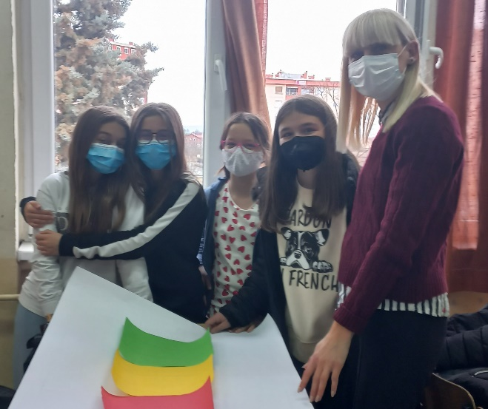
Google searches
https://en.wikipedia.org/wiki/Stanford_University
https://www.domain.com.au/news/cheap-properties-seven-homes-under-300000-that-you-can-buy-right-now-1041477/
https://www.booking.com/hotel/fr
https://www.edreams.com/travel/?locale=en_GB#results/type=R;dep=2022-04-29;from=SKP;to=PAR;ret=2022-05-05;internalSearch=true
https://www.jeep.com/wrangler/wrangler-4xe.html
https://solidarnost.redcross.org.mk/
Thank you for your attention!

