Slide 1
Good practice
Slow down education in the nature
Erasmus+ KA229 project

Slide 2
General information STEM CONTEST
School – LICEUL TEHNOLOGIC TOPOLOVENI
Country –ROMANIA
Subjects: Science, Maths, Sports
Topic –STEM beyond boundaries
Place: The students are placed outside the limits of their regular classroom activities
Teachers – VISAN NICULINA, MATEI LIVIU, BOTIRCA OANA
Date: March 2021

Slide 3
STEM CONTEST
Key skills:
Working with others (collaborative learning – quicker progress)
- Creative thinking (think outside the box)
Setting goals (taking on challenges, dividing the project into smaller steps, being resilient
- Developing communication skills

Slide 4
Activity description
Students are given a set of tasks to solve during a time limit (total duration 2 hours)
Location:
Classroom
Sports hall (it was raining heavily outside)
Tasks:
Science and Maths worksheet – analysing tasks
Practical Activity –
• establishing the route and drawing it using coloured chalk for the sports event – triangular, rectangular and circle shapes (using a measuring tool)
• the sports test: which consists in covering the routes in the shortest possible time (dwarf’s walk) - timing;
• recording and processing data necessary to determine the travel speed for each team;

Slide 5
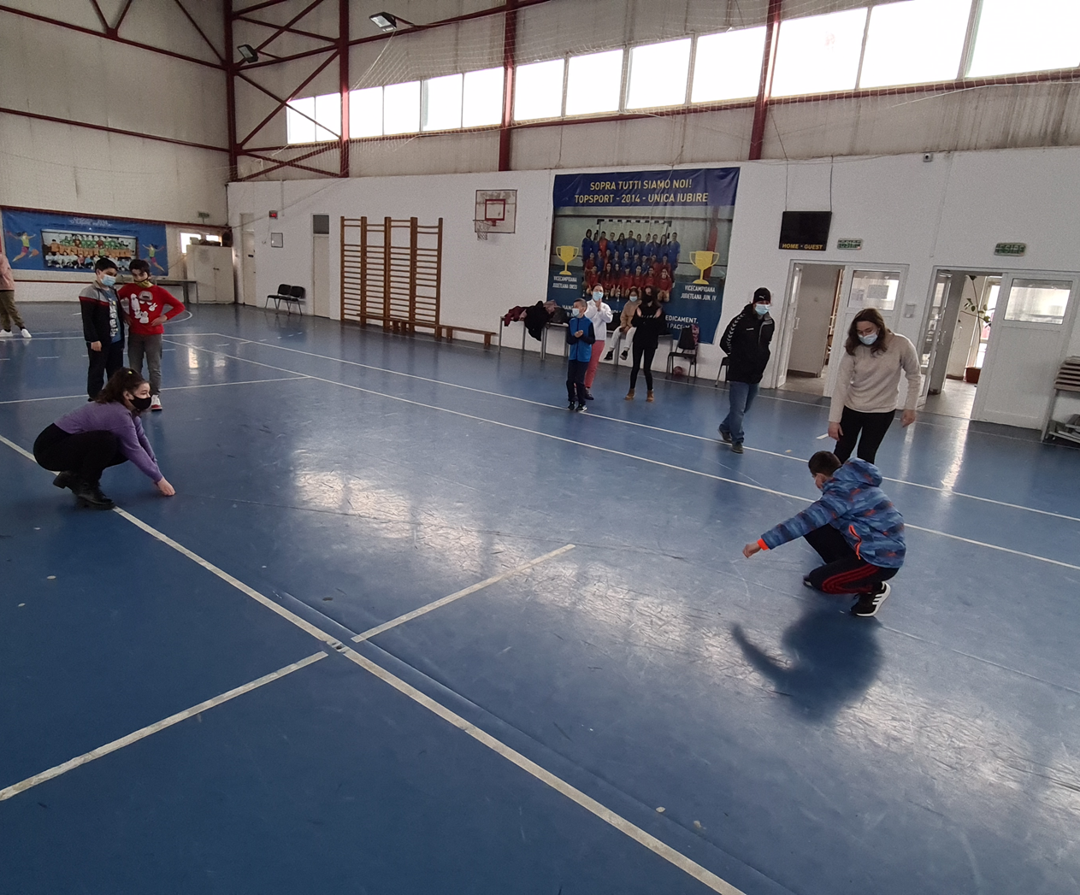
Activity description
Challenges:
Drawing the routes (triangular, rectangular and circle shapes)

Slide 6
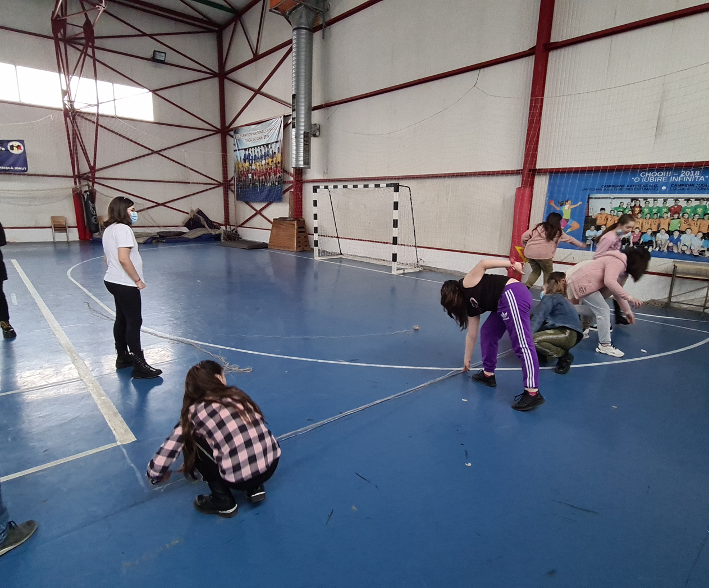
Activity description
Children had to use a string to draw the perimeter of the triangle, rectangle and circle (30 m).

Slide 7
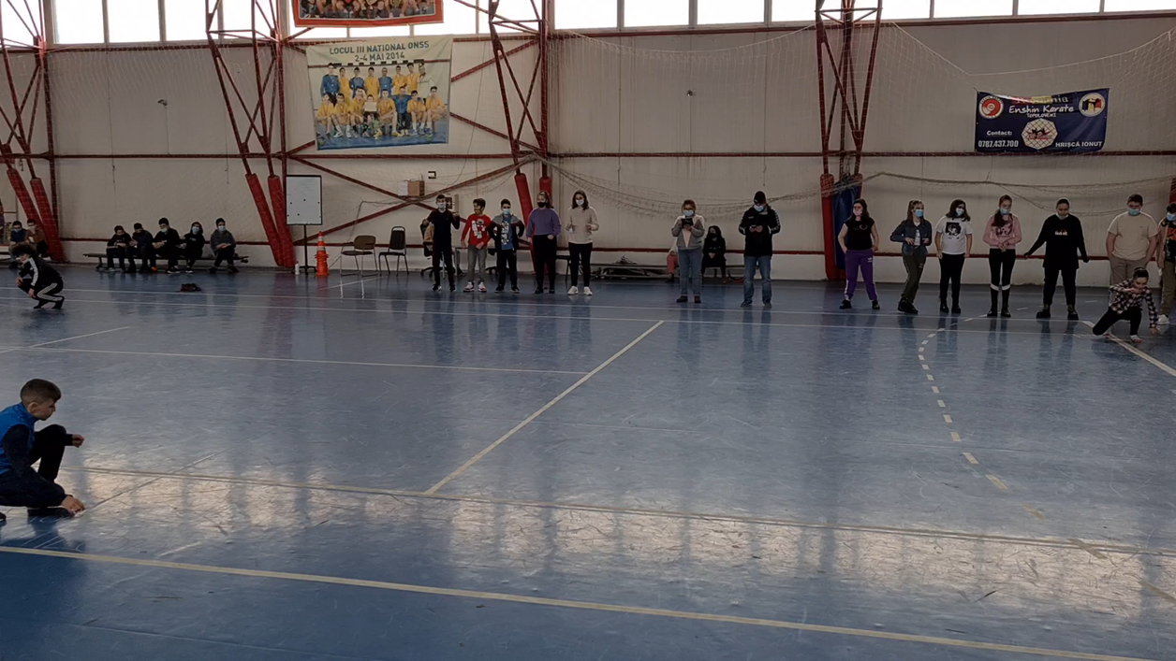
Activity description
After drawing the shapes, a representative of the team had to cover the perimeter (30 m) using “dwarf’s walk”.
The sports teacher timed and at the end the teams had to calculate the speed of each representative.

Slide 8
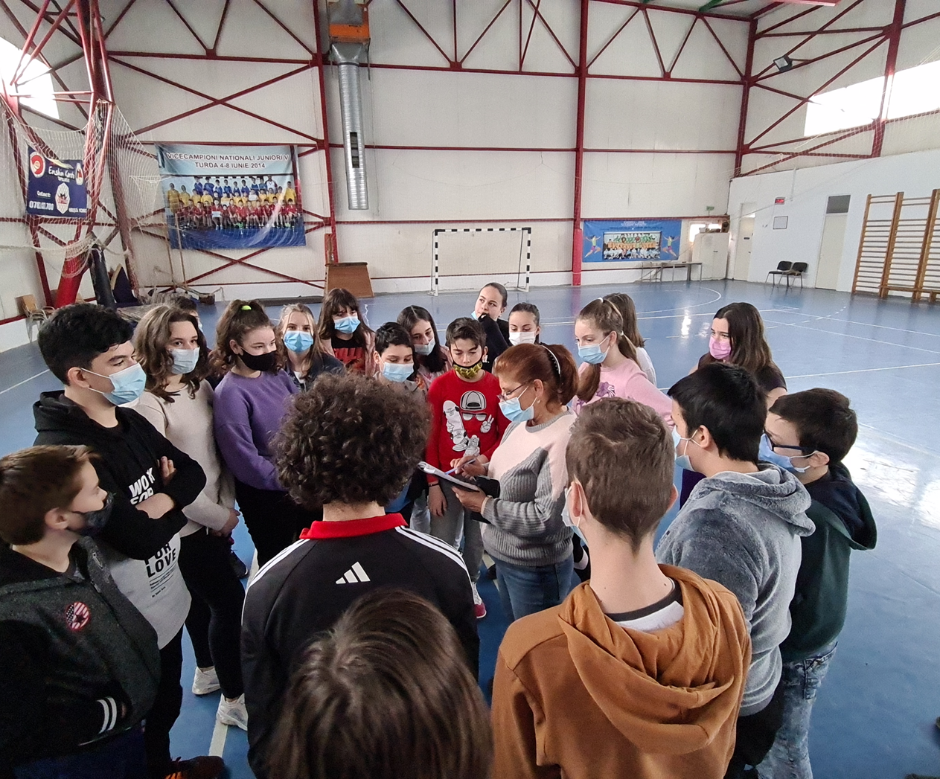
Activity description
Final Remarks
Evaluation
Self-evaluation

