Slide 1
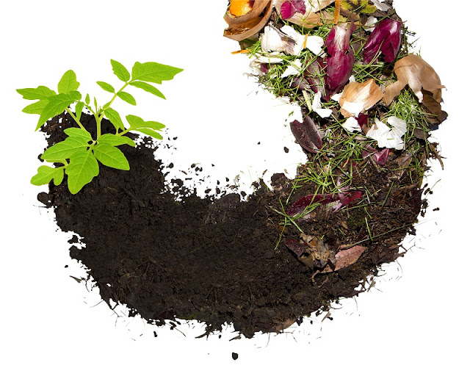
FROM WASTE TO FOOD!
Slow down education in the nature
Primary School “Lazo Angelovski” Skopje
Marko Panchevski VII, Kiril Zdravev VI,
Oleg Petrovski VII, Petar Mandzukovski VII
Mentors: Donka Miteva & Slobodan Stamatovski

Slide 2
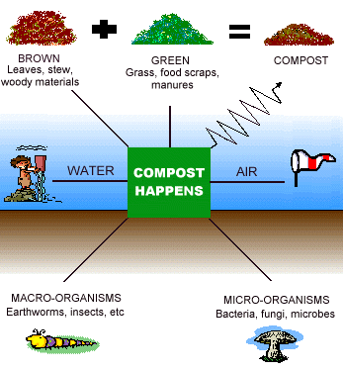
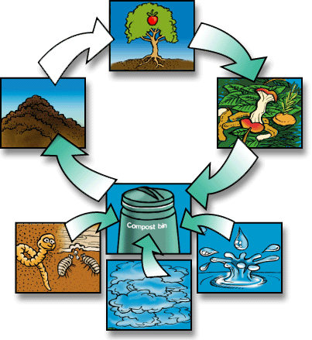
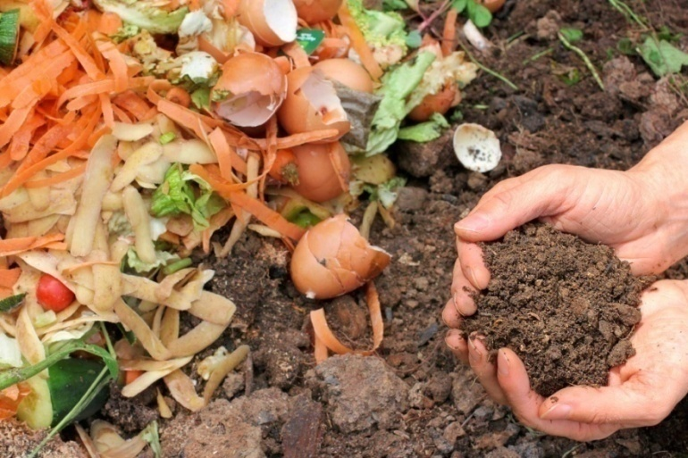
Composting – process where the compound organic matter from plant food waste is degraded by MO to its basic elements in presence of oxygen-O₂ and water-H₂O,and realising carbon dioxide - CO₂ and heat,
so the final result is a production of high quality compost.

Slide 3
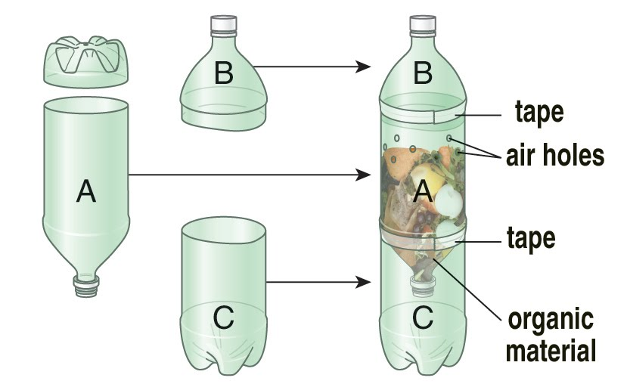
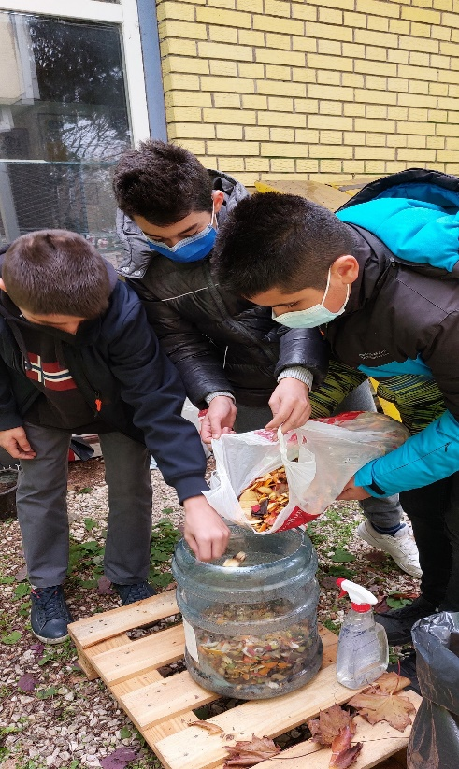
Mini compost bin in a transparent bottle!

Slide 4
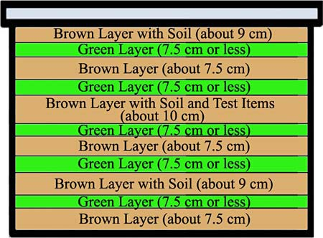
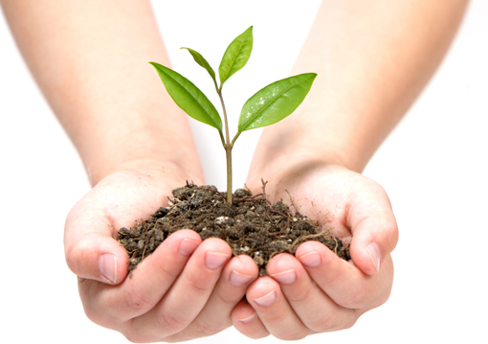
The first layer in the composter is a brown component followed by a green component, which alternate until the composter is full.
The last layer in the composter is obliged to be a brown component.
Little soil is added on every second layer of the brown component
(that is a source of MO which accelerate the decomposting process).
A green component (rich in nitrogen) | A brown component (rich in carbon) | It is not recommended for composting
Fruit | Dried leaves | Anything treated with pesticides or other chemicals
Vegetables | Newspapers | Non biodegradable plastic
Wilted flowers | Dried branches | Meat
Dead plants | Paper (it was not in contact to meat) | Fish
Mown grass | Straw | Bones
Coffee grounds | Hay | Dairy products
Leaves | Egg shells | Oils
 | Cardboard | Unhealthy plants
 | Wood ash | Baby nappies
 |  | Feces
 |  | Oil paper

Slide 5
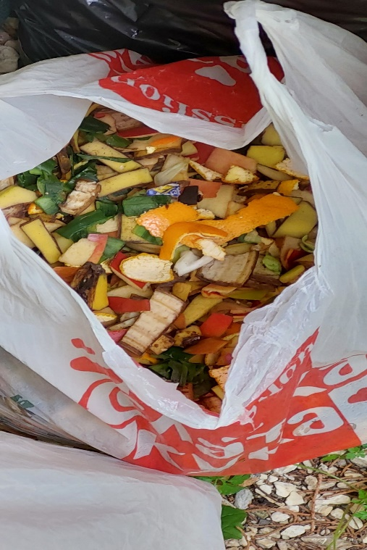
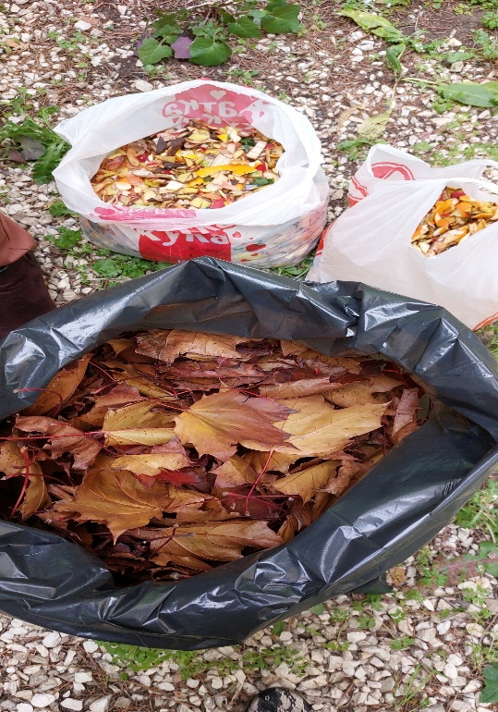
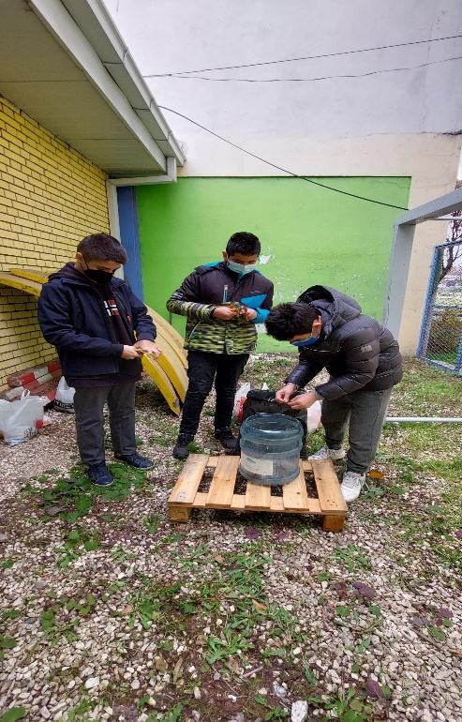
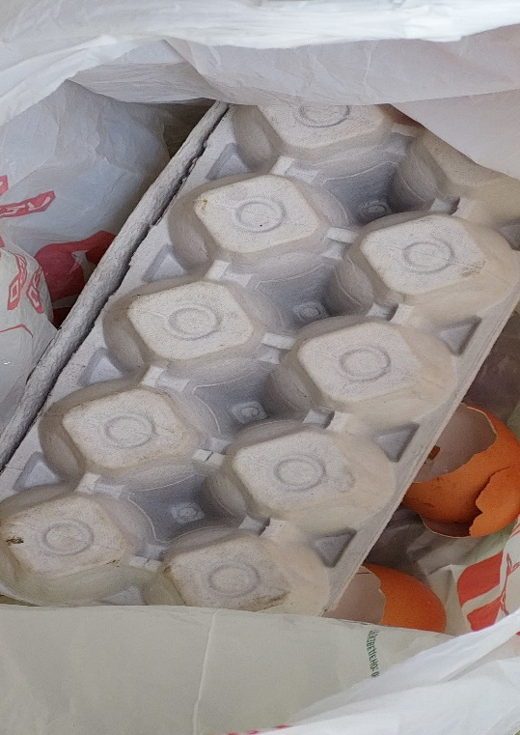
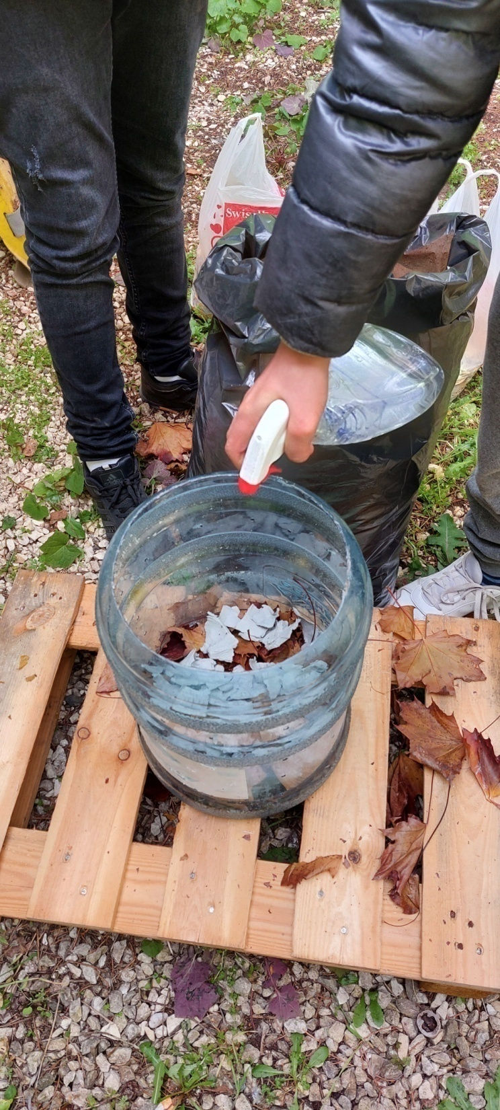
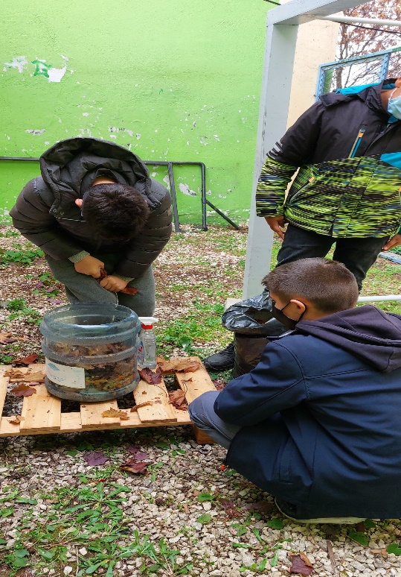
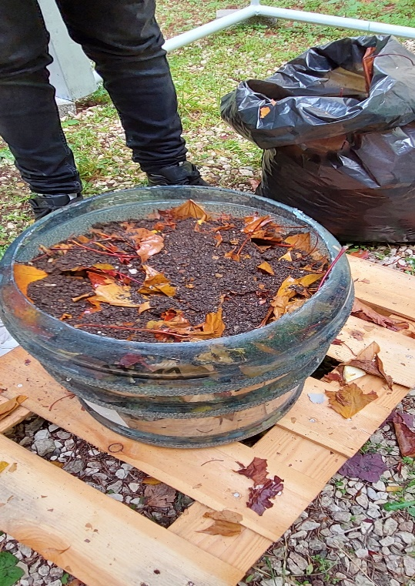
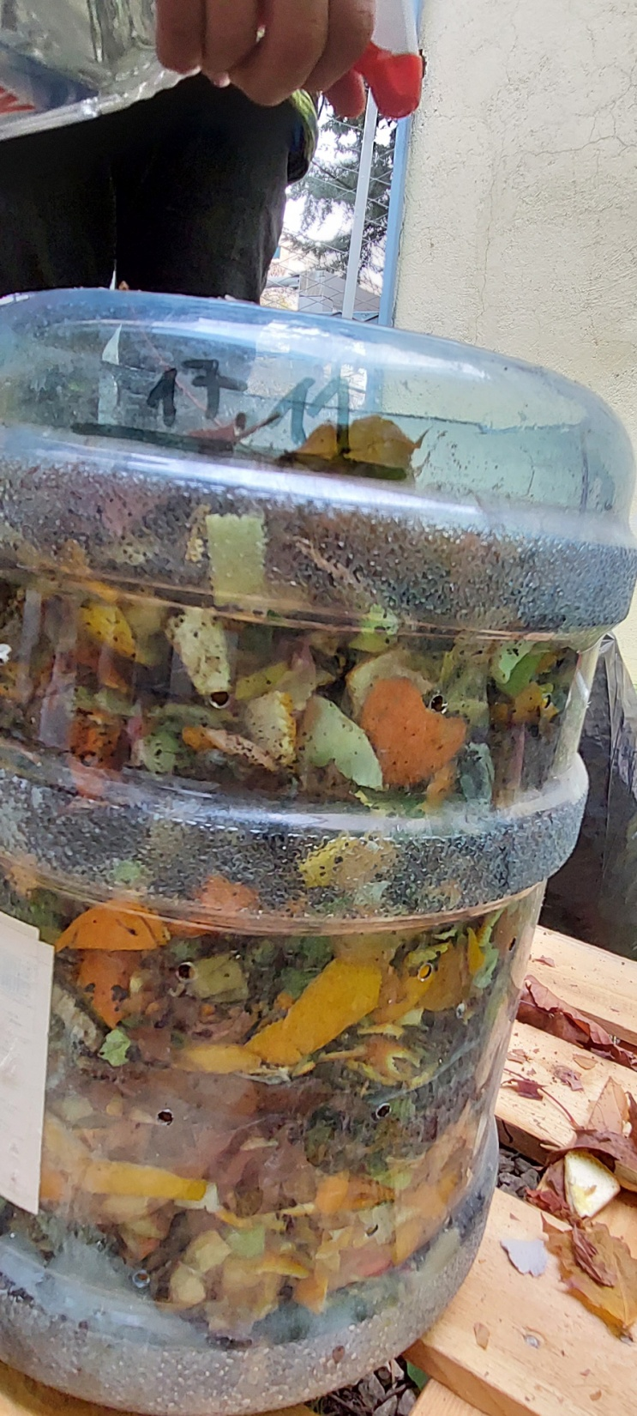
Our experiment...
2
4
3
1
8
5
6
7

Slide 6
The following parameters that were measured in the composting process:
phase | period (days) | volume decreasing, % | temperature, °C
thermophilic phase | 15-20 | 20 | 40-60
mesophilic phase | 20-30 | 20 | 25-35
cooling phase | 30-45 | 15 | 20-25
maturation | up to 60 | 15 | 15-20
Decreasing the number of MO which were decomposting the organic substance

Slide 7
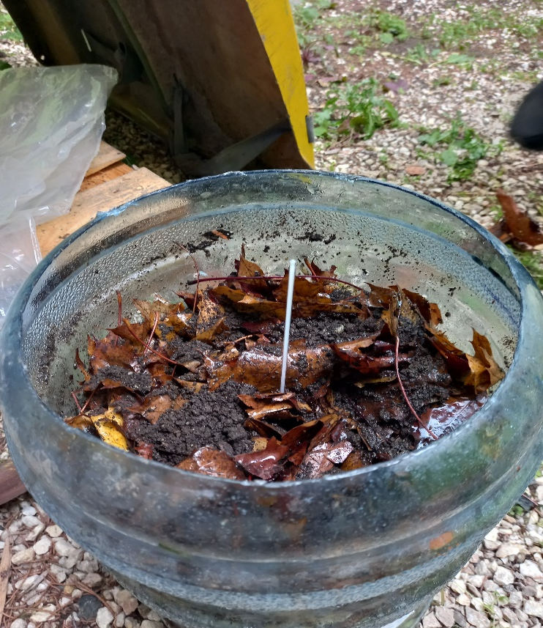
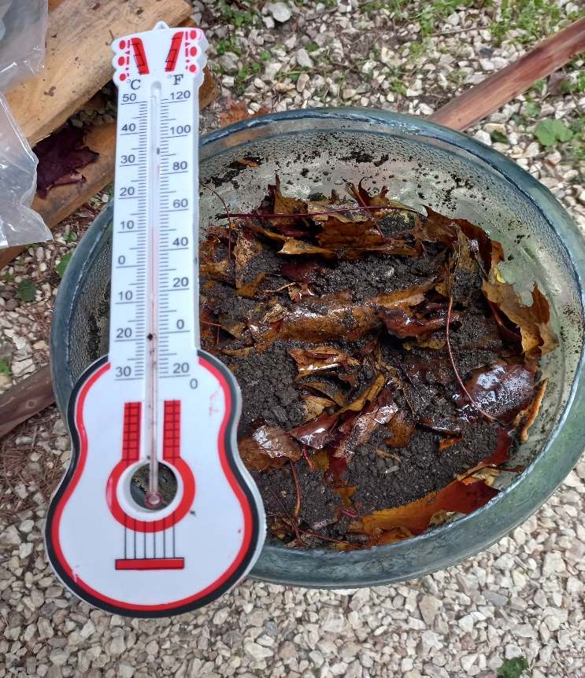
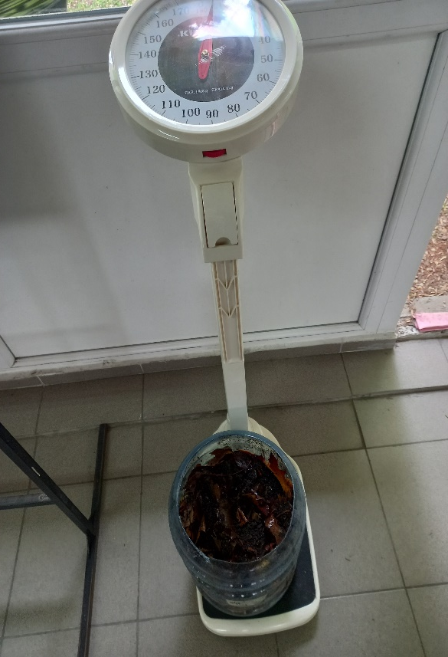
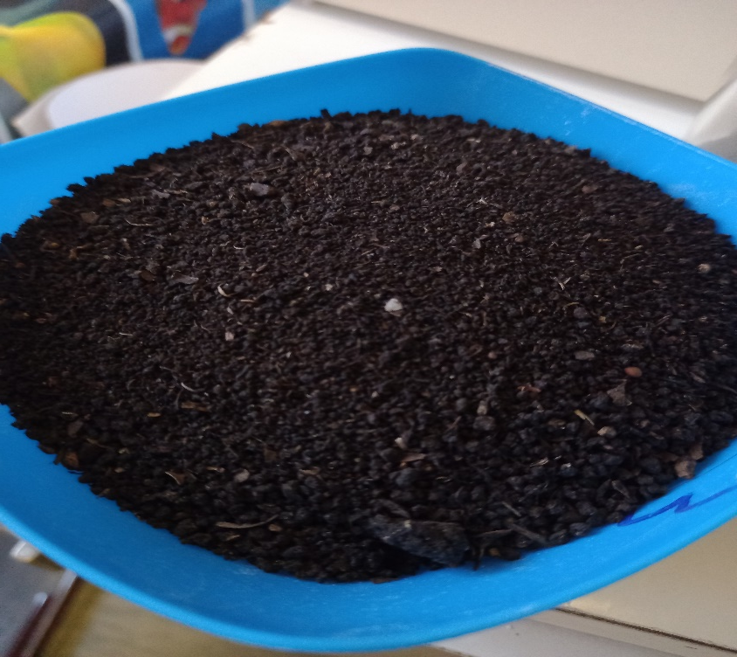
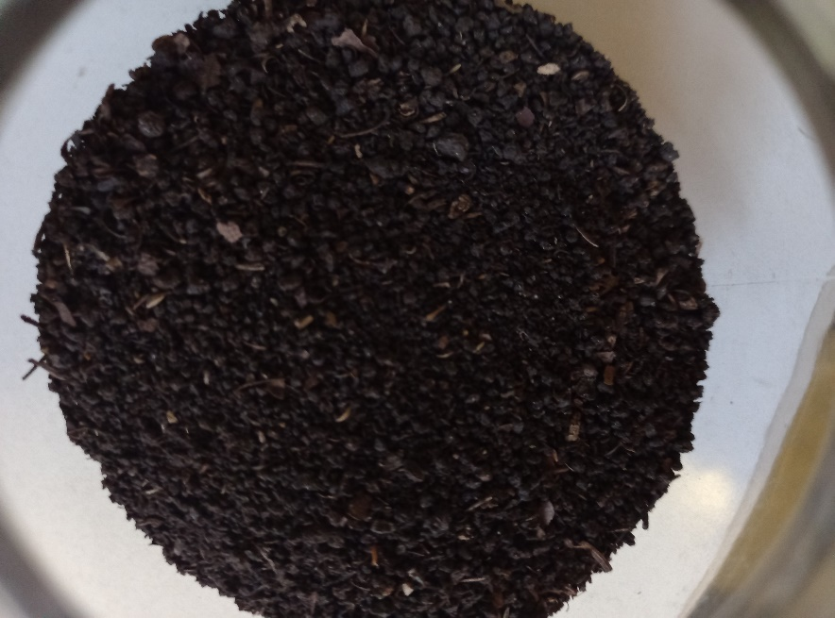
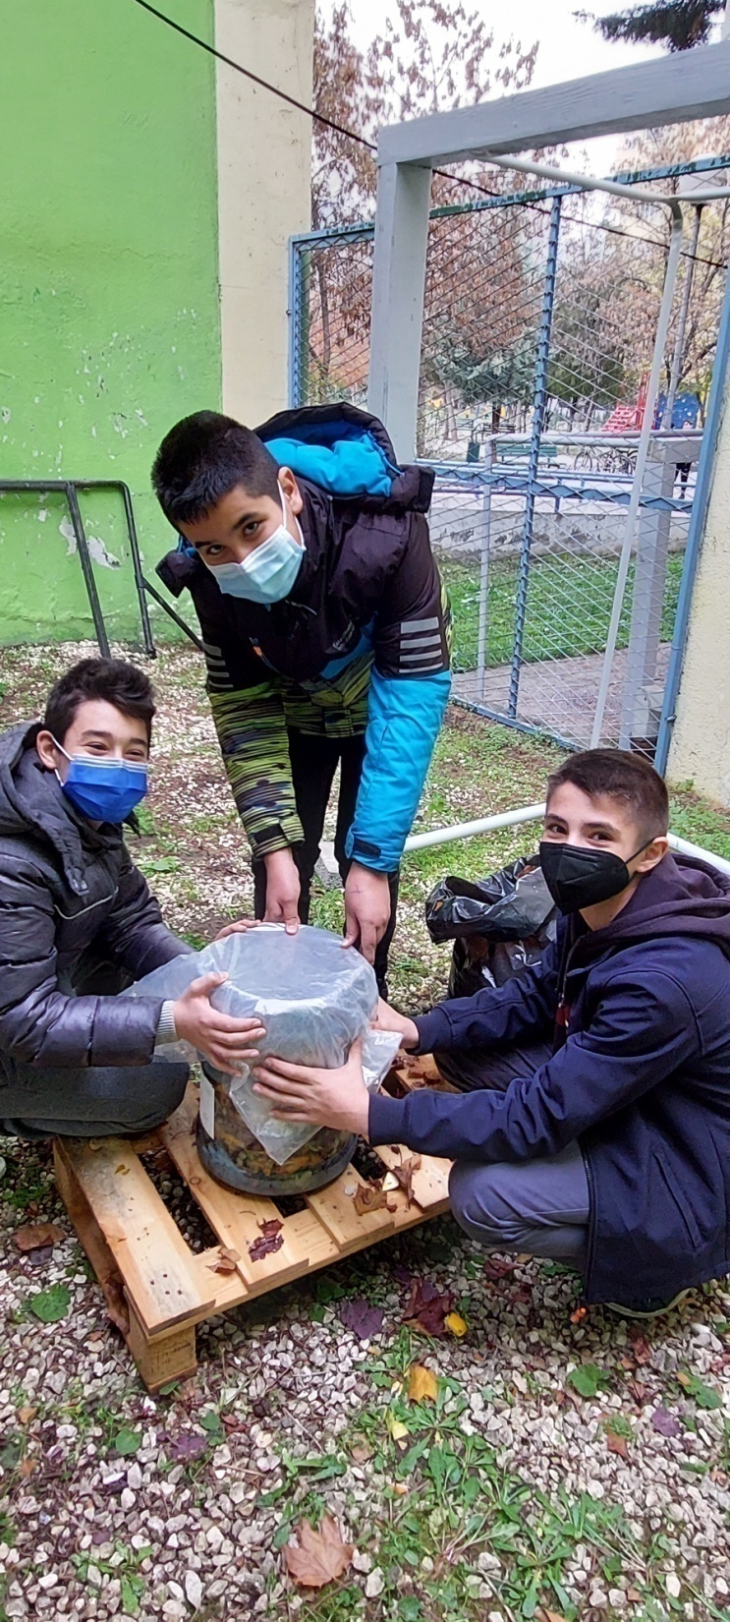
Experiment observation...

Slide 8
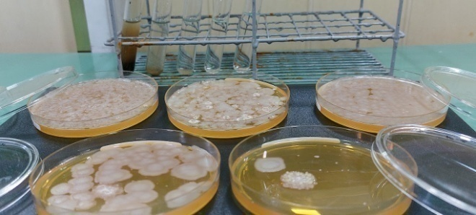
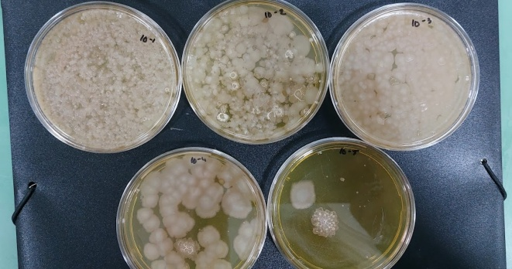
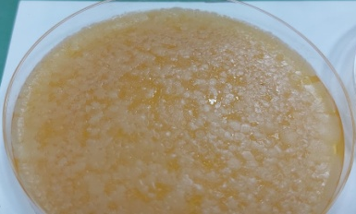
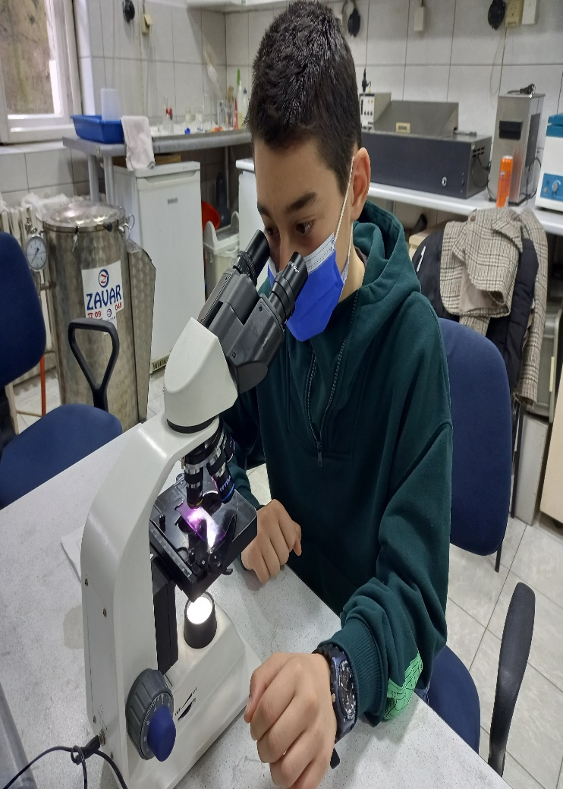
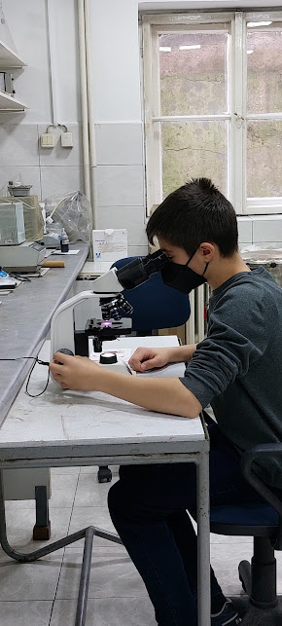
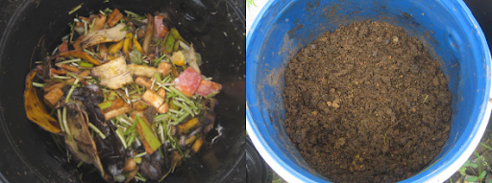

Slide 9
CONCLUSION
Food waste can be bio-recycled though composting in order to produce nutrient-rich fertilizer, instead of taking space in landfill side.
Composting can take place in a classroom, kitchen, yard, neighborhood or city.
Compost improves soil quality and gives opportunity for retaining air, nutrients and moisture in the soil.
Also, compost loosens hard soil (by making it friable), so plants can easily spread their roots and hold the soil in its place. As well as, it increases the soil’s ability for water retention and reduces rainwater runoff.
On one side, composting offer a way to reduce the amount of solid waste, on the other side, the nutrients are returned to the soil.

Slide 10
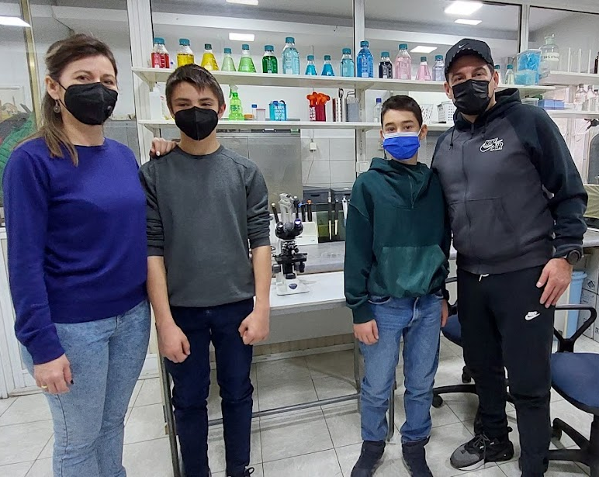
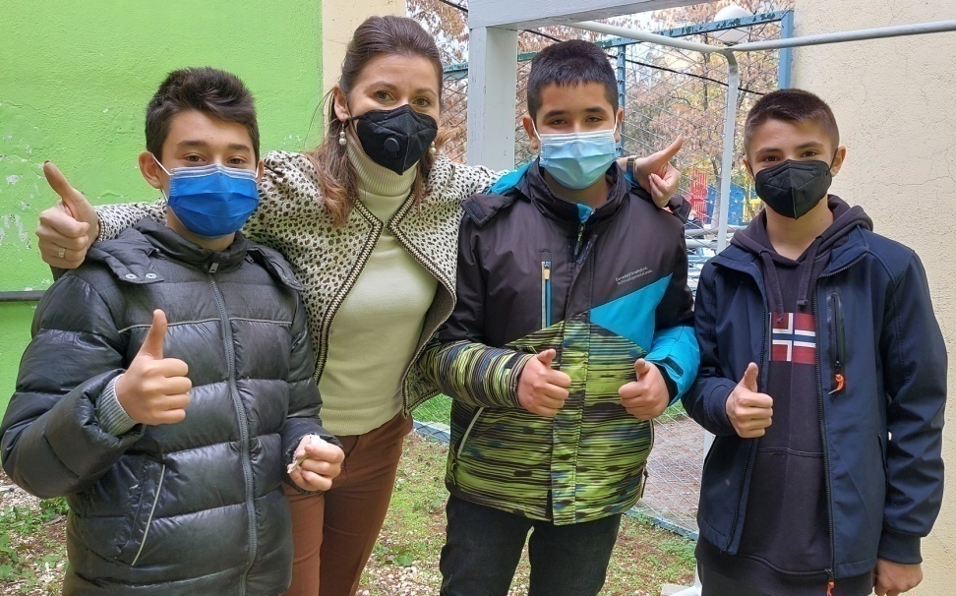
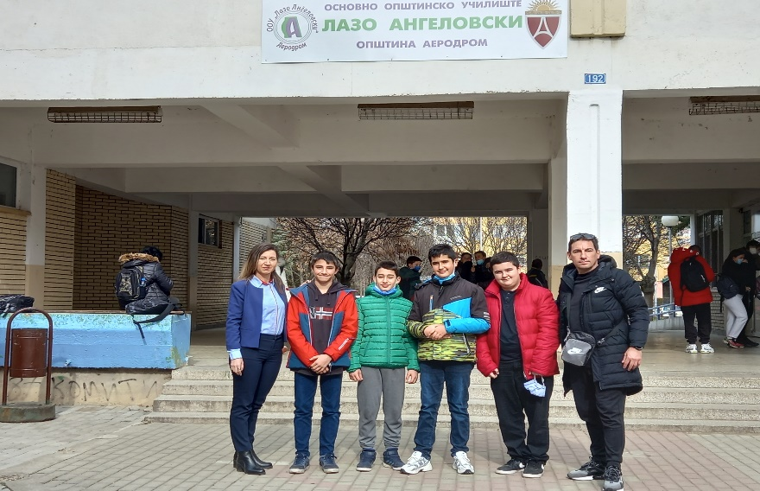
OUR WINNING TEAM

