Slide 1
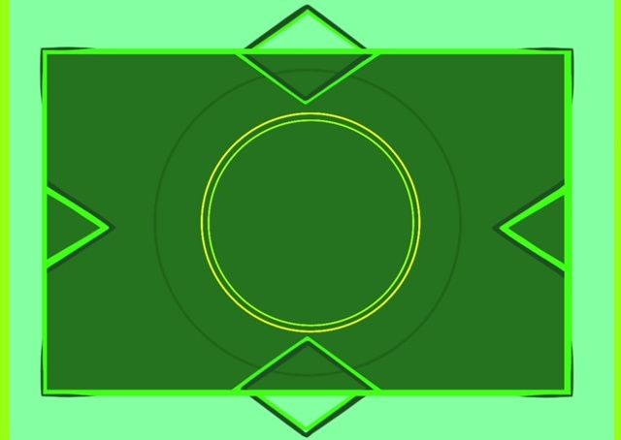
The STEM game
Created by Roberts Celmiņš, Sindija Mancēviča, Emīls Roze

Slide 2
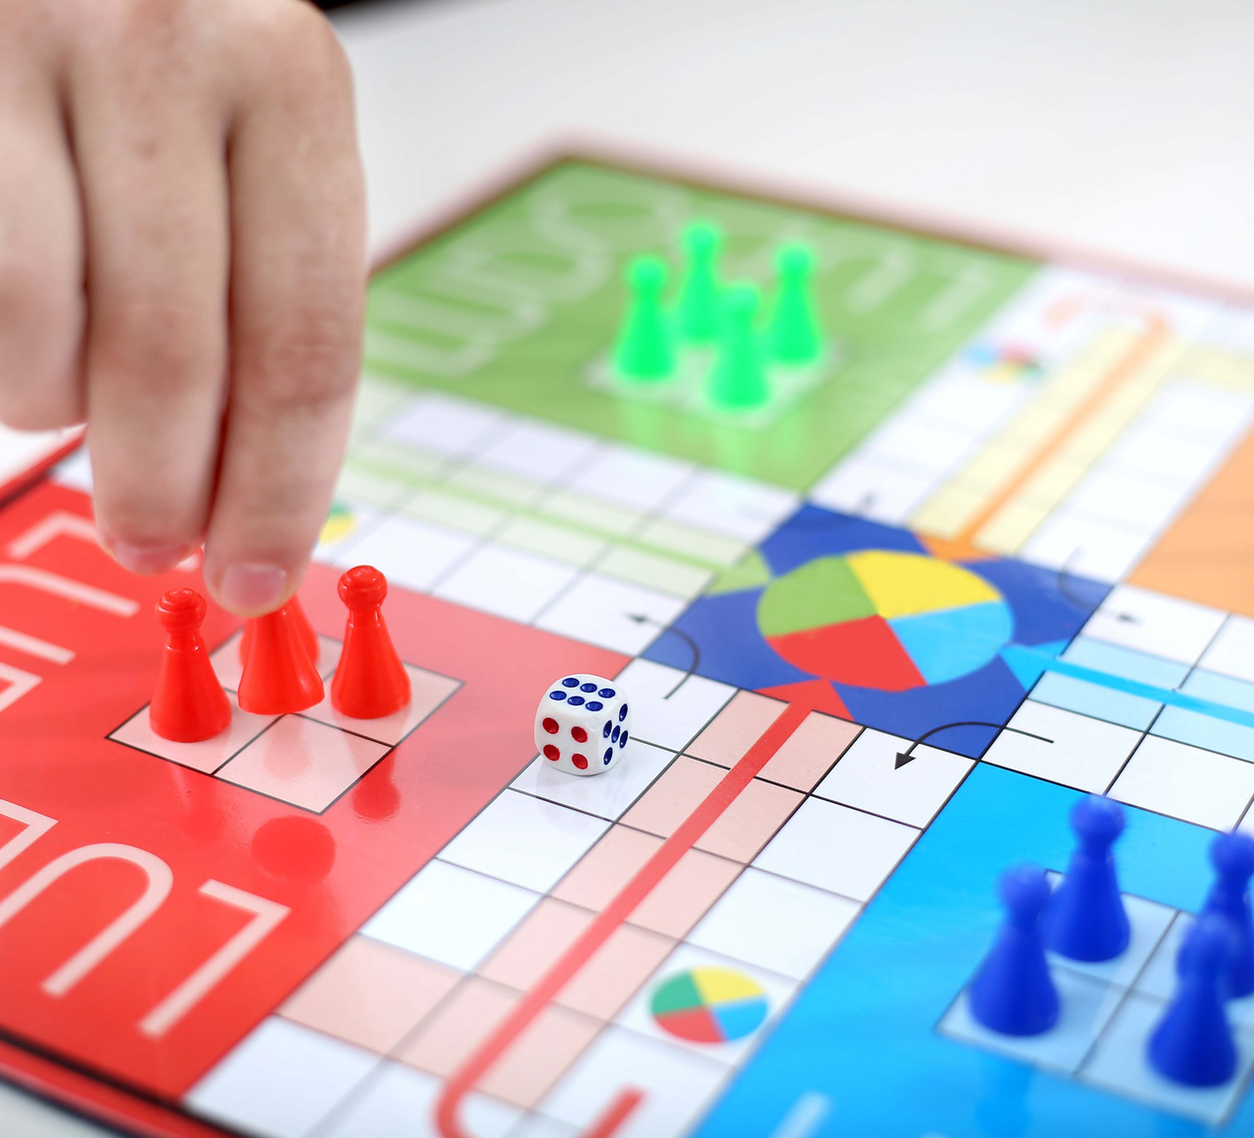
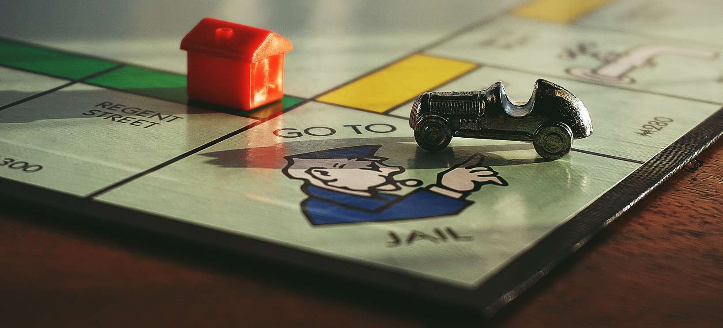
GOALS
Our group’s goal was to create a board game about STEM learning subjects, to make learning STEM more fun
The game would have:
unique design
challenging questions
trophies (collect all types and win)
more than one way to go
test the game and get ideas for improvements

Slide 3
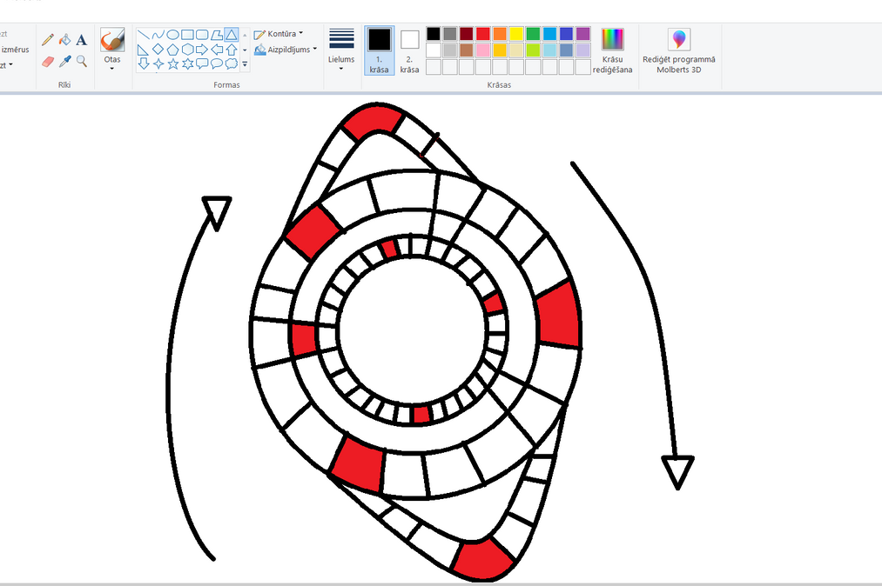
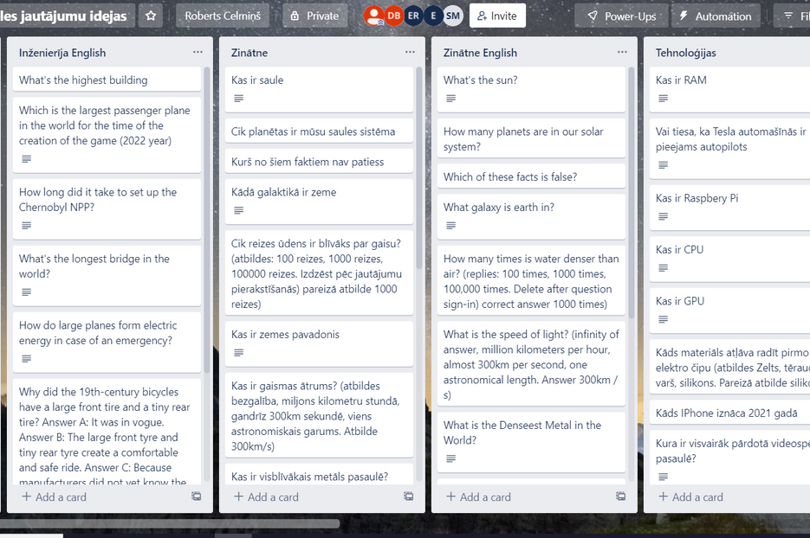
WORKFLOW
When we decided to make a board game, we started making ideas for the design.
We put our question ideas in a Trello workspace.

Slide 4
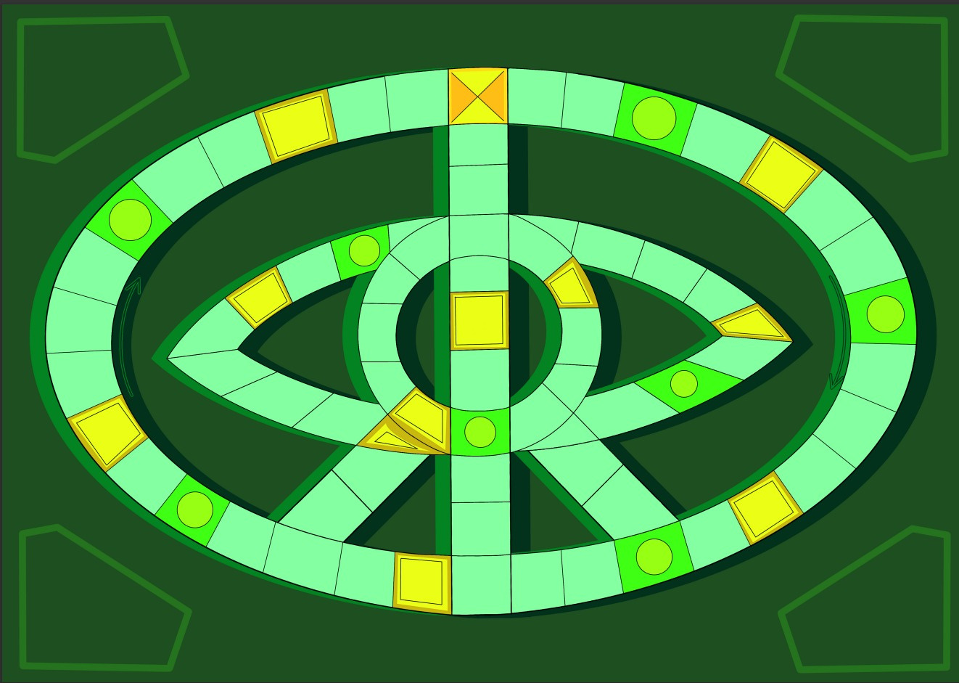
WORKFLOW
After some time Sindija made the design for the game.

Slide 5
WORKFLOW
The attachments were made
The rules were made

Slide 6
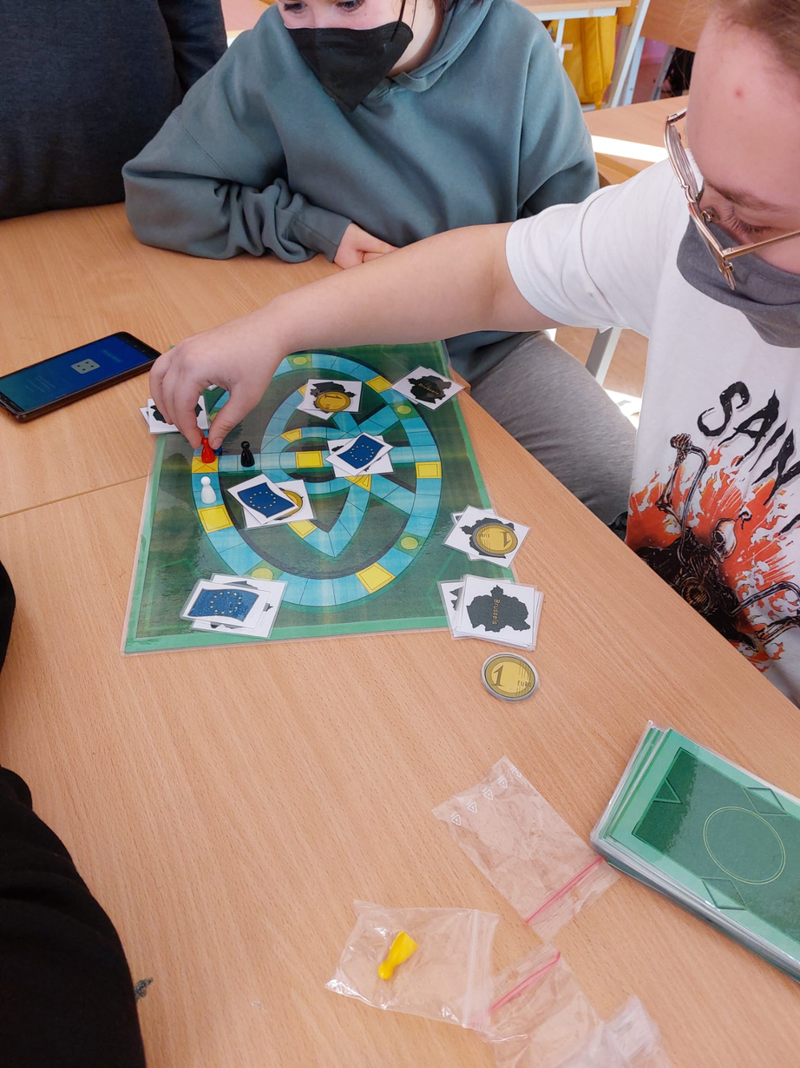
THE STEM GAME
The final result

Slide 7
Making a board game can be dificult.
CONCLUSIONS
Testing is useful.
Thinking the wrong answers can be hard.

