Slide 1
Forest School and Adventure Activities
Topic: How to involve peers in healthy lifestyle activities
Elisabet Kallas
Eliise Juhe
Karel Kivila
Palade Basic School

Slide 2
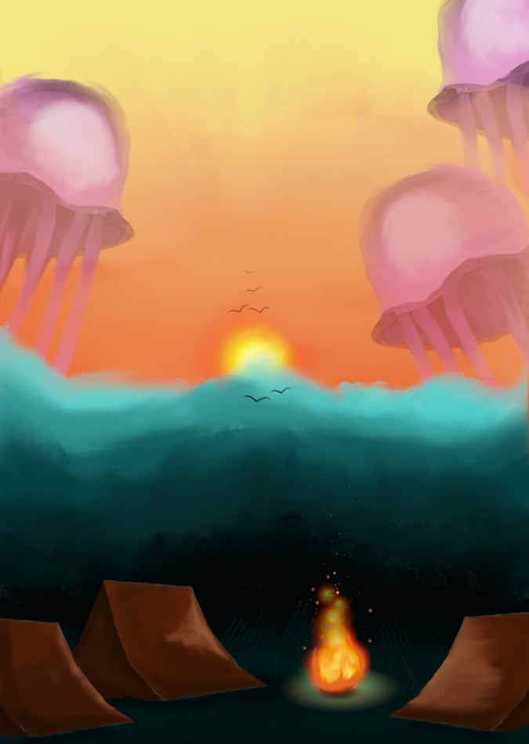
Aims of the project
To involve peers in healthy and active lifestyle
To show peers many possibilities for having fun in fresh air and forest all season long
To teach peers how to make fire for camp and cooking
To teach peers some easy tricks and DIY for being safe in nature
To teach peers useful tools in forest and how to use them properly
To offer peers emotions and experiences

Slide 3
Methology
Learning by doing and from peer to peer learning method:
practical and useful instructions from experienced peers
Hands-on activities and teamwork with other students
Safe experiential learning
Nature experiences:
Being outside with different kind of weather and all season long
Me-feeling and group-experience
and -emotion:
mental and physical achievement, creativity

Slide 4
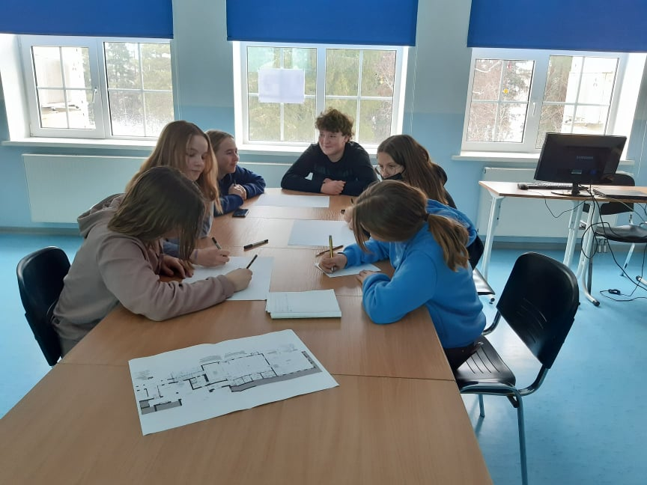
Work process
Meetings in Messenger group with Project coordinator and with team
Meetings at school with team and teachers
Meetings at school with ohter Project teams

Slide 5
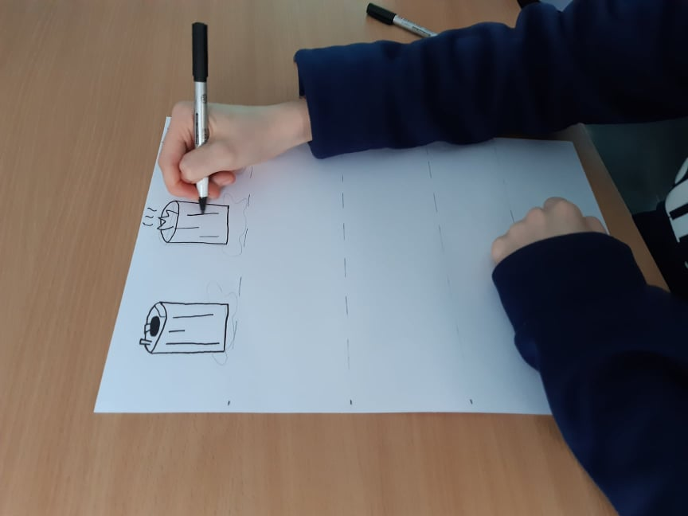
Work process
Collecting ideas from internet
Choosing our favourite activities to show to other students
Making some drawings and sketches about main ideas
Discussion with team about everyone’s best sides and abilities to teach peers some outdoor activities
Meeting with teachers and principal about dates and students who participating in our activities

Slide 6
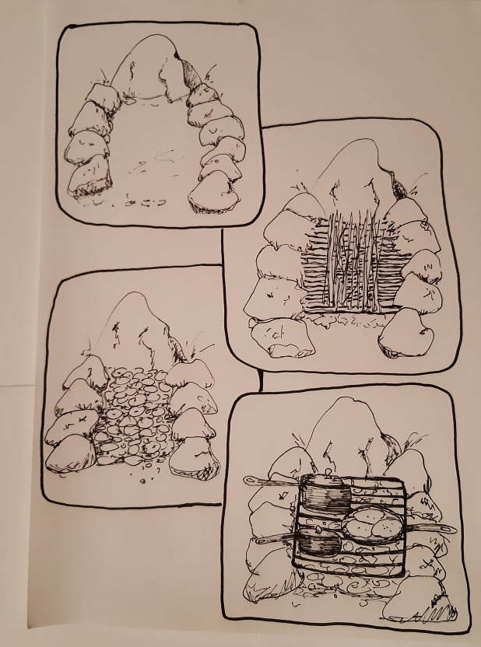
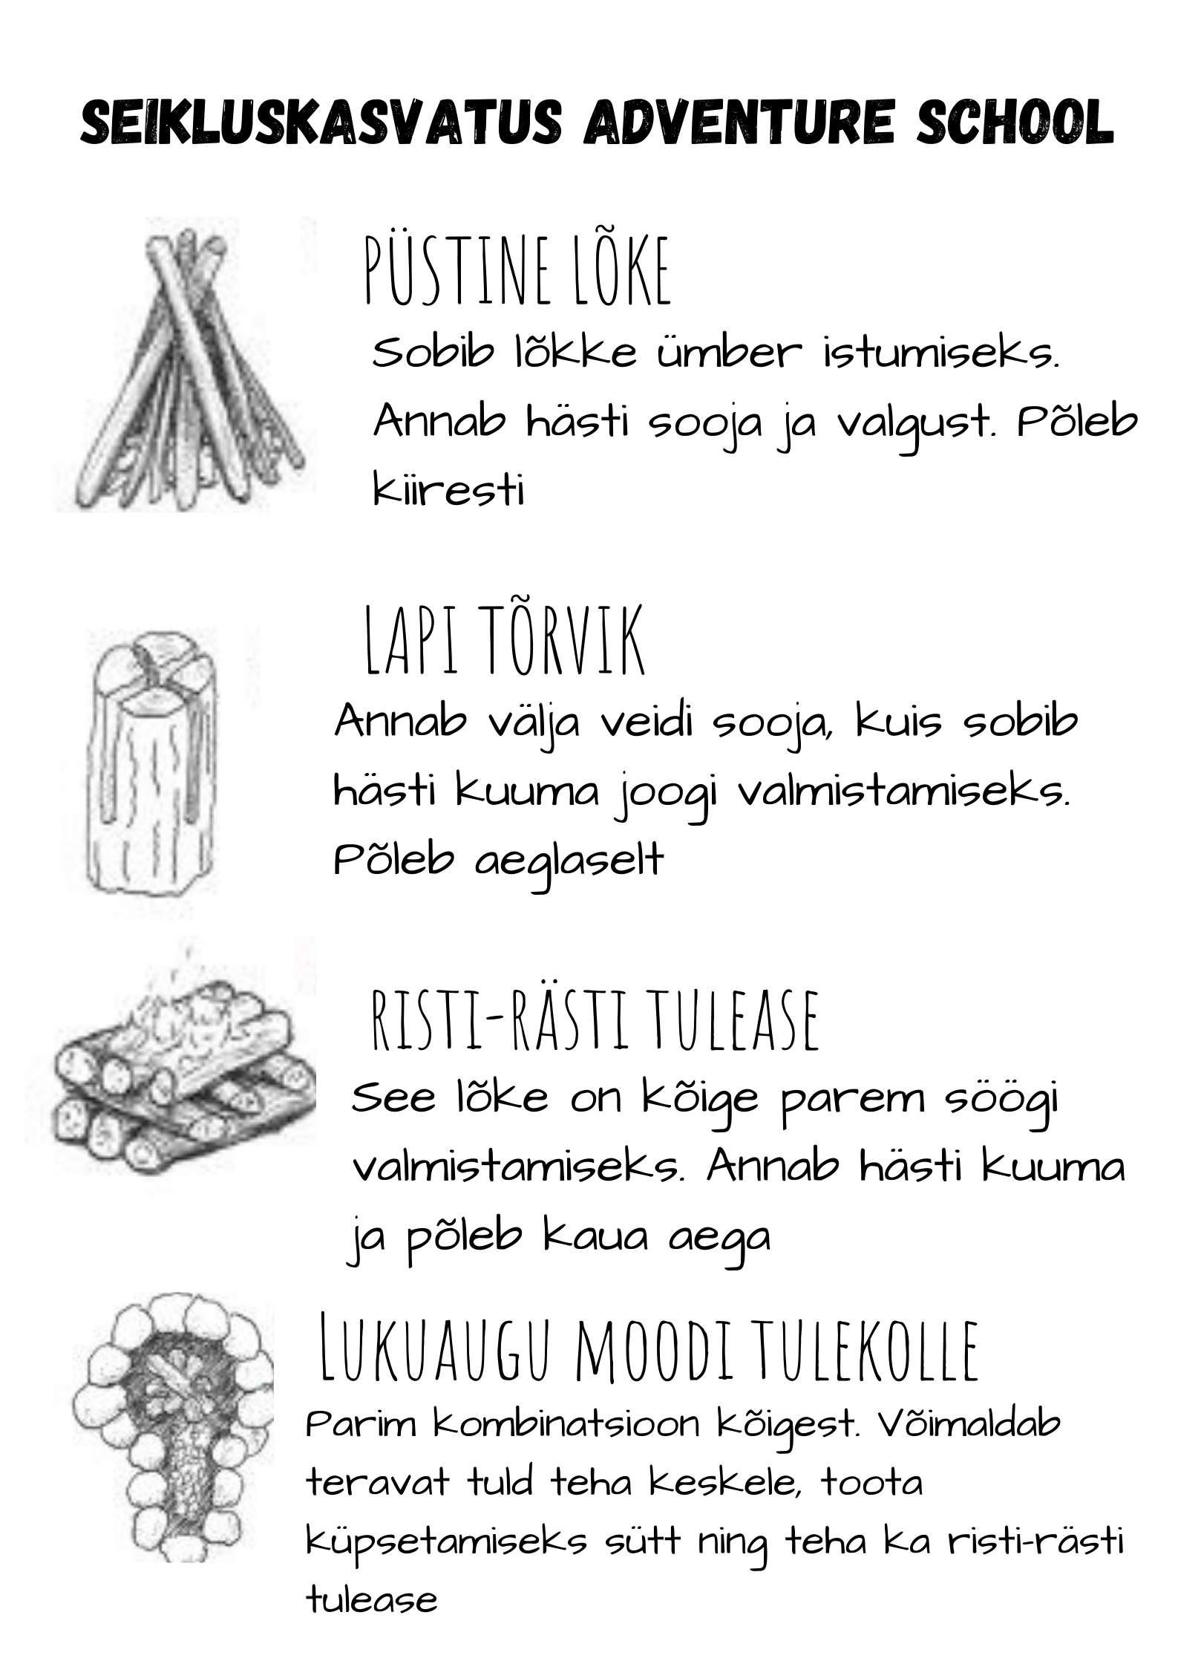
Work process
Some examples how to make a good fire place for cooking tea, pancakes or boiling eggs
Some examples which kind of fire places are best for getting warm or cooking

Slide 7
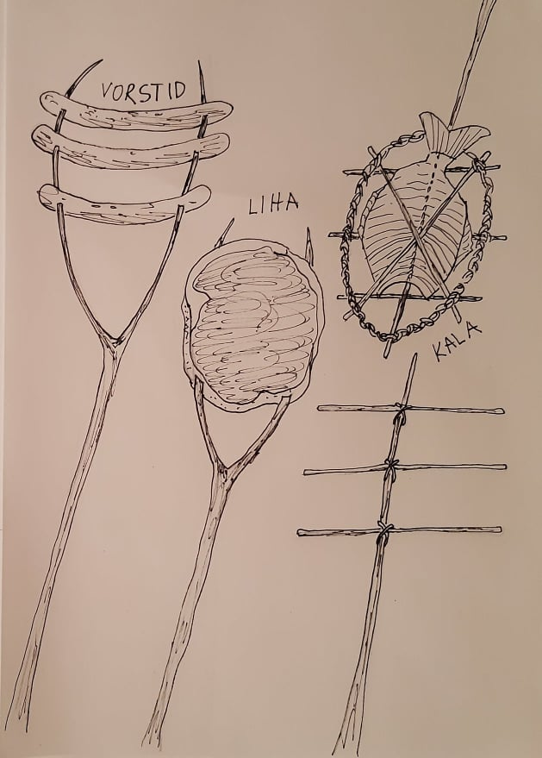
Work process
Some examples how to use branches as a tool for cooking sausages, meat or fish

Slide 8
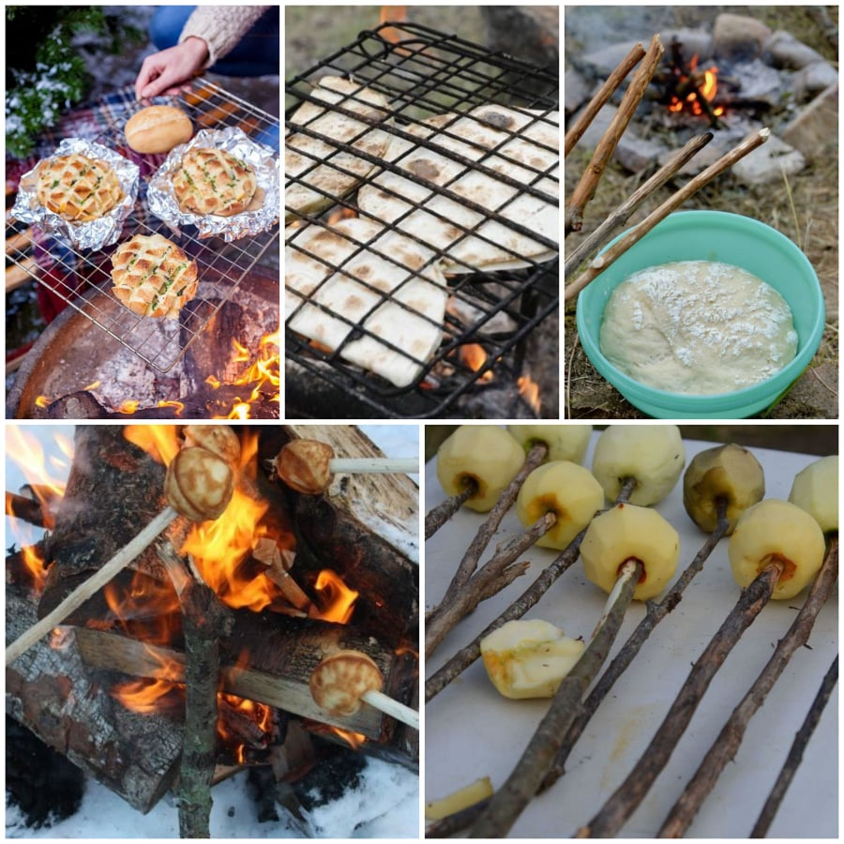
Work process
Collecting ideas from internet
and using them as an appetizer for the rest of activities
Collaborate with ohter team who’s one of their activities is healthy cooking

Slide 9
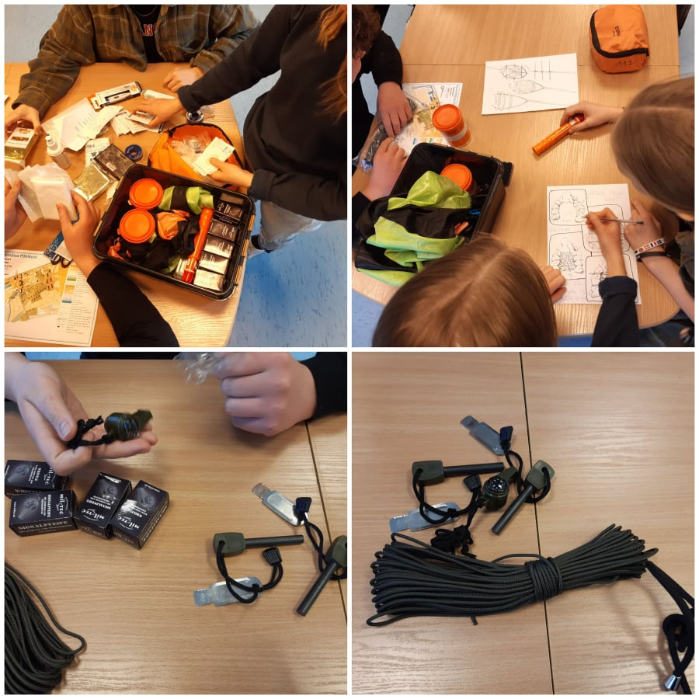
Work process
Adventure tools for using in fresh air activities:
Fire starter
Compass with whistle and thermometer
Cord for binding
Signal smoke for make yourself noticeable when getting lost

Slide 10
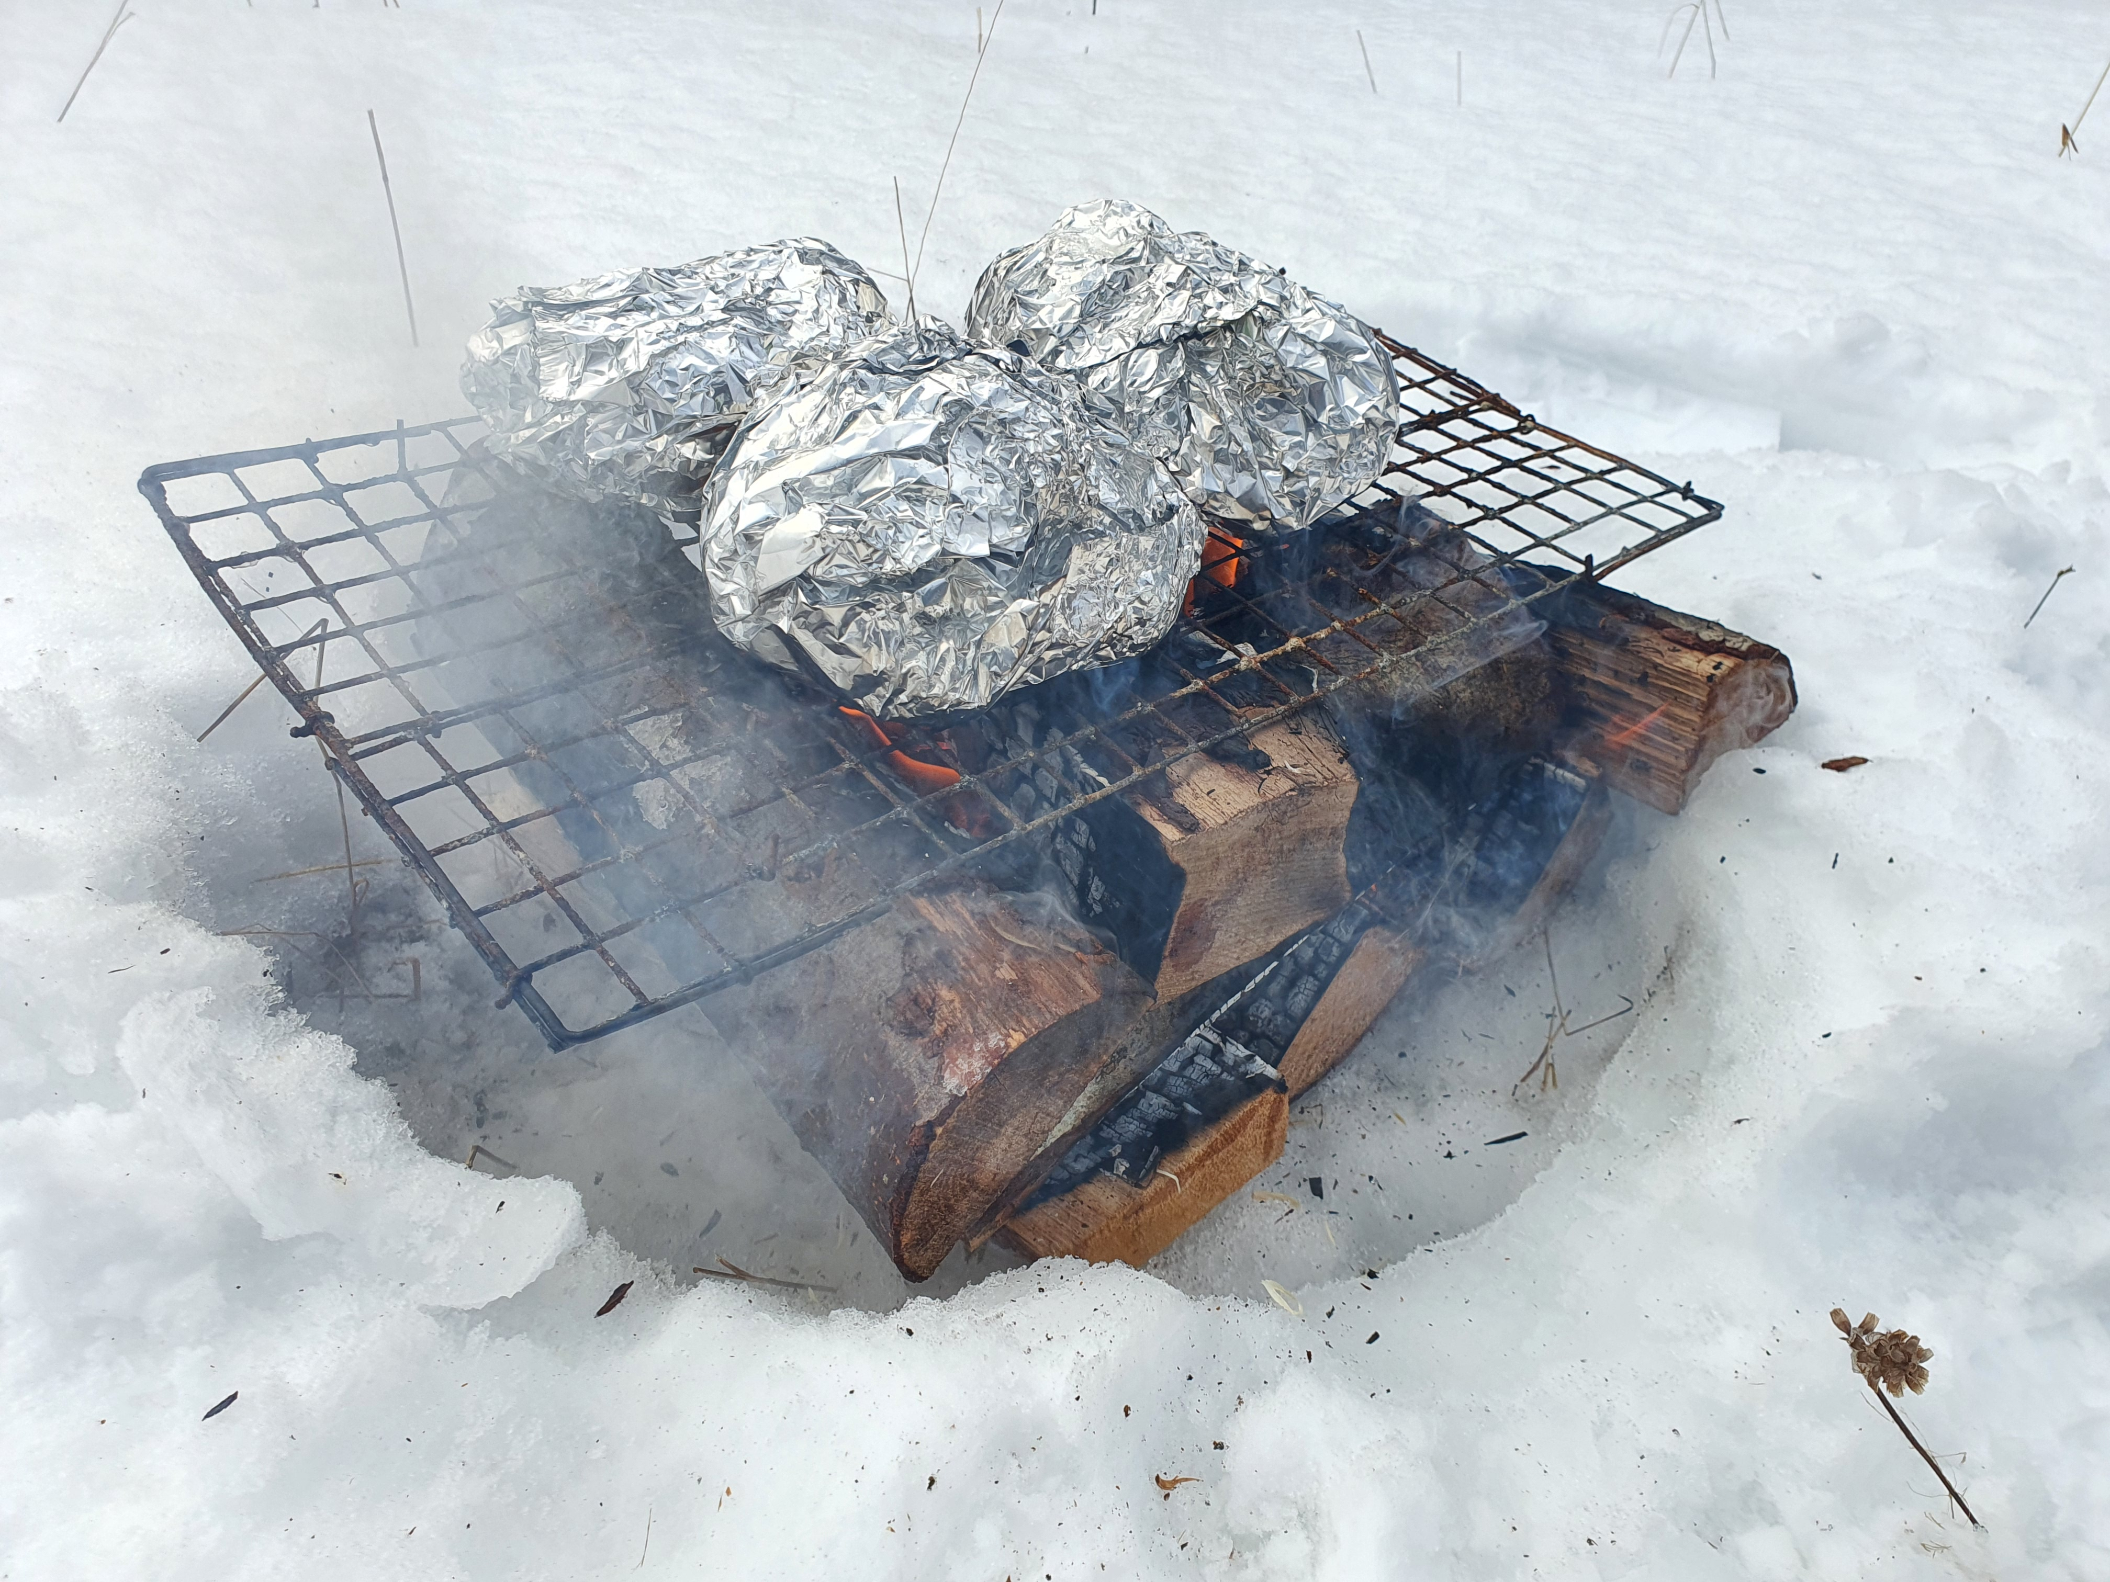
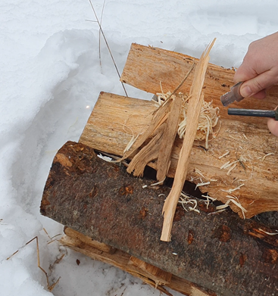
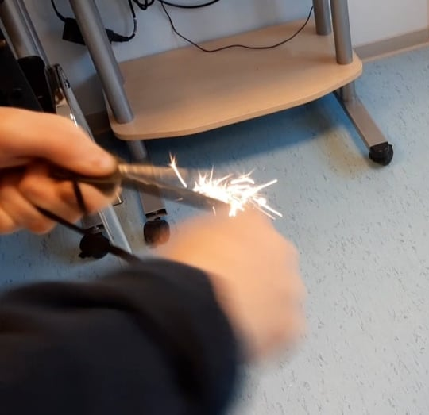
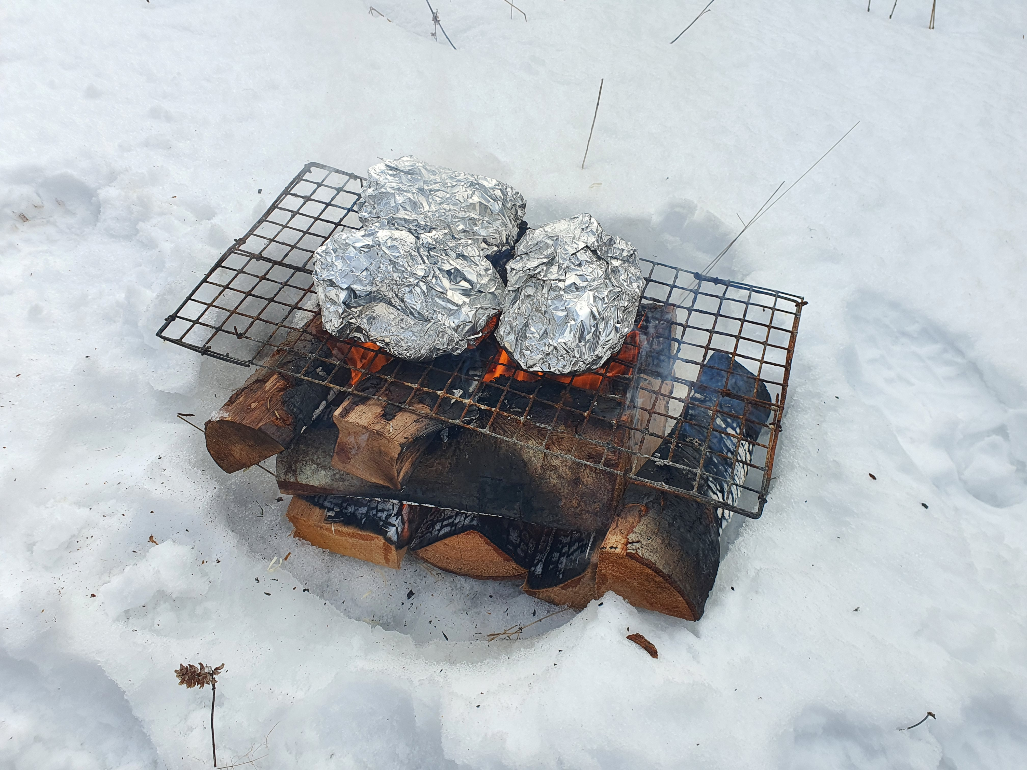
Work process
Using the fire starter

Slide 11
List of information sources
https://www.tlu.ee/opmat/tp/seiklus.pdf

