Slide 1

Nuria manzano Nicolás
A Spanish student

Slide 2
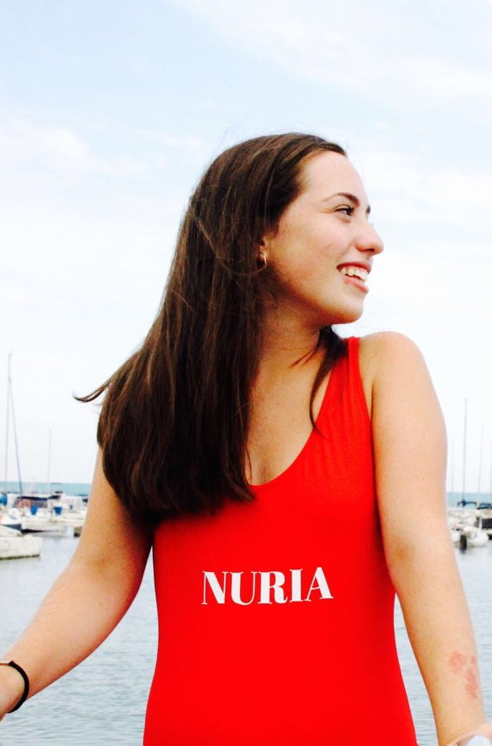
My name is Nuria
I’m fifteen years old
I was born in 2002 exactly on 28 of September
I study the fourth course in Francisco Salzillo’s high school
My favourite subjects are Spanish language and music
I love study English because I think it is very important for my future.

Slide 3
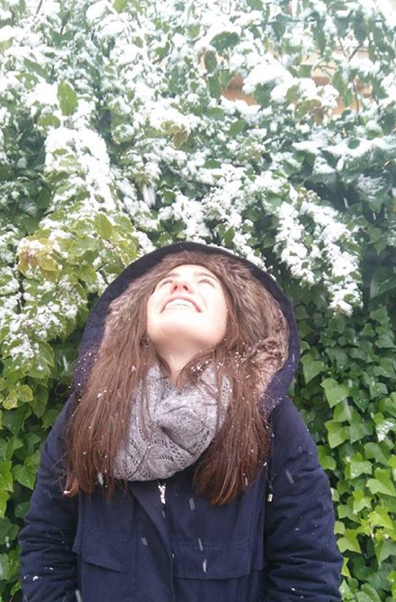
My favourite season is winter, I love it.
I have a brother who is younger than me
In my free time I would like reading some books and listening to music. Also I love the romantics films, my favourite is “Letters to Juliet”
But I love spend my time in something related to fashion. I love the fashionable gangplanks, the designers, the shops, the fashion in general
Thanks you!!!

