Slide 1
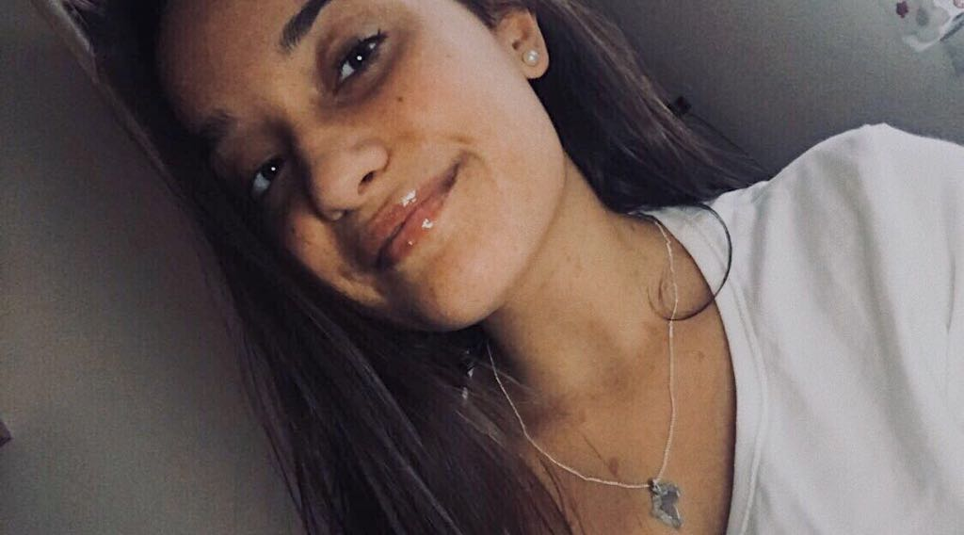
Ainhoa López
Hello, my name is Ainhoa. I’m 15 years old. I like listening to music and go to the cinema, especially horror films, apart from this I love meet my friends and go to have a drink. If I talk about my family, I have 1 sister and 3 brothers, I’m the youngest one.
And that’s all, regards.

