Slide 1
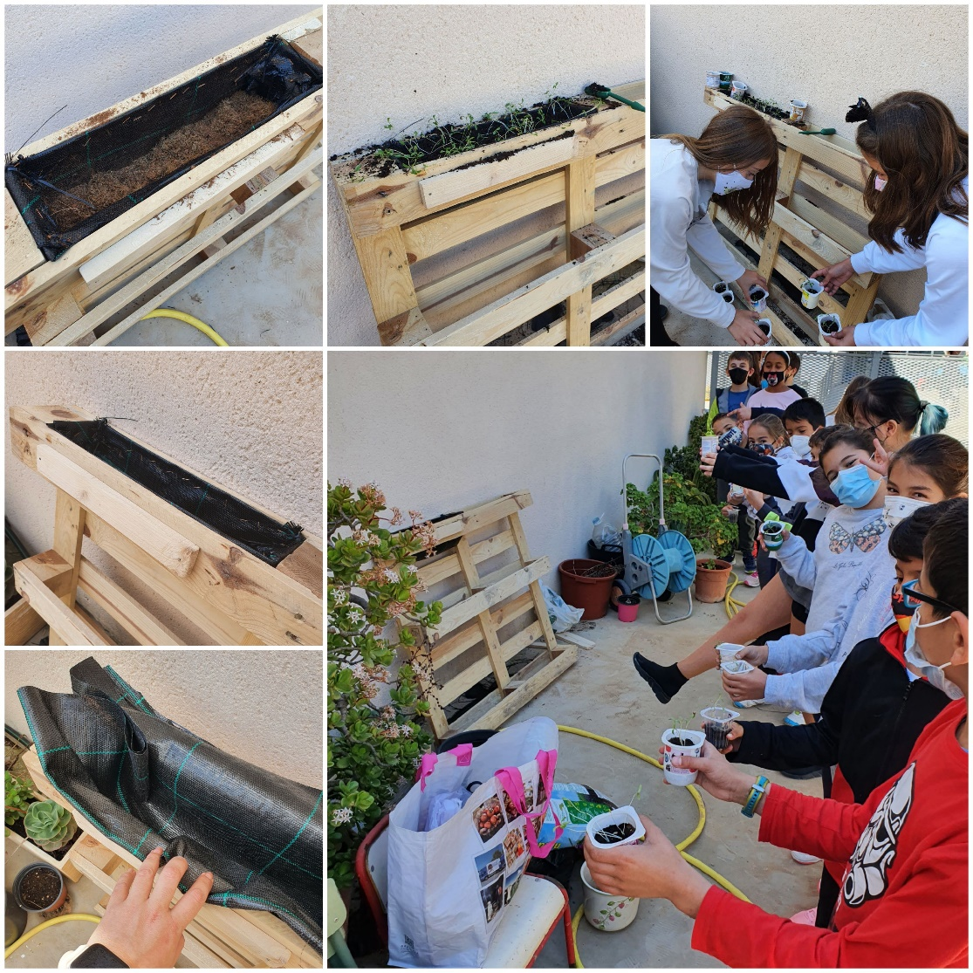
MEDITERRÁNEO SCHOOL. ERASMUS + 2020-2023
PLANTING SEEDS. 4th PRIMARY D
AWARENESS IS POWER

Slide 2
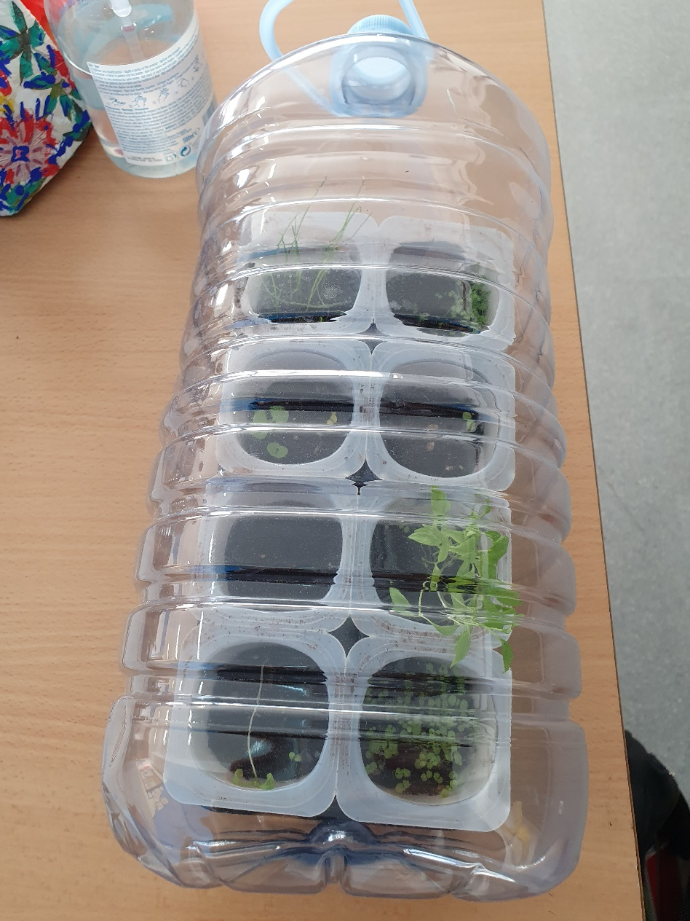
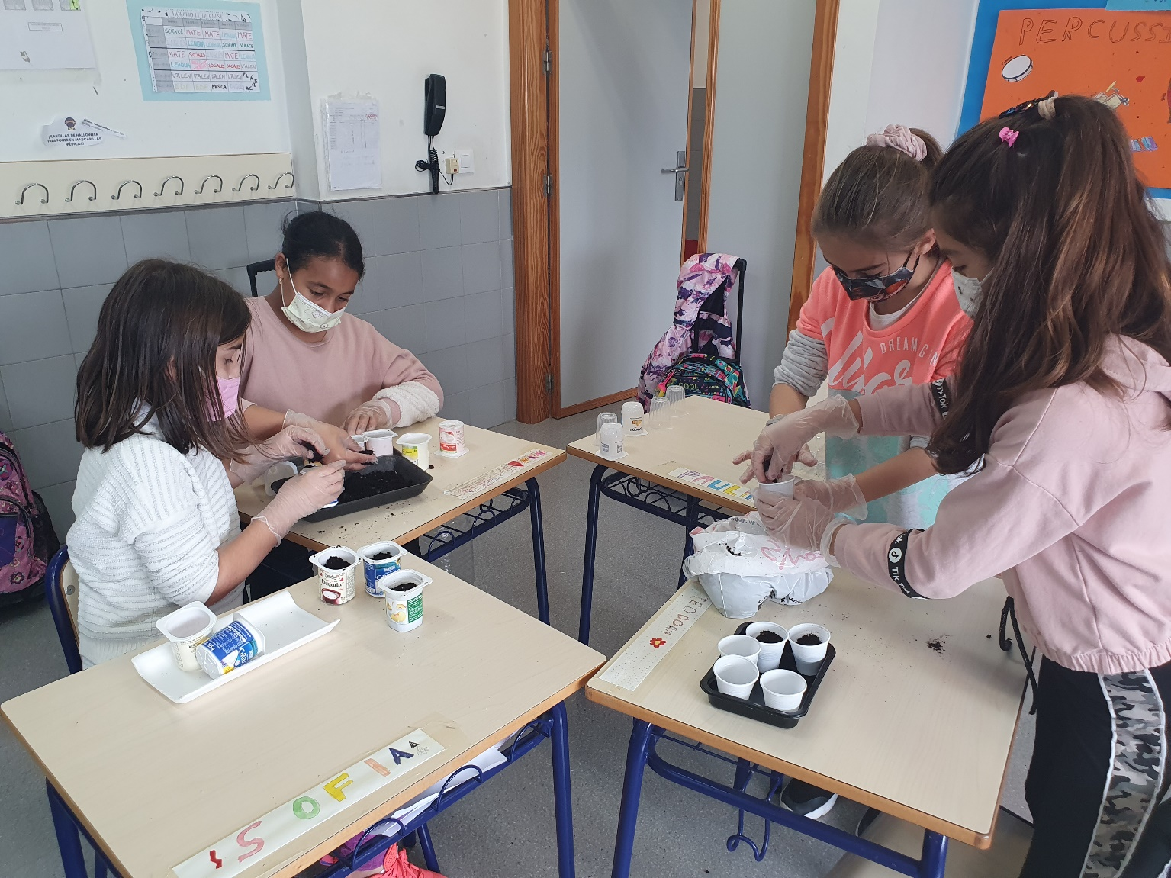
First, we brought plastic jugs from home to reuse, along with vegetable trays and yogurt cups, in order to create our home-made greenhouses. On February 26, we planted the seeds of coriander, oregano, chives, parsley and basil.

Slide 3
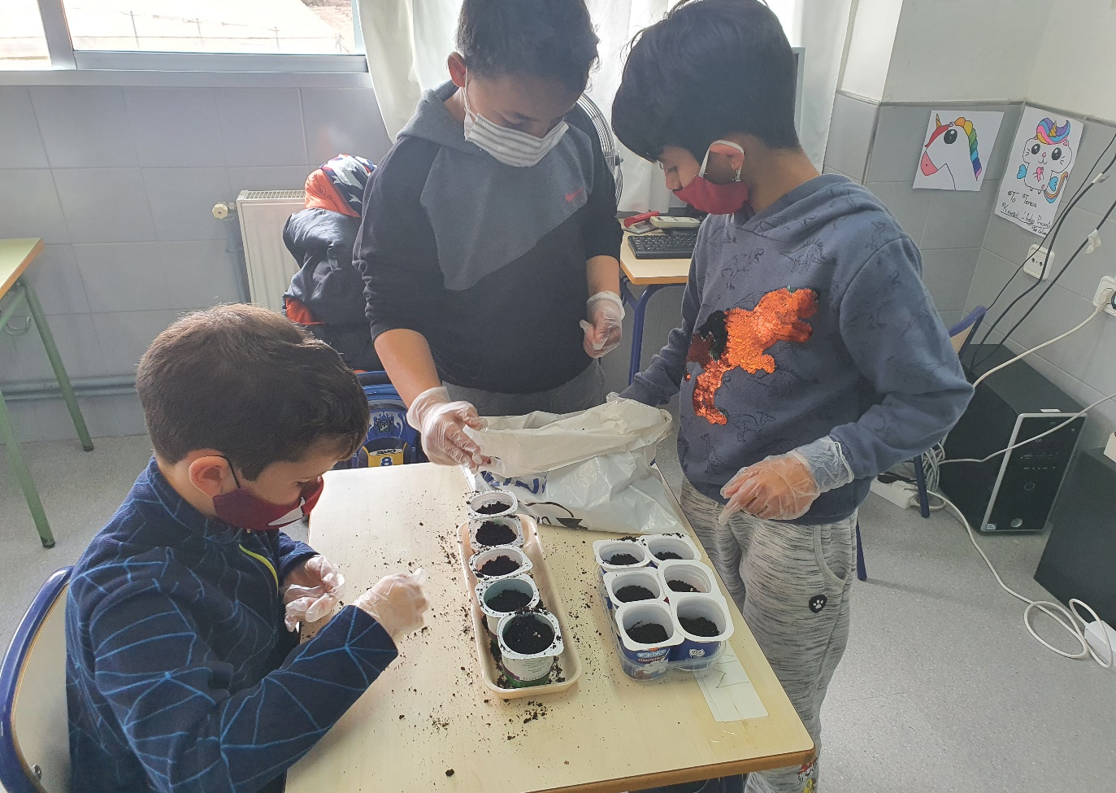
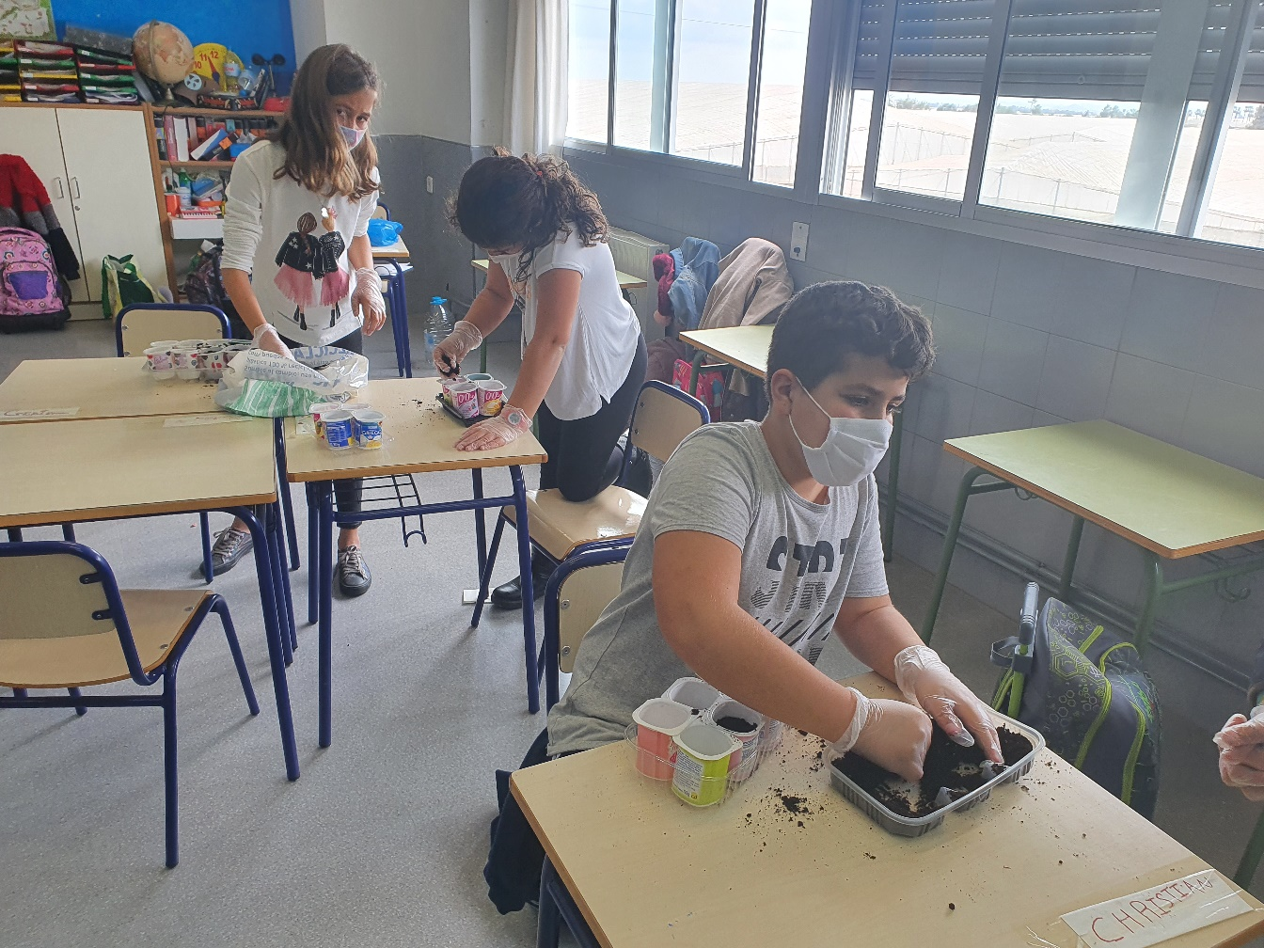

Slide 4
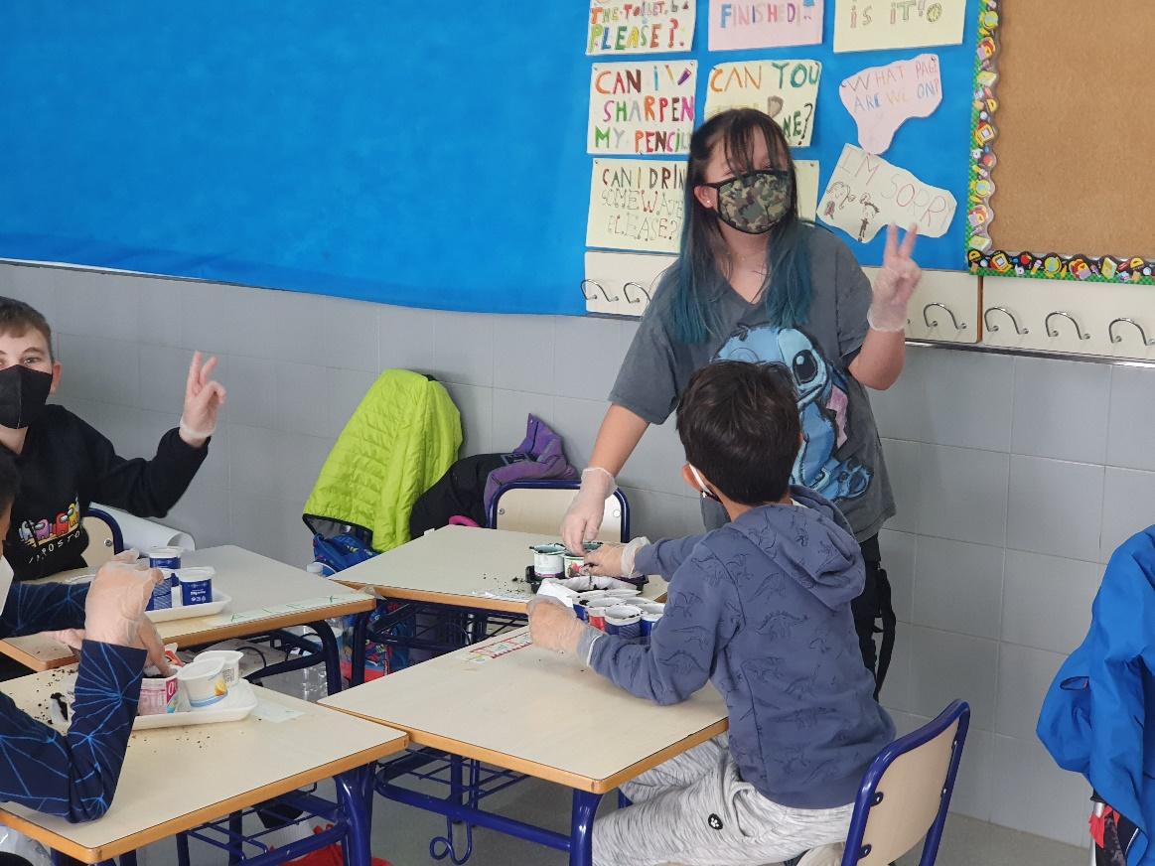
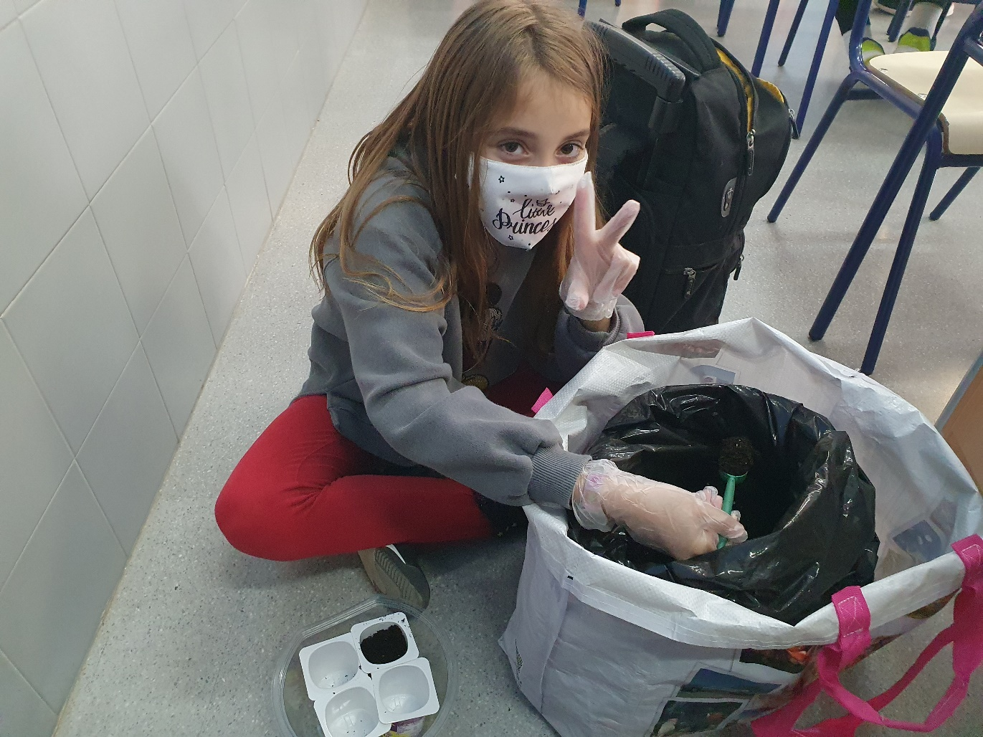

Slide 5
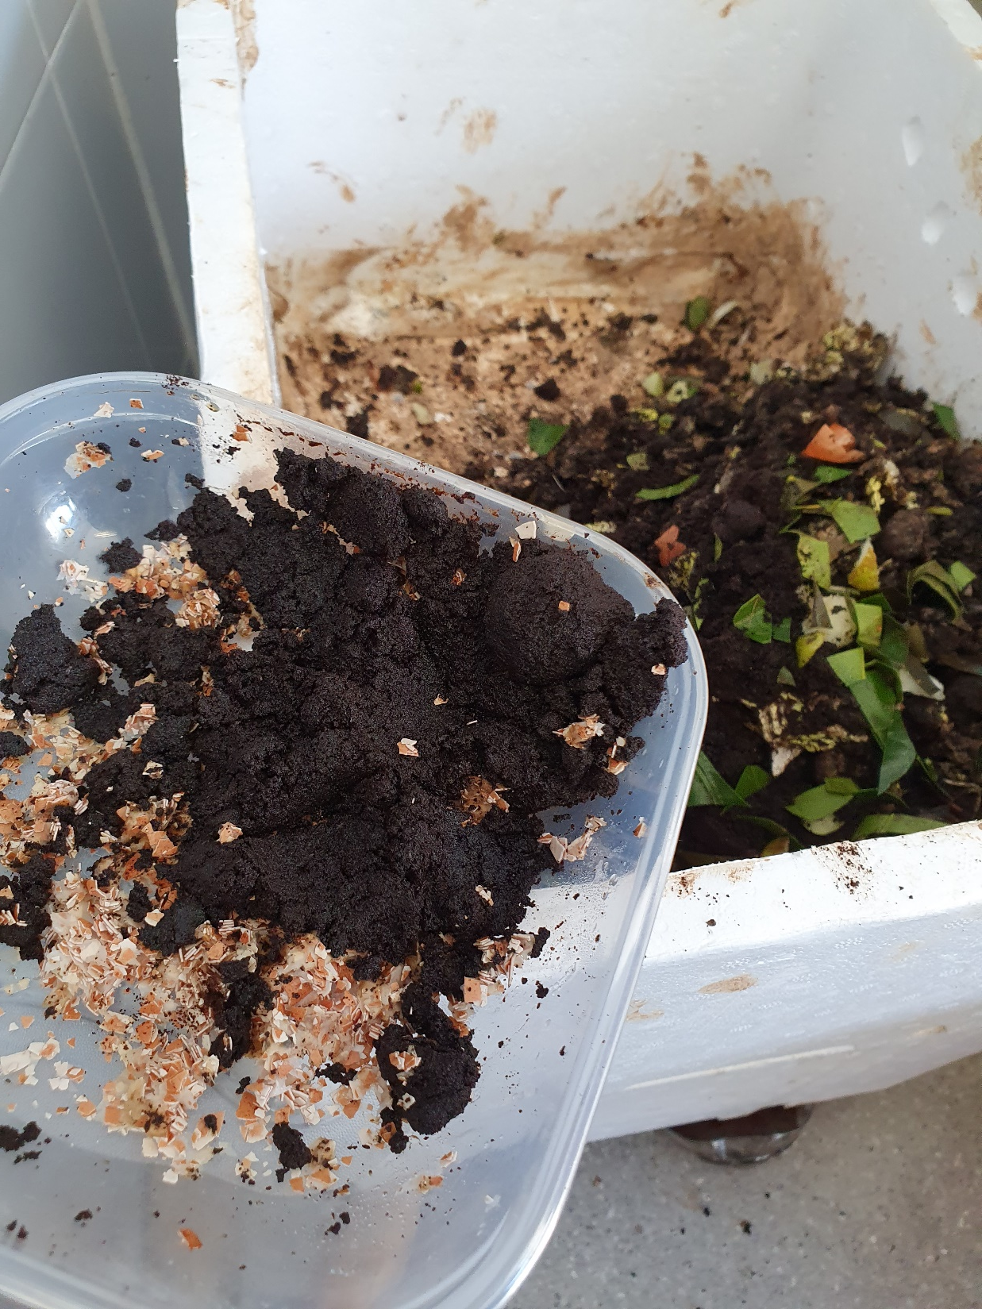
We have added dry green leaves, the waste of the fruit from our lunches and crushed eggshell to the compost. We do that to enrich the fertile soil with calcium.

Slide 6
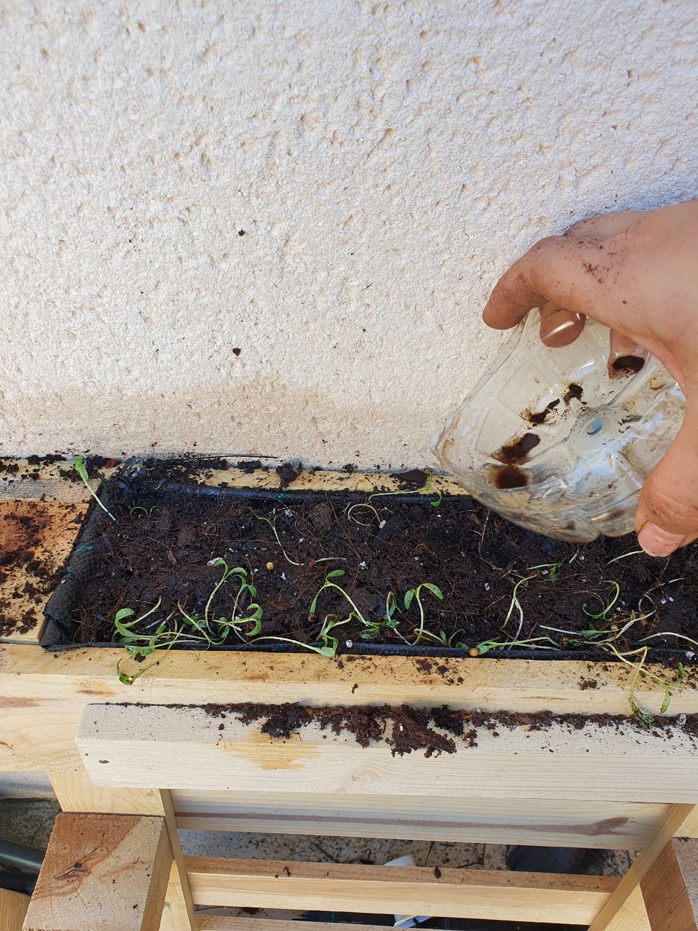
With all that, we have taken advantage of the liquid worm hummus as a natural and ecological fertilizer for our aromatic plants garden. Throughout the process we kept in mind the rule of the three "Ms" in our farmland:
Microorganisms
Organic Material
Minerals

Slide 7
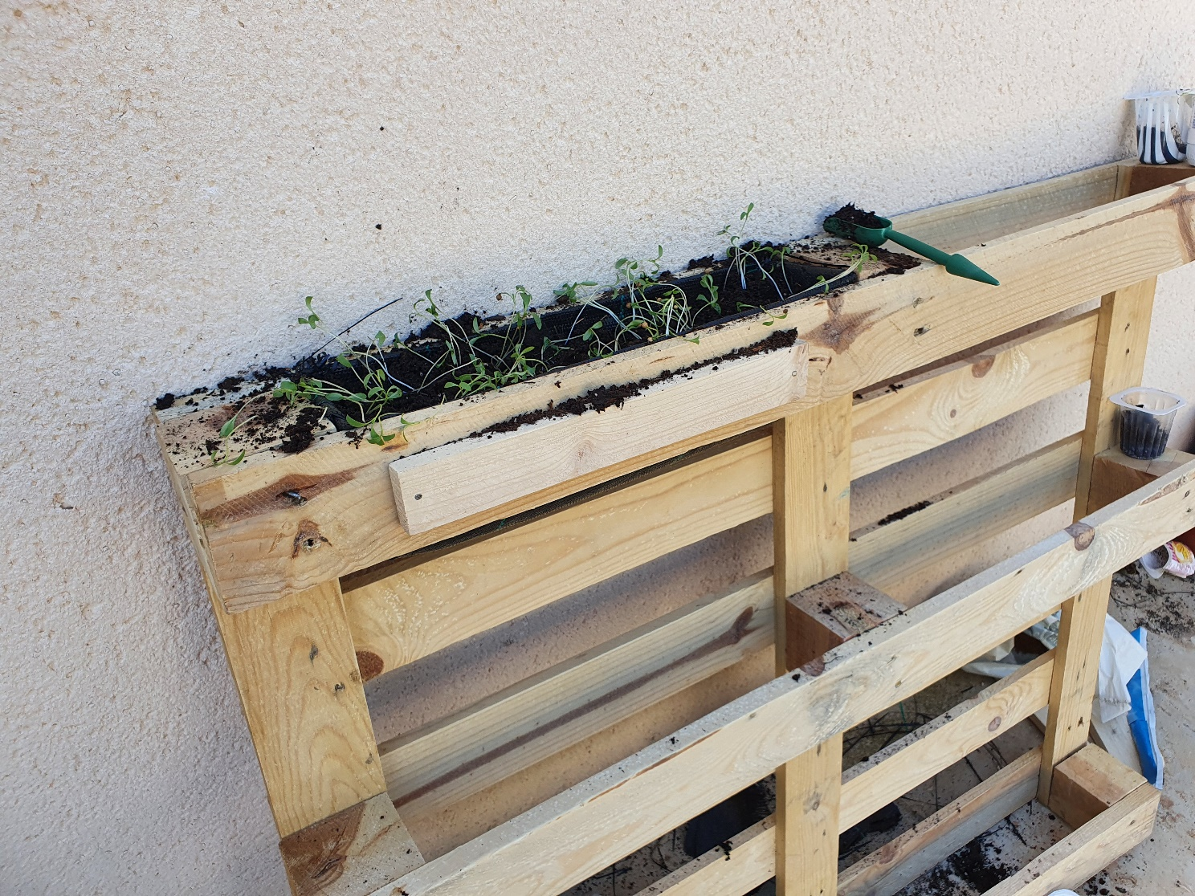
Our intention is to create a vertical garden of aromatic herbs that goes with the crops of zucchini and green beans.

Slide 8
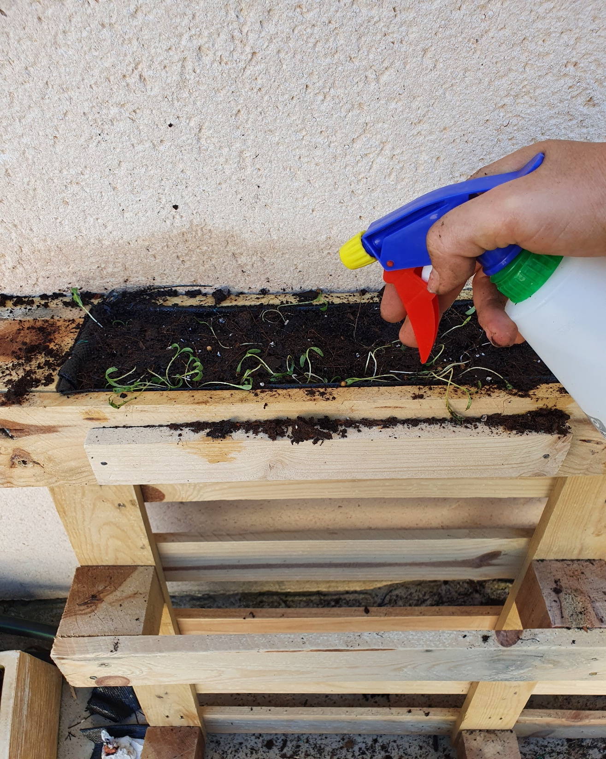
Conclusion: the seeds that germinated before were those of oregano and coriander.
They germinated after 9 days.

Slide 9
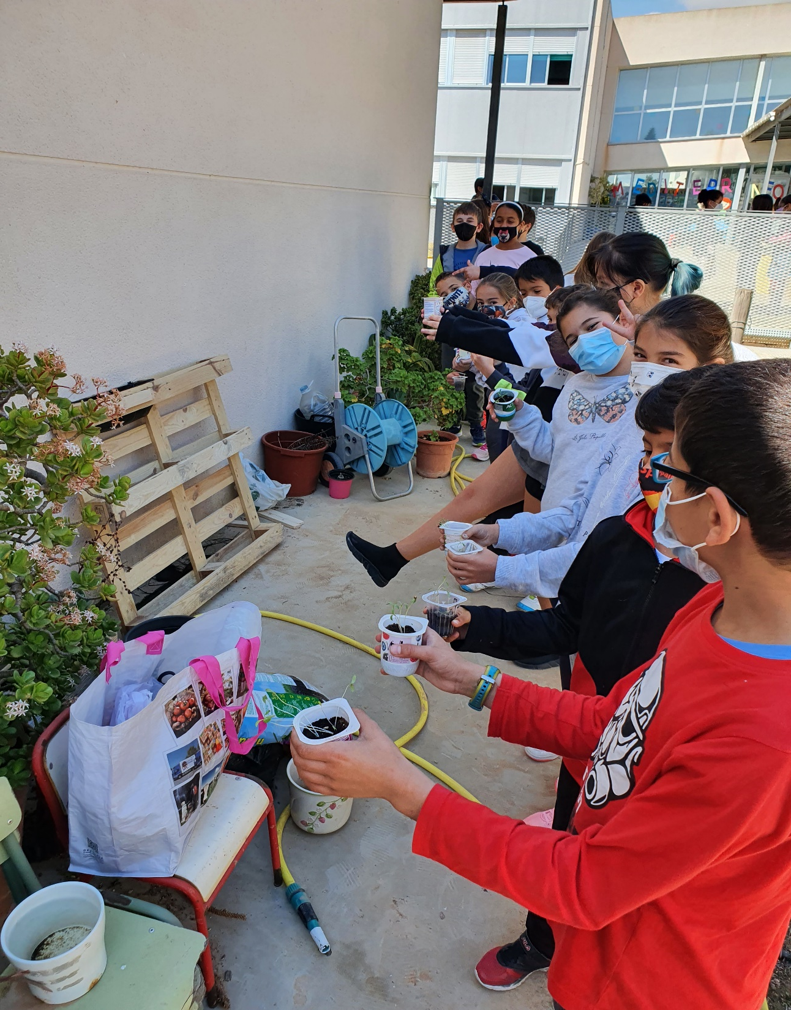
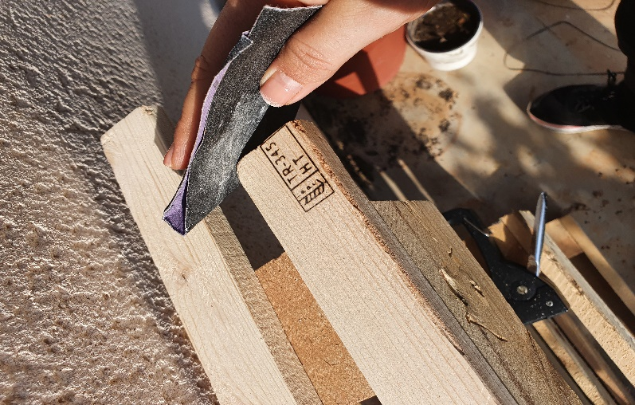
Yesterday, March 15, the whole class went to the garden to plant our coriander seedbeds, after preparing the wooden pallet (always with the initials HT or EPAL, which means that the pallet has been treated and has been disinfected with heat).

Slide 10
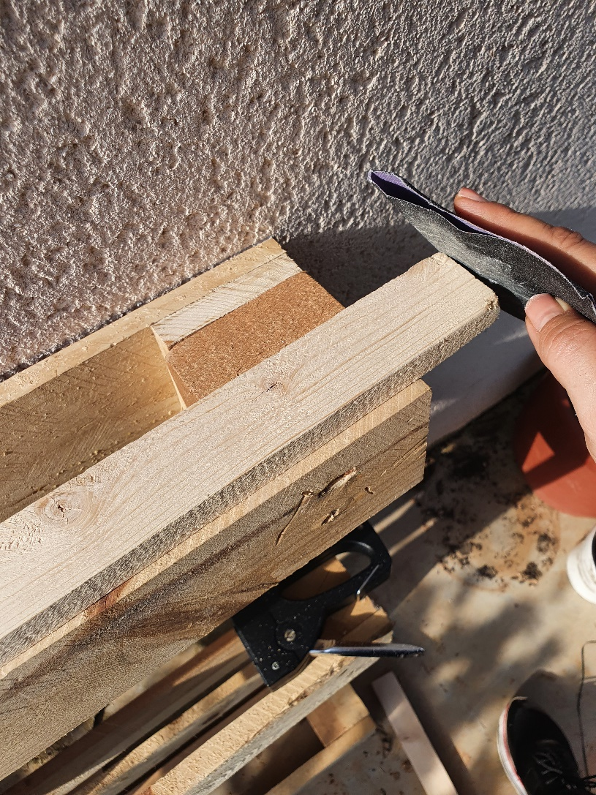
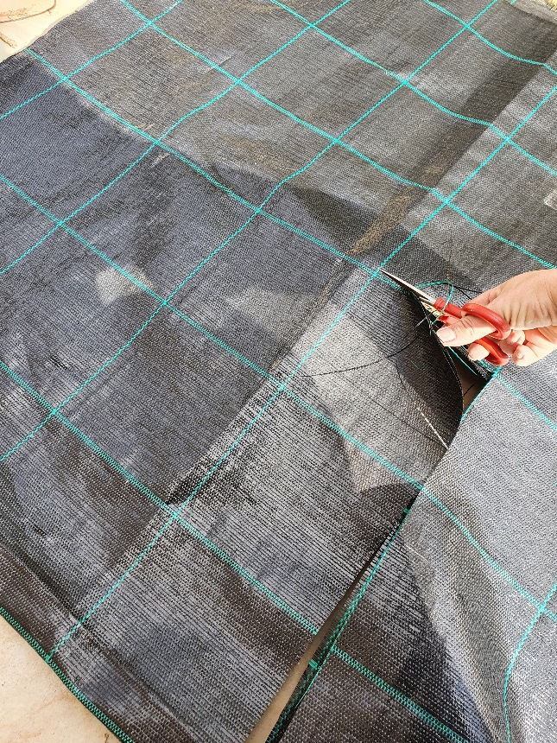
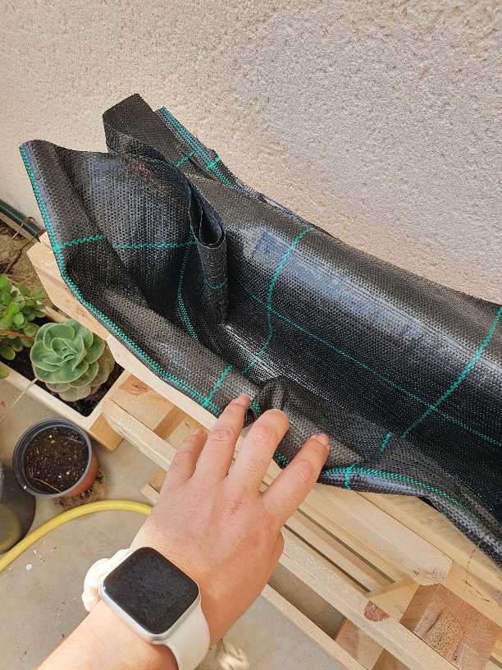
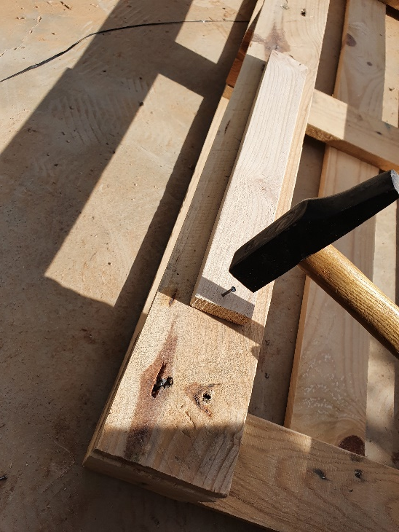
If it had the acronym DB, it is that they have not been treated.
We should never use in our gardens pallets with the acronym MB (methyl bromide)

Slide 11
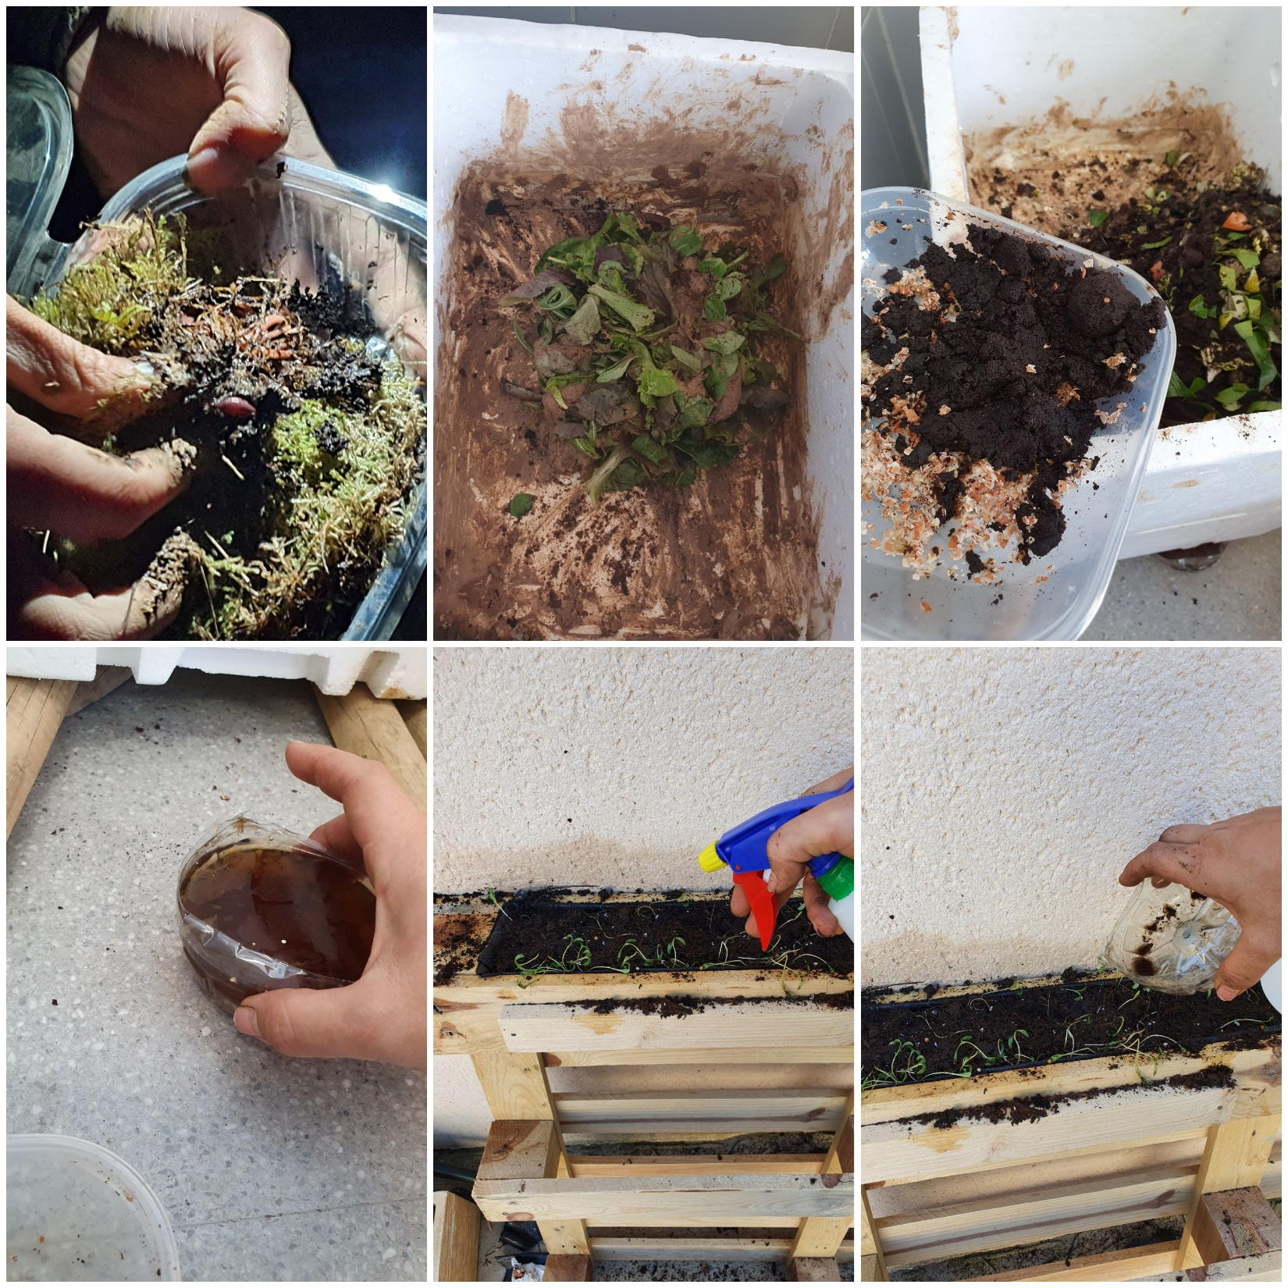
Once the seedbeds were transplanted, we have taken advantage of the liquid hummus that our friends, the Californian red worms that live happily in our homemade compost heap, have made.

Slide 12
