Slide 1
RARE SPECIES IN THE MAR MENOR
Grade 4 science project
Colegio Mediterráneo
Pilar de la Horadada (Alicante, Spain)

Slide 2
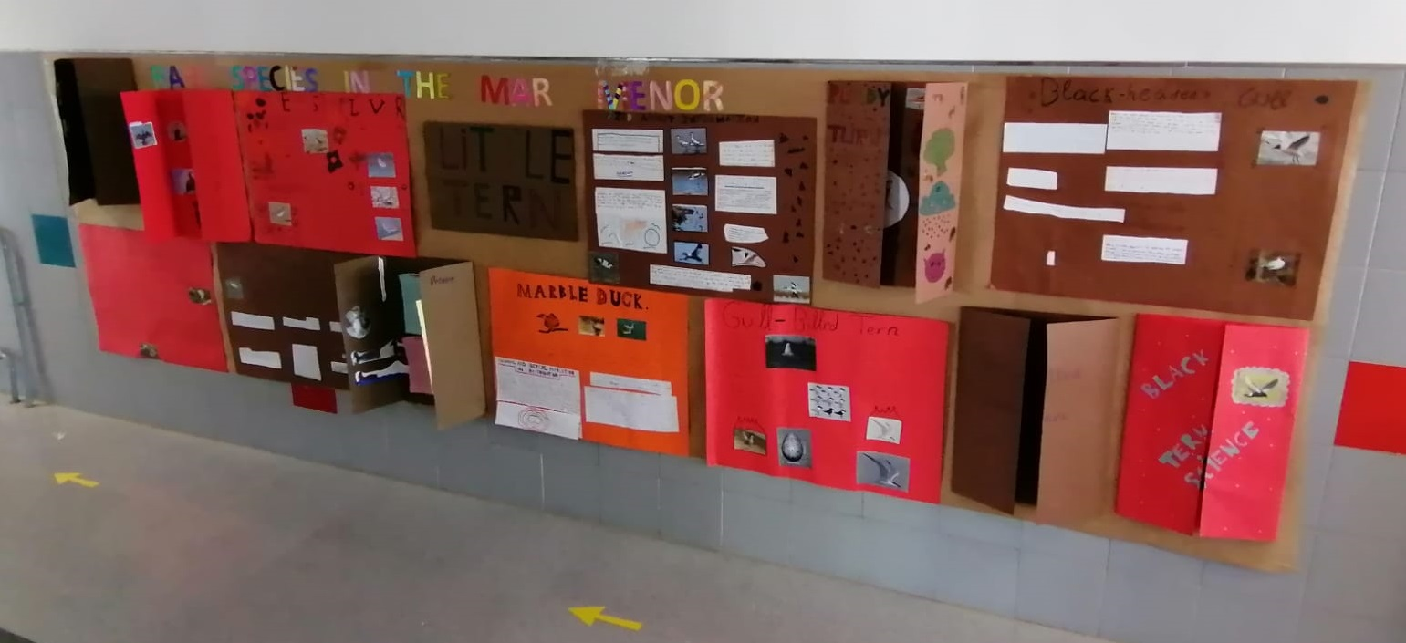
Rare species in the Mar Menor
In relation to the Erasmus + program in which our school takes part, the students in 4th grade have done some research in order to develop a project about rare species in our area. The chosen species are located in the Mar Menor and all of them belong to the group of aquatic birds.

Slide 3
Rare species in the Mar Menor
The 67 students in 4th grade (4A, 4B, 4C and 4D) have been divided in 14 groups to carry out the project. For each of the species, they have researched information about the following aspects:
Description
Habitat
Customs
Regional and iberical population and distribution
Status and population in the Mar Menor

Slide 4
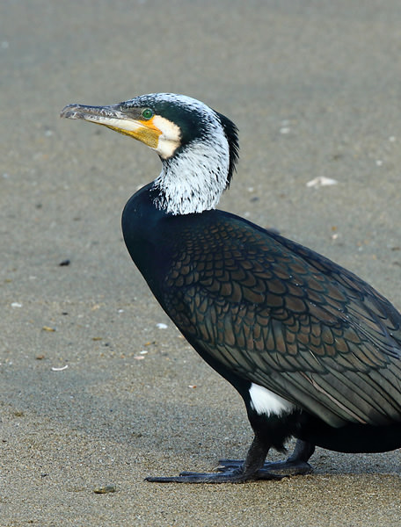
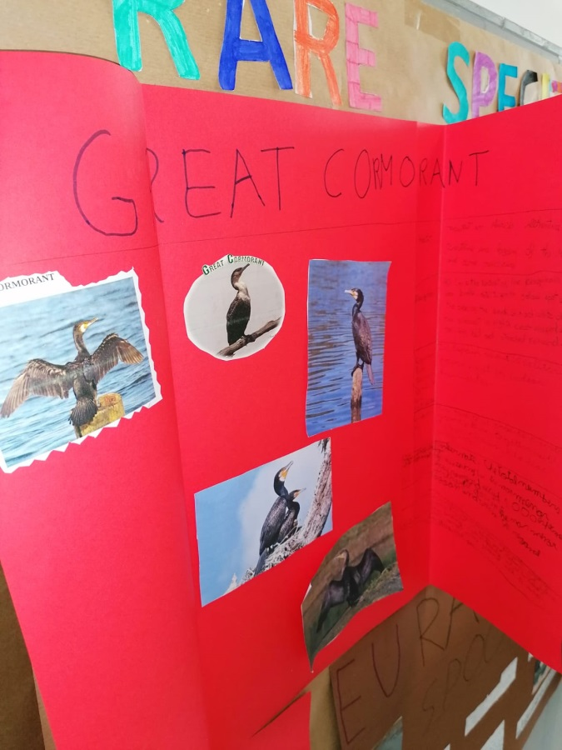
4A PROJECTS
GREAT CORMORANT

Slide 5
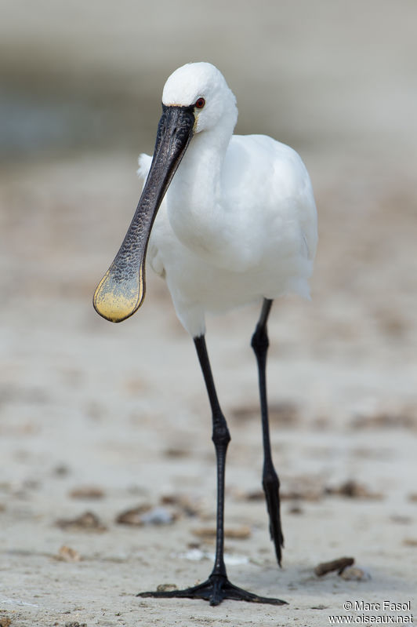
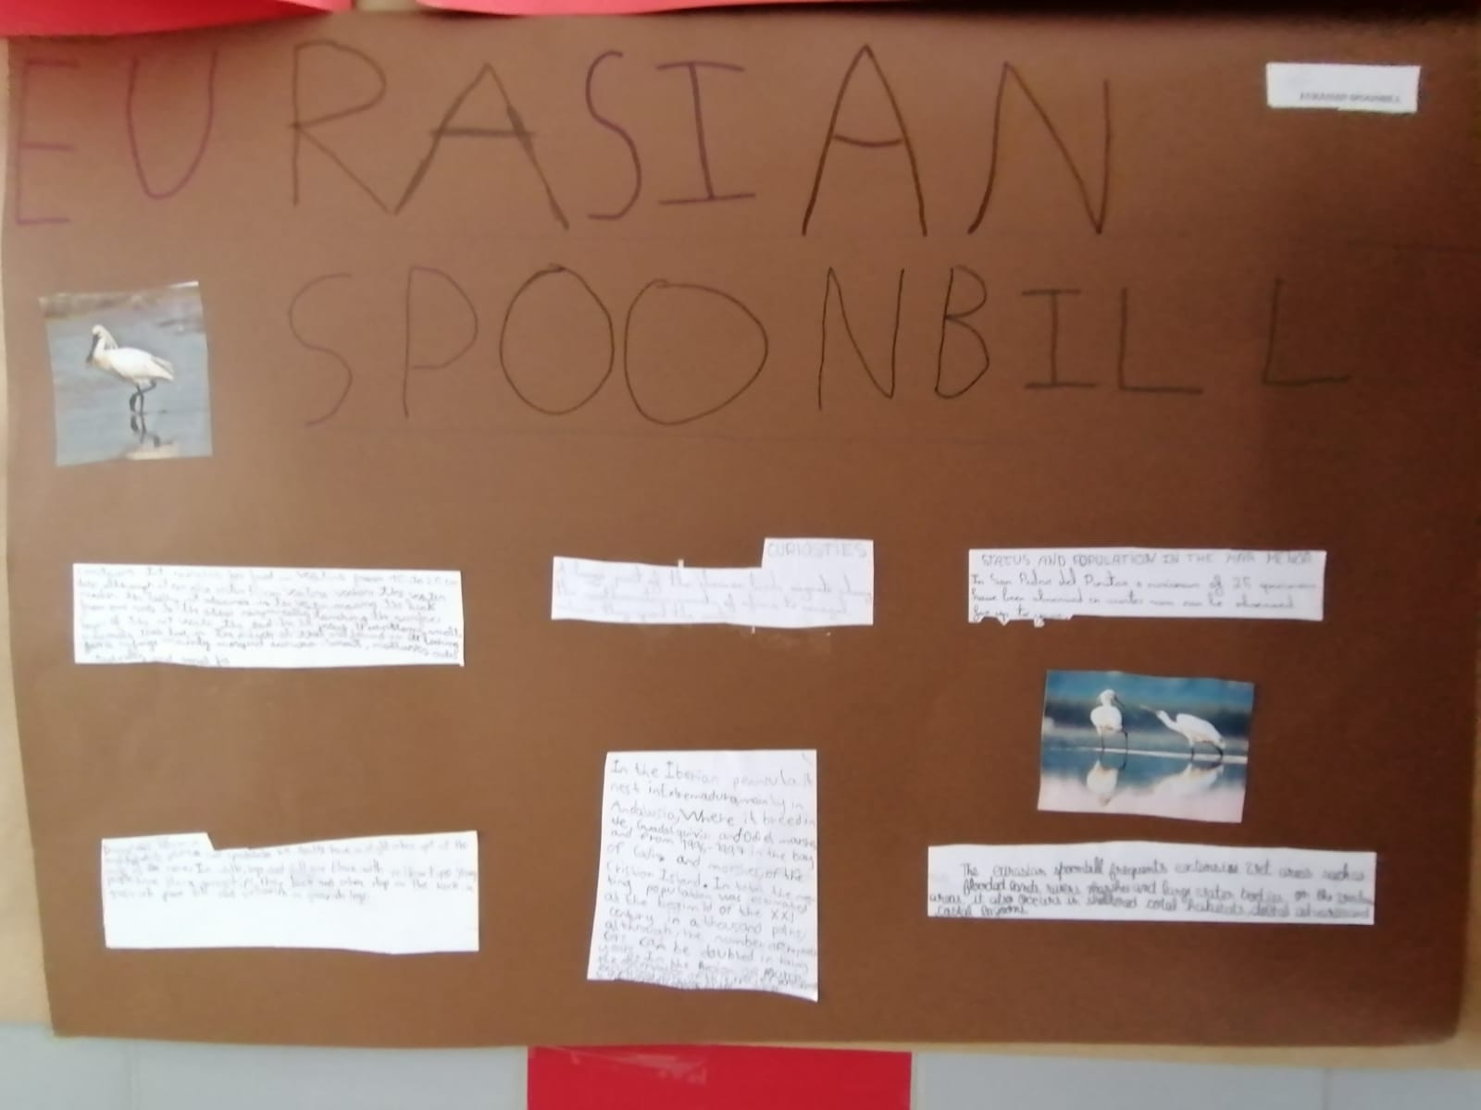
4A PROJECTS
EURASIAN SPOONBILL

Slide 6
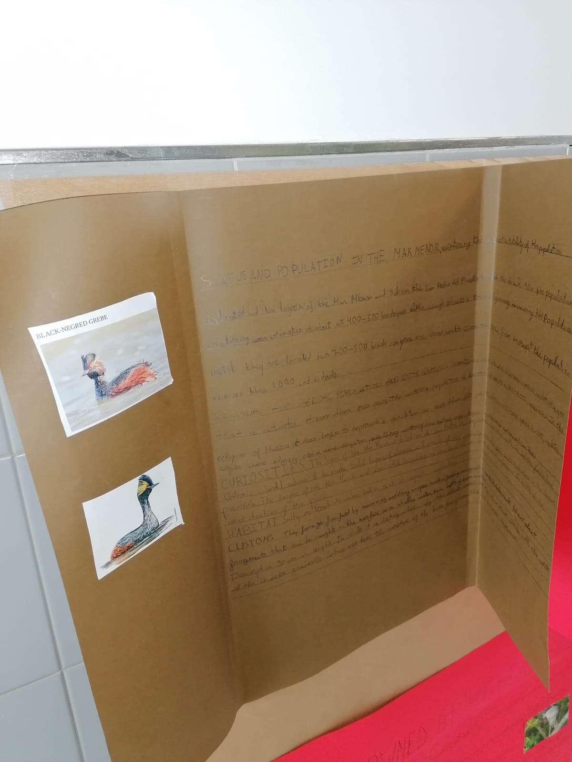
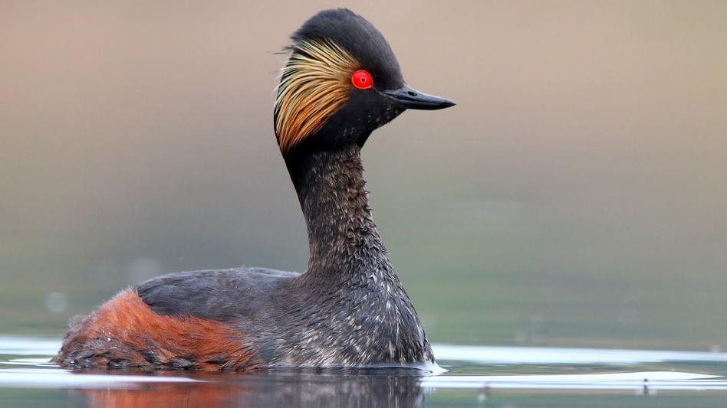
4A PROJECTS
BLACK-NECKED GREBE

Slide 7
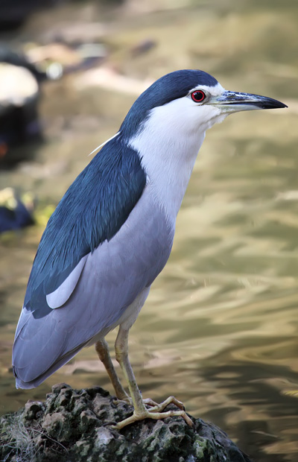
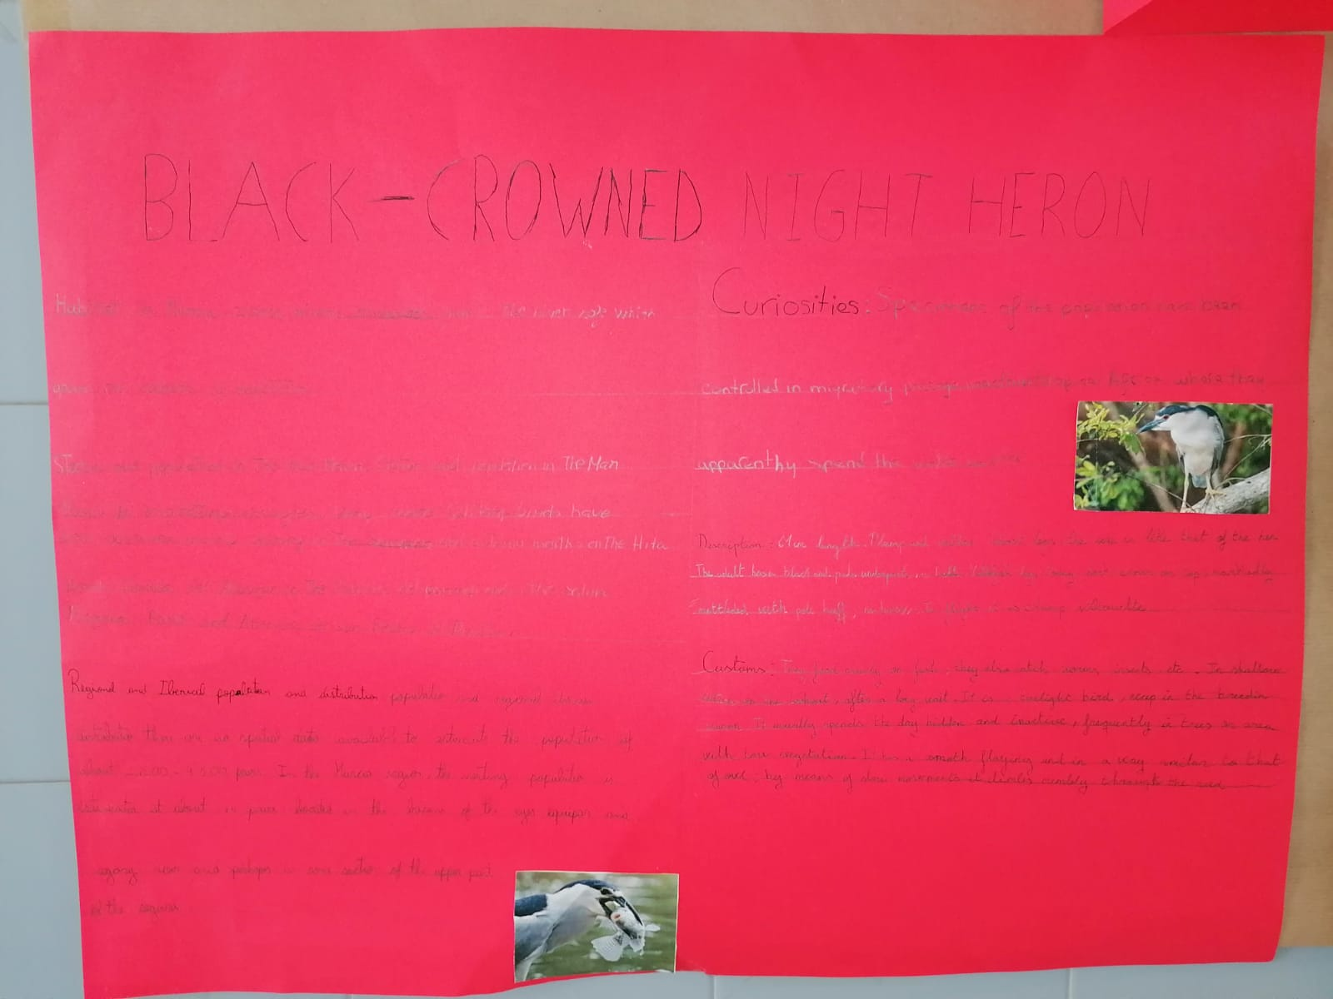
4A PROJECTS
BLACK-CROWNED NIGHT HERON

Slide 8
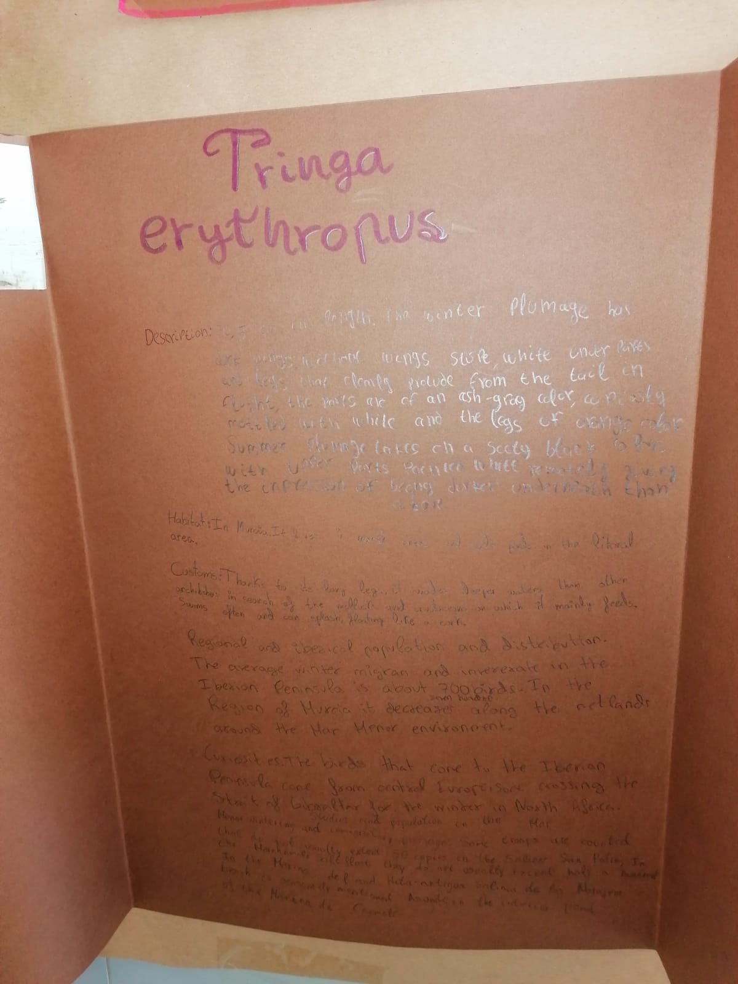
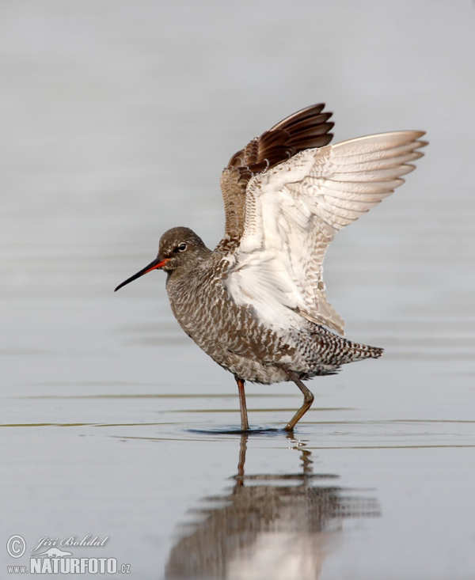
4B PROJECTS
SPOTTED REDSHANK

Slide 9
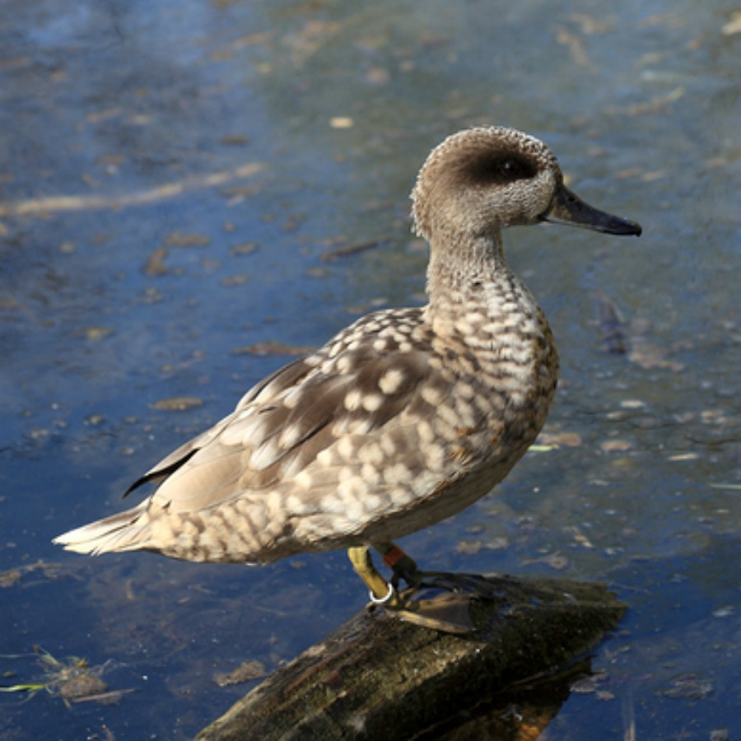
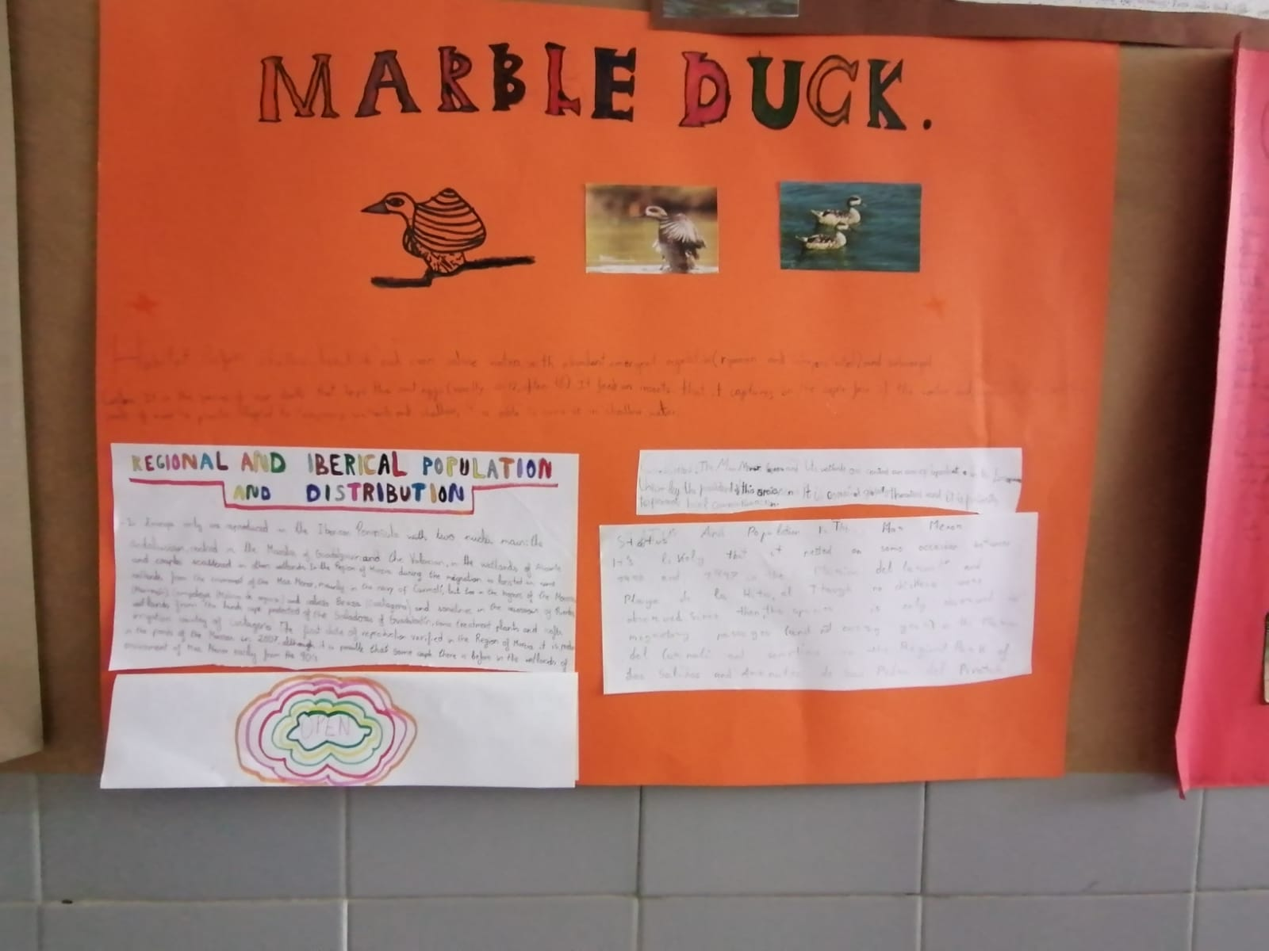
4B PROJECTS
MARBLED DUCK

Slide 10
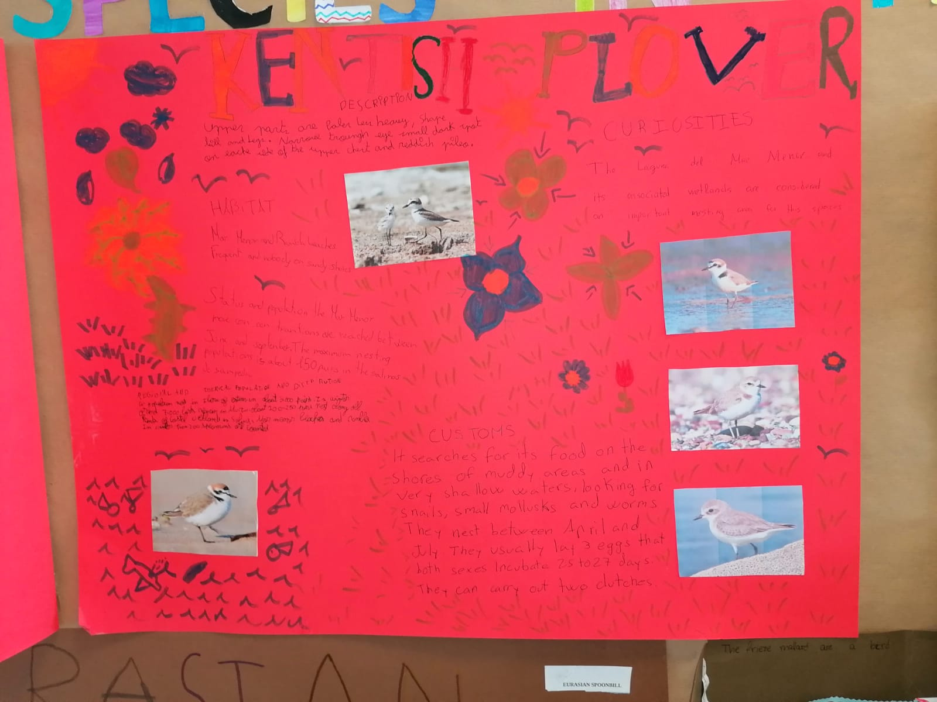
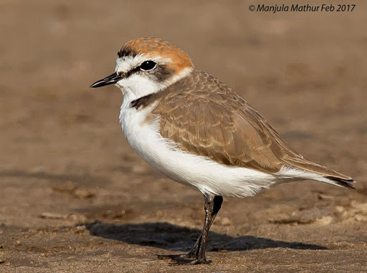
4B PROJECTS
KENTISH PLOVER

Slide 11
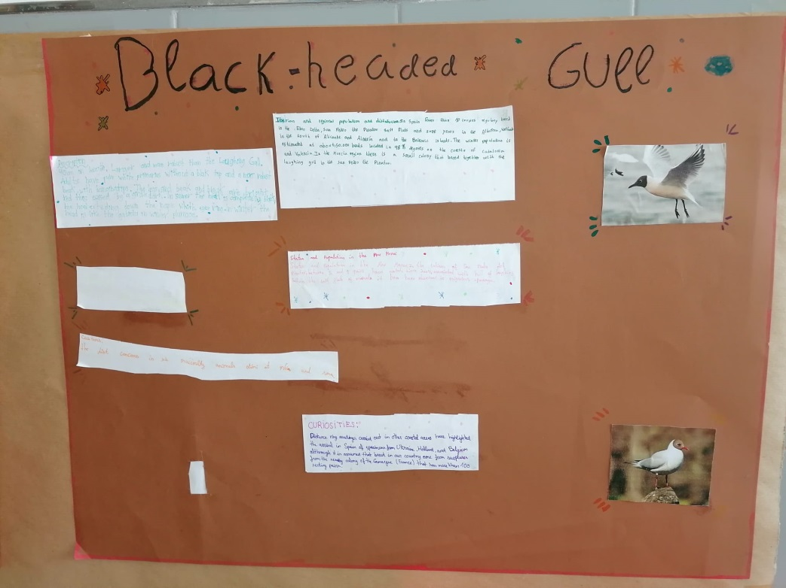
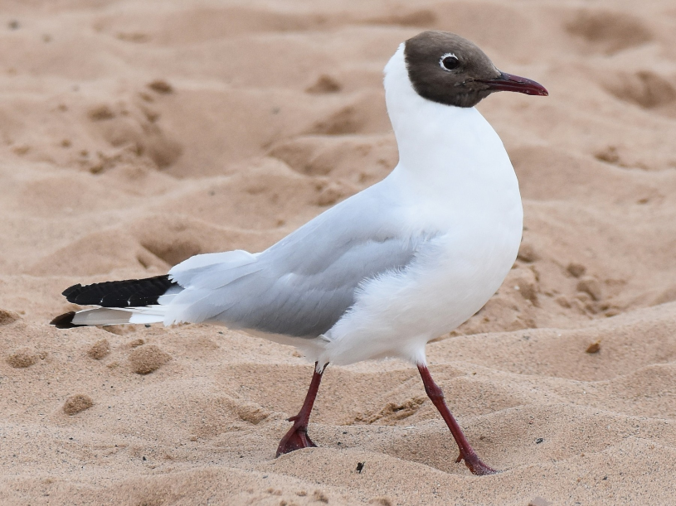
4C PROJECTS
BLACK-HEADED GULL

Slide 12
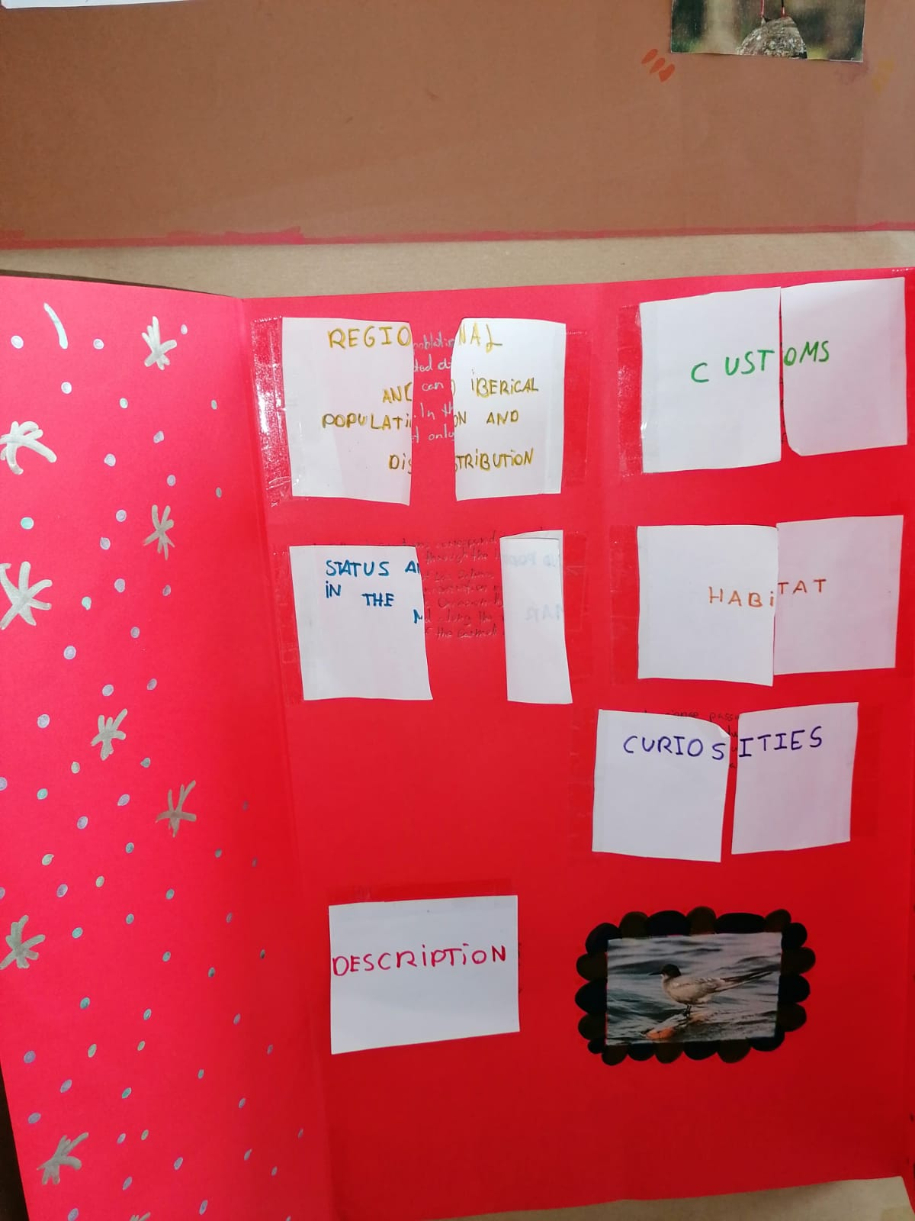
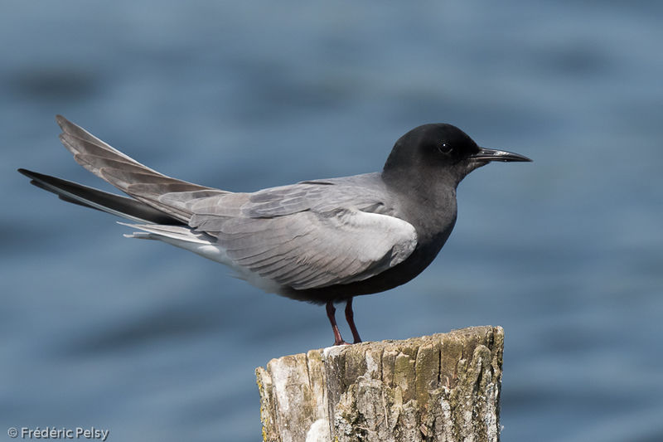
4C PROJECTS
BLACK TERN

Slide 13
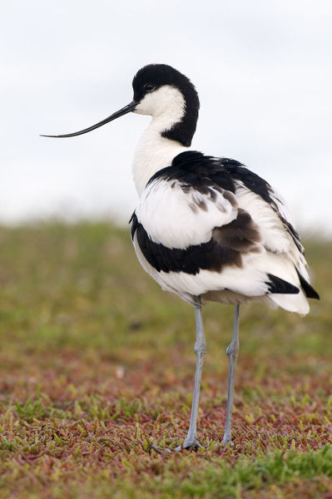
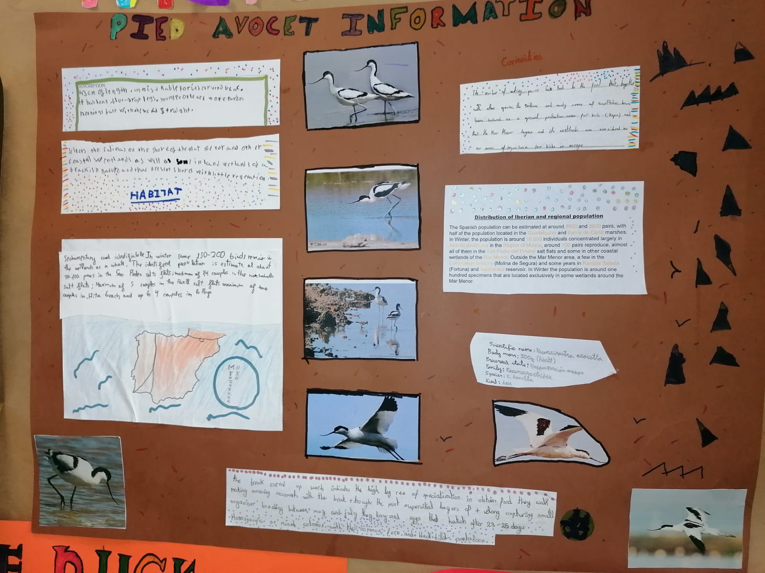
4C PROJECTS
PIED AVOCET

Slide 14
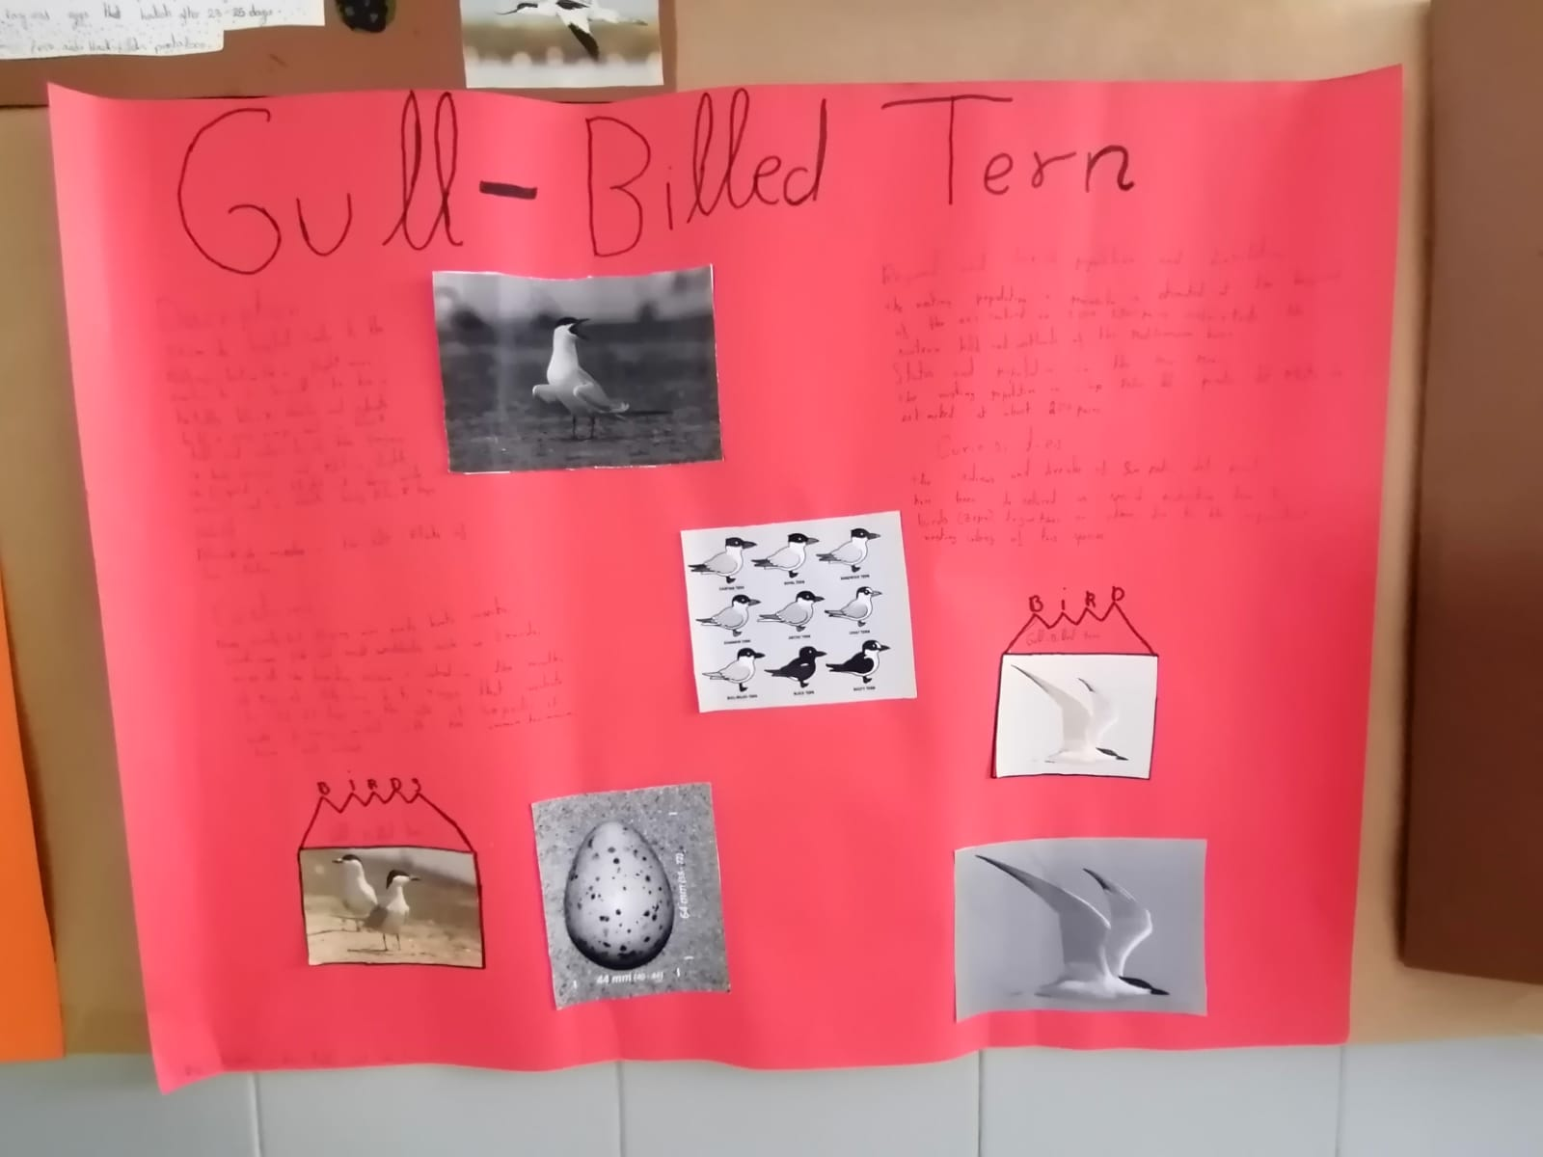
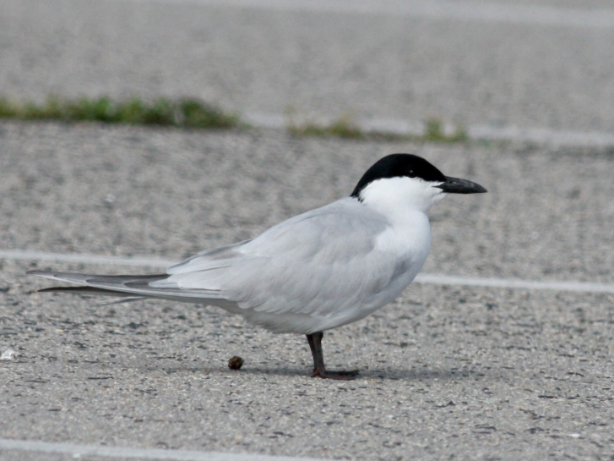
4D PROJECTS
GULL-BILLED TERN

Slide 15
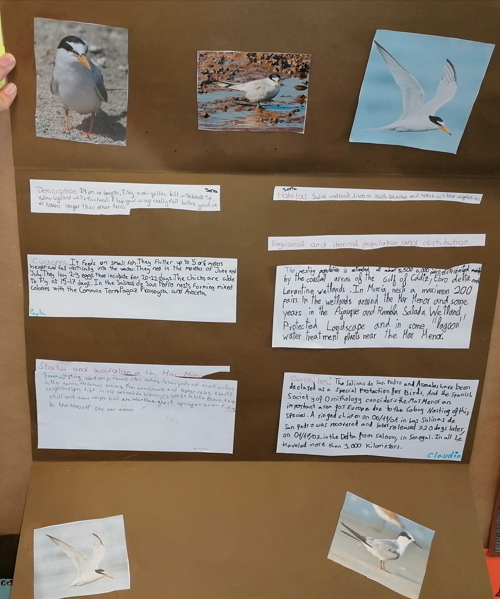
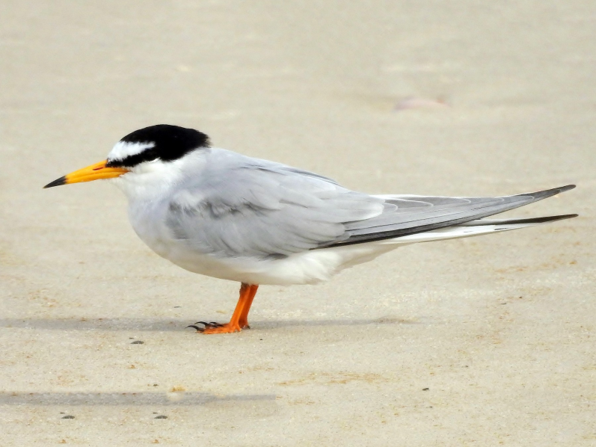
4D PROJECTS
LITTLE TERN

Slide 16
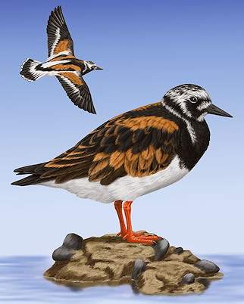
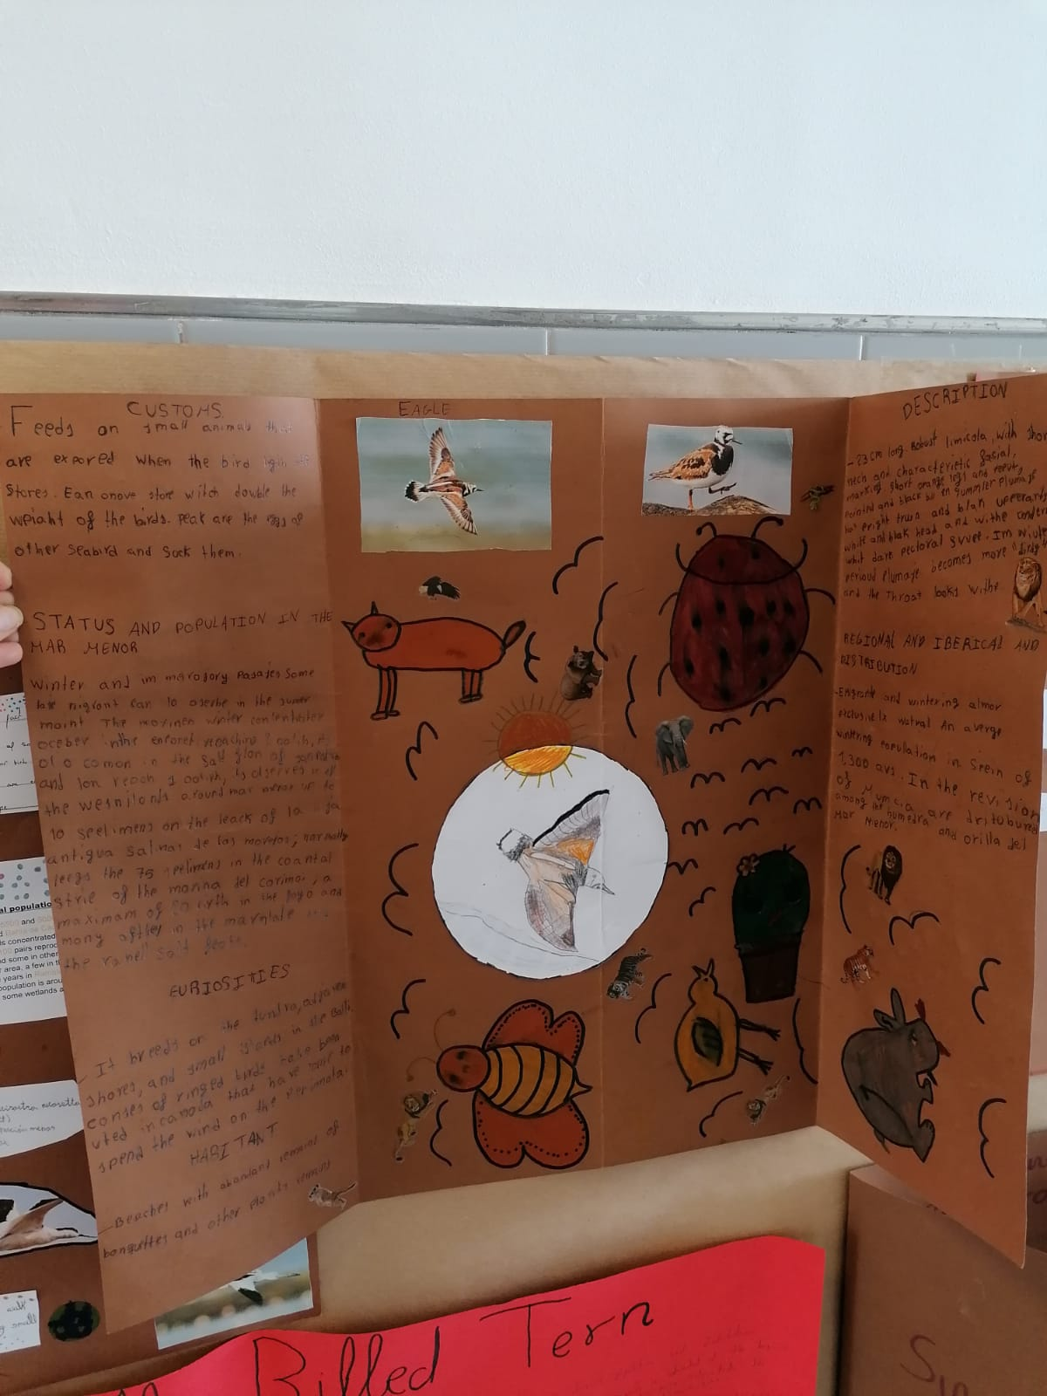
4D PROJECTS
RUDDY TURNSTONE

Slide 17
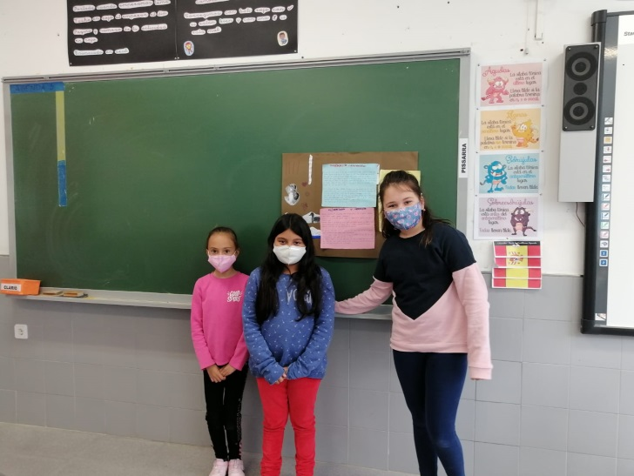
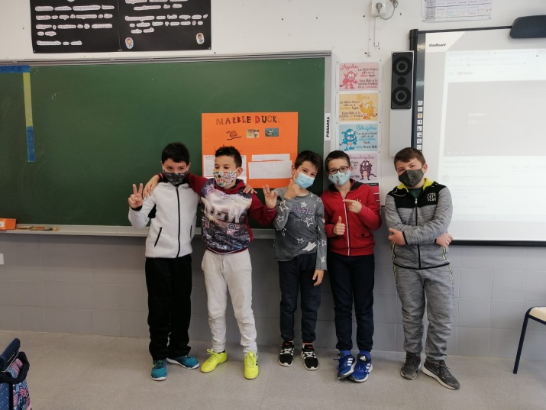
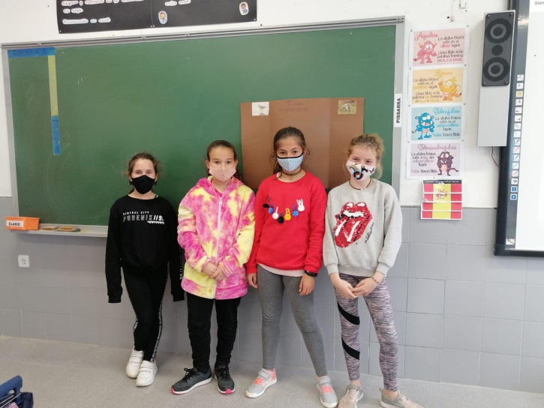
PRESENTATIONS

Slide 18
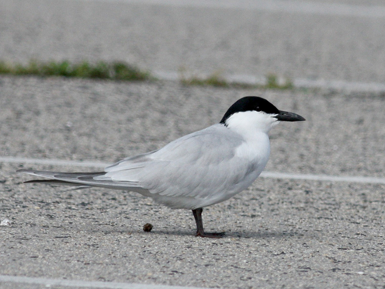
SOME PRESENTATIONS’ VIDEOS

