Slide 1
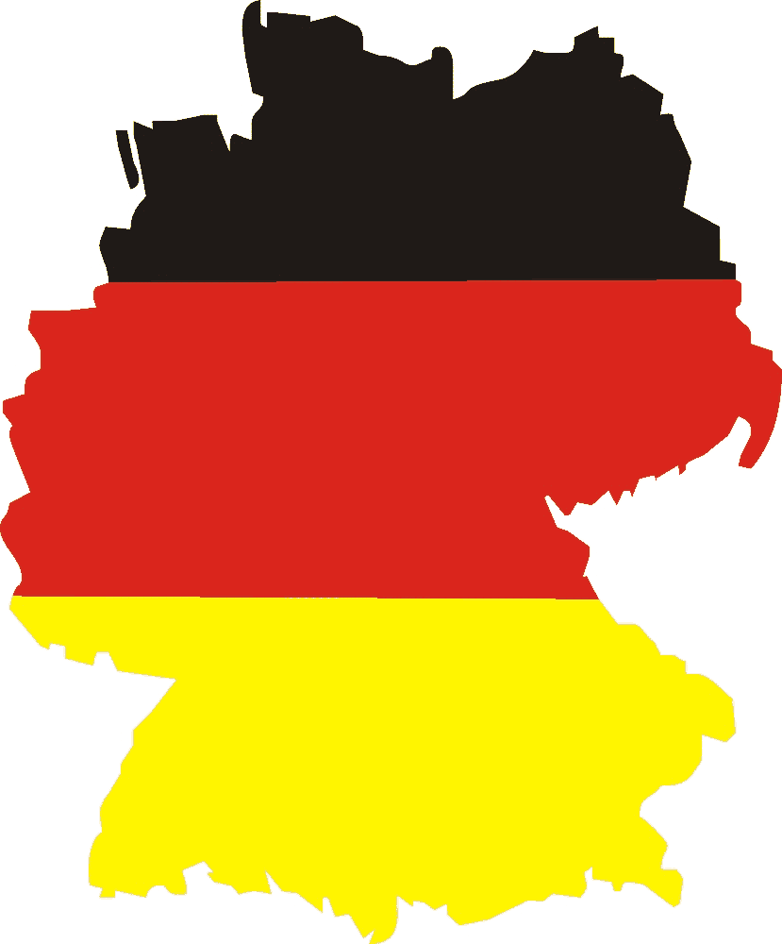
German identity
by Anne W., Johanna R. and Justine B.

Slide 2
structure
1 “Denglisch“
2 “Ampelmännchen”
3 cars
4 punctuality
5 food
6 “Fanmeile”

Slide 3
1 “Denglisch”
ENGLISH | GERMAN | MEANING
I think I spider. | Ich glaube, ich spinne. | I believe I‘m dreaming.
Now it goes around the sausage. | Jetzt geht‘s um die Wurst. | All or nothing.
There you are on the woodway. | Da bist du auf dem Holzweg. | You‘re completely wrong.
I understand only train station. | Ich verstehe nur Bahnhof. | I have no idea what you‘re saying.
My hair stands up to the mountain. | Mir stehen die Haare zu Berge. | I‘ve got goosebumbs.
The Devil I will do. | Den Teufel werde ich tun. | I will not do that.
I‘m foxdevilswild. | Ich bin fuchsteufelswild. | I‘m super mad.
Holla the woodfairy. | Holla die Waldfee. | Well, that‘s unexpected.

Slide 4
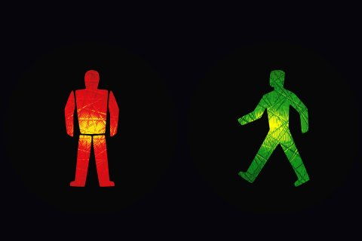
2 “Ampelmännchen“

Slide 5
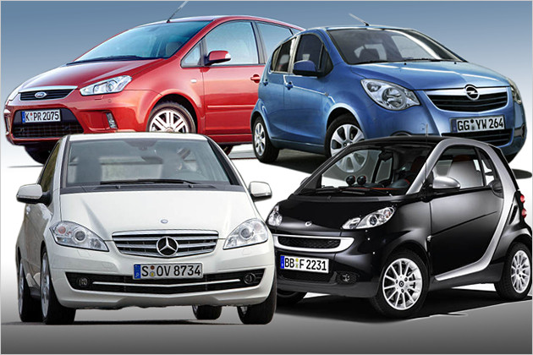
3 cars
good quality
good look
safe
high comfort
fast
non-polluting

Slide 6
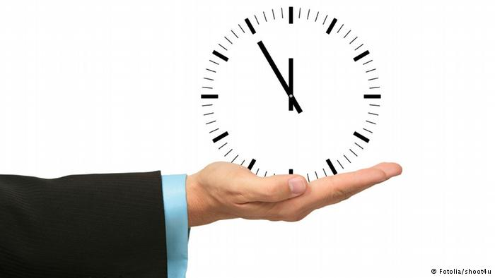
4 punctuality
set great store by punctuality
important if you have to travel by train, bus or airplane
being late → impolite
“Five minutes ahead of time is true punctuality.”

Slide 7
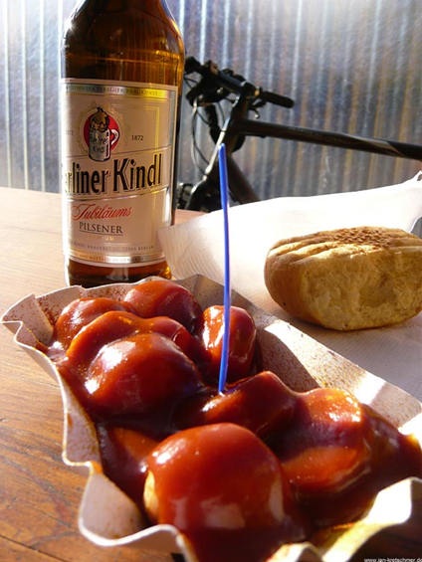
5 food
Currywurst and beer
- museum in Berlin called „ Deutsches Currywurst Museum“
→get to know historical facts about it
- in 1949 invented by Herta Heuwer
→ even popular today
- different variants
- usually served with a bread roll or
french fries
- many people enjoy a beer while eating

Slide 8
6 “Fanmeile”
http://www.youtube.com/watch?v=b-Q-rXy2vRI

Slide 9
Thanks for your attention.

