Slide 1
Paul Cézanne
“Art is a harmony parallel with nature.”
Hurani Ada
Tudor Todea
Anda Cirlig
Maria Buf
Raul Vadan

Slide 2
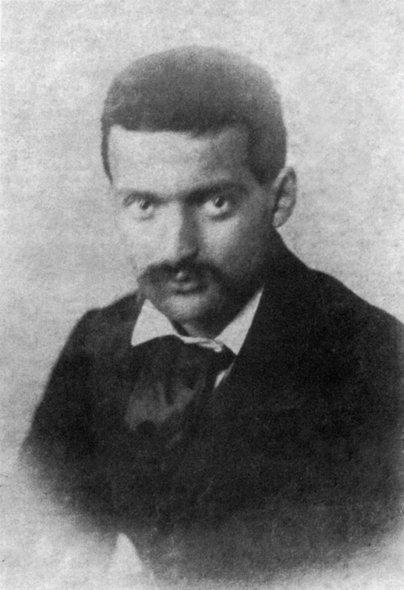
January 19, 1839 - October 22, 1906
The work of Post-Impressionist French painter Paul Cézanne, born in Aix-en-Provence in 1839, can be said to have formed the bridge between late 19th century Impressionism and the early 20th century's new line of artistic inquiry, Cubism. The mastery of design, tone, composition and color that spans his life's work is highly characteristic and now recognizable around the world. Both Henri Matisse and Pablo Picasso were greatly influenced by Cézanne.
“When I judge art, I take my painting and put it next to a God made object like a tree or flower. If it clashes, it is not art.”
—Paul Cézanne

Slide 3
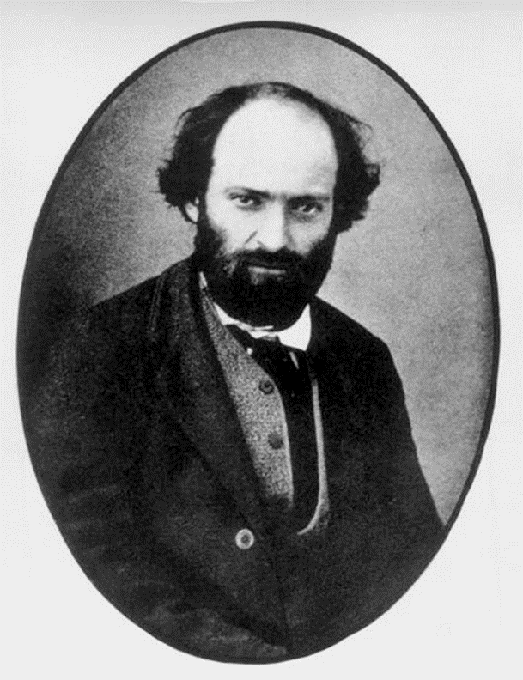
Early Life
“It's so fine and yet so terrible to stand in front of a blank canvas.”
—Paul Cézanne
His father, Philippe Auguste, was the co-founder of a banking firm that prospered throughout the artist's life, affording him financial security that was unavailable to most of his contemporaries and eventually resulting in a large inheritance.
Consequently, Cézanne began to study painting and drawing at the École des Beaux-Arts (School of Design) in Aix in 1856. His father opposed the pursuit of an artistic career, and in 1858 he persuaded Cézanne to enter law school at the University of Aix-en-Provence. Though Cézanne continued his law studies for several years, he was simultaneously enrolled at the École des Beaux-Arts, where he remained until 1861.

Slide 4
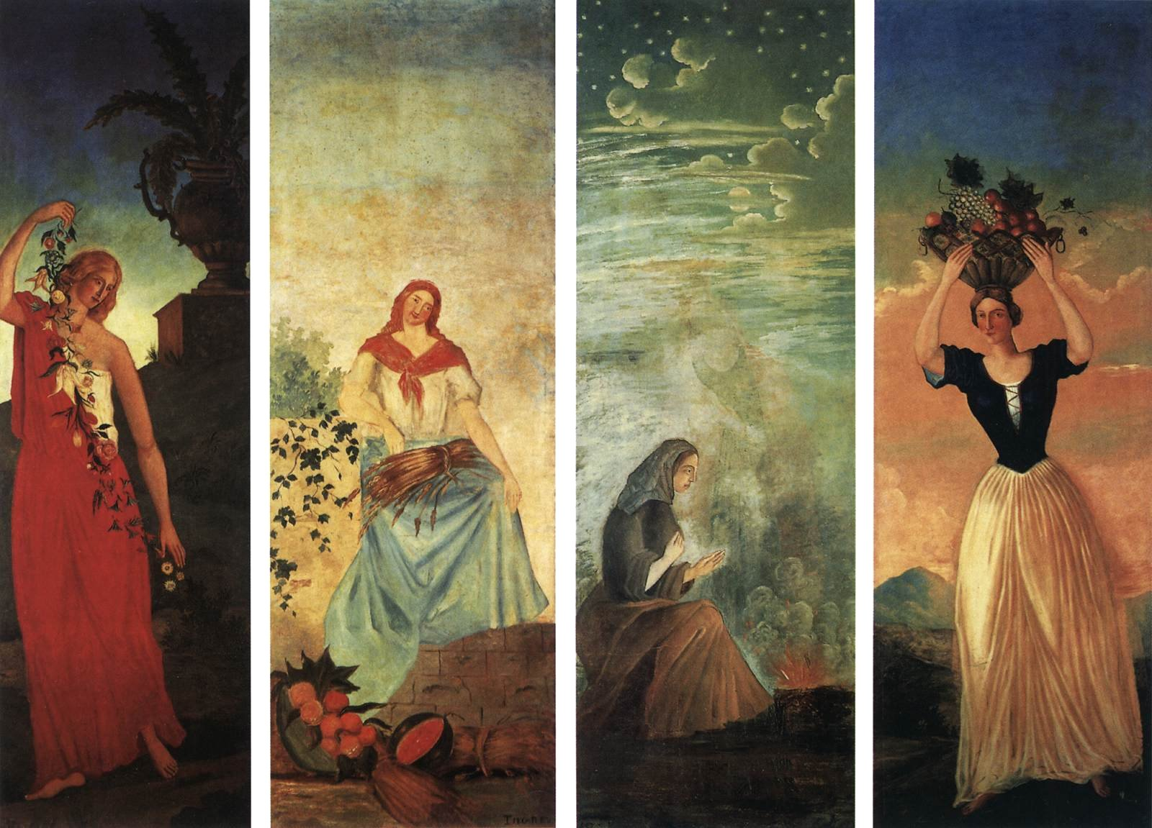
Works of the 1860s
Paul Cézanne's paintings from the 1860s are peculiar, bearing little overt resemblance to the artist's mature and more important style. The subject matter is brooding and melancholy and includes fantasies, dreams, religious images and a general preoccupation with the macabre. His technique in these early paintings is similarly romantic, often impassioned.
“Spring,Summer,Autumn and Winter”.

Slide 5
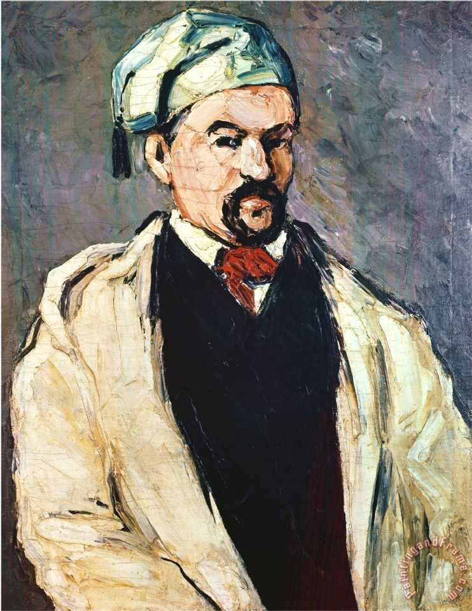
A fascinating aspect of Cézanne's style in the 1860s is the sense of energy in his work. Though these early works seem groping and uncertain in comparison to the artist's later expressions, they nevertheless reveal a profound depth of feeling. Each painting seems ready to explode beyond its limits and surface. Moreover, each seems to be the conception of an artist who could either be a madman or a genius—the world will likely never know, as Cézanne's true character was unknown to many, if not all, of his contemporaries.
For his "Man in a Blue Cap" (also called "Uncle Dominique," 1865-1866), he applied pigments with a palette knife, creating a surface everywhere dense with impasto.
The same qualities characterize Cézanne's unique "Washing of a Corpse" (1867-1869), which seems to both portray events in a morgue.
“The world doesn't understand me and I don't understand the world, that's why I've withdrawn from it.”
—Paul Cézanne

Slide 6
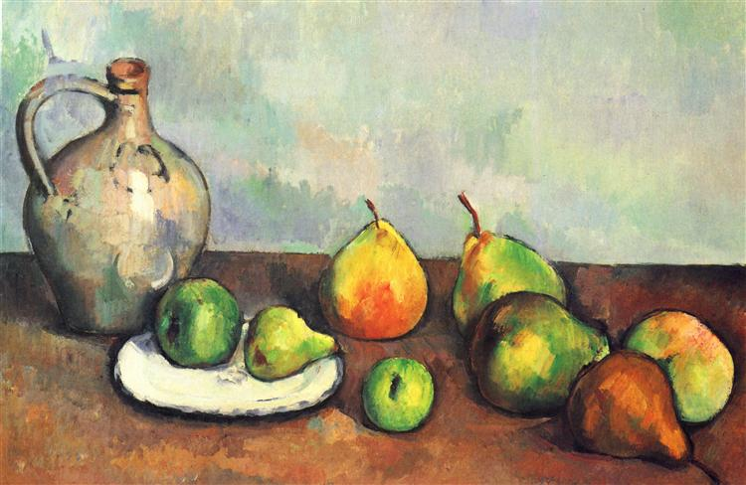
Cézanne and Impressionism
In 1872, Cézanne moved to Pontoise, France, where he spent two years working very closely with Pissarro. Also during this period, Cézanne became convinced that one must paint directly from nature. One result of this change in artistic philosophy was that romantic and religious subjects began to disappear from Cézanne's canvases. Additionally, the somber, murky range of his palette began to give way to fresher, more vibrant colors.
“Still Life, Pitcher And Fruit”

Slide 7
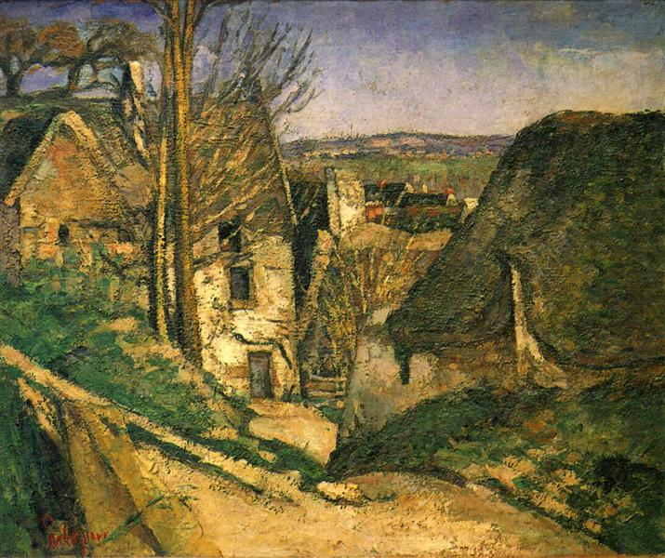
In "House of the Hanged Man" (1873-1874) and "Portrait of Victor Choque" (1875-1877), he painted directly from the subject and employed short, loaded brushstrokes—characteristic of the Impressionist style as well as the works of Monet, Renoir and Pissarro.
“I must be more sensible and realize that at my age, illusions are hardly permitted and they will always destroy me.”
—Paul Cézanne

Slide 8
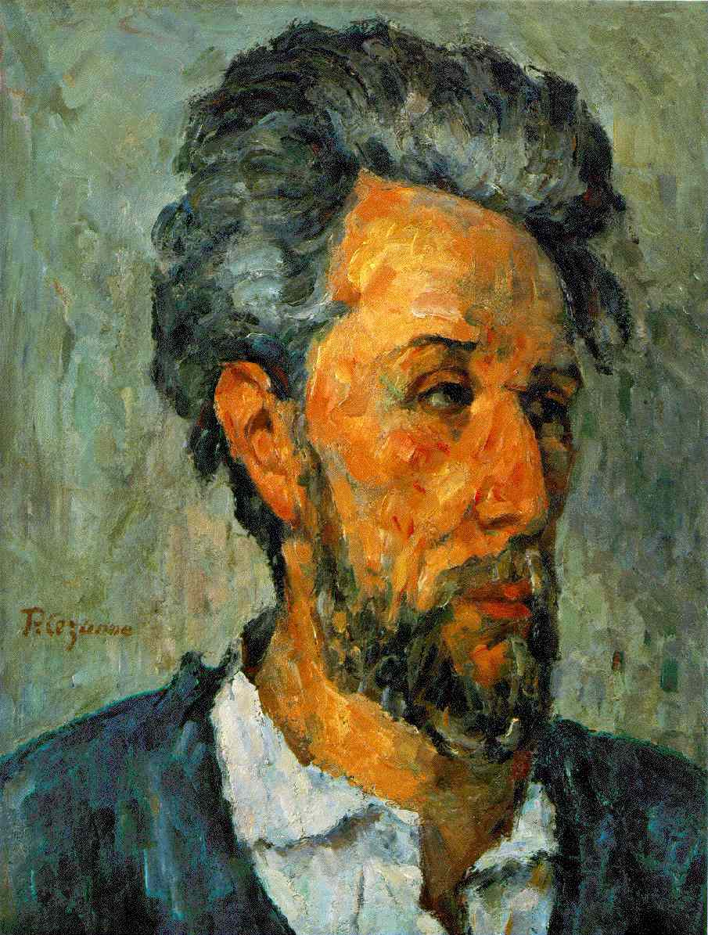
But unlike the way the movement's originators interpreted the Impressionist style, Cézanne's Impressionism never took on a delicate asthetic or sensuous feel; his Impressionism has been deemeed strained and discomforting, as if he were fiercely trying to coalesce color, brushstroke, surface and volume into a more tautly unified entity.
For instance, Cézanne created the surface of "Portrait of Victor Choque" through an obvious struggle, giving each brushstroke parity with its adjacent strokes, thereby calling attention to the unity and flatness of the canvas ground, and presenting a convincing impression of the volume and substantiality of the object.

Slide 9
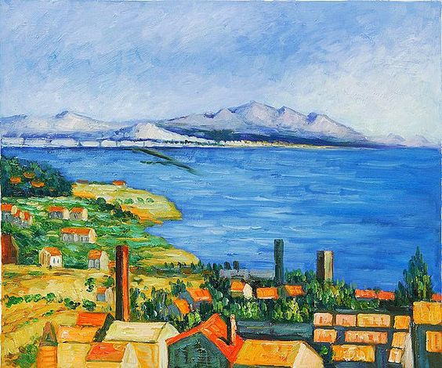
Mature Impressionism tended to forsake the Cézanne's and other deviating interpretations of the classic style. The artist spent most of the 1880s developing a pictorial "language" that would reconcile both the original and progressive forms of the style.
This new language is apparent in many of Cézanne's works, including "Bay of Marseilles from L'Estaque" (1883-1885);

Slide 10
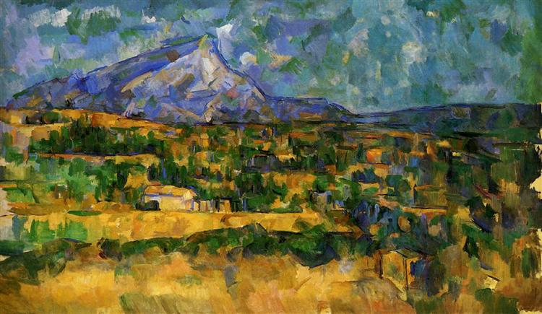
"Mont Sainte-Victoire" (1885-1887);

Slide 11
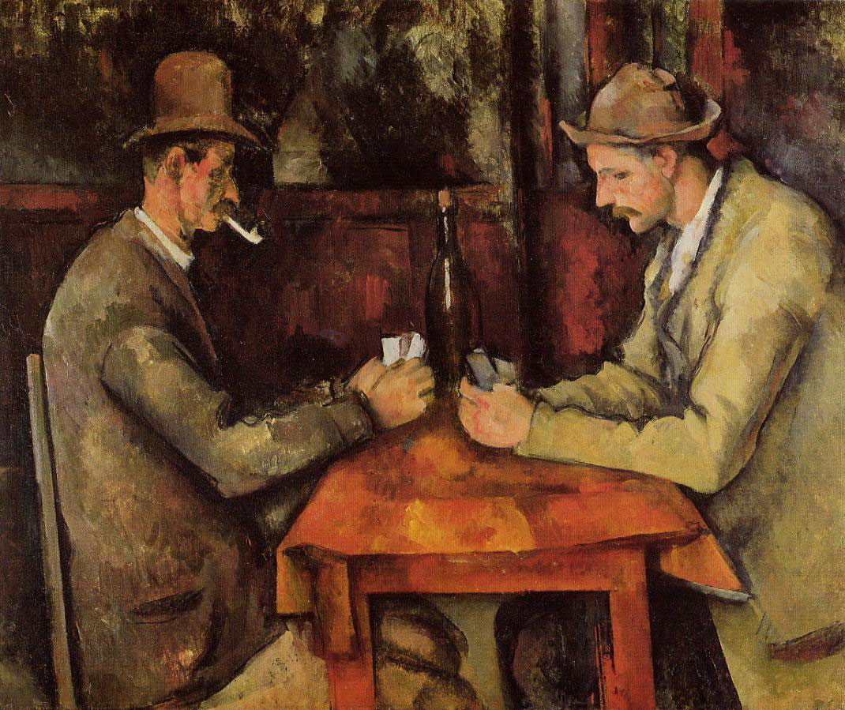
"The Cardplayers" (1890-1892);

Slide 12
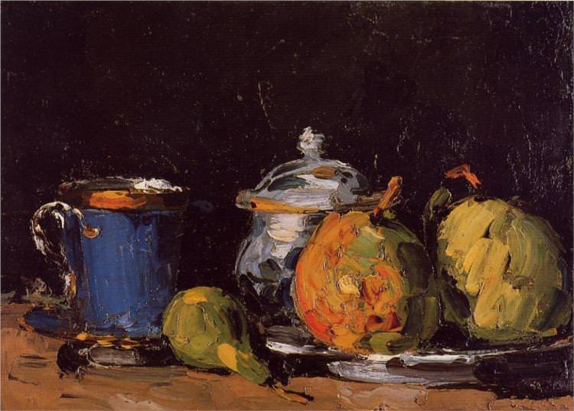
"Sugar Bowl, Pears and Blue Cup" (1866);

Slide 13
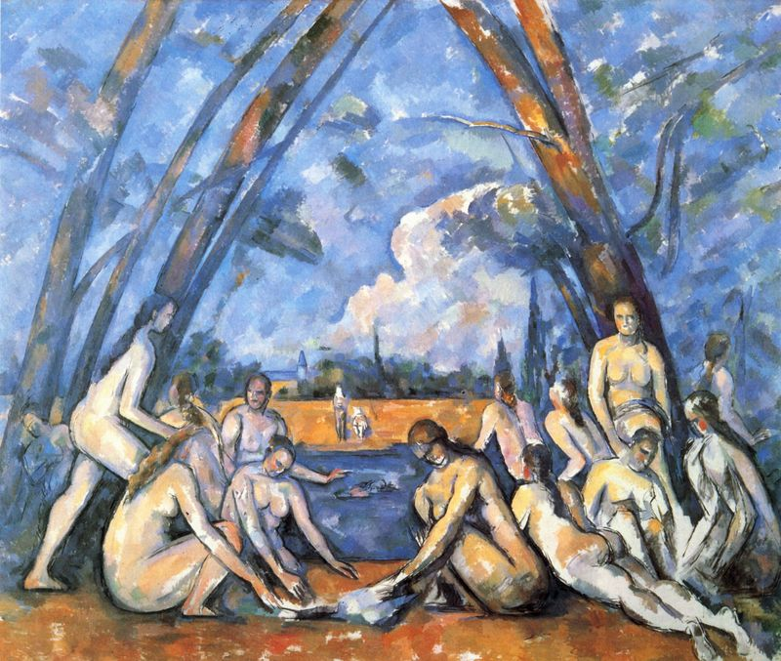
and "The Large Bathers" (1895-1905).
Each of these works seems to confront the viewer with its identity as a work of art; landscapes, still lifes and portraits seem to spread out in all directions across the surface of the canvas, demanding the viewer's full attention.
“Shadow is a colour as light is, but less brilliant; light and shadow are only the relation of two tones.”
—Paul Cézanne

Slide 14
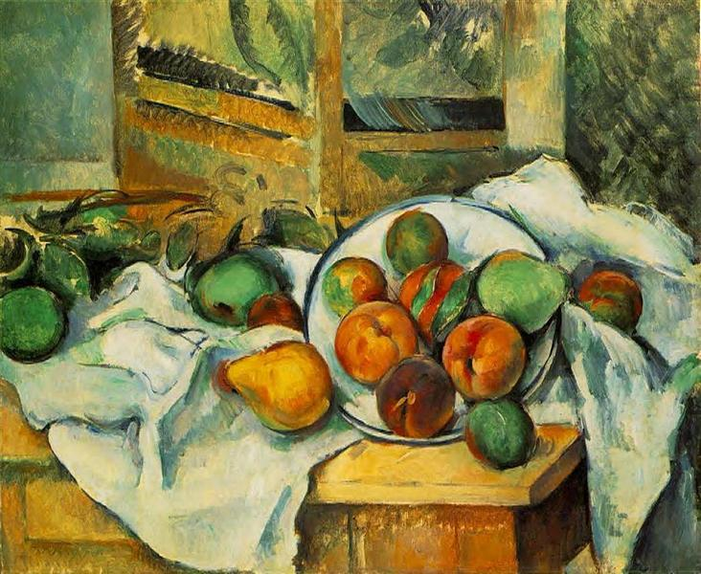
“Table, Napkin, and Fruit” (A Corner of the Table) (1895-1900)
After studying Dutch and French Old Master still life painting at the Musée du Louvre and other Paris galleries, Cézanne formulated his own semi-sculptural approach to still lifes. Typically strewn across an upturned tabletop, Cézanne's pears, peaches, and other pictorial elements seem at once to rest on a solid, wooden plank and yet float across the surface of the canvas like a new kind of calligraphy. As if to press home that point, Cézanne typically includes chairs, wooden screens, water pitchers, and wine bottles to suggest that the gaze of the viewer rise vertically up the canvas, rather than plunge deep within any implied corner of a real kitchen.
Oil on canvas, 47 x 56 cm (18 1/4 x 22 in) - The Barnes Foundation, Pennsylvania

Slide 15
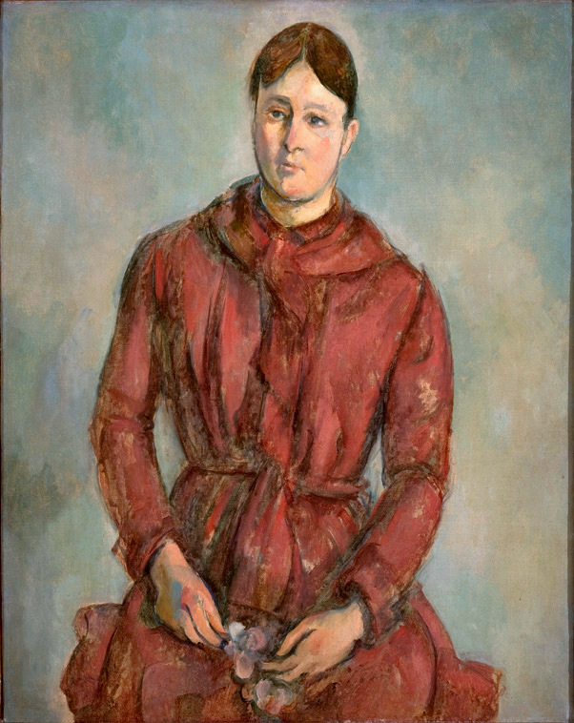
“Madame Cézanne in a Red Dress” (1888-1890)
Artwork description & Analysis: This is an example of the many portraits Cézanne painted of his mistress and eventual wife, Hortense Fiquet. Cézanne does not romanticize her form: the sitter's figure is rigidly imposing, almost soldier-like, her face bluntly plain and asymmetrical with only one ear visible. It seems that the sitter exists purely for compositional purposes, her dress in itself serving as an excuse for the artist to experiment with various tones of red, like a convenient palette. The stark geometrical accents dissect the canvas in both horizontal and vertical directions, thus creating the impression of a carefully arranged, monumental still life, as opposed to a portrait of a lifelong companion or "loved one."
Oil on canvas - The Metropolitan Museum of Art, New York.

Slide 16
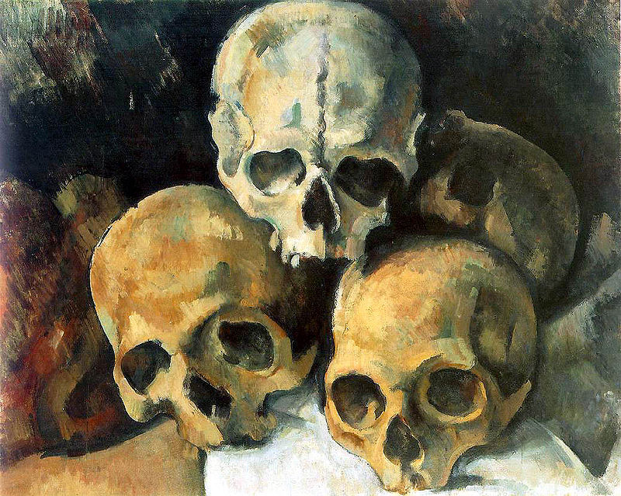
From 1890 until his death he was beset by troubling events and he withdrew further into his painting, spending long periods as a virtual recluse. His paintings became well-known and sought after and he was the object of respect from a new generation of painters.
Cézanne, however, returned to Provence to live.
From 1903 to the end of his life he painted in his studio, working for a month in 1904 with Émile Bernard, who stayed as a house guest. After his death it became a monument, Atelier Paul Cézanne, or les Lauves.
The problems began with the onset of diabetes in 1890, destabilizing his personality to the point where relationships with others were again strained. He traveled in Switzerland, with Hortense and his son, perhaps hoping to restore their relationship.

Slide 17
“Paul Cezanne was my one and only master."
- Pablo Picasso

Slide 18
Sources:
www.biography.com/people/paul-czanne-9542036
www.theartstory.org/artist-cezanne-paul.htm
https://en.wikipedia.org/wiki/Paul_Cézanne
https://www.britannica.com/biography/Paul-Cezanne
http://www.paulcezanne.org/

