Slide 1
Romania
K. Skarolskytė ir a. naujokaitė

Slide 2
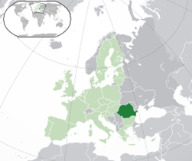
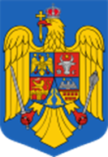
Romania is a sovereign state located in Southeastern Europe. It borders the Black sea, Bulgaria, Ukraine, Hungary, Serbia, and Moldova. It has an area of 238,391 square kilometres and temprante – continental climate. With 19.94 million inhabitants, the country is the seventh most popular member state of the European Union. Its capital and largest city, Bucharest, is the sixth largest city in the EU, with 1,883,425 inhabitants as of 2011.

Slide 3
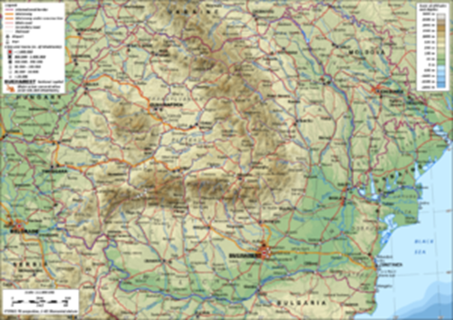
The Carpathian Mountains dominate the centre of Romania, with 14 mountain ranges reaching above 2,000 m or 6,600 ft, and the highest point at Moldoveanu Peak. They are surrounded by the Moldovian and Transylvanian plateaus and Carpathian Basin and Wallachian plains.

Slide 4
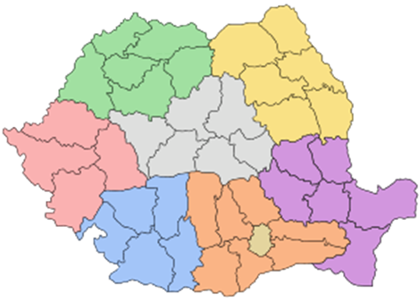
Governance
The country is governed on the basis of a multi-party democratic system and the separation of powers between the legislative, executive and judicial branches. It is a semi - presidental republic where executive functions are held by both government and the president. The 2007 entry into the EU has been a significant influence on its domestic policy.
Administrative divisions
Romania is divided into 41 counties (județe, pronounced judets) and the municipality of Bucharest. A total of 103 of the larger cities have municipality statuses, which gives them greater administrative power over local affairs.

Slide 5
Tourism
Tourism is a significant contributor to the Romanian economy. More than 60% of the foreign visitors in 2007 were from other EU countries.[218] The popular summer attractions of Mamaia and other Black sea resorts ,Most popular skiing resorts are along the Valea Prahovei and in Poiana Brasov. Castles in Transylvanian cities such as Sibiu, Brasov, and Sighisoara also attract a large number of tourists. Bran castle, near Brasov, is one of the most famous attractions in Romania, drawing hundreds of thousands of tourists every year as it is often advertised as being Dracula's Castle.
Rural tourism, focusing on folklore and traditions, has become an important alternative and is targeted to promote such sites as Bran and its Dracula‘s castle, the Painted churches of southern Moldavia, and the Wooden churches of Maramures. Other attractions include the Danube Delta, and the Sculptural Ensemble of Constantin Brâncuși at Târgu Jiu

Slide 6
Bran Castle

Slide 7
Anunciation Church

Slide 8
St. George Church

Slide 9
Demographics
According to the 2011 census, Romania's population is 20,121,641. In October 2011, Romanians made up 88.9% of the population. The largest ethnic minorities are the Hungarians, Roma. Other minorities include Ukrainians, Germans, Turks,Lipovans , Aromanians, Tatars, and Serbs.

Slide 10
Languages
The official language is Romanian, an Eastern Romance language similar to Aromanian,Megleno – Roma nian , and Istro - Romanian, but sharing many features with other Romance languages such as Italian, French, Spanish and Portuguese.

Slide 11
Religion
Romania is a secular state and has no state religion. An overwhelming majority of the population identify themselves as Christians. 81.0% of respondents identified as Orthodox Christans belonging to the Roamian Orthodox church. Other denominations include Roman Catholicism and Greek Catholicism From the remaining population, 195,569 people belong to other Christian denominations or have another religion, which includes 64,337 Muslims (mostly of Turkish and Tatar ethnicity) and 3,519 Jewish.

Slide 12
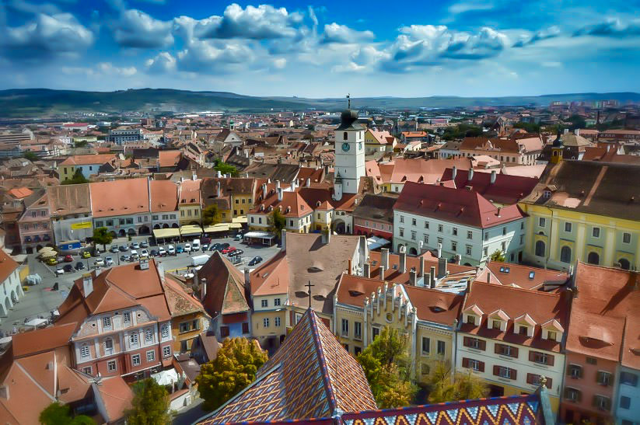
Culture
Sibiu was the european capital of culture in 2007.
There are 12 non-working public holidays, including the Great Union Day, celebrated on 1 December in commemoration of the 1918 Union of Transylvania and Romania.[298] Winter holidays include the Christmas festivities and the New Year during which, various unique folklore dances and games are common: plugusorul, sorcova, ursul, and capra. The traditional Romanian dress that otherwise has largely fallen out of use during the 20th century, is a popular ceremonial vestment worn on these festivities, especially in the rural areas. Sacrifices of live pigs during Christmas and lambs during Easter has required a special derogation from EU law after 2007. During Easter, painted eggs are very common, while on 1 March features mărțișor gifting, a tradition likely of Thracian origin

Slide 13
Cuisine
Romanian cuisine shares some similarities with other Balkan cuisines such as Greek, Bulgarian and Turkish cuisine Ciorbă includes a wide range of sour soups, while mititei and sarmale are featured commonly in main courses. Pork, chicken and beef are the preferred meats, but lamb and fish are also popular.Certain traditional recipes are made in direct connection with the holidays

Slide 14
Etiquette and society

Slide 15
HIERARCHY
Romania is a hierarchical society where age and position are respected.
Older people are viewed as wise since they have earned life experience.
Romanians expect the most senior person, by age or position, to make decisions that are in the best interest of the group.
Titles are very important and denote respect.
It is expected that you will use a person's title and their surname until invited to use their first name.

Slide 16
PRIVACY
Romanians are formal and reserved with a strong need for privacy.
Most do not trust strangers readily.
They are generally shy and quiet when you first meet and admire modesty and humility in themselves and others.
Once you develop a personal relationship Romanians will open up slightly.
Although always polite, they seldom move to a first-name basis with people outside their extended family or very close friends.

Slide 17
Meeting and Greeting
Initial greetings are formal and reserved: a handshake, direct eye contact, and the appropriate greeting for the time of day.
Some older Romanians kiss a woman's hand when meeting them. Foreign men are not expected to kiss a Romanian woman's hand.
Close friends may kiss and hug each other when they meet.
When kissing, expect to kiss twice, once on each cheek starting with the left cheek.
Allow your Romanian friends to determine when your relationship has reached this level of intimacy.

Slide 18
Dining Etiquette
Expect to be treated with great honour and respect.
Table manners follow established protocols of good behaviour.
Wait to be told where to sit. There may be a seating plan.
Table manners are Continental -- hold the fork in the left hand and the knife in the right while eating.
Wait for the host or hostess to say "pofta buna" (good appetite) before you begin eating.
Expect to be offered second and even third helpings.
You will have to insist that you cannot eat any more, as refusals are seen as good manners and are not taken seriously.

Slide 19
This project has been funded with support from the European Commission. This publication reflects the views only of the author, and the Commission cannot be held responsible for any use which may be made of the information contained therein.

