Slide 1
Impact on the participants of the project
Summary

Slide 2
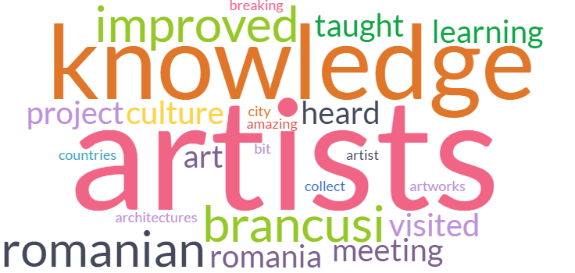
Say with a few words how the project - and the meeting in Cluj - has improved your knowledge of Europe and its artists

Slide 3
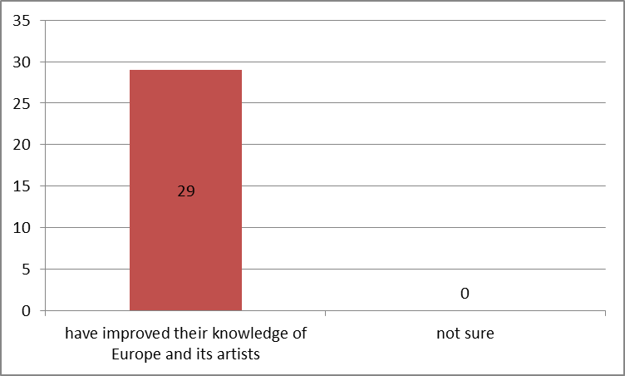
Knowledge of Europe and its artists

Slide 4
Knowledge of Europe and its artists

Slide 5
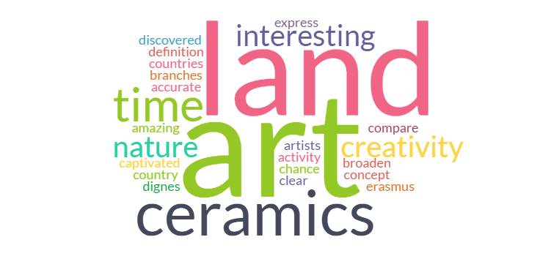
Say with a few words how the project – and the meeting in Cluj – has improved your knowledge of Land Art or Ceramics

Slide 6
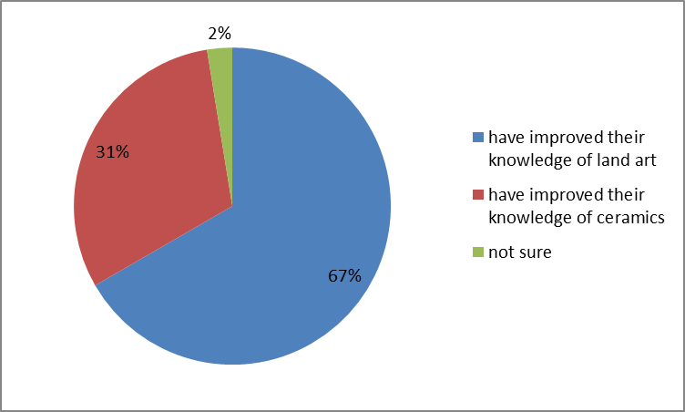
Knowledge of land art and ceramics

Slide 7
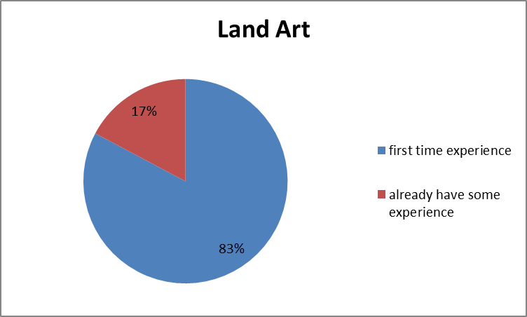
Knowledge of land art and ceramics

Slide 8
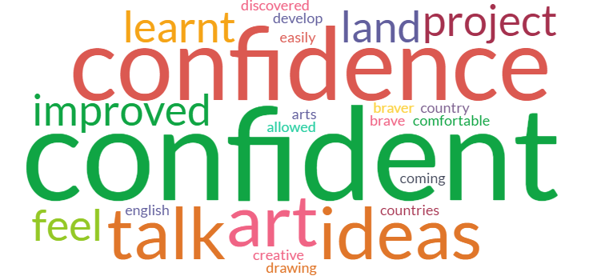
Say with a few words how the project – and the meeting in Cluj – has improved your self-confidence and creativity

Slide 9
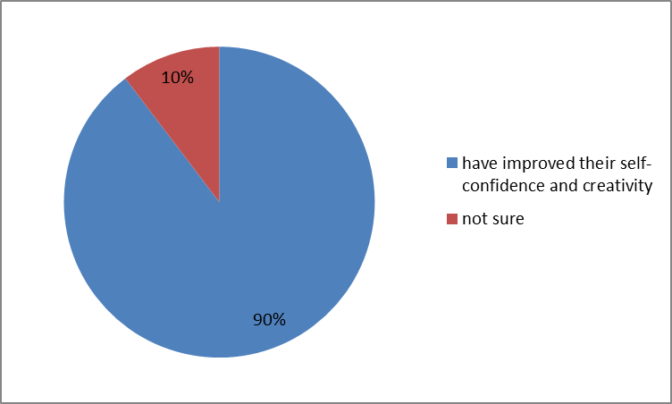
Self-confidence and creativity

Slide 10
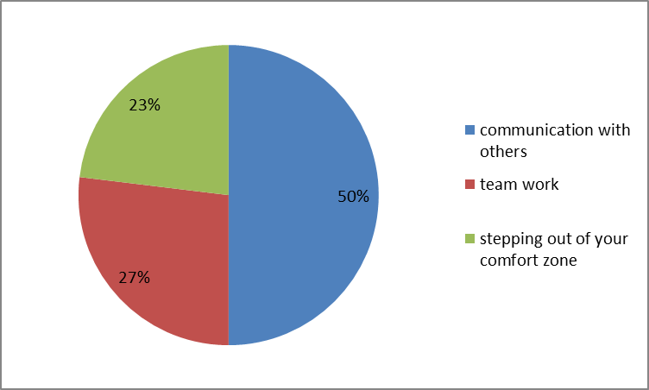
Self-confidence and creativity

Slide 11
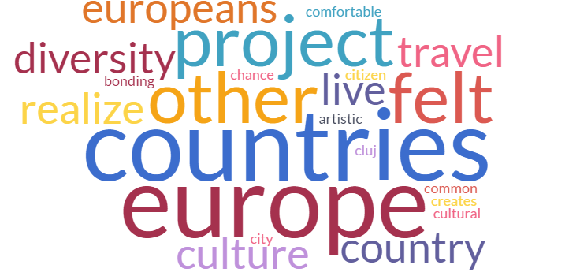
Say with a few words how the project – and the meeting in Cluj – has improved your European citizenship

Slide 12
European citizenship

Slide 13
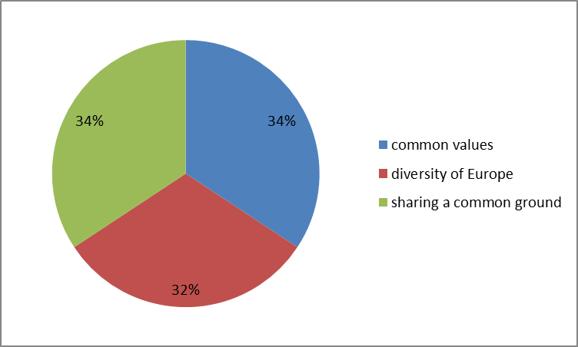
European citizenship

Slide 14
Conclusions
All of the respondents claim that the project and the meeting in Cluj has improved their knowledge of Europe and its artists. The most commonly used answers include discovery of Romania and its culture, previously unknown European artists and being involved in research prior to mobility.
All of the respondents claim that the project and the meeting in Cluj has improved their knowledge of Land Art and Ceramics. For majority of them working with land art was the first time experience and an interesting activity to improve their creativity. Ceramics workshop and pottery demonstration in Horezu was a great way to compare ceramics in other countries.

Slide 15
Conclusions
Majority of respondents feel that they have improved their self-confidence and creativity due to communication with colleagues from other European countries, team work and stepping out of their comfort zone and trying new things.
All of the respondents believe that they have improved their European citizenship while meeting people from other countries, sharing their cultures, finding things in common and realizing that people living in another country are similar to people living in their country. They are not different. They are all Europeans and share the same ground.

