Slide 1
Preparation for the 2nd mobility in Romania

Slide 2
Land Art

Slide 3
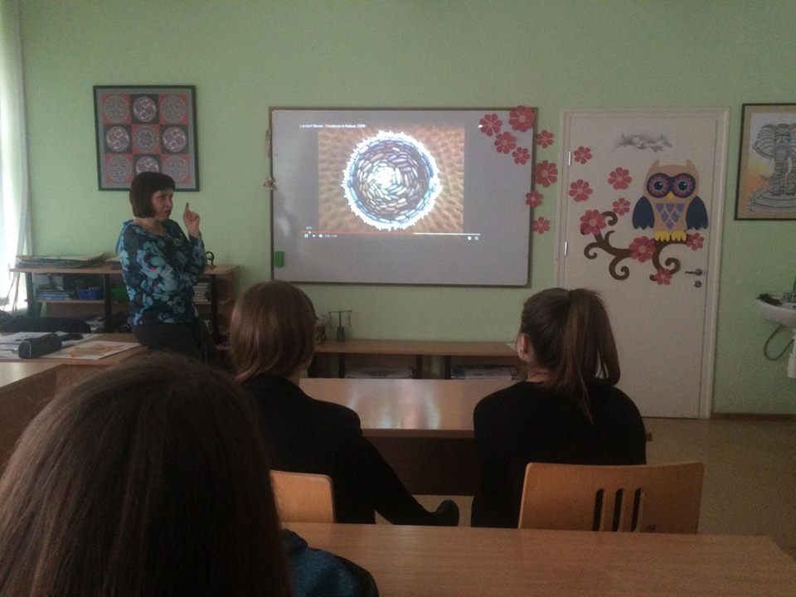

Slide 4
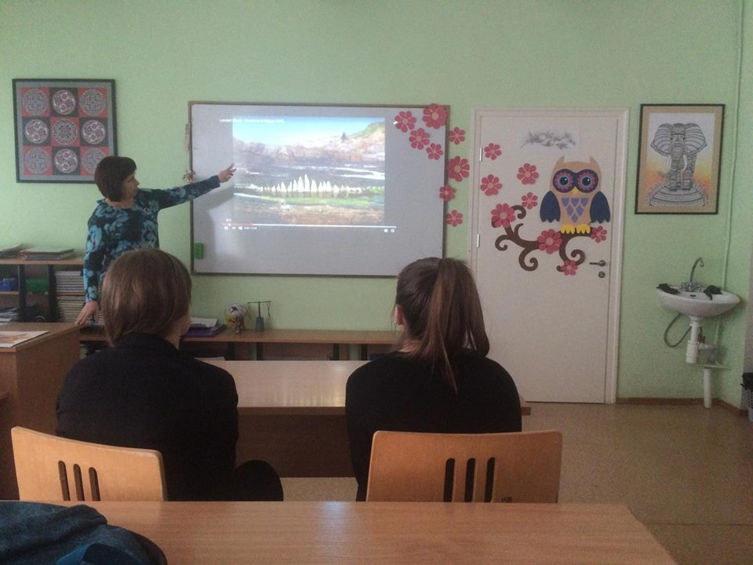

Slide 5
Ceramics

Slide 6
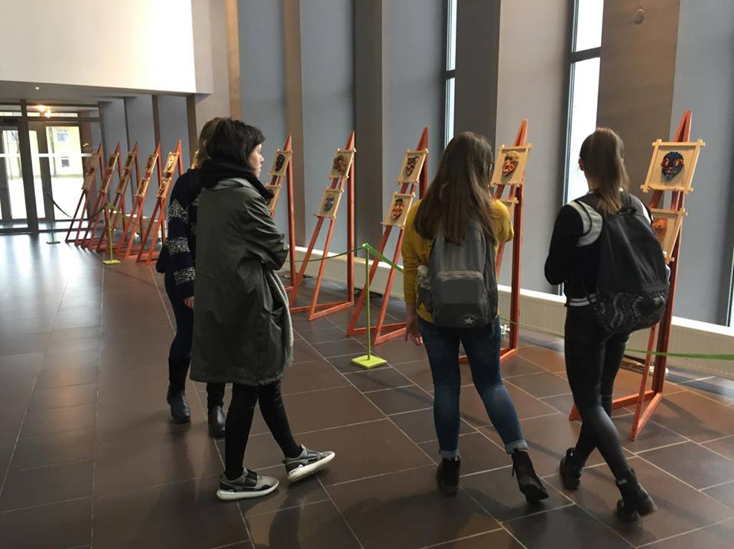

Slide 7
