Slide 1
The story of Matbuc

Slide 2
Long story short...
Matbuc is a character born in Luynes, Aix-en-Provence.
He dreams about his future a lot.
In the beginning he feels lost, he doesn‘t know what path to choose to become someone special in today‘s Europe.
He decides to challenge himself in order to see what he is good at.
He decides to travel and look for inspiration.
While visiting different European countries (France, Romania, Italy, Lithuania) he gets to know their culture, people, cuisine, artistic heritage. He wants to try different art forms, „see through the eyes“ of most notable artists, he studies different art techniques, biographies and works of various artists in order to relate to them and find himself.
He writes memoirs, takes a lot of pictures, records events, interviews people, shares his experience through different means of communicaton since he wants to show the world his progress and get some feedback in order to improve.
In the end he sees that he has acquired a lot of skills, improved in the artistic field, became more confident in everything he does. He has become a valuable person who is able to live in today‘s demanding world.

Slide 3
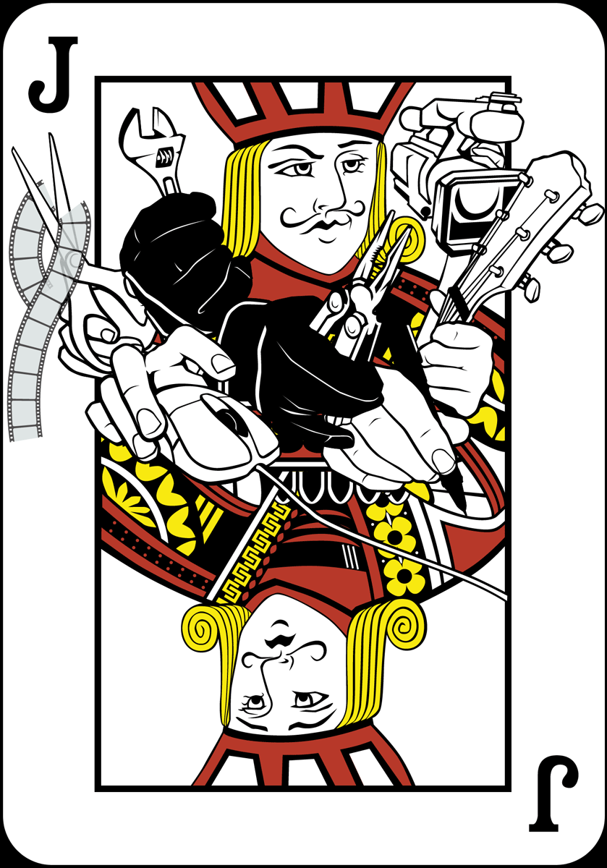
Jack-Of-All-Arts
Rather than becoming a master of one, Matbuc has become the jack-of-all-arts.
Being versatile and having many skills has helped him to adapt in today‘s world which is constantly changing.

