Slide 1
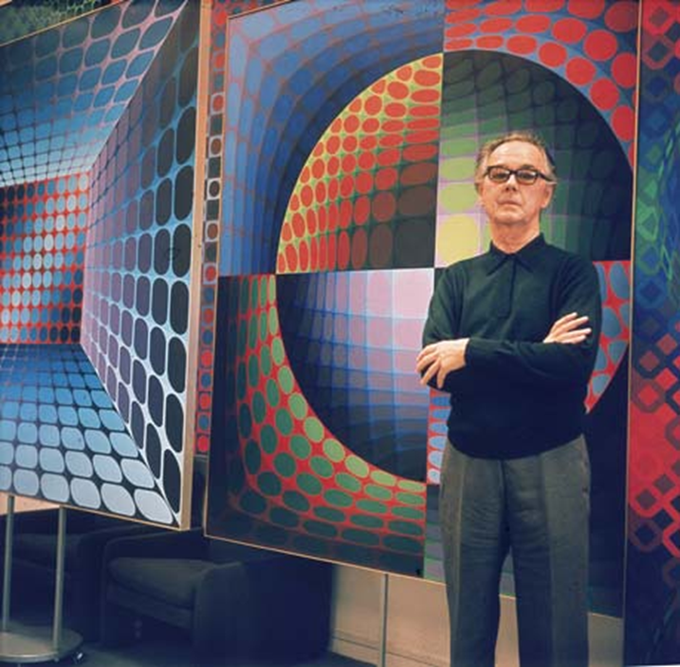
Victor Vasarely

Slide 2
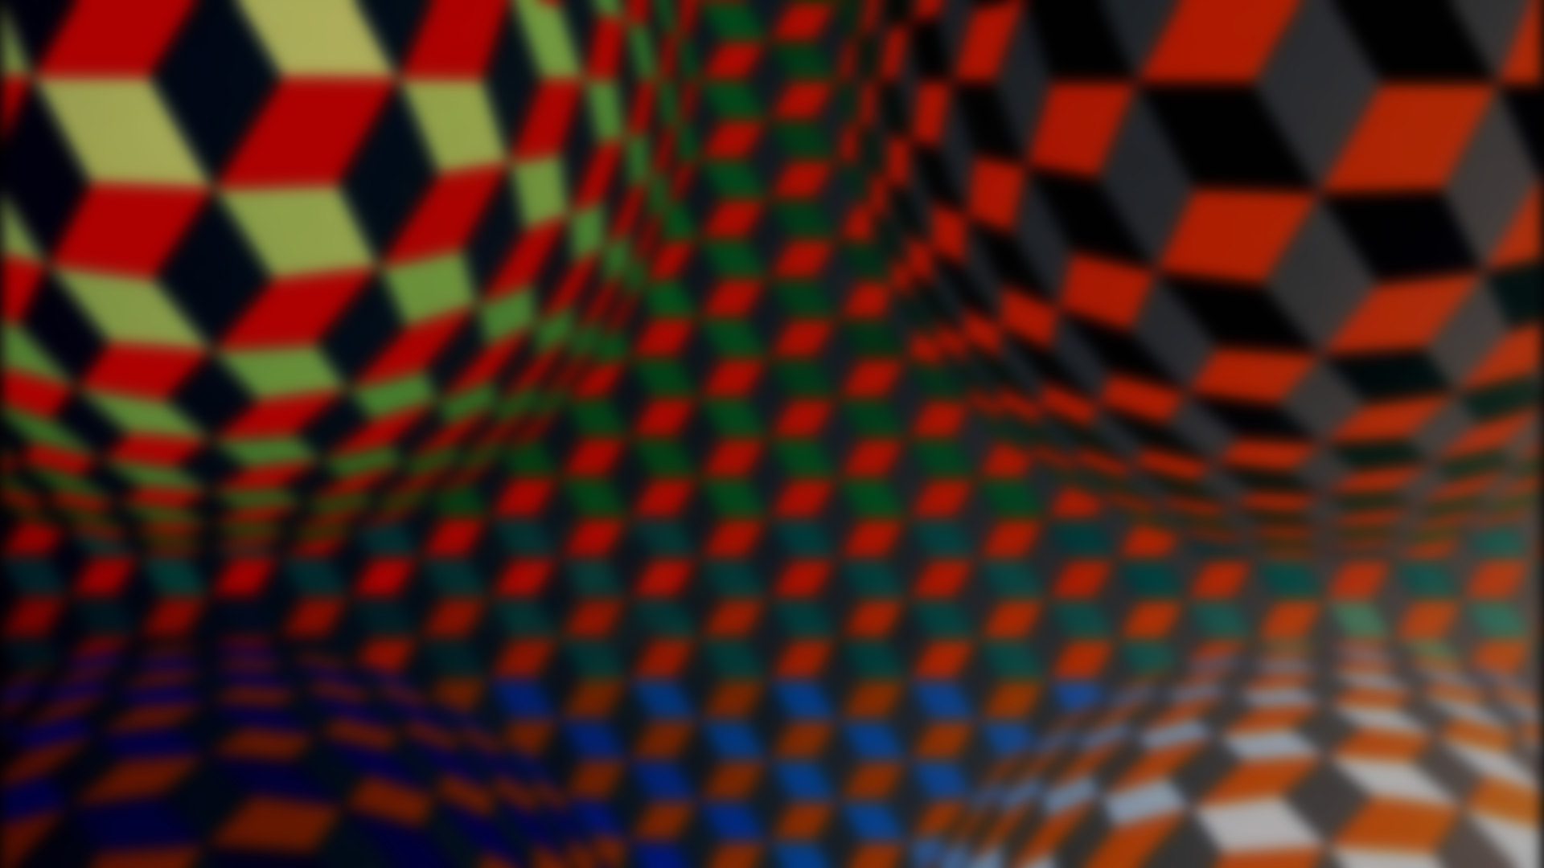
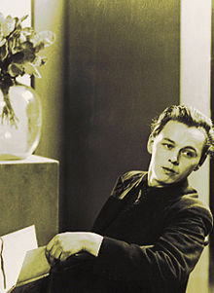
Victor biography
Vasarely was a Hungarian-French artist.
In 1927, he abandoned medicine to learn traditional academic painting at the private Podolini-Volkmann Academy.
In 1928/1929, he enrolled at Sándor Bortnyik's private art school called Műhely, then widely recognized as Budapest's centre of Bauhaus studies.
In 1929 he painted his Blue Study and Green Study
In 1930, he married his fellow student Claire Spinner (1908–1990). Together they had two sons.
Vasarely left Hungary and settled in Paris in 1930.
He worked as a graphic artist and as a creative consultant at the advertising agencies Havas, Draeger and Devambez (1930–1935).
Born in Pécs, Austro-Hungarian Monarchy (1906.04.09)
Died in Paris, France (1997.03.15)

Slide 3
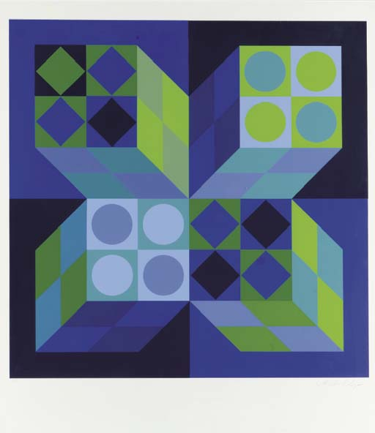
BLUE AND GREEN STUDY

Slide 4
FACT
1929-1944: Early graphics: Vasarely experimented with textural effects, perspective, shadow and light. His early graphic period resulted in works such as Zebras (1937), Chess Board (1935)

Slide 5
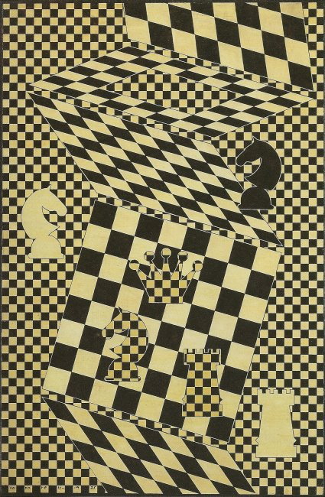
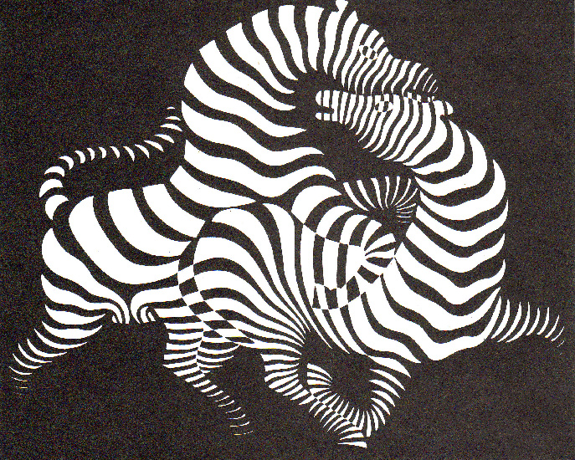
Chess Board (1935)
Zebras (1937)

Slide 6
FACT #2
1944-1947: Les Fausses Routes – (en.On the wrong track): During this period, Vasarely experimented with cubistic, futuristic,expressionistic, symbolistic and surrealistic paintings without developing a unique style. Afterwards, he said he was on the wrong track.
Jacques Prévert placed Vasarely among the surrealists.
Self Portrait (1941) and The Blind Man (1946) are associated with this period.

Slide 7
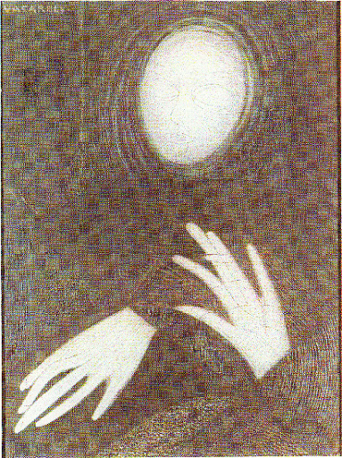
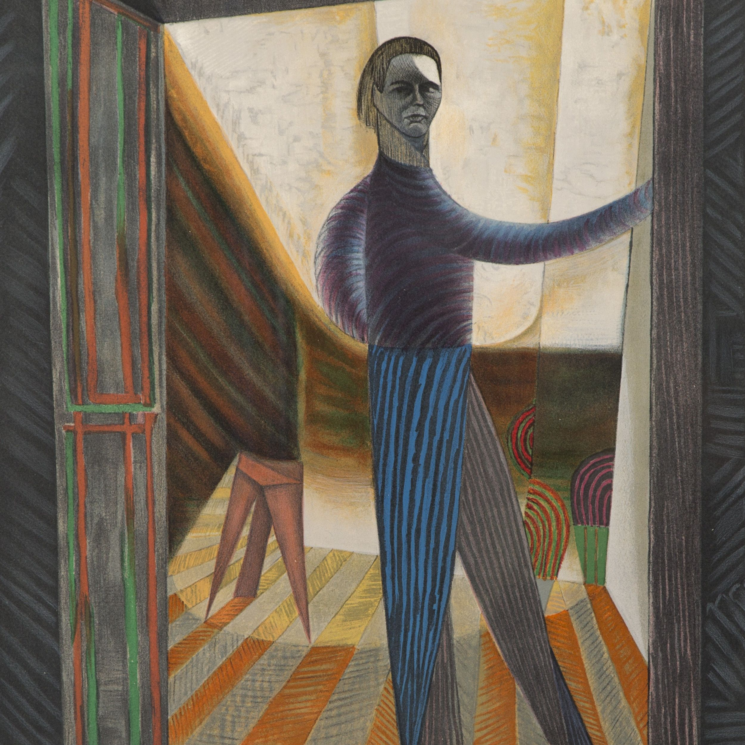
Self Portrait (1941)
The Blind Man (1946)

Slide 8
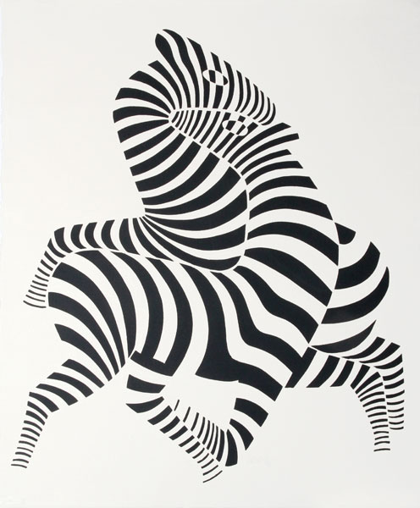
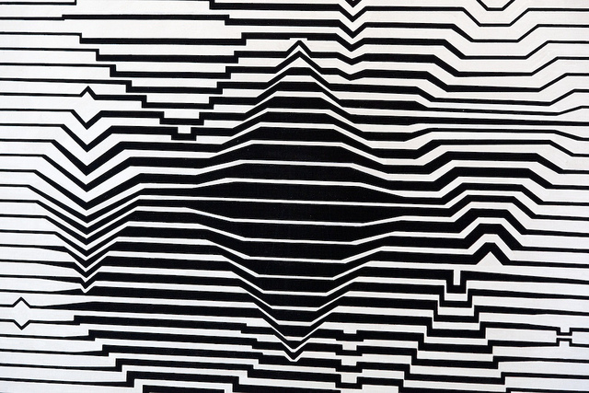
MORE Vasarely artworks

Slide 9
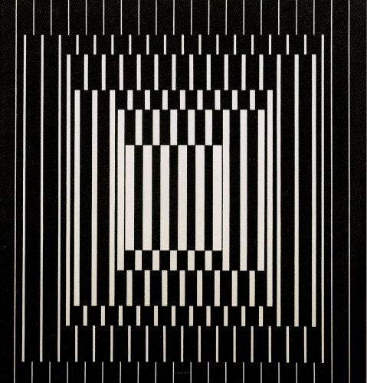
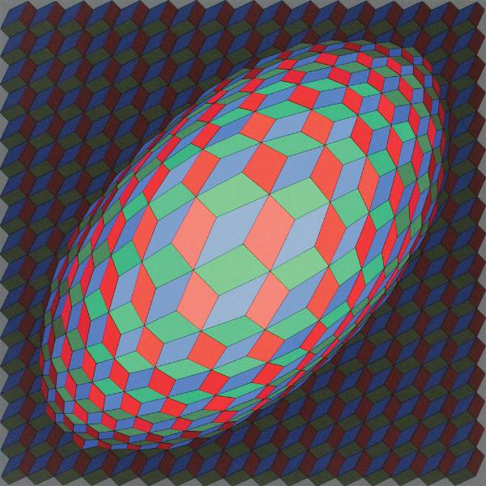
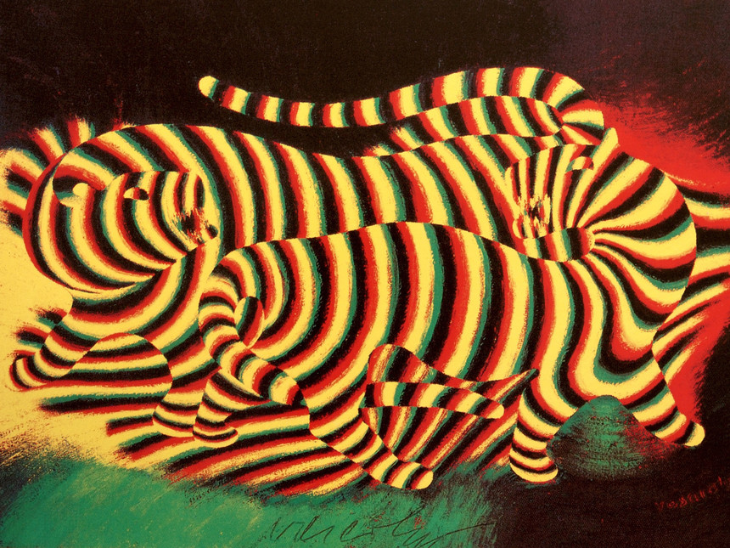
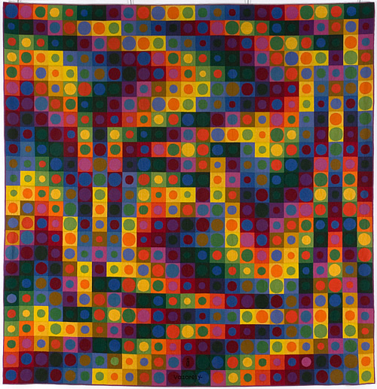
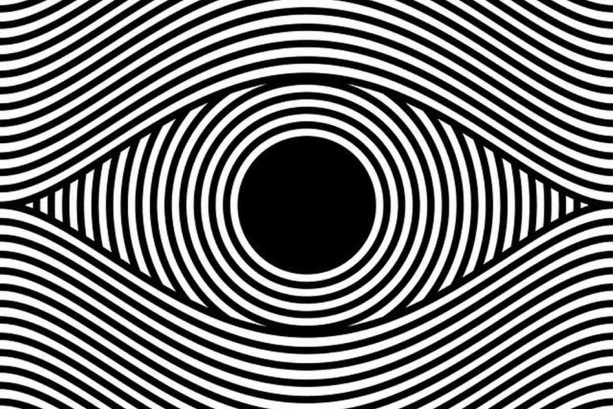
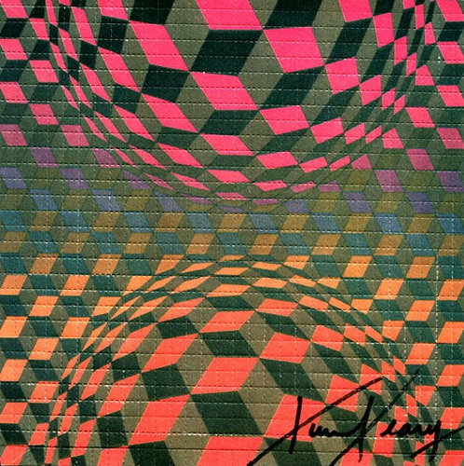

Slide 10
Making Art Together Brings Us Closer

