Slide 1
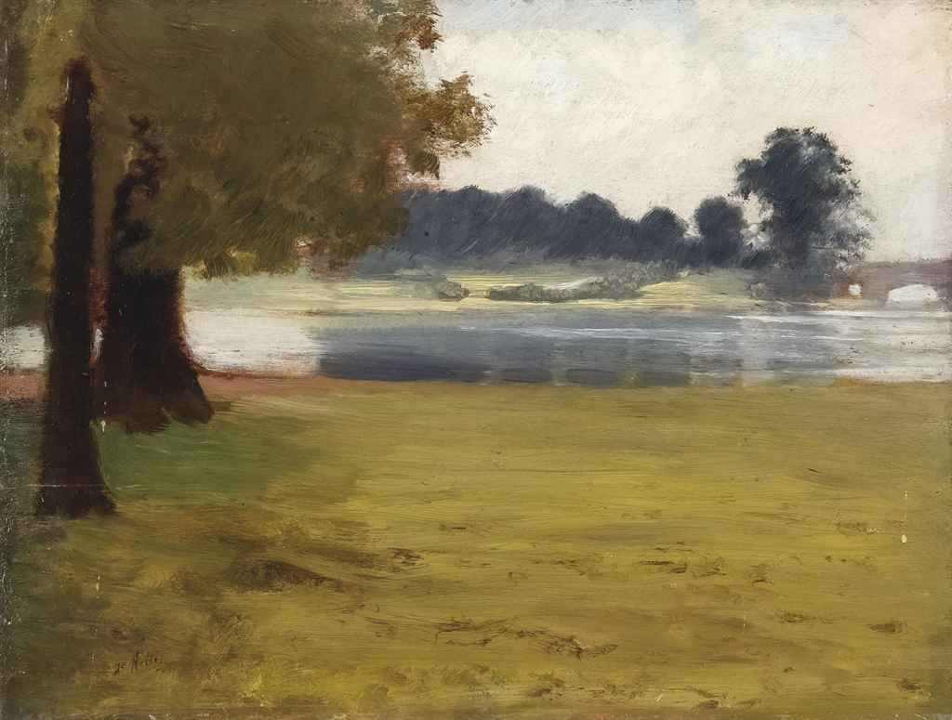
Giuseppe de Nittis
GIUSEPPE DE NITTIS

Slide 2
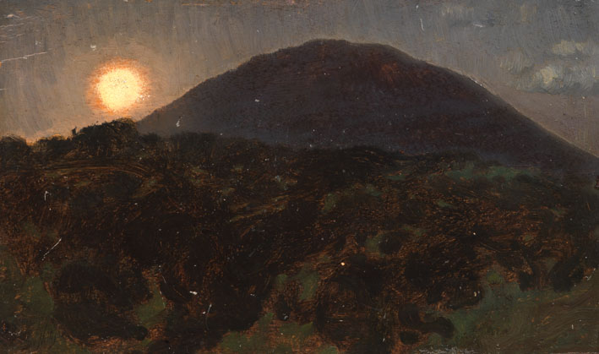
Giuseppe de Nittis - one of the most important Italian painters of the 19th century, whose work merges the styles of Salon art and Impressionism.

Slide 3
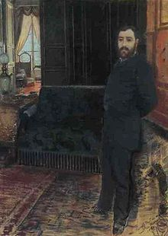
CHILDHOOD
De Nittis was born in Barletta in February 25, 1864, in the region of Apulia, where he first studied under Giovanni Battista Calò. His father was arrested for political reasons and just before de Nittis was born,he took his own life. Giuseppe started painting at a really young age. When Giuseppe was 17 years old,he founded the „School of Portici“ along with other young painters.

Slide 4
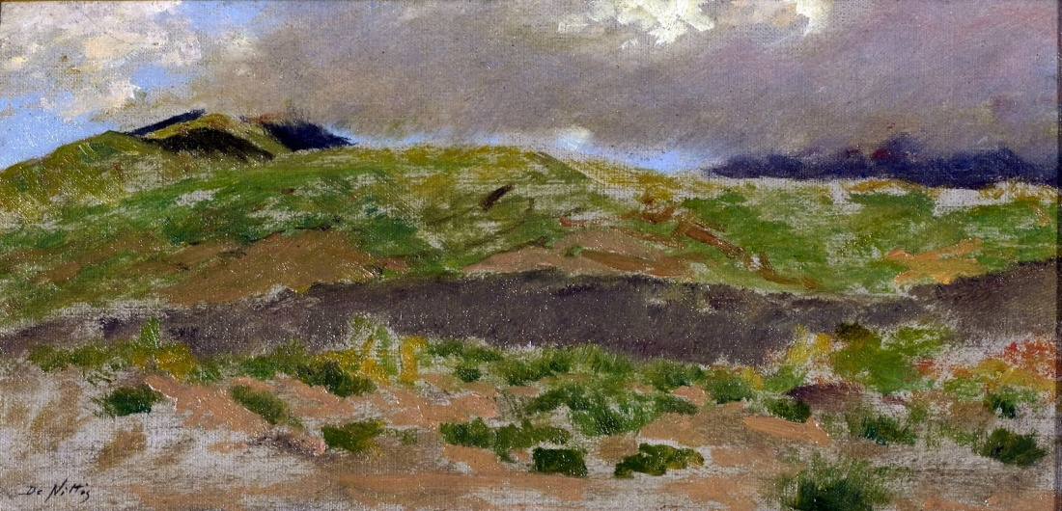
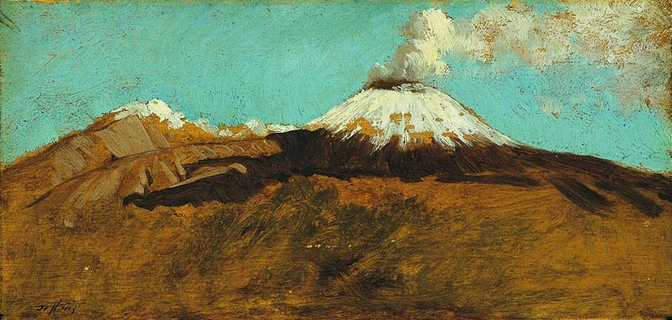
After gaining some visibility by exhibiting at the Salon he returned to Italy where, now free to paint from nature, he produced several views of Vesuvius

Slide 5
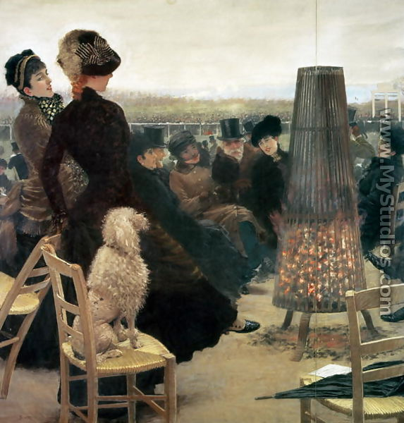
A trip to London resulted in a number of Impressionistic paintings. But he was not accepted by all of the Impressionists, and did not participate in their subsequent exhibitions. In 1875 De Nittis took up pastels, which became an important medium for him in his remaining years and which he helped popularize.
He preferred pastels as the medium for his largest works, such as the triptych entitled Races at Auteuil .

Slide 6
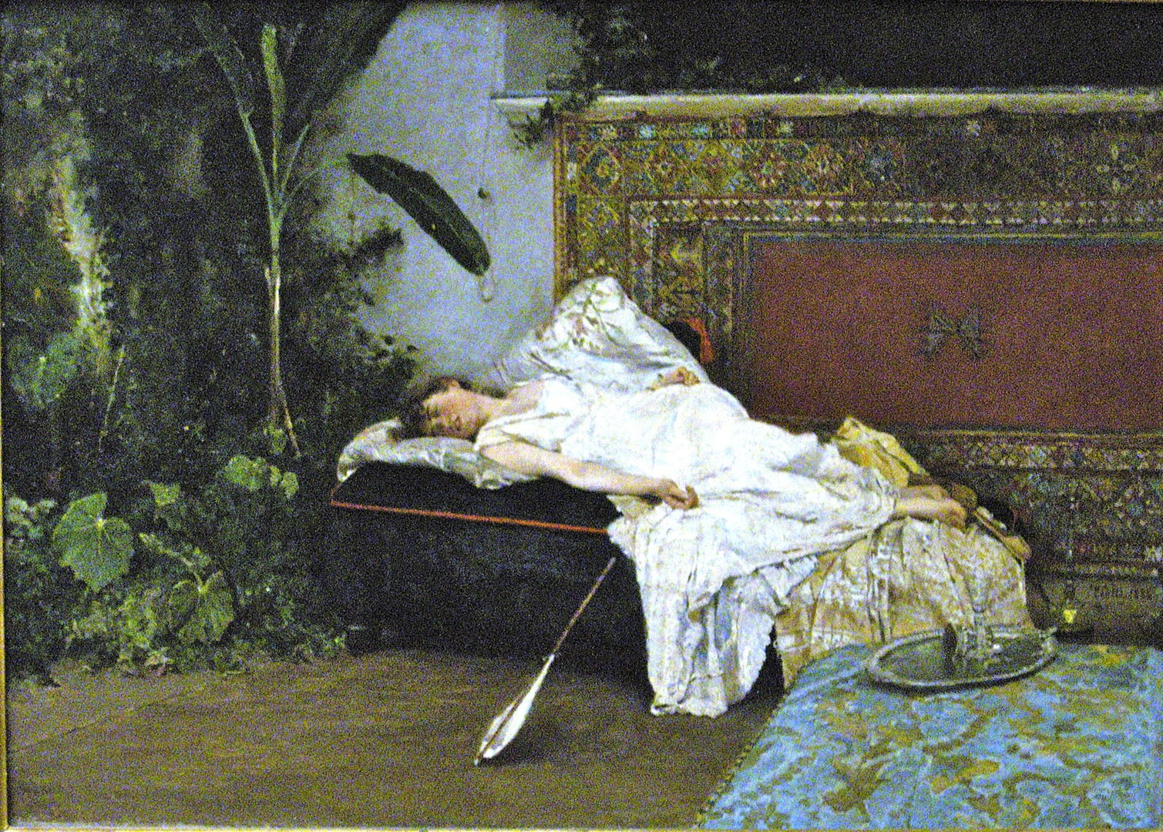
Realism, naturalism, impressionism, japonism … : was the “talented” De Nittis, admired by Goncourt, but tossed about by trends and acquaintances, fated to live without ever finding his own style ? There is no doubt that there is a chameleon like character to his painting.
Giuseppe loved Paris,he once said „ if I had stayed in Italy,I would not be the little they are today. Was in Paris that I owe my fame“.

Slide 7
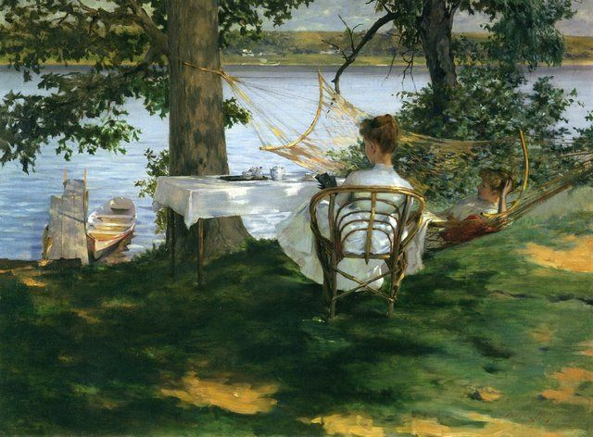
Death
In 1884, at the age of 38, De Nittis died suddenly of a stroke at Saint-Germain-en-Laye. His wife, the Parisian Léontine Lucile Gruvelle (married in 1869) donated his paintings to the town of Barletta and are now gathered in the Pinacoteca De Nittis in the Palace of the Marra in the hometown of the painter

Slide 8
This project has been funded with support from the European Commission. This publication reflects the views only of the author, and the Commission cannot be held responsible for any use which may be made of the information contained therein.

