Slide 1
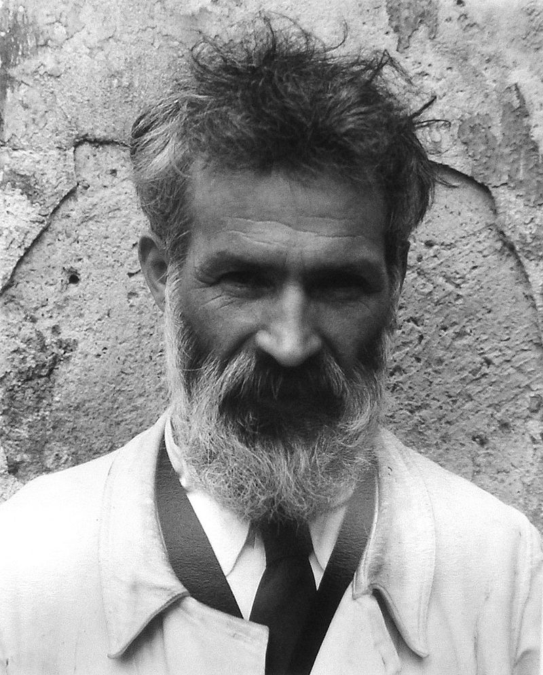
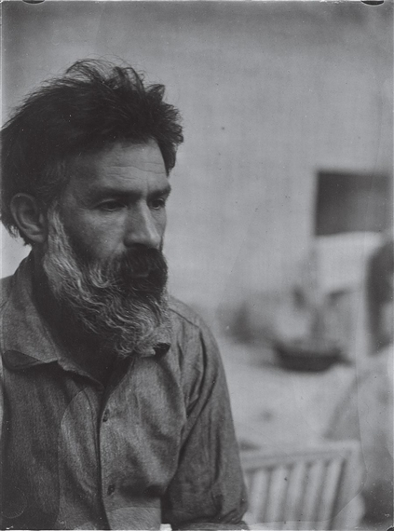
Constantin Brâncuși

Slide 2
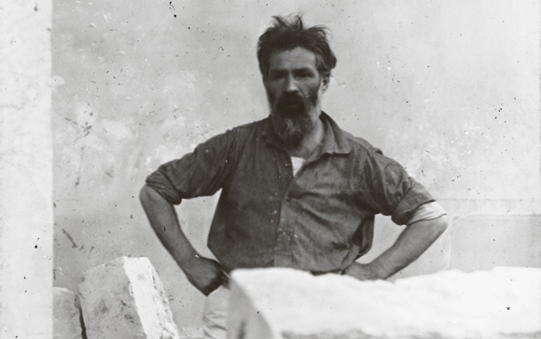
Constantin Brâncuși
Constantin Brâncuși was a Romanian sculptor, painter and photographer who made his career in France. Considered a pioneer of modernism, one of the most influential sculptors of the 20th-century, Brâncuși is called the patriarch of modern sculpture. As a child he displayed an aptitude for carving wooden farm tools.

Slide 3
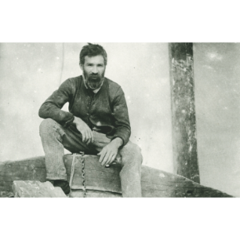
Constantin Brâncuși
The second of four children, Brancusi was born in the small farming village of Hobitza, Romania, in 1876. He had a difficult childhood, in part due to challenging relationships with his father. After several attempts to leave home, Brancusi finally did so permanently in 1887, at the age of eleven.

Slide 4
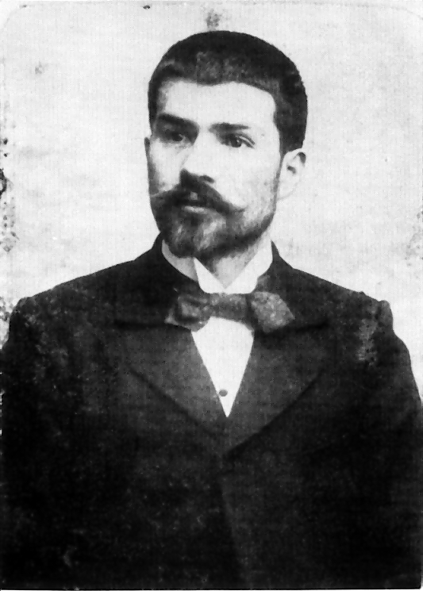
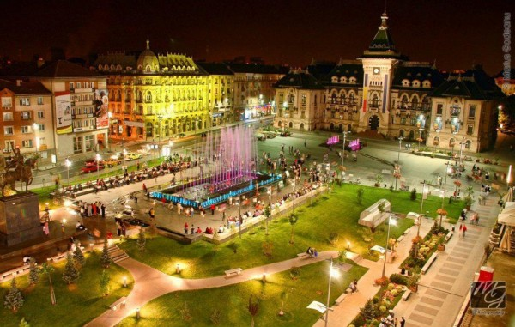
Constantin Brâncuși
From 1889 to 1893, Brancusi lived in the Romanian city of Craiova, while attending the School of Arts and Crafts part-time. In 1894, he enrolled full-time at the school, where he excelled in woodworking and ultimately graduated with honors in 1898. Brancusi then studied modeling and life sculpture at Bucharest's National School of Fine Arts (1898-1902). In 1904, he moved from Romania to Paris.

Slide 5
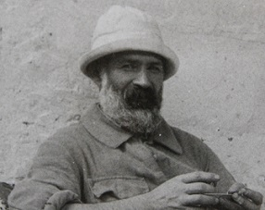
Constantin Brâncuși
From 1905 to 1907, Brancusi trained in sculpture and modeling at the Ecole des Beaux-Arts, in the sculpture studio of Antonin Mercie. Brancusi began working as a studio assistant to Auguste Rodin in 1907, but left after only a month, explaining, "Nothing grows under the shadow of big trees."

Slide 6
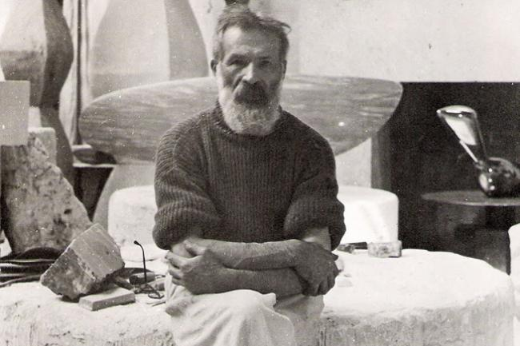
Constantin Brâncuși
After leaving Rodin's studio, Brancusi began establishing his own style, beginning with squared works such as The Kiss (1907-08). Around 1909, Brancusi started creating smoother, more contoured sculptures in marble and bronze. He produced multiple, yet distinct versions of works such as The Kiss, Maiastra, and Sleeping Muse.

Slide 7
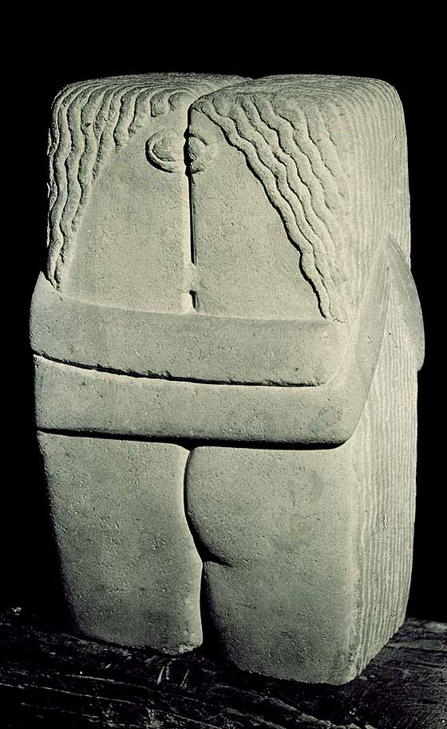
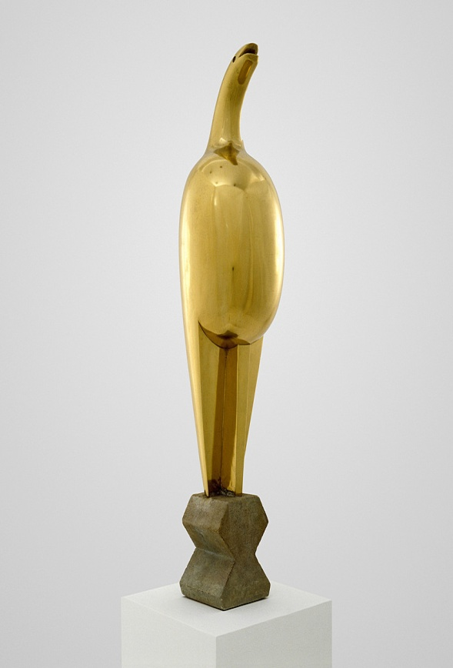
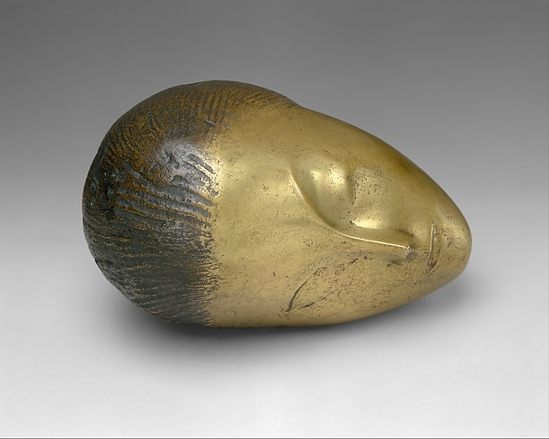
Constantin Brâncuși
The Kiss Maiastra Sleeping Muse

Slide 8
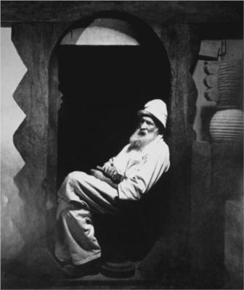
Constantin Brâncuși
In 1914 Brancusi began taking photographs. Many of his photos were of his own studio, recording the specific ways he organized the arrangement of his works, which was highly significant to his creative process, as he considered the base of the sculpture to be just as important as the sculpture itself.

Slide 9
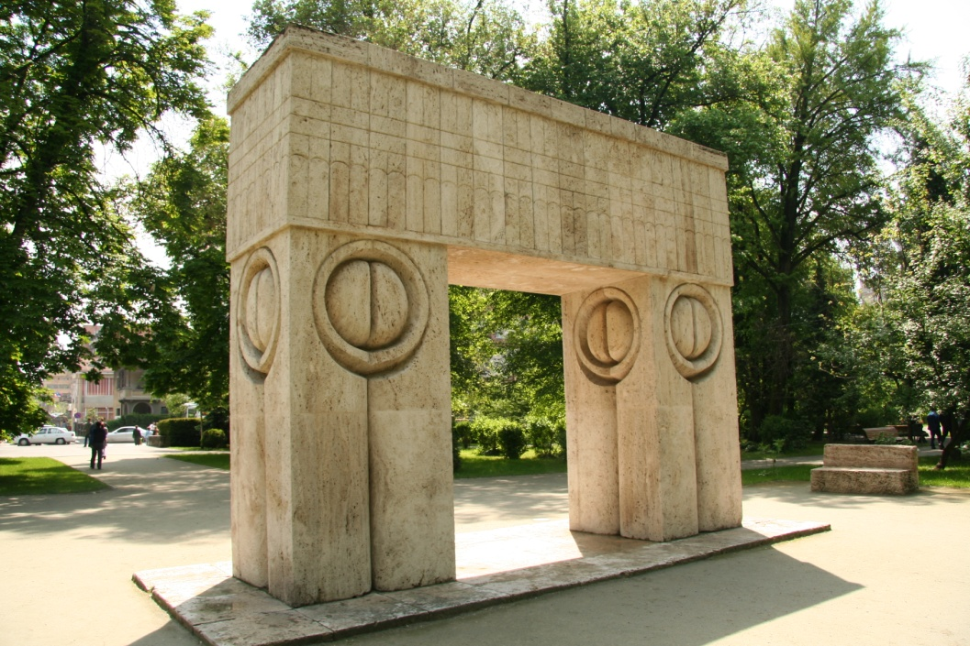
Constantin Brâncuși
In 1937-38, he created a monumental three-part public artwork for Targu-Jiu, Romania, to honor the Romanian soldiers who had fallen in World War I.

Slide 10
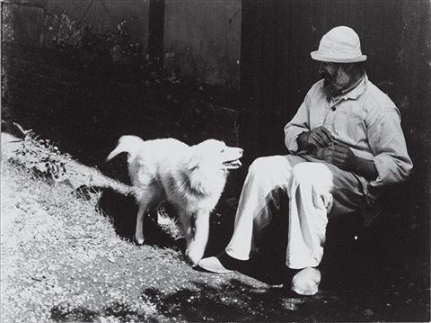
Constantin Brâncuși
Throughout his life, he had carefully arranged and documented the placement of sculptures in his Paris studio. Just prior to his death in 1957, he left his studio to the city's Museum of Modern Art with the proviso that it be preserved.

Slide 11
Constantin Brâncuși works
Brâncuși on his own work:
"There are idiots who define my work as abstract; yet what they call abstract is what is most realistic. What is real is not the appearance, but the idea, the essence of things."
“I ground matter to find the continuous line. And when I realized I could not find it, I stopped, as if an unseen someone had slapped my hands.”
“Work like a slave; command like a king; create like a god.”

Slide 12
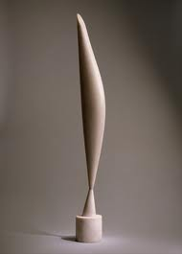
Bird in Space
Bird in Space is a series of sculptures. The original work was created in 1923. It was sold in 2005 for $27.5 million, at the time a record price for a sculpture sold in an auction. The original title in Romanian is Pasărea în văzduh.

Slide 13
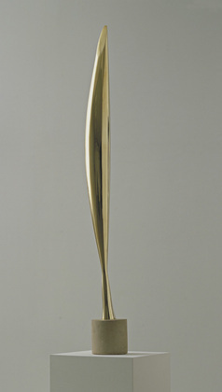
Bird in Space
One of these, constructed in 1925 using wood, stone, and marble stands around 72 inches tall and consists of a narrow feather standing erect on a wooden base. Similar models, but made from materials such as bronze, were also produced by Brâncuși and placed in exhibitions.

Slide 14
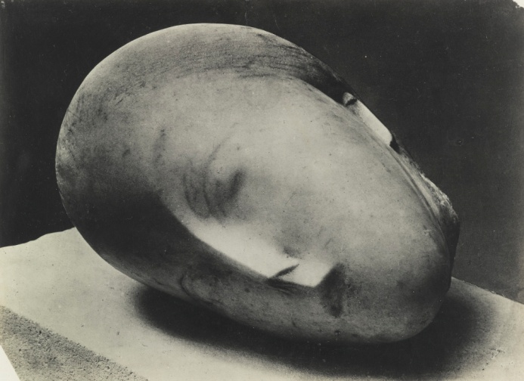
Sleeping Muse
The Sleeping Muse is a bronze sculpture created in 1910. It was originally carved from marble using Baroness Renée Irana Franchon as the model. Refining the sculpture, Brâncuși cast several of the sculptures in bronze, which are now in museums around the world, including the Metropolitan Museum of Art in New York City and the Musée National d'Art Moderne in Paris.

Slide 15
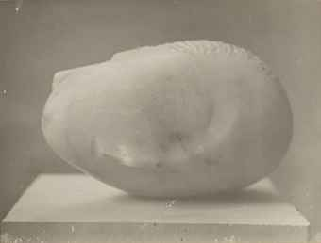
Sleeping Muse
It is a model of a head, without a body, with markings to show features such as hair, nose, lips, and closed eyes.

Slide 16
Head

Slide 17
Sleeping Muse II

Slide 18
Fish

Slide 19
The Newborn

Slide 20
Une Muse

Slide 21
Mademoiselle Pogany II

Slide 22
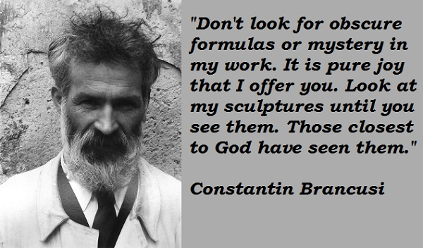
Constantin Brâncuși
Today the sculptor’s popularity is still evident as collectors pay millions of dollars to acquire his work. Christie’s has sold Un Muse for $12.5 million in 2012, Bird in Space for $27.5 million in 2005, Le Premier Cri for $14.9 million in 2011.

Slide 23
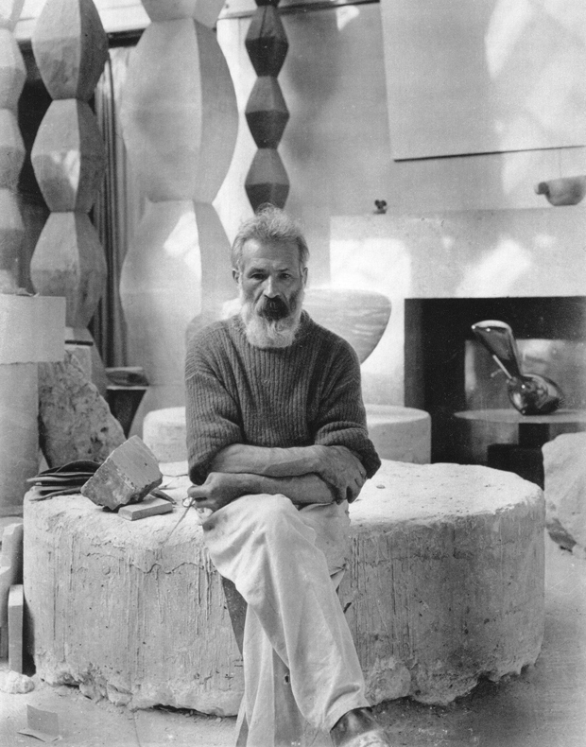
Constantin Brâncuși
His art emphasizes clean geometrical lines that balance forms inherent in his materials with the symbolic allusions of representational art. Brâncuși sought inspiration in non-European cultures as a source of primitive exoticism, as did Paul Gauguin, Pablo Picasso, André Derain and others. But other influences emerge from Romanian folk art traceable through Byzantine and Dionysian traditions.

Slide 24
This project has been funded with support from the European Commission. This publication reflects the views only of the author, and the Commission cannot be held responsible for any use which may be made of the information contained therein.

