Slide 1
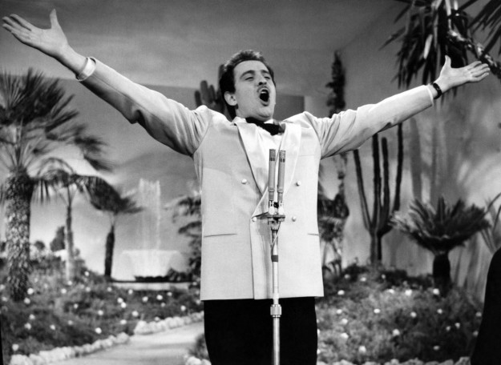
DOMENICO MODUGNO (9 January 1928 – 6 August 1994)

Slide 2
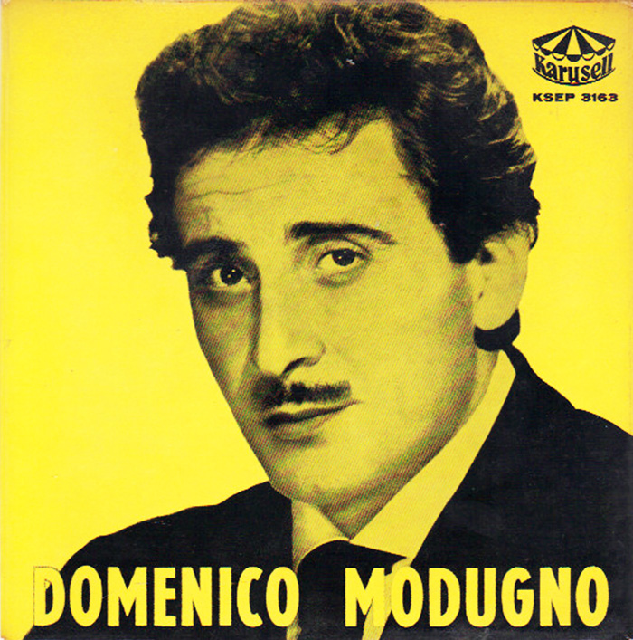
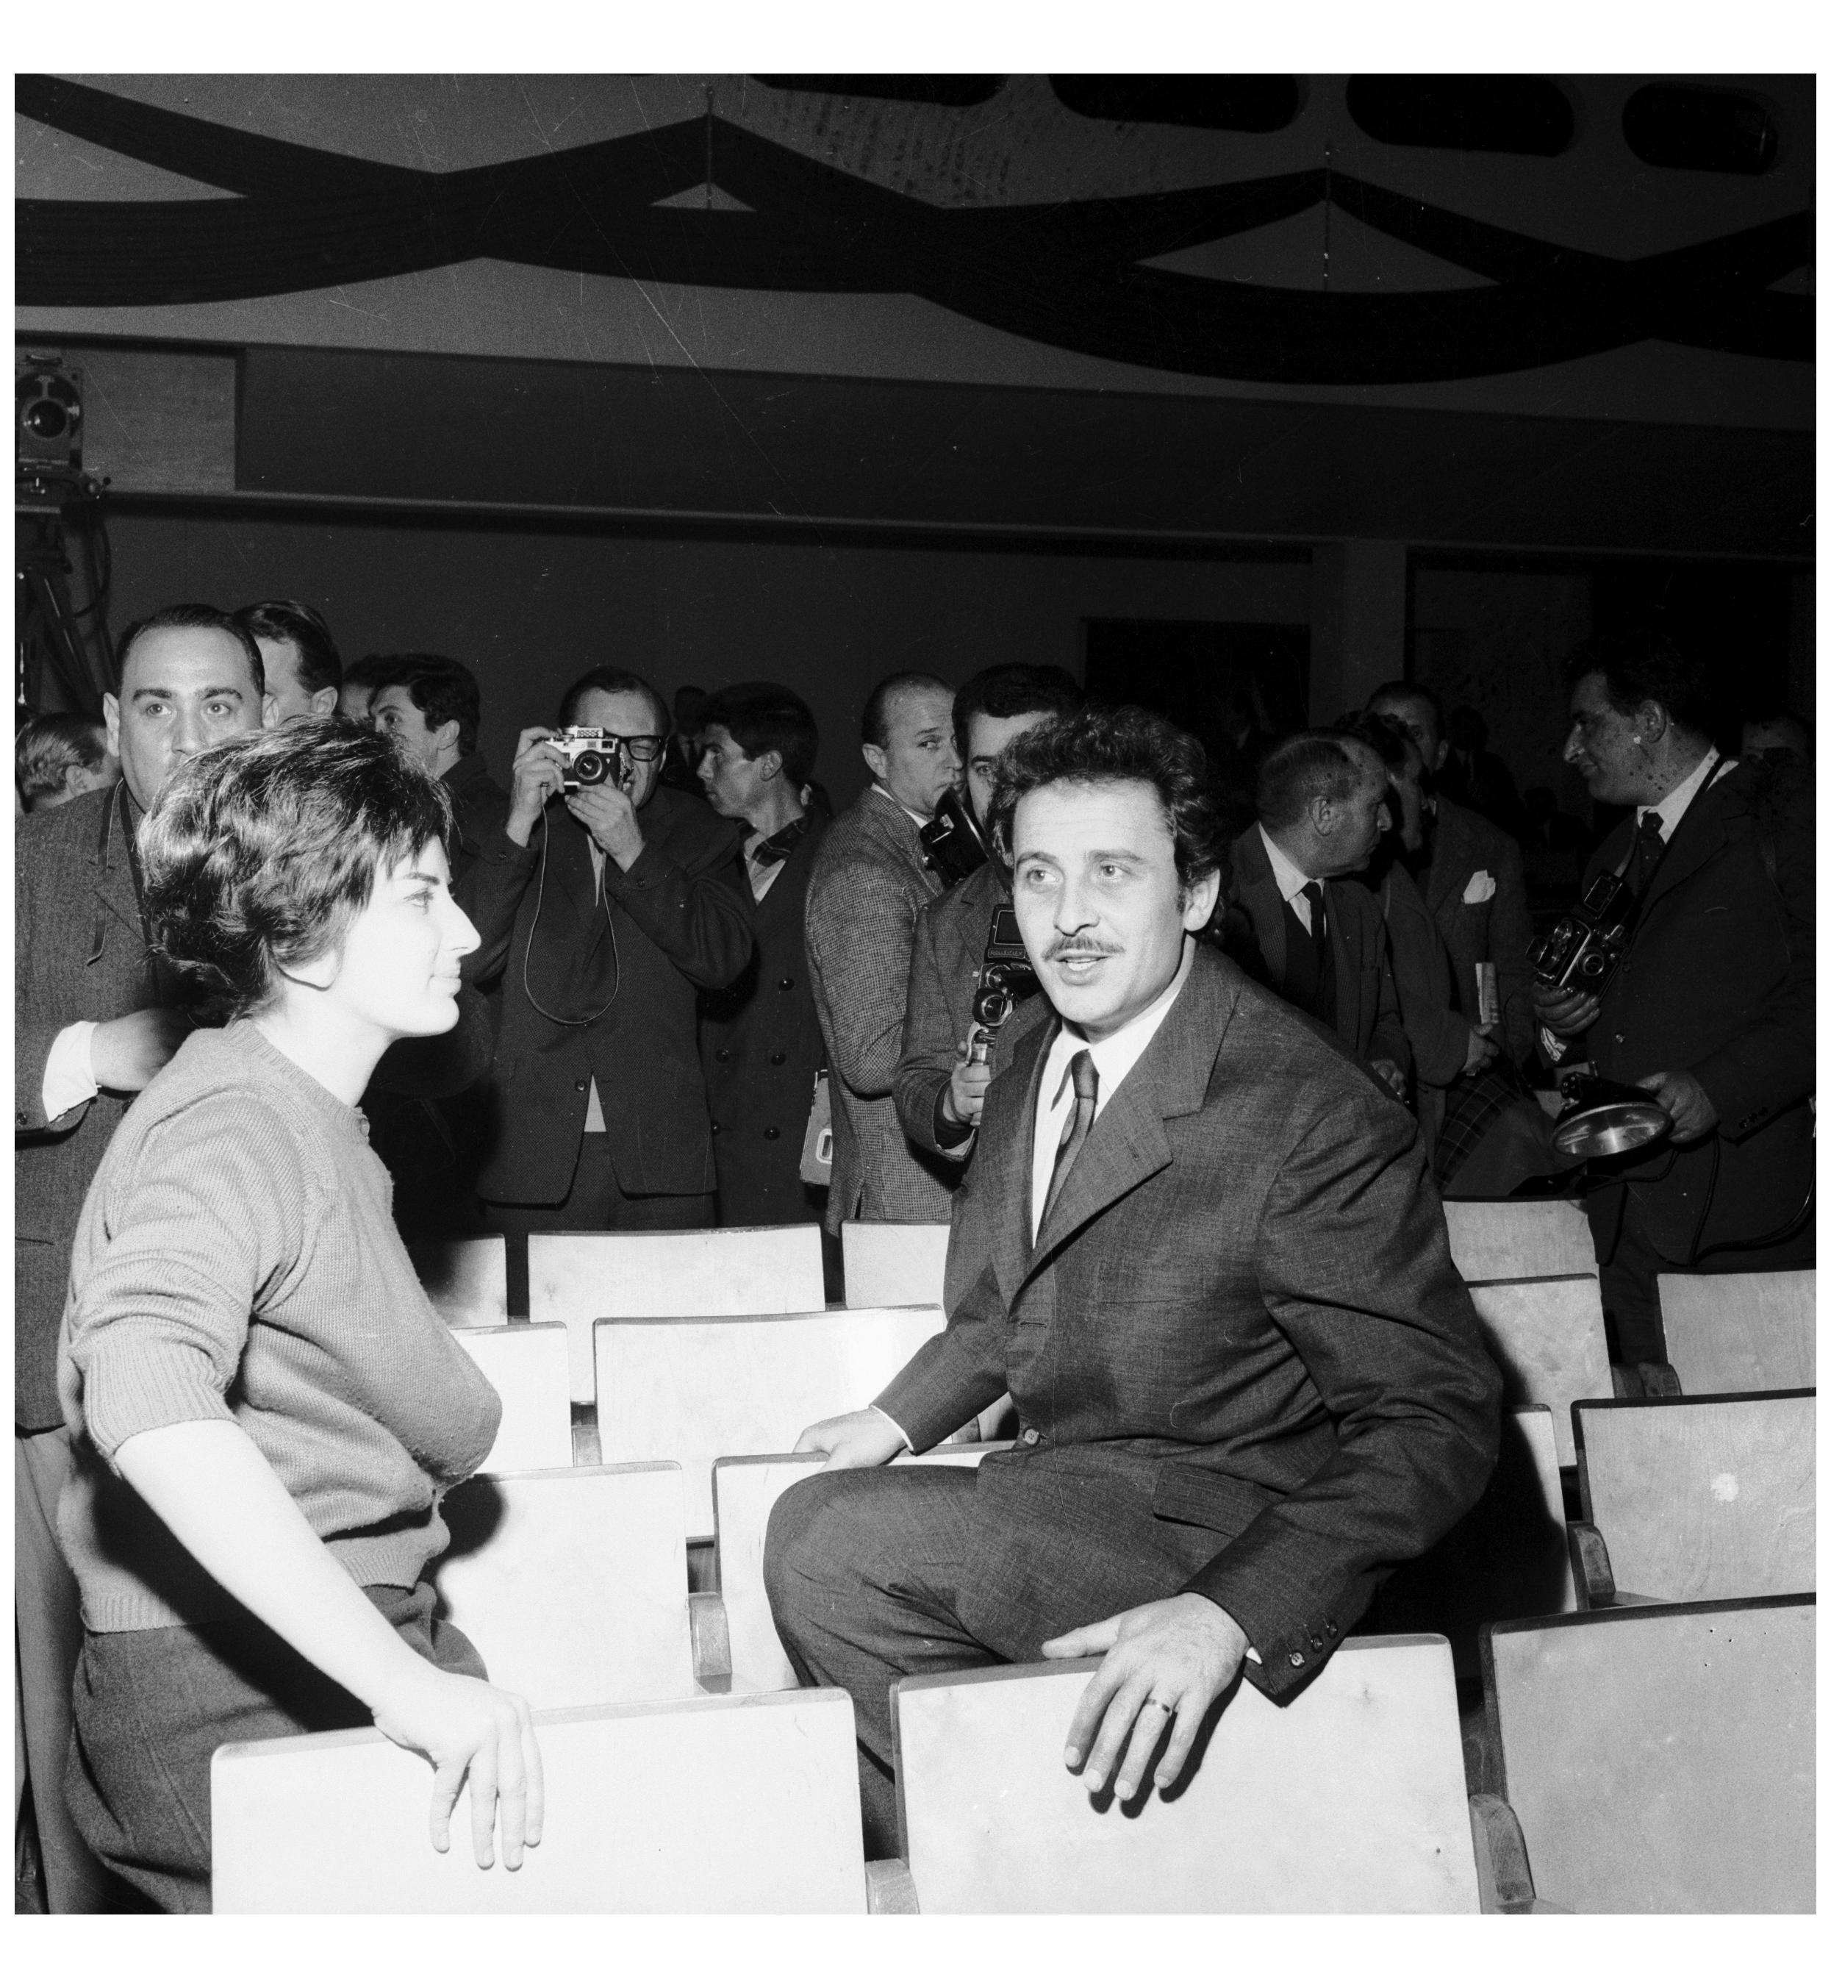
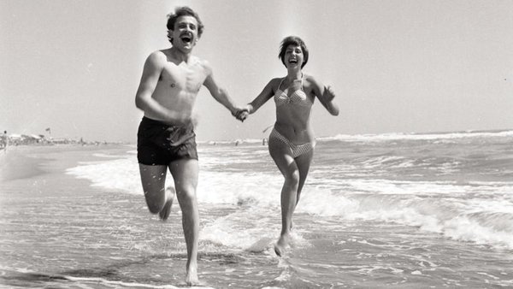
Domenico Modugno was an Italian singer, songwriter, actor, guitarist, and later in life, a member of the Italian Parliament.

Slide 3
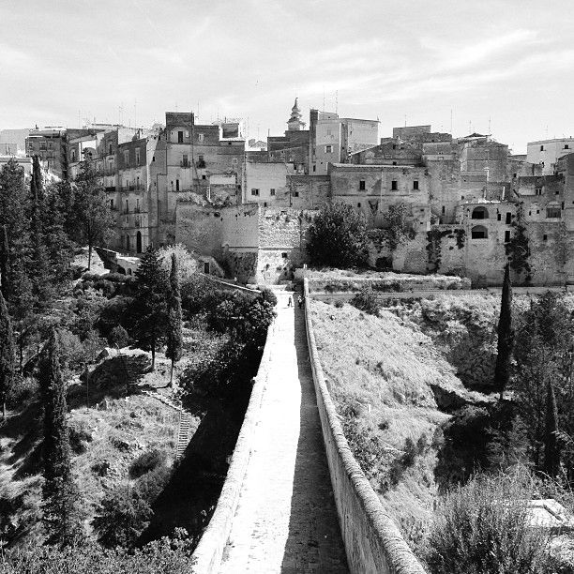
CHILDHOOD
Modugno was born at Polignano a Mare, in the province of Bari (Apulia), on 9 January 1928.His father, Vito Cosimo Modugno,was a municipal police commander,while his mother,Pasqua Lorusso,was a housewife.
From a young age he wanted to become an actor and in 1951, after his military service, he enrolled in an acting school.

Slide 4
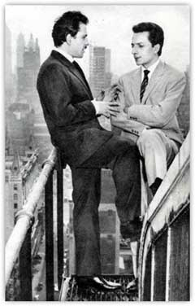
About career
The turning point of his career came in that year, when he also participated in the Sanremo Music Festival, presenting, together with Johnny Dorelli, the song "Nel blu dipinto di blu." Co-authored by Modugno and Franco Migliacci, the song won the contest and became an enormous success worldwide, including the United States. It received two Grammy Awards with sales above 22 million copies, and represented Italy in the 1958 Eurovision Song Contest, where it came in third.

Slide 5
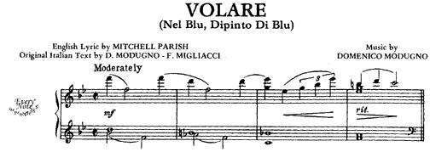
Migliacci wrote Volare lyrics inspired by two paintings of Marc Chagall. He had planned to go to the sea with Domenico Modugno, but while waiting for Modugno to show up, Migliacci started drinking wine and eventually fell asleep. He had vivid dreams, and when he woke up, he looked at the Chagall paintings (reproductions) on the wall.

Slide 6
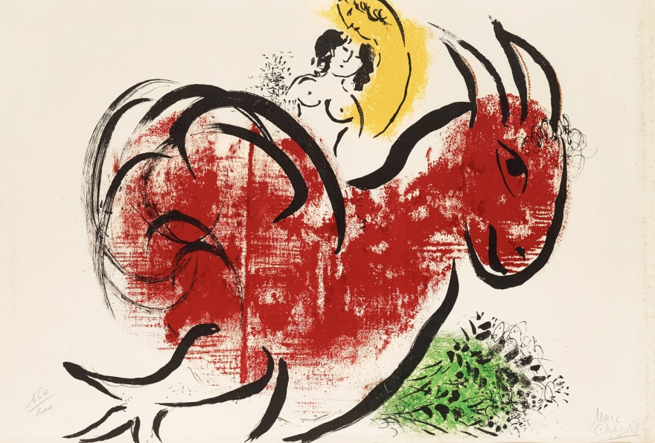
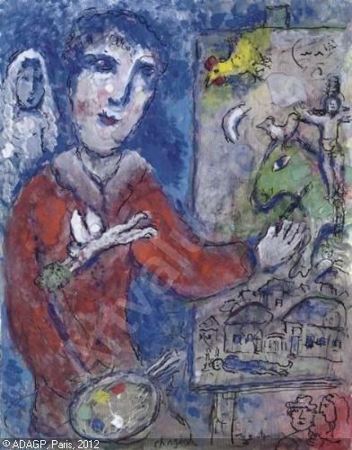
"Le coq rouge" was a yellow man suspended in midair.
in "Le peintre et la modelle", half of the painter's face was coloured blue.

Slide 7
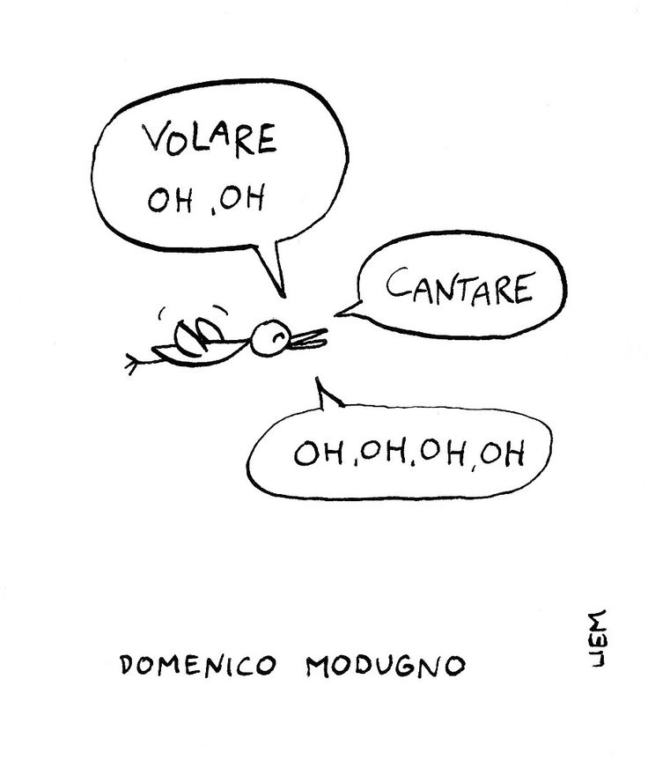
So he started penning a song about a man who dreams of painting himself blue, and being able to fly.

Slide 8
Modugno was an actor in 44 movies (such as Appuntamento a Ischia), and was a film producer of two.
In the 1970, Modugno focused on more classic music genres and profiles, as a singer and as a musician, adapting poetry, acting on television and in lead singing roles of modern operas

Slide 9
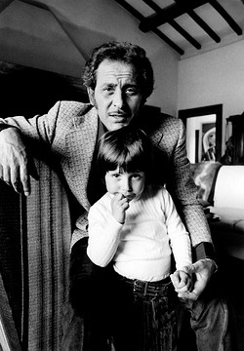
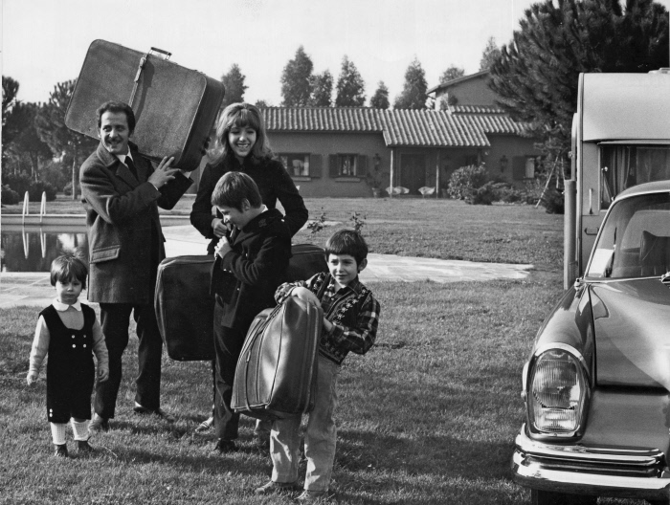
His last song was Delfini (Dolphins), in 1993 with his son, Massimo.

Slide 10
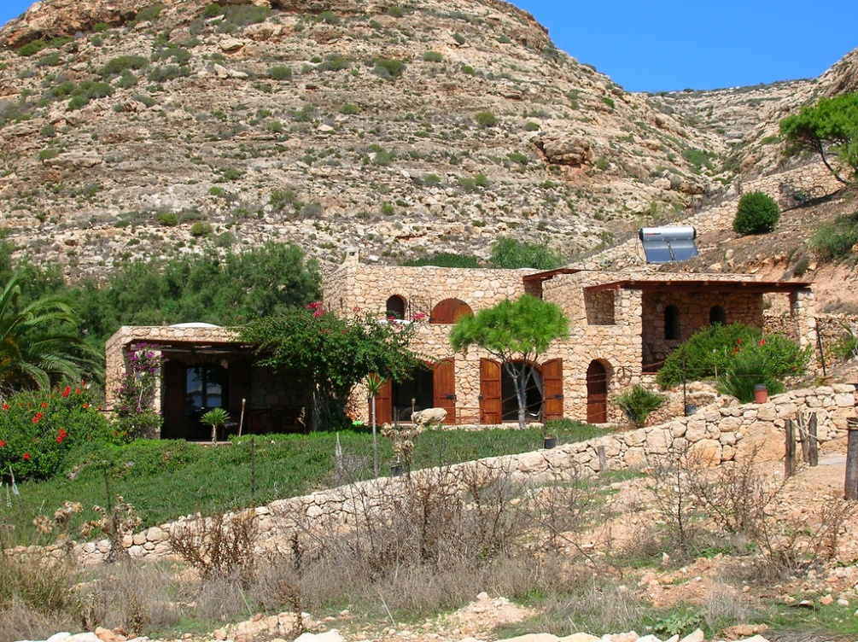
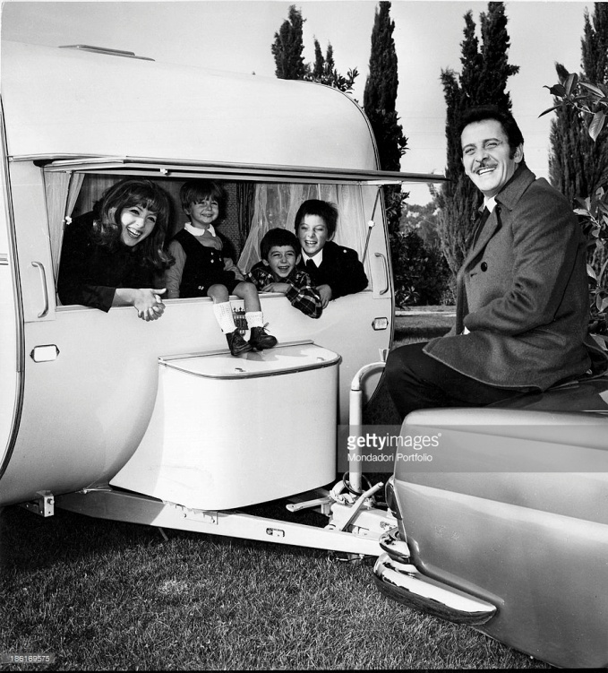
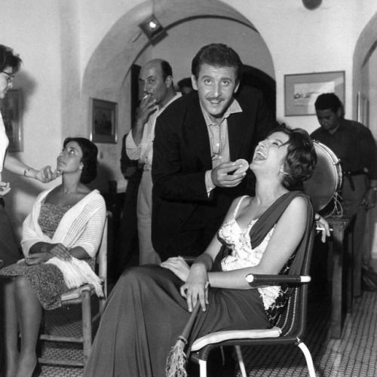
Death
On 6 August 1994, Modugno died at the age of 66, from a heart attack, on the island of Lampedusa, Sicily, while he was in his house by the sea.

Slide 11
This project has been funded with support from the European Commission. This publication reflects the views only of the author, and the Commission cannot be held responsible for any use which may be made of the information contained therein.

